Slide 1
The Trojan War
The Iliad =
What do you remember?
Who fought in the Trojan War?
Why was the war fought?
Who gave a golden apple? Why?

Slide 2
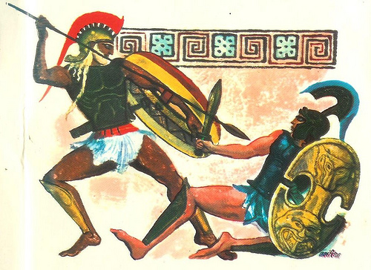
Achilles vs Hector
Objectives:
Read and analyse an extract of the famous Achilles vs Hector fight from Homer’s Iliad.

Slide 3
Achilles vs Hector
The Trojan War lasted for ten years.
The main hero of the Greeks was Achilles.
The main hero of the Trojans was Hector.
Achilles didn’t fight in some of the battles because he ‘fell out’ with the King of the Greeks, Agamemnon.
In one of these battles, Hector killed Achilles’ best friend, Patroclus and took his armour.
This made Achilles furious so he decided to fight Hector one-on-one in order to gain revenge!

Slide 4
Hector vs Achilles extract
TASK 1:
What is an epithet?
Can you spot any?
Talking points
Task 3 (rock, paper, scissors):
Winners: How is Achilles portrayed?
Losers: How is Hector portrayed?
What do you think is the main theme?
TASK 2:
What is a simile?
Can you spot any?
The key theme of the Iliad is Achilles’ rage NOT the War.
Notes:
Achilles’ rage = unstable, selfish, endangers his army, acts dishonourably, displeases the gods – Homer is deeply critical of this!

Slide 5
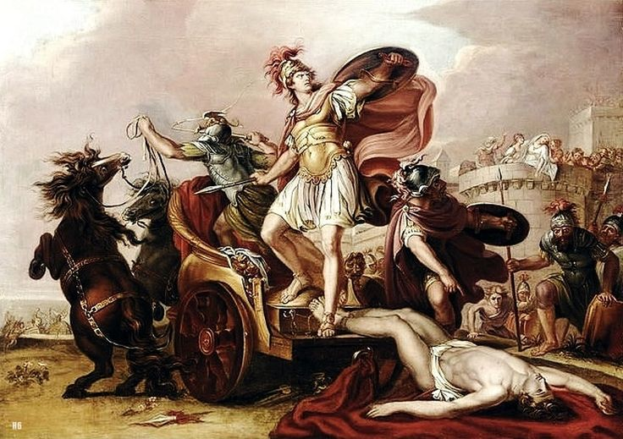
Talking points:
1. Why did Hector’s mother not want him to fight Achilles?
2. How did Hector say he would treat Achilles’ body?
3. What happened to Hector’s body?
4. Do you think Homer approved of Achilles doing this?

Slide 6
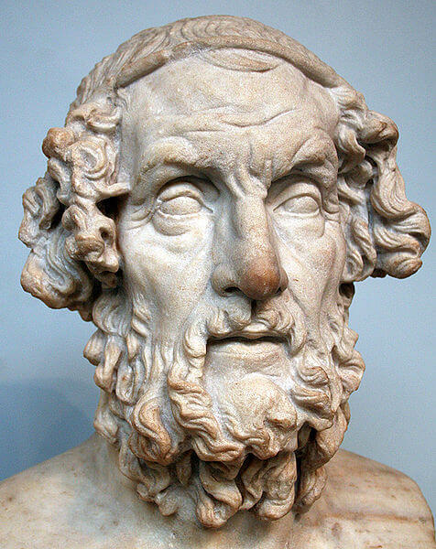
What message was Homer trying to send?
μηδέν άγαν
mēdén ágan = Nothing in excess
Achilles vs Hector clip

Slide 7
Horrible Histories: Achilles vs Hector

Slide 8
What was the Iliad?
Objectives:
Learn the basics about the Iliad and Homer, the Greek writer.
Read and analyse an extract of the famous Achilles vs Hector fight

