Slide 1
Date
Return from war: Torment & trial

Slide 2
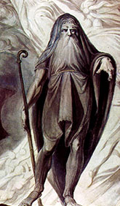
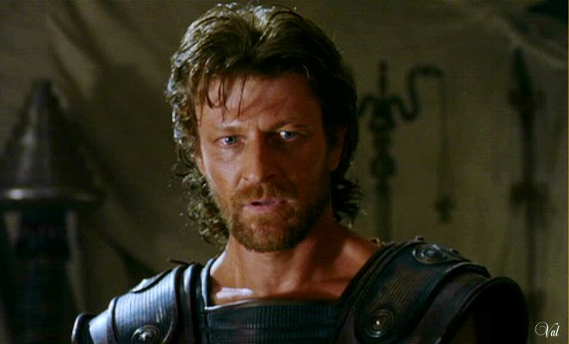
Tiresias’ Predictions
At the end of Episode 6, Tiresias made several predictions for Odysseus & his men
Revisit the second section of Episode 6
Can you identify Tiresias’ predictions?
Do you think Odysseus will pay attention to these warnings?
How do you think these will affect the journey of Odysseus & his men?

Slide 3
Examine Tiresias’ predictions once more
Do you notice any common features or similarities in the language Tiresias uses for each of the predictions?
Focus particularly on lines 1 – 23 of the second section to Episode 6

Slide 4
The language that Tiresias uses sounds very much as though he giving advice – he is telling Odysseus that there are certain things that he must do
The key devices that are used include:
the use of imperatives/orders
direct address (you)
verbs
present tense, past and future tense
emotive language

Slide 5
We will shortly listen to the next Episode of The Odyssey
The next Episode is ominously titled ‘Torment & Trial’
What do these words mean to you?
How might they relate to the predictions of Tiresias?

Slide 6
Torment suggests some kind of pain or suffering
Trial suggests some kind of punishment or some kind of task that must be completed
Neither of these words paint a very positive picture for whatever it is that Odysseus is to face in the next Episode

Slide 7
We are now going to listen to Episode 7 of The Odyssey:
As we listen, pay close attention to the words of Circe & her predictions
Do you notice any similarities in her use of language to that of Tiresias?

Slide 8
Both Tiresias & Circe use language that we would associate with the Writing to Advise style of writing
Essentially, neither of them are giving Odysseus their opinion, they are advising him as to what it is that he must do if he wishes to make it through his journey in one piece
Through the use of direct address (you), we know that their advice is directed solely at Odysseus – no one else can do this

Slide 9
Through the use of modal verbs (verbs that suggest probability or possibility) we can tell how important they both believe their advice is; however, it is up to Odysseus as to whether he listens or not
There is a great deal of emotive language in these predictions which highlight how important it is that Odysseus takes their advice
Finally, we notice that the predictions & advice are in chronological order (almost like instructions) so it is clear that there is a specific order in which he must carry these tasks out

Slide 10
And Finally…
How good do you think you would be at giving advice?
Consider the scenarios on the following slide
Choose one & provide advice to your friend
Remember to use the features that both Tiresias & Circe use in their predictions to Odysseus

Slide 11
Your friend has called you on your mobile phone to tell you that they are trapped in a bathroom. Give them some assistance on how to get out & make predictions about what will happen to them
Your best friend has never been abroad before & is really worried. Give some advice on how to prepare for a holiday & make predictions about what will happen to them when they get there

