Slide 1
Date
Return from war: shipwrecked

Slide 2
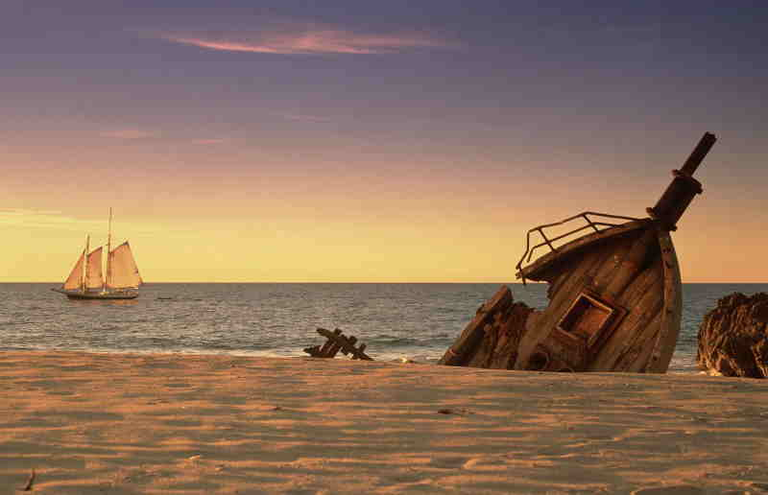
Painting a Picture
The title to our next Episode creates quite a dramatic picture in our minds
Think about the title ‘Shipwrecked’
What does this word make you think of?
Create a spider diagram of all of the words & phrases you can think of

Slide 3
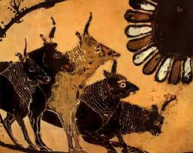
At the end of Episode 7, Odysseus & his men arrived at The Island of the Cattle of the Sun God, just as Tiresias predicted
Consider the following:
What warning had Odysseus previously heard?
Based on the title & what you have learnt so far, make three predictions about what you think will happen during this episode

Slide 4
Listen to Episode 8 of The Odyssey:
As you listen to the episode, think about whether your predictions were correct
Should you have been able to predict what has happened?
What clues were there in the earlier episodes as to what was going to happen?

Slide 5
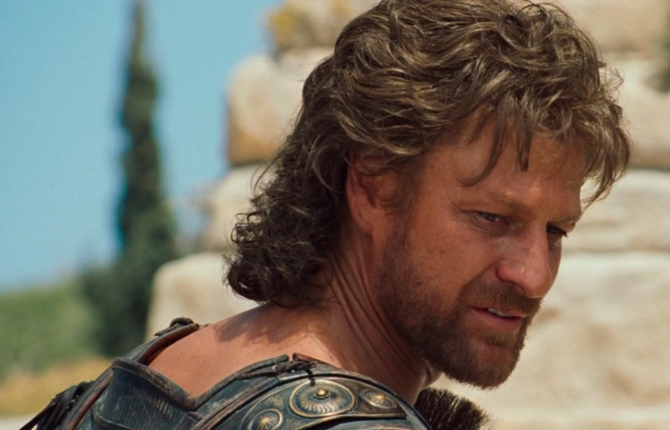
Odysseus – A Changed Man?
The character of Odysseus is not quite the same man at the end of Episode 8 of The Odyssey as he was at the beginning
What do we remember about Odysseus & his personality at the beginning of this epic poem?
How is he portrayed at the end of this Episode?

Slide 6
Even though it seems like a long time ago, Odysseus was presented as quite a nice man at the beginning of The Odyssey
Despite previously being a brave & noble warrior, we know that he didn’t want to go to Troy to fight in The Trojan War, especially as his wife, Penelope, had just given birth to their son, Telemachus
This makes Odysseus seem like a nice family man – but this did change!!!

Slide 7
Once Menelaus has convinced Odysseus to fight in The Trojan War, we begin to see a different side to him & he becomes a traditional Greek ‘hero’
Think about the first 5/6 Episodes of The Odyssey
What adjectives would you use to describe Odysseus?
Create a spider diagram outlining his attitude & behaviour – think about things such as how he treats Polyphemus

Slide 8
Arrogant
Odysseus

Slide 9
By the time we get to Episode 8 of The Odyssey, Odysseus is quite a different man with a changed outlook on life
Revisit the whole of Episode 8
What evidence can you find that Odysseus is becoming a different man?
Why do you think he is changing?

Slide 10
Examine the following statement by Odysseus:
She offered me immortal life, if I would only stay there with her. But as I lay there, unable to move, I knew all I wanted from the rest of my life was a simple human thing – I wanted to live and grow old and die with my wife, the woman I loved. So I refused the offer of eternal life.
What do you think Odysseus was searching for or hoping for when he joined The Trojan War?
What do you think he has now learnt?

Slide 11
And Finally…
Examine Odysseus’ final lines in this Episode:
Everything I took from Troy is gone – all that treasure, my ship, my friends – all I have left now is my name. And a longing as sharp as pain to see the land that gave me life.
Do you feel any sympathy for our ‘hero’?

