Slide 1
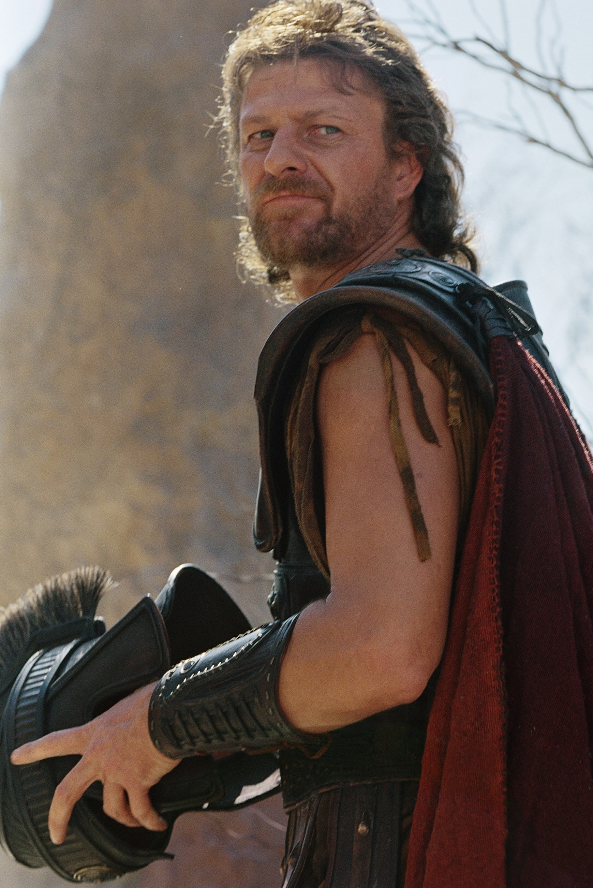
Date
Stranger in his own land

Slide 2
A Hero’s Welcome?
At the end of the last Episode, feeling moved by his story, King Alcinous vowed to send Odysseus home to his family
But, let’s not forget, Odysseus has been gone an very long time
Penelope has been alone & had to raise their son, Telemachus who is now 19, by herself
How do you think they will both react to Odysseus’ return?

Slide 3
Consider the curse from Polyphemus at the end of Episode 4:
Let him find danger waiting where there should be a welcome!
Considering the fact that all of the other warnings & predictions have so far come true, how might this curse relate to the return of Odysseus?
What will happen to him now?

Slide 4
Listen to Episode 9 of The Odyssey:
As you do, pay close attention to the instructions Odysseus is given for his return
Why is he in danger & why must he be disguised?

Slide 5
Examine Athene’s final words to Odysseus at the end of the second section to Episode 9:
Odysseus, listen. You must go as an old beggar now. Do not go to your feasting hall. Go rather to the hut of your faithful swineherd Eumaeus. Do not reveal yourself to him. But listen and you will learn much.
Of all the possible disguises, why does Athene choose that of an old beggar?
What do you believe it is that Odysseus needs to learn?

Slide 6
In the third section of Episode 9, a lot happens & Odysseus learns a great deal – even though we may not realise it, a lot of what happens is simply inferred.
This means that things are hinted at & we have to read between the lines to understand what is happening
Revisit the third section of Episode 9 once more
What do you feel Odysseus learns?
Remember, we will have to read between the lines

Slide 7
And Finally…
Odysseus is not the only person who is meant to learn something from the events of this story
We, as the reader/listener, are meant to learn from what has happened to Odysseus too
What do you think Homer wished the reader/listener to understand from this tale?

