Slide 1
Date
A beggar in his own palace

Slide 2
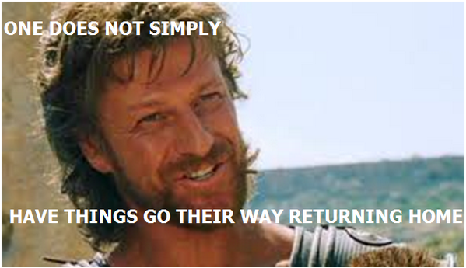
A Joyful Reunion?
In the next Episode of The Odyssey, we will see a reunion between father & son
But what do we think of when we hear the word ‘reunion’?
Create a spider diagram with all of your initial thoughts & feelings for this word

Slide 3
Happiness
Reunion

Slide 4
Listen to Episode 10 of The Odyssey:
As we listen, pay close attention to the reactions people have to ‘the beggar’
Is this how we would expect the Ancient Greeks to behave?
Consider what we know of Guest Friendship

Slide 5
Think about the ending to section two of Episode 10:
But in the moment of the old dog’s happiness, death struck. And it fell lifeless onto the grass at his feet. And Odysseus reached down and he lifted the dog tenderly in his hands and he carried it across and laid it on the soft grass. And as he looked at the dead dog, he remembered the welcome he had imagined for himself all those years before.
Why has Homer included this moment?

Slide 6
And Finally…
The reaction of Telemachus to the return of his father seems somewhat surprising to us in the 21st Century
Nowadays, with modern technology & social media, we might not be so happy to see someone who has not contacted us for the last 19 years!!!!
Nowadays, people are more likely to be reunited via a television programme such as ‘Long Lost Families’ or ‘The Jeremy Kyle Show’ – often with very different results!!!!

Slide 7
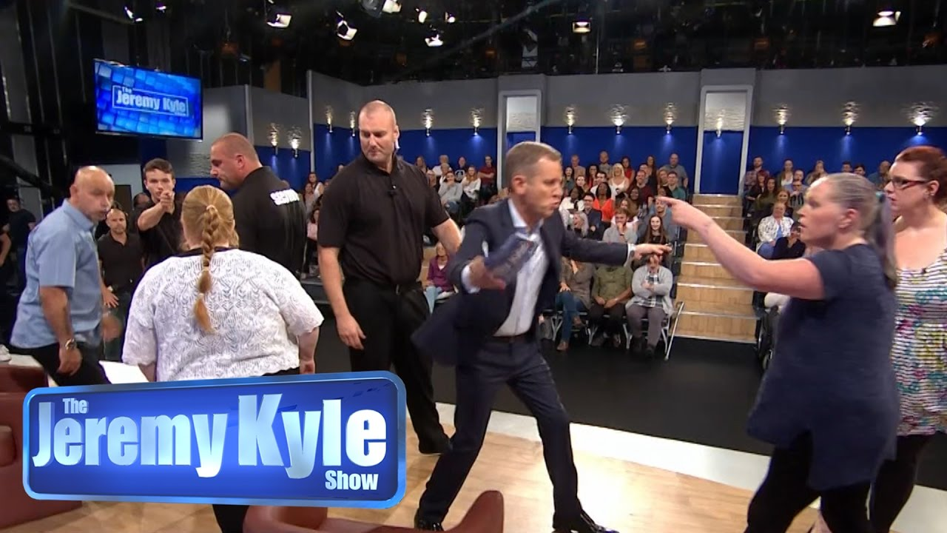
Working in groups of 5, recreate the reunion of Odysseus & Telemachus
You have the choice of either using the format of ‘Long Lost Families’, usually a happy reunion, or ‘The Jeremy Kyle Show’, usually not so happy!!!
What will happen?
What will be said?

