Slide 1
Date

Slide 2
Think about a journey you have been on…
How did that journey make you feel?
Was it a positive or a negative experience?
Use the following sentence starters to respond:
Once I had to travel to….
I felt…
Try to use some powerful adjectives to convey your emotions & don’t forget to explain why you felt the way that you did

Slide 3
A Brave Warrior…
Today, we are going to read/listen to the next episode from The Odyssey
We will be hearing from our hero, Odysseus, & will discover a little more about him & his life as a warrior
What does the word ‘warrior’ mean to you?
Create a spider diagram with key words

Slide 4
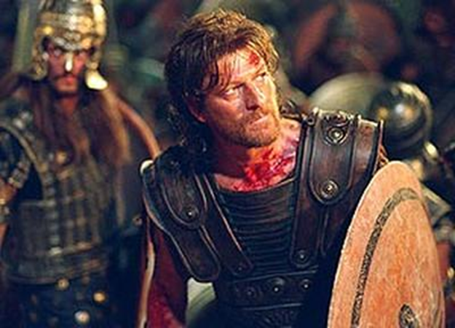
Brave
Warrior

Slide 5
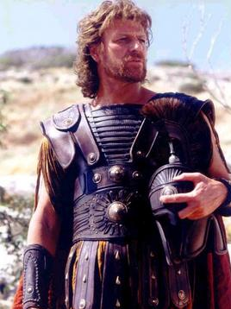

We are now going to read/listen to Episode 2 of The Odyssey
As we do, pay close attention to how Odysseus feels about travelling to fight in the Trojan War
Does he want to go?

Slide 6
So, it would seem our hero, Odysseus is something of a reluctant traveller!!!
Extended Writing Task
Imagine that you are our hero Odysseus
You are reluctant to travel & fight in the Trojan War but the army needs you!!!
How can we persuade you to go?
Write a letter to Odysseus, persuading him to travel to Troy
  Provide lots of good reasons why he should go & include lots of persuasive devices

Slide 7
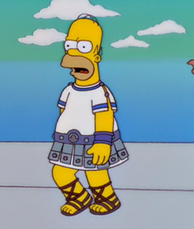
Persuasive devices could include:
flattery
make your opinion sound like common sense
repetition/rule of three
emotive language
inclusive language (we, us, our)
powerful adjectives & verbs
rhetorical questions
facts & statistics

Slide 8



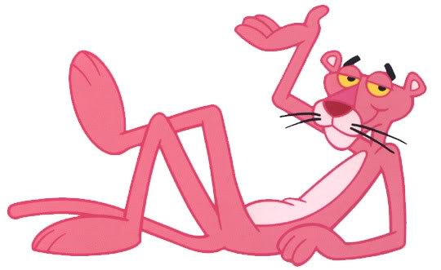





Peer Assessment
Double tick and label where you find any examples of persuasive writing
Think Pink!
Highlight any spelling or punctuation errors
Write down what you think they need to do to improve the content/writing.
Sign and date

