Slide 1
Date
An unfriendly host

Slide 2
A Warm Welcome…
As we know from our previous lessons, during the times of Ancient Greece, strangers would be welcomed in new cities & towns due to the rules of Guest Friendship
But, unfortunately, Odysseus is about to meet a rather unfriendly character
Who might that be & why might they not be so welcoming to Odysseus & his men?

Slide 3
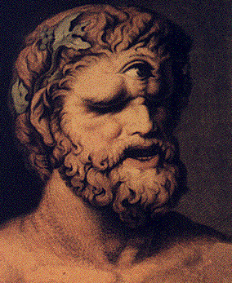
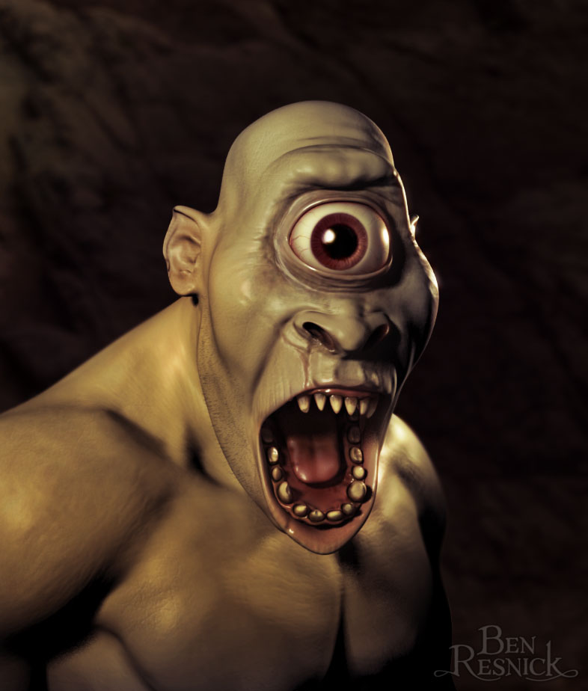
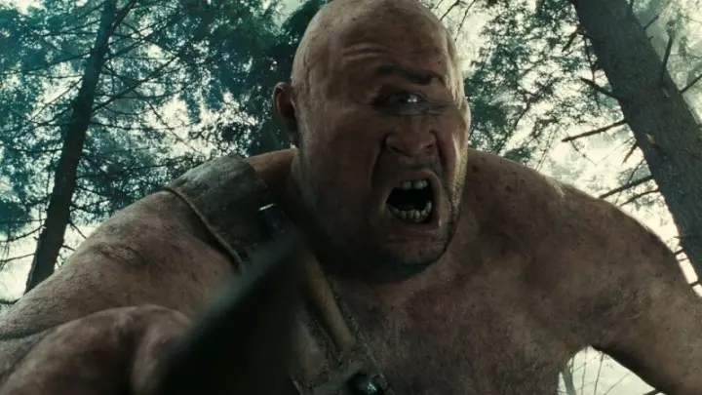
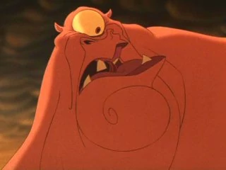
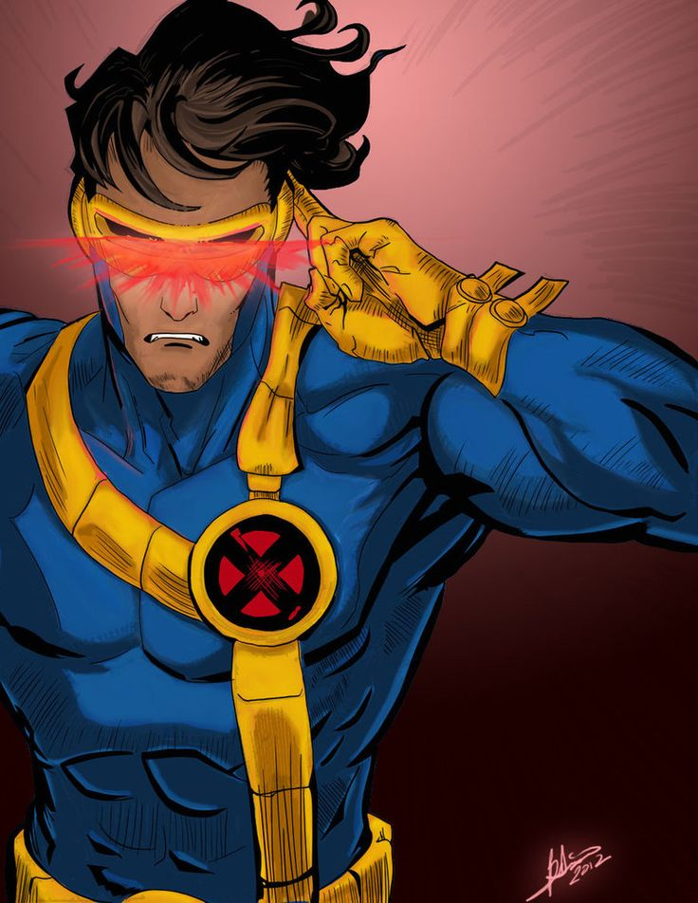
Who is this character?
Draw and label your own Cyclopes in true terrifying Greek fashion. The scarier the better!

Slide 4
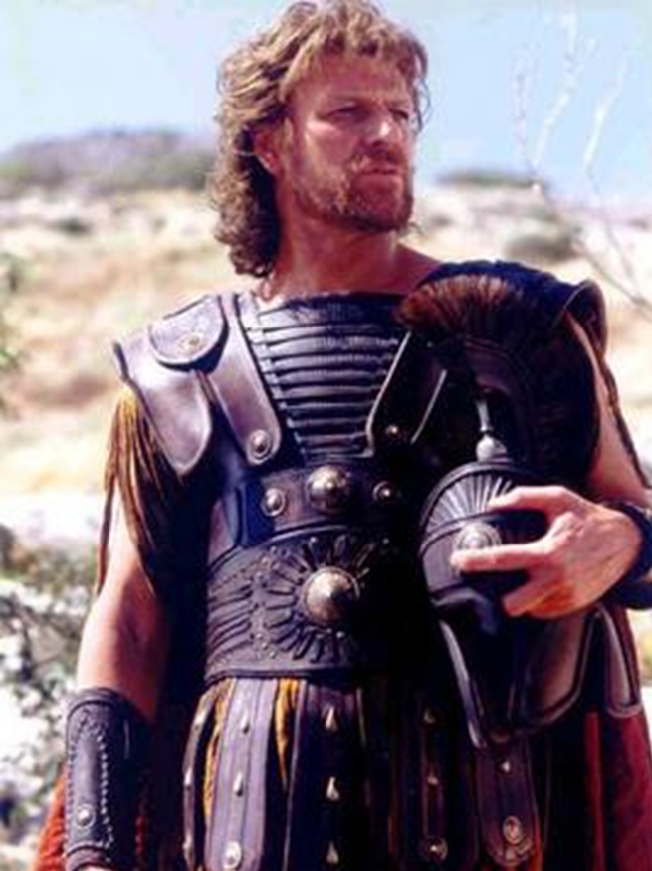
We are now going to read through the next section of Episode Two of The Odyssey
This section is called ‘An Unfriendly Host’
As we listen/read, pay close attention to the following:
Where are we?

Slide 5
Is the description of the Cyclopes what you expected?

Slide 6
A Modern Day Hero
In a wide variety of stories & fiction, we will often come across a hero who will swoop in & save the day right at a key moment in the plot
The Odyssey is no different – we have a hero &, for now at least, it would seem that this is Odysseus
When you think of the word ‘hero’, what do you imagine?
Create a spider diagram

Slide 7
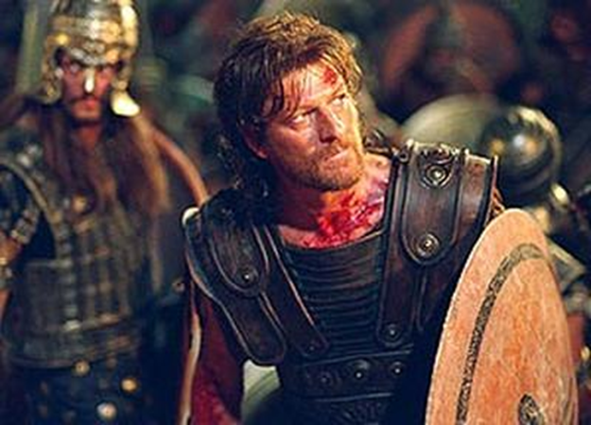
Fearless
Hero

Slide 8
Compare the words you have written in your spider diagram with those you included in your spider diagram for the term ‘warrior’
Are there any words that have been repeated?
Why might this be?

Slide 9
As we can see from our diagrams, we have a very definite ideas as to what we consider a hero to be
The Greeks were no different to us in this regard; however, their understanding of a hero had some slight differences to our thoughts today
Examine the ‘Features of a Hero’ grid
Which descriptions do you think are of modern heroes, which are Ancient Greek & which could be both?

Slide 10
A Hero should be | Ancient | Modern | Both
Male
The son of a god
Kind
Helpful to others
Courageous
Outstanding (better, faster, stronger or more clever than other people)
Self-sacrificing
Someone who kills lots of enemies
Beautiful
Someone who saves people
Morally virtuous
Strong
Motivated by fame and glory
Humble and modest (doesn’t boast or seek praise or fame)

Slide 11
A Hero should be | Ancient | Modern | Both
Male | X
The son of a god | X
Kind |  | X
Helpful to others |  | X
Courageous |  |  | X
Outstanding (better, faster, stronger or more clever than other people) | X
Self-sacrificing |  | X
Someone who kills lots of enemies | X
Beautiful | X
Someone who saves people |  | X
Morally virtuous |  | X
Strong |  |  | X
Motivated by fame and glory | X
Humble and modest (doesn’t boast or seek praise or fame) |  | X

Slide 12
Episode 3 – Odysseus, Our Hero?
We are now going to listen to/read through Episode 3 of The Odyssey
As we do, consider the following:
does Odysseus behave in a heroic way?

Slide 13
The Blame Game
Think back to all of the main events with Episode 2 & Episode 3
Who do you think is responsible for what happens to Odysseus & his men?
Is it Odysseus himself or does the responsibility lie with Polyphemus?

Slide 14
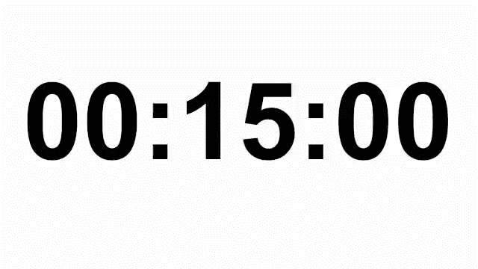
Using your knowledge of events, create a table in your books as below:
 | Odysseus is to blame because … | Polyphemus is to blame because …
Odysseus would say:
Polyphemus would say:
Odysseus’ men would say:
Poseidon would say:

