Slide 1
Date
The Calm Before The Storm

Slide 2
Examine the title of Episode 4 of The Odyssey:
The Calm Before the Storm
What might this title suggest?

Slide 3
The title of the next Episode can be seen of as a metaphor – bad times may well be on the horizon for Odysseus
At the end of Episode 3, we see Odysseus has blinded Polyphemus, the Cyclops who calls himself the son of Poseidon
What do you remember about Poseidon?
Why might this be a problem for Odysseus?

Slide 4
Techniques for Imaginative Description
To ensure a reader is engaged with a story, the writer needs to ensure that they can visualise what it is that is being described
But how do they do this?
What language devices can you think of that a writer may use to help the reader picture what is happening?

Slide 5
powerful adjectives
adverbs
the use of colour
metaphors
personification
similes
superlatives
powerful verbs
pathetic fallacy
List a variety of language devices

Slide 6
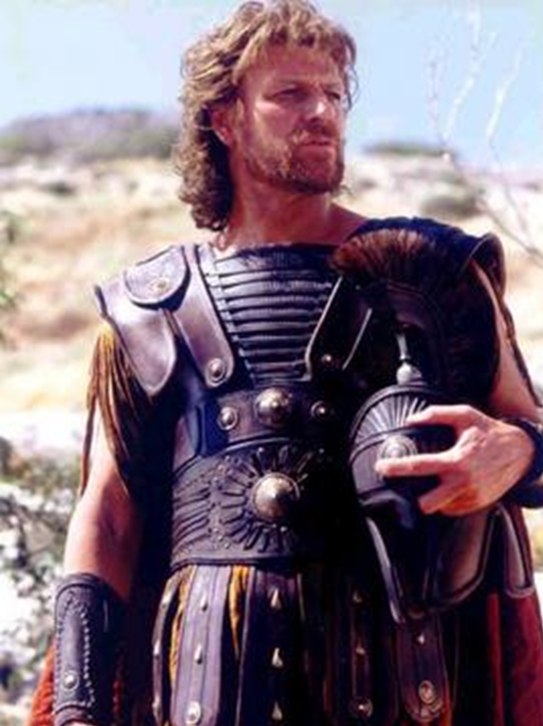
We are now going to read to the Episode 4 of The Odyssey – The Calm Before the Storm
As we do, can you identify any uses of descriptive language in the text?
Annotate as we read

Slide 7
Examine the following quote from Episode 4:
And the north wind threw us for the south wind to catch.
How could we annotate this quote for language devices & their effect?

Slide 8
Verbs such as ‘threw’ & ‘catch’ suggest a game – this makes Odysseus & his men seem vulnerable, like play-things
And the north wind threw us for the south wind to catch.
Personification of the winds – this presents the winds as acting like children playing a game
The use of a simple sentence mimics the child-like activity & ease with which the winds can throw Odysseus & his men about

Slide 9
Thinking about how we have annotated the previous quote, chose 3 quotations that you have identified a technique for
Annotate them for what you believe the intended effect is

Slide 10
Examine the following assessment style question:
How does the writer use language to present the storm in Episode 4 of The Odyssey?
Thinking about our first quotation, how would we turn this into a PETER paragraph?

Slide 11
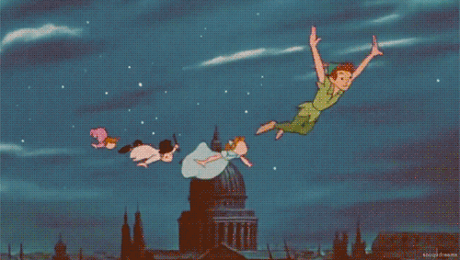
Examine the sample response
Can you identify the features of a PETER paragraph?
Point: Say how the storm is presented
Evidence: Use a quotation
Technique: Identify techniques in the quotation
Explanation: Explain the meaning & effect of the techniques/ key words in your quotation
Reader: Identify the effect on the reader or listener

Slide 12
The narrator make the storm seem frightening by personifying the winds. For example, when it says ‘And the north wind threw us for the south wind to catch.’ They use personification, suggesting that the winds are like children, playing a game of catch. This effect is reinforced by the simple sentence which implies that the winds are able to throw Odysseus and his men easily between them and that it is a game to them. This gives a clear sense of how vulnerable and powerless they are in this storm and makes it seem very dangerous. The childlike way of expressing this situation allows the listener to empathise with the situation they are in and understand how dangerous the storm is.

Slide 13
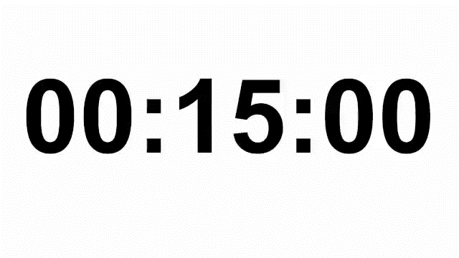
Take one of your annotated quotations
Can you turn it into a PETER paragraph in response to the question?
How does the writer use language to present the storm in Episode 4 of The Odyssey?
Point: Say how the storm is presented
Evidence: Use a quotation
Technique: Identify techniques in the quotation
Explanation: Explain the meaning & effect of the techniques/ key words in your quotation
Reader: Identify the effect on the reader or listener

Slide 14
And Finally…
Swap your response with your partner
Thinking about the PETER paragraph structure, provide them with some feedback
What have they done well?
Have they included all of the PETER paragraph elements?

