Slide 1
Date
Mood and Atmosphere

Slide 2
Why might this be the odd word out?
Tense
Sombre
Accusatory
Confrontational
Gripping
Respectful
Sarcastic
Truthful
Melancholy
Cheerful
Sinister
Playful
Normal
How do these words relate to today’s lesson objectives?

Slide 3
Apart from the word ‘normal’, all of these words can be used to describe the mood of a text
But what does the term ‘mood’ actually mean?
What about ‘atmosphere’ & ‘tone’?
Can you create a definition for each term?

Slide 4
Mood, atmosphere & tone all relate to the feelings & emotions within a text
Not only do we get a sense of how the characters are feeling but tone & atmosphere help to build tension & suspense for the reader
Thinking about the above definitions, examine your handout
Read each short extract
Can you identify 3 moods/atmospheres for each extract from the list provided
Use a dictionary if you are unsure as to what any of the words mean

Slide 5
Examine the opening two paragraphs to Episode 4 of The Odyssey:
“Father Poseidon, did you hear his name? It was Odysseus who blinded your son. Blight his voyage with trial and calamity, so that if at last he reaches his homeland let him be alone, and unknown, and under a strange sail, and let him find danger waiting where there should be a welcome!”
I laughed at the Cyclops’ rantings, I looked around me, I could see no sign of retribution. The sea was calm. But little did I know. Far below our ship the sea god Poseidon was scratching his barnacled chin and pondering a plan.
How would you describe the mood in these paragraphs?

Slide 6
Read through to Episode 4 of The Odyssey once more:
What mood can be found in each paragraph?
Is the mood the same from the beginning to the end of Episode 4?

Slide 7
Examine the following assessment style question:
How does the mood/atmosphere change throughout Episode 4 of The Odyssey?
How could we answer this question?
What are the changing moods throughout the Episode that we could discuss?
How would we analyse (explain) their effect?

Slide 8
One change in mood that we could focus on comes from at the beginning of the Episode
The mood in the first paragraph is tense & aggressive as Polyphemus is angry with Odysseus as he has blinded him so he seems to threaten Odysseus & put a curse on him
In the second paragraph, however, Odysseus seems light-hearted & laughs at Polyphemus & dismisses his threat
Is this a wise thing for Odysseus to do?

Slide 9
The reader may think that Odysseus is somewhat foolish here
Polyphemus has the power of Poseidon on his side – he is a powerful God so perhaps Odysseus should be a little more concerned
How could we turn this into a PETER paragraph to answer the assessment style question?

Slide 10
The mood at the beginning of Episode 4 of The Odyssey could be described as tense & aggressive. This is due to the fact that Polyphemus threatens Odysseus for his disrespect & the fact that he has blinded him. He states ‘Let him find danger waiting where there should be a welcome!” which suggests that Polyphemus is putting a curse on Odysseus. However, the mood appears to change as Odysseus ‘laughs’ at the threat, suggesting that this is just a joke & he isn’t taking the threat seriously. The reader would be concerned as it would seem that Odysseus underestimates the power of Polyphemus & his father, Poseidon. This can be seen through the use of the verb ‘laughs’ which highlights how dismissive Odysseus is, something that he may come to regret later in the story.

Slide 11
Does this sample paragraph include all of the necessary elements for a successful PETER paragraph?
Point: Identify a mood
Evidence: Use a quotation
Technique: Identify techniques in the quotation
Explanation: Explain the effect of the mood & identify how it changes & why
Reader: Identify the effect on the reader or listener

Slide 12
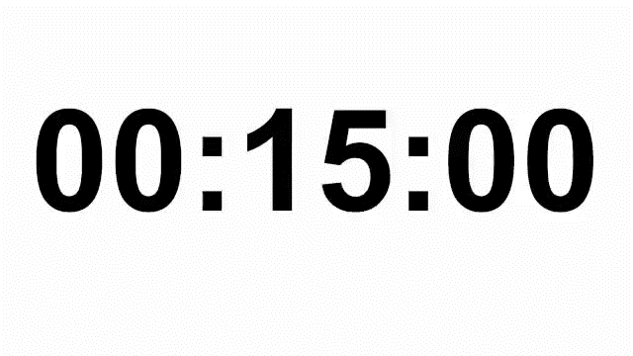
Thinking about our PETER paragraph structure, write a response to the assessment style question
Don’t forget, as you are looking at changes to mood, you will need to discuss how a mood changes from one kind to another so you will need to look at two different moods & what the effect of the change is
How does the mood/atmosphere change throughout Episode 4 of The Odyssey?

Slide 13
Point: Identify a mood
Evidence: Use a quotation
Technique: Identify techniques in the quotation
Explanation: Explain the effect of the mood & identify how it changes & why
Reader: Identify the effect on the reader or listener

