Slide 2
The Greek we Speak
ἀρχη
arche
φοβος
fobos
μονος
monos
λογος
logos
tεχνη
techne
Anarchy
Patriarchy
Monarchy
A ruler
agoraphobia
claustrophobia
arachnophobia
A fear
monotone
monochrome
monosyllabic
Alone/ a single thing
Anthropology
Biology
physiology
A reasoning/rationale
Technology
Technical
technique
A skill

Slide 3
Tracking the Alphabet
Split into 5 groups
Take your portion of the alphabet on the cue cards
Match the oldest alphabetical characters of the Protosinatic Alphabet (1750 BC) to our Modern Latin alphabet
Can you spot the letters we use from the ancient origins?

Slide 4
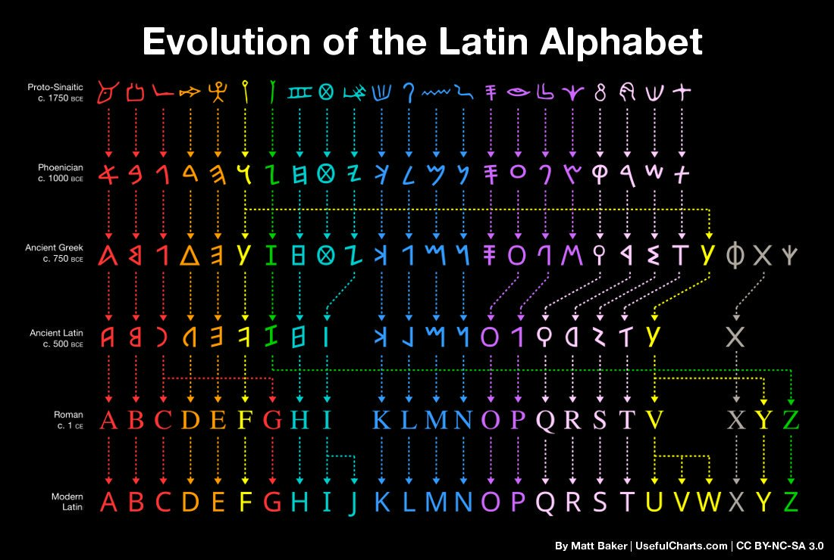

Slide 5
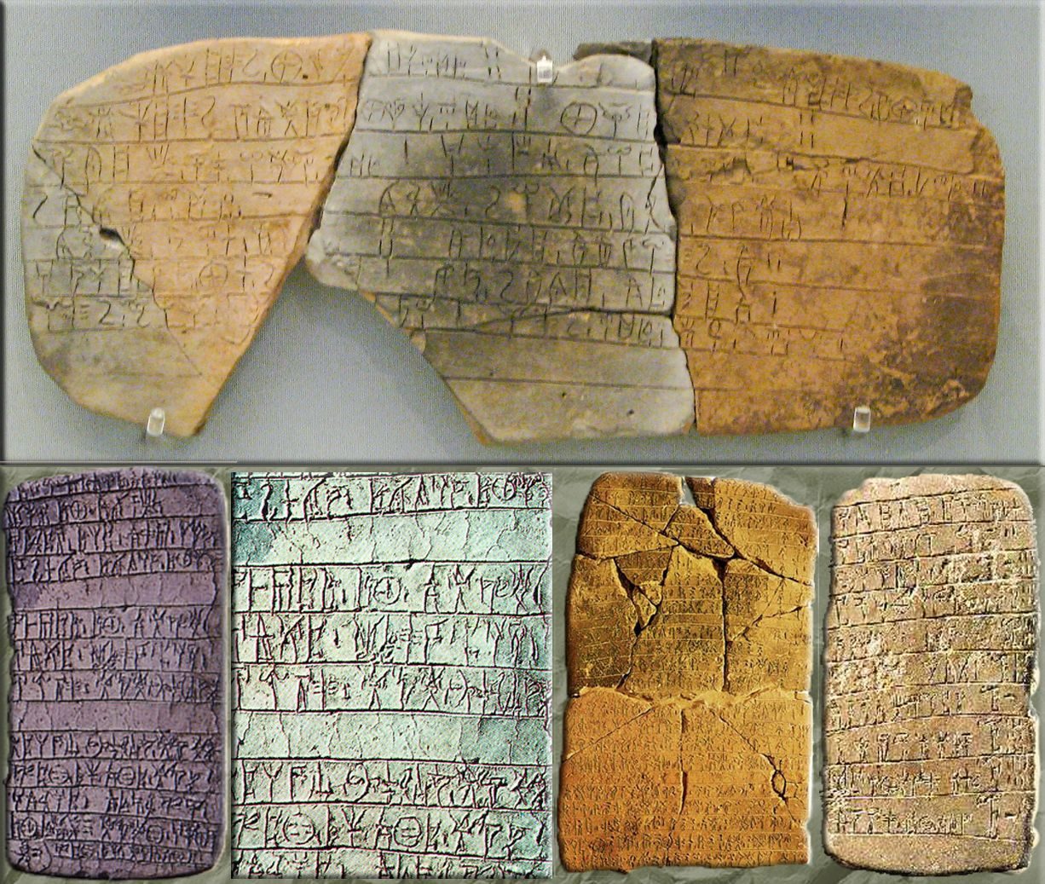
Linear B Tablets: When?
1250 BC Trojan War
776 BC Olympic Games
1450 BC Linear B tablets written

Slide 6
Linear B Tablets: What?
These tablets were found in the palace at Knossos….
What do you think they said?
What kind of texts do you think they are?

Slide 7
Linear B Tablets: Where?

Slide 8
Linear B Tablets: How?
Lead scribe overseeing quality control and storage.
Scribe writing on the clay tablets
A child rolling the clay to make the tablets.

Slide 9
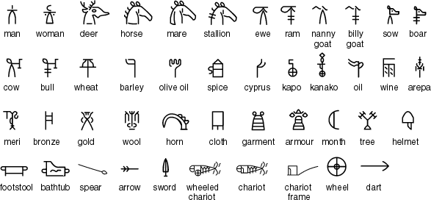

Linear B Ideograms: Why?
Why might ancient civilisations use shorthand on written messages?
This Photo by Unknown Author is licensed under CC BY-SA
Why do we use emojis on digital messages?

Slide 10
Linear B Ideograms: Try!

Slide 11


Why keep a receipt?
Roll your clay into a mini tablet
What can you do if you make a mistake?
That’s why clay was used for receipts.
The Linear B was preserved because….

Slide 12
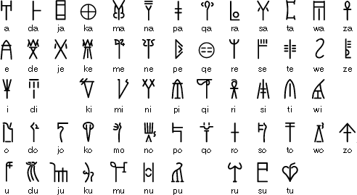
Linear B
Linear B consists of around 87 syllabic signs and over 100 ideographic signs.
Crete, Knossos, Pylos, Myceneae, Thebes and Tiryns.

Slide 13
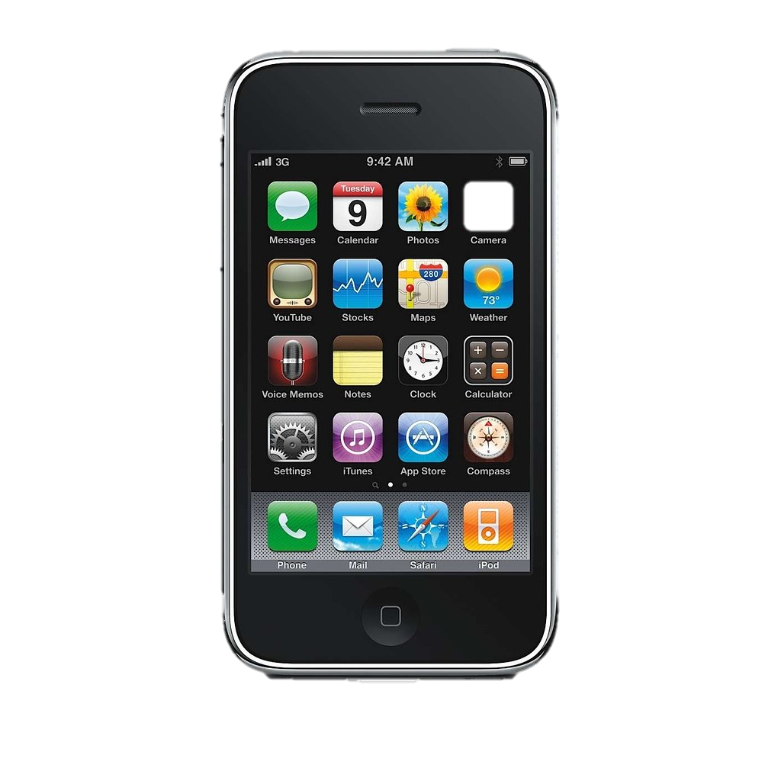
We have learned…
THINK:
If an archaeologist read your phone in 1000 years’ time what would they learn about you?
Root words of Greek in English language
How language shows what is important to a culture
How language is shaped by the materials we use to write
How we receive ancient languages through artefacts
This Photo by Unknown Author is licensed under CC BY-SA

