Slide 1
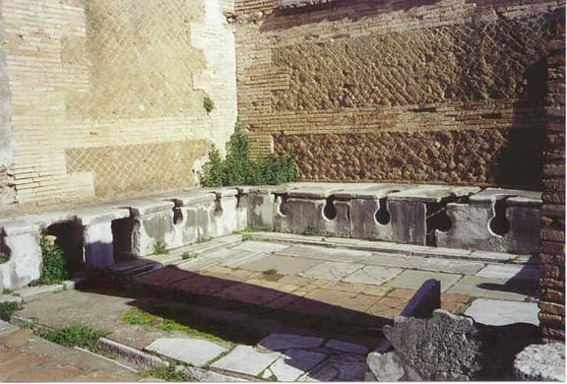
What is this?

Slide 3
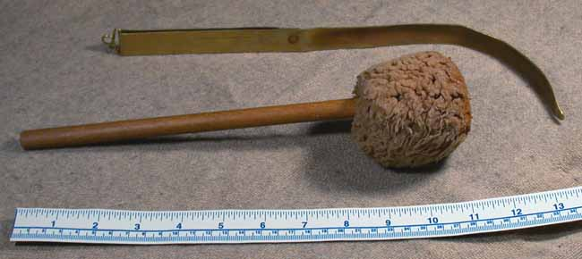
What is this?

Slide 4
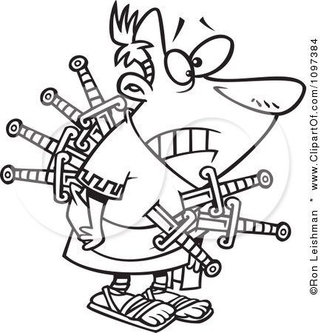
Ruthless Romans
Investigate five examples of ‘bad’ Romans.
Establish if these figures really are ‘ruthless Romans’.

Slide 5
What makes a baddie?
Why are some people viewed as baddies but not others, even if they have committed the same crimes?
Can you have good intentions, but still end up being viewed as evil?
Do good leaders sometimes have to do bad things?
Are villains born or made?

Slide 6
Ruthless Romans
Ancient Rome started life as a Republic.
The Roman Republic had many problems which caused lots of civil wars, especially in the 1st century BC.
After the civil wars, the Republic collapsed and Rome was ruled by Emperors – The Caesars.

Slide 7
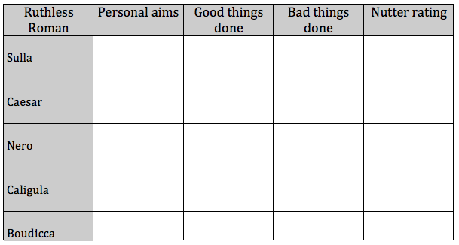
Ruthless Romans

Slide 8
Nutter rating
Blood thirsty psycho, no motives, enjoyed cruelty etc.
Some very nasty deeds but did have some reasons/motives.
Only seems to have killed in order to achieve an aim. Aim was not too psychotic!

Slide 9
Ruthless Romans
Investigate five examples of ‘bad’ Romans.
Establish if these figures really are ‘ruthless Romans’.

Slide 10
True or false?
It was considered good manners to throw up after dinner.
True! Rich Romans would do this in order to eat more at a feast!

Slide 11
True or false?
Both! The food of the poor and the army certainly was! Rich aristocrats would show off their wealth by hosting fabulous feasts – swans, peacocks… roasted door mice ☹.
Roman food was boring.

Slide 12
True or false?
The Romans invented the calendar.
Yes – all the months have a Latin meaning too!

Slide 13
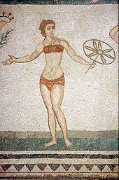
True or false?
Yes – simple loin cloths for men and strophiae for women.
Romans did not wear underwear.
A mosaic from the Piazza Armerina in Sicily showing a woman wearing a strophium.

Slide 14
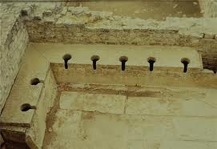
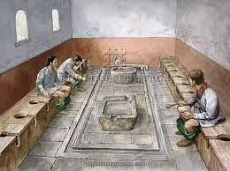
True or false?
No – for many it was a social occasion where some people completed business deals!
Romans thought going to the toilet was disgusting.

Slide 15
True or false?
No – The Romans fought against the Celts – who fought naked and painted themselves in blue paint!
All soldiers fought in armour.

Slide 16
True or false?
The Romans thought it was important to clean your teeth.
Absolutely… although they used powdered mouse brains as toothpaste!

Slide 17
True or false?
The Romans paid their teachers and doctors well.
No – nearly all doctors and teachers were well educated slaves!

