Slide 1
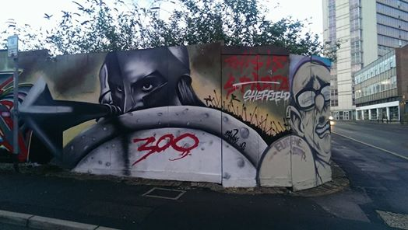
Is this Sparta?

Slide 2


Slide 3
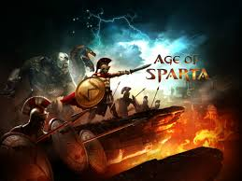

Slide 4


Slide 5


Slide 6




Slide 7
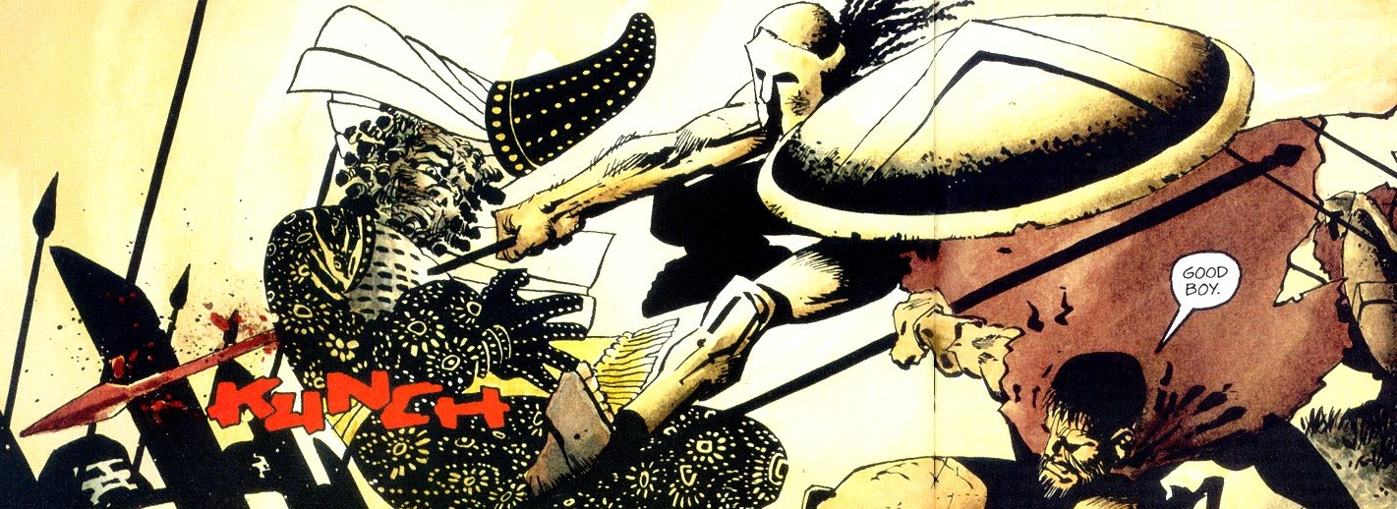
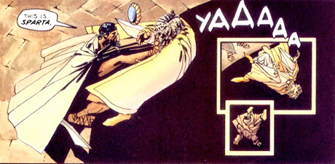

Slide 8
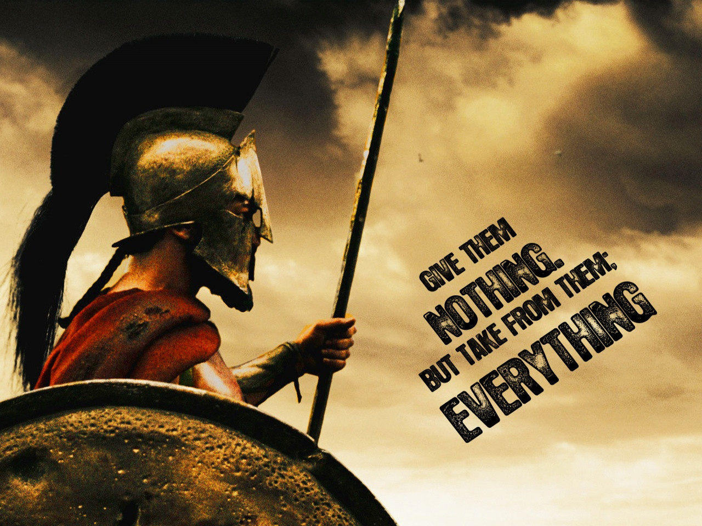

Slide 9


Slide 10
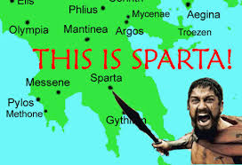
The Reality

Slide 11
We have learned…
There were more than 300 on the Spartans’ side at Thermopylae!
How the landscape could be used in military tactics
How popular culture adapts the ancient worlds has seeds of truth, plus a lot of fiction!
How to tell fact from fiction by evaluating sources like modern films and ancient texts.

