Slide 1
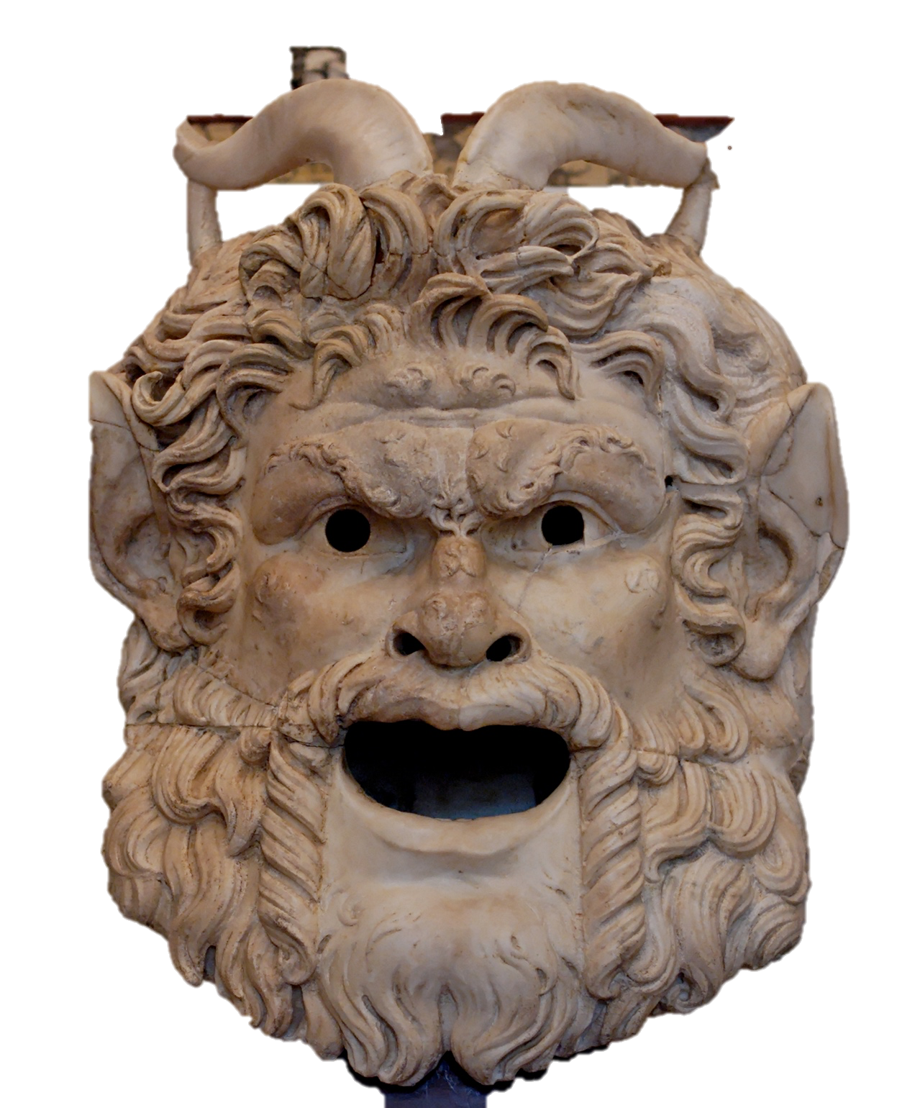
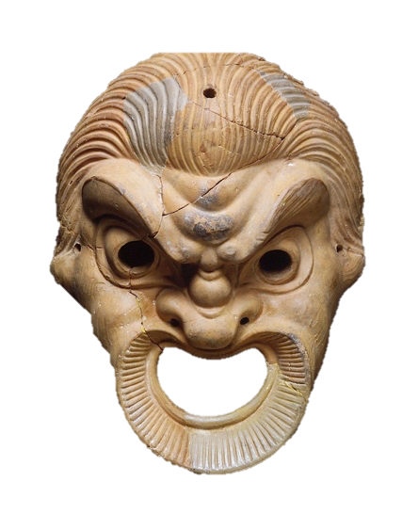
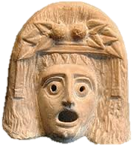
Ancient Theatre

Slide 2
Plotting the Theatre
Connect the description to the diagram
10 minutes

Slide 3
Oresteia
This is the only surviving trilogy from Greek tragedy, it includes 3 plays: Agamemnon, Libation Bearers and The Furies. In the first play Clytemnestra kills her husband Agamemnon. Throughout the remaining two plays Orestes tries to avenge his father by killing his mother and seeks redemption.

Slide 4
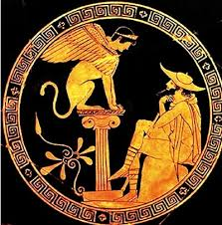
Oedipus
Having already solved the riddle of the Sphinx to become king, the king of Thebes cannot understand why his kingdom is now plagued. He will eventually learn that the gods are punishing him for unknowingly killing his father and marrying his mother, Jocasta. When he discovers this he gauges out his own eyes.

Slide 5
Heracles
Whilst in the underworld obtaining Cerberus for one of his labours, the hero discovers his father Amphitryon, wife Megara, and children are sentenced to death in Thebes by Lycus. Herakles arrives in time to save them, though the goddesses Iris and Madness cause him to kill his wife and children in a frenzy.

Slide 6
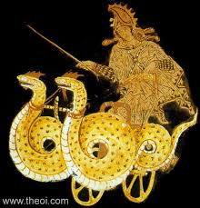
Medea
Having betrayed her father to provide Jason with the Golden Fleece and run away with the Argonauts, this ‘witch’ grows jealous of Jason’s new marriage and plots to kill Jason’s bride. Deciding this is not enough the ‘witch’ kills the children she shares with Jason and flies away on a dragon chariot.

Slide 7
Bacchae
The god Dionysus appears in Thebes where his cousin Pentheus is king, to avenge the claims that he is not the son of Zeus by introducing Dionysian rites into the city to prove he is a god. When the women at Thebes perform Dionysian rites they grow frantic and, believing that King Pentheus is a bull, they tear him limb from limb.

Slide 8
Ajax
Achilles has been killed in battle. The greatest warrior, should be given Achilles’ armor, but the two kings, Agamemnon and Menelaos, award it instead to Odysseus. The greatest warrior becomes furious about this and decides to kill them. However, Athena steps in and deludes the greatest warrior into killing instead the spoil of the Greek army’s cattle. Suddenly the warrior comes to his senses and realizes what he has done. Overwhelmed by shame, he decides to commit suicide.

Slide 9
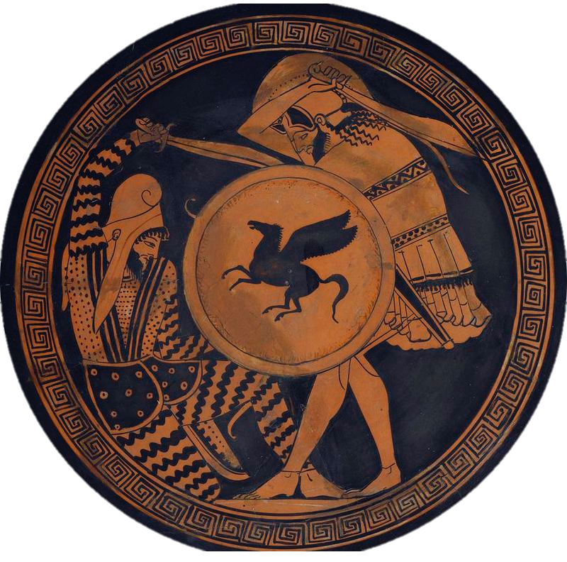
Persae
Queen Atossa awaits news of her son King Xerxes' expedition against the Greeks. At the tomb of her dead husband Darius, Atossa asks the chorus to summon his ghost. On learning of the Persian defeat, Darius condemns
his son’s decision to invade Greece and build a bridge over the Hellespont to expedite the Persian army’s advance. Xerxes finally arrives, dressed in torn robes and reeling from his crushing defeat.

Slide 10
Prometheus
Kratos (Authority), Bia (violence), and the smith-god Hephaestus chain the Titan to a mountain in the Caucasus, because henot only for stealing fire, but also for thwarting Zeus's plan to obliterate the human race. The Titan talks to the Oceanids and Io and refuses to tell Hermes who will overthrow Zeus. Zeus finally strikes the Titan with his thunderbolt.

Slide 11
Myth Now
Over to you to rebrand these tragedies for Netflix.
In pairs, summarise one tragedy in 3 sentences without naming characters.
Build suspense for your audience by not giving the ending away!
Can we guess which play?
Hercules: S1 Ep1
He’s fought a three-headed dog, an armoured lion and defeated the Hydra. Now the hero returns home to save his family. But can he save them from himself?

Slide 12
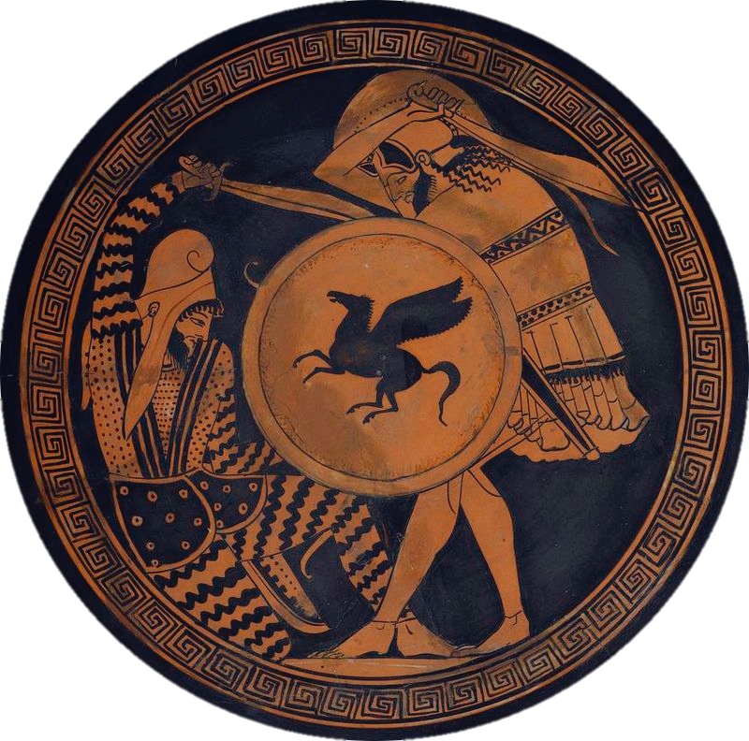
Aeschylus
525-456 BC
Persians (only surviving historical play)
Oresteia (only surviving trilogy)
Prometheus Bound
Seven Against Thebes
The Suppliants
Re-performed after death

Slide 13
Sophocles
468-416 BC
Ajax
Philoctetes
Antigone
Oedipus Tyrranos
Oedipus at Colonus
Women of Trachis
Electra

Slide 14
Euripides
480-406 BC
Escape tragedies Alcestis, Iphigenia in Tauris & Helen
Cyclops ( only surviving satyr play)
Hecuba, Iphigenia in Aulis, Trojan Women, Heracles, Suppliant Women, Medea, Hippolytus, Electra, Phoenecian, Women, Orestes, Andromache, Rhesus, Ion and Bacchae

Slide 15
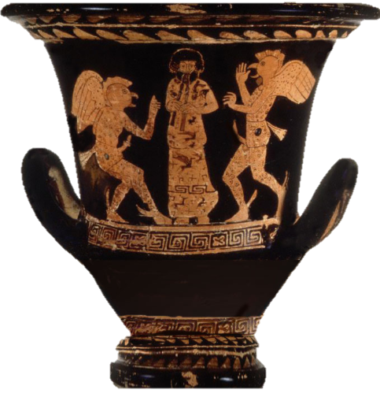
Aristophanes
444-385 BC
Birds, Wealth, Women at the Thesmophoria, Wasps, Frogs, Clouds, Knights

Slide 16
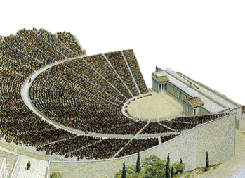
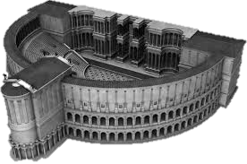
Spot the Difference
Look at the Greek theatre at the top of your sheet (6C BC)
Compare it to the Roman theatre below (55BC)
What differences can we spot?
Why might these changes have been made?

Slide 17
We have learned…
How people in the ancient world heard myths
What technology and special effects were used and how they changed through time
What kinds of entertainment were shown in the theatre
Who wrote versions of each myth for a mass audience

