Slide 1
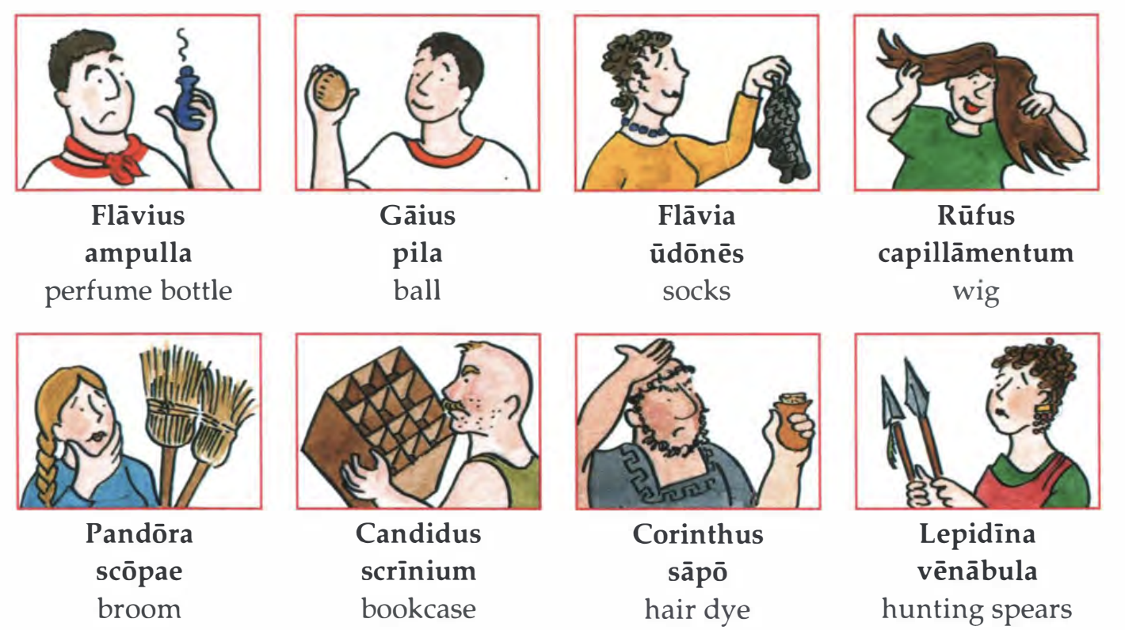
Io
Saturnalia
CHALLENGE
Look at the pictures and the Latin phrases below.
Can you guess what the family got for their Saturnalia presents?
Write the Latin and the answer in YOUR CLASS BOOK.
LESSON OBJECTIVES:
To make Christmas Cards in Latin
To Learn New Festive vocab

Slide 2
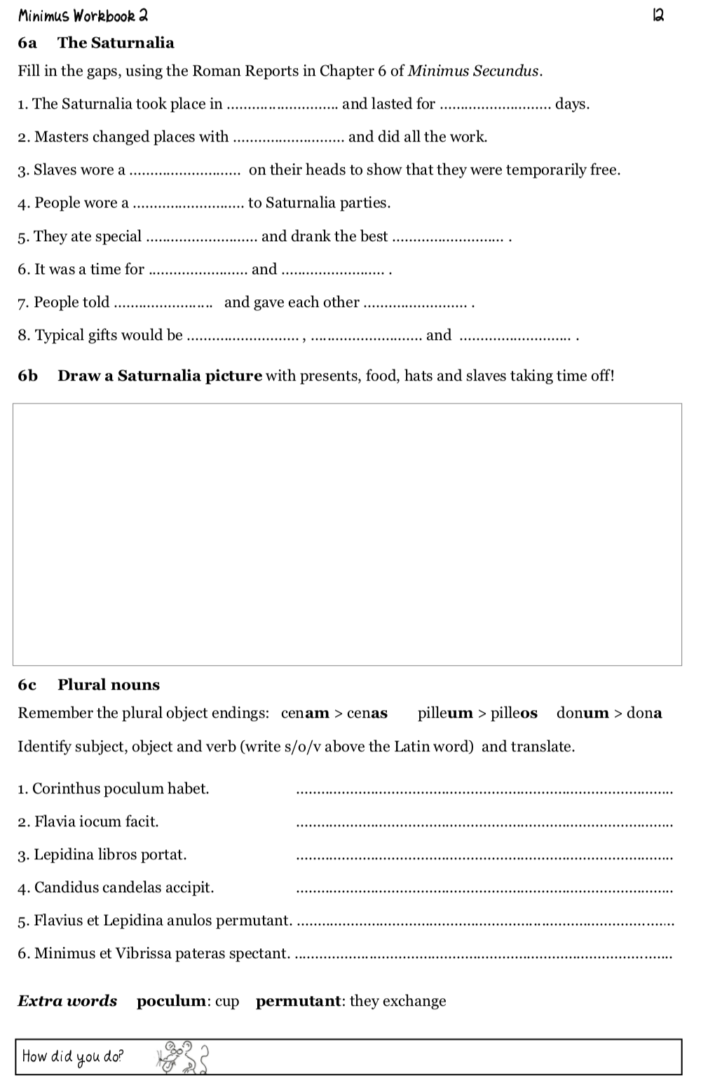
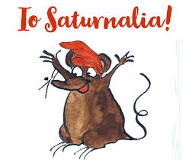
Homework HAND IN
For next lesson complete the Saturnalia worksheet.
Use what we have learned about the Saturnalia this lesson to illustrate the scene and label key features.

Slide 3
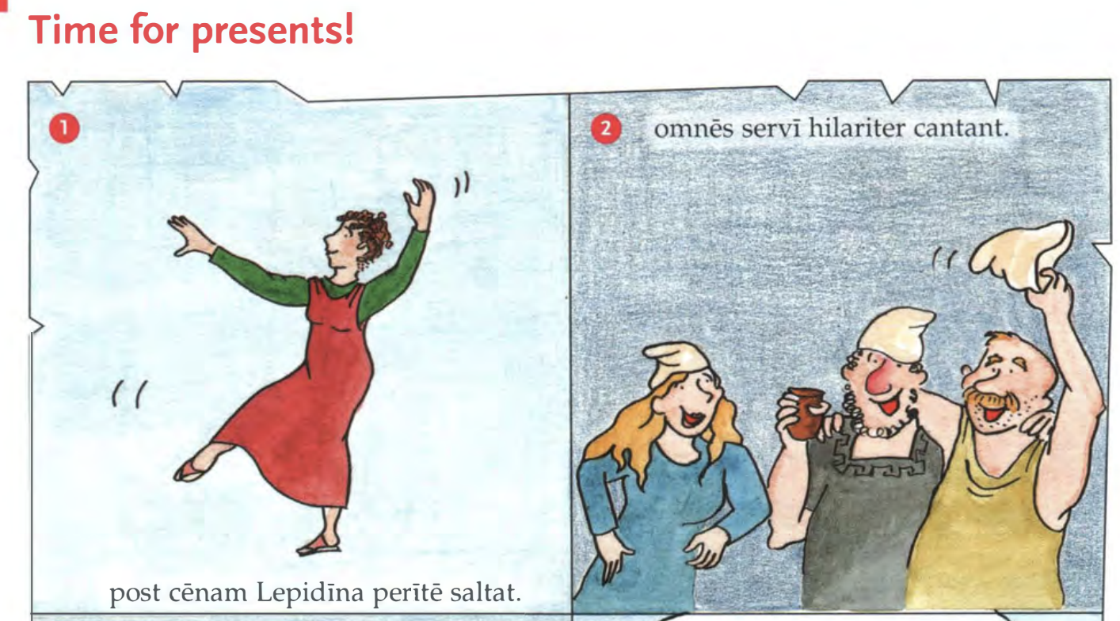
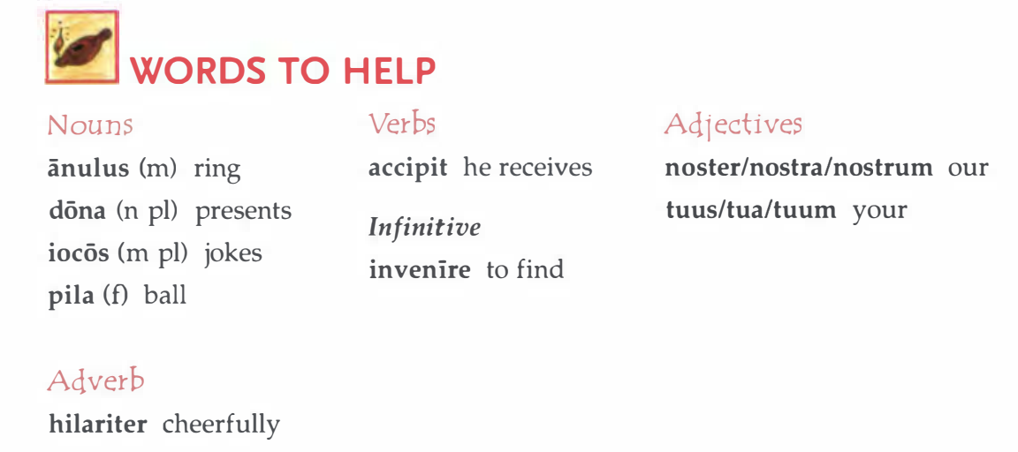

Slide 4
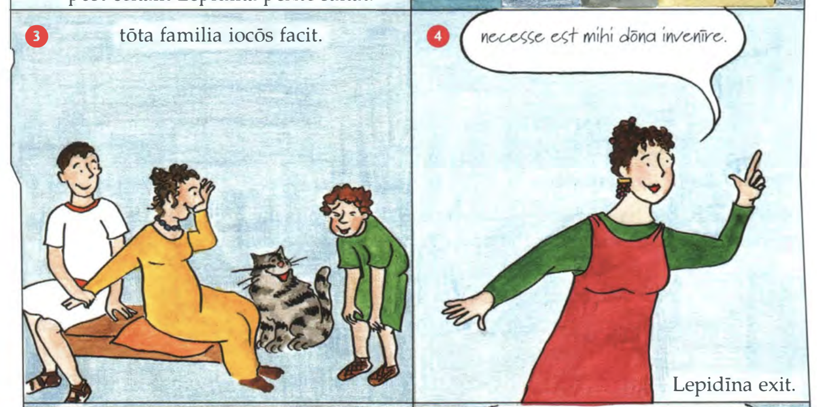

Slide 5
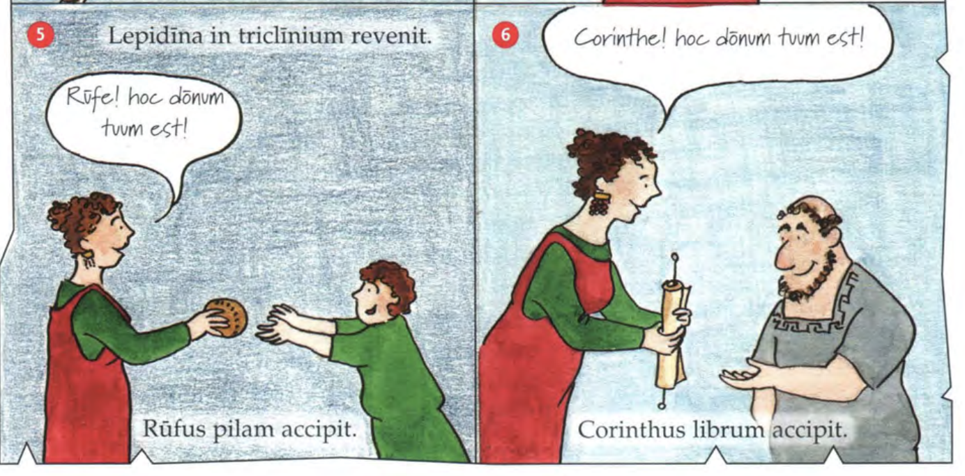

Slide 6
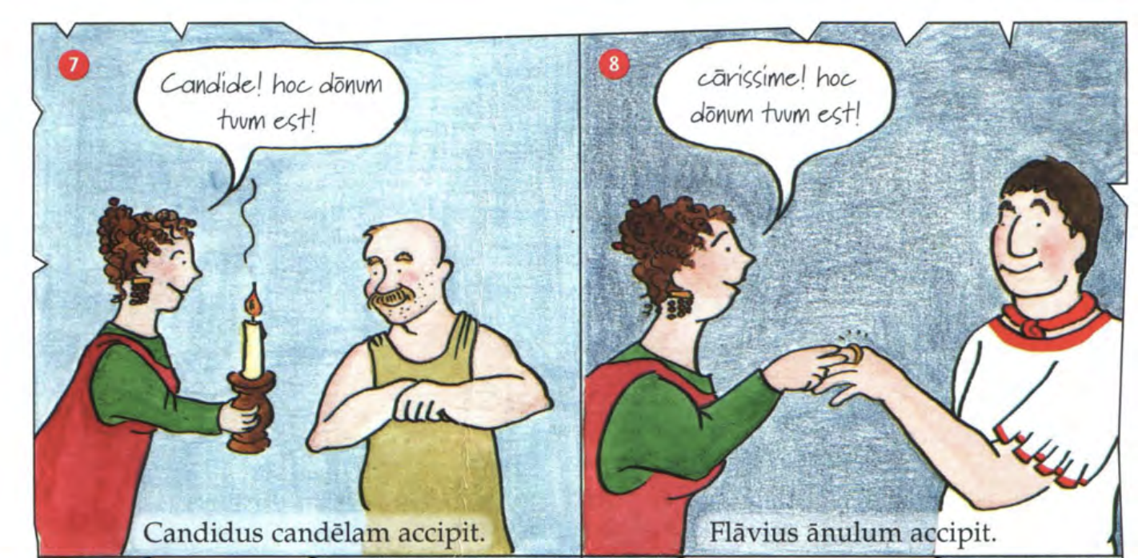

Slide 7
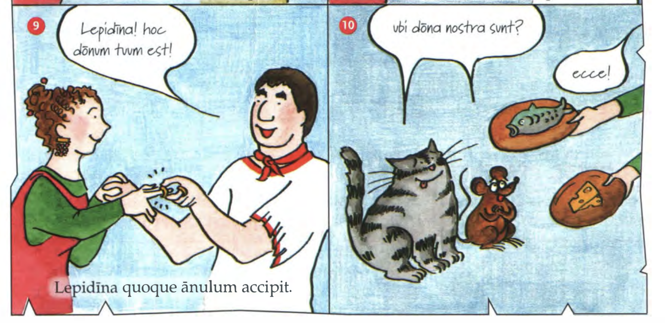

Slide 8
Making our cards
TASK:
IN YOUR CLASS BOOK
Practice your message before writing it on the card.
io, Saturnalia! = Hurray, Saturnalia!
laeta Saturnalia! = Merry Saturnalia!
hilare festum nativitatis Christi et felicem annum novum!
= Merry Christmas and a Happy New Year!
omnia optima festo nativitatis Christi et felici anno novo!
= All the best for Christmas and for a Happy New Year!
beatum annum novum! = Happy New Year!
CHALLENGE:
Write the message in side the card.
carissime/ carissima= dearest
te amo= I love you
hoc donum est tibi
Finished early?
Make a Latin gift tag.

Slide 9
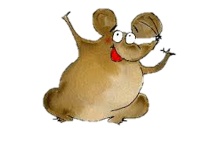
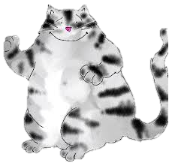
Plenary
What does “donum” mean?
What English words do we get from “donum”?
How do you say “Happy New Year” in Latin?

