Slide 1
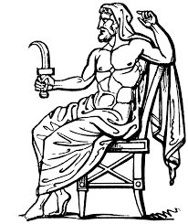
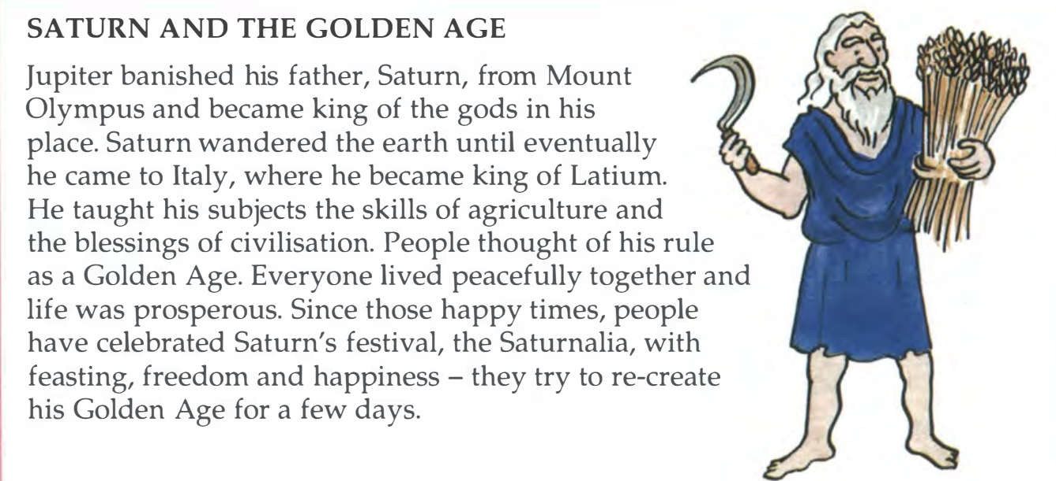
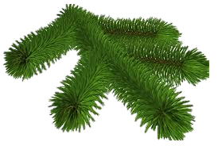
Io Saturnalia
Which Roman god was celebrated in the Saturnalia?
(Think of the planets)
CHALLENGE Can you name these Christmas Carols written in Latin?
Tranquilla nox
Adeste fideles
TIP: think of the roots
Nox> nocturnal> night
Fideles> fidelity> faithful
LESSON OBJECTIVES:
To RECAP Latin verb endings
To Learn about The Saturnalia

Slide 2
Verb Endings quiz

Slide 3
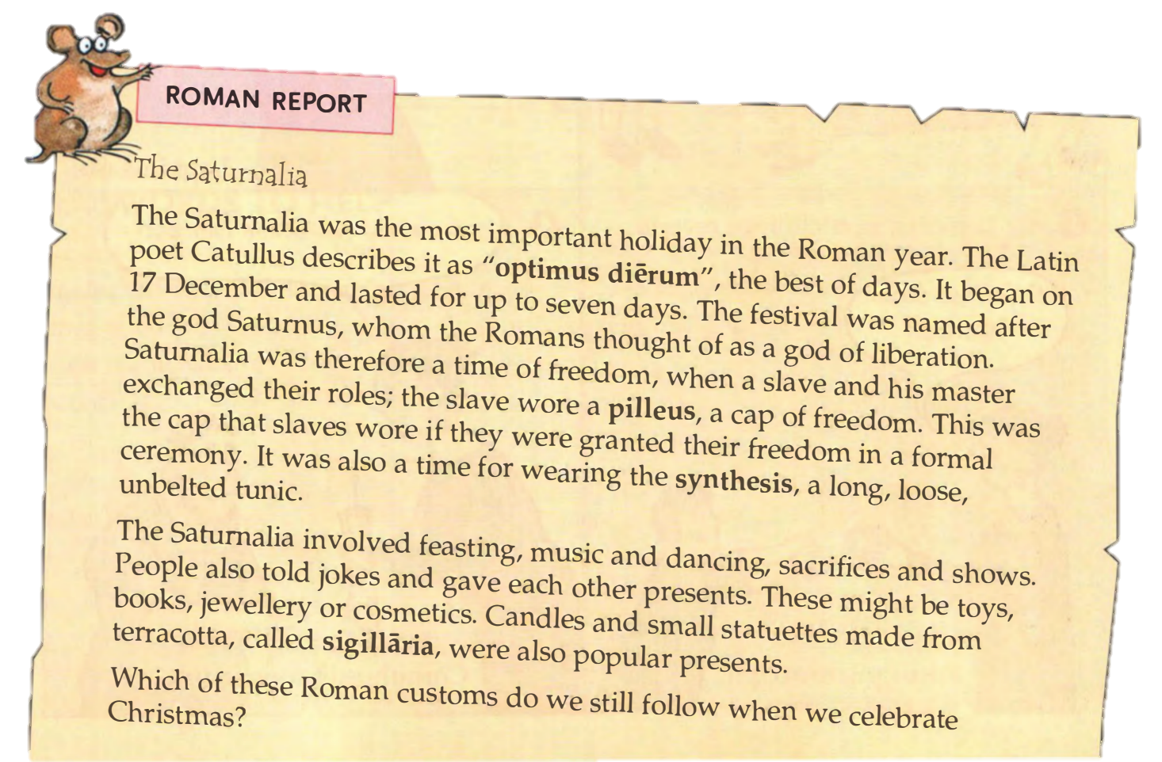
What is the Saturnalia?
TASK:
Read the Roman Report and complete these sentences in YOUR CLASS BOOK:
Catullus describes the Saturnalia as the “best of days” “optimus dierum”.
The festival began on the 17th of December.
Slaves wore a pilleus to show they were free.
Everyone wore a long synthesis.
People gave each other siglillaria gifts.
CHALLENGE:
Which practices do we still follow at Christmas time? List them in your book.

Slide 4
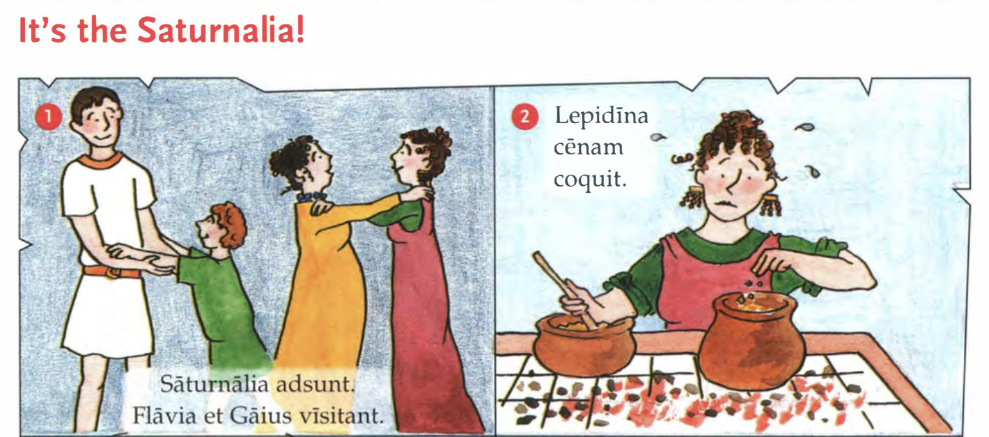
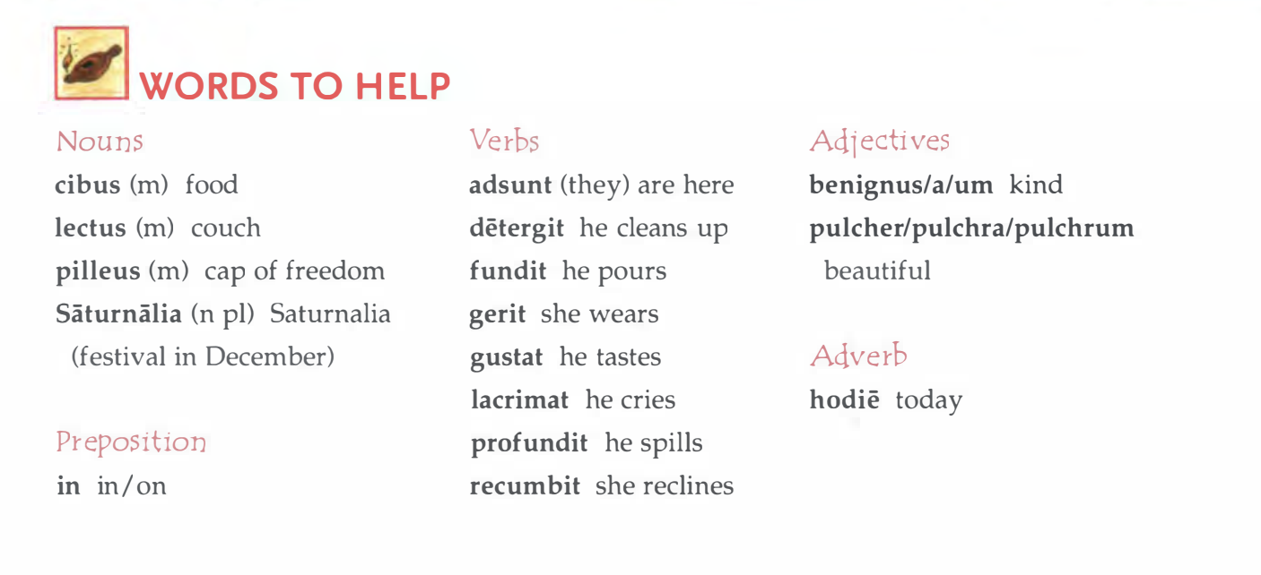

Slide 5
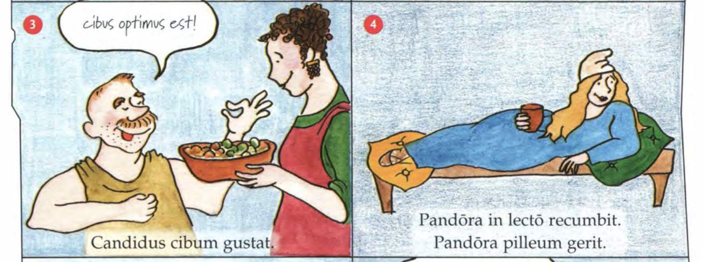

Slide 6
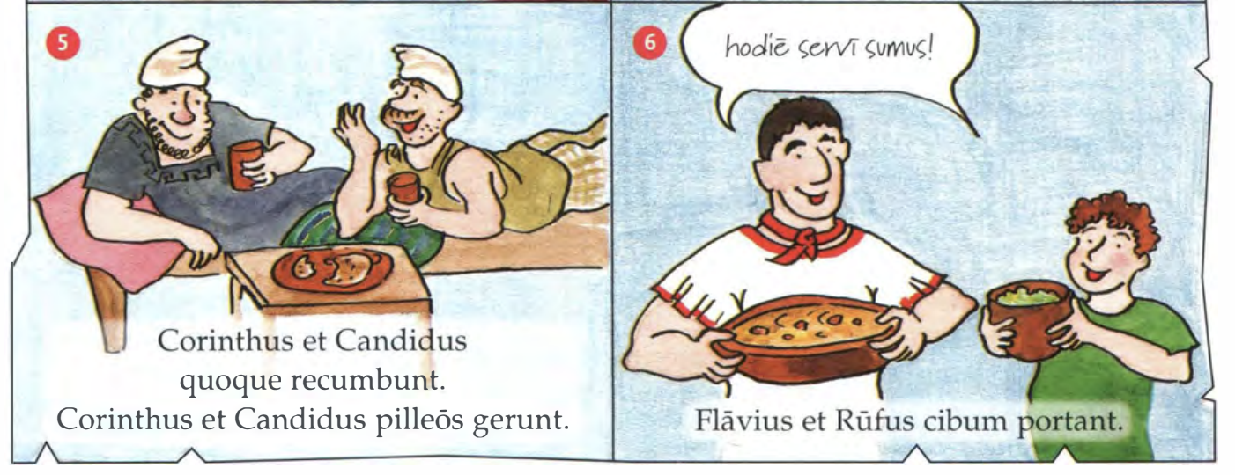

Slide 7
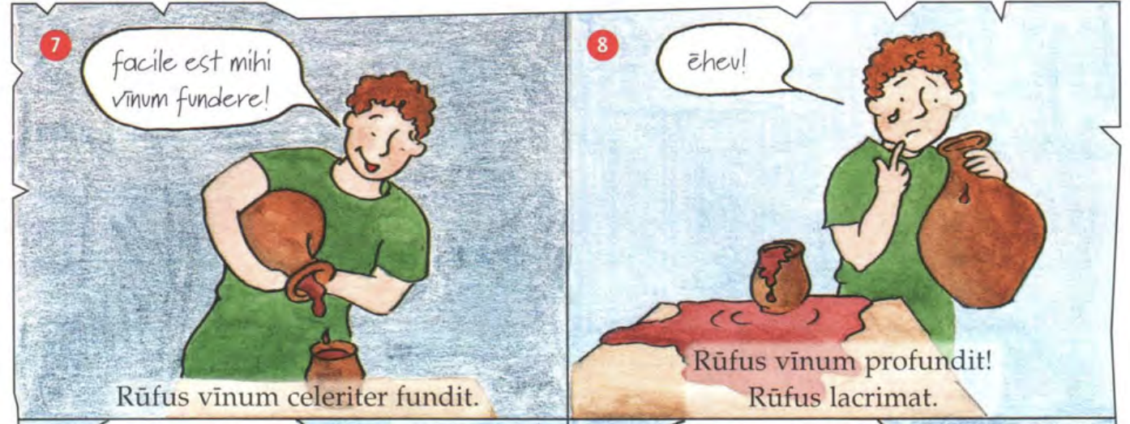

Slide 8
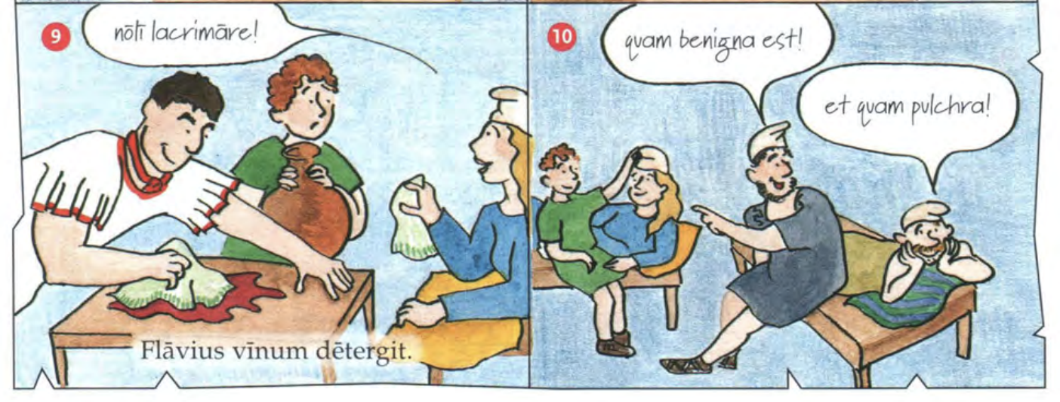

Slide 9
Verb Endings
TASK:
IN YOUR CLASS BOOK
Copy and translate verbs 1-9 into English. Remember to check the endings!
CHALLENGE:
Can you write these verbs in Latin?
I carry
I visit
I pour

Slide 10
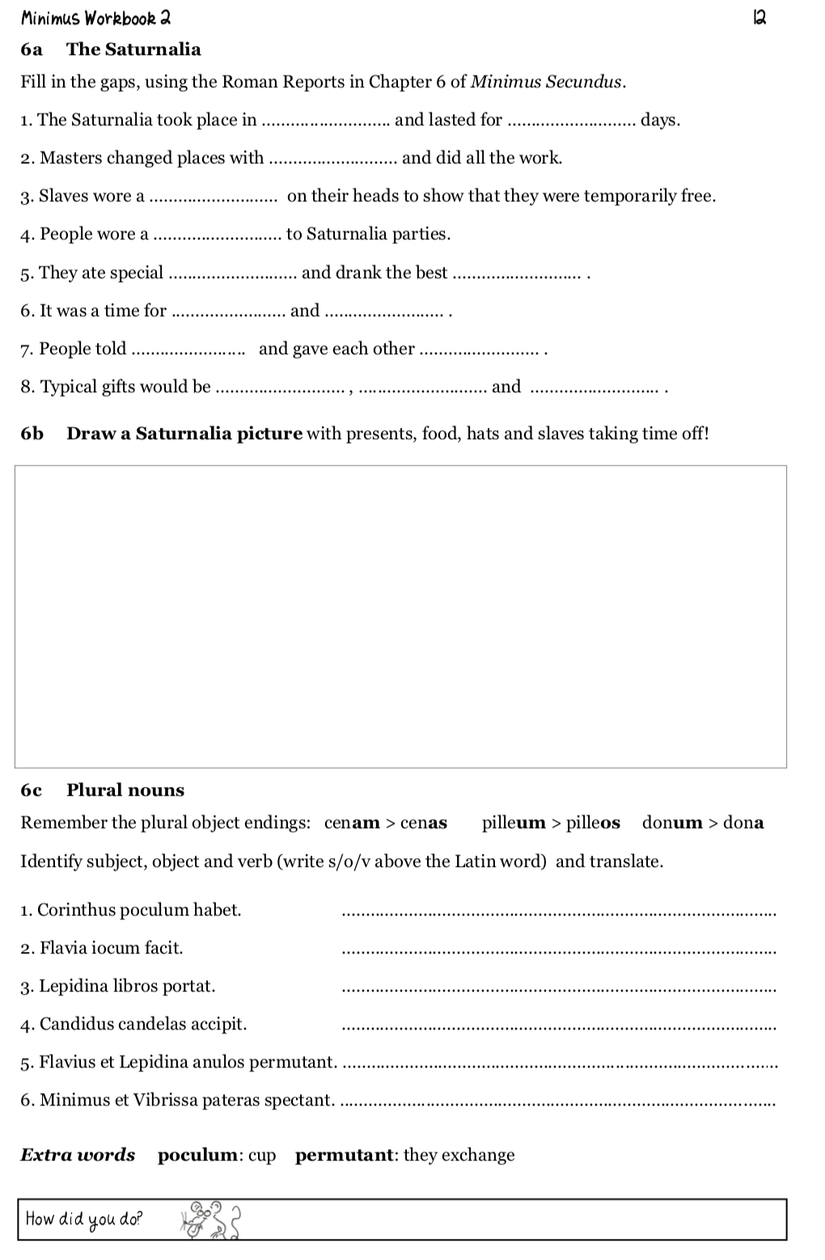
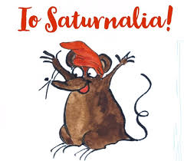
Homework
For next lesson complete the Saturnalia worksheet.
Use what we have learned about the Saturnalia this lesson to illustrate the scene and label key features.

Slide 11
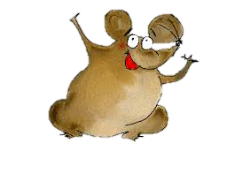
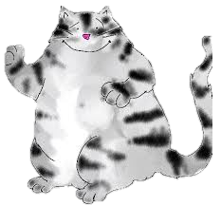
Plenary
To show who is doing what, Latin uses verb…
To show who is doing what, English uses…
What does the Roman Saturnalia have in common with our Christmas?

