Slide 1
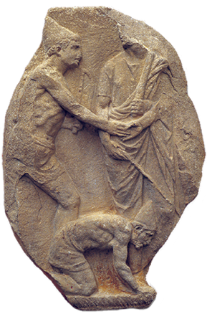
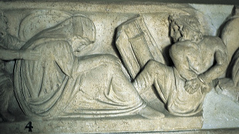
SLAVES
&
Saturnalia
CHALLENGE:
Think of a Latin word starting with each letter.
S
A
T
U
R
N
LO1: To Practice Independent Translation
LO2:To UNDERSTAND HOW SLAVES CELEBRATED THE SATURNALIA

Slide 2
TENSES Test
Write the Latin, then take 5 minutes to translate the verbs into English.
ambulabat
emebant
vendebant
recitabat
ridebant
festinavit
superavit
agitavit
laudaverunt
habebat
He was walking
They were buying
They were selling
He was reciting
They were laughing
He hurried
He overcame
He pursued
They praised
He was having
Finished early?
CHALLENGE:
Name an English word that derives from our Latin vocabulary. Add as many as you can find.

Slide 3
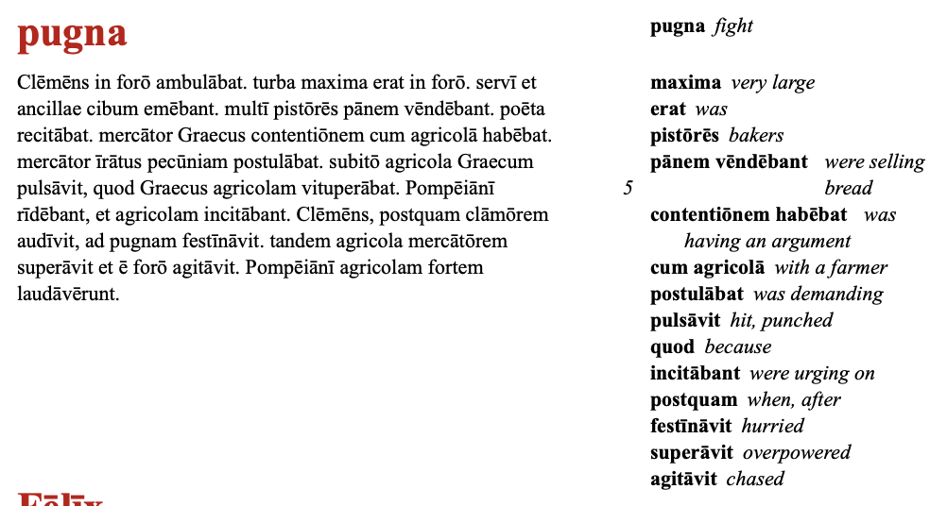
Perfect vs imperfect
TASK:
IN YOUR CLASS BOOK
Work in pairs to complete the pugna passage. You have 20 mins before we check this together.
Stretch and Challenge:
IN YOUR CLASS BOOK
Translate independently.
Finished Early? Challenge:
Write the subheading “Roman Slavery”
Read the passages on slavery on pp.78- 9 and answer in full sentences.
What were slaves not allowed to do?
How did people become slaves in the Roman empire?
Where did the slaves come from?
Who owned 400 slaves and what happened to him? Why do you think this happened?

Slide 4
Slaves in the Saturnalia
https://www.youtube.com/watch?v=OImabGvoQNs&t=38s
What did slaves wear on Saturnalia? Why
What did Senators carry to the forum?
What entertainment took place after the feast?
Why were they inclusive?
What lined the streets?
What does Saturanlicius Princeps mean in English?
What did people gamble?
What happened on December 19th?
What is a sigallaria?
TASK:
Watch the video and answer the questions to the left in full sentences IN YOUR CLASS BOOK.
Stretch and Challenge:
IN YOUR CLASS BOOK
Create a list of Saturnalia practices and tick the ones we also practice at Christmas time.

Slide 5
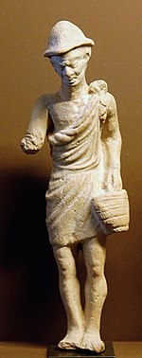
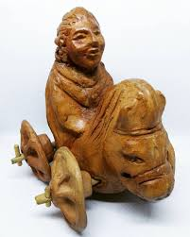
Plenary
pilleum
How do we translate verbs in the perfect tense?
How do we translate verbs in the imperfect tense?
How did Roman slaves live differently during the Saturnalia?
What do these images show?
sigillaria

Slide 6
HOMEWORK
Research 3 Key Facts about Roman slaves to build on what we have learnt today.
Note them down IN YOUR PRACTICE BOOKS for next lesson.

