Slide 1
What is the oldest known book?
Notes:
It is actually the Legend of Gilgamesh – a 13-16th century BC text. But they won’t know! Lol! Homer’s Iliad is the oldest complete surviving “book”.

Slide 2
What was the Iliad?
Objectives:
Learn the basics about how the Trojan War started in Homer’s Iliad.

Slide 3
The Trojan War
The Iliad =
What do you know?
Who fought in the Trojan War?
Why was the war fought?
Which side won?
Who told us about it?

Slide 4
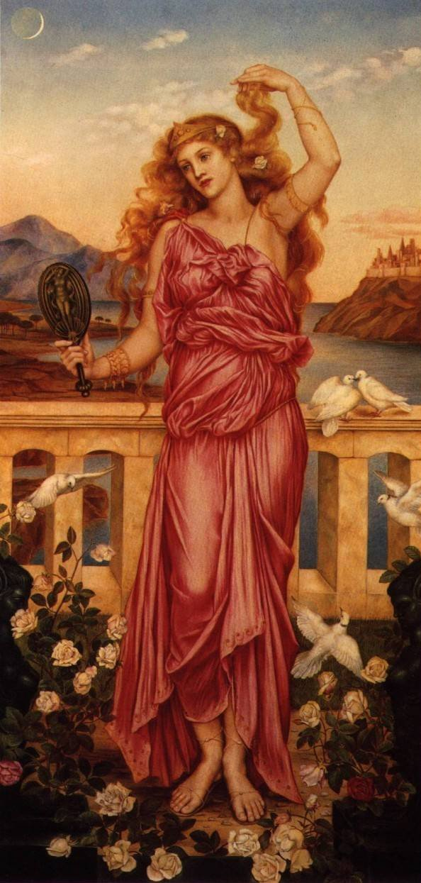
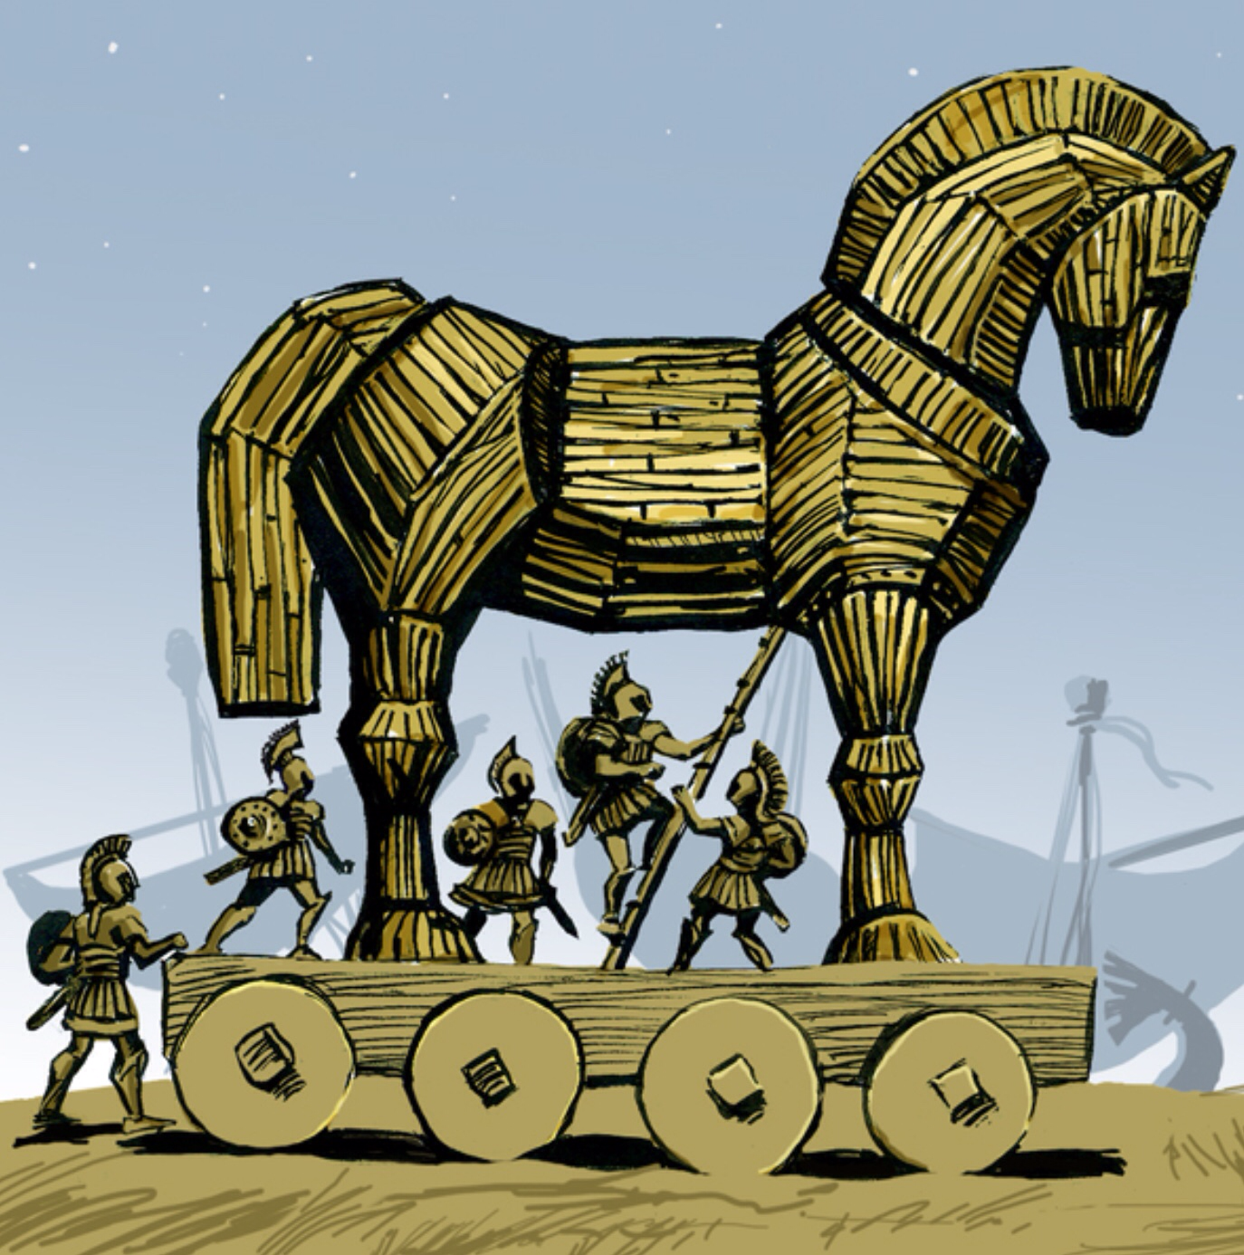
Helen of Troy
The Trojan Horse

Slide 5
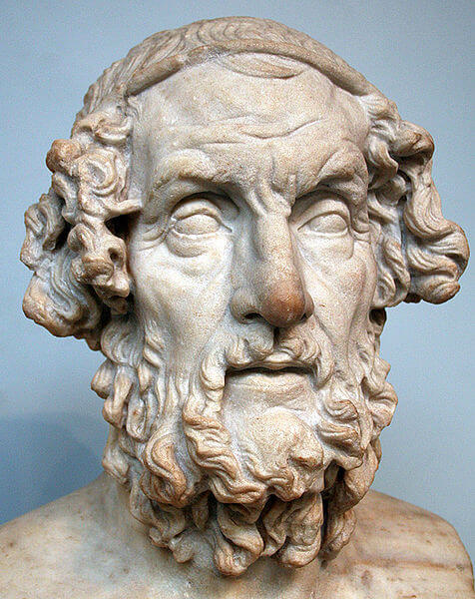
Who was Homer?
Iliad
Odyssey
8th century BC
Very little info
Oral transmission – then written
Notes:
Trojan War probably took place in around 1000 BC (although not on the scale that Homer says!) – Homer didn’t write it down for another 3-400 years later. This meant that the story went through a “Chinese whispers” process and that is why there are gods / goddesses etc throughout the story.

Slide 6
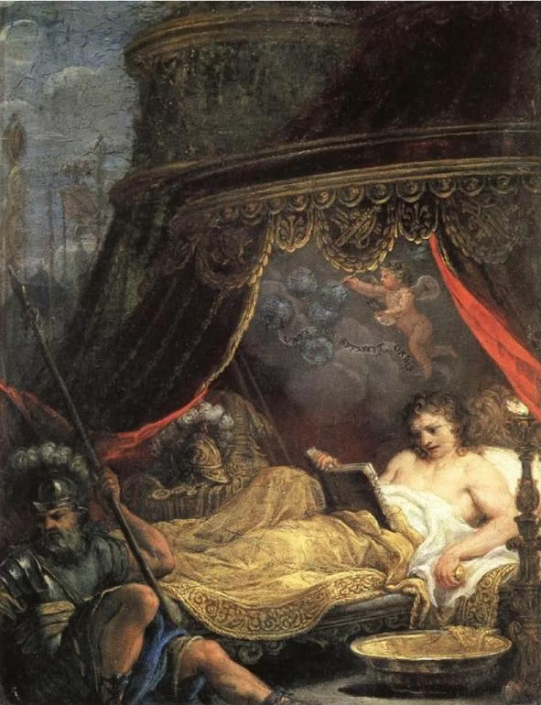
Talking point:
Alexander the Great (and a weird fat cupid)
The Iliad was the favourite book of Alexander the Great – but where did he keep his copy?
Have a guess – where would you put your favourite book in your bedroom?
Notes:
Ans: Alexander the Great

Slide 7
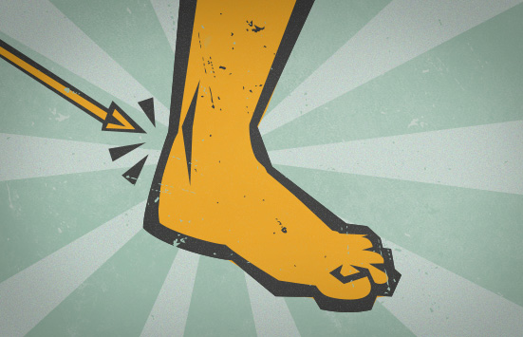
The Iliad
Don’t copy
Why are we still talking about this 2,500 years on?
Hugely influential to the Greeks – morals, gods, kleos (reputation)
Romans studied it – mark of education and influenced them
English and European Renaissance
Shakespeare and writers
HUGE influence on poetry, literature, culture
What is this called?

Slide 8
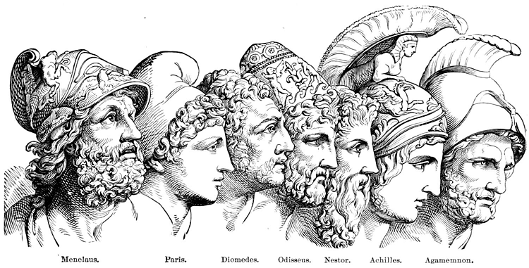
The Trojan War
Card sort activity

Slide 9
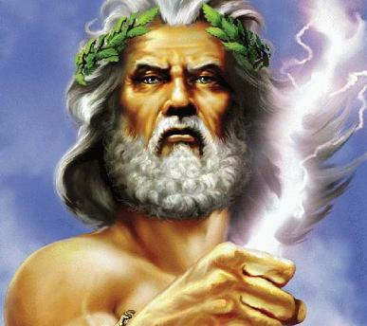
Zeus, was celebrating a marriage on Mount Olympus. All the gods and goddesses were invited except Eris.

Slide 10
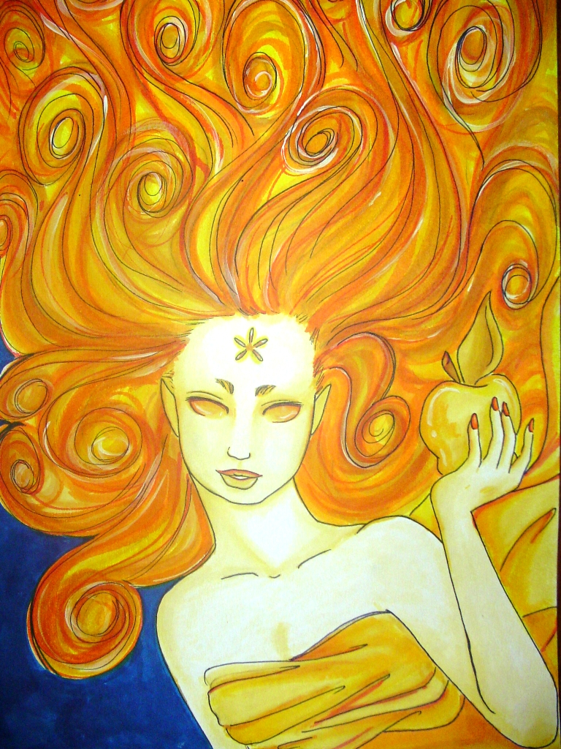
Eris, the goddess of strife and discord, met Hera, Athena and Aphrodite. Eris offered a golden apple to ‘the fairest’.

Slide 11
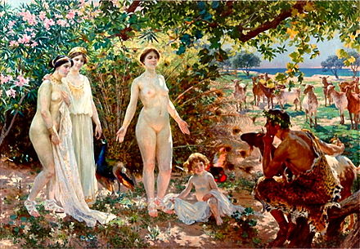
All 3 goddesses quarreled so Zeus sent them to Prince Paris of Troy to judge.

Slide 12
Aphrodite
Paris
Eros / cupid
Aphrodite (goddess of love) promised Paris that she would make the most beautiful woman in the world fall in love with him, Helen.

Slide 13
Helen was already married to Menelaus – the King of Sparta.
Menelaus’ brother was Agamemnon, the King of all the Greeks.
There had been lots of suitors who had wanted to marry Helen.

Slide 14
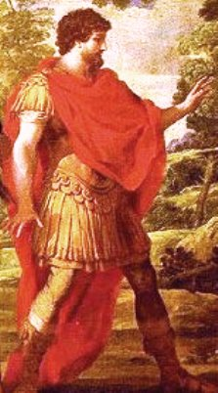
Odysseus, King of Ithaca, had persuaded all the suitors to agree to an oath. This had avoided fighting over Helen.
The oath was that all must defend the chosen husband in any quarrel.
Straws were drawn for Helen’s hand. Menelaus won.

Slide 15
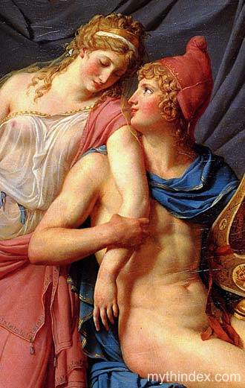
Paris travelled to Sparta pretending to be on a diplomatic mission. Whilst there, Paris seduced Helen.

Slide 16
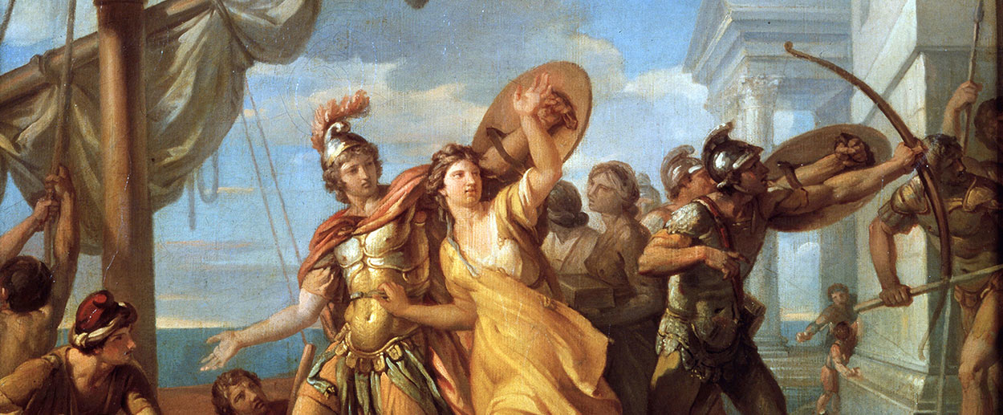
Paris took
Helen to Troy.

Slide 17
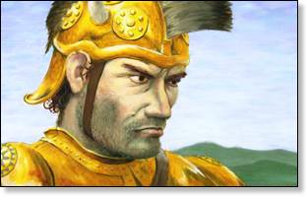
A furious Menelaus called for all the suitors to honour their oath.

Slide 18
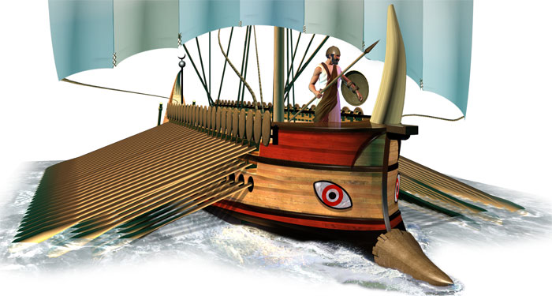
A huge fleet of Greek ships sailed to attack the Trojans – in revenge for Paris’ actions. All the heroes of Greece made the journey.

Slide 19
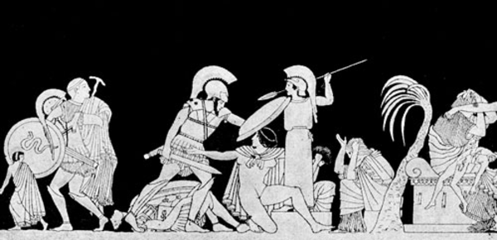
The Trojan War would last ten years. After the deaths of many heroes, Troy would fall to the trick of the Trojan Horse.

Slide 20
Iliad in a nutshell!
5 min clip using playmobile

