Slide 1
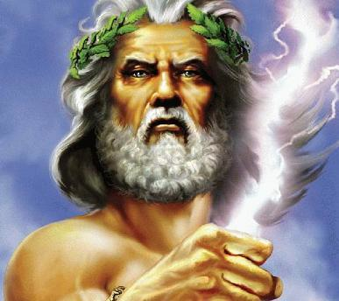
Zeus, was celebrating a marriage on Mount Olympus. All the gods and goddesses were invited except Eris.

Slide 2
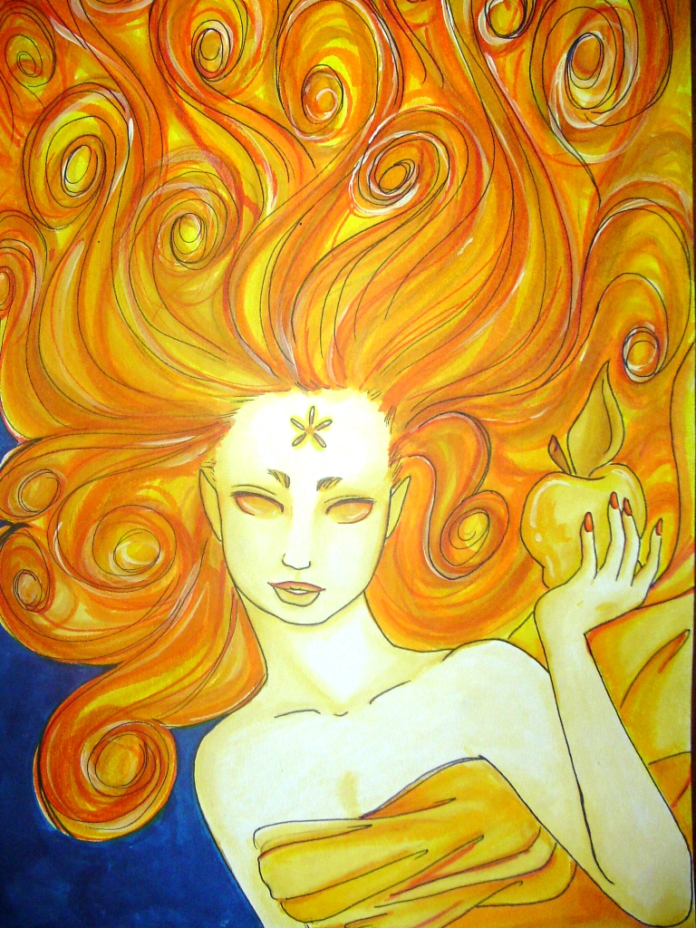
In revenge, Eris, the goddess of strife and discord, met Hera, Athena and Aphrodite. Eris offered a golden apple to ‘the fairest’.

Slide 3
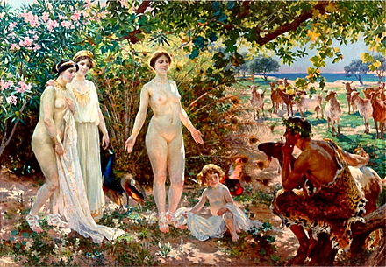
All 3 goddesses quarreled so Zeus sent them to Prince Paris of Troy to judge.

Slide 4
Aphrodite
Paris
Eros / cupid
Aphrodite (goddess of love) promised Paris that she would make the most beautiful woman in the world fall in love with him, Helen.

Slide 5
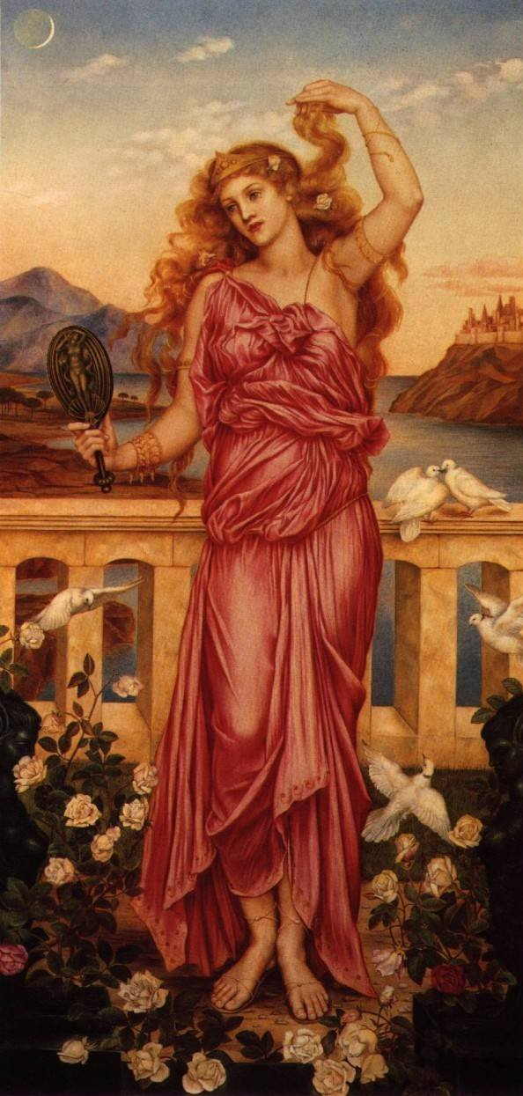
Helen was already married to Menelaus – the King of Sparta.
Menelaus’ brother was Agamemnon, the King of all the Greeks.
There had been lots of suitors who had wanted to marry Helen.

Slide 6
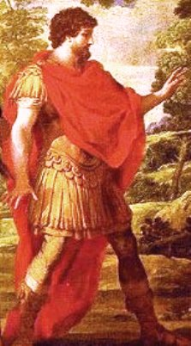
Odysseus, King of Ithaca, had persuaded all the suitors to agree to an oath. This had avoided fighting over Helen.
The oath was that all must defend the chosen husband in any quarrel.
Straws were drawn for Helen’s hand. Menelaus won.

Slide 7
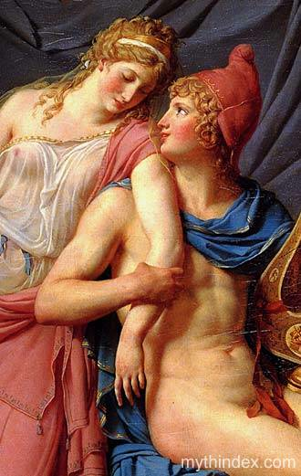
Paris travelled to Sparta pretending to be on a diplomatic mission. Whilst there, Paris seduced Helen.

Slide 8
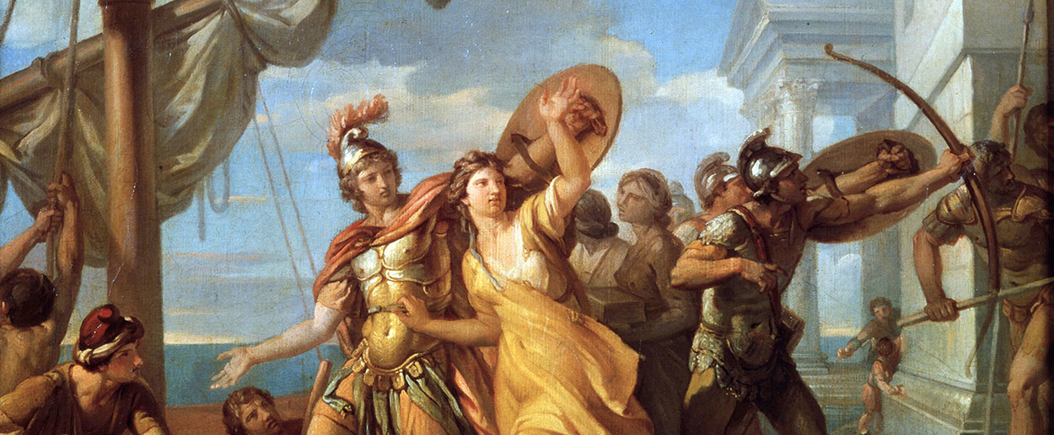
Paris took
Helen to Troy.

Slide 9
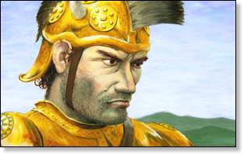
A furious Menelaus called for all the suitors to honour their oath.

Slide 10
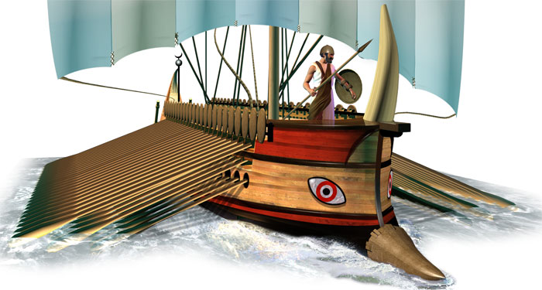
A huge fleet of Greek ships sailed to attack the Trojans – in revenge for Paris’ actions. All the heroes of Greece made the journey.

Slide 11
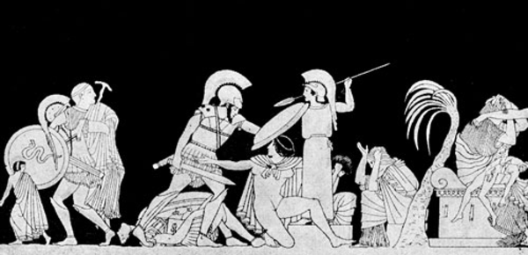
The Trojan War would last ten years. After the deaths of many heroes, Troy would fall to the trick of the Trojan Horse.

