Slide 1
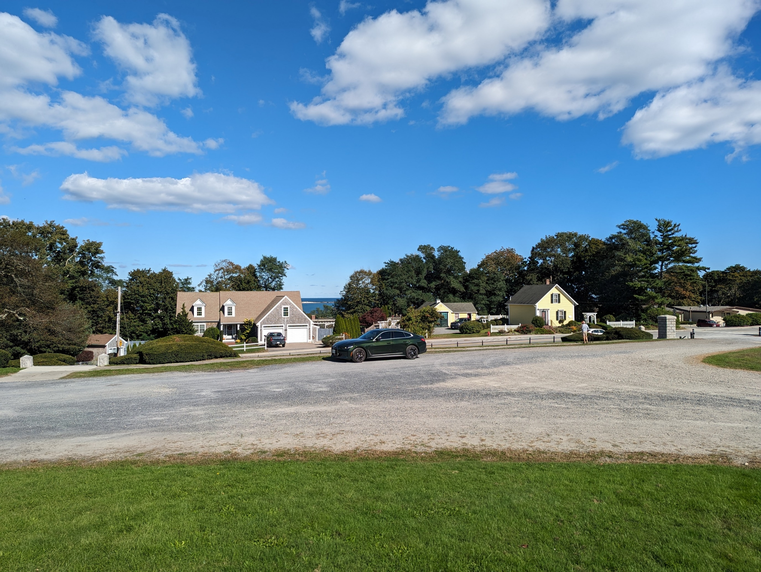
Northeast 2023

Slide 2
Northeastern US road trip October 2023
18 days
14 States
4100 Miles
996 kWh
42 Charging Stops

Slide 3
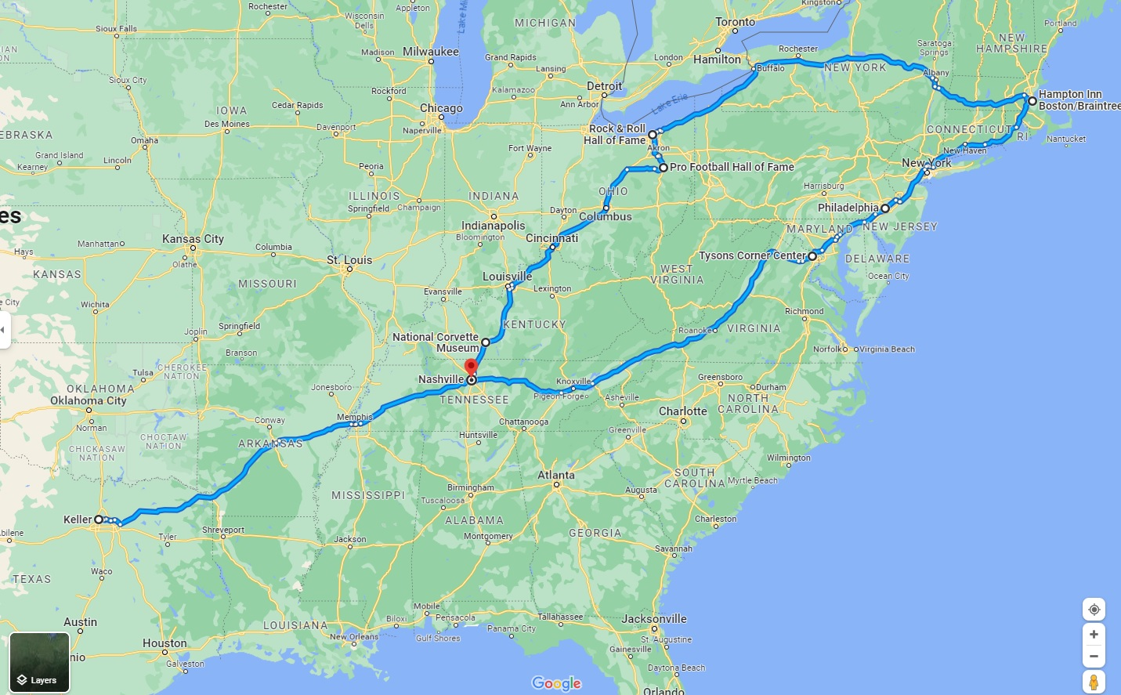

Slide 4
Stops along the way
National Corvette Museum in Bowling Green, Kentucky
Pro Football Hall of Fame in Canton, Ohio
Rock and Roll Hall of Fame in Cleveland, Ohio
Salem, Massachusetts
Boston, Massachusetts
Plymouth, Massachusetts
Philadelphia, Pennsylvania

Slide 5
42 total charging stops
34 charges at 26 unique Electrify America stations
4 charges at Tesla Superchargers with Magic Dock
1 charge at TVA/ChargePoint Level 3 station
2 hotels with free destination charging
1 tourist attraction with destination charging

Slide 6
Electrify America fast charging network
As of November 2023

Slide 7
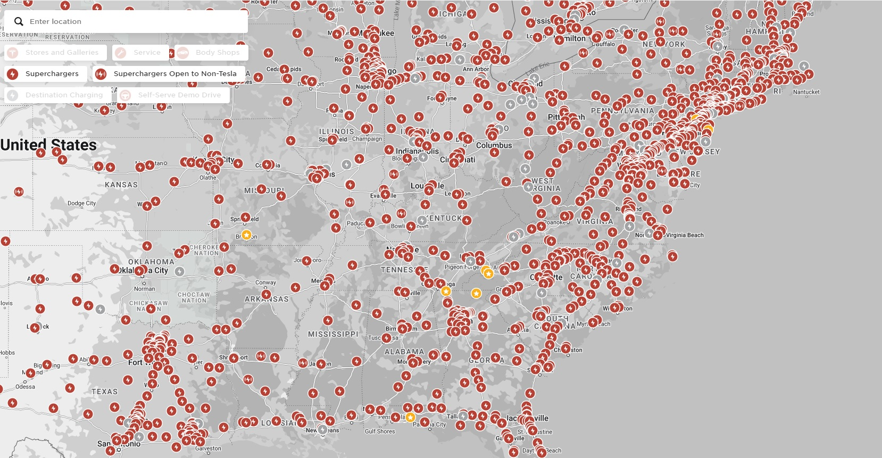
Tesla fast charging network
As of November 2023
Includes Tesla-only locations

Slide 8
Louisville, KY. Electrify America and Tesla Supercharger in the same parking lot. ($0.37/kWh)

Slide 9
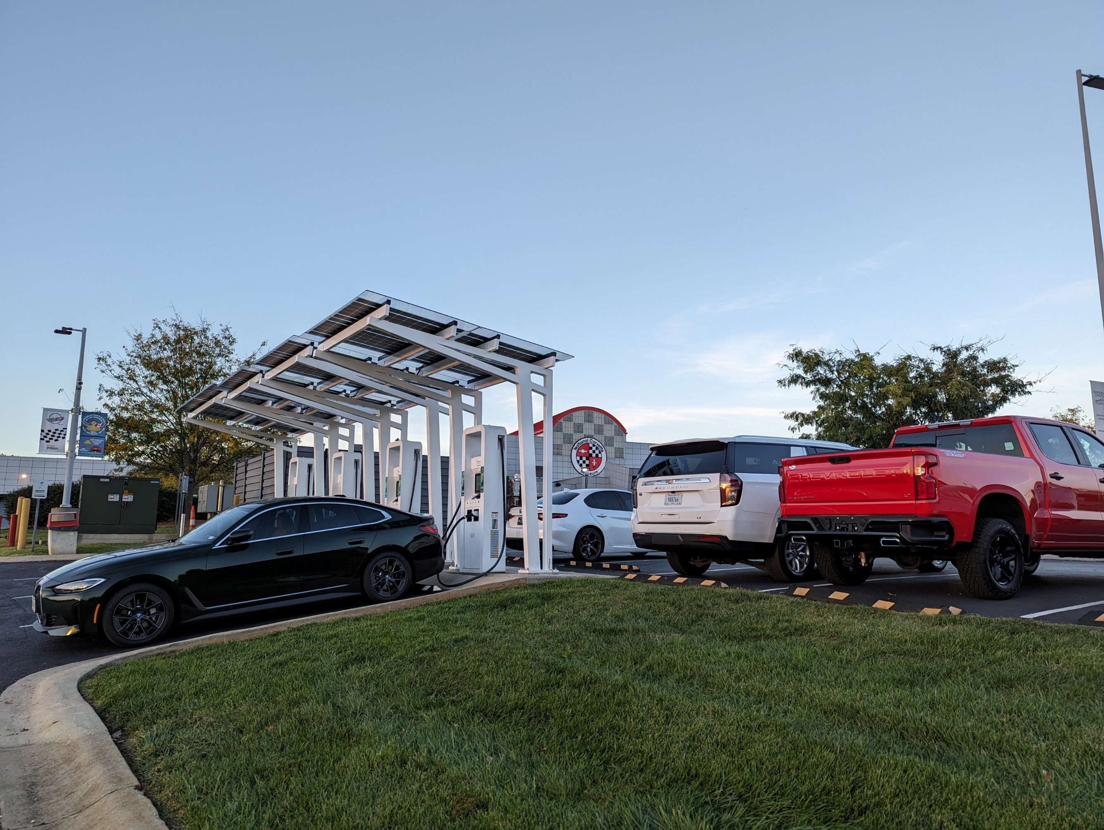
Electrify America charging at the National Corvette Museum in Bowling Green, KY. ($0.37/kWh)

Slide 10
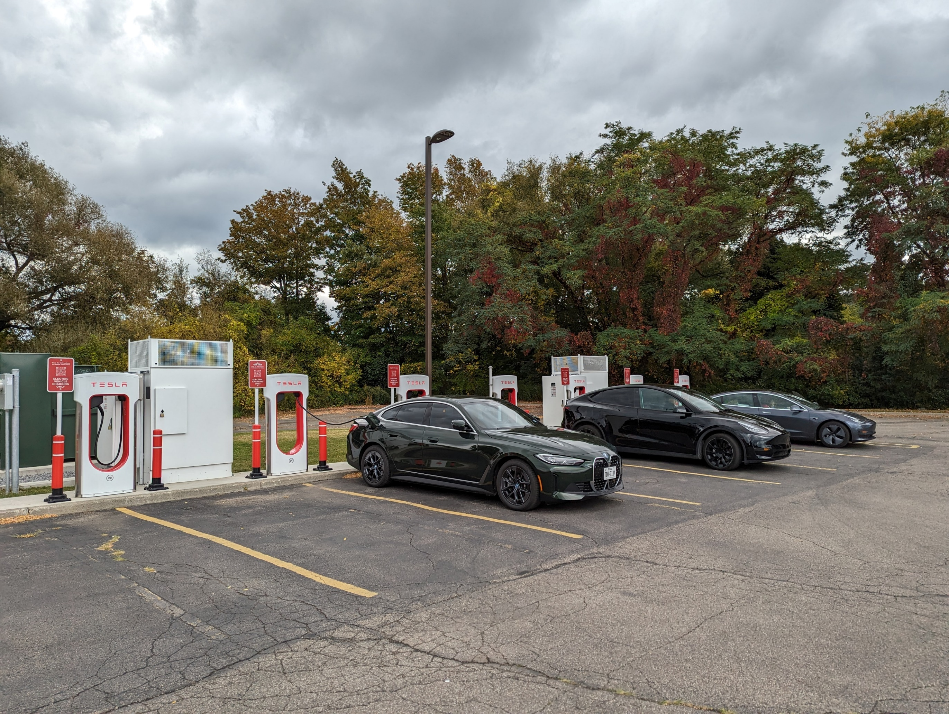
First Tesla Supercharger of the trip, in Fredonia, NY. ($0.52/kWh)

Slide 11
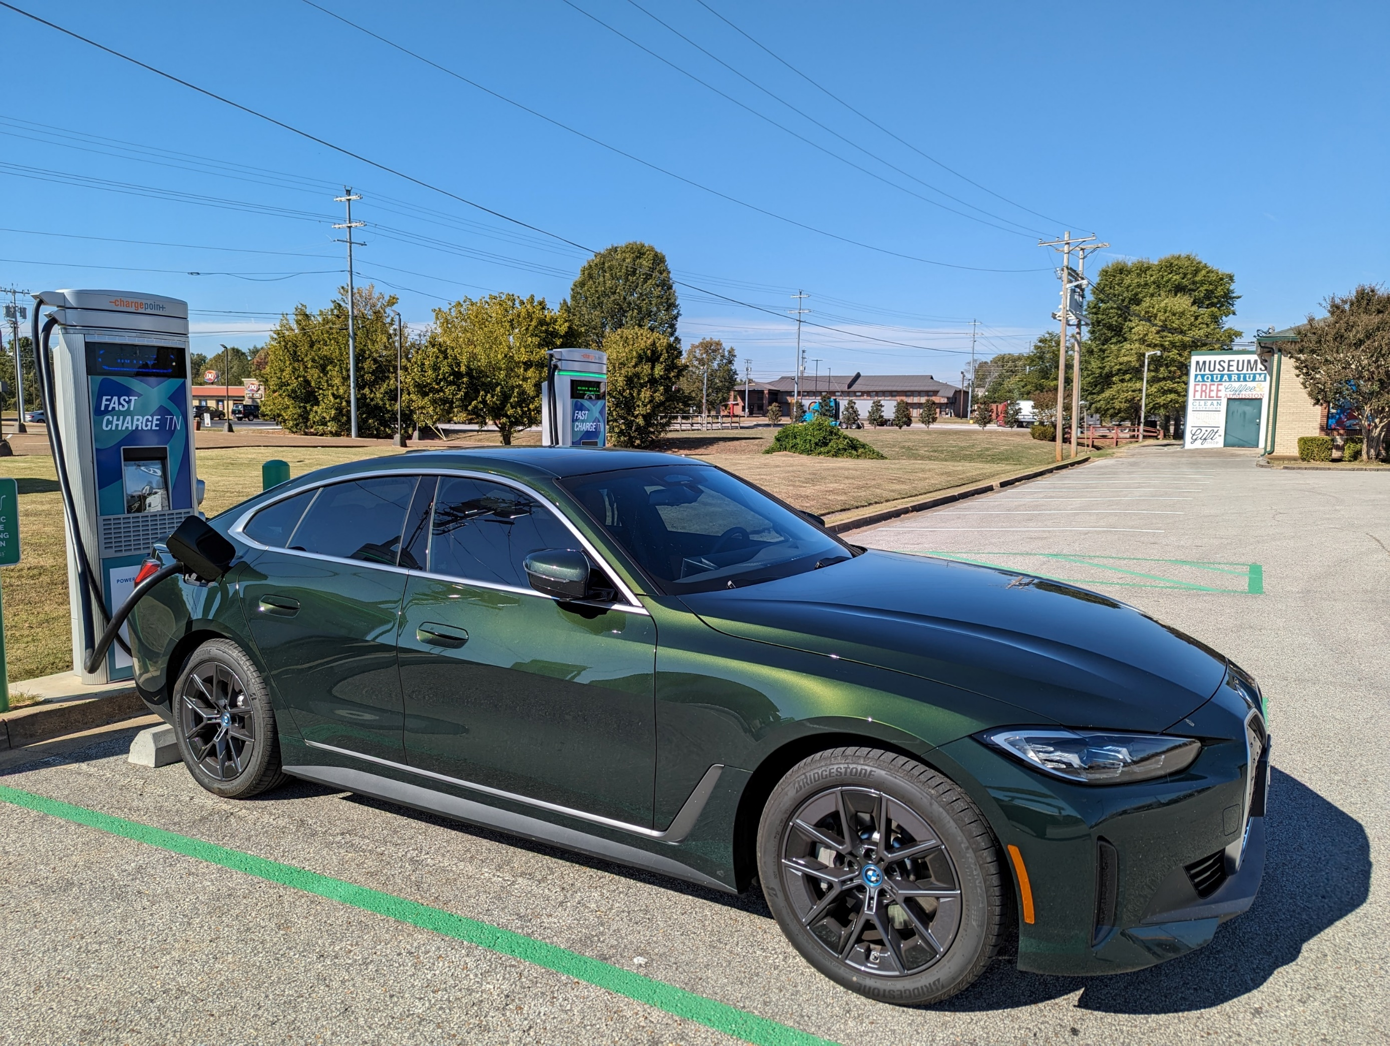
TVA/ChargePoint fast charging in Brownsville, TN. ($0.42/kWh)

Slide 12
How did the car do?
In reasonable weather at 70 MPH the BMW i4 can meet or beat its EPA range rating.
EPA range is 301 miles and claimed useable battery capacity is 81 kWh. This translates to energy usage of 269 Wh/Mile. Observed energy usage on the trip was 242 Wh/Mile. Speed and weather make a difference. My best day was 235 Wh/Mile.
How did the charging infrastructure do?
I was able to charge everywhere I wanted to.
Many chargers are not conveniently located for Interstate travelers. Sometimes I had to wait in line for a few minutes.
Sometimes the chargers were much slower than expected (around 40 kW).
Chargers rarely have shelter from weather.

Slide 13
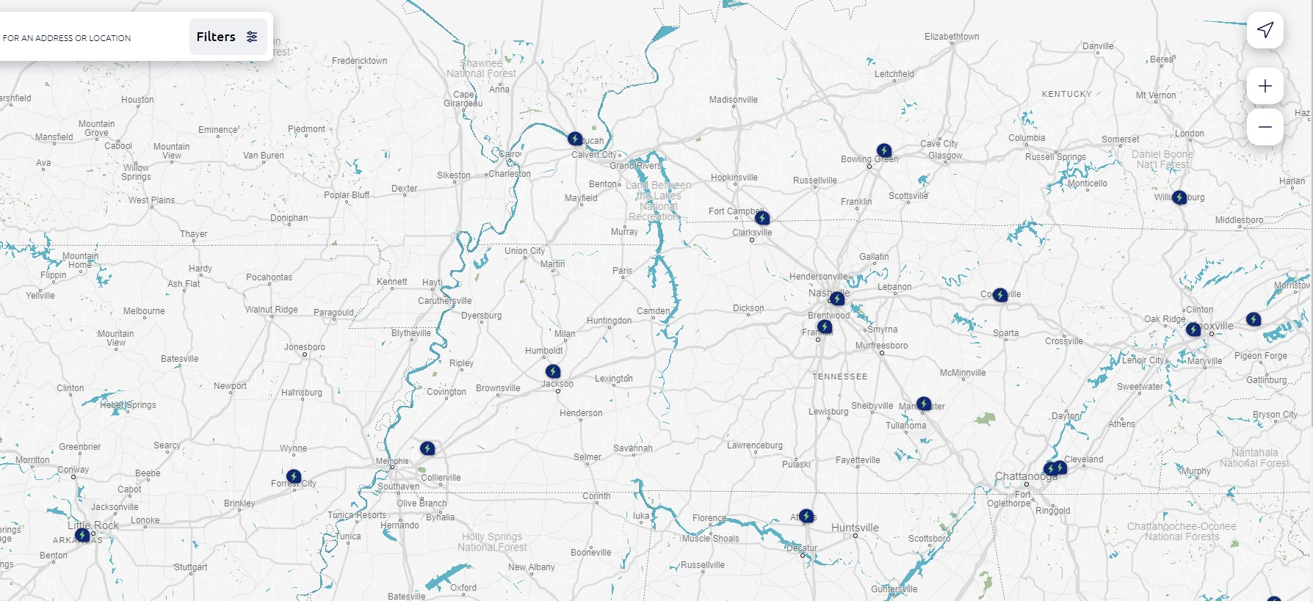
Western Tennessee was a challenge
Nashville, TN
Jackson, TN
Brownsville, TN
Memphis, TN
Forrest City, AR
Electrify America charging stations in western Tennessee had some issues.
Memphis – not open yet at the time
Jackson – 4 chargers, only 1 working at full speed
Nashville – difficult to get to due to city traffic
Brownsville – TVA charging station is helpful
Forrest City to Jackson – 130 miles
Jackson to Nashville – 135 miles
Jackson, TN to Bowling Green, KY – 195 miles

Slide 14
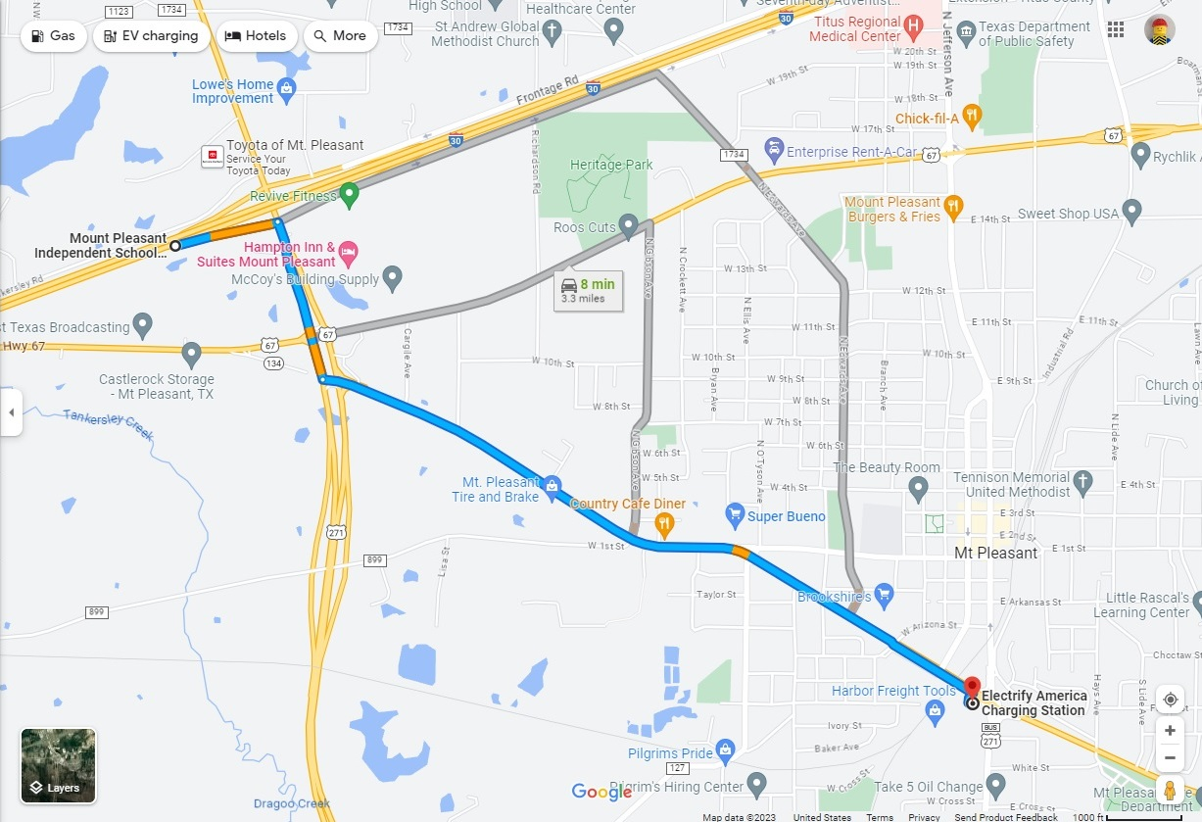
Locations of chargers are not always convenient for Interstate travelers
Mount Pleasant, TX
Electrify America station is at a Wal-Mart 2.5 miles from the Interstate exit

Slide 15
Energy cost comparisons
BMW i4, Electric, observed mileage Typical Electrify America non-member pricing is about $0.48/kWh 996 kWh x $0.48 = $478 EA Pass+ subscription is $7/month, charging is about $0.36/kWh 996 kWh x $0.36 = $359, + $7 = $366
BMW 430i, Gasoline, EPA highway mileage EPA highway mileage 34 MPG Average gasoline cost about $3.40 per gallon 120 gallons x $3.40 = $408
Toyota Prius, Gasoline, EPA highway mileage EPA highway mileage 52 MPG Average gasoline cost about $3.40 per gallon 79 gallons x $3.40 = $269

Slide 16
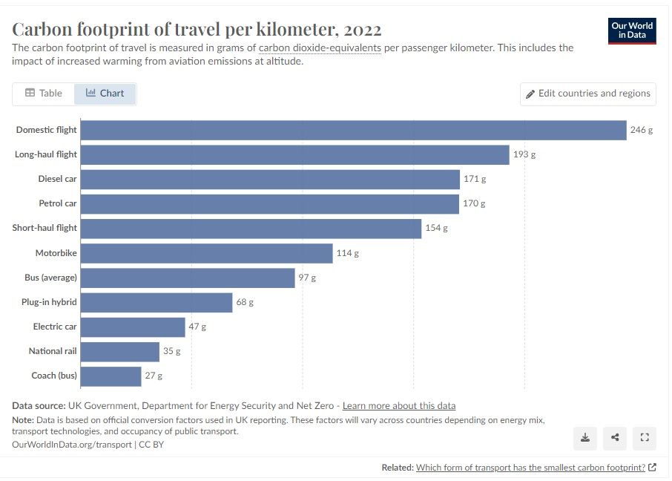
CO2 per passenger-mile

Slide 17
The perfect charging station
Stations every 50 miles
Easy access from major highways
Enough chargers with enough power
Bathrooms and food
Covered charging area
Fair pricing
Overnight charging at hotels

