Slide 1

Fixed Indexed Annuity
Protection and Performance

Slide 2
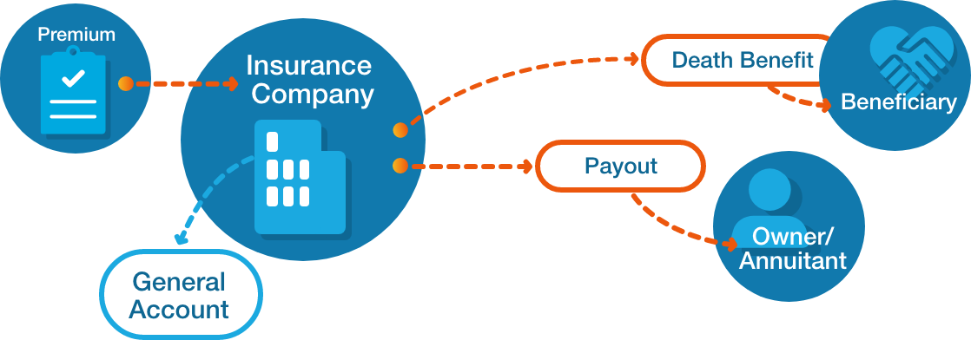

Slide 3
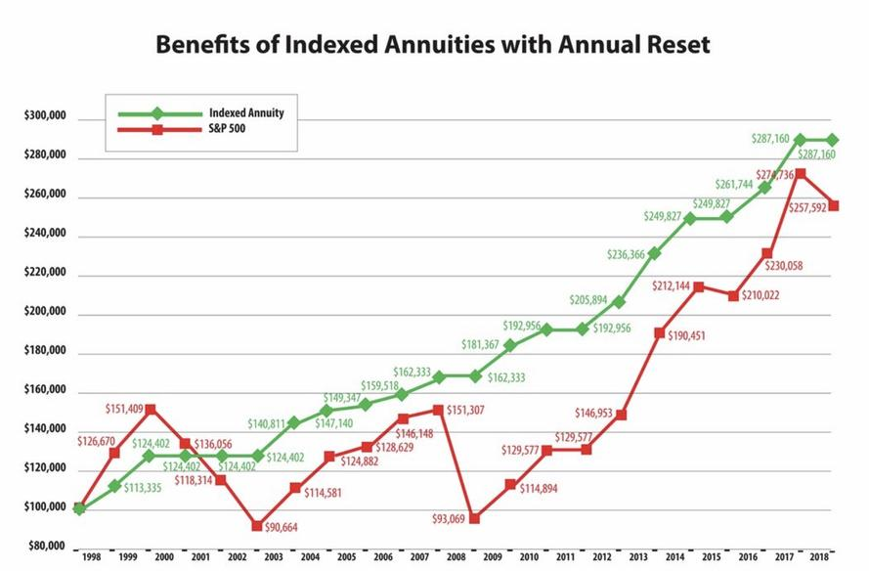

Slide 4
Fixed Indexed Annuity w/ Income Benefit
Annual Income
Index Return
Adjusted Value

Slide 5
Allianz 360 Fixed Indexed Annuity
Index Strategies with Participation Rates or Caps
100% Downside Protection with Gains Locked In Annually
Guaranteed Lifetime Income / Level or Increasing
Indexes
Protection
Income

Slide 6
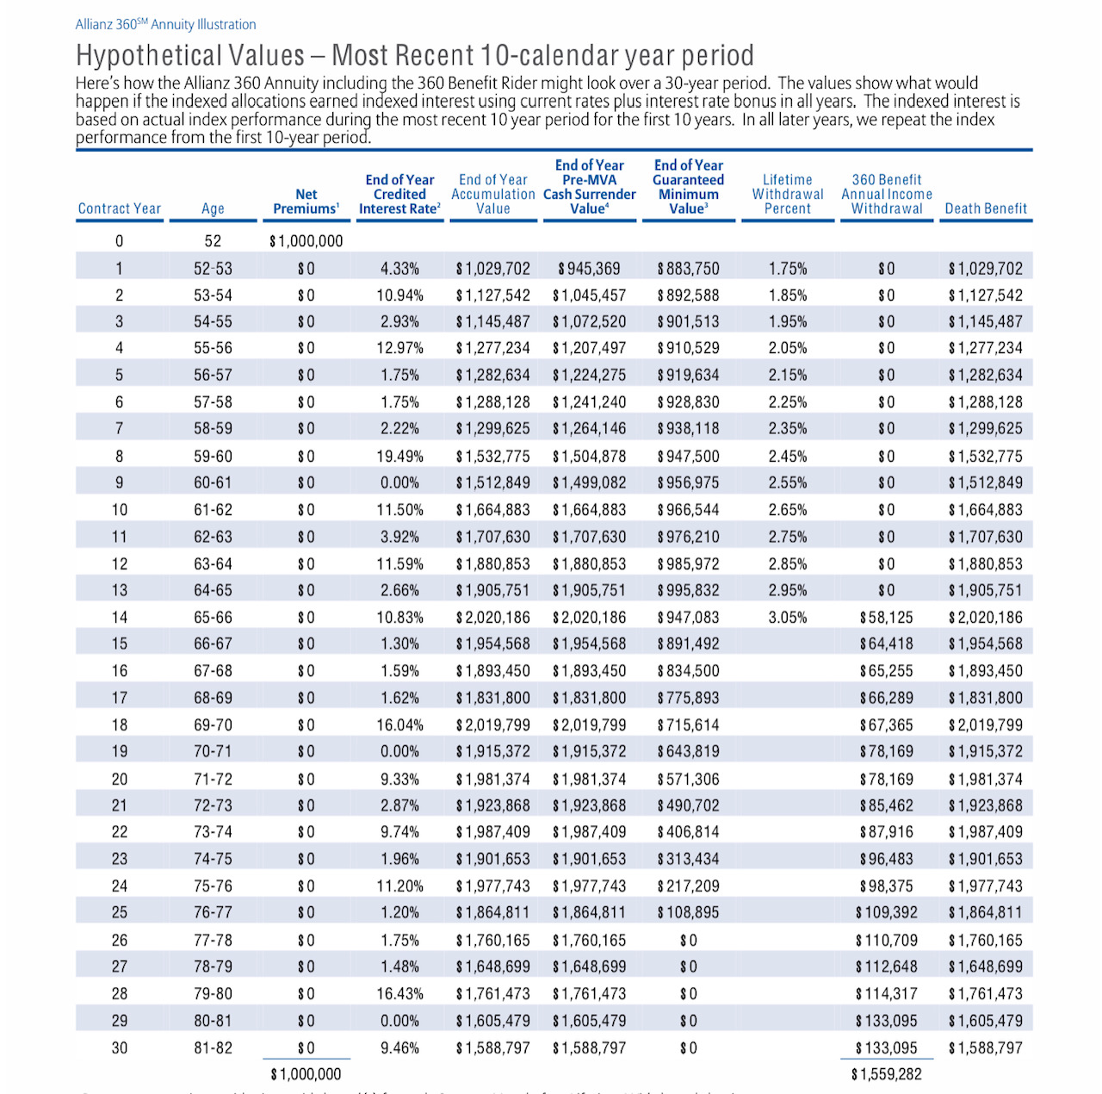

Slide 7
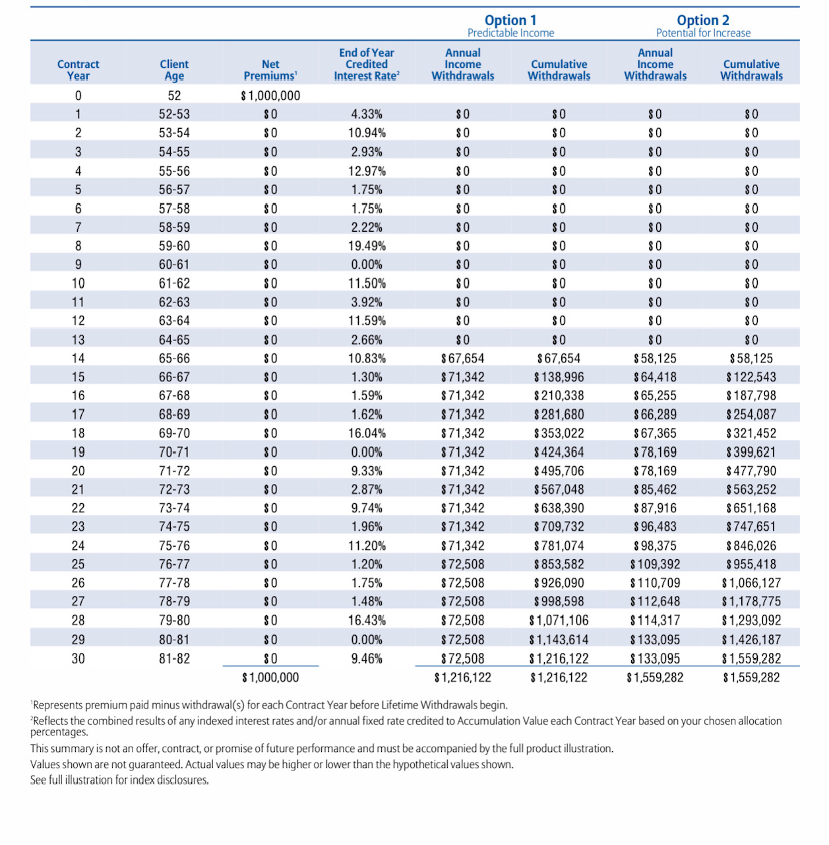

Slide 8
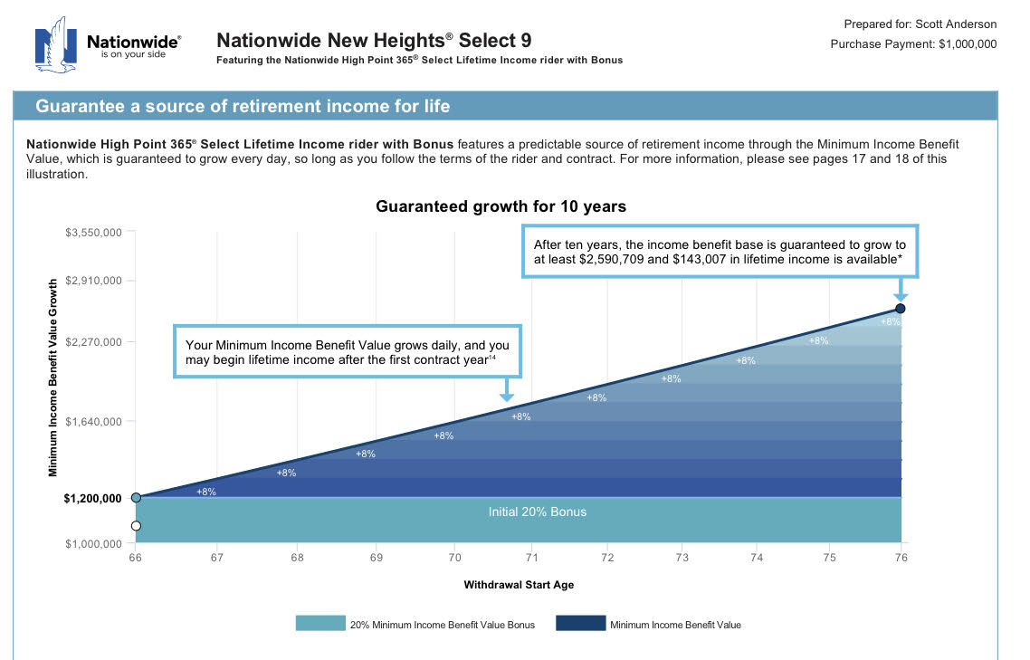

Slide 9
Nationwide New Heights
Index Strategy Gains Locked Annually
Guaranteed Lifetime Income
100% Downside Protection

Slide 10
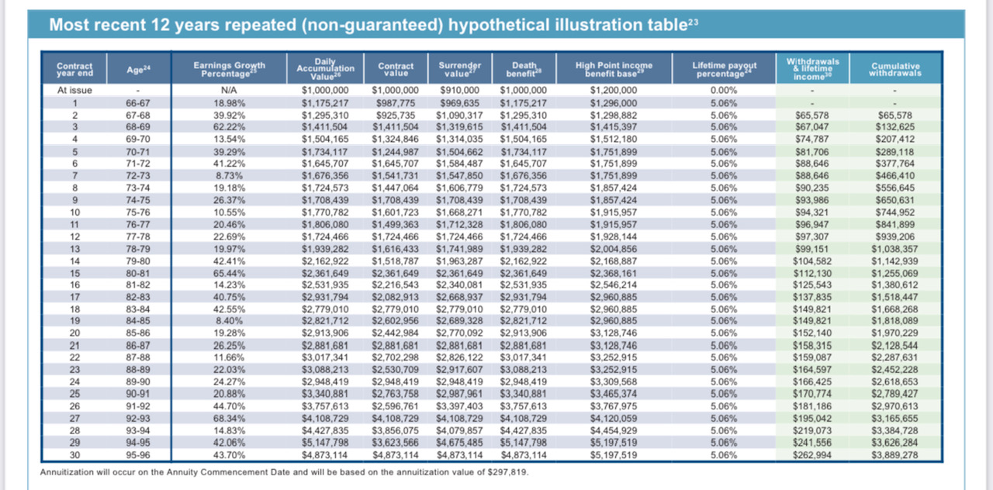

Slide 12
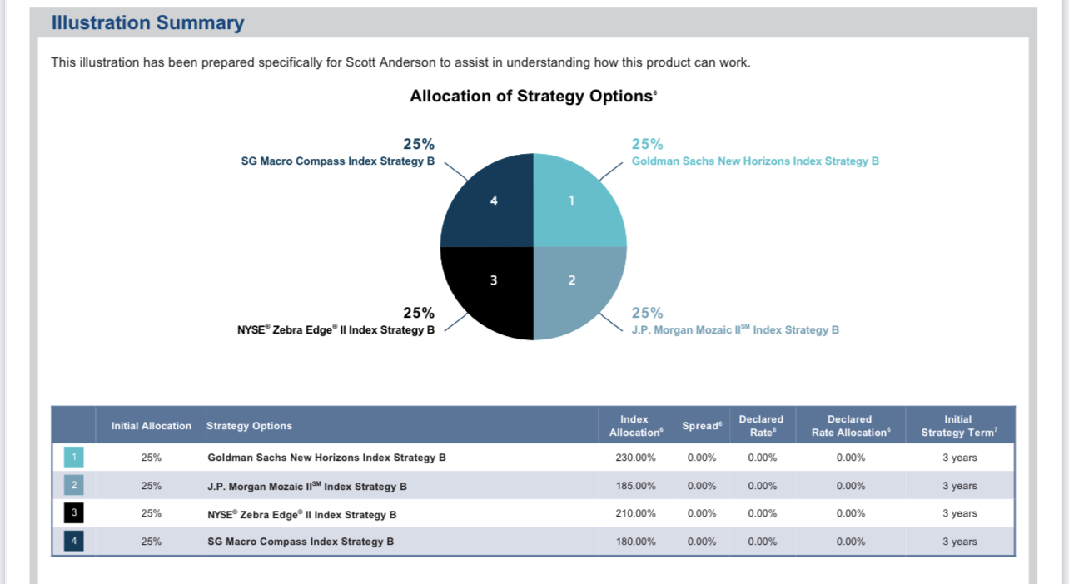

Slide 13
Multi Year Rate Guarantee Annuity
Interest Guaranteed
Annual Income
Principal Protected

Slide 14
Athene Protector 5 – Highlights
3%
Indexes
Liquidity
Index Return or 10% Simple Interest after 5 years
Index Strategies with Participation Rates not Caps
Initial Investment Penalty Free Withdrawals

Slide 15
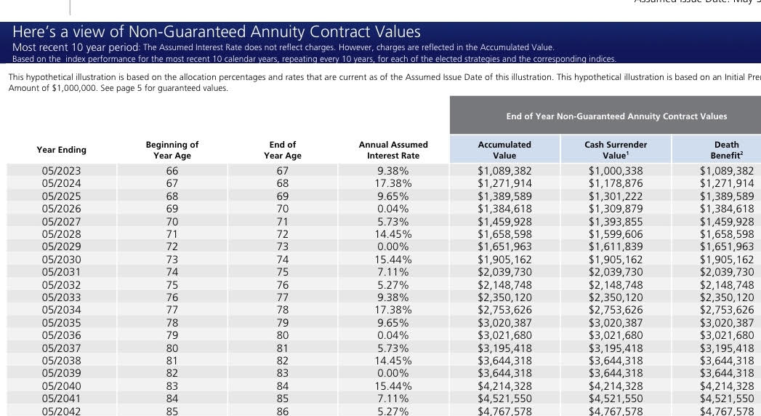

Slide 16
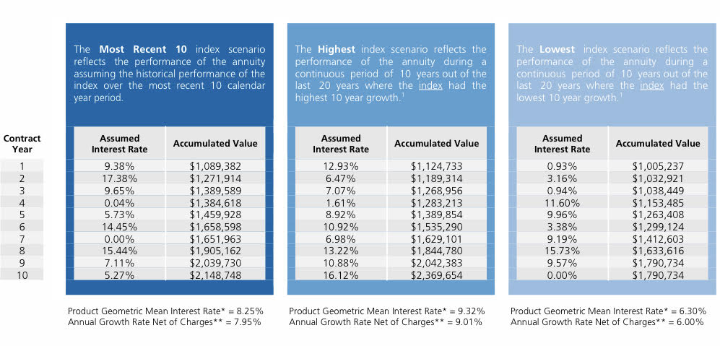

Slide 17
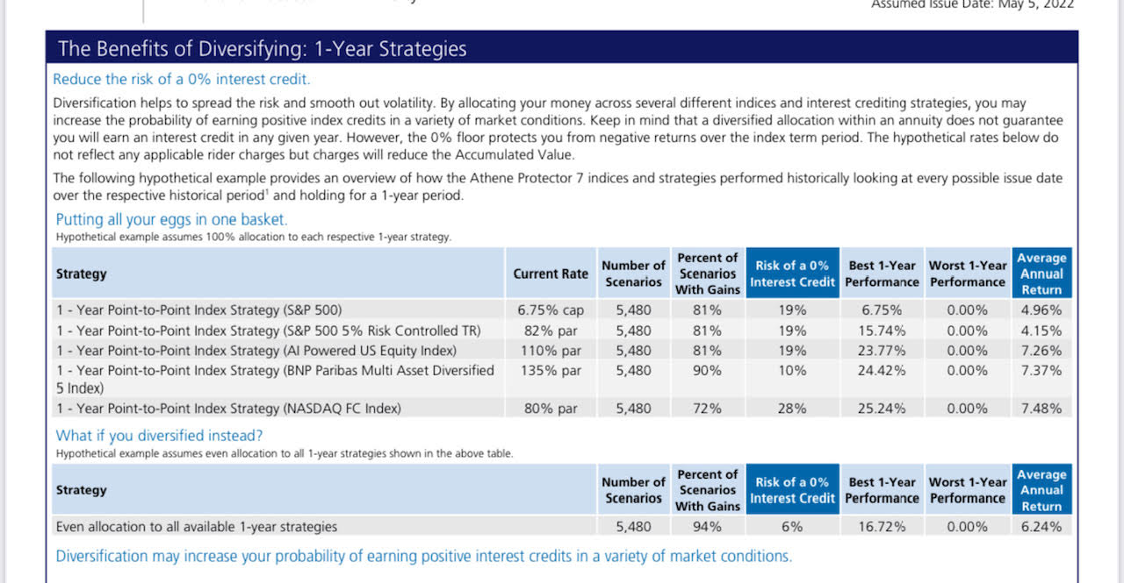

Slide 18
North American Life – Fixed Indexed Annuity
Indexing Strategies
Protection
Tax Advantages
Indexing Strategies for Growth with Participation Rates & Caps
100% Downside Protection w/ Gains Locked In Annually
Tax Deferred Growth

Slide 19
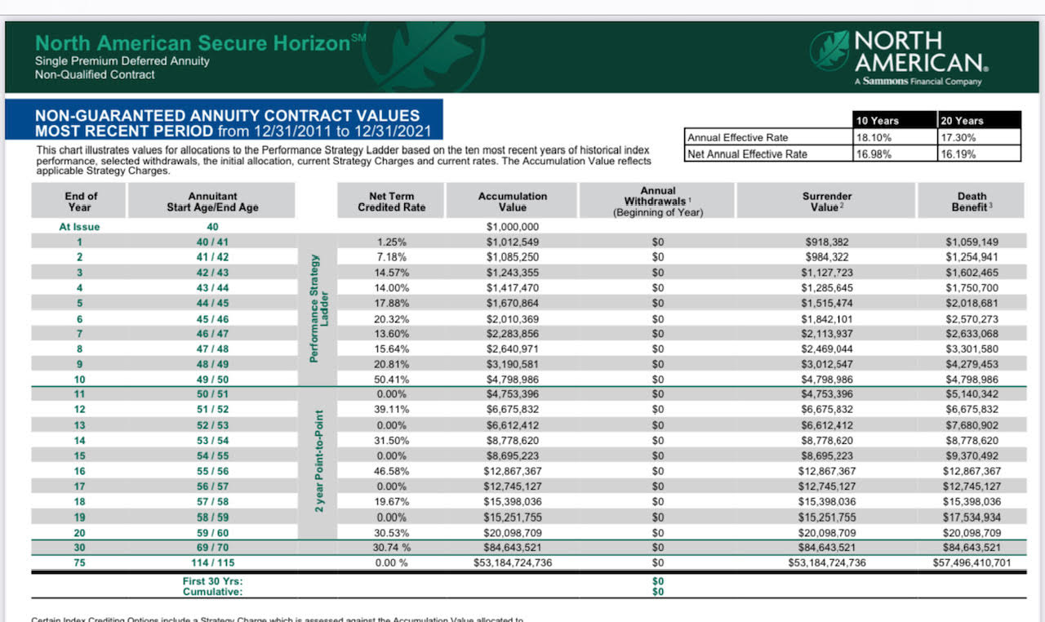

Slide 20
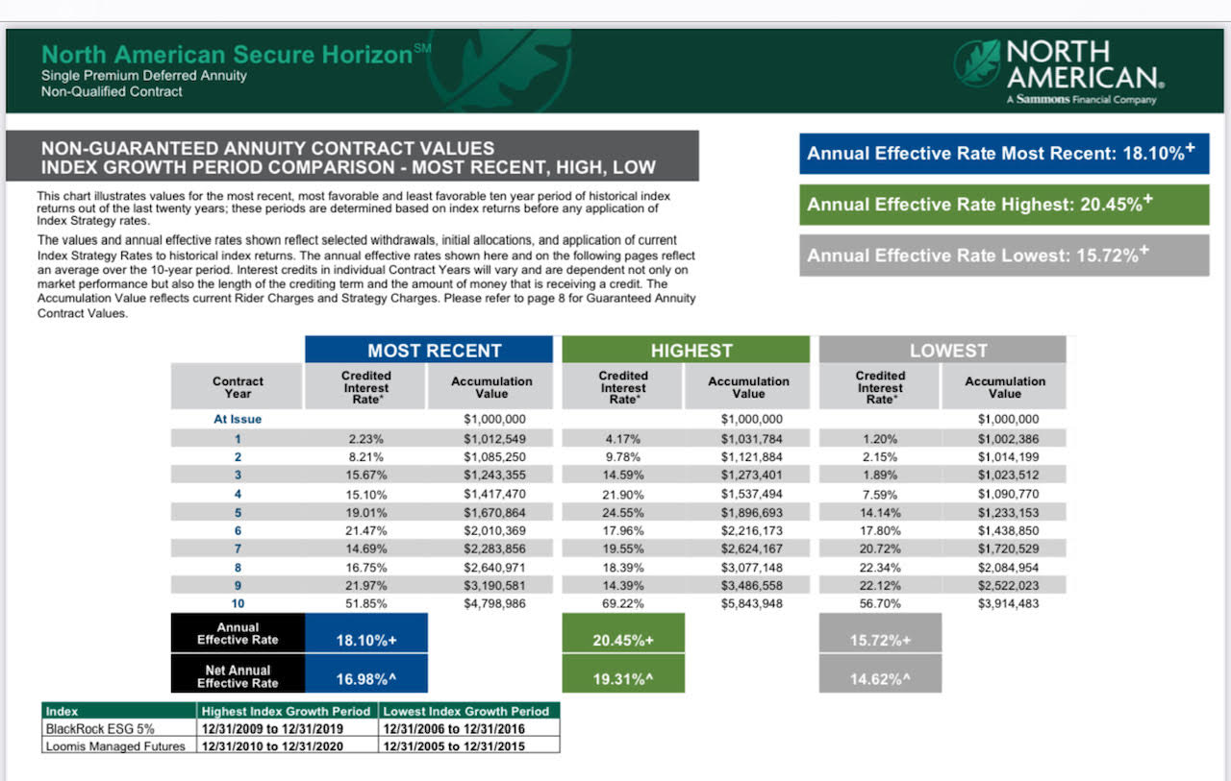

Slide 21
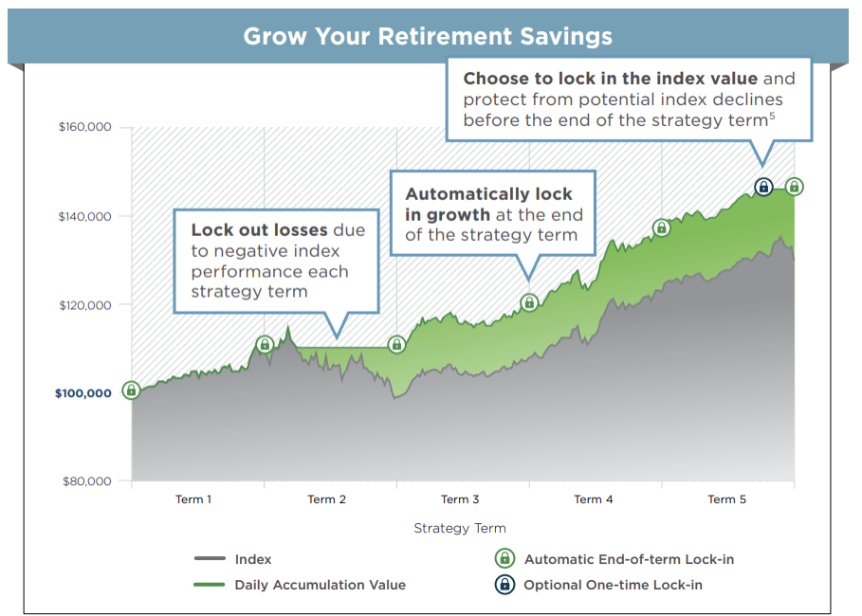

Slide 22
