Slide 1

Annuities
Providing Guarantees & Peace of Mind

Slide 2
Opportunities with Annuities
Lifetime Income
Guarantee
100% Downside Protection
Index / Interest Returns w/o Risk of Loss
Death Benefit

Slide 3
Benefits of Annuities
Safety of Principal
Asset Protection
Gains Locked in Annually
Tax Advantages

Slide 4
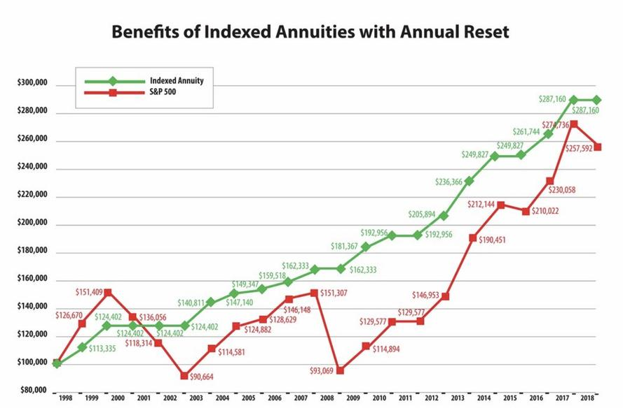

Slide 5
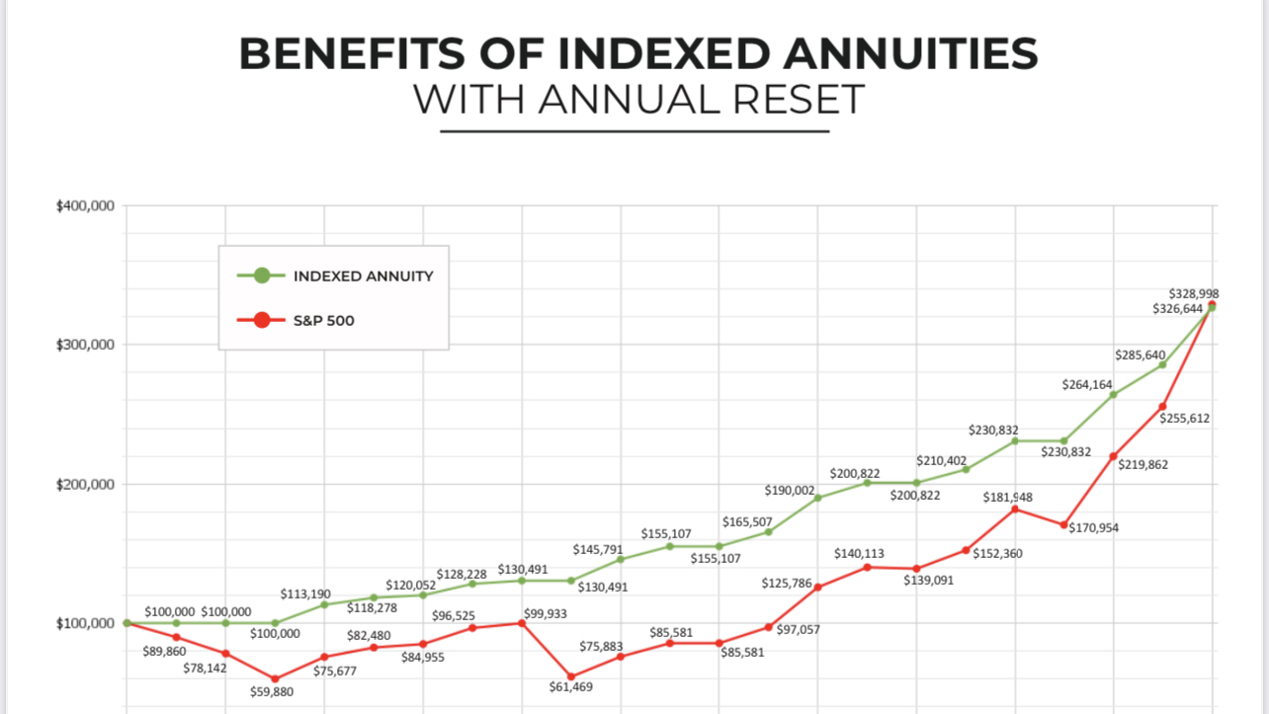

Slide 6
Stock Market Declines -20% or More
October 1987
Trading Programs
July 1999
Iraq
January 2000
Dot Com
September 2001
Twin Towers
2007-2009
Credit Crisis
August 2011
Short Lived Bear
August 2015
February 2020
January 2022

Slide 7



2000 to 2024
1427
1,379
3,217
4,869

Slide 8

Protection Against
Stock Market Declines
Indexing Strategies w/out Market Risks
Gains Locked In @ Policy Anniversary
Assets in General Account of Insurance Co.

Slide 9

Indexing Crediting Rates –
Never a Negative Return
Participation Rates
No Caps / Enhanced Returns
Caps
Maximum Rates
Strategy Charge
Enhances Returns

Slide 10
Fixed Indexed Annuities
Indexing Strategies Growth
100% Downside Protection
Guaranteed Lifetime Income

Slide 11
Guaranteed Lifetime Income
Individual or Joint
Regardless of Account Value
Complements Government Benefits
Level or Increasing Income

Slide 12

Future Income Planning
Initial Income Base Bonus of 30%
Annual Increase in Income Base 8%
Annual Step Up in Account Value
Annexus Product Design and Indexing Strategies

Slide 13
Income Rider Key Words
Income Base / Protected Balance
Roll Up
(Bonus)
Step Up
Guaranteed Minimum Withdrawal Benefit

Slide 14
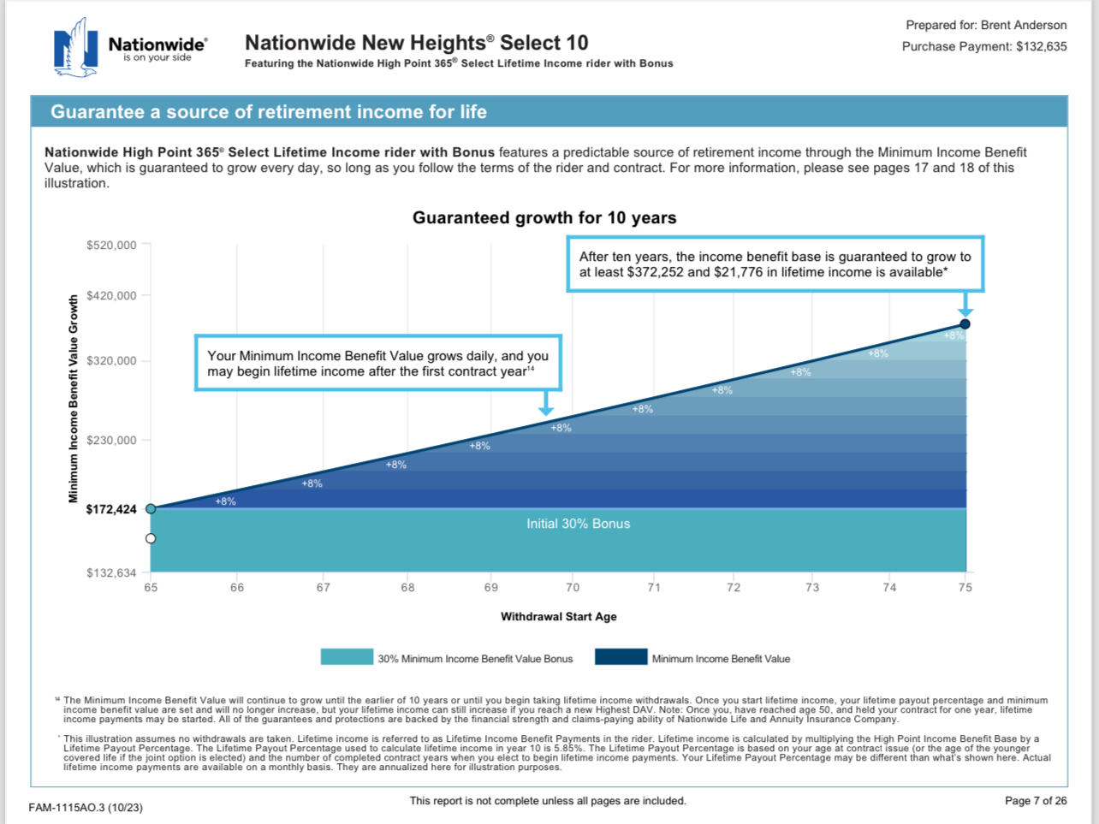
Protected Income Base

Slide 15
Growth and Income
Account Values
  Actual Cash Value
  Indexing Strategies
  Earns Index / Interest Returns
  Gains Locked In Annually
  100% Downside Protection
  Death Benefit
Protected Income Base
  Initial Bonus Credit
  Annual Bonus
  Used for Income Calculation
  No Cash Surrender Value
  Guaranteed Future Income

Slide 16
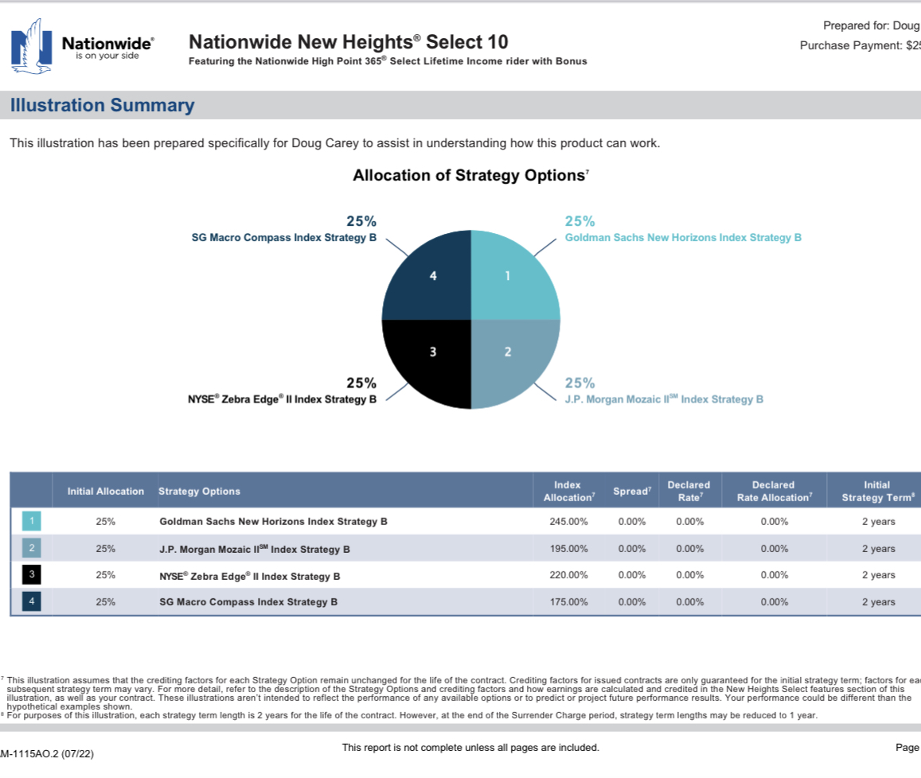

Slide 17
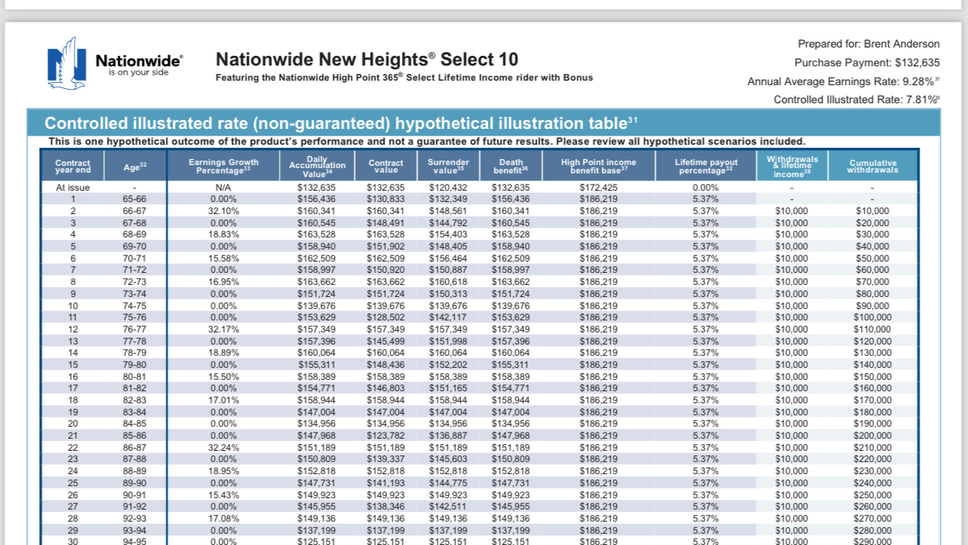

Slide 18

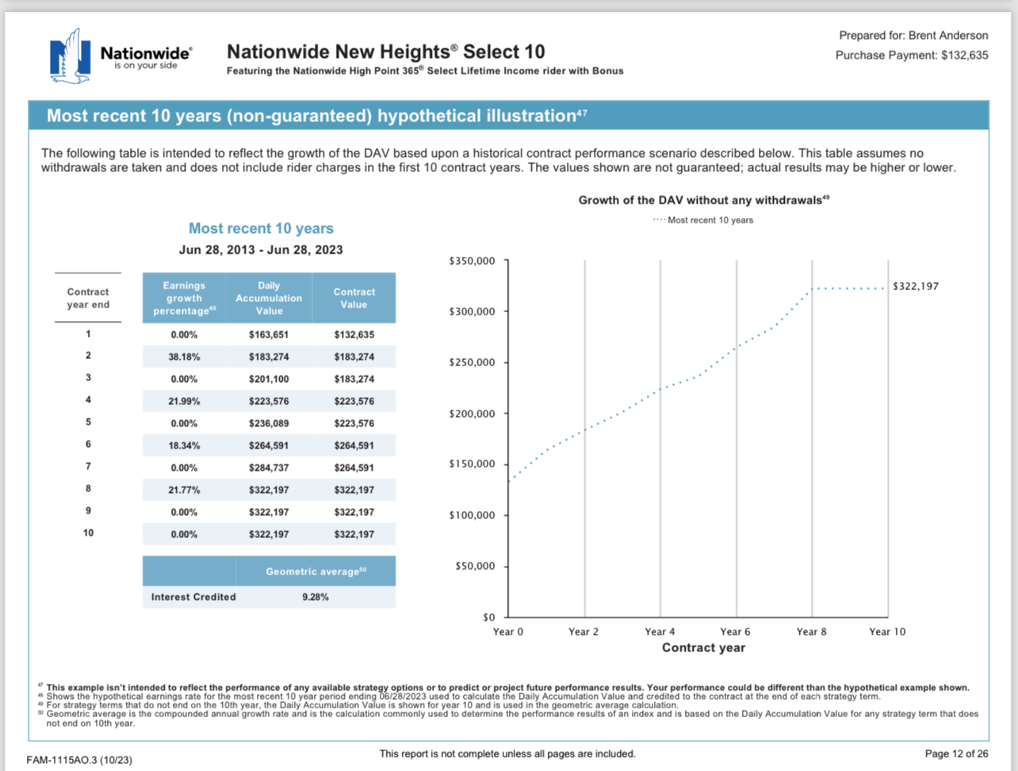
Accumulation Opportunity

Slide 19
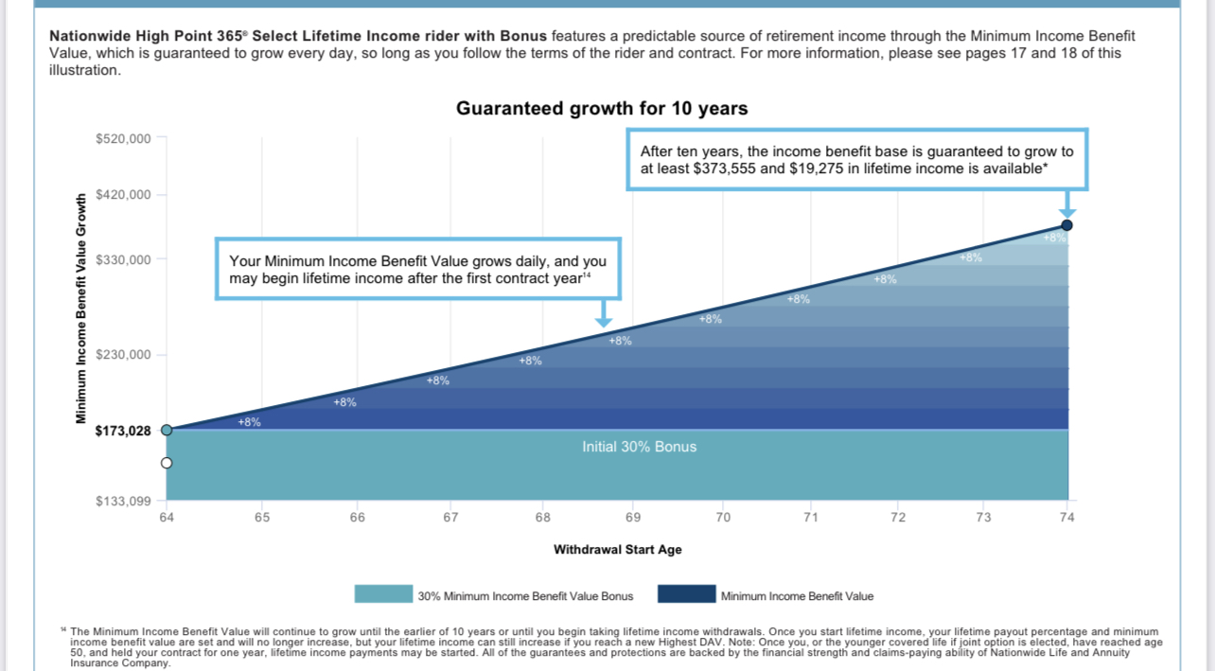

Slide 20
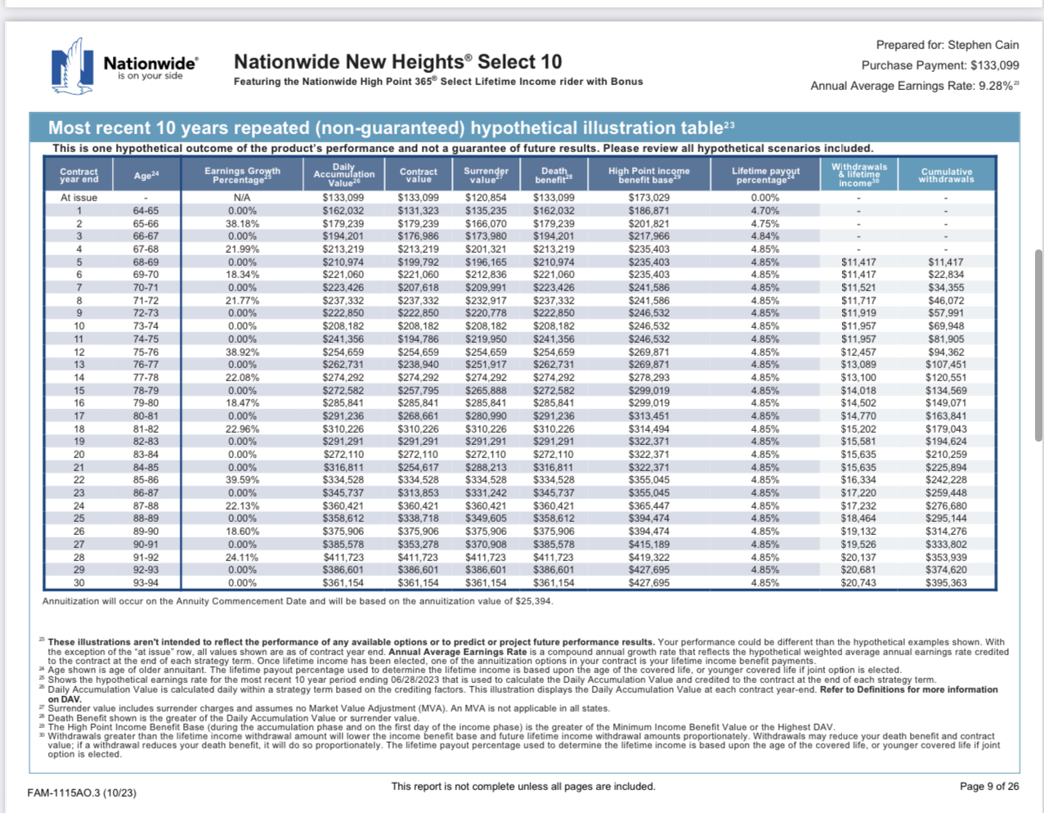
Most recent 10 Years
Performance Increases Income Payments
Protected Income Base drives Annual Withdrawal
Joint Income Option for Surviving Spouse

Slide 21
Fee Structure
Riders
Early Cash Out
A rider charge on an annuity is an additional fee that can be added to the cost of the annuity contract. Riders are optional features that provide additional benefits, such as death benefits, long-term care coverage, or guarantees on the minimum interest rate earned on the annuity.
Guaranteed Lifetime Income : 1.10%-1.20%
Annuity Surrender Charges. A surrender charge is a penalty for taking out money from an annuity before it matures, usually within six to eight years of purchasing. This charge can be as much as 7% of your annuity's value. To avoid or reduce this charge, wait until the surrender period ends.

Slide 22
Talking Points of a Fixed Indexed Annuity
Premium Payments are Deposited into the General Account of the Insurance Company
Policy is Issued and Benefits Guaranteed based on the secured assets of the Insurance Company
The Insurance Company makes their money earning interest from the Premium Payment deposited in General Account
Insurance Company purchases Option Contracts based on your preferred indexing strategies using a small portion of the interested earned from the Premium Deposit
IF an Option is In the Money , the option is exercised, and the proceeds are credited to your Policy Account Value. Gains are locked in
If the Option is Out of the Money, the option expires, no loss to the account value.
100% Downside Protection , annual return cannot be less than 0%
Indexing Strategies have caps (maximum return for the that index) or participation rates (percent of the annual gains credited to your account, participation rate can exceed 100%)
There is a fee associated with the Lifetime Income Benefit – 1.1% annually
If a there is no Income Benefit needed – fee is 0%
Surrender Penalties are applied due to an early contract / policy liquidation . Most FIA have 10 years or less surrender penalties.
A Market Value Adjustment might be applied during the Surrender Penalty Years – MVA is based on the current bond markets , sudden increases in rates has a negative effect, sudden decrease in rates has a positive effect.
Fixed Indexed Annuities are Tax Deferred Investments
They are a contract between the insurance company and the policy owner.
They are Asset Protected in some States.

