Slide 1


Fixed
Indexed
Annuities
Trick or Treat

Slide 2
The Search is On
Protection
Growth
Income

Slide 3



Slide 4

Definition
An annuity is a contract between you and an insurance company that requires the insurer to make payments to you, either immediately or in the future. You get a fixed amount of money for the rest of your life in return for a lump sum payment or a series of instalments.

Slide 5
Opinions
Tricks
Treats
Issues with annuities have prompted some financial advisors, such as Ric Edelman, founder of Edelman Financial Engines, to refuse to sell them to clients.
“One of the problems with many of today’s products is that they are ridiculously complicated and complex,” Edelman said. “They have features and riders that serve no useful purpose to the consumer, that are both confusing, limiting and very expensive.”
2020 CNBC
Michael Finke, professor of wealth management at The American College of Financial Services, at a recent press event about annuities.
“To an economist, an annuity is the most efficient way to create income in retirement,”
Another reason is longevity. The longer you live, the more money you must have to cover your needs.
2020 CNBC

Slide 6





Only Pay for what you need!

Slide 7
CNBC
‘Ugly times’ are pushing record annuity sales. Here’s what you need to know before you buy
PUBLISHED WED, OCT 26 20222:35 PM EDT

Slide 8

Experts Say
A number of experts suggest that your combination of Social Security, any pension and an annuity should generate income to cover your essential expenses.
By simple arithmetic, that means that most plans would include some annuity payments.
Of course, under some circumstances, an annuity may not fit into your plan.

Slide 9
Choices
Financial advisors often recommend using a different flavor of annuity when building financial plans: a single-premium immediate annuity or deferred-income annuity.

Slide 10
Annuities - Types
Immediate
Fixed Payments
Period Certain
Guaranteed
Deferred
Fixed Interest
Indexing Options
Tax Deferred
Variable
Sub Accounts
Market Risk
Tax Deferred

Slide 11
Fixed Indexed Annuity
Deferred Annuity
Interest or Index Strategies
Lifetime Income Riders

Slide 12
Experts Say
These are for retirees seeking a guaranteed, pension-like income each month for life. Payouts from immediate annuities start right away, while those from deferred-income annuities starts later, perhaps in a retiree’s 70s or 80s.
CNBC

Slide 13
Experts Say:
McClanahan, a member of CNBC’s Advisor Council, doesn’t use single-premium immediate annuities or deferred-income annuities with clients who have more than enough money to live comfortably in retirement.
Annuities become more of a preference for those in the middle, who are likely but not necessarily going to have enough; for them, it’s more of an emotional calculus:
Will having more guaranteed income offer peace of mind?

Slide 14
Income Producing Assets
Stocks
Bonds
Alternatives

Slide 15

Sources of Income
Buy and Hold
Trading
Stocks Dividends
Bonds Interest
REITS Distributions
Stocks & Bonds
Commodities
Real Estate

Slide 16
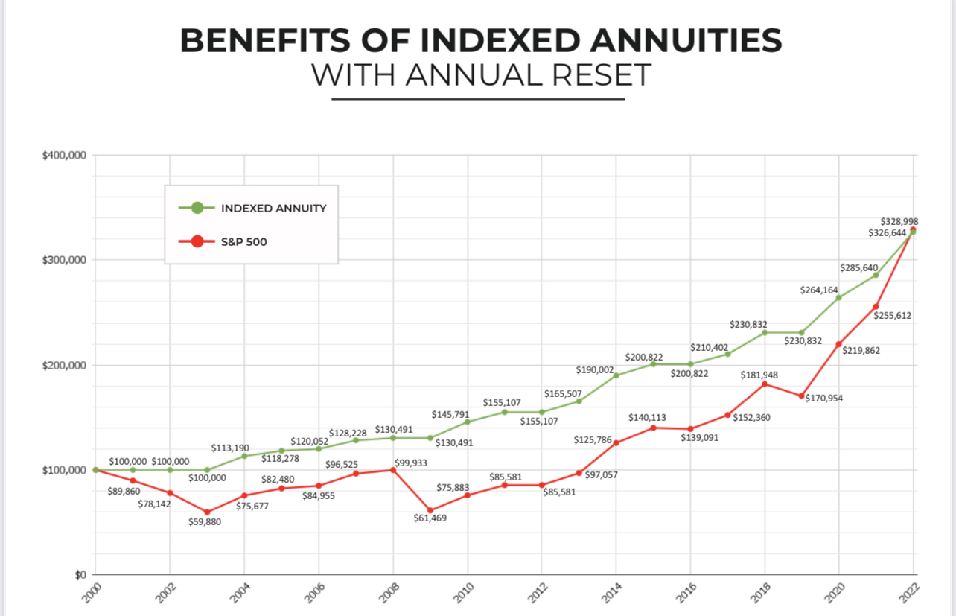

Slide 17
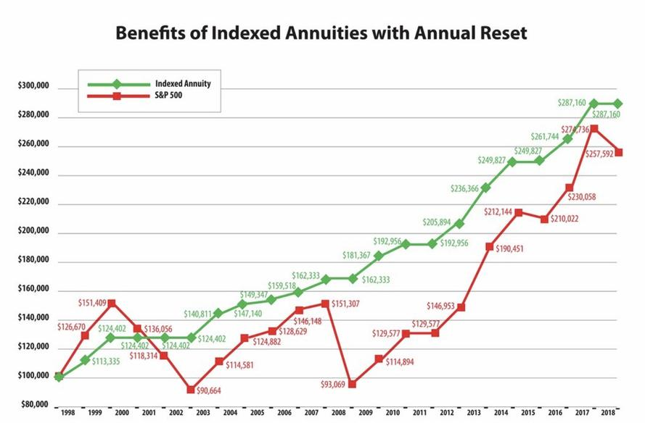

Slide 18

EQUITIES
The 5 year to 10 year period are more influenced by politics and macroeconomic forces and swings.
Gordcollins.com
The stock market forecast for 2024 paints a gloomy picture. Some systemic failures in the system could lead to stocks crashing in the immediate future. It's a combination of various macro factors that have been predicted near the end of last year that could finally begin to come to fruition.
Sep 11, 2023
Matthew Farley Investor Place

Slide 19
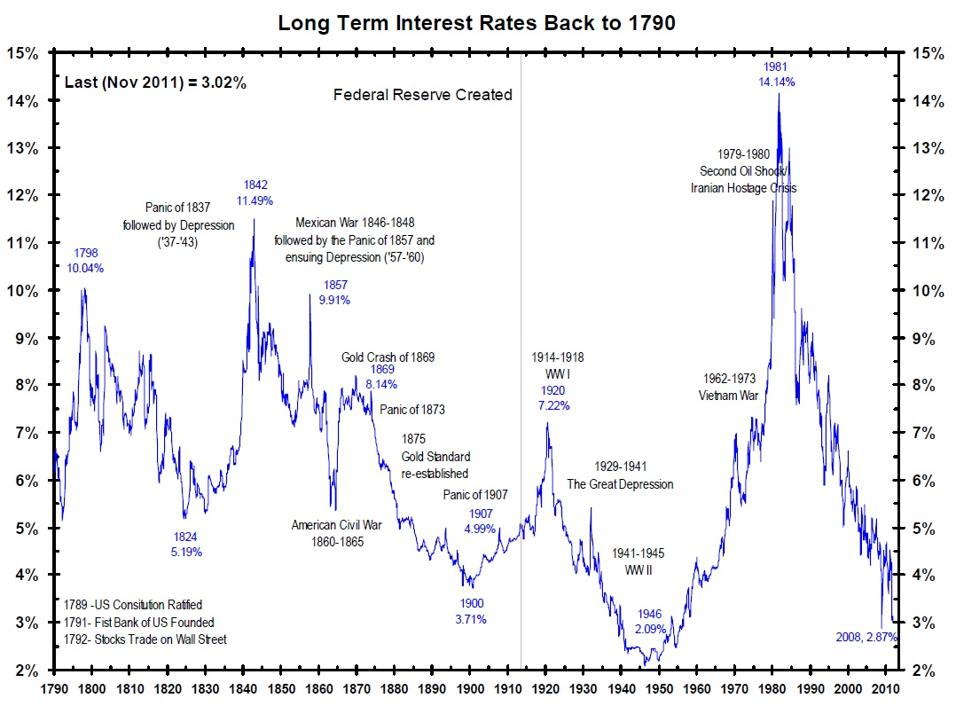
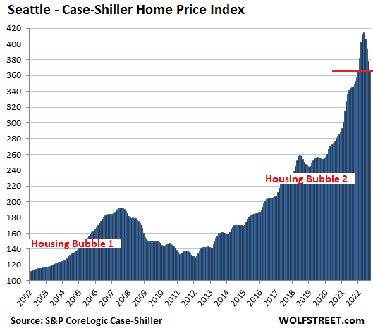
Volatility
Bond Yields
Alternatives

Slide 20
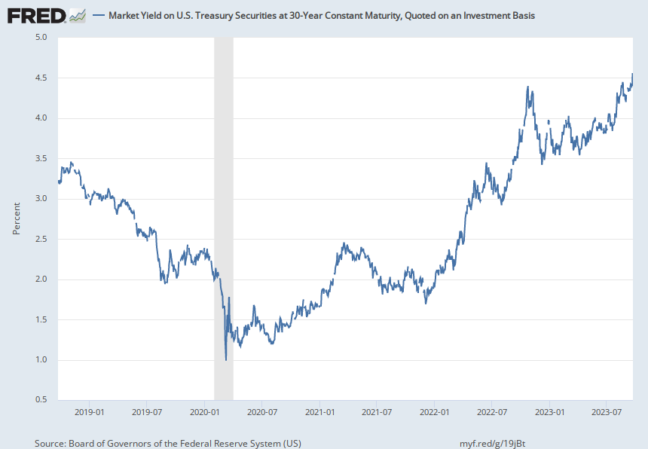
Notes:
Source:
Board of Governors of the Federal Reserve System (US)
Release:
H.15 Selected Interest Rates
Units:
Percent, Not Seasonally Adjusted
Frequency:
Daily
Yields on actively traded non-inflation-indexed issues adjusted to constant maturities. The 30-year Treasury constant maturity series was discontinued on February 18, 2002, and reintroduced on February 9, 2006.For further information regarding treasury constant maturity data, please refer to the H.15 Statistical Release notes and the Treasury Yield Curve Methodology.
Board of Governors of the Federal Reserve System (US),
Market Yield on U.S. Treasury Securities at 30-Year Constant Maturity, Quoted on an Investment Basis [DGS30],
retrieved from FRED,
Federal Reserve Bank of St. Louis;
https://fred.stlouisfed.org/series/DGS30,
September 25, 2023.

Slide 21
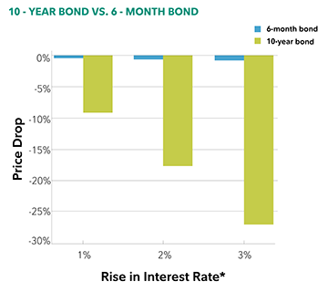
Bonds
Price
Yield
Duration

Slide 22

Fixed Indexed Annuity Protection Against
Market Declines
Indexing Strategies w/out Market Risks
Gains Locked In Annually or at Index Maturity
Deposits are held in the General Account of Insurance Company

Slide 23

Guarantees
A Fixed Annuity can provide a very secure, tax-deferred investment. It can provide a guaranteed minimum interest rate, with no taxes due on any earnings until they are withdrawn from the account.
AARP

Slide 24
Ideal Policyholder
Protection
Income
Growth

Slide 25
Factors Impacting Financial Decisions
Income
Assets
Age
Family
Debt
Health

Slide 26
Longevity
Protection
Income
Taxes
Survivors

Slide 27

Experts Weigh In
“An annuity can not only reduce the risk of an unknown lifespan, it can also allow retirees to spend their savings without the discomfort generated by seeing one's nest egg get smaller,” wrote David Blanchett and Michael Finke in a Think Advisor article.
Mar 14, 2023
Blanchett is managing director of PGIM DC Solutions, a division of Prudential Financial, and Finke is a professor of wealth management at the American College of Financial Services.

Slide 28
Benefits of Annuities
Safety of Principal
Asset Protection
Tax Deferred Growth
Guaranteed Lifetime Income

Slide 29
Fixed Indexed Annuity
100% Downside Protection
Guaranteed Lifetime Income
Growth Opportunities

Slide 30
Guaranteed Lifetime Income
Individual or Joint
Regardless of Account Value
Complements Government Benefits
Level or Increasing Income

Slide 31
Income Rider Key Words
Income Base / Protected Balance
Roll Up
(Bonus)
Step Up
Guaranteed Minimum Withdrawal Benefit

Slide 32

Level Income Planning
Initial Income Base Bonus of 20%
Annual Increase in Income Base 8%
Annual Step Up in Account Value
Annexus Product Design and Indexing Strategies

Slide 33
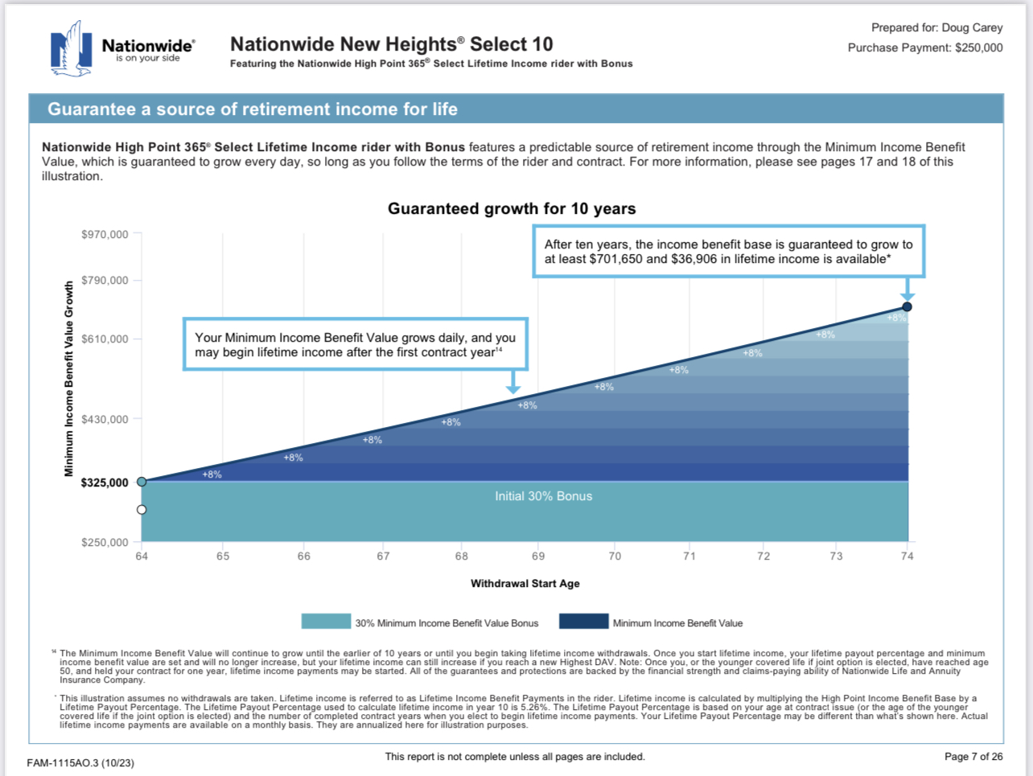

Slide 34
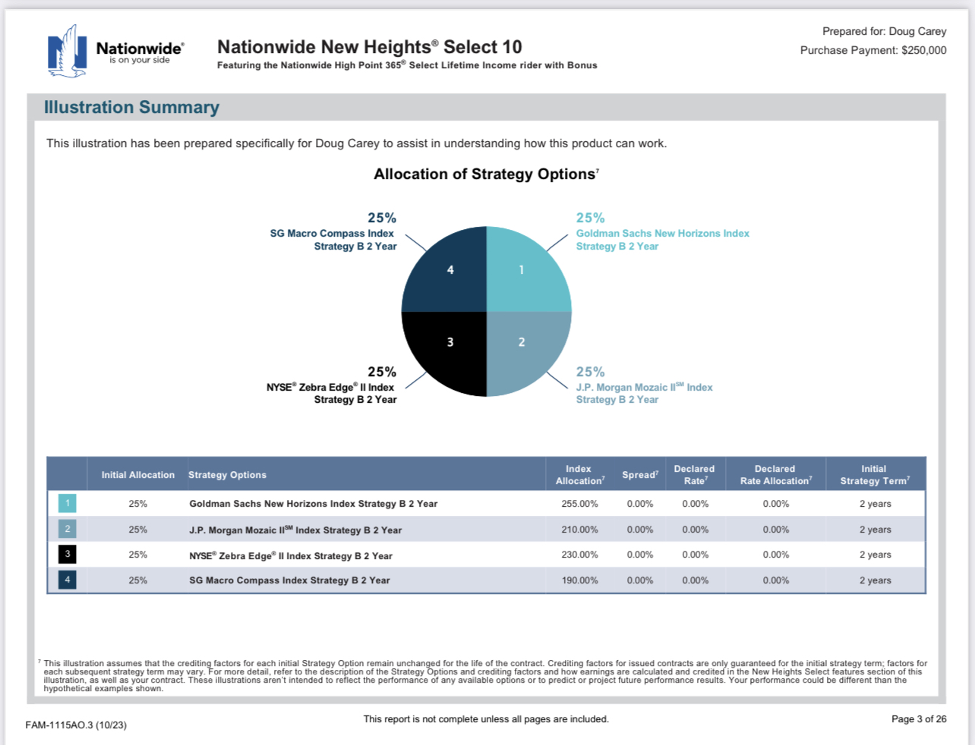

Slide 35
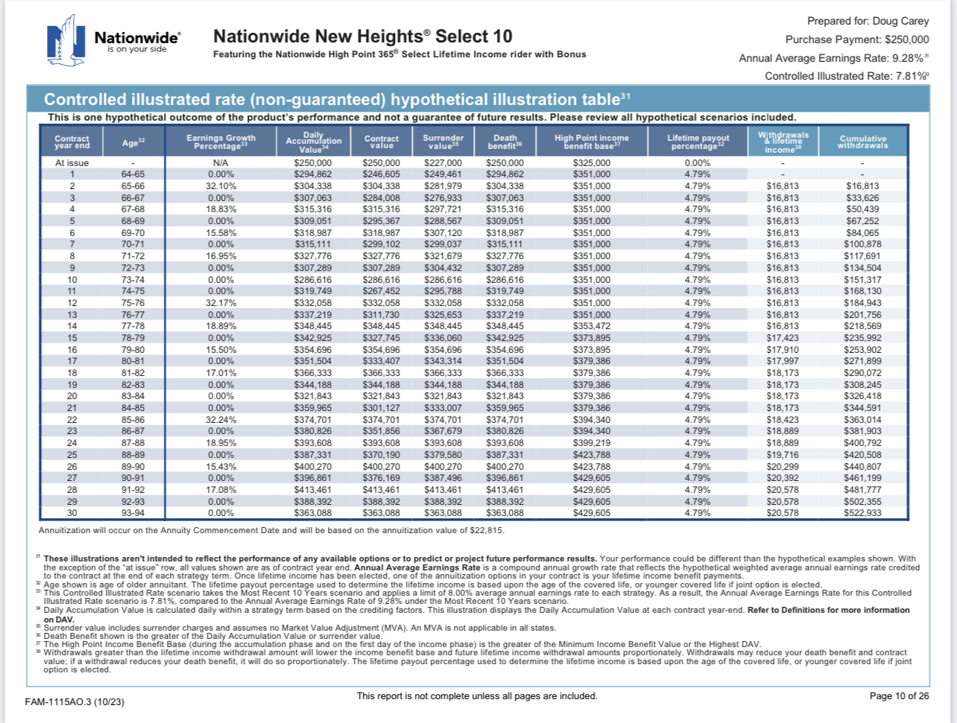

Slide 36
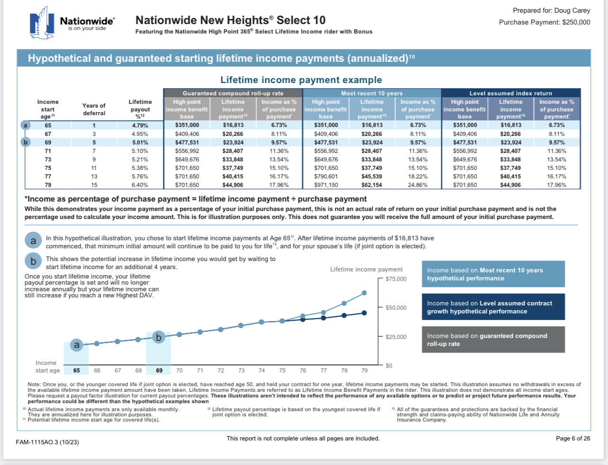

Slide 37
Math Behind the Income Guarantee
$250,000 Investment
$16,813 Income
6.72% Rate of Return
Joint Lifetime Income
$250,000 Investment
$75,000 30% 1x Bonus
$26,000 8% Annual
$351,000 High Point
4.79% Payout %
$16,813.00 Income

Slide 38
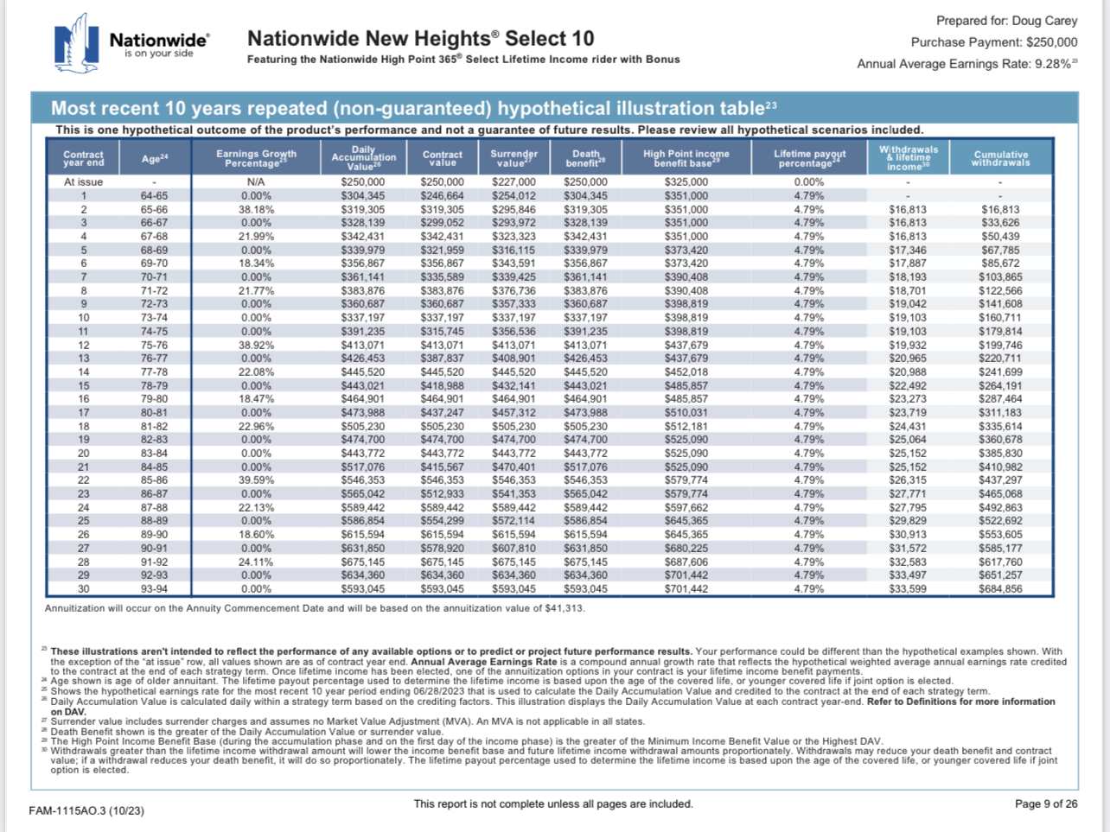

Slide 39
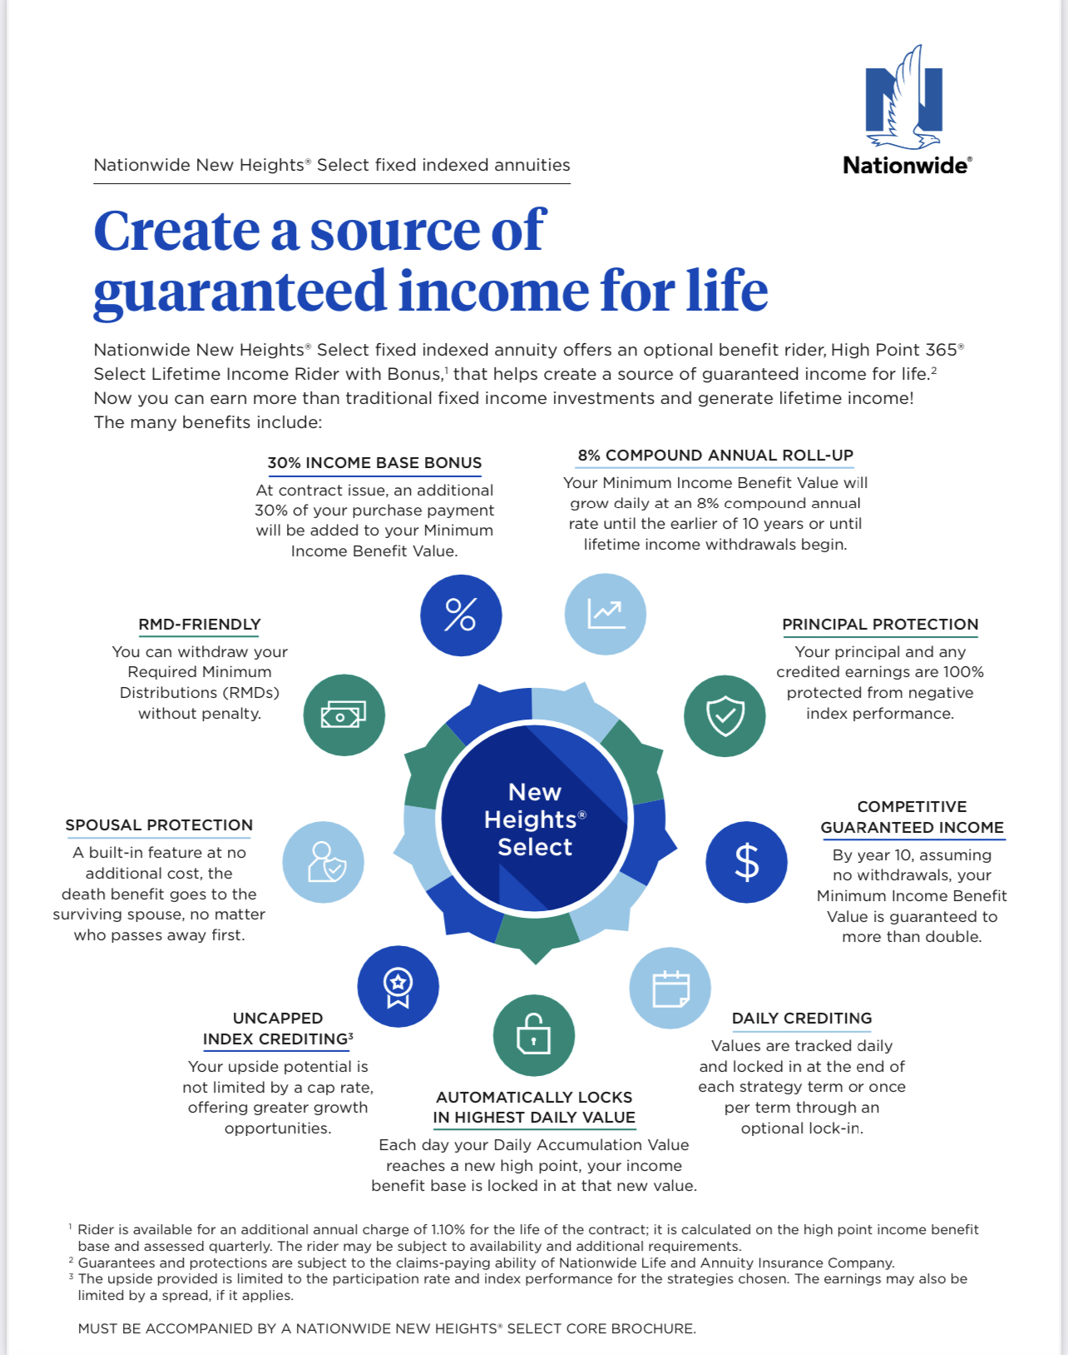

Slide 40
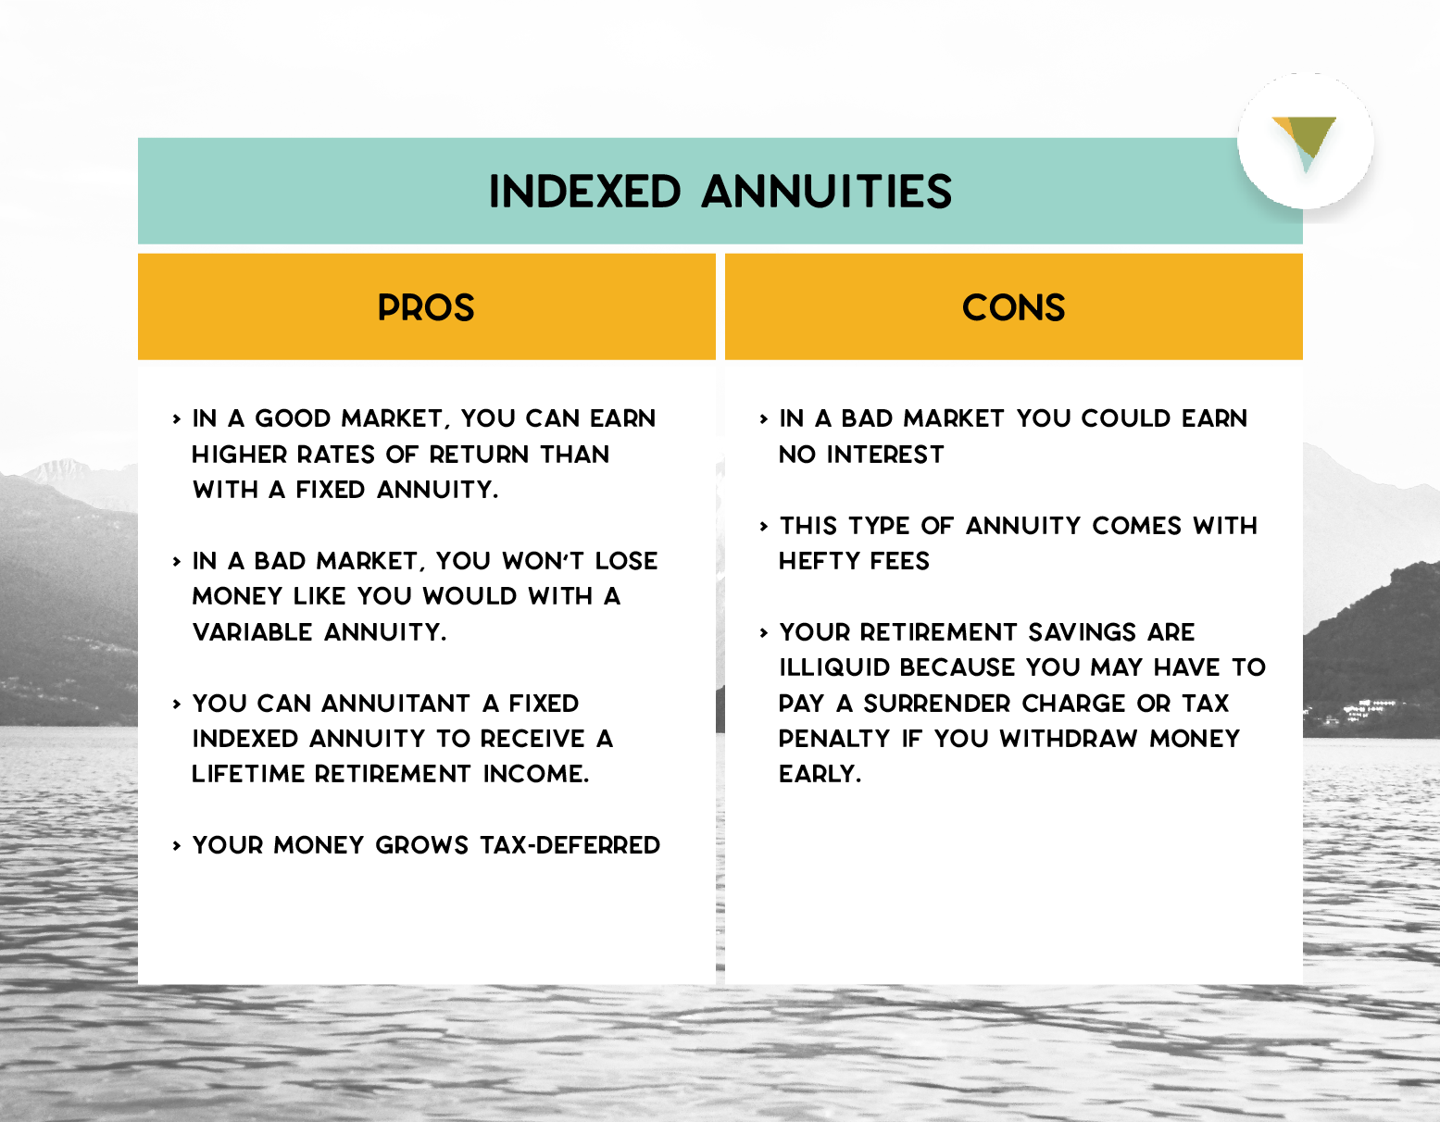

Slide 41
Fee Structure
Riders
Early Cash Out
A rider charge on an annuity is an additional fee that can be added to the cost of the annuity contract. Riders are optional features that provide additional benefits, such as death benefits, long-term care coverage, or guarantees on the minimum interest rate earned on the annuity.
Guaranteed Lifetime Income : 1.10%-1.20%
Annuity Surrender Charges. A surrender charge is a penalty for taking out money from an annuity before it matures, usually within six to eight years of purchasing. This charge can be as much as 7% of your annuity's value. To avoid or reduce this charge, wait until the surrender period ends.

Slide 42
Talking Points of a Fixed Indexed Annuity
Premium Payments are Deposited into the General Account of the Insurance Company
Policy is Issued and Benefits Guaranteed based on the secured assets of the Insurance Company
The Insurance Company makes their money earning interest from the Premium Payment deposited in General Account
Insurance Company purchases Option Contracts based on your preferred indexing strategies using a small portion of the interested earned from the Premium Deposit
IF an Option is In the Money , the option is exercised, and the proceeds are credited to your Policy Account Value. Gains are locked in
If the Option is Out of the Money, the option expires, no loss to the account value.
100% Downside Protection , annual return cannot be less than 0%
Indexing Strategies have caps (maximum return for the that index) or participation rates (percent of the annual gains credited to your account, participation rate can exceed 100%)
There is a fee associated with the Lifetime Income Benefit – 1.1% annually
If a there is no Income Benefit needed – fee is 0%
Surrender Penalties are applied due to an early contract / policy liquidation . Most FIA have 10 years or less surrender penalties.
A Market Value Adjustment might be applied during the Surrender Penalty Years – MVA is based on the current bond markets , sudden increases in rates has a negative effect, sudden decrease in rates has a positive effect.
Fixed Indexed Annuities are Tax Deferred Investments
They are a contract between the insurance company and the policy owner.
They are Asset Protected in some States.

Slide 43
3 Planning Objectives
Living Too Long
Dying Too Soon
Unexpected
Events

