Slide 1
General Meeting
Loughborough Students Canoe Club
14th November 2022

Slide 2
Training Sessions
Intro to Canoe Polo – Thursday! – Will be doing sign-ups
General Sessions – Please ask if you want to develop further. We will be at sessions
MAX 14 Boats on the water at once. Check before you get on
No deliberate swimming
Nottingham HPP Sessions – Will be announced on a weekly basis starting next week.
Outdoor First Aid Course – 21st 22nd January

Slide 3
Planned Trips/Events
Boater X – Wed 7th December (Afternoon)
Intersemester Trip (Tees & Kent) – 11th – 12th Feb
Warwick Canoe Polo Tournament – A’s (19th Nov), Ladies (28th Jan) , B’s (25th Feb)
National Student Rodeo – 4th -5th March
Cardiff Canoe Polo Tournament – 11th-12th March
Surf Trip – 25th 26th March
Summer Trip – Slovenia - after exams

Slide 4
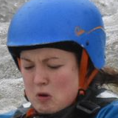
A Quick Word on Summer Trip – From Jenny !
Come on Summer Trip! You will have fun and have great paddling faces like me

Slide 5
BUCS Slalom
Dates TBC – End of Feb
Selections - Start of Semester 2

Slide 6
BUCS Sprint
18-19th March
Training sessions on the canal beforehand

Slide 7
BUCS Canoe Polo
Confirmed for 22nd – 23rd April 2022
Polo trials – 7th February 2022
All 4 Leagues (Open, Womens, B and Old Boys)
Team Selections start of Semester 2
Open Team (A)
Ladies Team
B Team
Help needed on event weekend

Slide 8
Upcoming Socials
Wednesday – Hey Ewe VS AU – Nautical Theme
Friday –Movember Charity Quiz (Village Bar)
Sunday – Ninja Warrior
Pub Golf – Wednesday 30th TBC
Christmas Dinner – Sat 10th Dec
Vodka Social – Wed 14th Dec
End of Exam Social – 8th February

Slide 9
Friday – Movember Quiz & Raffle
Ticket Release this week – Josh will give more information – lots of prizes!!
Kukri kit - £50 voucher
Escape Watersports dryrobe
Bom Bom Patisserie Cookie Club Boc
Love Loughborough - £20 Voucher
Loughcamra Pint Glasses
The Deli at 58 Voucher
Pub Quiz – Come along and bring some friends!!

Slide 10
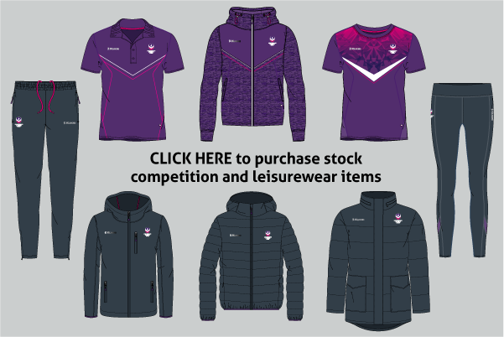
Kukri
lsu.co.uk/kukri
Rash vest Payments
Cags

Slide 11
CANOE POLO

Slide 12
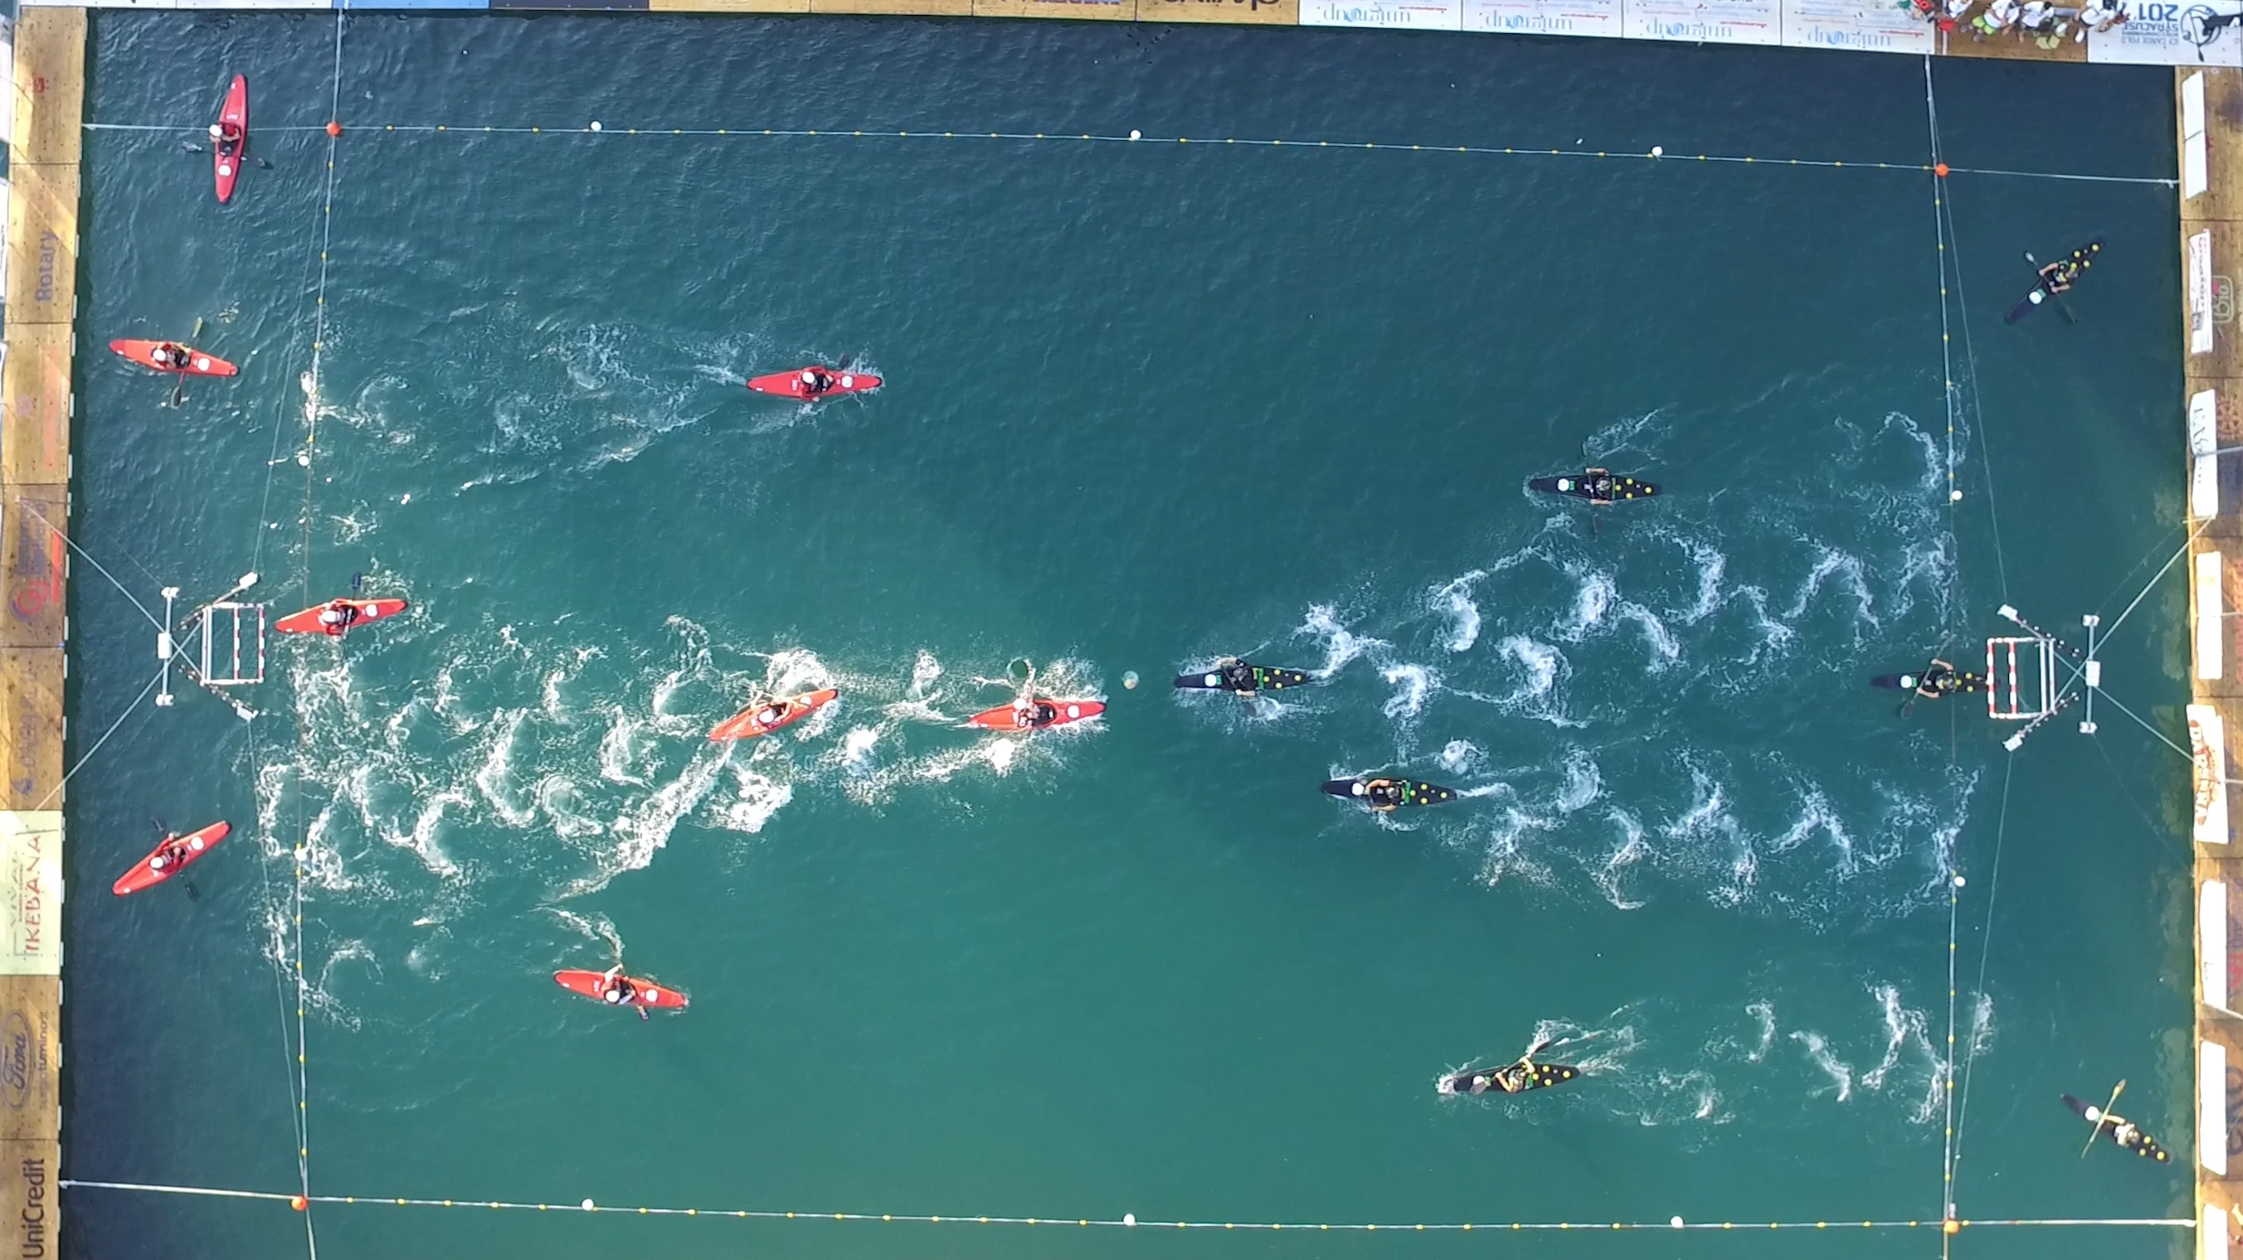
Canoe Polo Rules & Tactics

Slide 13
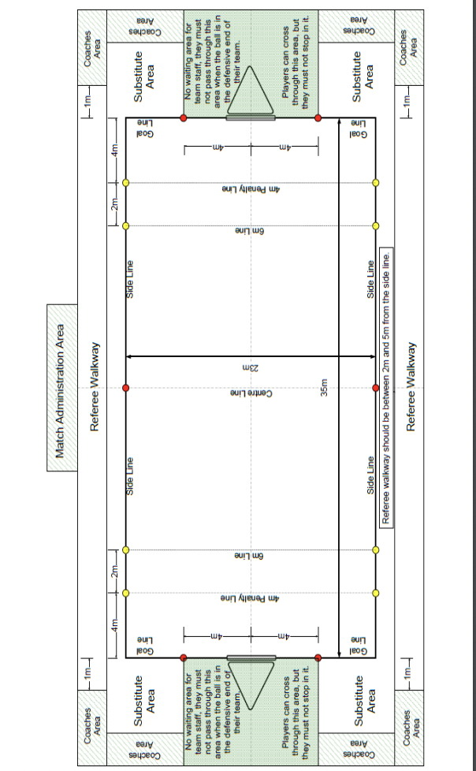
Playing area & some basics
What is needed for a game of canoe polo
20 gametime: 2 x 10 min halves
With a 2 min half time break in-between
2 referees
2 teams of 8 players
5 players from each team on pitch at any time
Score keeper
Time keeper

Slide 14
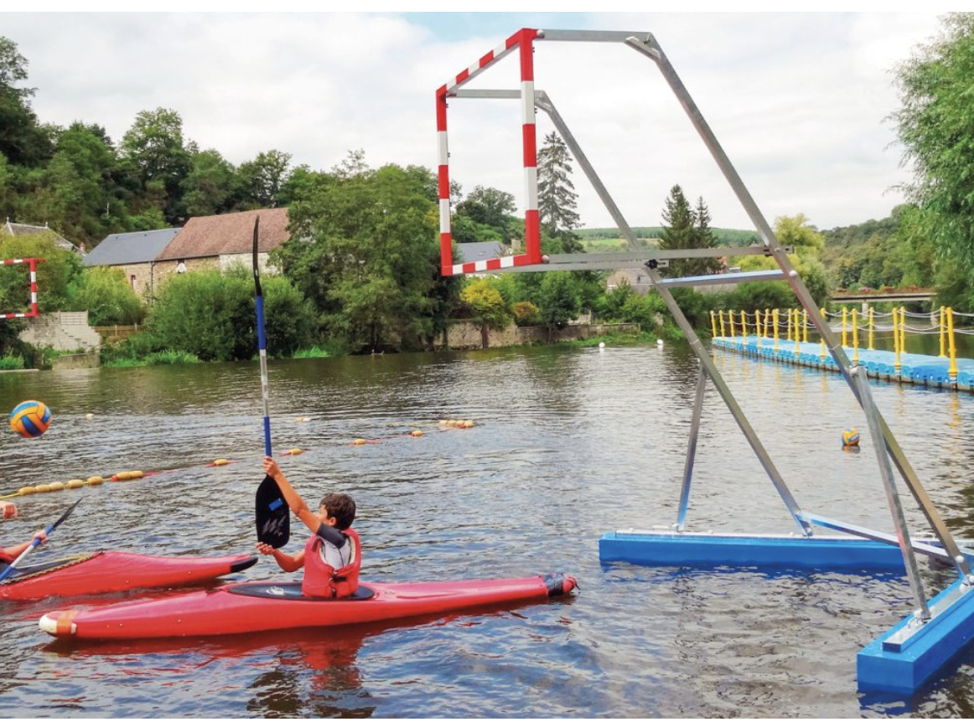
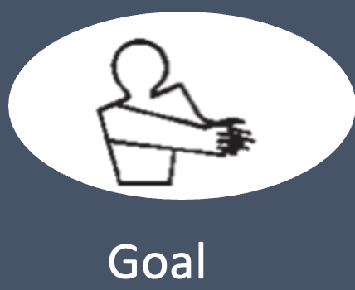
Scoring & passing
The Objective of canoe polo is to score points.
To score you must get the ball into the oppositions net.
Any player can score points and the ball can be passed by any player in any direction.
This can be done by using your hands to throw the ball or using your paddle to flick the ball. Any shot scored is worth 1 point. (a paddle flick goal is worth a crate).
60 seconds to score (every time possession changes the shot clock resets)
Team that conceded the goal re-start at halfway mark of the pitch after a goal is scored.

Slide 15
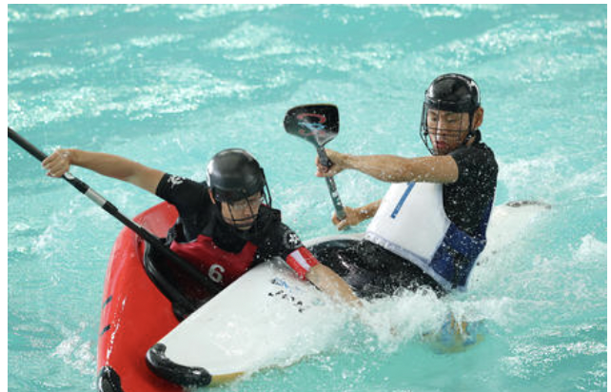
illegal possession of the ball
The ball may only be held for 5 seconds then it must be dribbled (thrown 1 metre in any direction then picked up again) or Passed to another player.
No part of your body may touch an opposition boat or player in order to gain or retain possession of the ball. (leaning foul)

Slide 16
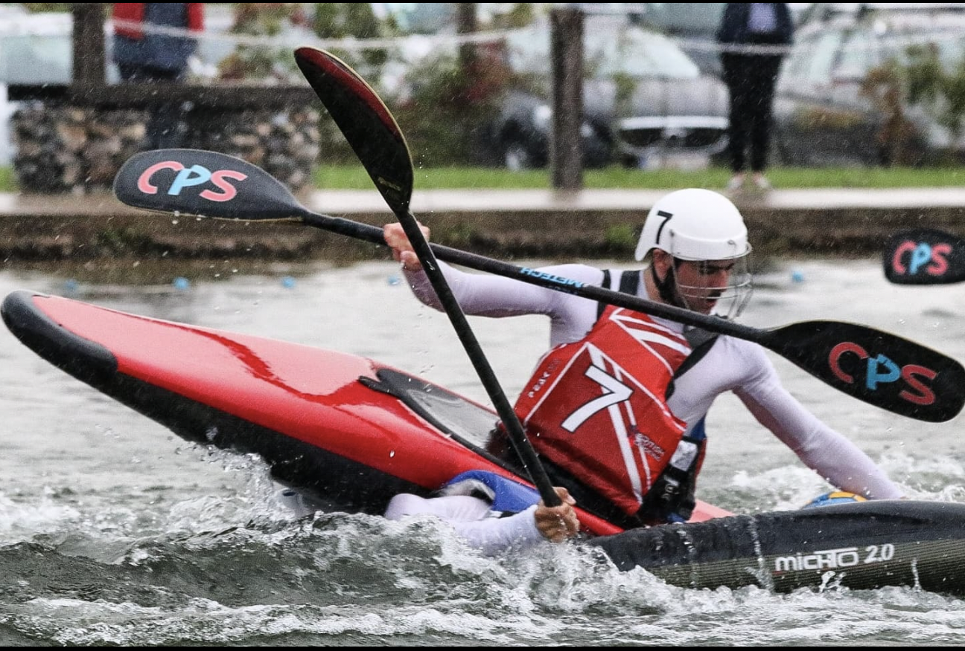
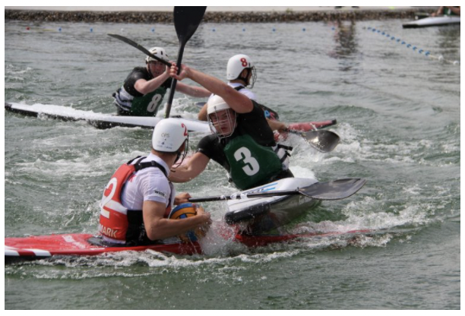
Kayak tackle
A kayak-tackle is a player manoeuvring their kayak against an opponent’s kayak in an attempt to gain possession of the ball.
Your boat must not touch any part of a players head or torso and their spraydeck.
You can only kayak tackle a player when they are competing for the ball.
You can only tackle a player when they are within 3m of the ball.
No hard tackles that results in significant contact to the side of the kayak, at an angle between (80) and (100) degrees

Slide 17
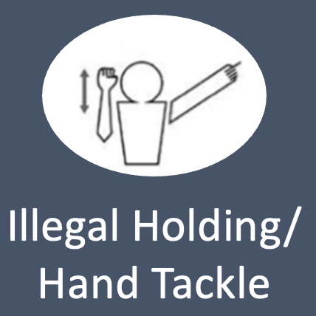
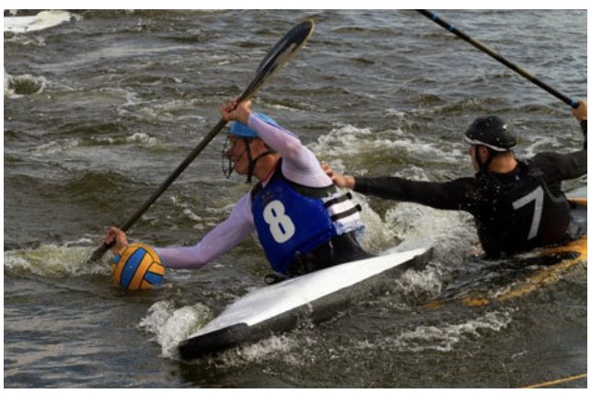
Hand tackling (Binning) The best part
The only form of hand tackle that is allowed is a push (using 1 open hand) on either the shoulder, back or side of the player that is in possession of the ball.
(If the ball is within 1m of the player or within reaching distance then the player is considered to have possession of the ball.)
No pulling, choking or grabbing is allowed (sorry horny people)
Any hand tackle that endangers a player is illegal. The main concern of this rule is a player being pushed onto the boat of another player.
If you are going to grab the ball from another player you must take the ball with out making contact with the players hands and the action must be perpendicular to the hands.

Slide 18
Paddle fouls
A player must not attempt to play the ball with their paddle when another player is attempting to play the ball with their hands.
A player must not place a paddle within arms reach of an opponent who has the ball in their hand.
No throwing a paddle or any other action that may endanger a player

Slide 19
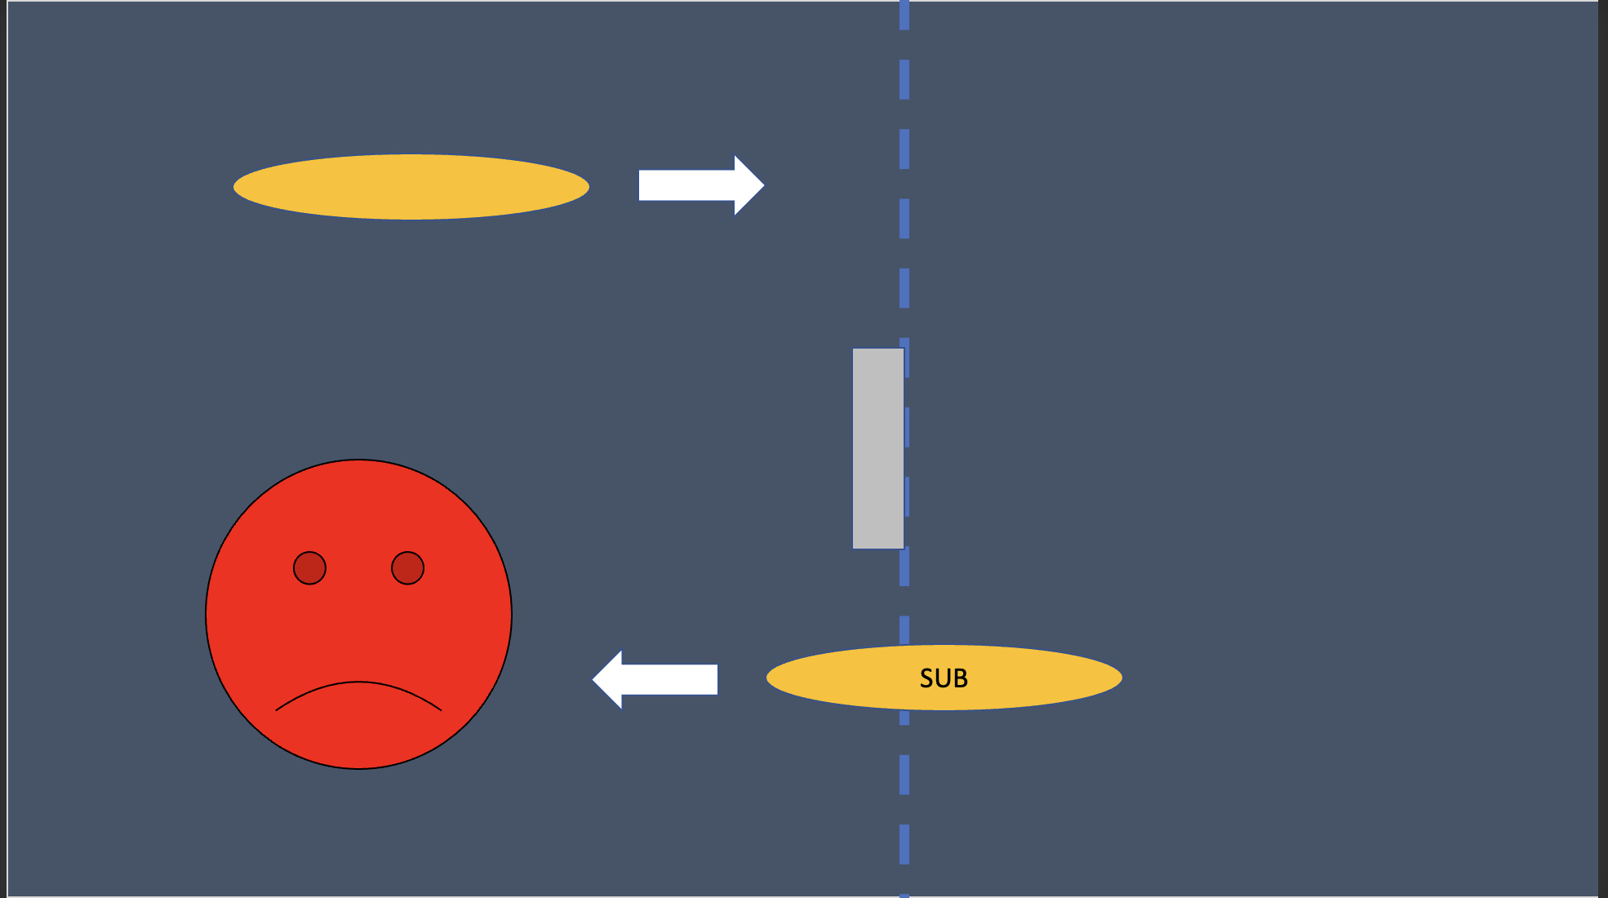
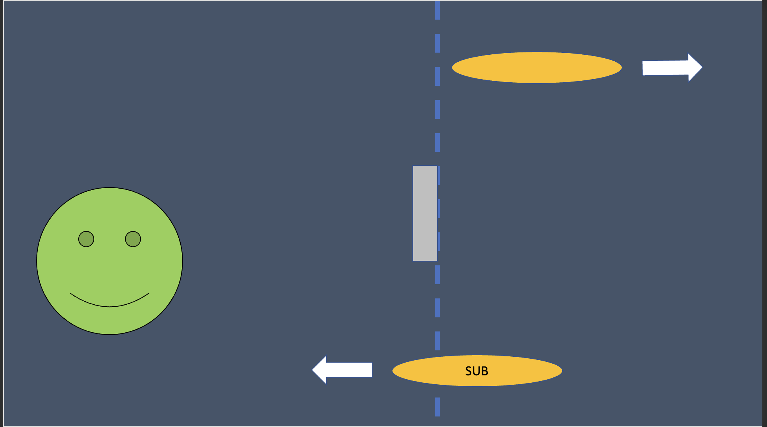
Making substitutions
Team size: Teams of up to 8 players are allowed. This breaks down as 5 players on the pitch with 3 substitutes.
Substitutions are rolling so if you are substituted you can sub on again at any time during the match.
When subbing the player subbing off and all their equipment must be off the pitch before substituting.
This is also important if someone capsizes, another player can sub onto the pitch when the capsized player and all their equipment is off the pitch.
Sub area
Sub area

Slide 20
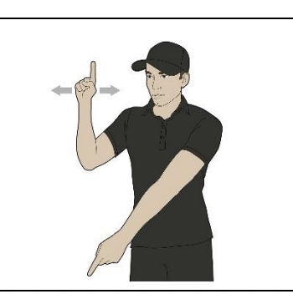
Unsporting behaviour
A player must not hinder another player’s attempt to roll after being capsized. The capsized player must have their head and both shoulders above the water before attempting another tackle.
No deliberate time wasting tactics such as throwing the ball away and obstructing the opposition to prevent a quick restart.
Bouncing the ball off an opponent’s boat out of play to gain an advantage.
Use of foul or abusive language: no calling anyone “a toxic elitist cu….”
Also please don’t punch anyone.

Slide 21
Card system
Green Card: warning
Yellow Card: Sent off for 2 mins
Red Card: Sent off for rest of the game and miss the next game.
2 Green cards = A yellow card
1 Yellow + 1 green = A red card
Please avoid swearing as its a very easy way to get a straight yellow. ( This advice is for myself)
A foul may be committed without a card given out if the ref deems the foul to be minor or accidental
If a team receives 4 green cards the player that receives the 4th is given a yellow card.

Slide 22
Some other info about the card system
Green card: usually for a repeated not deliberate foul or first time offence.
Yellow card: given for a foul that has stopped an almost certain goal from being scored but was not dangerous enough to be a red card offence or for a foul being committed by a player that has already received a green card.
Red card: Usually given for a deliberate foul that had a significant amount of danger.

Slide 23
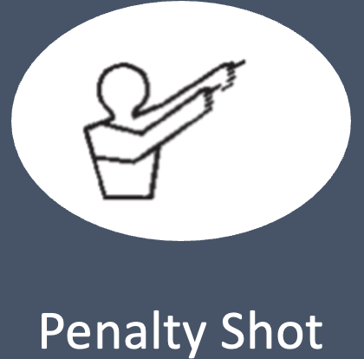
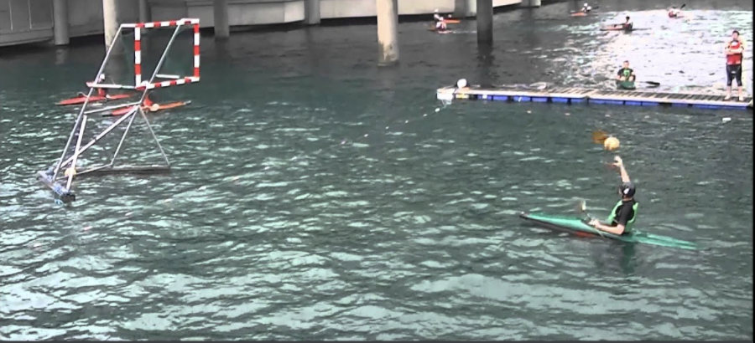
Penalties
There are two types
For a penalty the fouled player must position their body on the 4m line and attempt to score.
If the foul was committed while the defending team had a keeper in nets then a keeper will be in nets for the penalty.
If there was no keeper in nets when the foul was committed then there will be no keeper in nets for the penalty
All other players on the pitch must position their bodies on the 6m line once the player has shot the game restarts and the other players can play the ball.

Slide 24
The power play
If a yellow card is awarded without a penalty being awarded for the foul then it is what is called a power play this means the team that committed the foul loose a player until the opposition score or until the full 2 minutes is served for the yellow card.

Slide 25
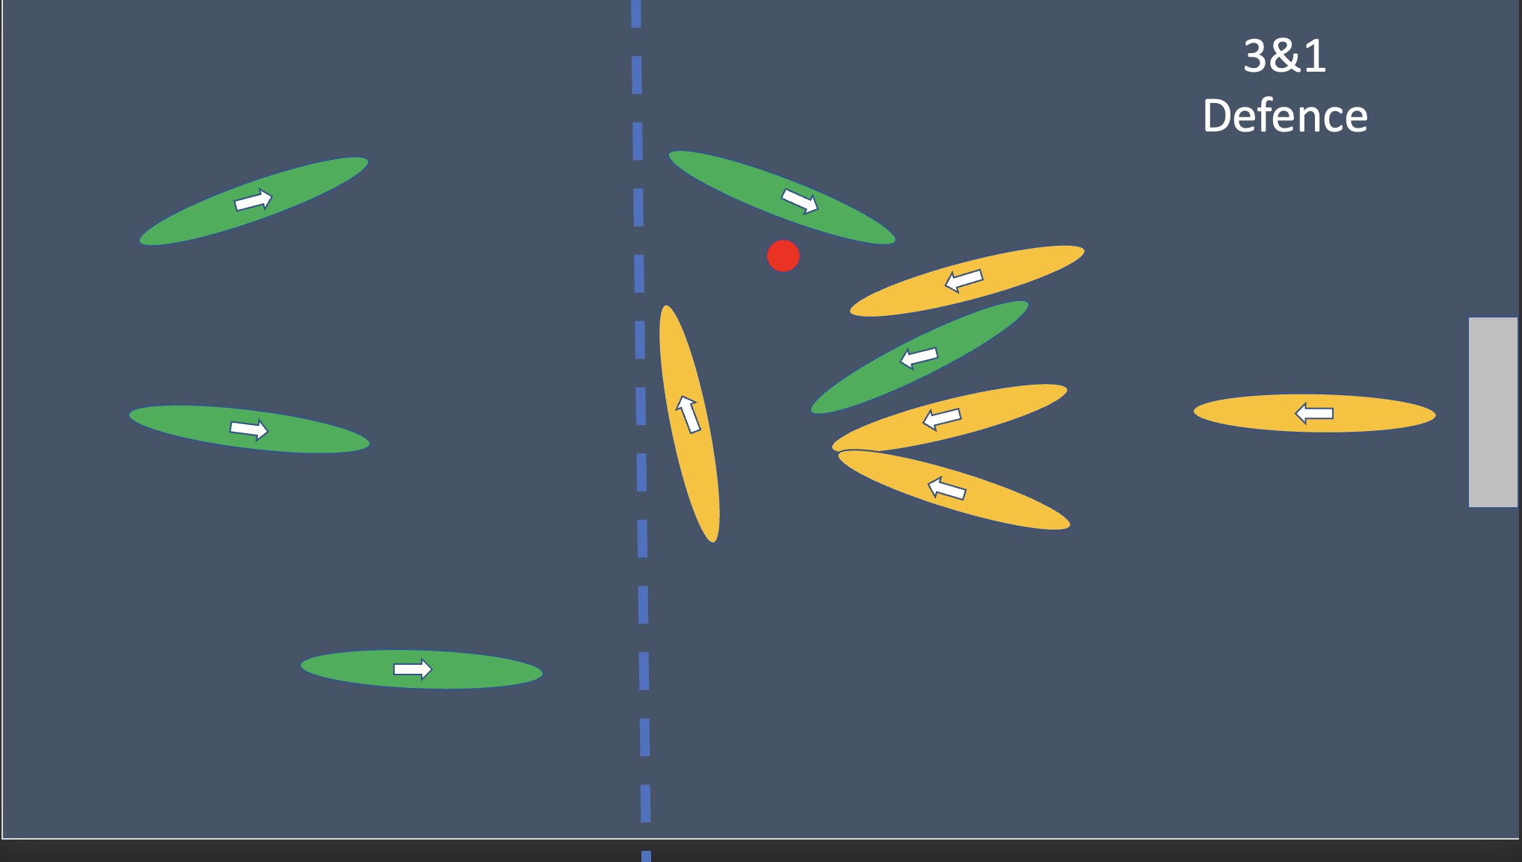
6 metre line, Defence and the Goalkeeper
When within the 6 metres of the defending teams net.
Both teams may use their boats to jostle for position.
Can jostle a player for 2m while in contact with their boat.
The Goal keeper: The player on the defending team that is directly under the net with their paddle in raised in the air to block a shot.
Attackers can’t make any contact with the goal keeper.
6m line
Goal keeper

Slide 26
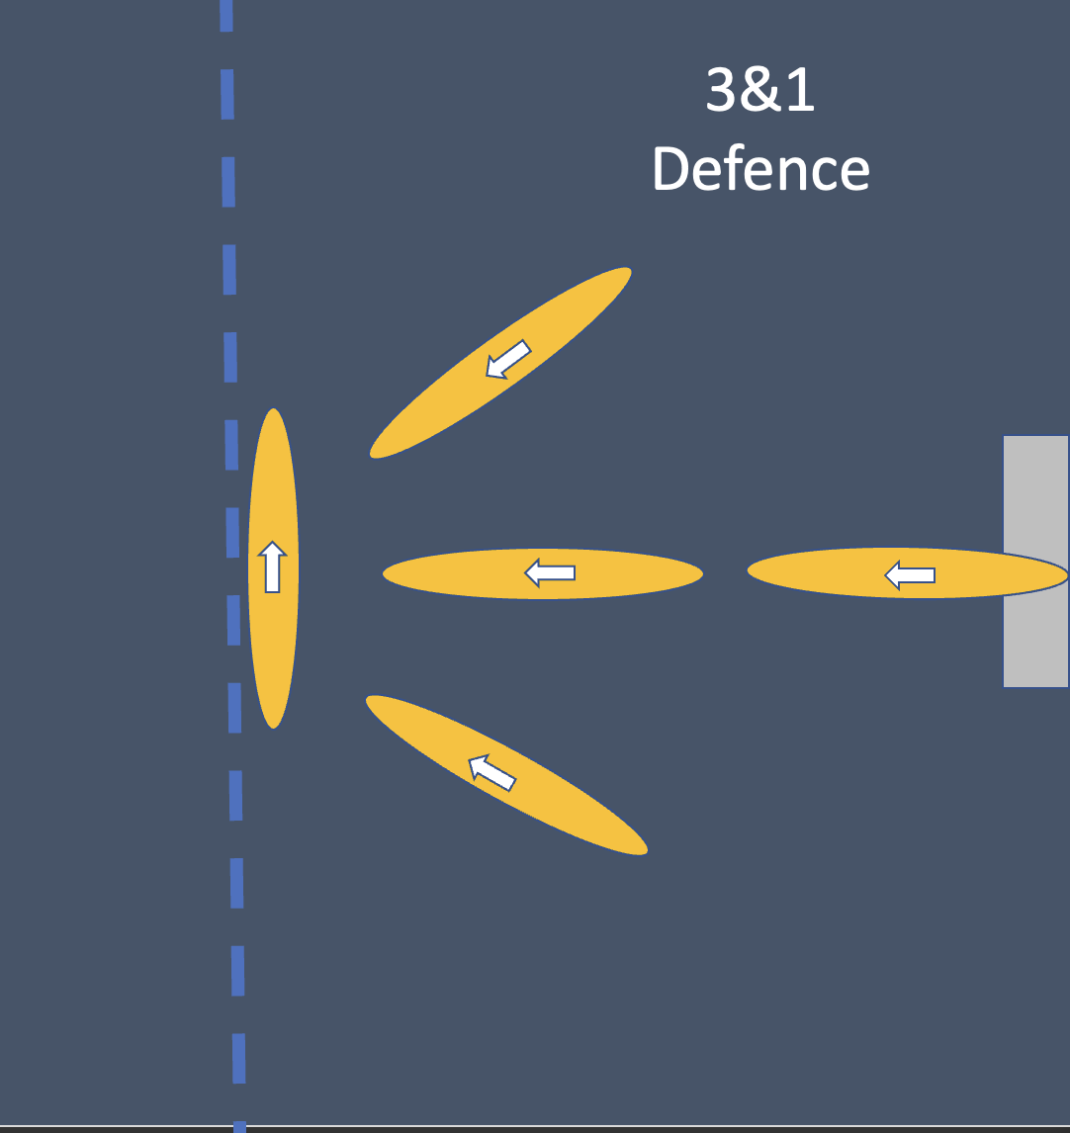
Defence Tactics
2 - 2 and 3 -1 and man on

Slide 27
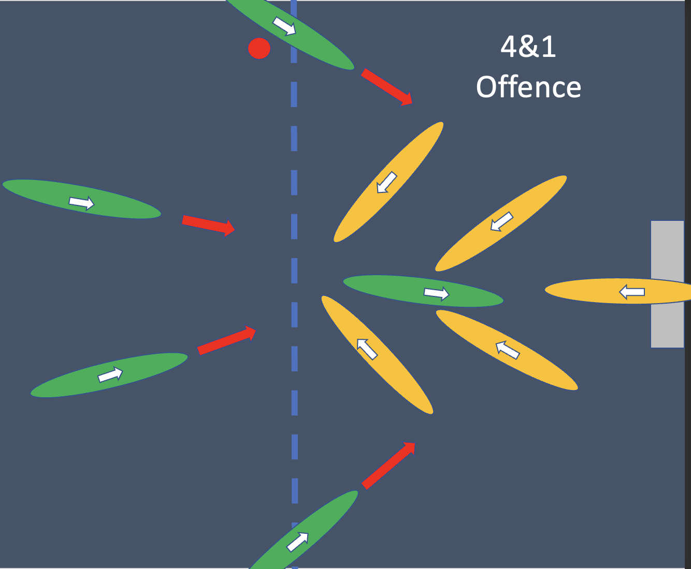
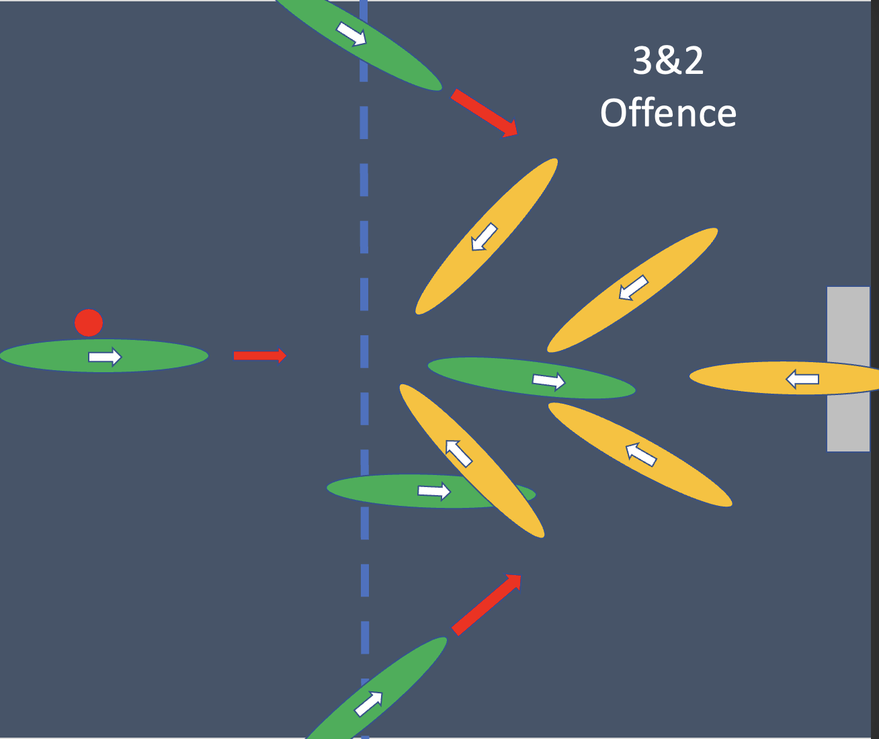
Attack tactics
(4 - 1)
Attackers attempt to move the ball around the defensive zone

Slide 28
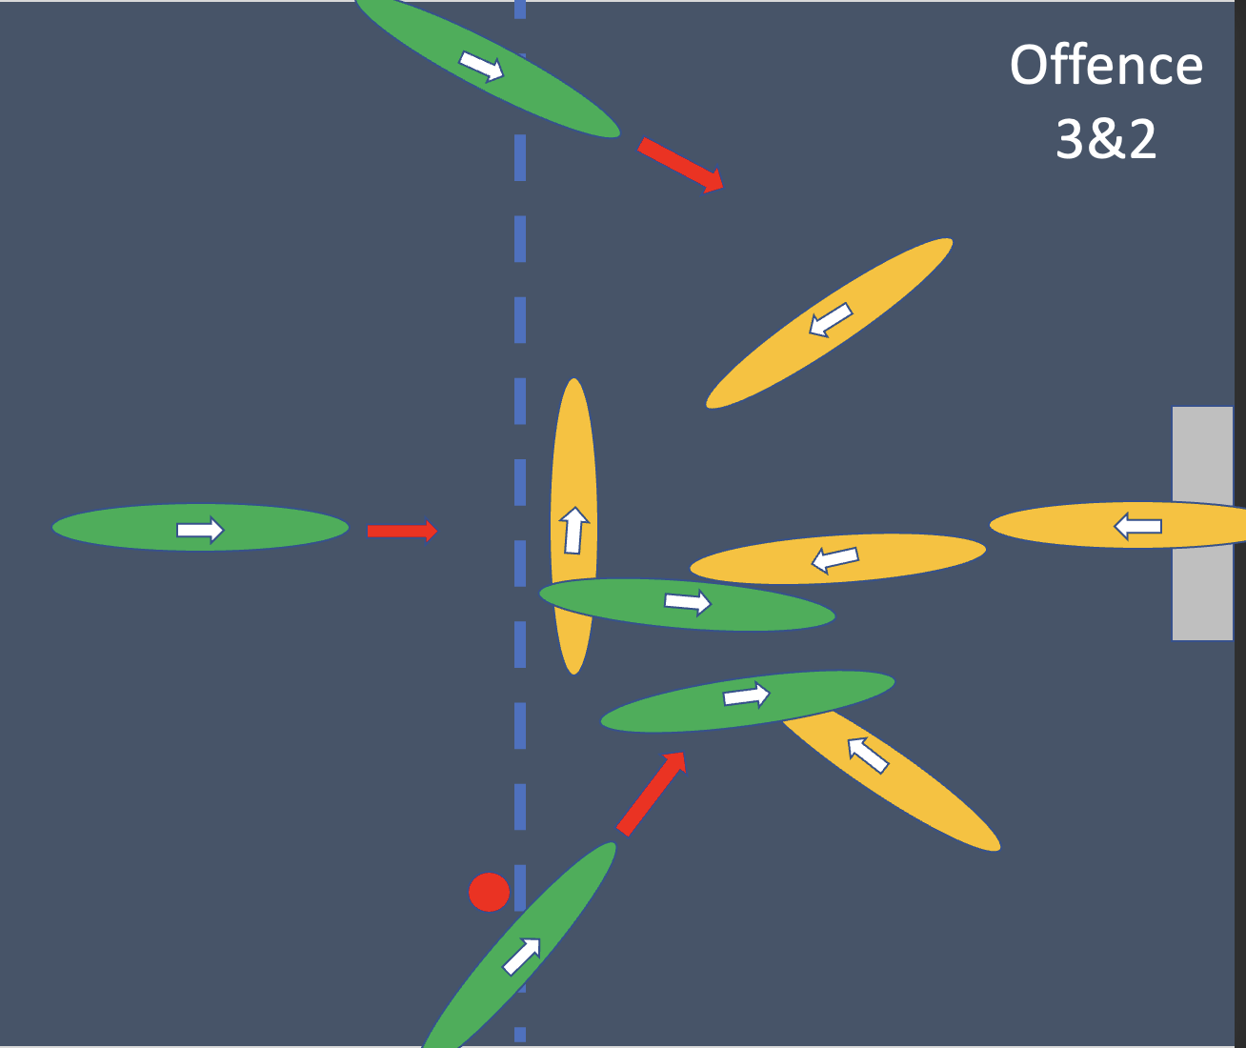
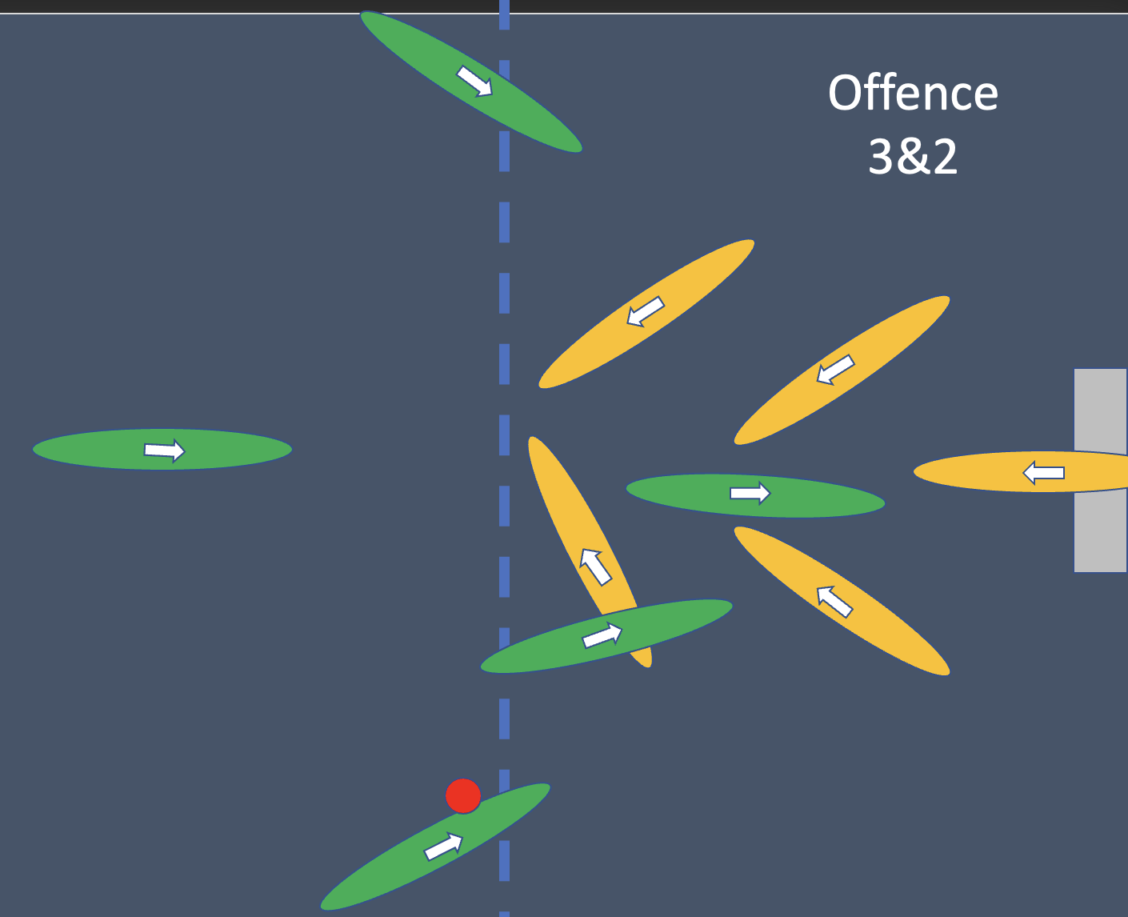
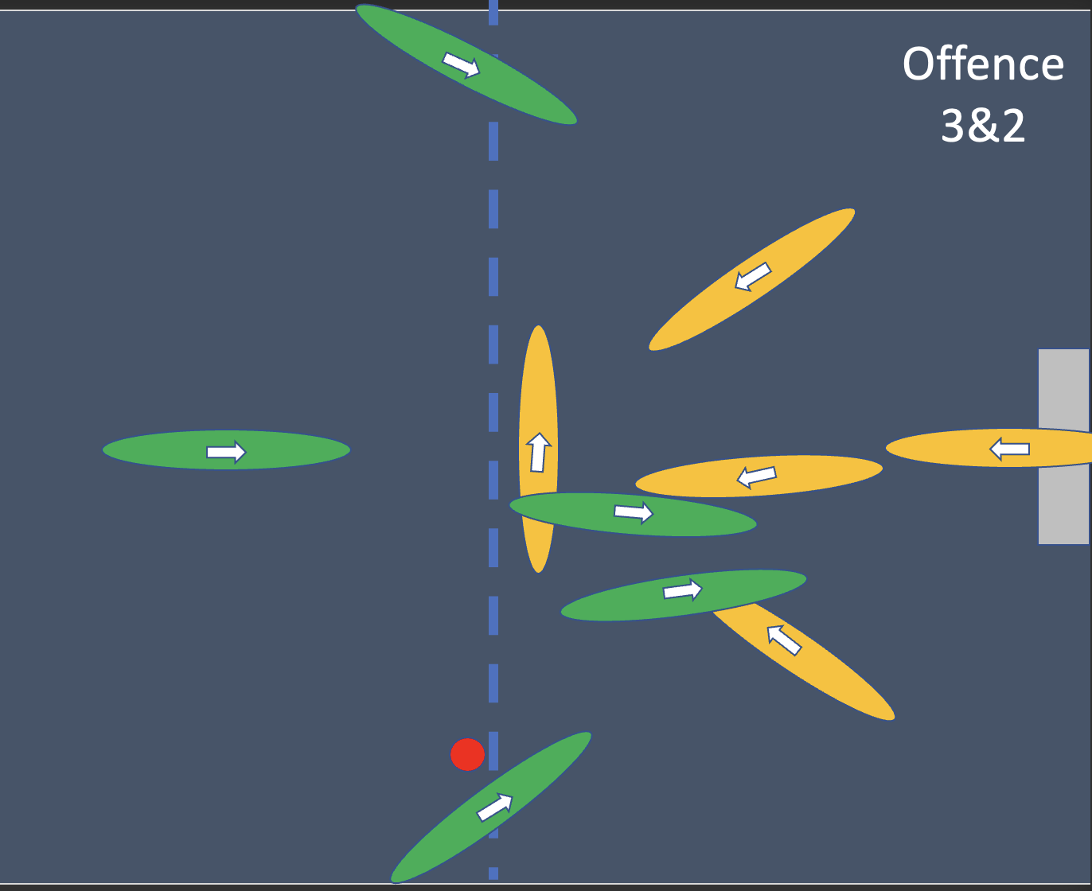
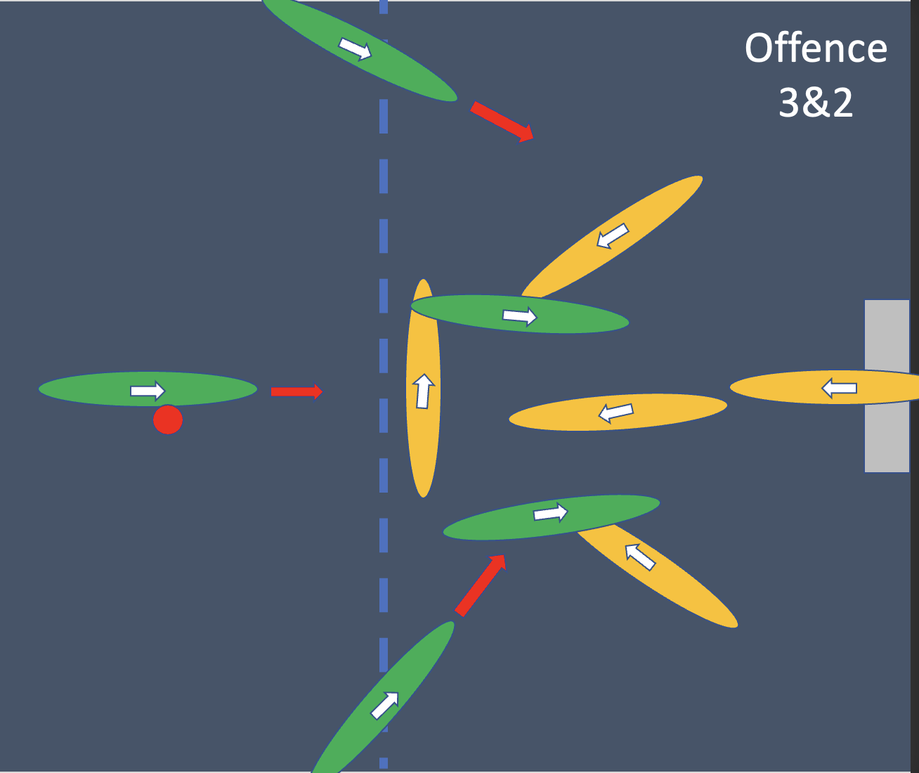
Attack tactics
attack

Slide 29
Link to tactics Videos https://drive.google.com/drive/folders/1Uyq37w_CKEmcWDP55OKqwlHJJiMFb4dF?fbclid=IwAR136ILR1bbESjjAuFgF0UmcXZU98AKQo__1dm4cTzKf_F-vN3qxOsUS0T4

Slide 30
Freshers Rep:
ELECTIONS

Slide 31
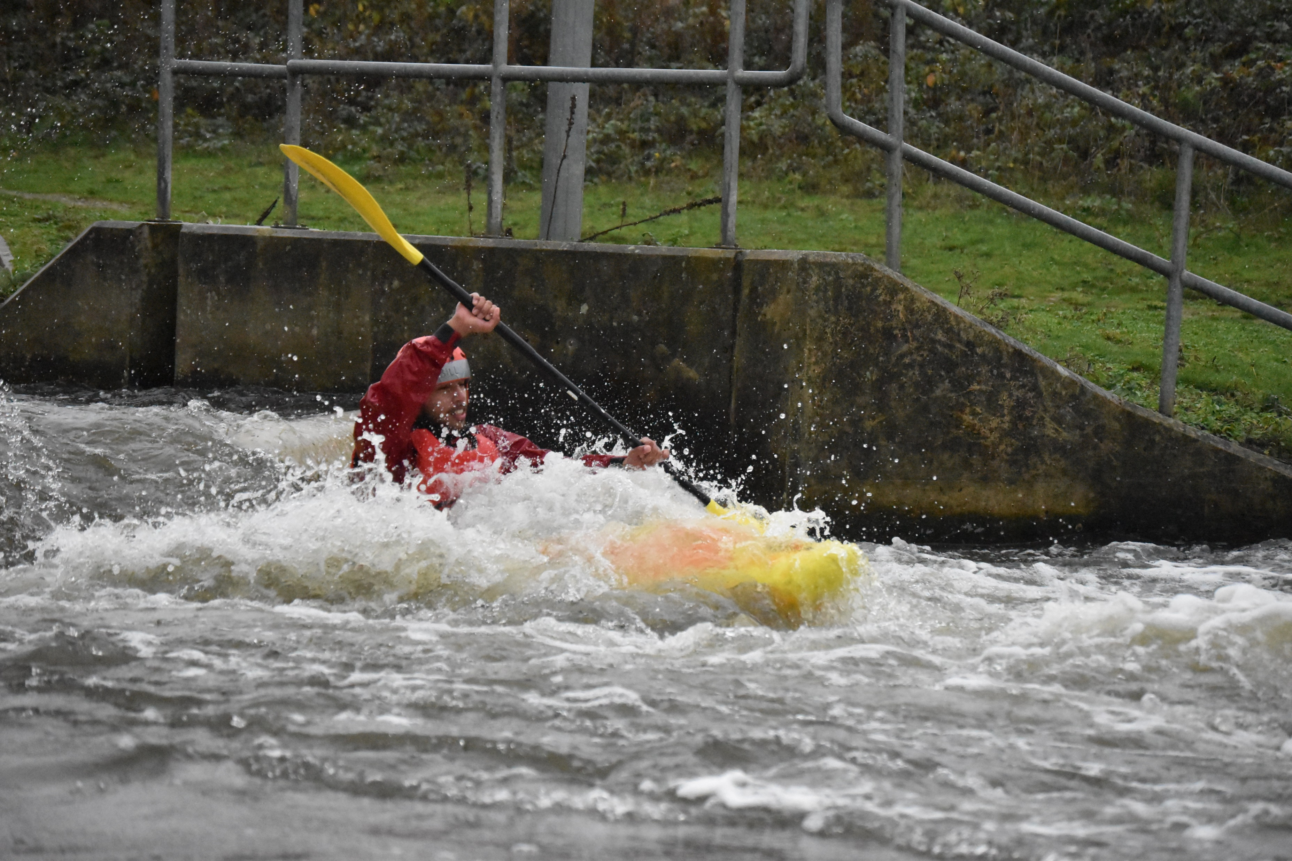
Nishchay Bhalla He/Him
I love canoe because it gives me a sense of satisfaction and peace. It gives me ability to cross my limits and makes my mindset powerful.

Slide 32
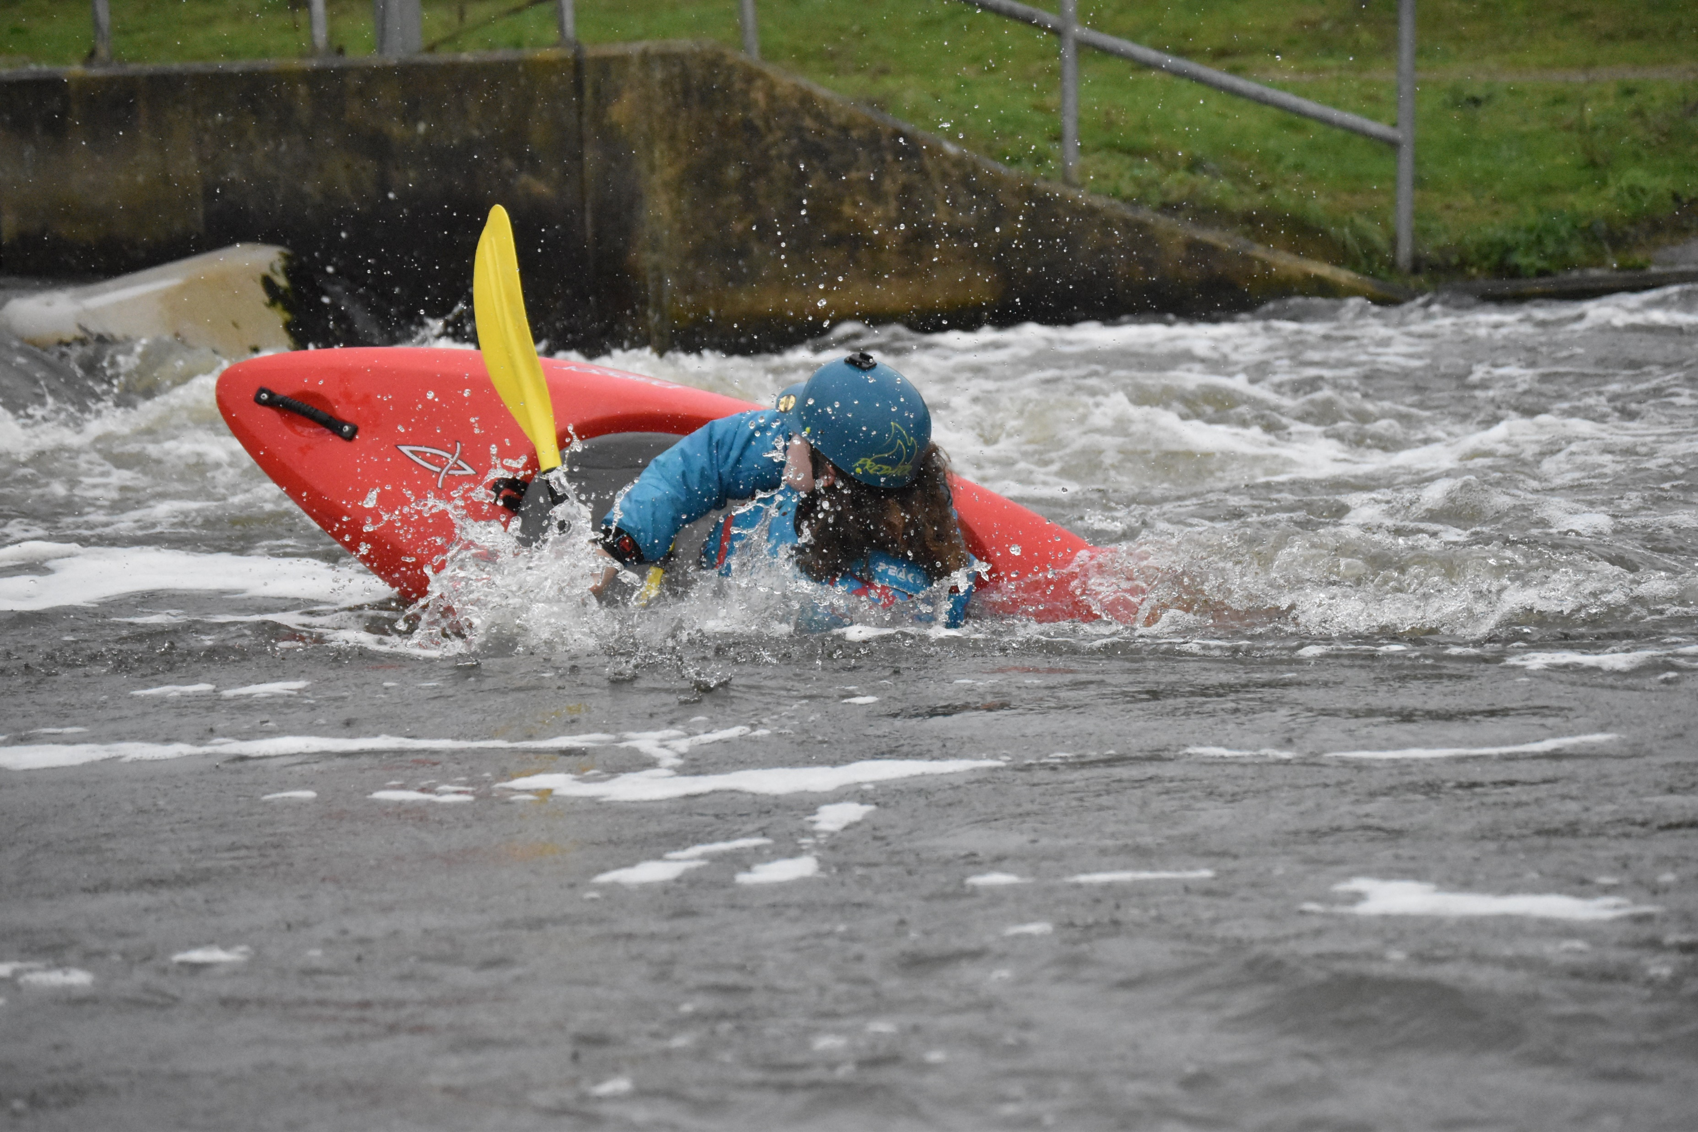
Matthew Cattanach He/Him
I love canoeing as you get to explore and travel around the country or just have a nice time on a local river and there is so much in between. I believe there is a genuinely friendly and enjoyable atmosphere within the canoe/kayak community as well as the AU club and I have been able to meet and talk to so many new people and friends and learn from them. This has not only helped me get to know so many people but also helped me improve my own social and communication skills and have more confidence in myself on and off the water. It has enabled me to do so much and I wish to continue that and be able to help anyone and everyone both on and off the water. And I believe this role could allow me to help the club and provide that relationship with the committee and freshers, not only this year but in the ones to come.

Slide 33
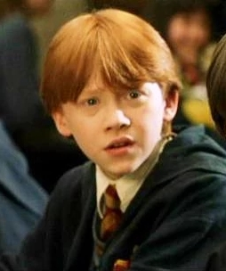
R.O.N
Every election has an option for R.O.N (Re-Open Nominations).
Only use this if you believe the nominees for that role would not be able to perform up to the standards required

Slide 34
Elections Intro
VOTING OPEN:
Vote on Microsoft Form
Live now on Facebook Page
NOW

Slide 35
VOTING FORM
https://forms.office.com/r/4h4TRvVnx5

Slide 36
Questions?

