Slide 1
PAG-02 Comparison 2019 vs. 2024
Robert Jevin, P.E., Permits Chief
DEP Northeast Regional Office
Waterways & Wetlands Program
03/12/2025
JOSH SHAPIRO, GOVERNOR | JESSICA SHIRLEY, ACTING SECRETARY
Notes:
This presentation has been developed to review some of the significant changes that have been made to the reissued PAG-02 General NPDES Permit that became effective on December 8, 2024, and identify how these changes compare to the previous version of the PAG-02 Permit that was issued in 2019.

Slide 2
Learning Goals
Identify the changes for the 2024 PAG-02 permit
Compare the changes between the 2019 permit and 2024 PAG-02 permits
Explain the purpose of the changes
Notes:
The learning goals of this lesson are to understand the changes made to the PAG-02 General NPDES Permit, compare the changes between 2019 and 2024 and the purpose of these changes.

Slide 3
PAG-02 General Permit
Everyone with coverage under the 2019 PAG-02 is covered under the 2024 PAG-02 on December 8, 2024.
If a Notice of Intent (NOI) was submitted by December 7, 2024
Failure to submit a renewal NOI means the project no longer has NPDES permit coverage
The terms and conditions of the 2024 PAG-02 went into effect immediately on December 8, 2024
Notes:
It is important to understand that everyone with coverage under the 2019 version of PAG-02 is covered under the 2024 version of PAG-02 as long as they submitted a Notice of Intent or NOI to renew their coverage by December 7, 2024. Failure to submit a renewal NOI means the project no longer has NPDES permit coverage and is considered a violation if there is stormwater discharges. For those who did submit a timely renewal NOI, the terms and conditions of the 2024 PAG-02 went into effect immediately on December 8, 2024. There is no grace period to comply with any new provisions of the general permit unless explicitly stated in the general permit.

Slide 4
Definitions
Designee
Operator Co-Permittee
An alternative to a licensed professional who conducts oversight of critical stages of PCSM Plan implementation
Distinguishes between an operator who is a co-permittee per § 102.1 and co-applicants that become co-permittees upon approval of coverage
Notes:
Let’s begin by reviewing certain definitions that were added or updated for clarity purposes in the 2024 PAG-02.
[CLICK] DEP added a definition for “Designee”. A Designee is a person who serves as an alternative to a licensed professional who may conduct oversight of critical stages of PCSM Plan implementation.
[CLICK] Another definition added is, “Operator Co-Permittee”. The 2019 PAG-02 referred to both an operator (as defined in Chapter 102.1) and a co-applicant as simply Co-Permittees. The “Operator Co-Permittee” definition now distinguishes between the two terms and is specific to operators who become Co-Permittees because of the work they are conducting on a project site.

Slide 5
Definitions
Environmental due diligence
Investigative techniques, including but not limited to, visual property inspections, electronic database searches, review of ownership and use history of property, Sanborn maps, environmental questionnaires, transaction screens, analytical testing, and environmental assessments or audits
Notes:
A definition for environmental due diligence was added for clarity on what investigative techniques are expected of each applicant for on-site soils that will be disturbed when applying for a PAG-02 General Permit. This definition matches the definition published in DEP’s Management of Fill Policy.

Slide 6
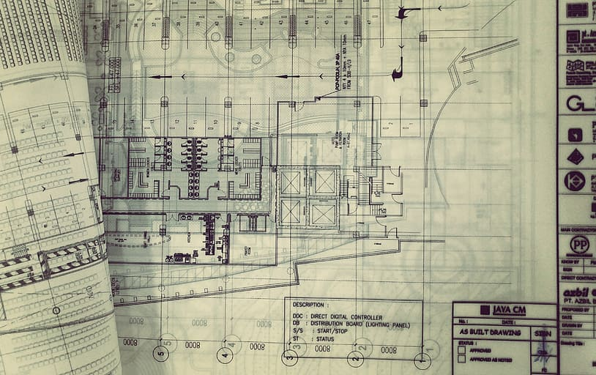
Definitions
Record drawings
Drawings that wholly and accurately depict as-built conditions of a project site following completion of an earth disturbance activity
Notes:
DEP also included definitions for record drawings and Stormwater Control Measures or SCMs. Under the Chapter 102 regulations, record drawings must be submitted with a Notice of Termination or NOT for any Chapter 102 permit. DEP has defined the term to ensure permittees understand what is expected for record drawings. In addition, record drawings have additional uses under the 2024 PAG-02 as will be discussed further.

Slide 7
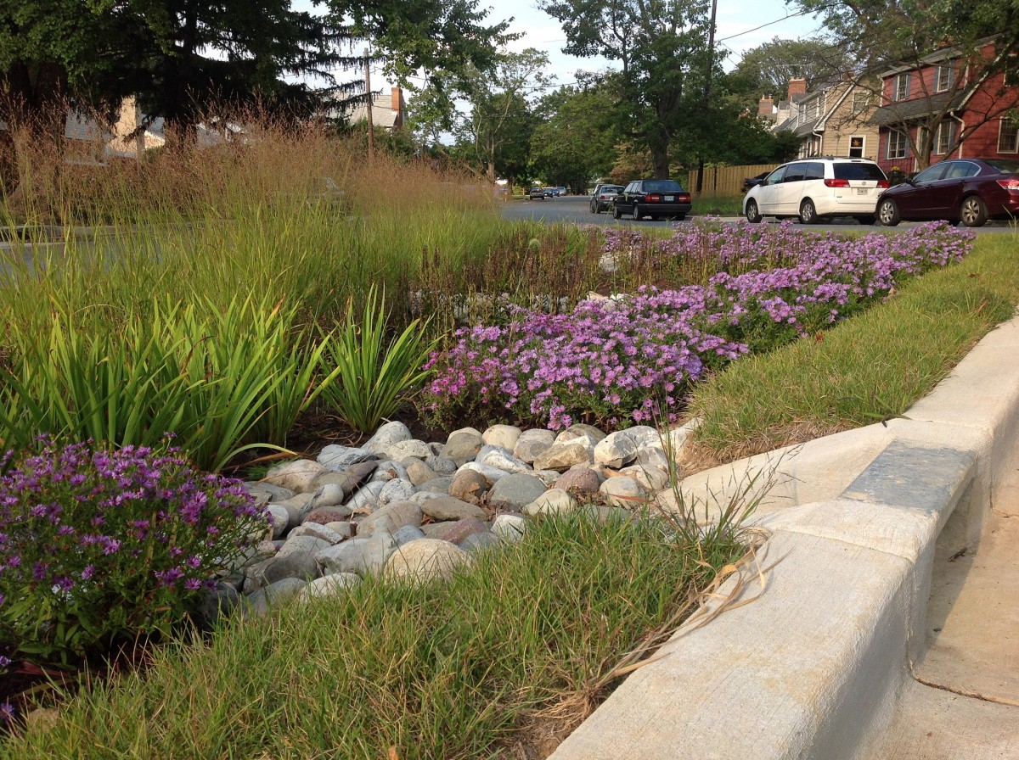
Definitions
Stormwater Control Measure (SCM)
Any natural feature or manmade structure designed or utilized to reduce or manage the volume, pollutant load, or peak rate of stormwater runoff
Notes:
Stormwater control measure, or SCM, is a new term that DEP has decided to use to describe best management practices or BMPs for post-construction stormwater management. SCMs are a type of BMP designed or utilized to reduce or manage the volume, pollutant load, or peak rate of stormwater runoff.

Slide 8
PAG-02 Notice of Intent (NOI)
Several updates have been made to the PAG-02 NOI (form number ending in 0345a)
For example, the operator information section has been removed
Renewal NOI no longer available for use
All existing permittees must have submitted a Renewal NOI by December 7, 2024, to remain covered
Notes:
Several updates were made to the PAG-02 Notice of Intent or NOI. For example, the operator information section has been removed. The intended operator is often not known at the time the NOI is submitted, and this information is collected later during the pre-construction meeting after issuance of permit coverage. The publicly available PAG-02 course on Clean Water Academy walks the viewer through the process of completing the updated NOI.
DEP created a separate streamlined version of the NOI to be used for the 2024 renewal process, but as of December 8, 2024, this Renewal NOI should no longer be used. Permittees who did not submit a renewal by the December 8th deadline must now submit a new NOI.

Slide 9
Impairment Causes
Non-discharge alternatives or ABACT BMPs are required when discharging to surface waters impaired
siltation, turbidity, TSS, water/flow variability, flow modifications/alterations, or nutrients
siltation, turbidity, TSS, algae, eutrophication, nutrients,
flow regime modifications, and
habitat alterations
Notes:
The 2019 PAG-02 required the use of non-discharge alternatives or ABACT BMPs when discharging to surface waters impaired for siltation, turbidity, suspended solids, water/flow variability, flow modifications/alterations, or nutrients.
[CLICK] Since the 2019 PAG-02 issuance, several of these causes of impairments have been renamed through DEP’s Integrated Water Quality Report. Therefore, the permit has been updated to include causes of siltation, turbidity, TSS, algae, eutrophication, nutrients, flow regime modifications, and habitat alterations. Those underlined are new causes of impairment that have been added to the 2024 PAG-02.

Slide 10
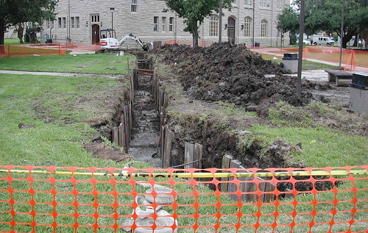
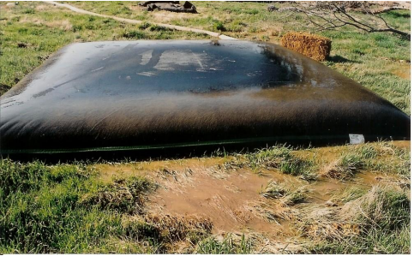
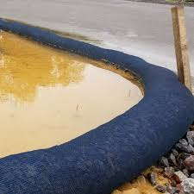
EPA Technology–Based Standards
Incorporating EPA’s 40 CFR Part 450 technology-based standards into the effluent limitation requirements
Notes:
DEP has incorporated EPA’s technology-based standards, at 40 CFR Part 450, into the effluent limitation requirements. This includes but is not limited to things like minimizing sediment discharges, soil stabilization, and pollution prevention measures. These standards were referenced in the 2019 PAG-02 but are now formally identified in the 2024 PAG-02.

Slide 11
Instrument Recording
2019 Permit
2024 Permit
Required recording of an instrument for PCSM BMPs within 45 days of issuance
Proof of the recording was required with the submission of a Notice of Termination (NOT) or transfer application
Requires submission of the full recording and proof of recording initially, prior to scheduling the pre-construction meeting, unless excepted
Requires proof of the recording with the submission of an NOT or transfer application
Notes:
The 2019 PAG-02 General Permit required recording of a legal instrument for disclosing PCSM BMPs (now SCMs) within 45 days of the permit issuance. Proof of the submission was to be provided with the Notice of Termination, or NOT, or a transfer application, if applicable.
[CLICK] The 2024 PAG-02 requires submission of the full recording and proof of the recording to the office that approved PAG-02 coverage prior to scheduling the pre-construction meeting with the exception of projects conducted for the benefit of a public utility as defined in the Public Utility Code and other projects that receive prior written approval from DEP or a County Conservation District. Additionally, the legal instrument must also be provided upon submission of the NOT to reflect actual as-built conditions. A pre-construction meeting may not be scheduled if the recording is not deemed complete.

Slide 12
Exceptions to Initial Recording
2024 Permit
Utility Projects: The permittee must submit the recording (and proof of recording) within 45 days of permit issuance.
Other Projects: Either:
Municipal approvals are not required, and all other state approvals are in hand at time of Chapter 102 approval, or
Municipal approval are required, and the municipality is waiting on the Chapter 102 approval.
Other Projects must receive approval from DEP/CCD to submit within 45 days of issuance rather than before the pre-construction meeting.
Notes:
Under the 2024 PAG-02, DEP/CCD will consider requests for exceptions to specific 102 permit requirements. There are two possible exceptions to the initial recording requirements, one for public utility projects and the other for other projects that receive written approval from DEP/CCD.
For utility projects, the project that is approved must be conducted for the benefit of a public utility, as defined in the Public Utility Code. The permittee will not be required to record the legal instrument and attachments and submit this documentation to DEP/CCD prior to scheduling the pre-construction meeting but must still do so within 45 days of permit issuance as was required in prior versions of the PAG-02 General NPDES Permit.
DEP has added another category of exceptions for other projects if either municipal approvals are not required, and all other applicable state approvals are in hand at the time of permit approval OR municipal approvals are required, and the municipality is waiting on the applicant's receipt of the Chapter 102 permit to issue the approvals, and all other applicable state approvals are in hand at the time of coverage approval.
Non-utility projects that wish to use this exception and submit the recording within 45 days of issuance rather than before the pre-con meeting must provide evidence of meeting these criteria prior to or immediately following permit coverage approval. DEP/CCD staff will then send written approval via email.

Slide 13
Visual Site Inspection
Site inspections must be conducted by qualified personnel
Three options to demonstrate qualifications:
Qualified Site Inspector Training Program
Active Certification
Written Approval
Active Certified Professional in Erosion and Sediment Control (CPESC)
OR
Certified Erosion, Sediment, and Stormwater Inspector (CESSWI) certification
Submit documentation of training and experience and receive written approval from DEP/CCD
Approval must be received prior to commencing site inspections
Qualified Site Inspector Training Program on Clean Water Academy
www.dep.pa.gov/constructionstormwater → E&S Resources
Effective December 8, 2025
Notes:
Consistent with EPA’s Construction General Permit, the 2024 PAG-02 includes a requirement for site inspections to be conducted by qualified personnel.
[CLICK] Three options are provided to demonstrate qualifications to conduct site inspections:
Completion of the Qualified Site Inspector Training Program within the Clean Water Academy. This will be required to be repeated every two years. A link to this program is available on DEP’s website under E&S Resources. A certificate of completion can be printed and shown to DEP or Conservation District inspectors.
An active CPESC or CESSWI certification
Submission of documentation of training and experience to DEP or a Conservation District that receives written approval prior to conducting site inspections.
[CLICK] This requirement for qualified site inspectors begins on December 8, 2025, and DEP’s Clean Water Academy course is available to complete at any time.

Slide 14
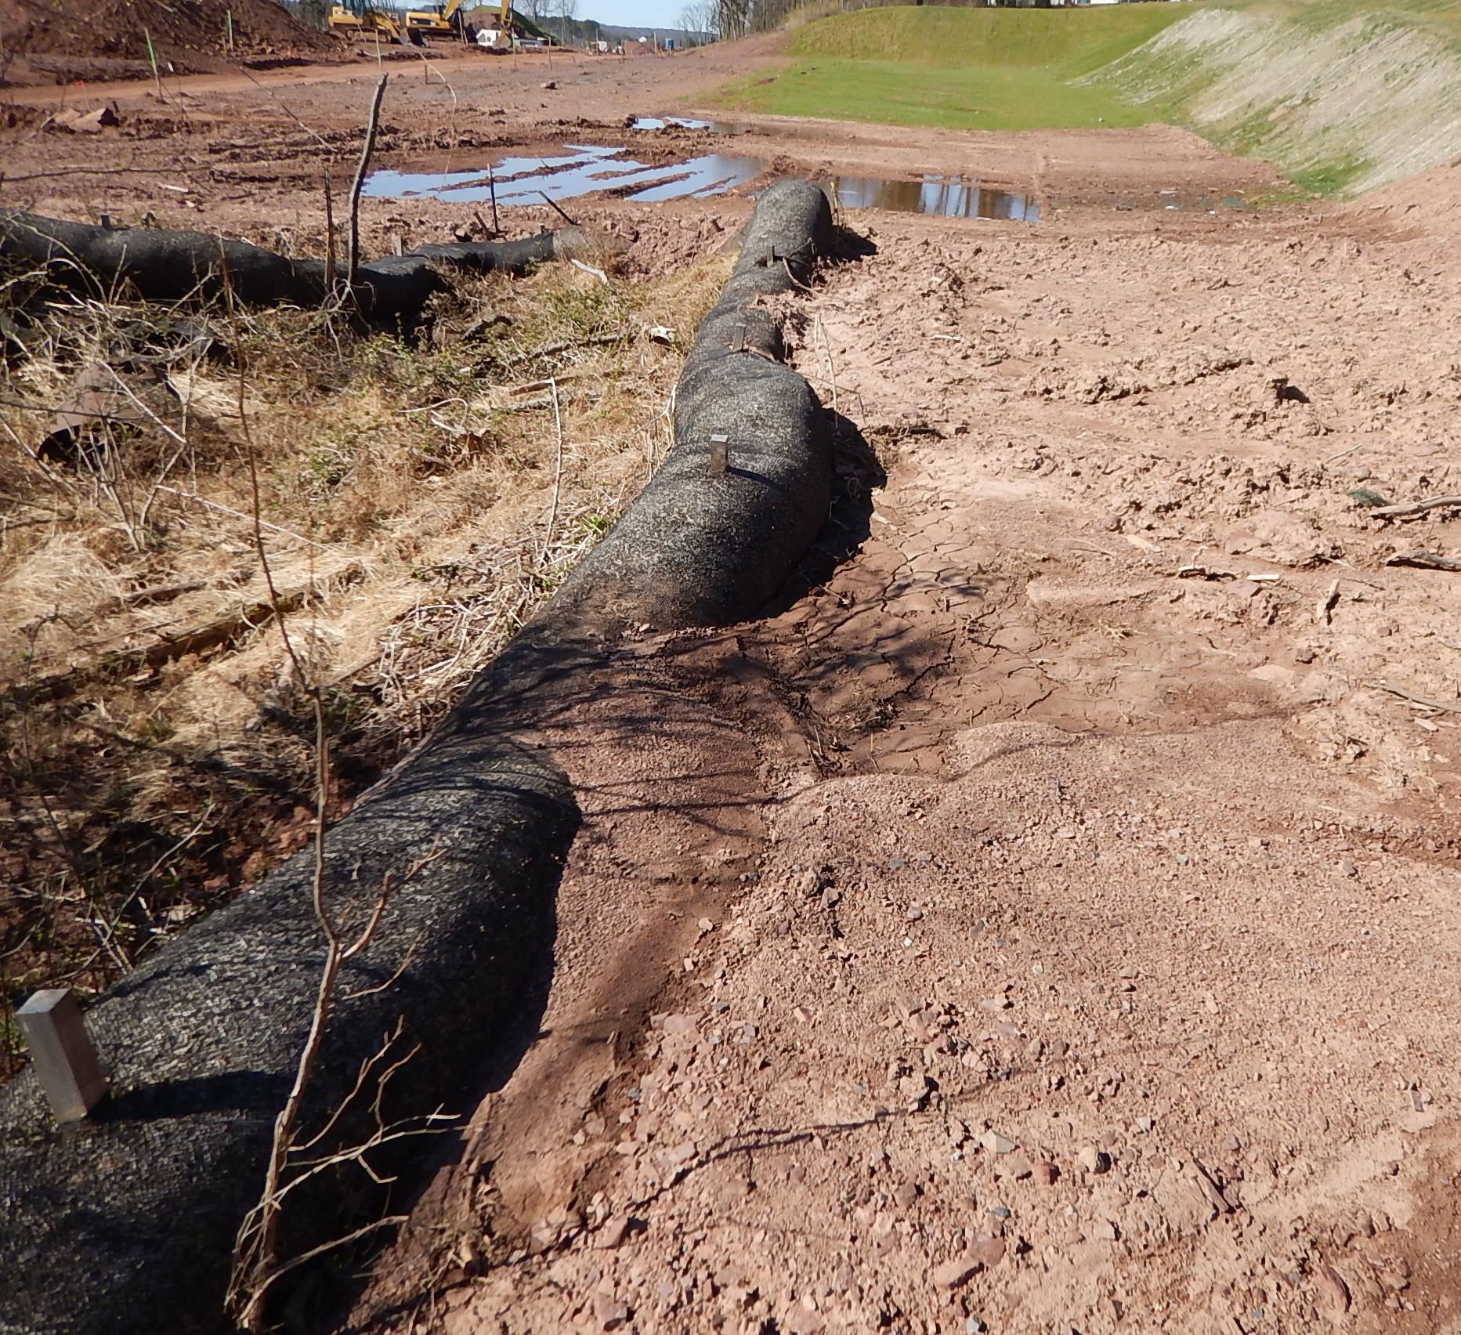
BMP/SCM Corrective Actions
The permittee shall repair or replace any E&S BMP or PCSM SCM within 24 hours of discovery by the permittee, co-permittee, an operator co-permittee, or DEP/CCD to effectively control pollution unless otherwise extended by DEP/CCD in writing.
However, in cases where the reduction, loss or failure of the BMP/SCM is causing or is likely to cause pollution, repair or replacement should still be addressed immediately upon discovery.
Notes:
DEP has clarified the standard in the 2024 PAG-02 that the permittee must complete the repair or replacement within 24 hours if the loss of the BMP or SCM has resulted in or is likely to result in pollution, or within 7 days if pollution is not likely. In either case, the time to complete the repair or replacement may be decreased or increased by DEP or the County Conservation District. An extension would typically be documented in an inspection report but can also be handled other ways including email. The 2019 version indicated that “immediate action” must occur, but that timeframe was not clear.
DEP or Conservation District staff will use their discretion to determine whether the repair can be completed within 24 hours or not.
For example, as shown in the picture, if on Monday a large storm damages a compost filter sock BMP and an inspector observes the condition on Friday, this could be considered non-compliance. That said, in cases where the reduction, loss, or failure of the BMP or SCM is causing or is likely to cause pollution, it should be repaired or replaced immediately. For example, if a sediment filter bag is ripped, dewatering should cease immediately until the bag can be replaced. It is recommended that whenever possible, extra supplies should be kept on-site.

Slide 15
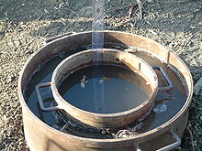
Confirmation Testing for Infiltration
For infiltration-based SCMs, post-construction testing is required when:
Infiltration area has not been protected
E&S BMP will be converted for infiltration purposes
Must be overseen by a licensed professional or designee
Should be conducted after major earthwork is complete, after permanent stabilization of the SCM’s drainage area, and prior to placing soil media or stone for E&S conversion to PSCM
Effective December 8, 2025
Notes:
The 2024 PAG-02 contains a more detailed requirement concerning post-construction testing of infiltration-based SCMs as compared to the 2019 PAG-02.
Testing is necessary anytime the area of an infiltration SCM has not been protected, or an E&S BMP will be converted to a PCSM SCM and used for infiltration, such as a sediment basin that is converted to an infiltration basin.
This testing must be overseen by a licensed professional or designee.
Construction confirmation testing for infiltration capacity may be performed by either 1) a simulated runoff test using a ponding depth of no less than 6 inches within the SCM; 2) inspection during and after a storm event that produces a ponding depth of no less than 6 inches within the SCM; or 3) infiltration testing using acceptable methods from the Pennsylvania Stormwater BMP Manual, as amended and updated. The testing or inspection must be performed after major earthwork is complete, after permanent stabilization of the SCM’s drainage area and where an E&S BMP is being converted to a PCSM SCM, prior to placing soil media or stone in an SCM.
[CLICK] This requirement becomes effective one year following the effective date of the PAG-02 or December 8, 2025.

Slide 16
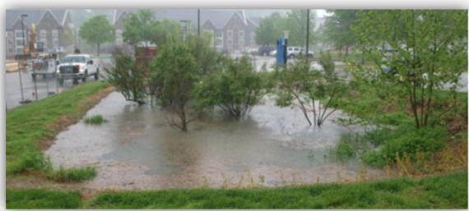
Confirmation Testing for Infiltration
Corrective action will be necessary prior to completion of the SCM if the licensed professional determines the SCM will not function as designed.
Results are submitted with the SCM Construction Certification Form.
Notes:
In the event the licensed professional determines that the SCM will not function as designed, the permittee must implement corrective measures under the direction of the licensed professional and retest, prior to completion of the SCM. If the license professional recommends changes to the dimensions, location, or type of SCM, the permittee must notify DEP/CCD prior to implementing the changes.
These requirements can be reviewed in Part C of the PAG-02 General NPDES Permit.
The results of this testing must be submitted with the SCM Construction Certification Form starting December 8, 2025.

Slide 17
Forms
Existing Requirements with a New Form:
New
Requirements:
Erosion Potential Analysis
Annual Report
SCM Construction Certification Form
New Property Owner Notification Form
Notes:
Several forms have been updated or created with the 2024 PAG-02 reissuance. One of these forms, the Erosion Potential Analysis, is new, however the concept has been an existing requirement, which is the completion of an off-site discharge analysis when necessary. The PAG-02 renewal also introduced new requirements and their respective forms such as the Annual Report, SCM Construction Certification Form and the New Property Owner Notification Form.
All of these forms became effective on December 8, 2024.

Slide 18
Additional Updates
Authorized Non-Stormwater Discharges
Clarifying requirements around imported fill and soil/groundwater contamination
Permit Module Updates
E&S Module 1
PCSM Module 2
Various Form/Instruction Updates
Notes:
Other updates or changes DEP has made to the PAG-02 include listing the specific non-stormwater discharges that are authorized with earth disturbance. This is consistent with other DEP stormwater general permits and includes but is not limited to discharges of air condition condensate, noncontact cooling water, pavement wash water, external building washdown, and uncontaminated groundwater.
DEP has also provided clarification on requirements regarding imported fill and the discovery of soil and groundwater contamination during construction. For more information regarding authorized non-stormwater discharges and imported fill, check out the Clean Water Academy PAG-02 course.
E&S Module 1 and PCSM Module 2 have also been updated with the 2024 PAG-02 reissuance.
Lastly, there have been general updates to the various forms and their instructions.

Slide 19
Summary
Several changes have been made to the PAG-02
Some of these changes are brand new while others are clarifications or modifications
Notes:
In summary, we have reviewed some of the substantial differences between the 2019 and 2024 PAG-02 General Permit.
Some of the changes to the 2024 PAG-02, such as the need to submit annual reports, are brand new, while others, such as the timing of legal instrument recording and the inclusion of EPA’s technology-based standards, are clarifications or modifications of requirements that were part of the 2019 PAG-02 General Permit.

Slide 20
Get In Touch
Robert J. Jevin III, P.E.
Environmental Group Manager
Waterways & Wetlands Program | Permitting Section
Department of Environmental Protection | Northeast Regional Office
2 Public Square | Wilkes-Barre, PA 18701
Phone: 570.830.3093
rojevin@pa.gov
www.dep.pa.gov
The Department of Environmental Protection’s mission is to protect Pennsylvania’s air, land and water resources and to provide for the health and safety of its residents and visitors, consistent with the rights and duties established under the Environmental Rights Amendment (Article 1, Section 27 of the Pennsylvania Constitution).
Notes:
(To be filled out by whoever is giving the presentation)

Slide 21
Brief Introduction to
Clean Water Academy (CWA)
Robert Jevin, P.E., Permits Chief
DEP Northeast Regional Office
Waterways & Wetlands Program
03/12/2025
JOSH SHAPIRO, GOVERNOR | JESSICA SHIRLEY, ACTING SECRETARY

Slide 22
How to Access CWA
Go to https://pacleanwateracademy.remote-learner.net/
From the “Home” tab, you can access the full course catalogue or various training programs organized by program area or topic.
From the “Find Learning” tab, you can jump right into various featured courses, which can be organized and filtered by experience level or focus area.
By creating an account, you can even track your progress and store completion certifications for trainings that your or staff have completed.

Slide 23
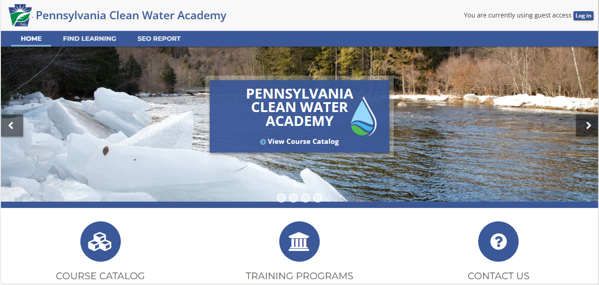

Slide 24
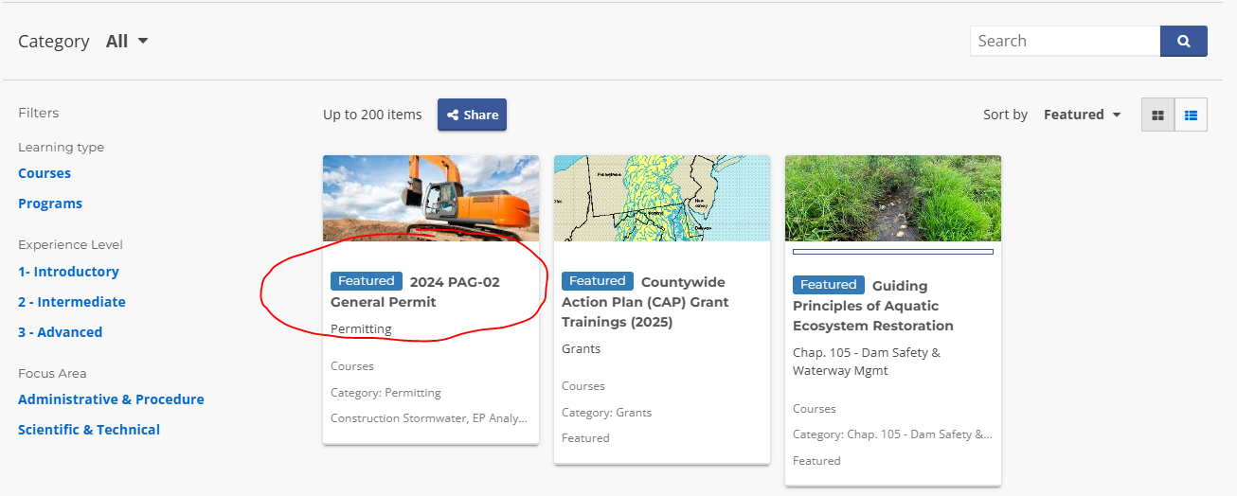

Slide 25
Get In Touch
Robert J. Jevin III, P.E.
Environmental Group Manager
Waterways & Wetlands Program | Permitting Section
Department of Environmental Protection | Northeast Regional Office
2 Public Square | Wilkes-Barre, PA 18701
Phone: 570.830.3093
rojevin@pa.gov
www.dep.pa.gov
The Department of Environmental Protection’s mission is to protect Pennsylvania’s air, land and water resources and to provide for the health and safety of its residents and visitors, consistent with the rights and duties established under the Environmental Rights Amendment (Article 1, Section 27 of the Pennsylvania Constitution).

