Slide 1
CHRISTIANITY INCORPORATED PRESENTS
THE EIGHT LAWS OF HEALTH FOR TODAY
PART 2
Notes:
#

Slide 2
8 LAWS OF HEALTH FOR TODAY
1. Nutrition 2. Exercise 3. Water 4. Sunshine 5. Temperance 6. Air
7. Rest 8. Trust in God
Notes:
A lot has changed since these Laws of Health were given to us in the 1800s by Ellen G. White. We have a multitude of mostly negative things that are affecting our health, especially in the last 20 years. We were informed by Mrs. White about the negative effects of the drug system which is now beyond belief and about the health issues with meat, especially red meat and processed meat (which we went over last time I spoke about health.) I found that to go over all 8 in one session we would need to be here quite a while- that is how much has changed from the 1800s. Today, I will focus on summarizing number 1- Nutrition. To do it justice it would take all day.

Slide 3
Life Expectancy in the United States (CDC)
2019: 78.8 years 2022: 77.5 years
Comparable countries to the U. S. 2022: 82.2
Every state in the United States falls below comparable countries.
Notes:
What’s wrong. Well, part of it is nutrition, or lack of it. It’s what we are eating. How can we live longer with nutrition? There are several things to consider. (Explain not to try to make changes all at once.)……………

Slide 4
Review of Nutrition
Best Diet- Genesis 1:29, 3:18- Fruits/Grains/Nuts/Legumes/Vegetables
Avoid Aspartame & Other Artificial Sweeteners- present in more than 6 thousand products.
Limit/Eliminate Refined Foods of all Kinds ie white bread/rice/sugar/flour, bagels, cakes, waffles, sports drinks, breakfast cereals, etc.
Notes:
Fruits/Grains/Nuts/Legumes/Vegetables Best- REFINED FOODS: The American Heart Association links these foods to medical conditions such as diabetes, obesity, cardiovascular disease, insulin resistance and inflammatory disorders.”

Slide 5
Food Revolution Network
“But according to Consumer Reports brown rice had 80% more arsenic than white rice. Arsenic, along with many valuable nutrients, tends to collect in Rice’s brown outer hull.”
Lindsay Oberst, Arsenic in Rice, How Concerned Should You Be? https://foodrevolution.org/blog/arsenic-in-rice/ March 2, 2018

Slide 6
Arsenic
“Does arsenic affect your health? Arsenic is a known human carcinogen associated with skin, lung, bladder, kidney, and liver cancer. Long-term exposure to arsenic, even at lower levels, can increase the risk of other types of chronic disease. Arsenic can affect a broad range of organs and systems including: • Cardiovascular system • Endocrine system • Immune system • Liver, kidney, and bladder.” https://www.niehs.nih.gov/sites/default/files/health/materials/arsenic_and_your_health_508.pdf October 2023
Notes:
Why is brown rice worse than white rice? The Hull- cut off on white rice. Get Brown basmati rice from California, India, or Pakistan- 1/3 less Arsenic (Consumer Reports)…………………………

Slide 7
Review of Nutrition Continued
Avoid Refined Sugar
Avoid Table Salt
Best Food in order: Fresh/Frozen/Canned/Dried
Limit Processed Foods
Limit Fried Foods/Restaurant Oils
Avoid Genetically Modified Food
Notes:
The American Heart Association explains that refined sugars also raise triglyceride levels and may increase your risk of fatty liver disease, cardiovascular problems such as coronary disease and Type 2 diabetes.” Fruit Juice- Diabetes Table Salt- The table salt or common salt that is found on the supermarket shelf contains only 2 minerals- sodium & chloride. This is a harsh salt and a dangerous salt because it causes an electrolyte imbalance by bringing sodium into the body in an unbalanced way. Sea Salt- 82-92 minerals- get Celtic/Himalayan/Real Salt- mines in Salt Lake City. PROCESSED FOODS:About 678,000 Americans die each year from chronic food illness. That toll is higher than all our combat deaths in every war in American history—combined. That’s right: there are more deaths each year from our food than all the combat deaths from the Revolutionary War through the wars in Afghanistan and Iraq. LIMIT FRIED FOODS- abundance of Omega 6 oils RESTAURANT OILS- FRIED CHICKEN/FRENCH FRIES ETC

Slide 8
The Truth About Restaurant Oil
“In conclusion, oil changes can cost a restaurant hundreds of dollars each month, depending on the size of the fryer. While many owners believe that changing the oil in the fryer once per week is sufficient, most foodservice experts agree that the fryer requires daily maintenance to keep it clean and operating at peak efficiency.”Jeff Smith, What Oils Do Restaurants Use? https://restaurantsuperstar.com/what-oils-do-restaurants-use/ January 10, 2024
Notes:
What are the best oils?

Slide 9
Best Oils to Use Are:
Olive Oil, Avocado Oil, Coconut Oil
Notes:
Vvproduce.com (Valley View) Olive Oil- good for sauteing and light frying- has a low smoking point of 325-375. Coconut Oil is 350, 450 if refined (used when coconut flavoring is wanted- high in saturated fat) and Avocado Oil is 480-520 (Expensive)

Slide 10
EWG’s Dirty Dozen/Clean 15
Pesticides In Produce
Dirty Dozen Clean 15
1. Strawberries 8. Apples 1. Avocados 9. Kiwi
2. Spinach 9. Bell/Hot Peppers 2. Sweet Corn 10. Cabbage
3. Kale, Collard, & Mustard Greens 3. Pineapple 11. Mushrooms
4. Grapes 10. Cherries 4. Onions 12. Mangoes
5. Peaches 11. Blueberries 5. Papaya 13. Sweet Potatoes
6. Pears 12. Green Beans 6. Sweet Peas 14. Watermelon
7. Nectarines 7. Asparagus 15. Carrots
8. Honeydew Melon
Notes:
Environmental Working Group

Slide 11
Review of Nutrition Continued
Avoid Refined Sugar
Avoid Table Salt
Best Food in order: Fresh/Frozen/Canned/Dried
Limit Processed Foods
Limit Fried Foods/Restaurant Oils
Avoid Genetically Modified Foods
Notes:
The American Heart Association explains that refined sugars also raise triglyceride levels and may increase your risk of fatty liver disease, cardiovascular problems such as coronary disease and Type 2 diabetes.” Fruit Juice- Diabetes Table Salt- The table salt or common salt that is found on the supermarket shelf contains only 2 minerals- sodium & chloride. This is a harsh salt and a dangerous salt because it causes an electrolyte imbalance by bringing sodium into the body in an unbalanced way. Sea Salt- 82-92 minerals- get Celtic/Himalayan/Real Salt- mines in Salt Lake City. PROCESSED FOODS:About 678,000 Americans die each year from chronic food illness. That toll is higher than all our combat deaths in every war in American history—combined. That’s right: there are more deaths each year from our food than all the combat deaths from the Revolutionary War through the wars in Afghanistan and Iraq. LIMIT FRIED FOODS- abundance of Omega 6 oils RESTAURANT OILS- FRIED CHICKEN/FRENCH FRIES ETC……………………..

Slide 12
Avoid Foods That Are Irradiated
Cookware: Bad- Non-stick, Aluminum & Copper
Good- Stainless Steel & 100% Ceramic
Limit Microwaves & Don’t Stand Near It
Limit Plastics
Notes:
“Bisphenols and phthalates in our food are concerning for several reasons. To start, growing research shows that they are endocrine disruptors, which means that they can interfere with the production and regulation of estrogen and other hormones. Even minor disruptions in hormone levels can contribute to an increased risk of several health problems, including diabetes, obesity, cardiovascular disease, certain cancers, birth defects, premature birth, neurodevelopmental disorders, and infertility. The 7 types of plastic……….

Slide 13
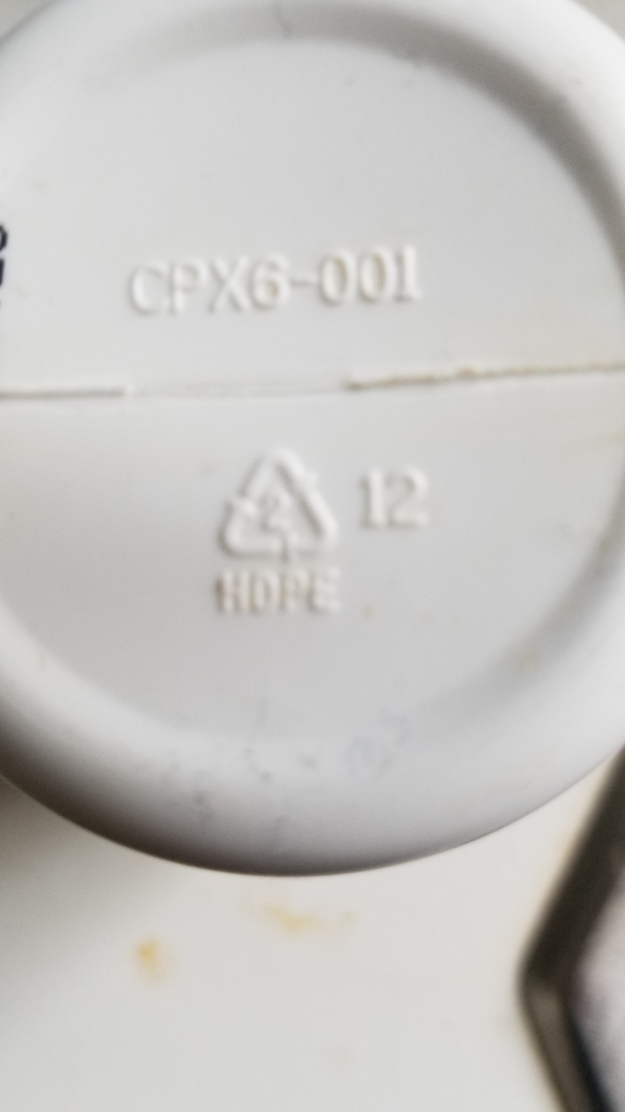
Notes:
#

Slide 14
Different Kinds of Plastic Container’s
#1- Polyethylene terephthalate, also known as PETE or PET (Polyester) in disposable food/water containers and bottles. Considered fairly safe except where it is heated. If heated it can cause carcinogens to leach into any liquid. Also, it is porous and flavorings as well as bacteria can get into it which would cause disease. Do not reuse these containers.
#2- High-density Polyethylene or HDPE. Most detergent and juice bottles, butter containers, milk jugs, and toiletries containers. Considered safe- leaching risk is low.
#3- Polyvinyl Chloride or PVC. Considered unsafe for heating. Affects your hormones- contains Pthalates. Do not use this plastic wrap for cooking.
#4- Low-density Polyethylene. Used to make grocery bags, bread bags, squeezable bottles, some food wraps. Considered relatively safe.
https://www.nontoxicrevolution.org/blog/7-types-of-plastic
Notes:
From nontoxicrevolution.org. Look at the plastic containers and find a triangle with a number in the center of it. Number 1: Water/juice/soda and other liquid bottles- summer heat- trucks- becomes carcinogenic. Okay for products that are refrigerated. What about Bottled Water: All have #1 on the bottle- all are transported in trucks with no AC. Lately inside those trucks could reach 100 degrees and more. That means Pthalates, carcinogens are leaching into your water. They come to the local grocery store- placed on the shelves- bought by you- cancer-causing. The enemy- has 3 ways to kill us with toxins- through our food- water- air (Child leaves a water bottle with water in a heated car in the summer). Number 2: As above. Number 3: PVCs used in plastic wrap, piping, gloves, raincoats, to name a few. Especially don’t use plastic wrap in a microwave oven (vibrating back and forth and transferred into the food.) Recommendations……………………..

Slide 15
#5 Polypropylene. Items produced with it include yogurts, ketchup containers, wares in the kitchen, microwave safe containers- which aren’t safe to eat from when cooked in a microwave. (Plastics can still be transferred to the foods. Best to microwave in glass containers.) Generally safe except when put in a microwave.
#6 Polystyrene (Styrofoam). Most disposable food containers made from it as well as packaging. Toxic chemicals from it leach into food. Avoid it!
#7 Everything Else- some products have polycarbonate which includes BPA. Food products in this category should be avoided.
Bree Flory, “The 7 Types of Plastic & What They Mean to Your Health” https://www.nontoxicrevolution.org/blog/7-types-of-plastic
Notes:
Summary- plastics in 2, 4, 5 generally considered safe. #3, 6, 7 should be avoided. #1- in the most foods/drinks should be limited.

Slide 16
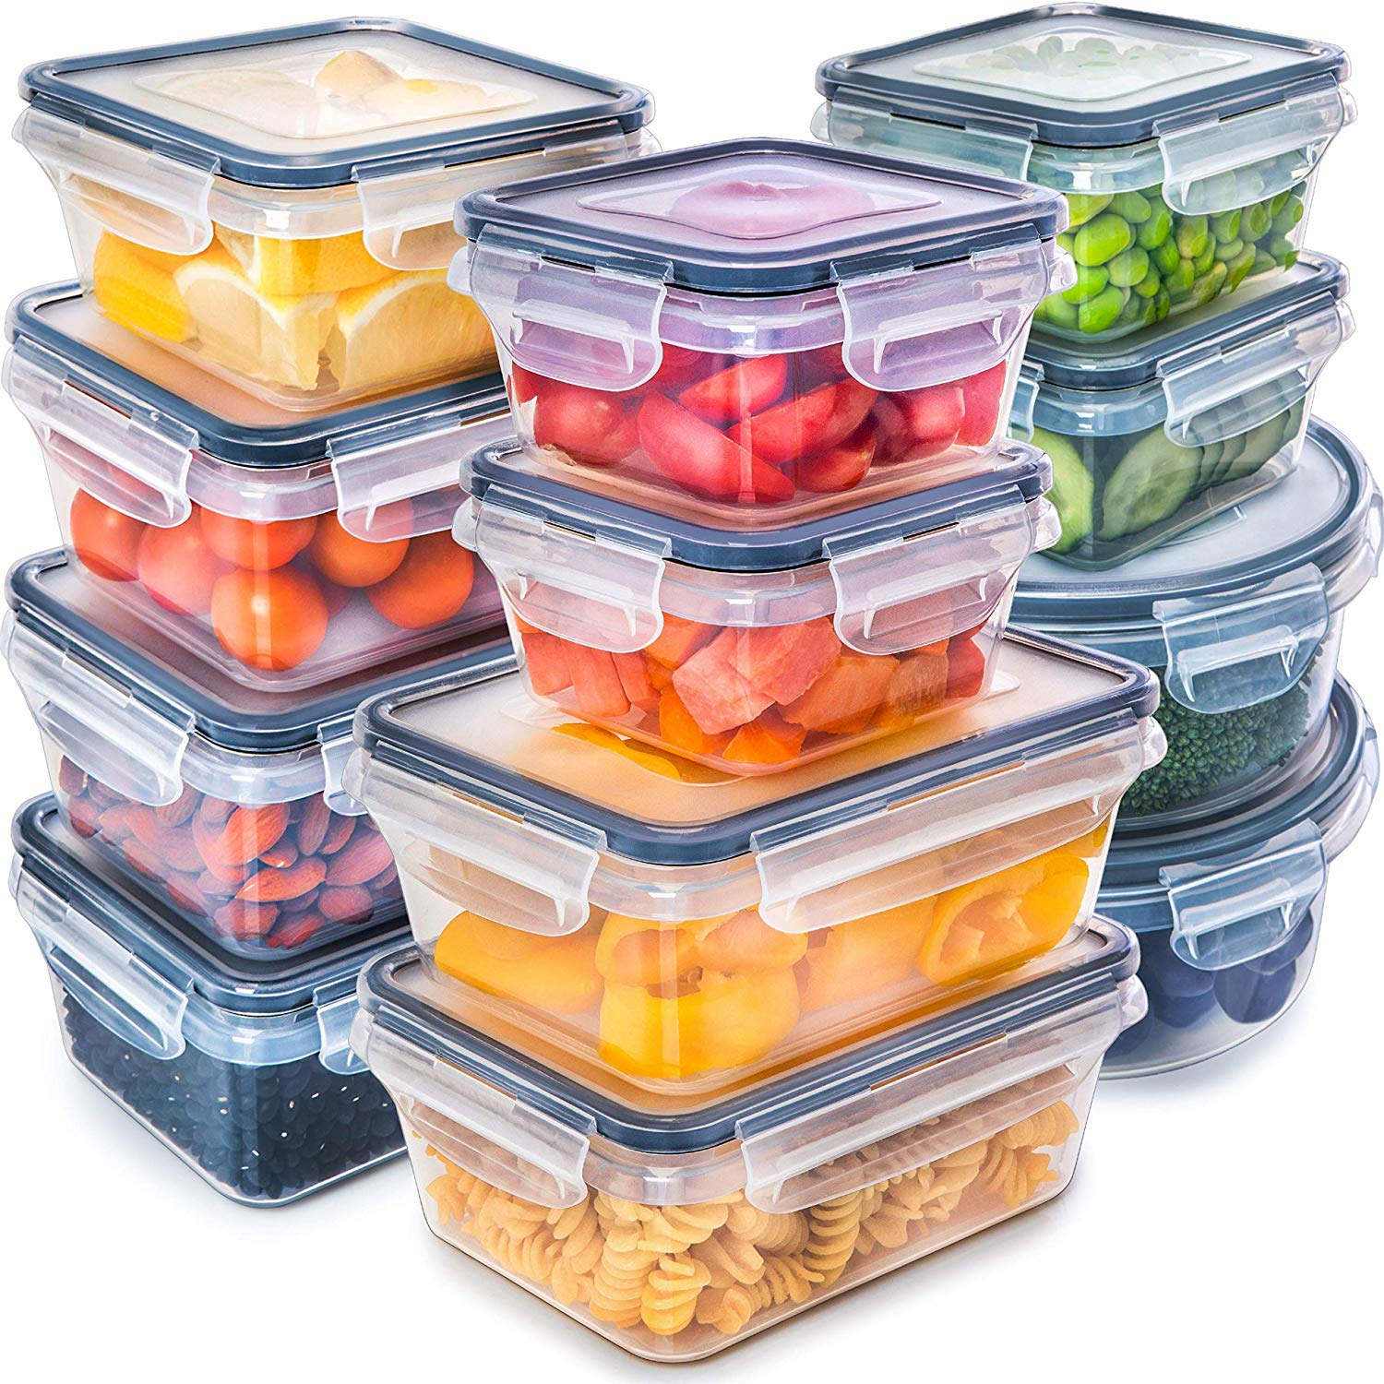
Notes:
Glass containers with plastic tops. Don’t completely fill them and nothing will touch plastic. If it is not heated in any way it should be ok. The best……………..

Slide 17
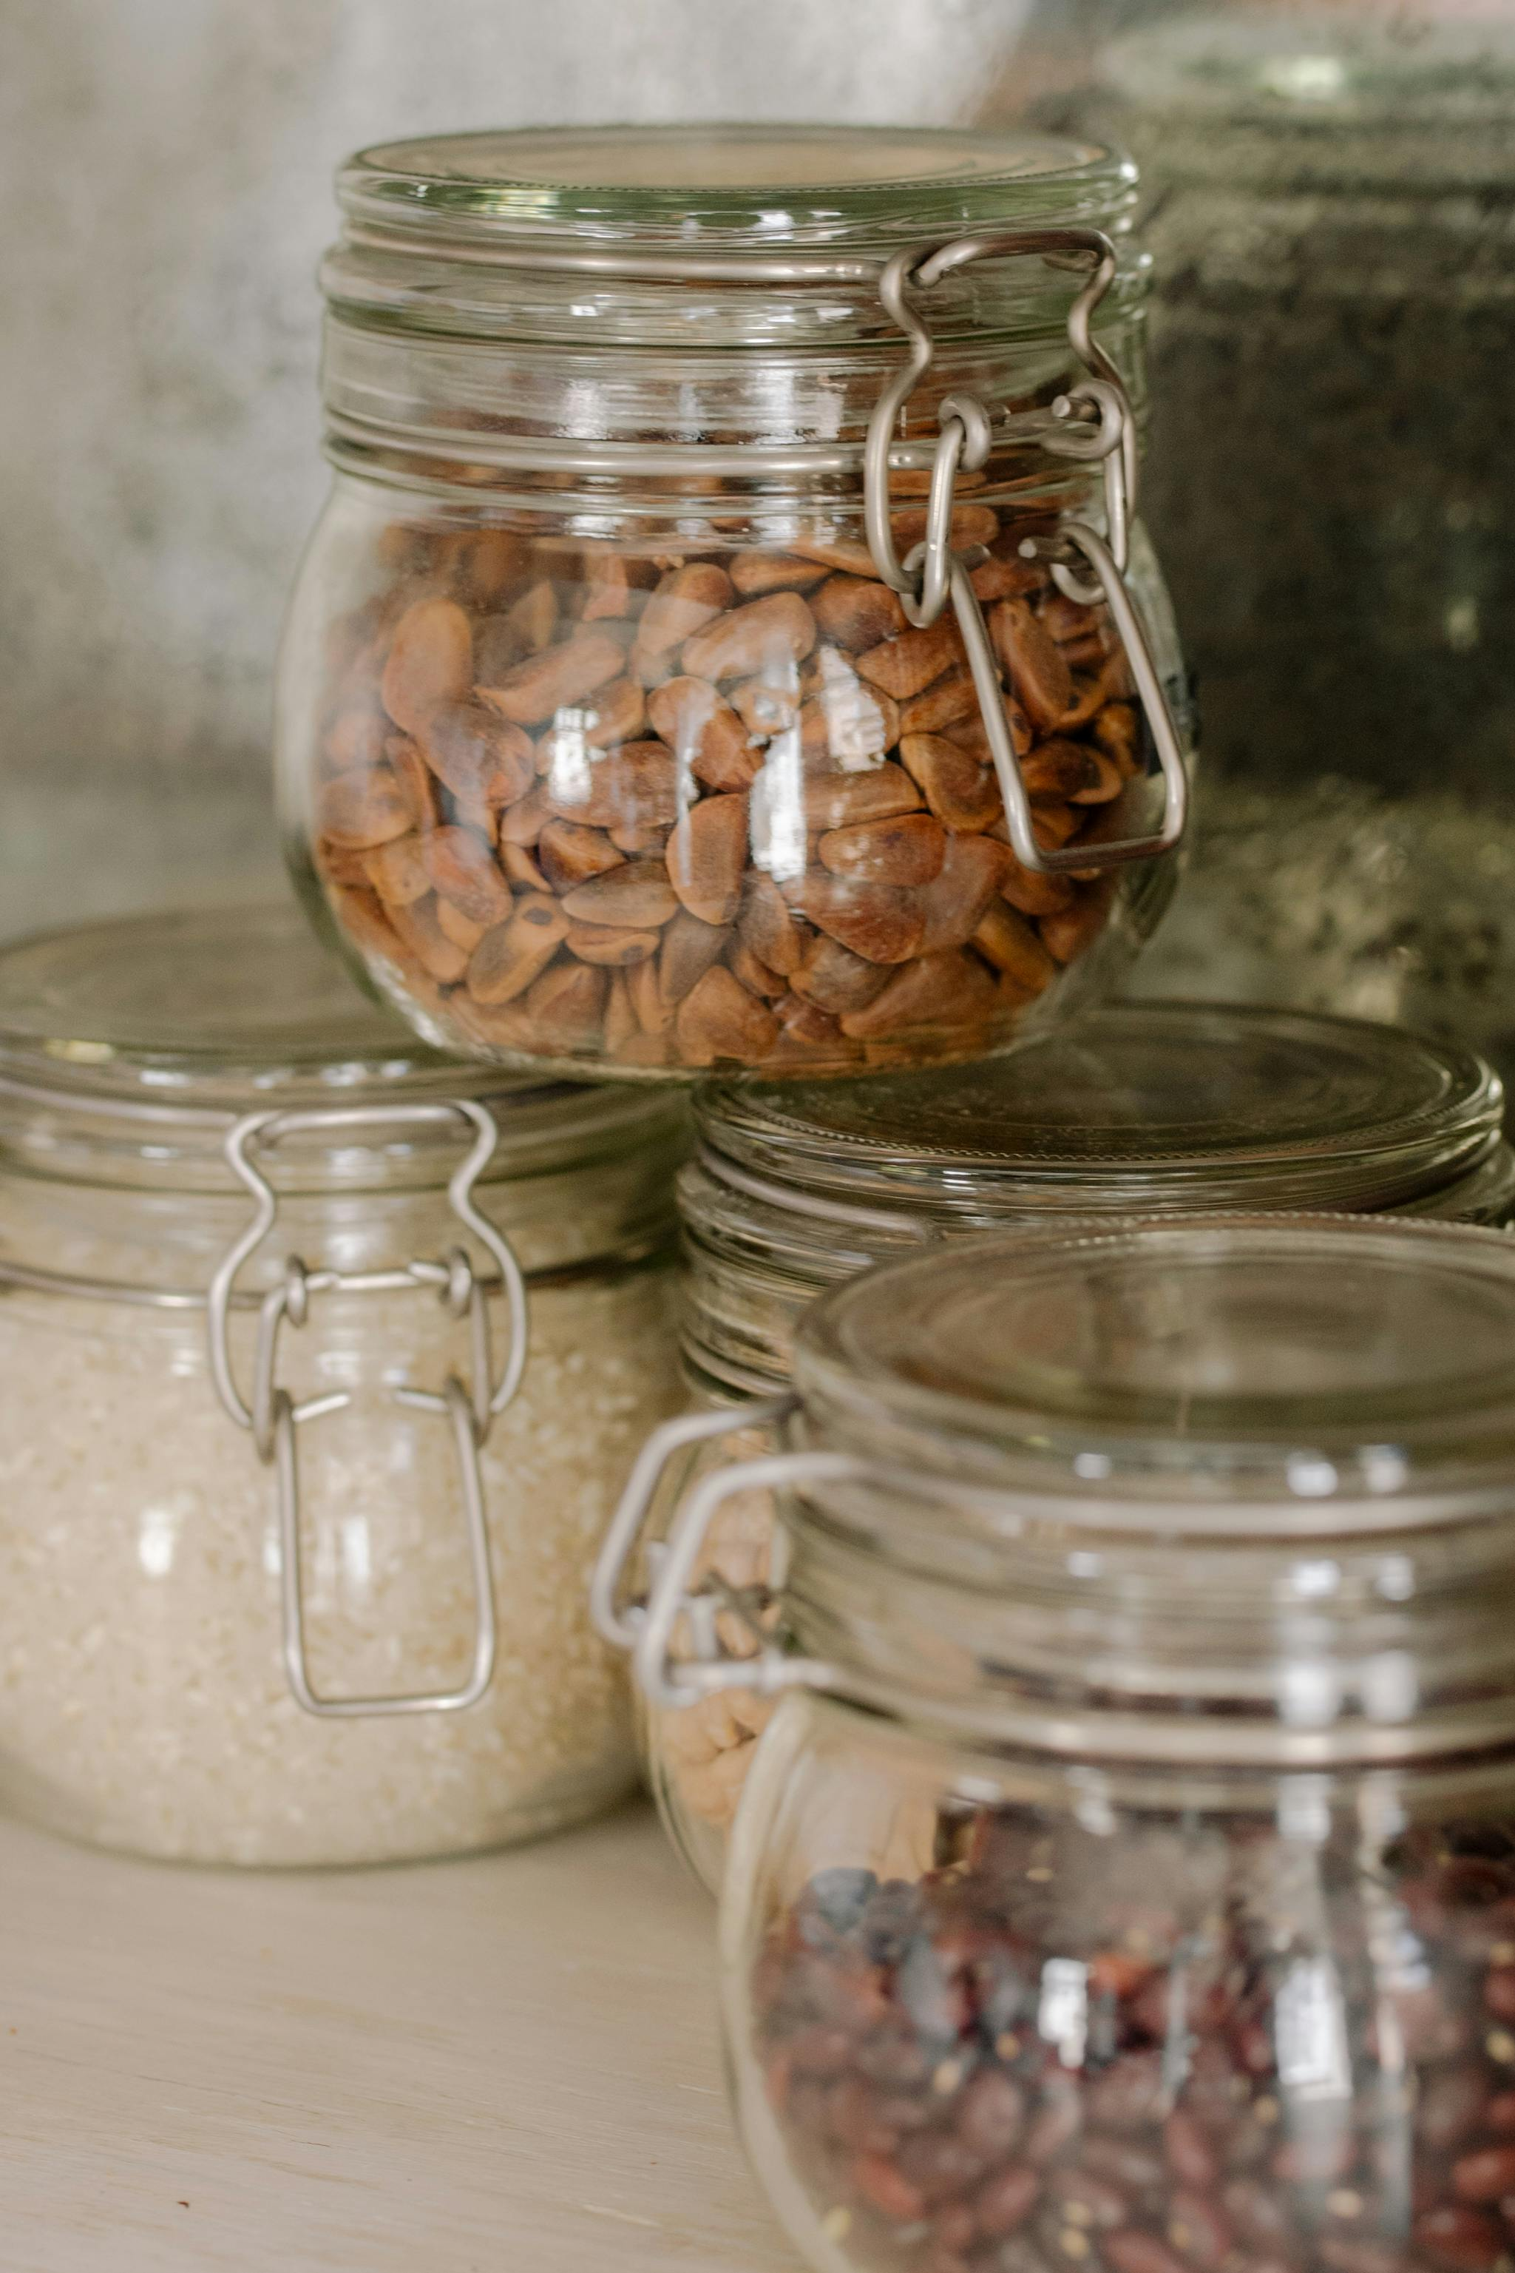
Notes:
If you or someone you know is very sick and has been unable to get well try this………………….

Slide 18
GO GLUTEN, DAIRY, AND PROCESSED SUGAR FREE!
After everything else has been tried and nothing worked this has given a lot of people success!
Notes:
These are the ones that cause the most problems. You should begin detoxing. After a while, once the body resets from this you may be able to add some foods back in one at a time and see if it affects you………………..

Slide 19
Additional
One food processor, Tyson Foods, dumps 87 billion gallons of toxic waste, including cyanide, blood, and feces into U.S. rivers and lakes- enough to fill 132,000 Olympic-size pools. The meat processing giant released 186,000 tons= 372 million pounds of toxic chemicals from 41 factories into rivers and lakes between 2018 & 2022 across 17 states.
*Scientists were only able to count discharges from a third of its factories because most meat processing plants do not have to report figures.
*The chemicals have been linked with cancer, blood disorders, thyroid disease, and brain defects in children.
Daily Mail- dailymail.co.uk
Notes:
But this study by the Union of Concerned Scientists looked at just 2% of meat processing plants nationwide leaving the total terrifyingly uncertain. “As a multibillion-dollar company, Tyson can treat even hefty fines and penalties for polluting the environment as simply the cost of business its way”. The over 5000 meat and poultry processing plants in the United States, but only a fraction are required to report pollution and abide by limits……………….

Slide 20
Additional
Cassava Flour- Testing has found high amounts of lead in this staple of health foods.
Do not buy!
Lead Safe Mama Website tamararubin.com
Since July of 2022- responsible for 5 product recalls by the FDA
Best Puffs: Once Upon A Farm Organic Fruit and Veggie Puffs
Notes:
Lesser Evil & Serenity Kids Cassava Based Puffs found with high lead- Simple Mills Crackers- loaded with Cassava- my story. #Best Puffs “Once Upon A Farm Organic

Slide 21
8 LAWS OF HEALTH FOR TODAY
1. Nutrition 2. Exercise 3. Water 4. Sunshine 5. Temperance 6. Air
7. Rest 8. Trust in God
Notes:
Next is Exercise………………

Slide 22
THE TOP 10 BENEFITS OF REGULAR EXERCISE
Arlene Semeco, https://www.healthline.com/nutrition/10-benefits-of-exercise#muscles-and-bonesberNovem13,2023
1. Exercise Can Make You Feel Happier
“2019 Review: 10 to 30 minutes of exercise is enough to improve your mood.”
“A 2017 Review found that active people who stopped exercising regularly experienced significant increases in symptoms of depression and anxiety, even after only a few weeks.”
Notes:
Exercise increases the hormones Serotonin and Norepinephrine which can relieve feelings of depression- increase endorphins

Slide 23
2. Helps With Weight Management
3. Good For Your Muscles and Bones
4. Can Increase Energy Levels
5. Can Reduce Your Risk of Chronic Disease of All Kinds
6. Can Help Skin Health
7. Can Help Brain Health & Memory
8. Can Help With Relaxation & Sleep Quality
9. Can Reduce Pain
10. Can Promote A Better Sex Life
Arlene Semeco, https://www.healthline.com/nutrition/10-benefits-of-exercise#muscles-and-bonesberNovem13,2023
Notes:
Weight Management: regular exercise may increase your metabolic rate which can burn more calories and help you to maintain your weight. Muscles & Bones- Exercise- reduces bone/muscle loss- can keep your muscles and bones strong as you age- otherwise you can get frail- bad sign. Energy Levels- the movement of exercise, especially aerobic, has great benefits for your heart as it moves oxygen into the blood more effectively which increases your energy and benefits your lung function as well. Chronic Disease- all kinds. Skin Health- mainly helps deter skin aging. Brain Health- increases blood flow and oxygen to the brain. Relaxation & Sleep Quality- Takes away stress- gets you more tired so you can sleep better. Can Reduce Pain- studies have shown that aerobic exercise can help reduce pain. Better Sex Life- aerobic exercise may help erectile function, improve sexual satisfaction, and arousal due to increased circulation. HIIT (High Intensity Interval Training)- Kerry- Barbara O’Neill. Weights to build up muscle. As you get older the body tends to use your muscle. You need muscle so you don’t become frail.

Slide 24
8 LAWS OF HEALTH FOR TODAY
1. Nutrition 2. Exercise 3. Water 4. Sunshine 5. Temperance 6. Air
7. Rest 8. Trust in God
Notes:
Next is Water…………………

Slide 25

Water
Notes:
How much water to drink- various recommendations- at least 8 cups per day. Start out with one or two first thing in the morning. After sleeping 8 hours- somewhat dehydrated- you need more water to start the day. Stop drinking ½ hour before a meal and wait up to 2 hours afterward. You do need water for digestion so drink a little about a half hour before your meal and that will help. Drink small amounts throughout the day. If you drink large amounts you will be going to the bathroom all day. Some people say their feet swell up when they drink a lot of water. The water is not getting into the cells. Tip (Barbara O’Neill)- put a small amount of Celtic, Himalayan , or Redmond Real Salt on the tongue before drinking your water- it helps the water to be absorbed and you won’t be going to the bathroom so much. Sodium is necessary to get water into the cells (Barbara O’Neill).

Slide 26
Limit Bottled Water- Especially In the Summer
The Plastic Leaches into the water in heat. If You Drink Bottled Water, There Are Ways to Do It More Safely
Don’t reuse single-use bottles. These break down more quickly than sturdier plastic bottles that are meant to be reused, and studies suggest that this microscopic damage can shed microplastics, says Susan Richardson, chemistry professor at the University of South Carolina.
Don’t let plastic water bottles get too hot. High heat can damage plastic and lead to chemicals leaching into water, especially when exposed for extended periods, Krithivasan says. So Krithivasan recommends that you not store water bottles in vehicles.
Look for purified bottled water, CR’s experts say. That typically indicates that the water has undergone filtration before being bottled.
Editor’s Note: This article also appeared in the January 2024 issue of Consumer Reports magazine.
https://www.consumerreports.org/health/bottled-water/the-problem-with-bottled-water-a9416685511/
Notes:
If you give a child a water bottle on a 95 degree day and let it sit in the car while at work what happens to it. Becomes toxic with leached chemicals. Then the child later drinks from it…………………

Slide 27
Tap Water Must Be Filtered With The Best Filters
Chlorine and Fluoride in tap water is well known. However, anything that is flushed down the drains and toilets is being found in public water as well, including hormones, blood pressure medication and other medications like Ritalin (for ADHD), narcotics, etc. At least 70 million people in this country live in areas where forever chemicals, lead and arsenic have been reported in water systems according to USA Today, May 2, 2024. If wells are within 300 feet of a field or other source, they may have chemicals, pesticides- especially Glyphosate (Great Endocrine Disruptor/Cancer Cause, etc.) in them. Check out Environmental Working Group database for toxins in your municipality water using your ZIP code. Please go to their website, EWG.org and at the top right-hand corner click on “Tap Water Database”
Notes:
For well water, research- talk to local authorities- get it tested. Best Filters to buy………………….

Slide 28
Notes:
Highly recommended by doctors. They have Aquatru themselves. Pay $20 per month on your credit card. This has 3 filters- carbon, Reverse Osmosis, and VOC- Volatile Organic Compounds/Carbon.

Slide 29
Sunshine
When the sun shines on the skin a form of cholesterol underneath the skin is converted to Vitamin D. Vitamin D can inhibit cancer cell growth. Only 10 minutes of sun on the face will give you what you need.
Notes:
I think up to 20 minutes a day is optimal. You don’t want a burn.

Slide 30
Benefits of Sunlight
1. Get Better Sleep
2. Stronger Bones
3. Helps Prevent Cancer
4. Could Lower Blood Pressure
5. Can Create a Better Mood
6. Reduces Inflammation
7. Promotes Good Mental Health
Notes:
1. Get up at the same time every day and go asap outside. It tells your body it is daylight and sets your circadian rhythm- regulates your melatonin (shuts it down due to the light)- helps with sleep as a result. 2. You can absorb Calcium and Phosphate better due to sunlight- necessary for strong bones. 3. Cancer- there is a link between low levels of Vitamin D and some cancers. 4. Believed that UV rays trigger the body (skin) to release stores of Nitrogen Oxide which dilates blood vessels- lowers Blood Pressure. 5. The Sun increases Vitamin D production which helps with your mood- lowers depression. 6. Reduces Inflammation- especially of the skin- helps with eczema, other skin conditions. 7. Helps with Mental Health. (If time- sunscreen study.)

Slide 31
8 LAWS OF HEALTH FOR TODAY
1. Nutrition 2. Exercise 3. Water 4. Sunshine 5. Temperance 6. Air
7. Rest 8. Trust in God

