Slide 1

ACT III: The Big Picture
Macro Measures
Economic Growth
Labor Markets
Savings and Consumption
Savings and Investment
Money and Monetary Policy
Aggregate Supply and Demand
Fiscal Policy

Slide 2

Macro Measures
Notes:
Y on the left always stands for all three, income, expenditures and production, but on thew right we see the different sides to GDP.

Slide 3
Macro Measures
Objective: Describe how Gross Domestic Product , the Consumer Price Index and the Unemployment Rate are used to measure macroeconomic performance.
What is Gross Domestic Product?
How do we calculate GDP, what are the shortcomings, and what are some alternatives?
What is the Consumer Price Index?
How are the CPI and inflation calculated?
What are some shortcomings of the CPI, and what are some alternatives?
What is the Unemployment Rate?
How do we calculate the Unemployment rate, what are the shortcomings, and what are some alternatives?
Notes:
Y on the left always stands for all three, income, expenditures and production, but on thew right we see the different sides to GDP.

Slide 4
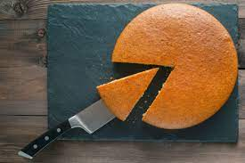
GDP – Production, Income and Expenditures
GDP: The market value of final goods and services produced within a country’s borders during a specified time period.
*GDP per capita is better measure of standard of living.
Notes:
GDP per capita is better measure of standard of living.
https://cambiocoach.com/2016/08/11/want-win-salary-negotiation-increase-size-pie/

Slide 5


Market Value
We can compare apples-to-apples, apples-to-oranges or even apples to cars using market values.
Market Value Comparisons
Notes:
https://www.publicdomainpictures.net/en/view-image.php?image=119165&picture=marcos-mantara-convertible-car

Slide 6
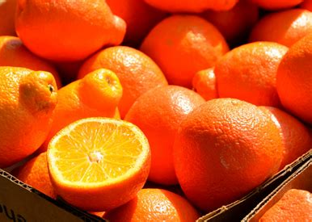
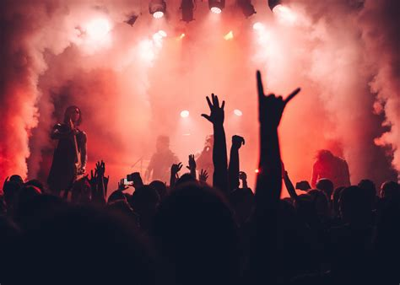
Final Goods and Services
To avoid double counting, we exclude intermediate goods and services. Goods are things that are tangible and services are things that are intangible.
Goods
Services
Notes:
https://publicdomainpictures.net/en/view-image.php?image=119008&picture=naranjas-para-la-venta
https://www.pexels.com/photo/people-in-concert-1763075/

Slide 7
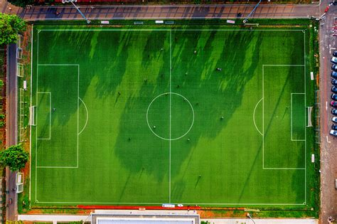
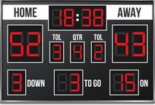
Within a Country’s Borders During a Specified Time Period
Gross National Product (GNP), is a closely related indicator, which measures everything a nation produces no matter where it produces it.
GDP excludes used or resold goods that were not produced within the specified time period. GDP is estimated quarterly.
Within the Borders
During a Specified Time Period
Notes:
https://www.pexels.com/photo/top-view-photo-of-soccer-field-during-day-3448250/
https://www.publicdomainpictures.net/en/view-image.php?image=89208&picture=football-score-board

Slide 8
GDP Components
Two different ways to account:
Income Approach:
Y = W + R + I + PR
- wages, rent, interest and profits
Expenditure Approach:
Y = C + I + G + NX
- consumption, investment, government purchases and net exports (exports – imports)

Slide 9
Simplified Circular Flow Diagram
Markets for Goods and Services
Firms
Households
Markets for Factors of Production

Slide 10
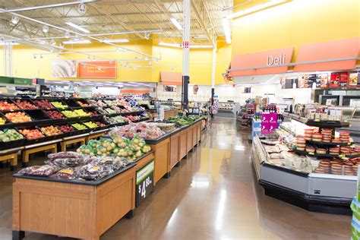
GDP Components: Y=C+I+G+NX: C = Consumption
Personal Consumption Expenditures are the goods and services purchased by persons, except for new home purchases. Persons consist of individuals, nonprofit institutions that primarily serve individuals, private noninsured welfare funds, and private trust funds. This is mostly spending by households on goods and services.
Notes:
https://pxhere.com/en/photo/898411

Slide 11
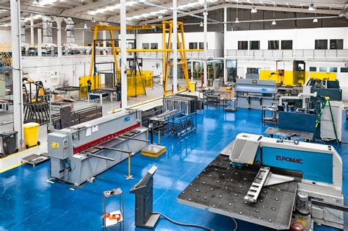
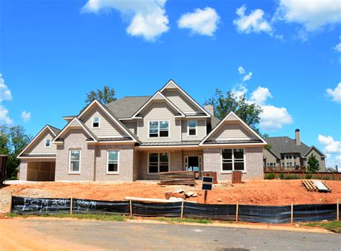
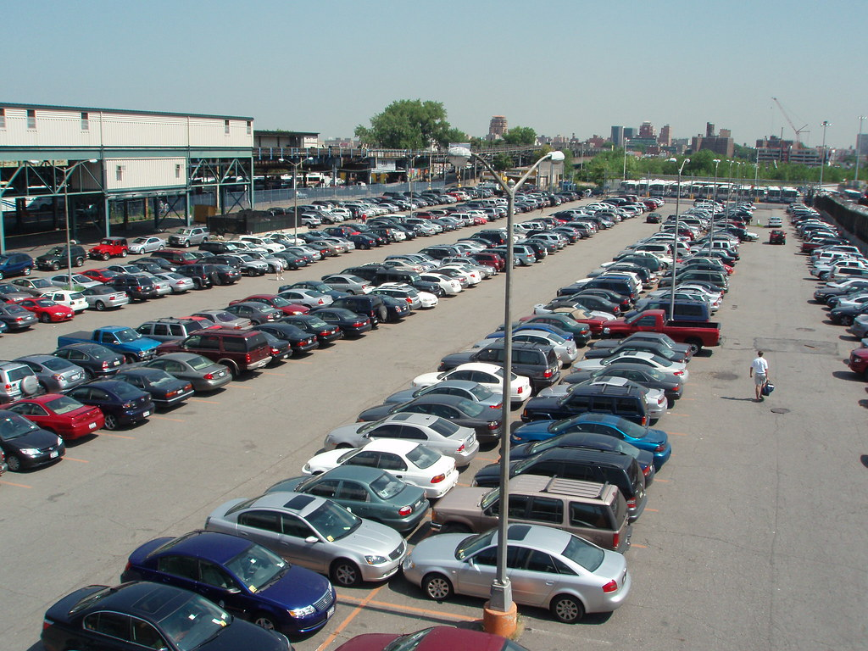
GDP Components: Y=C+I+G+NX: I = Investment
Gross private domestic investment includes Private fixed investment, including residential and nonresidential structures, and changes in private inventories.
Physical Capital
Residential Structures
Change in Inventories
Notes:
https://pxhere.com/en/photo/65832
https://www.publicdomainpictures.net/en/view-image.php?image=202647&picture=porsche-cayman-car
https://www.flickr.com/photos/alex92287/3379625639/

Slide 12
Inventories: Produce In Year 1 and Sell in Year 2
$50M
Year One: Y=C+I+G+NX
$50M
Year Two: Y=C+I+G+NX
$50M

Slide 13
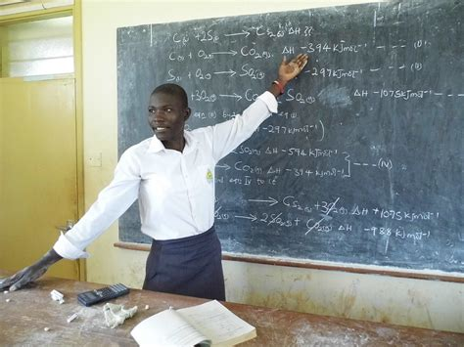

GDP Components: Y=C+I+G+NX: G = Government Purchases
The sum of government consumption expenditures and government gross investment. It is spending by local state and federal governments with the exception of transfer payments.
Salaries to Public Workers
Government assets
Notes:
https://pixabay.com/photos/school-chemistry-uganda-teacher-1589323/
https://www.goodfreephotos.com/weapons/fleet-of-navy-ships.jpg.php

Slide 14
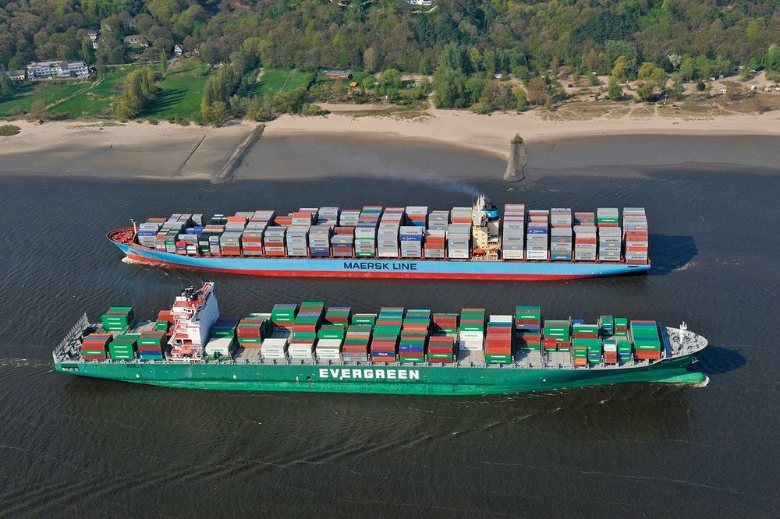
GDP Components: Y=C+I+G+NX: NX = Net Exports = Exports - Imports
Net Exports are spending on domestically produced goods by foreigners (exports) minus spending on foreign goods by domestic residents (imports).
$50
$1M
$1B
$50+$1M+$1B
Y=C+I+G+(X-M)
Notes:
https://www.spotlightmetal.com/why-2018-could-become-a-record-year-for-machine-manufacturers-a-686784/

Slide 15
How Do We Calculate GDP
We can calculate nominal or real GDP.
Nominal GDP: the production of goods and services valued at current prices.
Real GDP: the production of goods and services valued at constant prices.
We use this measure in economics when studying growth over time or comparing time periods to keep our measure consistent.

Slide 16
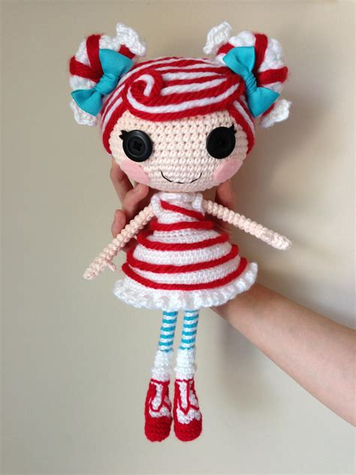

REAL VS NOMINAL
and
YEAR | $ LALALOOPSY DOLLS | # LALALOOPSY DOLLS | $ RED RYDER BB GUNS | # RED RYDER BB GUNS | NOMINAL GDP | REAL GDP Base Year = Year 1
Year 1 | $10 | 100 | $20 | 50 | $2,000 | $2,000
Year 2 | $15 | 200 | $30 | 100 | $6,000 | $4,000
Year 3 | $20 | 300 | $40 | 150 | $12,000 | $6,000
Notes:
https://www.deviantart.com/npantz22/art/LALALOOPSY-Mint-E-Stripe-Crochet-Amigurumi-Doll-396159651
https://flickr.com/photos/roaminggecko/8279527193

Slide 17


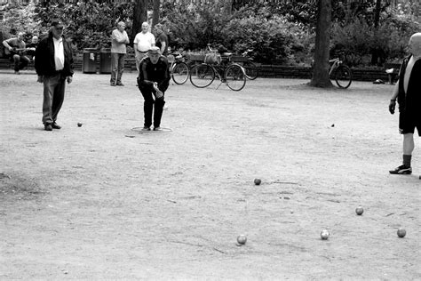
Short Comings in the Measurement GDP
Does not include:
Household Production
Underground Economy
Leisure Time
Notes:
http://www.clipartpanda.com/categories/dealer-clip-art
https://pxhere.com/en/photo/618074

Slide 18
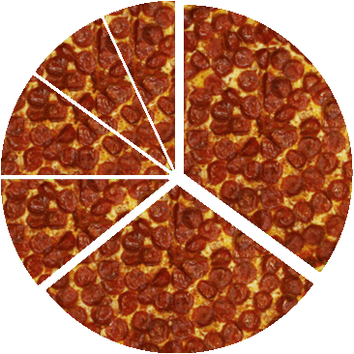



Shortcomings of GDP as a Measure of Well Being
Does not account for:
Pollution and Consequences
Crime and Social Problems
Inequality

Slide 19
Some Alternative Measures of Standards of Living
OECD Household Disposable Income – includes per capita income available to households such as wages and salaries, income from self-employment and unincorporated enterprises, income from pensions and other social benefits, and income from financial investments (less any payments of tax, social insurance contributions and interest on financial liabilities). https://data.oecd.org/hha/household-disposable-income.htm
UN Human Development Index - is a summary measure of average achievement in key dimensions of human development: a long and healthy life, being knowledgeable and have a decent standard of living. The HDI is the geometric mean of normalized indices for each of the three dimensions. https://hdr.undp.org/en/content/human-development-index-hdi
Bhutan’s Gross National Happiness Index - includes both traditional areas of socio-economic concern such as living standards, health and education and less traditional aspects of culture and psychological wellbeing. https://ophi.org.uk/policy/gross-national-happiness-index/
Gini coefficient measures the inequality among values of a frequency distribution, like levels of income.

Slide 20
CPI - Inflation
Consumer Price Index (CPI): a measure of the average change over time in the prices paid by urban consumers for a representative basket of consumer goods and services.
“Inflation is when you pay fifteen dollars for the ten-dollar haircut you used to get for five dollars when you had hair.“ Sam Ewing
Inflation: is an increase in the overall level of prices in the economy.
Hyperinflation is a term to describe rapid, excessive, and out-of-control general price increases in an economy.
Core Inflation: Inflation minus food and energy.
These categories are often subject to large shocks and can distort the picture with increased volatility.
Notes:
CPI Data Sources
https://www.bls.gov/opub/hom/cpi/data.htm

Slide 21
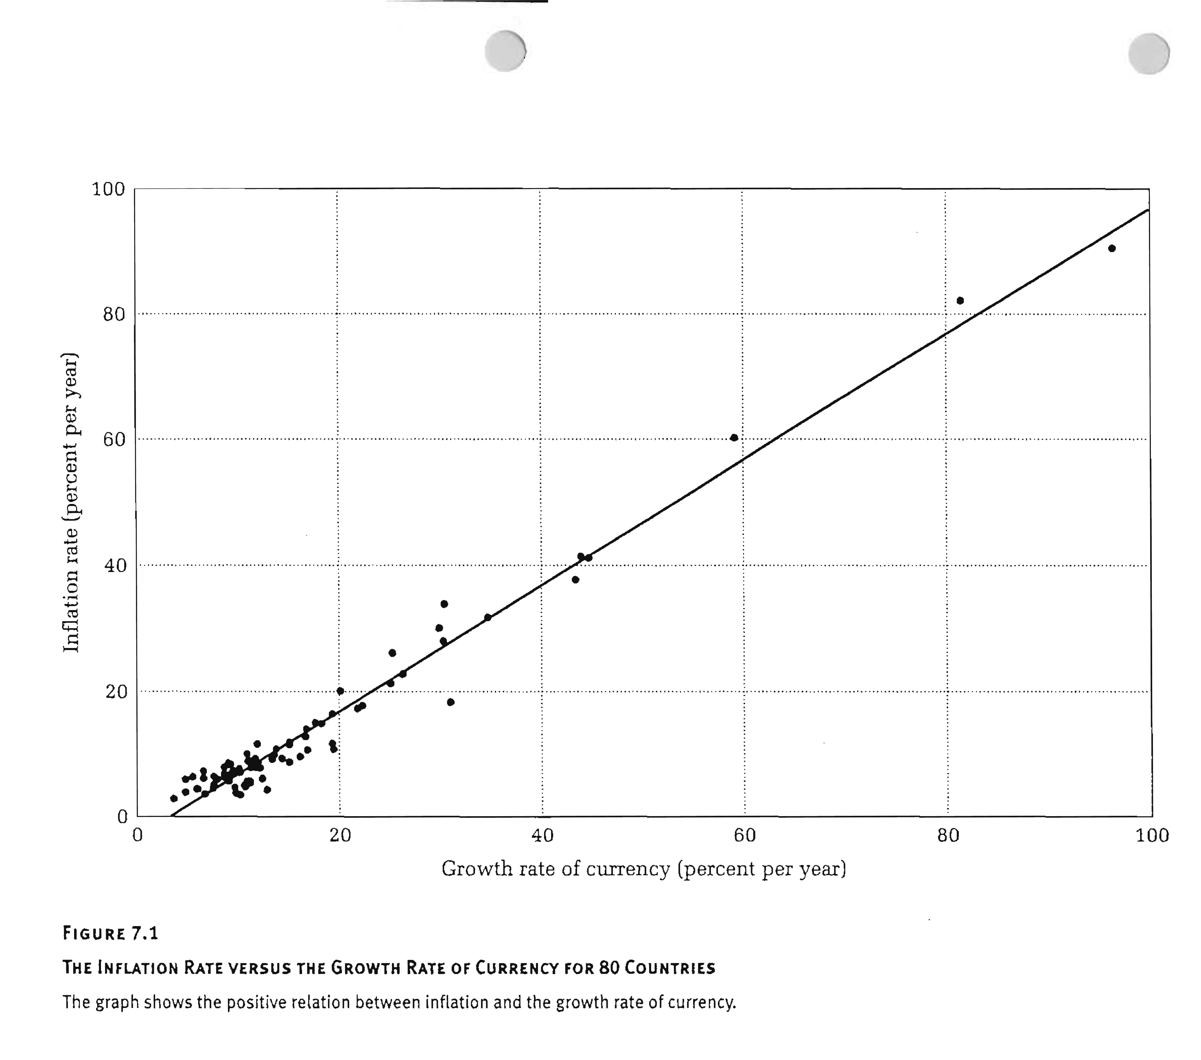
Money Supply and Inflation
Notes:
German Hyperinflation
http://www.youtube.com/watch?v=YvN3wBPBDW0
Making Germany Pay Part 1
http://www.youtube.com/watch?v=FG6U9lcPnAw
Making Germany Pay Part 2
http://www.youtube.com/watch?v=AK3X4Luq2L0

Slide 22
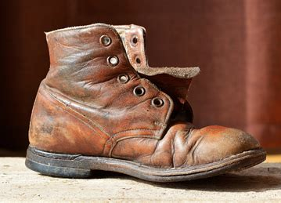






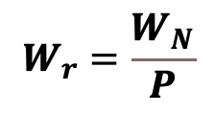
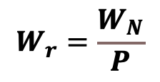
Some Costs of Inflation:
Shoes Leather Costs
(inflation tax)
Unexpected Redistribution
of Wealth
$$W_{r}=\frac{W_{N}}{P}$$
$$i=r+π_{expected}$$
Distortions in the Tax System
$$r=i−π$$
$$W_{r}=\frac{W_{N}}{P}$$
Menu Costs
Noisy Signal
Notes:
https://pxhere.com/en/photo/1081457
https://freesvg.org/hand-offering-money-vector-image
https://www.pexels.com/video/white-noise-texture-6923433/

Slide 23
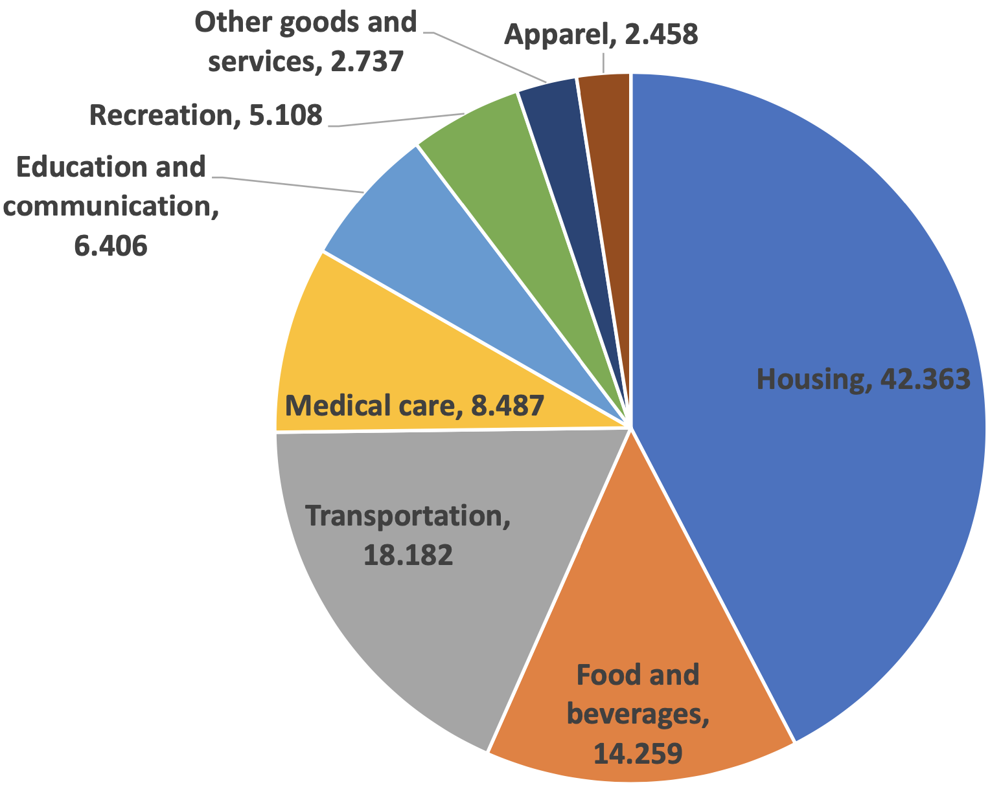

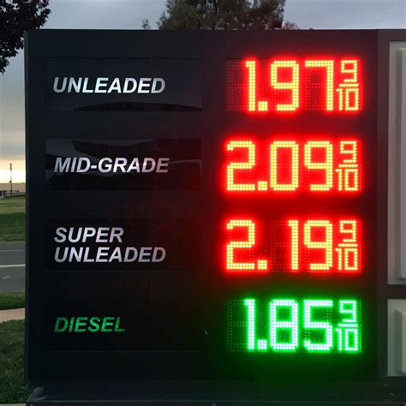
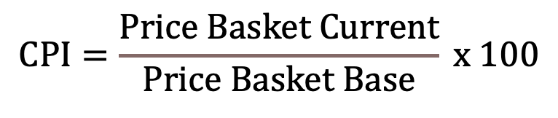
Measuring the CPI
$$CPI=\frac{Price Basket Current}{Price Basket Base} x 100$$
Fix Weighted Basket
Find the Prices
Compute Basket Price
Notes:
https://www.quora.com/What-is-the-sum-of-n-natural-numbers
https://pxhere.com/en/photo/393826
Basket Weights:
https://www.bls.gov/cpi/tables/relative-importance/home.htm
Changes to basket:
https://www.bls.gov/cpi/additional-resources/revision-1998-item-structure.htm
Revisions paper:
https://www.bls.gov/opub/mlr/1996/12/art1full.pdf

Slide 24
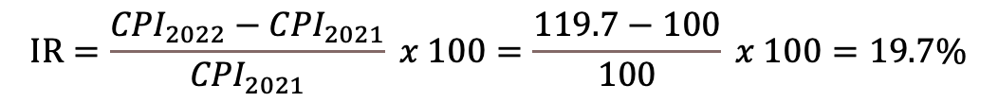
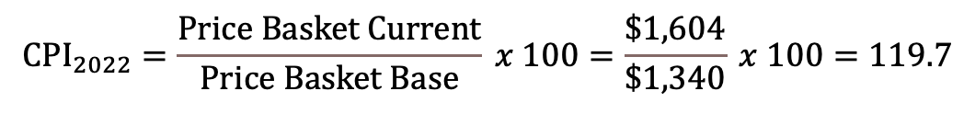
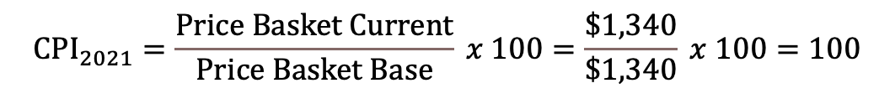
Calculate CPI and Inflation: Base Year Prices = June 2021 Prices
Item/Quantity Per Month | June 2021 Prices | June 2021 Cost | June 2022 Prices | June 2022 Cost
1 Rent, 2BR | $1,000 | $1,000 | $1,200 | $1,200
60 Cheeseburgers | $5 | $300 | $6 | $360
2 Movie Tickets | $20 | $40 | $22 | $44
Total Expenditure |  | $1,340 |  | $1,604
$${CPI}_{2021}=\frac{Price Basket Current}{Price Basket Base} x 100=\frac{\$1,340}{\$1,340} x 100=100$$
$${CPI}_{2022}=\frac{Price Basket Current}{Price Basket Base} x 100=\frac{\$1,604}{\$1,340} x 100=119.7$$
$$IR=\frac{{CPI}_{2022}−{CPI}_{2021}}{{CPI}_{2021}} x 100=\frac{119.7−100}{100} x 100=19.7\%$$

Slide 25
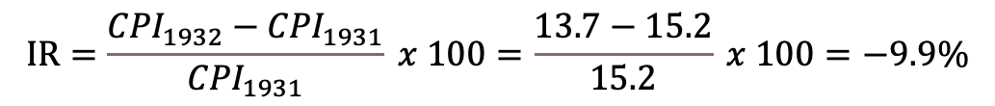
Calculate Inflation: Example
Calculate the inflation rate for 1931 to 1932.
Year | CPI
1929 | 17.1
1930 | 16.7
1931 | 15.2
1932 | 13.7
1933 | 13.0
$$IR=\frac{{CPI}_{1932}−{CPI}_{1931}}{{CPI}_{1931}} x 100=\frac{13.7−15.2}{15.2} x 100=−9.9\%$$
Now that is called deflation!

Slide 26


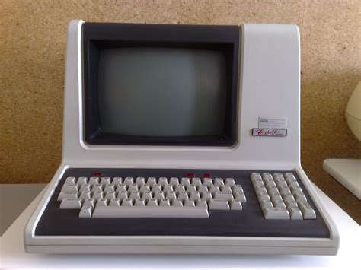


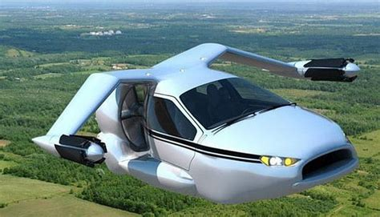
Shortcomings of the CPI: Reasons Inflation May Be Overstated
Substitution Bias
Quality Adjustment Bias
New Goods Bias
Notes:
New Goods Bias – talk in terms of diminishing marginal utility of consumption and variety added by new goods – dollar more meaningful
https://www.pexels.com/photo/black-coffee-mug-997670/
https://www.publicdomainpictures.net/en/view-image.php?image=267585&picture=herbal-tea
https://pxhere.com/en/photo/611980
https://pixabay.com/de/photos/fang-pc-es-apple-inc-computer-464737/
https://pixabay.com/de/photos/mercedes-benz-wagen-amg-gt-1470136/
https://www.al.com/breaking/2013/10/george_jetson_envy_first_flyin.html

Slide 27

Shortcomings of the CPI: Does Not Take Inequality Into Account
Notes:
https://www.naccchildlaw.org/news/288854/The-one-thing-rich-parents-do-for-their-kids-that-makes-all-the-difference-Washington-Post.htm

Slide 28

Indexing
Indexing: Practice of increasing a nominal quantity each period by an amount equal to the percent increase in a specified price index. Indexing prevents the purchasing power of the nominal quantity from being eroded by inflation.
Nominal Quantity: Quantity that is measured in terms of a current dollar value.
Real Quantity: Quantity measured in physical terms…what matters is what we can buy.

Slide 29
Some Alternative Measures
Personal Consumption Expenditure Index (PCE)- the value of the goods and services purchased by, or on the behalf of, U.S. residents. This is estimated by the BEA and is the central measure the Federal Reserve uses to gauge inflation. https://www.bea.gov/data/personal-consumption-expenditures-price-index
Producer Price Index (PPI) - a family of indexes that measures the average change over time in selling prices received by domestic producers of goods and services. PPIs measure price change from the perspective of the seller and is estimated by the BLS. https://www.bls.gov/ppi/overview.htm
GDP Deflator - measures changes in the prices of goods and services produced in the United States, including those exported to other countries. Prices of imports are excluded. https://www.bea.gov/data/prices-inflation/gdp-price-deflator
Notes:
PPI This contrasts with other measures, such as the Consumer Price Index (CPI), that measure price change from the purchaser's perspective. Sellers' and purchasers' prices may differ due to government subsidies, sales and excise taxes, and distribution costs. https://www.bls.gov/ppi/faqs/questions-and-answers.htm#6
Difference between CPI and PPI:
https://www.bea.gov/research/papers/2007/reconciliation-between-consumer-price-index-and-personal-consumption

Slide 30


Unemployment Rate
The unemployment rate represents the number of unemployed people as a percentage of the labor force.
Labor Force = Employed + Unemployed
Employed: Work full or part time during the past week, or sick or on vacation from your regular job.
Unemployed: you did not work in the past week but made some effort to find work in the past 4 weeks.
Notes:
https://freesvg.org/excited-employees
https://www.publicdomainpictures.net/en/view-image.php?image=204339&picture=&jazyk=CS

Slide 31



Reasons for Unemployment
Fired
Cutbacks
Replaced
by
Technology
Has a negative connotation
Short run versus long run
Due to economic conditions
Notes:
https://www.dreamstime.com/royalty-free-stock-images-you-re-fired-yellow-sticky-note-image22382739

Slide 32



Monetary Costs of Unemployment
Lost Personal Income
Lost Skills
Increased Benefits and Lost Taxes
Notes:
http://clipart-library.com/no-money-cliparts.html
https://www.youtube.com/watch?v=3sUCSGVYzI0

Slide 33
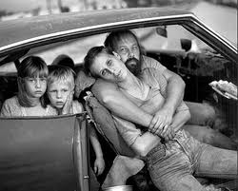

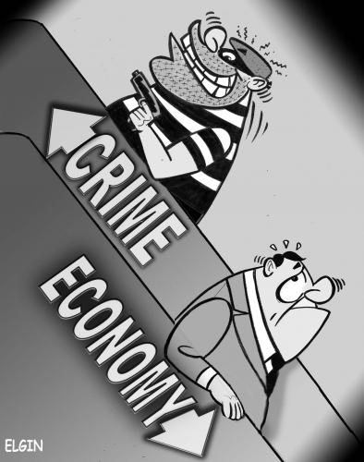

Social Costs
Homelessness
Substance Abuse
Crime
Social Tensions
Notes:
http://subwaysurfer.blogspot.com/2009/04/editorial-cartoon-wave-newspaper.html
http://www.luckinlove.com/cruelempire.htm
http://subwaysurfer.blogspot.com/2009/04/editorial-cartoon-wave-newspaper.html

Slide 34

Psychological Costs of Unemployment
I’m a born loser. I’ll never get another job. I’m letting my family down.
VS

Slide 35
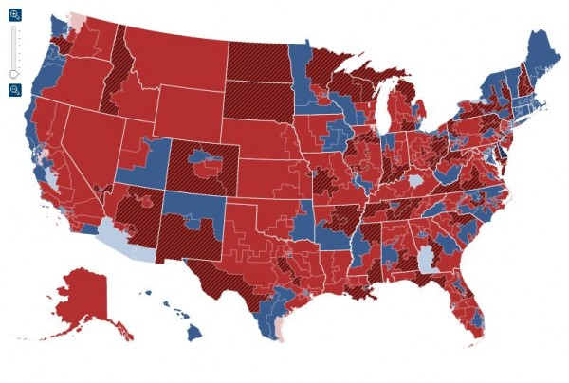
Political Costs

Slide 36


Types of Unemployment
Frictional Unemployment: arises from the process of managing firms and workers making a suitable match, or the job search process.
Structural Unemployment: Arises from a mismatch between the skills workers possess and the skills that firms desire.
Notes:
https://www.rawpixel.com/search/job%20search?page=1&sort=curated
https://draup.com/talent/blog/skills-mismatch-its-impact-on-the-technology-talent-ecosystem/

Slide 37
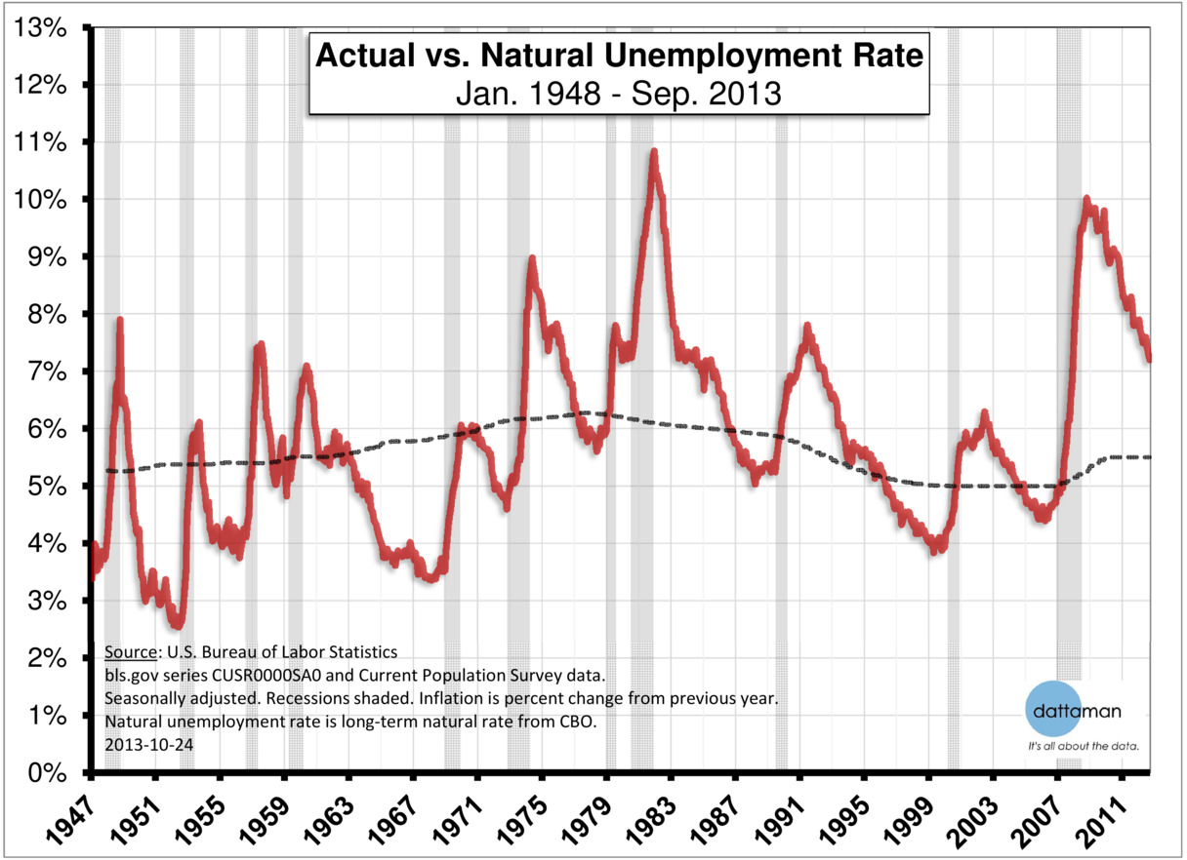
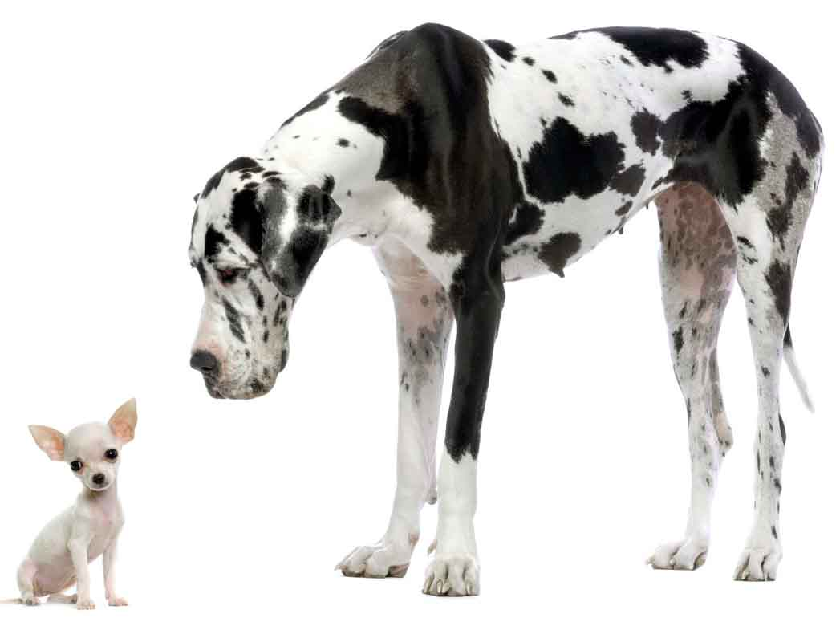
Types of Unemployment
Natural Unemployment Rate: the normal rate of unemployment around which the unemployment rate fluctuates.
Cyclical Unemployment: the difference between actual unemployment rate and natural unemployment rate.
DOWNSZING
Notes:
Cyclical unemployment is associated with the business cycle, which concerns expansions, contractions and recessions.
growth. It can be negative.

Slide 38
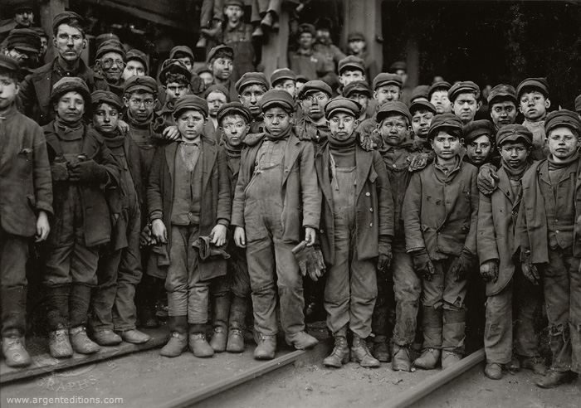
Calculations
Unemployment Rate
Participation Rate
Working Age Population (WAP)- The civilian noninstitutional population age 16 and older is the base population group, or universe, used for Current Population Survey (CPS) statistics published by BLS.
Notes:
https://www.historyonthenet.com/authentichistory/1898-1913/2-progressivism/3-laborreform/2-hine/

Slide 39
Some Alternative Measures
Marginally Attached: those persons not in the labor force who want and are available for work, and who have looked for a job sometime in the prior 12 months but were not counted as unemployed because they had not searched for work in the 4 weeks preceding the survey.
Discouraged Workers: a subset of persons marginally attached to the labor force. Among the marginally attached, discouraged workers are not currently looking for work specifically because they believed no jobs were available for them or there were none for which they would qualify.
Involuntary Part Time Workers (also called part time for economic reasons): are those that want to work full time but are only able to find part time employment.
Chronically Unemployed: People who experience long duration spells, normally associated with structural unemployment.

