Slide 1

Aggregate Supply and Demand

Slide 2
Aggregate Supply and Demand
Objective: Explain the interaction between aggregate demand and aggregate supply to determine the price level, real GDP, and employment.
What is aggregate supply and demand?
What is the relationship between prices and aggregate demand?
What is the relationship between short run aggregate supply and long run aggregate supply with prices?
How does the market restore long run equilibrium?

Slide 3




Aggregate Supply and Demand
P
LRAS
AD
SRAS
P - price level relative to other periods of time.
Y – GDP represents the total aggregate output in the economy.
$$LRAS=Y^{∗}=Af(K,L,H,R)$$
$$AD=C+I+G+NX$$
$$SRAS=Y^{∗}+a\left(P−P_{E}\right)$$
Y*
Y
Notes:
PE is the expectations of prices from both sides, the consumer and the producer!
WRITE IT UP ON THE BOARD AND KEEP DOING IT WITH THE DIFFERENT EXAMPLES.
for SRAS talk about how prices are higher than what you expected and what you set your prices at, you can sell more.

Slide 4


Aggregate Demand: Downward Sloping
AD Curve: A curve that shows the quantity of goods and services that households, firms and the government demand at each price level. The curve is downward sloping due to the wealth effect, interest rate effect and the exchange rate effect.
$$AD=C+I+G+NX$$
Wealth Effect: a decrease in price level makes consumers wealthier, which encourages more consumption. If you go to the shoe store and find out the store is having a 50% off sale, you may just buy two pairs of shows instead of one! This is especially true for luxury goods.
Notes:
https://www.freestock.com/free-photos/shopping-woman-carrying-bags-outdoors-24367093

Slide 5

Aggregate Demand: Downward Sloping
Interest Rate Effect: a lower price level reduces the demand for money, which increases savings and the supply of loanable funds, lowers the real interest rate and increase the demand for loanable funds for investment.
$$AD=C+I+G+NX$$
i
S_{M}
r
D_{LF}
S_{LF}
S’_{LF}
i
r
r’
i’
D_{M}
D’_{M}
Q_{M}
Q_{M}
Q’_{LF}
Q_{LF}
Q_{LF}

Slide 6

Aggregate Demand: Downward Sloping
Exchange Rate Effect: A lower real interest rate means a lower return on domestic assets, which results in an increase in the supply of dollars for NCO, causing a depreciation of the RER making domestic goods and services relatively cheaper compared to foreign goods and services, driving up NX.
S_{NCO}
S’_{NCO}
RER
RER
$$AD=C+I+G+NX$$
RER’
D_{NX}
Q_{$,NX,NCO}
Q’_{$,NX,NCO}
Q_{$,NX,NCO}
Notes:
last two plus this. TALK ABOUT DOLLARS FLOWING OUT OF US BECAUSE INTEREST RATE GOES DOWN. Our dollars go chase foreign assets.

Slide 7

Shifts in Aggregate Demand
$$AD=C+I+G+NX$$
Factors that shift the AD curve include:
Consumption - changes in current and future income, taxes, and wealth.
Investment - changes in the demand for loanable funds from changes to in the MPK, UCC or taxes on capital equipment.
Government Purchases - Changes in government spending.
Net Exports - changes in demand for imports or exports.

Slide 8
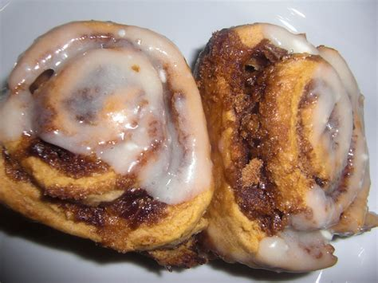
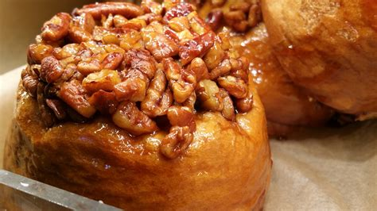
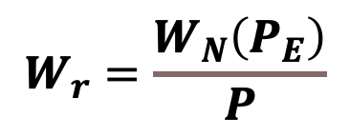

SRAS: Upward Sloping
$$SRAS=Y^{∗}+a\left(P−P_{E}\right)$$
Sticky Prices: Firms face menu costs, which are costs associated with changing prices. These costs can be thought of literally as there is a cost to a restaurant to reprint a menu or to a store to change a price tag when firms adjust prices. There can also be costs to the firm from the effects of price changes, especially increases in prices, on the psychology of consumers.
Sticky Wages: Wages are based on your prices expectations to be competitive in hiring. Wages do not adjust immediately to the price level. A higher price level makes employment and production more profitable, so firms increase the quantity of the goods and services they supply.
$$W_{r}=\frac{W_{N}\left(P_{E}\right)}{P}$$
Notes:
https://www.publicdomainpictures.net/en/view-image.php?image=128036&picture=sticky-bun-closeup
PE is the expectations of prices from both sides, the consumer and the producer!
TALK IN TERMS OF MARGINAL COST OF LABOR AND MARGINAL PRODUCT OF LABOR. The wage stays the same but we can charge more meaning we can hire more workers.

Slide 9
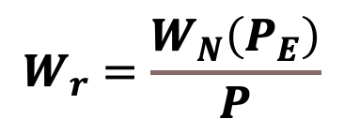
SRAS: Upward Sloping
Sticky Wages
$$W_{r}=\frac{W_{N}\left(P_{E}\right)}{P}$$
MPL,MC
MPL
MC
MC’
L*
L’
L

Slide 10
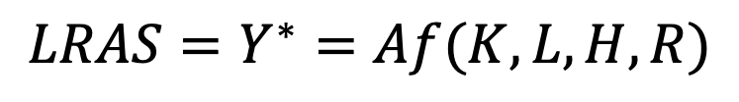
Long Run Aggregate Supply
$$LRAS=Y^{∗}=Af(K,L,H,R)$$
LRAS is determined by the available inputs and technology. It is our steady state depending on TFP, capital labor, human capital, and natural resources.
It is vertical because it does not depend on prices!
The LRAS shifts to the right over time with economic growth, represented by the trend line from our business cycle graph.
P
LRAS
AD
SRAS
A
B
Y*
Y*

Slide 11

SRAS: Shifts
$$SRAS=Y^{∗}+a\left(P−P_{E}\right)$$
Factors that shift Aggregate Supply
LRAS
Labor
Capital
Human Capital
Natural Resources
Total Factor Productivity
SRAS
Everything that affects LRAS plus price expectations.

Slide 12
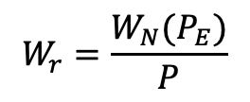

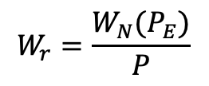

Recovery Through Wages
Example…say we go into demand side recession.
A to B: Demand side negative shock
P
LRAS
$$SRAS=Y^{∗}+a\left(P−P_{E}\right)$$
AD
SRAS
$$W_{r}=\frac{W_{N}(P_{E})}{P}$$
A
B to C: Recovery
B
C
$$SRAS=Y^{∗}+a\left(P−P_{E}\right)$$
$$W_{r}=\frac{W_{N}(P_{E})}{P}$$
Y*
Y
Notes:
PE is the expectations of prices from both sides, the consumer and the producer!
WRITE IT OUT AND TAKE THEM THROUGH IT!
TALK IN TERMS OF MARGINAL COST OF LABOR AND MARGINAL PRODUCT OF LABOR. CHANGES IN PRICES CAUSE A DECEREASE IN EMPLOYMENT.
AS FAR AS CHANGES IN PRICE EXPECTATIONS, TALK ABOUT FUTURE PEOPLE BEING HIRED ARE PAID LESS.

