Slide 1

Monopolistic Competition and Oligopoly

Slide 2
Monopolistic Competition and Oligopoly
Objective: Describe the attributes of monopolistic competition and Oligopoly.
What is monopolistic competition and what is an oligopoly?
What are the implications of monopolistic competition for profits and economic well-being?
How is pricing determined in an oligopoly and why is cooperation difficult?

Slide 3
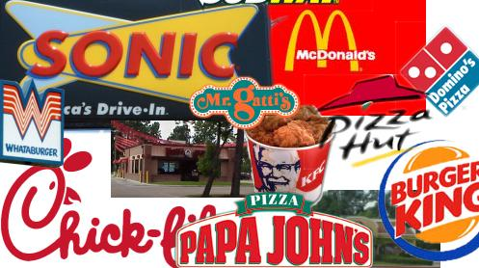
Monopolistic Competition
Monopolistic Competition: a market structure in which many firms sell products that are similar but not identical.
Many Sellers: Many firms competing for same customers.
Product Differentiation: firms produce slightly different products…rather than being a price taker, they have a downward sloping demand curve.
Free Entry and Exit: the number of firms in the market adjust until economic profits are zero.

Slide 4

Oligopoly
Oligopoly (Duopoly – 2 firms): a market structure in which a few sellers offer similar or identical products.
Game Theory: the study of how people behave in strategic situations.
Notes:
Princess Bride
http://www.youtube.com/watch?v=U_eZmEiyTo0

Slide 5
Monopolistic Competition: Short Run
Like the monopolist, monopolistic competitors maximize profit where marginal cost equals marginal revenue. If the price is above ATC, the firms make a profit. If the price is below average total cost, the firms make a loss.
Firms with Profits
Firms with Losses
P
P
MC
MC
ATC
ATC
Price
ATC
Profit
D
Loss
ATC
Price
MR
D
MR
Q_{Max}
Q
Q_{Min}
Q

Slide 6
Monopolistic Competition: Long Run
P
In the short run, the monopolistic competitor here is making a profit at P1 and Q1…
…in the long run the profits induce entry and shifts demand and marginal revenue left…
…leaving P2 equal to average total cost and the profit equal to zero.
The opposite would take place if firms are making a loss.
MC
P₁
ATC
P₂=ATC₂
ATC₁
D₁
D₂
MR₁
MR₂
Q₂
Q₁
Q

Slide 7
Monopolistic Competition vs Perfect Competition
The perfectly competitive firm produces at the efficient scale, where average total cost is minimized, while the monopolistically competitive firm’s have excess capacity.
Under perfect competition, price equals marginal cost, while price is above marginal cost for the monopolistically competitive firms leaving a deadweight loss.
Monopolistically Competitive Firm: Long Run
Perfectly Competitive Firm:
Long Run
P
P
MC
MC
P=ATC
ATC
ATC
P=MC
AR=D=MR
D
MR
Q
Q
Q
Q
Notes:
For the policy maker, dealing with the inefficiency of a monopoly is difficult enough, but dealing with the inefficiency of monopolistic competition is even more complicated. It is difficult to ascertain the appropriate number of firms in a monopolistically competitive market. While firms in monopolistic competition have slightly differentiated products, there is still room for only so many firms in a market. If the policy maker forces new firms into the market, it may force exiting firms into losses causing exit from the market. It may even have a difficult time enticing new firms into a market they think will be oversaturated. The policy maker could try to regulate prices as is often the case with a natural monopoly, but they run into the same difficulties. The policy maker again needs to determine the “right” price. As far as efficiency is concerned, we know from perfect competition that a price equal to the marginal cost is the most efficient. However, if firms in monopolistic competition are earning zero economic profit in the long run, then the MC is below the ATC, and you will force firms into losses. Even if you set the price above the MC, it is still a problematic situation leaving the firm no incentive to innovate for efficiency’s sake, and in fact can encourage less efficient practices. If the price always changes commensurate with your costs, there is no incentive to be cost efficient. Whether talking about regulation or increasing competition, the policy maker is more likely to end up just picking winners and loser as opposed to making the market more efficient. Sometimes accepting markets may not always be perfect and taking a hands-off approach may the right thing to do.

Slide 8
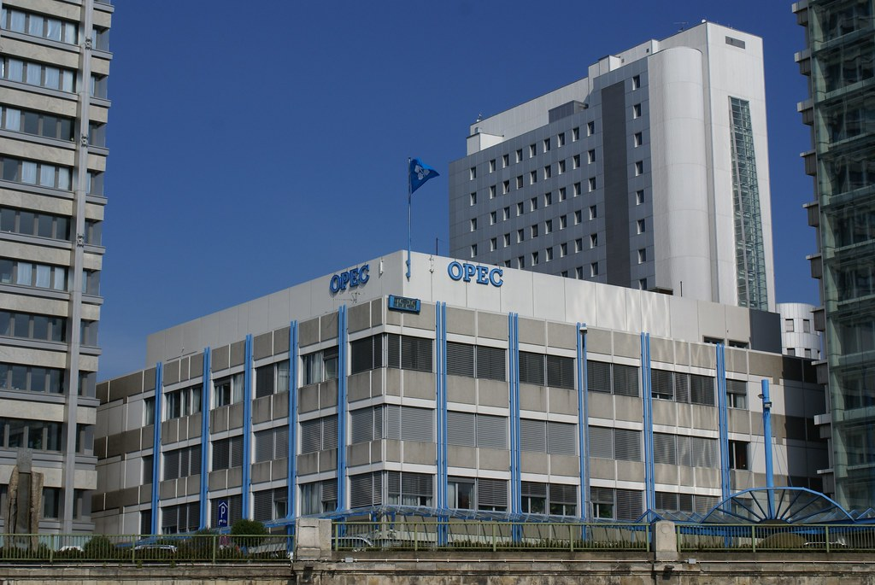
Oligopoly Pricing
Collusion: agreement among firms in a market about quantities to produce or prices to charge.
Cartel: a group of firms acting in unison.
Notes:
https://www.flickr.com/photos/alex-photos/6379201779/

Slide 9
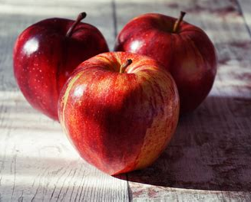
A Duopoly Example: Jack vs Diane
Demand Schedule for Apples Producers (assume costs equal zero for simplicity)
Apples | Price | Profits
0 | $10 | $0
30 | $9 | $270
60 | $8 | $480
90 | $7 | $630
120 | $6 | $720
150 | $5 | $750
180 | $4 | $720
210 | $3 | $630
240 | $2 | $480
270 | $1 | $270
300 | $0 | $0
https://open.spotify.com/track/43btz2xjMKpcmjkuRsvxyg?si=22d5a175ff954e23

Slide 10
A Duopoly Example: Jack vs Diane
Demand Schedule for Apples Producers (assume costs equal zero for simplicity)
Jack | Price | Profits | Diane | Price | Profits
75 | $5 | $375 | 75 | $5 | $375
105 | $4 | $420 | 75 | $4 | $300
105 | $3 | $315 | 105 | $3 | $315
105 | $3 | $315 | 105 | $3 | $315
135 | $2 | $270 | 105 | $2 | $210

Slide 11

Prisoners’ Dilemma
Prisoners’ Dilemma: a particular “game” between two captured prisoners that illustrates why cooperation is difficult to maintain even when it is mutually beneficial.
Notes:
https://www.flickr.com/photos/gforsythe/8245308748/
Golden Balls
https://www.youtube.com/watch?v=S0qjK3TWZE8

Slide 12
Prisoners’ Dilemma: Oligopoly
Dominant Strategy: a strategy that is best for a player in a game regardless of the strategies chosen by the other players.
Jack’s Decision
105 apples
75 apples
Jack gets $315 profit
Jack gets $300 profit
105 apples
Diane gets $315 profit
Diane gets $420 profit
Diane’s
Decision
Jack get $420 profit
Jack gets $375 profit
75 apples
Diane gets $300 profit
Diane gets $375 profit

Slide 13
Prisoners’ Dilemma: Oligopoly
Jack’s Decision
105 apples
75 apples
Jack gets $315 profit
Jack gets $300 profit
105 apples
Diane gets $315 profit
Diane gets $420 profit
Diane’s
Decision
Jack gets $420 profit
Jack gets $375 profit
75 apples
Diane gets $300 profit
Diane gets $375 profit
Notes:
Also talk about the following
We have looked at the cost curves for firms in an oligopoly, but we know that when there is collusion and firms act like a cartel, they charge a price and produce a quantity equal to that of a monopoly. When they compete, an oligopoly falls between a monopoly and monopolistic competition in terms of its rank of competitiveness meaning it charges a lower price and produces more than a monopoly but charges a higher price and produces less than monopolistic competition. While we know it is difficult for firms to cooperate, it is possible. When it comes to the market for goods, as with Jack and Diane producing apples, cooperation is a bad thing leading to higher prices and a lower quantity. There are antitrust laws in place to deal with firms coordinating prices and quantities to stop that from occurring. Beyond forcing an oligopoly to compete, the policy maker runs into many of the same issues they face with trying to increase competition or regulate prices with a monopoly or monopolistic competition.

Slide 14
Golden Balls: Not Pure Prisoner’s Dilemma
Player B
Steal
Split
Steal
0%
0%
0%
100%
Player A
100%
50%
Split
0
50%
Notes:
Golden Balls
https://www.facebook.com/watch/?v=2294216330611721
https://m.youtube.com/watch?v=mVi7XQP-wDU
https://www.youtube.com/watch?v=S0qjK3TWZE8

Slide 15
Golden Balls: My Thought Process
Player B
Steal
Split
Steal
0% + schadenfreude
0% and feel dumb
0% + schadenfreude
100%
Player A
100%
50%
Split
0%, and feel dumb
50%

