Slide 1

Markets

Slide 2
Markets
Objective: Describe the relationship between prices, market demand and market supply.
  What is a market?
  What is market demand and how is it related to prices?
  What is market supply and how is it related to prices?
  How do we determine market equilibrium?

Slide 3


Markets
A market is a group of buyers and sellers of a particular good or service.
The buyers as a group determine the demand for the product, and the sellers as a group determine the supply of the product.
Notes:
https://theculturetrip.com/europe/spain/articles/the-best-markets-to-visit-in-valencia/

Slide 4
Markets
We assume that markets are perfectly competitive, which is a market with many buyers and sellers, identical products, free entry and exit into the market, and homogenous firms facing the same costs of production.
    Buyers and sellers are price takers…they must accept the price the market determines.
      At the market price, buyers can buy all they want, and sellers can sell all they want.
In this chapter we discuss the goods market, but a market for services displays the same characteristics regarding prices.

Slide 5
Market Demand
Price
Quantity Demanded: the amount of a good buyers are willing and able to purchase.
Law of Demand: the claim that, all other things being held equal, the quantity demanded of a good falls when the price of the good rises.
Quantity

Slide 6
Shifts in Demand
Price
Anything that increases the quantity demanded at a given price shifts the demand curve right.
Anything that decreases the quantity demanded at a given price shifts the demand curve left.
Quantity

Slide 7


Shifts in Demand
Changes in income:
  Normal goods: all things equal, as income rises, demand rises.
  Inferior Goods: all things equal, as income rises, demand falls.
Normal good
Inferior good

Slide 8

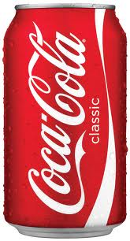
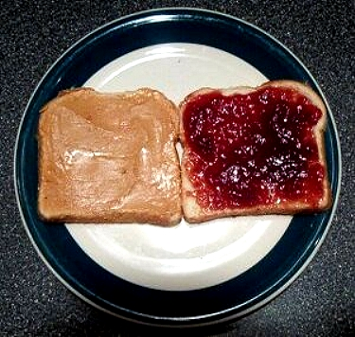

Shifts in Demand
Prices of Related Goods:
  Substitutes: two goods for which an increase in the price of one, leads to an increase in the demand for the other.
  Complements: two goods for which an increase in the price of one, leads to a decrease in the demand for the other.
Substitutes
Complements

Slide 9


Shifts in Demand
A Change in Preferences : This is the whole point of advertising, to get folks to buy your goods and build up brand loyalty.
A Change in Expectations: If you expect a future recession, your demand will go down now to prepare for possible lost income.

Slide 10

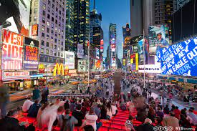
Shifts in Demand
A Change in the Number of Buyers: An increase in the number of people who desire a product will increase the products demand.

Slide 11
Market Supply
Price
Quantity Supplied: the amount of a good that sellers are willing and able to sell.
Law of Supply: the claim that, other things equal, the quantity supplied of a good rises when the price of the good rises.
Quantity

Slide 12
Shifts in Supply
Price
Anything that increases the quantity supplied at a given price shifts the supply curve right.
Anything that decreases the quantity supplied at a given price shifts the supply curve left.
Quantity

Slide 13
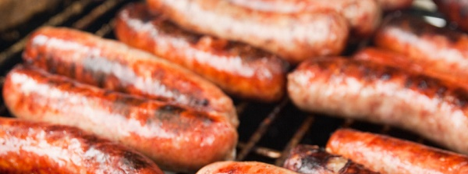
Shifts in Supply
Input Prices - When the price/cost of one or more inputs increases supply shifts left.

Slide 14
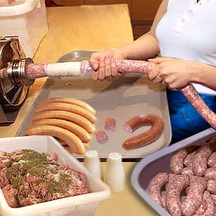
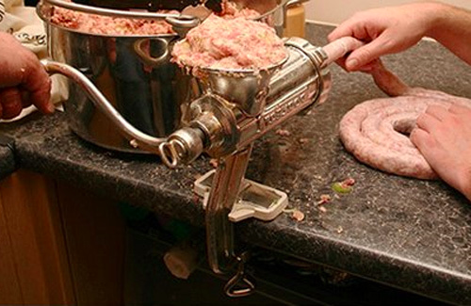
Shifts in Supply
Technology - The technology used to turn inputs into products can also shift the supply curve.

Slide 15

Shifts in Supply
Expectations - If a firm expects higher prices, they will hoard their supply today and the curve will shift left.

Slide 16
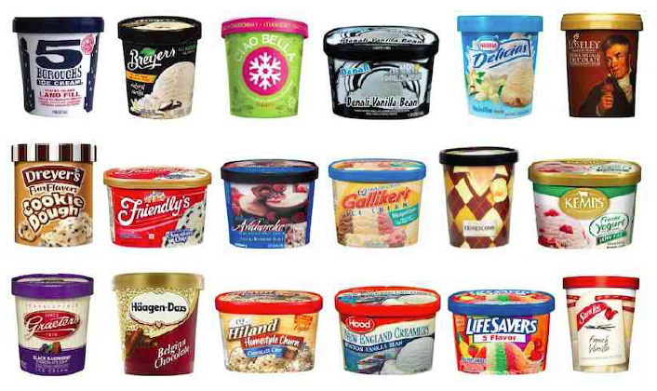
Shifts in Supply
Number of Sellers -As the number of producers increase the supply curve will shift right.

Slide 17
Market Equilibrium
P
Demand
Supply
Equilibrium: a situation in which the market price has reached the level at which the quantity supplied equals the quantity demanded.
P*
equilibrium price
Q*
equilibrium quantity
Q

Slide 18
Market Surpluses and Shortages
P
Surplus
D
S
P^{high}
If firms initially set prices too high or too low, market forces will bring them toward the equilibrium.
P*
P^{low}
Shortage
Q*
Q

Slide 19
Market Equilibrium: Increase in Demand
P
D’
D
S
P’
P
Q
Q’
Q

Slide 20
Market Equilibrium: Decrease in Demand
P
D
S
D’
P
P’
Q’
Q
Q

Slide 21
Market Equilibrium: Increase in Supply
P
D
S
S’
P
P’
Q
Q’
Q

Slide 22
Market Equilibrium: Decrease in Supply
P
D
S’
S
P’
P
Q’
Q
Q

Slide 23
Market Equilibrium: Shifts in Both
Quantity Could Go Up
Quantity Could Go Down
P
P
S’
D’
S’
D’
S
D
S
P’
P’
D
P
P
Q
Q’
Q
Q’
Q
Q

Slide 24
Cheat Sheet
Cheat Sheet | No Change in Supply | An Increase in Supply | A Decrease in Supply
No Change in Demand | P – Same Q – Same | P – down Q – up | P – up Q – down
An Increase in Demand | P – up Q – up | P – ambiguous Q – up | P – up Q – ambiguous
A Decrease in Demand | P – down Q – down | P – down Q – ambiguous | P – ambiguous Q – down

