Slide 1

Labor Markets

Slide 2
Labor Markets
Objective: Describe the relationship between real wages, the supply of labor and the demand for for labor, and explain the reasons unemployment exists.
  What is the relationship between labor and production?
  Why is the relationship between the real wage with labor supply and labor demand?
  How do we explain unemployment through the search and matching model of labor?
  How does the reservation wage affect unemployment in the search and matching model of labor?

Slide 3
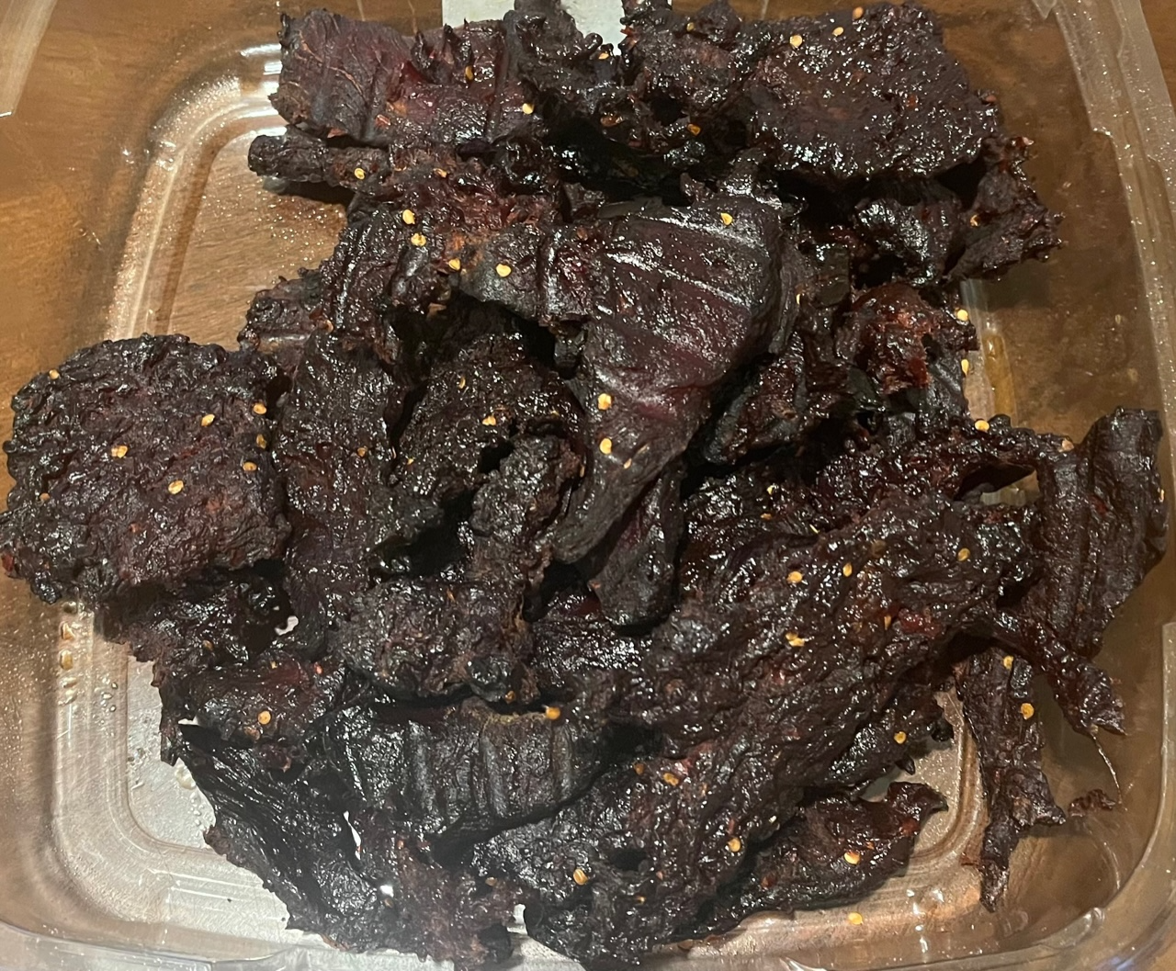

Jimmy D’s Smoked Jerky Shack

Slide 4
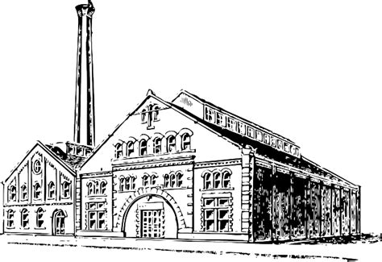


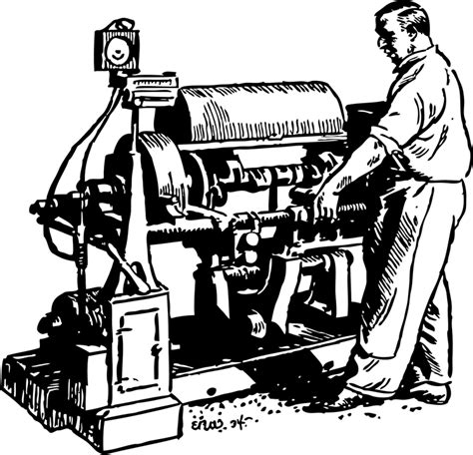



Assumptions…for Now
Fixed Capital
Homogeneous Workers
Profit Maximization
Competitive Markets
Notes:
https://www.freestock.com/free-photos/3d-happy-business-team-pyramid-isolated-74198149
https://pixabay.com/illustrations/currency-market-stock-exchange-1019996/
https://pixabay.com/illustrations/competition-run-sports-championship-1019774/

Slide 5
How Many Workers Do We Hire?
Jimmy D’s Smoked Jerky Shack: Bag of Jerky=$10 ; Wages=$100 per day
#Workers | # Bags | # MPL | $ Total Revenue | $ MRPL | $ MCL | #MCL
0 | 0
1 | 22
2 | 32
3 | 36
4 | 38
5 | 39

Slide 6
How Many Workers Do We Hire?
Jimmy D’s Smoked Jerky Shack: Bag of Jerky=$10 ; Wages=$100 per day
#Workers | # Bags | # MPL | $ Total Revenue | $ MRPL | $ MCL | # MCL
0 | 0 | 0 | 0 | 0 | 0 | 0
1 | 22 | 22 | 220 | 220 | 100 | 10
2 | 32 | 10 | 320 | 100 | 100 | 10
3 | 36 | 4 | 360 | 40 | 100 | 10
4 | 38 | 2 | 380 | 20 | 100 | 10
5 | 39 | 1 | 390 | 10 | 100 | 10

Slide 7
How Many Workers Do We Hire?
Jimmy D’s Smoked Jerky Shack: Bag of Jerky=$10 ; Wages=$100 per day
#Workers | # Bags | # MPL | $ Total Revenue | $ MRPL | $ MCL | # MCL
0 | 0 | 0 | 0 | 0 | 0 | 0
1 | 22 | 22 | 220 | 220 | 100 | 10
2 | 32 | 10 | 320 | 100 | 100 | 10
3 | 36 | 4 | 360 | 40 | 100 | 10
4 | 38 | 2 | 380 | 20 | 100 | 10
5 | 39 | 1 | 390 | 10 | 100 | 10

Slide 8
Nominal Marginal Profit

Slide 9
MPL and MCL
MPL,MCL
MPL
MPL-MCL = real marginal profit.
MCL
L*
L

Slide 10
Aggregate Labor Supply and Demand
W_{r}
D
S
Labor Demand is downward sloping. As the marginal cost of labor decreases, firms hire more workers to maximize profits.
W*_{r}
Labor Supply is upward sloping. The higher the wage, the more workers are willing and able to work.
L*
L
Notes:
We assume the substitution effect dominates.

Slide 11
Increases in the MPL
W_{r}
D’
D
S
An increased MPL from things like improvements in technology or human capital or increases in physical capital will increase the demand for labor at a given wage.
W’_{r}
W_{r}
L
L’
L

Slide 12
Decreases in Number of Workers
W_{r}
S’
D
S
Anything that decreases the supply of labor like brain drain out of your country or an aging population with larger percentages of the workforce retiring than entering.
W’_{r}
W_{r}
L’
L
L

Slide 13
A Negative Wealth Effect:
Financial Crisis Destroying 401K’s
W_{r}
D
S
S’
With a negative wealth effect, workers enter the labor force. If something like a financial crisis destroys retirements funds, retired workers need to reenter the workforce to maintain their standards of living.
W_{r}
W’_{r}
L
L’
L

Slide 14

Unemployment: Search Theory
Unemployment is a result of workers and jobs being heterogeneous causing frictions for both employees and employers finding a suitable match.
Difficulties in making a match can come from noise in the job search process or skills mismatches.
We are going to model a long run equilibrium Unemployment rate akin to the natural rate of unemployment.
Notes:
Talk about minimum wage, efficiency wage and insider-outsider model.
The number doesn’t matter, it just changes the scale. so 1 is fine.

Slide 15


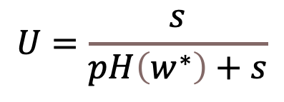
Unemployment: Search Theory
First, we fixed and normalize labor force, making the unemployment rate equal to the number of unemployed. The Scale should not matter in these models, so we can make this simplifying assumption.
$$E=1−U$$
In a long run equilibrium, the flow of workers from unemployment to employment on the right must equal the flow of workers from employment to unemployment on the left.
$$s\left(1−U\right)=UpH\left(w^{∗}\right)$$
$$U=\frac{s}{pH\left(w^{∗}\right)+s}$$
s = separation rate.
H(w*) = fraction of job offers with a wage greater than the reservation wage w*.
p is the frequency of job offers or the percentage of the unemployed offered a job.
Notes:
Talk about minimum wage, efficiency wage and insider-outsider model.
The number doesn’t matter, it just changes the scale. so 1 is fine.

Slide 16
Determination of the Unemployment Rate
s(1-U),
UpH(w*)
s(1-U)
UpH(w*)
(0,0)
U*
1
U
Notes:
If we were to the left of equilibrium, more people would be losing jobs than getting jobs, pulling us back to wards equilibrium. This would be like transition dynamics.

Slide 17
Reservation Wage
V_{e}(w), V_{U}
V_{e}(w)
w* is the reservation wage or the wage that is sufficiently high for the unemployed worker to accept a job offer.
w* is the wage that sets
V_{e}(w) ≥ V_{u.}
V_{U}
w*
w
Notes:
Value of unemployment…first we value our leisure time. From there, things can make us better or worse off when we are unemployed.

Slide 18
The Value of Employment
V_{e}(w), V_{U}
V_{e}(w)
V’_{e}(w)
V_{U}
An increase in the Separation Rate (s) or the Wage Tax (τ_{w}) leads to a decrease in the value of employment.
w*₁
w*₂
w
Notes:
Think of separation rate as an indicator of the stability of a job. (compare to jobs at same wage – one more stable than another.) You need more money to accept a less stable job. Jobs that re project driven have less likelihood of continuing so they usually pay more.

Slide 19
The Value of Unemployment
V_{e}(w), V_{U}
V_{e}(w)
V’_{U}
V_{U}
  Increases in unemployment benefits (b) or the frequency of job offers (p) leads to an increase in (V_{u}).
w*₁
w*₂
w
Notes:
Frequency of job offers – you are in a better position when you are unemployed if there are a lot of job offers. You don’t necessarily have to take the first job that comes along, because something better for you may come down the line. You would have to pay me more to accept a job offer now.

Slide 20
An Increase in Unemployment Benefits
s(1-U),
UpH(w*)
An increase in unemployment benefits increases the value to being unemployed, increases reservation wages, decreases the fraction of job offers accepted and puts upwards pressure on unemployment.
s(1-U)
UpH(w₁*)
UpH(w₂*)
(0,0)
U₁
U₂
1
U
Notes:
Less job offers are accepted.

Slide 21
A Decrease in Wage Taxes
s(1-U),
UpH(w*)
A decrease in the wage tax increases the value to being employed, decreases reservation wages, increases the fraction of job offers accepted and puts downward pressure on unemployment.
s(1-U)
UpH(w₂*)
UpH(w₁*)
(0,0)
U₂
U₁
U
1

Slide 22
An Increase in the Job Offer Rate
UpH (w*)
s(1-U),
UpH(w*)
An increase in the job offer rate directly puts downward pressure on the unemployment rate.
However, it also increases the value to being unemployed, increasing reservation wages, decreasing the fraction of job offers accepted and putting upwards pressure on unemployment.
s(1-U)
Up_{2a}H_{2a} (w*)
Up₁H(w*)
Up_{2b}H_{2b} (w*)
(0,0)
U_{2a}
U₁
U_{2b}
1
U
Notes:
Show with change in separation rate.

Slide 23
An Increases in the Separation Rate
s(1-U),
UpH(w*)
An increase in the separation rate directly puts upward pressure on the unemployment rate.
It also decreases the value to being employed, increasing reservation wages, decreasing the fraction of job offers accepted and putting upwards pressure on unemployment.
s’(1-U)
UpH(w₁*)
s(1-U)
UpH(w₂*)
(0,0)
U₁
U₂
1
U
Notes:
Less job offers are accepted.

