Slide 1

The Welfare of Markets

Slide 2
The Welfare of Markets
Objective: Calculate and interpret the meaning of market efficiency.
  What is welfare economics?
  Where is welfare maximized?
  How do taxes affect the welfare of a market and how does the outcome depend on elasticity and the size of the tax?
  How do trade and tariffs affect the welfare of a market?
  What are the arguments for trade and for restricting trade?

Slide 3

The Welfare of Markets
Welfare Economics: the study of how the allocation of resources affects economic well-being.
Notes:
https://thoughtleadershipzen.blogspot.com/2017/01/how-to-fight-price-war.html

Slide 4


Consumer Surplus
Willingness to Pay: the maximum amount that a buyer will pay for a good.
Consumer Surplus: the amount a buyer is willing to pay for a good minus the amount the buyer actually pays for it.
Notes:
https://blog.sellercloud.com/becoming-a-10-million-dollar-seller-on-an-auction-marketplace/
https://usready.org/5-things-consider-choosing-apartment/exchange-money/

Slide 5
Consumer Surplus
At a price of $140
Eddard’s willingness to pay
$200
Robb’s willingness to pay
$60
$160
$20
Jon’s willingness to pay
$140
Bran’s willingness to pay
$100
Total Surplus=$80
1
2
3
4
Notes:
individual demand put in animation

Slide 6
Consumer Surplus
Consumer Surplus at P₁*
Consumer Surplus at P₂*
P
D
P
D
consumer surplus
initial consumer surplus
Consumer surplus to new consumers
P₁*
P₁*
Additional consumer surplus to initial consumers
P₂*
Q₁*
Q
Q₁*
Q₂*
Q
Notes:
This all of course is a description of surplus using extensive increases in demand, meaning that as prices go down, you will entice more consumers to come in the market. You could also describe surplus as occurring intensively, meaning that as prices go down, consumers already in the market will be willing and able to purchase more of the good.

Slide 7
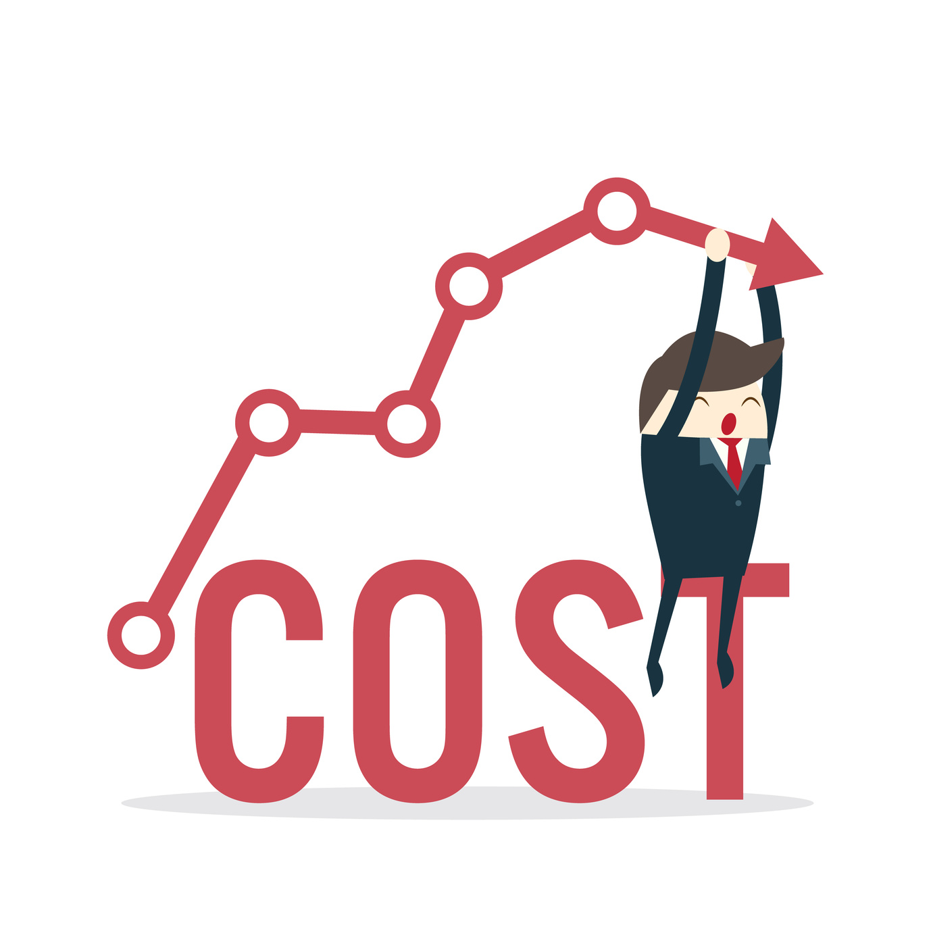

Producer Surplus
Cost: the value of everything a seller must give up to produce a good.
Producer Surplus: the amount a seller is paid for a good minus the seller’s cost of providing it.
Notes:
https://www.allbusiness.com/indirect-loss-costs-are-big-cost-drivers-15698139-1.html
https://www.investopedia.com/terms/p/profit.asp

Slide 8
Producer Surplus
At a price of $400
supply
$450
Cat’s Cost
$400
$150
$100
Sansa’s Cost
$300
Arya’s Cost
$250
Rickon’s Cost
Total Surplus=$250
1
2
3
4
Notes:
put in animation

Slide 9
Producer Surplus
Producer Surplus at P₁*
Producer Surplus at P₂*
P
P
producer surplus to new producers
S
S
P₂*
additional producer surplus to initial producers
P₁*
P₁*
initial producer surplus
producer surplus
Q₁*
Q
Q₁*
Q₂*
Q
Notes:
Again, this is an explanation of surplus increasing extensively meaning that as prices go up, you will entice more producers to come in the market. Surplus could also increase intensively, meaning that as prices go up, producers already in the market will be willing and able to sell more of the good.

Slide 10
Total Surplus
P
A
D
consumer surplus
D
S
AE value the good more than the price and buy the good.
EB value the good less than the price and do not buy the good.
CE have cost less than the price and sell the good.
ED have cost greater than the price and do not sell the good.
P*
represents total surplus.
E
producer surplus
C
B
Q*
Q
Notes:
Maximize total surplus in a perfectly competitive

Slide 11

Role of Government in Welfare Economics
Benevolent Social Planner: an all-knowing, well-intentioned dictator.
Efficiency: the property of a resource allocation of maximizing the total surplus received by all members of society.
Surplus is maximized in a perfectly competitive market with no externalities.
Inefficiencies leave a role for the social planners.
Notes:
https://www.fanpop.com/clubs/disney/images/9415987/title/king-goofy-fanart

Slide 12
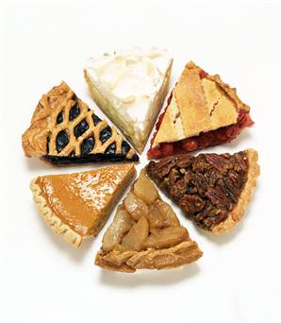
Role of Government in Welfare Economics
Equality: the property of distributing economic prosperity uniformly among the members of society.
Social planners may care about both the size of the pie (efficiency) and how the pie is distributed or sliced up (equality).
Notes:
https://photos.com/featured/assorted-pie-slices-laura-johansen.html

Slide 13
Taxes and Welfare
P
D
S
A tax on a good places a wedge between the price that buyers pay and the price that sellers receive and causes the quantity of the good produced and purchased to fall.
PBP
Tax Revenue =
(T X Q_{T})
P*
TAX Wedge
The tax revenue that the government receives is the size of the tax (T), which is equal to the tax wedge, times the quantity of the good sold with the (Q_{T}).
PSR
Q_{T}
Q*
Q

Slide 14
Taxes and Welfare
P
Demand
C+E shows the fall in total surplus and is the deadweight loss of the tax…not offset by revenue gains.
Supply
A
PBP
B
 | without tax | with tax | change
consumer surplus | A+B+C | A | -(B+C)
producer surplus | D+E+F | F | -(D+E)
tax revenue | None | B+D | +(B+D)
total surplus | A+B+C+D+E+F | A+B+D+F | -(C+E)
C
P*
E
D
PSR
F
Q_{T}
Q*
Q

Slide 15
Taxes, Elasticity, and Welfare
A tax has a deadweight loss because it induces buyers and sellers to change their behavior. The elasticity of the supply curve measures how much sellers respond to changes in price. The more elastic the supply, the more their behavior changes with price.
Inelastic Supply
Elastic Supply
P
P
The more inelastic the supply curve, the smaller the deadweight loss and the larger the tax revenue.
The more elastic the supply curve, the larger the deadweight loss and the smaller the tax revenue.
Q_{T}
Q*
Q
Q_{T}
Q*
Q
Notes:
SAME EQUILIBRIUM….same size tax means it has to shift left.

Slide 16
Taxes, Elasticity, and Welfare
A tax has a deadweight loss because it induces buyers and sellers to change their behavior. The elasticity of the demand curve measures how much buyers respond to changes in price. The more elastic the demand, the more their behavior changes with price.
Inelastic Demand
Elastic Demand
P
P
The more inelastic the demand curve, the smaller the deadweight loss and the larger the tax revenue.
The more elastic the demand curve, the larger the deadweight loss and the smaller the tax revenue.
Q_{T}
Q_{T}
Q*
Q
Q*
Q
Notes:
SAME EQUILIBRIUM….same size tax means it has to shift left.

Slide 17
Tax Size and Welfare
Small Tax
Medium Tax
Large Tax
P
P
P
PB
PB
PB
PS
PS
PS
Q taxes
Q
Q taxes
Q
Q taxes
Q
Deadweight loss
From small to medium to large tax, deadweight loss continually increases
Tax Revenue
From small to medium to large tax, tax revenue increases and then decreases
tax size
tax size

Slide 18
Trade and Welfare: Exporter
P
D
S
EXPORTS
A
Price After Trade
 | Before Trade | After Trade | Change
consumer surplus | A+B | A | -B
producer surplus | C | B+C+D | (B+D)
total surplus | A+B+C | A+B+C+D | +D
B
D
Price Before Trade
C
EXPORTS
domestic Q demanded
domestic Q supplied
Q
Notes:
Now consumers and producers face a higher world price (that is why the export), which is the price of a good that prevails in the world.
Here consumers are worse off and producers are better off, but total surplus increases by D.

Slide 19
Trade and Welfare: Importer
P
D
S
A
 | Before Trade | After Trade | Change
consumer surplus | A | A+B+D | +(B+D)
producer surplus | B+C | C | -B
total surplus | A+B+C | A+B+C+D | +D
Price Before Trade
B
D
Price After Trade
C
Imports
domestic Q supplied
domestic Q demanded
Q
Notes:
Now consumers and producers face a lower world price (that is why the import), which is the price of a good that prevails in the world.
Here producers are worse off and consumers are better off, but total surplus increases by D.

Slide 20
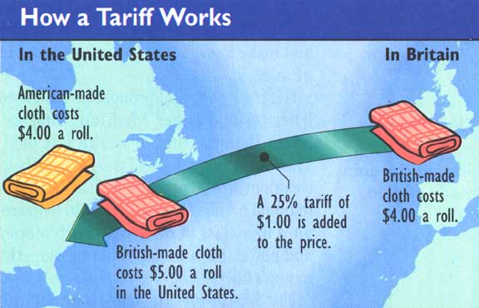
Trade, Tariffs, and Welfare
Tariff: a tax on goods produced abroad and sold domestically.
Notes:
https://www.columbiadailyherald.com/story/opinion/2018/03/19/commentary-trump-8217-s-tariffs/12950393007/

Slide 21
Trade, Tariffs, and Welfare
P
D
S
 | Before Tariff | After Tariff | Change
consumer surplus | A+B+C+D+E+F | A+B | -(C+D+E+F)
producer surplus | G | C+G | +C
government revenue | None | E | +E
total surplus | A+B+C+D+E+F+G | A+B+C+E+G | -(D+F)
A
Price After Tariff
B
C
D
E
F
tariff
Price Before Tariff
G
Imports with tariff
Q₁^{s}
Q₂^{s}
Q₂^{D}
Q₁^{D}
Q
Notes:
A tariff reduces the quantity of imports and moves a market closer to the equilibrium without trade.
Producers are better off and consumers are worse off.
The deadweight loss from the tax is D+F.

Slide 22

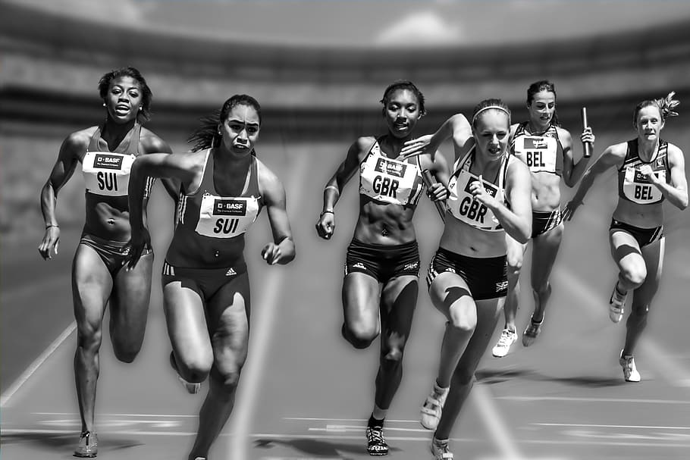


Arguments for Trade
Increased Variety of Goods
Increased Competition
Economies of Scale
Enhanced Flow of Ideas
Notes:
https://athomebrewer.com/best-german-beer/
https://datalanguage.com/news/scaling-up
https://www.piqsels.com/en/public-domain-photo-foujg
https://www.publictechnology.net/articles/news/innovative-ideas-invited-£25000-whitehall-prize

Slide 23
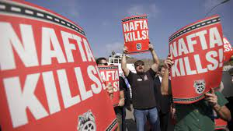
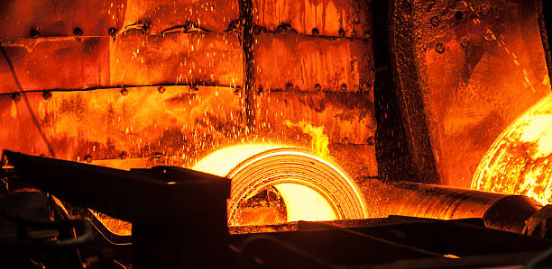
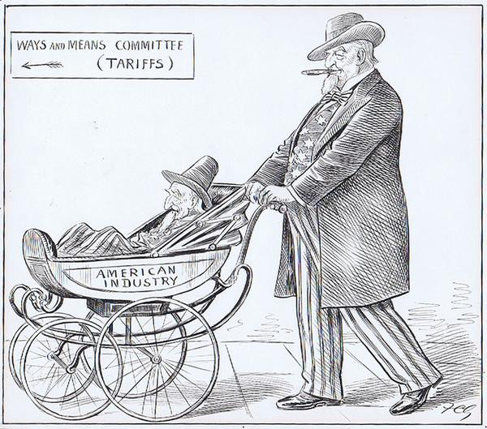
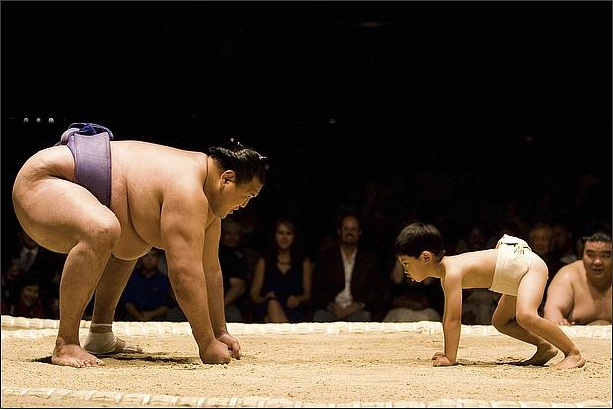

Arguments for Restricting Free Trade
Jobs Argument
National Security Argument
Infant Industry Argument
Unfair Competition Argument
Self-Reliance Argument
Notes:
https://www.npr.org/sections/thetwo-way/2016/11/11/501732648/after-22-years-is-nafta-headed-back-to-the-drawing-board
https://www.istockphoto.com/photos/hot-rolled-steel
https://www.legalteamusa.net/unfair-competition-how-does-it-relate-to-trademark-infringement/
https://dariusforoux.com/self-reliance/

