Slide 1
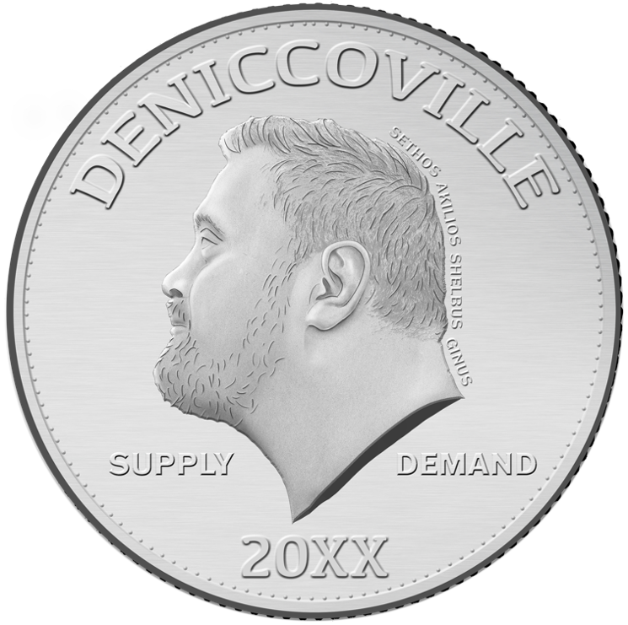
Money and Monetary Policy

Slide 2
Money and Monetary Policy
Objective: Identify the function of the federal reserve, describe the relationship between nominal interest rates, money demand and money supply, and describe the relationship between exchange rates and Net Exports.
What is money?
Who controls the money supply and how much money is there?
How does the Fed conduct monetary policy?
How can monetary policy help achieve full employment?
How do income and prices affect money demand?
What are exchange rates and what is their relationship with net exports and net capital outflows?
How does monetary policy affect exchange rates, net exports, and net capital outflow?
What is the purchasing power parity theory?

Slide 3

Money
Money - any asset that can be used in conducting transactions.
Liquidity - how quickly and easily can an asset can be used to conduct transactions.
Commodity Money - Money that takes the form of a commodity with intrinsic value.
Fiat Money: Money without intrinsic value that is used as money because of government decree.
Notes:
https://www.wallpaperflare.com/life-cycle-illustration-productive-life-goes-on-illustration-wallpaper-u/download/1366x768

Slide 4
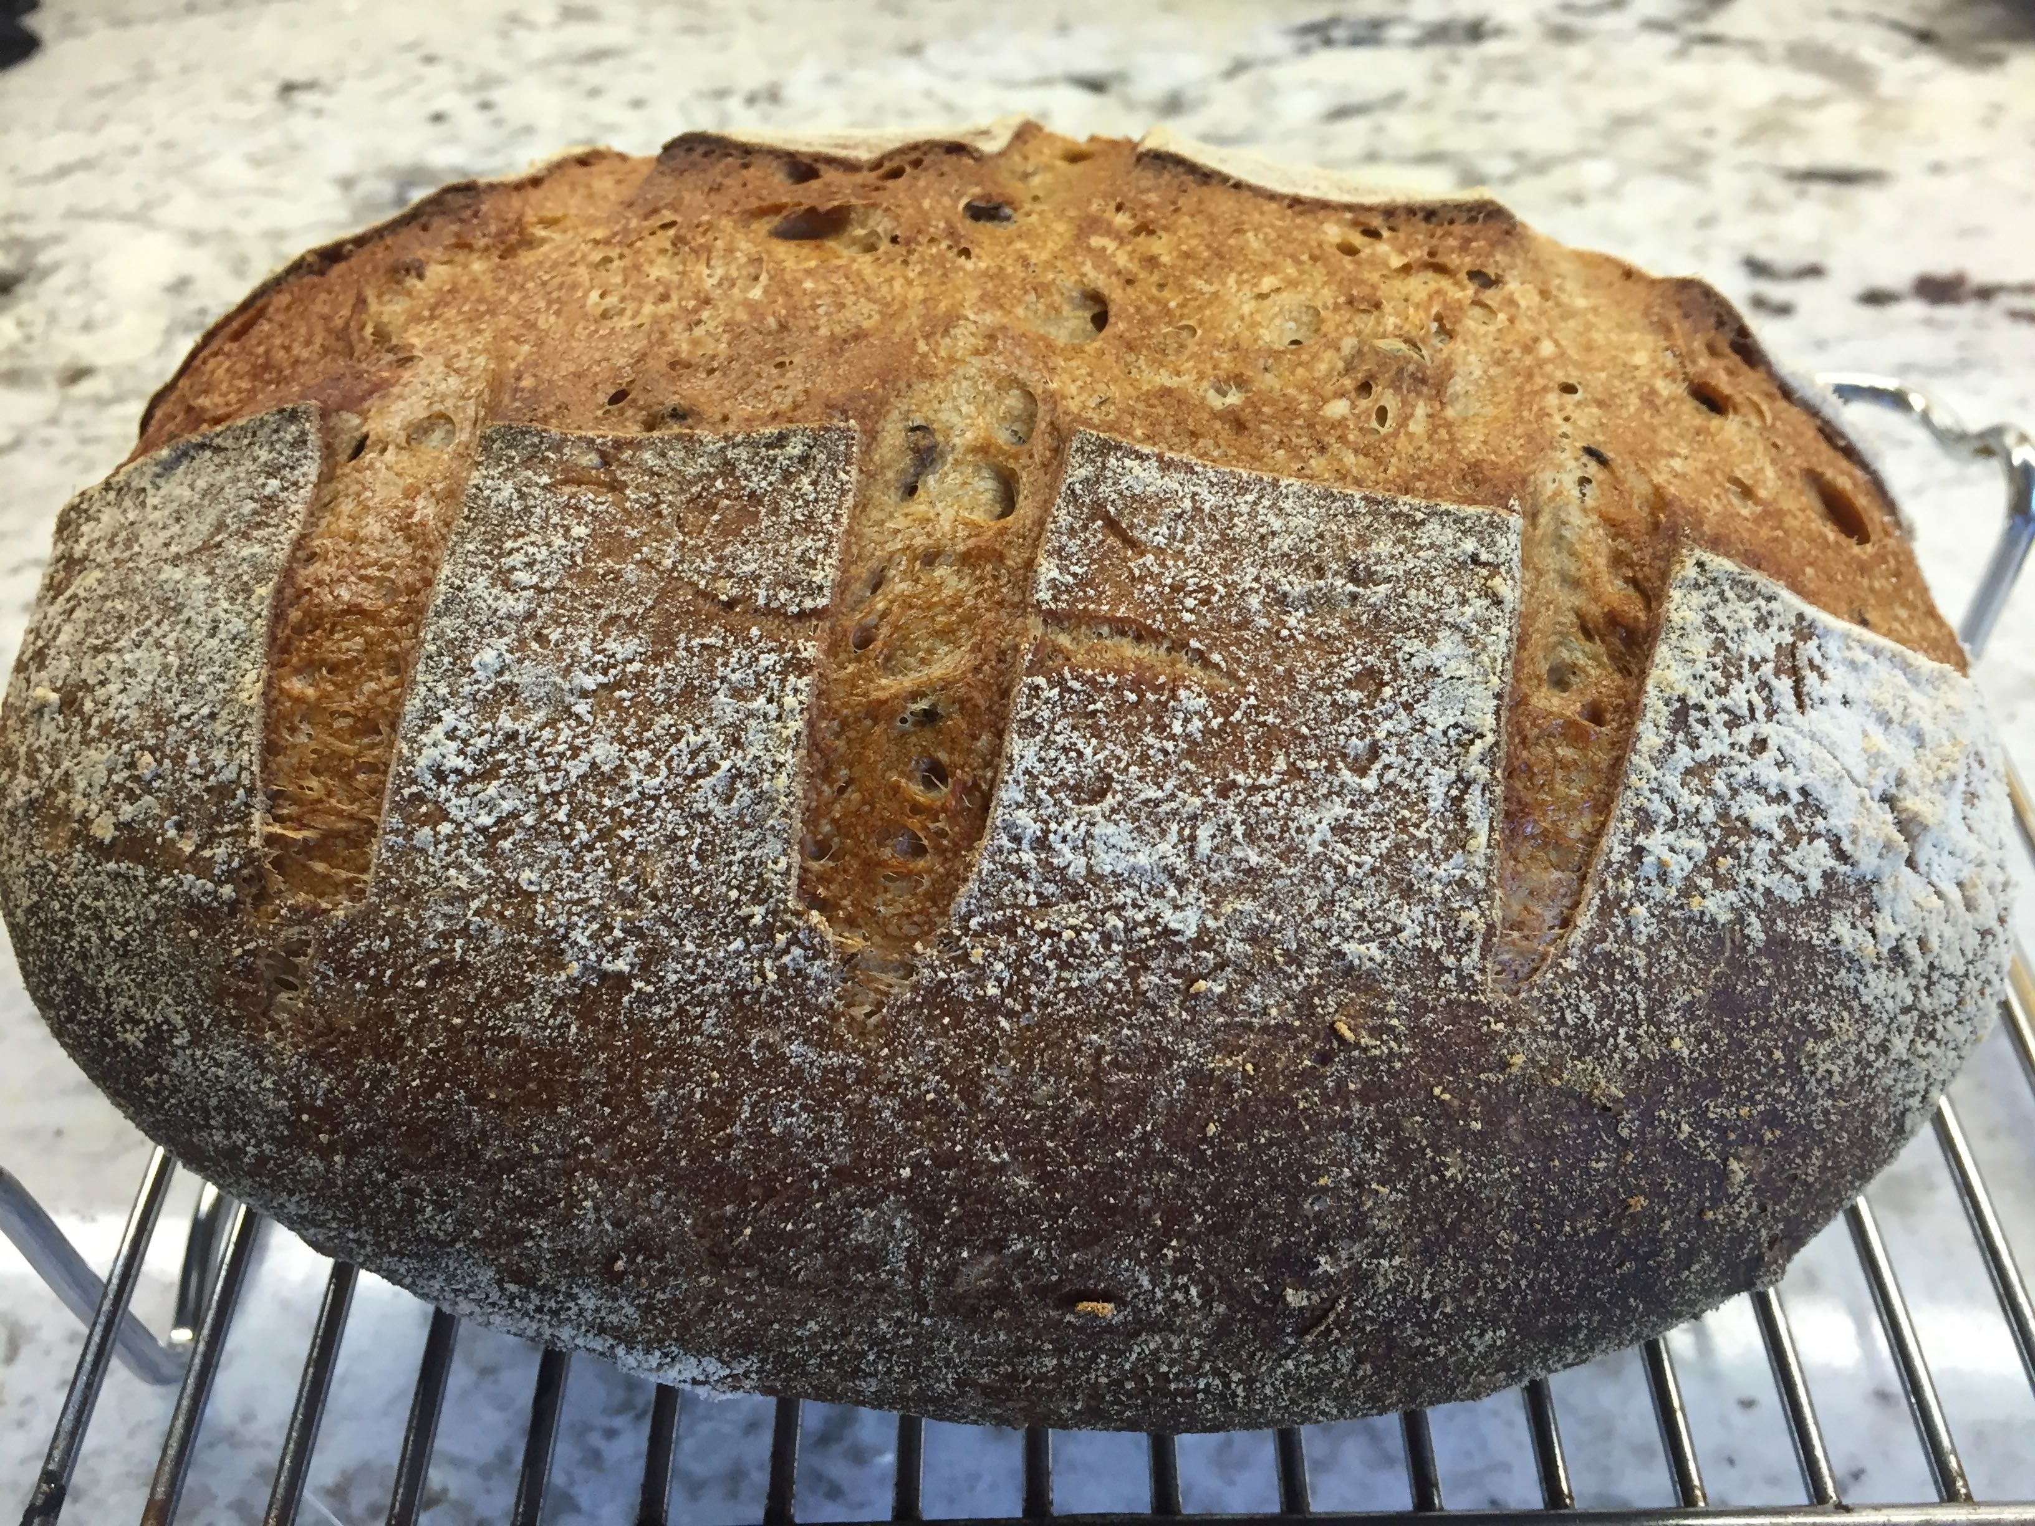
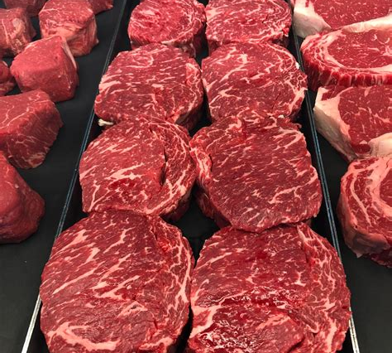
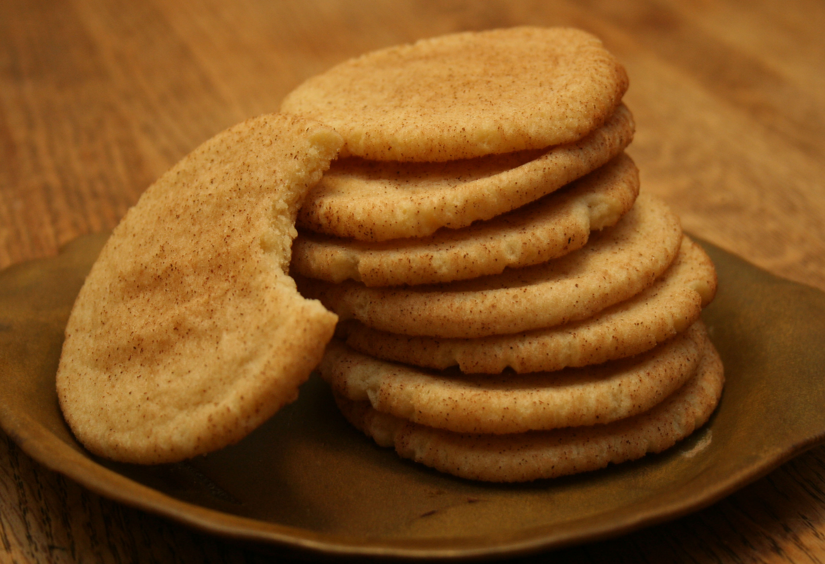


Three Roles of Money:
Medium of Exchange: an asset used in providing goods and services.
Unit of Account: a basic measure of economic value.
Store of Value: An asset that serves as a means of holding wealth. It is not a great one though unless you earn some interest that at least keeps up with inflation. The money under your mattress earns zero interest!
Notes:
https://www.pexels.com/photo/bread-sourdough-loaf-543276/
https://www.reddit.com/r/steak/comments/9okuq4/prime_saratoga_ribeye_take_the_cap_and_the_eye/
https://thatsonetoughcookie.com/2009/03/05/snickerdoodles/
https://www.pexels.com/photo/flower-designed-latte-159090/
https://www.pexels.com/photo/aroma-aromatic-art-artistic-434213/
https://actmedia.eu/financial-and-banking/cash-money-in-romania-doubled-in-5-years-suggesting-money-under-the-mattress-phenomenon/82492

Slide 5

Federal Reserve:
The Federal Reserve System is the central bank of the United States. It performs five general functions to promote the effective operation of the U.S. economy and, more generally, the public interest. The Federal Reserve:
conducts the nation’s monetary policy to promote maximum employment, stable prices, and moderate long-term interest rates in the U.S. economy;
promotes the stability of the financial system and seeks to minimize and contain systemic risks through active monitoring and engagement in the U.S. and abroad;
promotes the safety and soundness of individual financial institutions and monitors their impact on the financial system as a whole;
fosters payment and settlement system safety and efficiency through services to the banking industry and the U.S. government that facilitate U.S.-dollar transactions and payments; and
promotes consumer protection and community development through consumer-focused supervision and examination, research and analysis of emerging consumer issues and trends, community economic development activities, and the administration of consumer laws and regulations.
Notes:
https://www.federalreserve.gov/aboutthefed.htm

Slide 6
Money Supply: DeNiccoville
A new currency called DeNickles (D$) is created and D$1,500,000 are introduced into DeNiccoville. Required reserves are 5% and excess reserves are 5%. Assume the currency held by the public is D$ 500,000.
With a 10% Reserve to Deposit Ratio
Assets
Liabilities
Reserves = ?
Deposits = ?
Loans = ?
Money Supply = currency held by the public + deposits

Slide 7
Money Supply
With a 10% Reserve to Deposit Ratio
A.
Assets
Liabilities
Reserves = 100,000
Deposits = 1,000,000
Loans = 900,000
New Deposits = 900,000
Total Deposits = 1,900,000
_______________________________________________________________
B.
Assets
Liabilities
Old Reserves = 100,000
Old Deposits = 1,900,000
New Reserves = 900,000 x 10%
New Deposits = 810,000
Total Reserves = 190,000
Total Deposits = 2,710,000
New Loans = 810,000
Old Loans = 900,000
Total Loans = 1,710,000
Notes:
Old reserves, the 100,000 plus the 900,000 we got back.

Slide 8
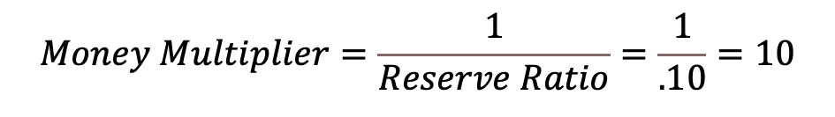
Money Supply
Eventually….
With a 10% Reserve to Deposit Ratio
Assets
Liabilities
Reserves = 1,000,000
Deposits = 10,000,000
Loans = 9,000,000
$$Money Multiplier=\frac{1}{Reserve Ratio}=\frac{1}{.10}=10$$
Money Supply = 500,000 + 10,000,000 = 10,500,000

Slide 9
Money Market
i
S_{M}
i, the nominal interest rate, is the opportunity cost of holding money.
i*
D_{M}
Q*_{M}
Q_{M}
Notes:
Talk about increase and decreasing money supply in terms of expansionary and contractionary monetary policy and what they are trying to do with consumption and investment (investment through real interest rates). Talk about Contractionary is to battle inflation.

Slide 10
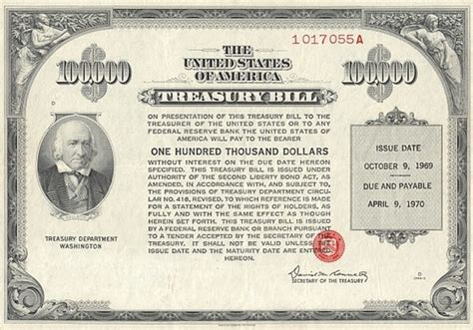
Monetary Policy: Open Market Operations
Open MKT Operations: consists of both open market purchases and open market sales of government bonds.
Notes:
https://invezz.com/news/2020/02/28/looking-at-us-treasury-bonds-in-2020/
Tell them bonds are actually from the treasury. Fed buys IOUs, not govt owes Fed.
From Fed website:
The monetary policy decisions of the Federal Reserve are made independently of the borrowing decisions of the federal government and are intended solely to fulfill the mandate set out for the Federal Reserve by law--maximum employment, stable prices, and moderate long-term interest rates.
The Federal Reserve purchases Treasury securities held by the public through a competitive bidding process. The Federal Reserve does not purchase new Treasury securities directly from the U.S. Treasury, and Federal Reserve purchases of Treasury securities from the public are not a means of financing the federal deficit.
In financing the federal deficit, the federal government borrows from the public by issuing Treasury securities which are sold at auction according to a schedule that is published quarterly. The Treasury determines the types and amounts of Treasury securities sold at auction with the goal of achieving the lowest financing costs for the federal government over time. The Federal Reserve does not participate in competitive bidding at Treasury auctions, and the Treasury's debt management decisions are not influenced by the Federal Reserve's purchases of Treasury securities in secondary markets.

Slide 11
Open Market Purchases
i
S_{M}
S_{M}
Open Market Purchases: purchases of government bonds for the purpose of increasing the supply of money and lowering the nominal interest rates
i
i’
D_{M}
Q_{M}
Q’_{M}
Q_{M}

Slide 12
Open Market Sales
S_{M}
S_{M}
i
Open Market Sales: sales of government bonds for the purpose of decreasing the supply of money and raising the nominal interest rates
i’
i
D_{M}
Q’_{M}
Q_{M}
Q_{M}

Slide 13

Monetary Policy: The Reserve Requirement
Reserve requirement is the minimum level of the ratio of reserves to deposits that commercial banks must hold.
Lower reserve requirements allow banks to loan out more money.
Notes:
https://www.wallpaperflare.com/safe-deposit-box-bank-safety-vault-illustration-artistic-3d-wallpaper-chrqe

Slide 14

Monetary Policy: The Discount Rate
Discount Window Lending: the lending of reserves by the Fed Commercial Bank (lender of last resort).
Discount Rate: the interest the Fed charges commercial banks to borrow reserves. Banks are more willing to borrow from the Fed.
* Federal Funds: Rate is the rate at which commercial banks charge one another for loans.
Notes:
https://pixabay.com/en/offer-sale-deal-discount-promotion-706849/

Slide 15
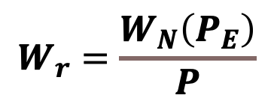




Phillips Curve
$$U=\overline{U}−a\left(π−π_{E}\right)$$
π
In the short run firms can charge higher prices and pay their workers the same so they can hire more workers and produce more. If firms get lower prices than they thought, they have to let workers go and produce less.
$$π>π_{E}$$
$$π=π_{E}$$
$$W_{r}=\frac{W_{N}\left(P_{E}\right)}{P}$$
$$π<π_{E}$$
Price expectations come from both sides, the consumer and the producer.
U_{low}
Ū
U_{high}
U
Notes:
Talk about monetary policy to increase employment/decrease unemployment. If firms get higher prices then they though, they can hire more workers. If firms get lower prices than they thought, they have to let workers go.

Slide 16
Phillips Curve

Slide 17


Expectations-Augmented Phillips Curve
π
The Expectations-Augmented Phillips curve allows that if actual inflation rises, expected inflation and nominal wages can also increase, keeping the real wage the same and shifting the Phillips Curve upward.
This can lead to stagflation, which is a situation with high rates of inflation and high rates of unemployment.
$$π=π_{E}$$
$$π=π_{E}$$
Ū
U
Notes:
Talk about firms anticipating what the fed will do. They raise nominal wages to be competitive so other companies won’t steal their workers.

Slide 18
Money Demand: Income and Price Level
i
S_{M}
An increase in either income or prices increase the demand for money and shifts the demand curve to the right, driving up the nominal interest rate.
i’
i
D’_{M}
D_{M}
Q_{M}
Q_{M}

Slide 19

Open Economy: Exchange Rates
Nominal Exchange Rate (NER): the rate at which a person can trade the currency of one country for the currency of another.
U.S. exchange Rate with Euro: How many Euros can I buy with one dollar.
Appreciation: an increase in the value of a currency as measured by the amount of foreign currency it can buy.
Depreciation: a decrease in the value of a currency as measured by the amount of foreign currency it can buy.
Notes:
https://pixabay.com/illustrations/dollar-rate-world-economy-boom-1881265/

Slide 20

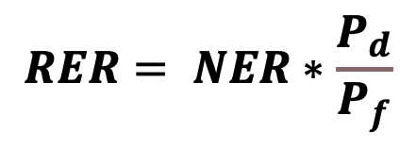
Open Economy: Exchange Rates
Real Exchange Rate(RER): the rate at which a person can trade the goods and services of one country for the goods and services of another.
The RER equals the nominal exchange rate adjusted by the ratio of domestic to foreign prices.
$$RER= NER∗\frac{P_{d}}{P_{f}}$$
Real exchange rates are a key determinant of net exports. Appreciation means that domestic goods have become relatively more expensive than foreign goods. This discourages exports and encourages imports, drives down net exports.
American Cheese,
made in America
VS
American Cheese,
made in Canada
Notes:
Talk in terms of lb of American cheese and 1 lb of Canadian Americamn Cheese, same price one day. (real exchange rate is 1). Next day you can buy same amount of American cheese, but 2 lb Mexican cheese. Real exchange rate is 2 now and dollar appreciated in real terms. We export less and import more, because our stuff become more expensive relative to their stuff.
https://www.flickr.com/photos/peachyogurt/6348377385/
https://commons.wikimedia.org/wiki/Category:American_cheese
You take the nominal exchange rate and adjust it by the ratio of prices to find out how much stuff you can buy!

Slide 21
Open Economy: Exchange Rates
Supply of Dollars for Net Capital Outflows
Supply of dollars from NCO is vertical because it does not depend on real exchange rates, it depends on real interest rates.
Demand for dollars for NX is downward sloping because as the real exchange rate depreciates and US goods and services become relatively cheaper.
Foreign countries need to exchange their currency for U.S. dollars in order to buy U.S. goods and vice versa.
RER
RER*
Demand for Dollars for Net Exports
Q*_{$,NX, NCO}
Quantity of Dollars Exchanged into Foreign Currency for Net Exports and Net Capital Outflows
Notes:
Supply does not depend on the RER it depends on the real interest rate. Yes the RER affects the price of assets, but to get return on the asset back into your currency the exchange rate benefit would be wiped out.
If Americans demand more foreign goods and services, yes we would haver to supply dollars to do that but it shows up as a decrease in the demand for to purchase American goods and services, because supply here is strictly for assets.
RER=(e*Pd)/Pf talk in terms of this
Supply : lower domestic r leads to +NCO with dollars chasing (buying) foreign assets. We exchange dollars for foreign currency and buy foreign assets. Yes, then foreigner have our dollars, but the exchange rate depreciates with the increased supply of dollars and we export more, which means foreigners relinquish their ownership of our assets to buy our goods and services.
Demand for dollars is to buy American goods. As real exchange rate decreases, the us demands more of our dollars and foreign countries demand more of our dollars to buy American goods and services. As real exhcnage rate rise, US goods become more expensive and we and other countries demand less dollars to buy American goods and services.
As foreign interest rates go up there is an increase in the supply of dollars in the world market exchanged for foreign currency to by foreign assets from us and the other countries.
http://www.policonomics.com/loanable-funds/

Slide 22
Open Economy: Exchange Rates
Supply of dollars
A decrease in domestic real interest rates or an increase in foreign real interest rates, results in an increase in the supply of dollars exchanged into foreign currency searching out a higher return on assets.
With an increased supply of dollars in foreign markets, there is depreciation of the RER making domestic goods and services relatively cheaper compared to foreign goods and services, driving up NX.
This means foreigners relinquish their ownership of our assets to buy our goods and services. This drives up NCO!
S_{NCO}
S’_{NCO}
RER
RER
RER’
D_{NX}
Q_{$,NX,NCO}
Q’_{$,NX,NCO}
Q_{$,NX,NCO}
Notes:
REX=(e*Pd)/Pf talk in terms of this
Supply : lower domestic r leads to +NCO with dollars chasing (buying) foreign assets. We exchange dollars for foreign currency and buy foreign assets. Yes, then foreigner have our dollars, but the exchange rate depreciates with the increased supply of dollars and we export more, which means foreigners relinquish their ownership of our assets to buy our goods and services.
If Demand for us dollars increases for net exports, the real exchange rate goes up to offset the change in net exports so that net exports still equals NCO. NCO don’t change with a shift in demand because there was no change in the real interest rate.

Slide 23
Monetary Policy and Exchange Rates: Open Market Sale
S’_{M}
S_{M}
i
r
S’_{LF}
D_{LF}
S_{LF}
r’
i’
r
i
D_{M}
Q’_{M}
Q_{M}
Q_{M}
Q’_{LF}
Q_{LF}
Q_{LF}
Notes:
r=i-pie, holding prices constant, increase i will certainly increase r. As long as inflation increases less than the nominal interest rate changes, r will still change. In the short run, we consider prices sticky so inflation doesn’t change.
Now if the price decrease is enough to off set it, then there would be no change in r. That would occur if the higher interest rate results in more people saving to offset the decrease in savings from lower money supply.
Open market sale, decreases supply of loanable funds, decreases investment and Y decreases so savings decreases with investment.

Slide 24
Effect of Monetary Policy on Exchange Rates: Open Market sale
S’_{NCO}
S_{NCO}
RER
Contractionary Monetary Policy; higher nominal interest rates; higher real interest rates; increased demand for the U.S. assets; decrease in the Supply of dollars from Net Capital Outflows; appreciation of exchange rate; decrease in Net Exports
RER’
RER
D_{NX}
Q’_{$,NX,NCO}
Q_{$,NX,NCO}
Q_{$,NX,NCO}
Notes:
Lower Talk in terms of more expensive, but actually it takes more of my goods and services to get more of your goods and services. Talk about higher domestic interest rates makes people want to have dollars in the US to take advantage of. Dollars come home.

Slide 25
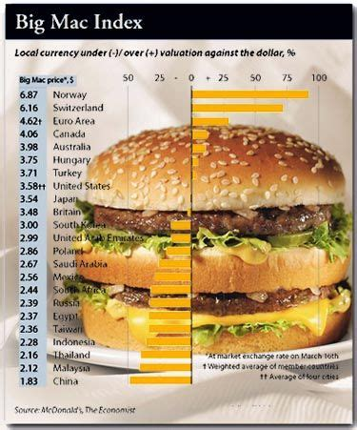
Purchasing Power Parity Theory
Purchasing Power Parity: a theory of exchange rates whereby a unit of any given currency should be able to buy the same quantity of goods in all countries.
Notes:
https://www.pinterest.com/pin/340936634269471714/

Slide 26
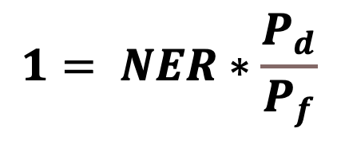
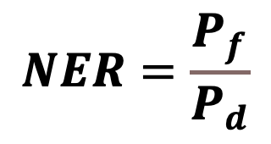
Purchasing Power Parity Theory
The “Law of One Price” – a good must sell for the same price in all locations otherwise there would be arbitrage situation, which a situation where a trader can profit from the imbalance of asset prices in different markets.
The theory is that in the long run, this guides exchange rates. Under purchasing power parity, the nominal exchange rate between currencies of two currencies must reflect the price levels in those countries.
$$1= NER∗\frac{P_{d}}{P_{f}}$$
$$NER=\frac{P_{f}}{P_{d}}$$
Notes:
Example of two McDonalds on campus. Or example of arbitrage between two countries. Country selling at a lower price could raise prices so the other country can’t import and make profit off of them. They might as well get the profits at the higher price.

Slide 27


Purchasing Power Parity Theory
The PPP does not hold perfectly, however, because goods are not able to be traded without cost, and goods are usually not perfect substitutes, which can result in quality differences and preferences.
Notes:
https://pixabay.com/illustrations/cost-dollar-finance-money-business-1174932/

Slide 28
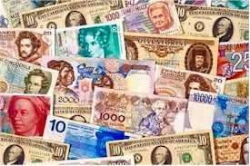
Purchasing Power Parity Theory
While the PPP and Law of One Price may not hold perfectly, the theories are still useful to help us understand changes in nominal exchange rates.
The costs of trade and the differences in products allow the RER to deviate from one, but only to a point. If the RER moves too far away from one, an arbitrage situation will be created.
The PPP theory captures the fact that changes in nominal exchange rates over time often just reflect changes in the prices of goods and services between countries.
Notes:
http://compsci.ca/blog/24-money-saving-ideas-for-university-students/

