Slide 1

A Story of Economics: A Principles Tale
ACT II: Getting Down to Business
7. The Costs of Production
8. Perfect Competition
9. Monopoly
10. Monopolistic Competition and Oligopoly
11. Household Choices

Slide 2

The Costs of Production

Slide 3
The Costs of Production
Objective: Identify the costs of production and interpret their shapes.
  What is the difference between economic profit and accounting profit?
  What costs do firms face in production?
  What are the shapes of the costs curves a typical firm faces in production?
  What are economies of scale in the long run?

Slide 4
Total Revenue, Total Cost and Profit
Total Revenue
The amount a firm receives for the sale of its output.
Total Cost
The market value of the inputs a firm uses in production.
Profit
Total revenue minus total cost.
PROFIT = REVENUE - COST
⬆
To increase this…
⬆
you must increase this…
⬆
or decrease this…

Slide 5
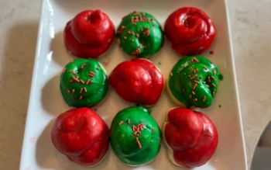

Conan’s Cookie Cakes
Notes:
https://www.wallpaperflare.com/men-warrior-long-hair-wavy-hair-beard-armor-battle-axe-wallpaper-grpzi

Slide 6
Cookie Instructions
Cookie Ingredients: 5 eggs, 1 cup sugar, ½ cup butter, 2 tsp. vanilla extract, 1 tsp. lemon extract, about 4 cups flour and 4 tsp. of baking powder.
Icing Ingredients: About 2 cup confectioner’s sugar, 2 tsp. vanilla, 2 tsp. vanilla extract 1 tsp. lemon extract, and water.
Cookie Instructions: Get two big bowls. In one sift the flour and baking powder together. In another cream the butter (leave butter out for an hour or so and it will be perfect) and sugar together and mix in eggs, vanilla extract, and lemon extract. Add in the flour and baking powder mix. Knead the dough until it is firm. It shouldn’t ne sticky. You will probably need to add more flour as you do this. Put it in the refrigerator for an hour or so and then take it out and make the cookies. I like to make mine a little bigger, but you take piece of dough and roll it into a worm shape about 6 inches long about the thickness of just under a quarter. Then you wrap the tube around and up into the shape you see in the picture. Bake at 375 degrees for 8-12 minutes depending on the size. The bottom of it should have a light brown color when it is done. Take them out and let them cool.
Icing Instructions: Put the confectioner’s sugar into a bowl and add the vanilla and lemon extract. Add a little bit of water at a time and stir. You don’t want the icing too runny or too thick. You will have to practice getting it just how you want it. Then dip the top of the cookie in the icing, twirl it around a little and let it dry.

Slide 7

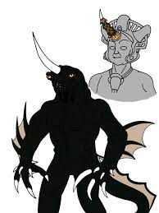
Costs as Opportunity Costs
Explicit Costs
Input costs that require an outlay of money by the firm.
  Conan spends rubies on flour for his cookie shop. This is an explicit cost, but also an opportunity cost because he could use the rubies elsewhere like paying to have his sword sharpened and polished.
Implicit Costs
Input costs that do not require an outlay of money by the firm.
  Conan spends his time setting up his cookie shop. This is an opportunity cost because he could be doing something else with his time, like fighting the dreaming god Dagoth as a hired sword to earn more rubies or relaxing with a nice skull mug of ale.
Notes:
https://pixabay.com/photos/gems-jewelry-rubies-jewel-3418293/
https://www.deviantart.com/kooshmeister/art/The-Dreaming-God-152885130

Slide 8
Economist Versus Accountant
Economic Profit
Accounting Profit
Economic profit
Accounting profit
revenue
Implicit costs
revenue
Explicit costs
Explicit costs
Notes:
Use example of doctor opening restaurant. 100K as doctor ; 600K revenue from restaurant – 500 explicit costs….accounting profit but 0 ecnomic.

Slide 9
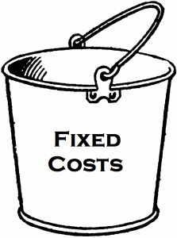
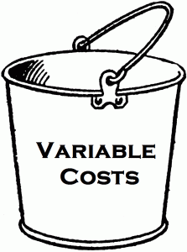
Types of Cost: Two Big Buckets
Fixed Cost: costs that do not vary with the quantity of output produced.
Here we will consider the cost of capital to be fixed.
Variable Cost: costs that vary with the quantity of output produced.
Here we will consider the cost of labor to be variable.

Slide 10
Production Function
Production Function: relationship between quantity of inputs used to make a good and the quantity of output of that good.
Marginal Product : increase in output from and additional unit of input.
Diminishing Marginal Product: the property whereby the marginal product of an input declines as the quantity of the input increases.
Number of Workers | Output | Marginal Product of Labor | Fixed Cost of Capital | Variable Cost of Workers | Total Costs
0 | 0 |  | 100 | 0 | 100
1 | 100 | 100 | 100 | 50 | 150
2 | 180 | 80 | 100 | 100 | 200
3 | 240 | 60 | 100 | 150 | 250
4 | 280 | 40 | 100 | 200 | 300
5 | 300 | 20 | 100 | 250 | 350
6 | 310 | 10 | 100 | 300 | 400

Slide 11
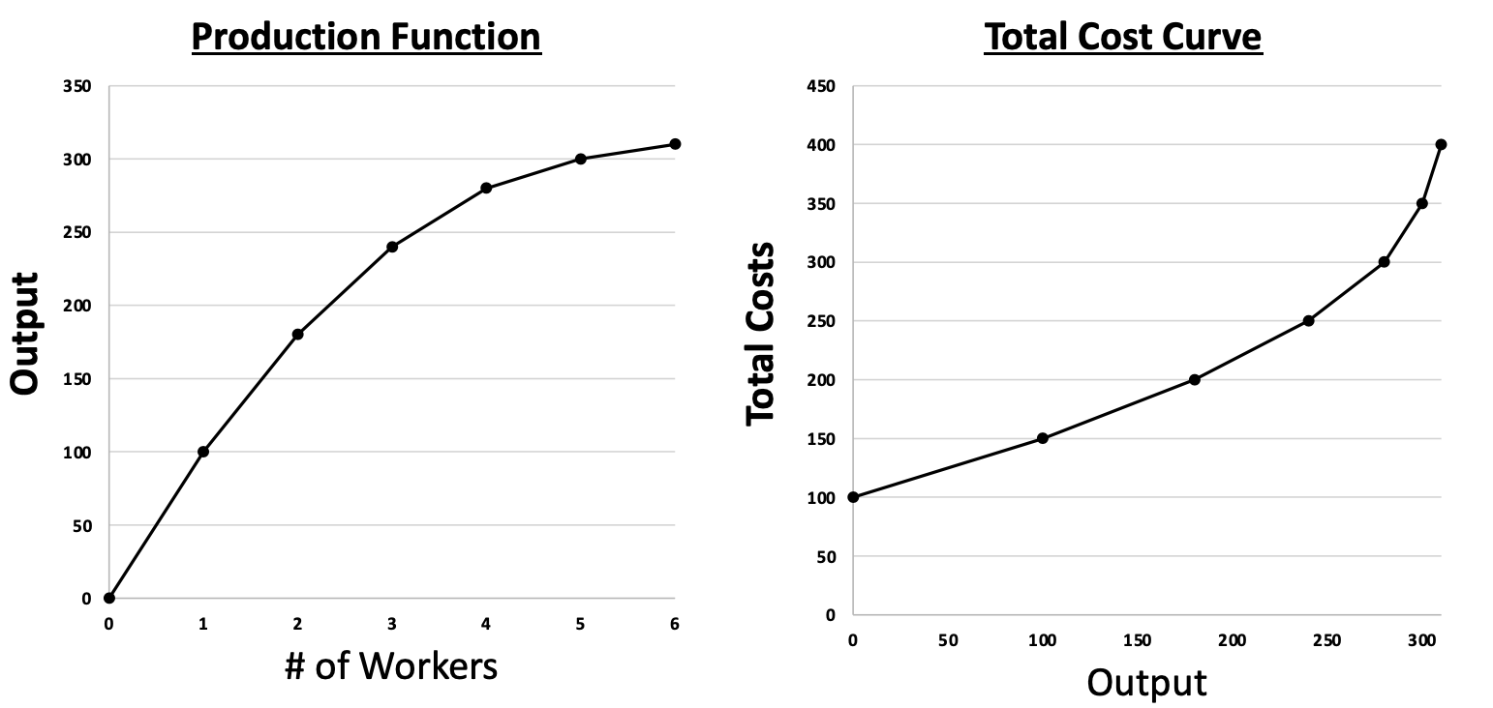
Production Function and Total Cost Curve
Notes:
Draw picture showing first making 50 units, second 30 and third 20 for costs going up when each paid $10.

Slide 12
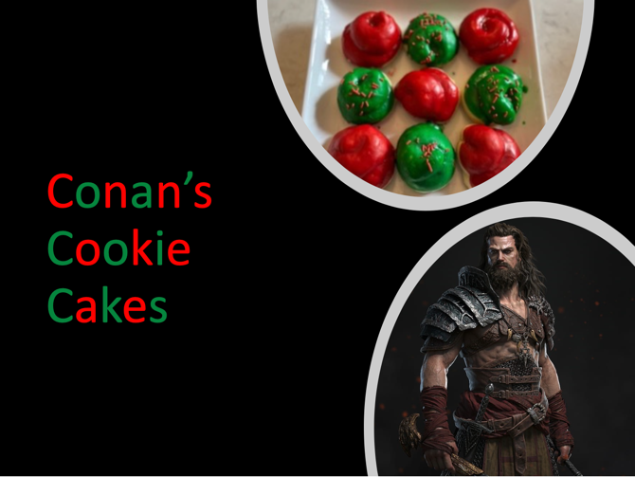
Rising Marginal Cost
When you fix capital and increase labor, production will increase at a decreasing rate.
Production increases because the capital will be used more often as we add more workers. There will be less idle time for the capital.
However, the size of the increase in production gets smaller and smaller as we add workers. If the capital doesn’t increase as well, workers need to share creating logistical and coordination issues resulting in more idle time for workers.
At low levels of production, it is easier and less costly to produce one more unit. At high levels of production, it is more difficult and more costly to produce one more unit.

Slide 13
Teamwork Effect
Number of Workers | Output | Marginal Product of Labor | Cost of Capital | Cost of Workers | Total Costs
0 | 0 |  | 100 | 0 | 100
1 | 10 | 10 | 100 | 50 | 150
2 | 40 | 30 | 100 | 100 | 200
3 | 90 | 50 | 100 | 150 | 250
4 | 130 | 40 | 100 | 200 | 300
5 | 160 | 30 | 100 | 250 | 350
6 | 180 | 20 | 100 | 300 | 400
7 | 190 | 10 | 100 | 350 | 450
8 | 195 | 5 | 100 | 400 | 500

Slide 14
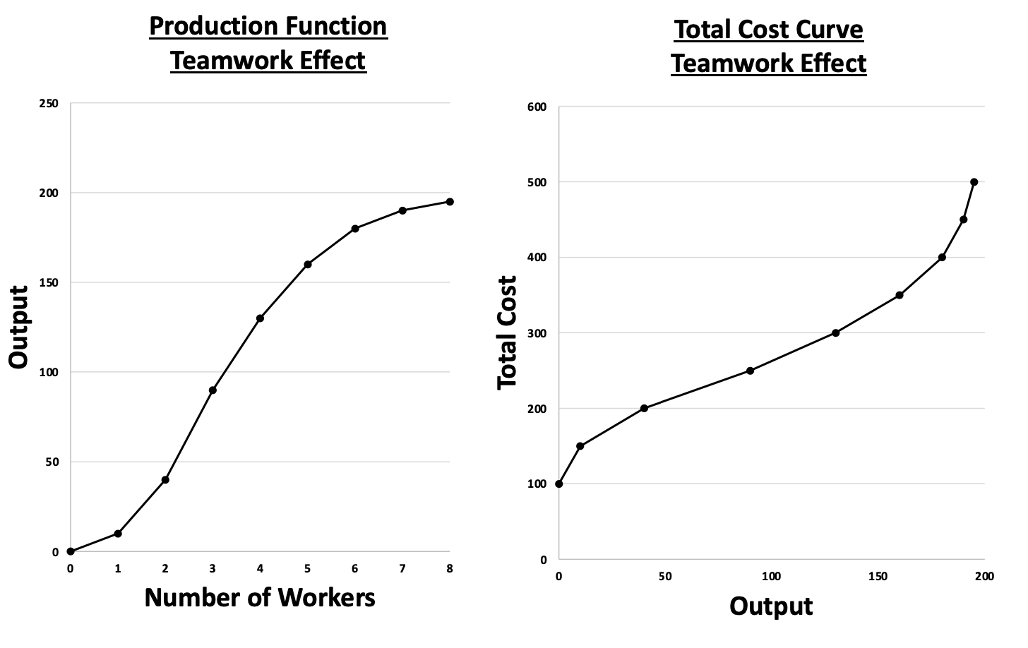
Teamwork Effect

Slide 15
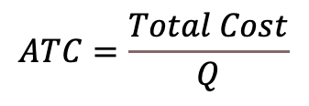
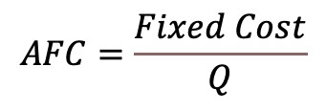
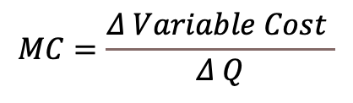
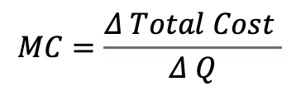
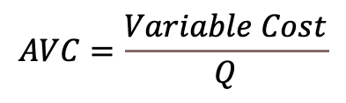
Average and Marginal Cost
$$AFC=\frac{Fixed Cost}{Q}$$
Average Fixed Cost: fixed cost divided by the quantity of output.
$$AVC=\frac{Variable Cost}{Q}$$
Average Variable Cost: variable cost divided by the quantity of output.
$$ATC=\frac{Total Cost}{Q}$$
Average Total Cost: total cost divided by the quantity of output. It is also AFC+AVC.
$$MC=\frac{Δ Total Cost }{Δ Q}$$
Marginal Cost: the increase in total cost that arises from and extra unit of production. It is the change in total cost to produce one more unit or the change in variable cost to produce one more unit.
or
$$MC=\frac{Δ Variable Cost }{Δ Q}$$

Slide 16
Shape of AFC
AFC decreases at a decreasing rate. That is because you pay this cost once no matter how many units you produce.
Q | Fixed Cost | Average Fixed Cost | Change in Average Fixed Cost
1 | $100 | $100
2 | $100 | $50 | -$50.00
3 | $100 | $33 | -$16.67
4 | $100 | $25 | -$8.33
5 | $100 | $20 | -$5.00
6 | $100 | $17 | -$3.33
7 | $100 | $14 | -$2.38
8 | $100 | $13 | -$1.79
9 | $100 | $11 | -$1.39
10 | $100 | $10 | -$1.11
cost
AFC
Q

Slide 17
Shape of MC
MC - The shape of the MC curve is driven by the production function. With the teamwork effect, the marginal cost falls. With diminishing marginal returns, the marginal cost rises. The MC must cross the AVC and the ATC at their minimum points. The MC is the next cost. If the next cost is below the average, the average falls. If it is above the average, the average rises.
cost
MC
AFC
Q

Slide 18
Shape of AVC
The AVC curve is shaped by the MC curve. The MC is the change in the VC. With the teamwork effect, the marginal cost decreases causing the AVC to fall. With diminishing marginal returns, the marginal cost begins to rise. Once the marginal cost rises above the AVC, the AVC begins to rise.
cost
MC
AVC
AFC
Q

Slide 19
U-Shaped ATC
ATC is the sum of AFC and AVC. At first both the AFC and the AVC fall causing the ATC to fall. Then the AVC begins to rise but more slowly than the AFC falls, leaving the ATC falling. Eventually at efficient scale, the AVC begins rising faster than the AFC falls causing the ATC to rise.
cost
MC
Efficient Scale
ATC
AVC
AFC
Q

Slide 20
Short Versus Long Run ATC
Costs that are fixed in the short run can be variable in the long run.
  i.e. We can move from a small factory to a larger factory.
  Economies of Scale: the property whereby the long-run average total cost falls as the quantity of output increases.
  Constant Returns to Scale: the property whereby the long-run average total cost stays the same as the quantity of output increases.
  Diseconomies of Scale: the property whereby the long-run average total cost rises as the quantity of output increases.
Average
Total Cost
economies of scale
diseconomies of scale
constant returns to scale
Q
Notes:
Economies of scale – share resources, materials, management knowledge….constant – at some point getting larger requires hiring people to watch people, payroll, quality control, scheduling, human resources, all things that don’t go toward producing, logistical constraints cancel out efficiency gains…diseconomies – big bureaucracy with logistical constraints overwhelming efficiency gains. So talk about not only the average fixed costs resetting but the AVC slowing down from sharing resources, management and such.

