Slide 1

Elasticity

Slide 2
Elasticity
Objective: Calculate and interpret the meaning of an elasticity coefficient.
What is the price elasticity of demand?
How do we calculate the price elasticity of demand?
What is the relationship between the price elasticity of demand and revenue?
What is the income elasticity of demand and the cross-price elasticity of demand for a good?
What is the price elasticity of supply?

Slide 3

Price Elasticity of Demand
Elasticity: a measure of the responsiveness of the quantity demanded or quantity supplied to a change in one of its determinants.
Price Elasticity of Demand: is a measure of how much the quantity demanded for a good or service responds to a change its price, computed as the percentage change in quantity demanded divided by the percentage change in price.
Notes:
http://www.thunderboltkids.co.za/Grade5/03-energy-and-change/chapter3.html

Slide 4
Price Elasticity of Demand
P
B
Demand curve “A” is more elastic than demand curve “B” at every price. With a flatter slope, there will be a larger percent change in the quantity demanded for a given change in price.
A
P₁
P₂
Q₁
Q_{2B}
Q_{2A}
Q

Slide 5
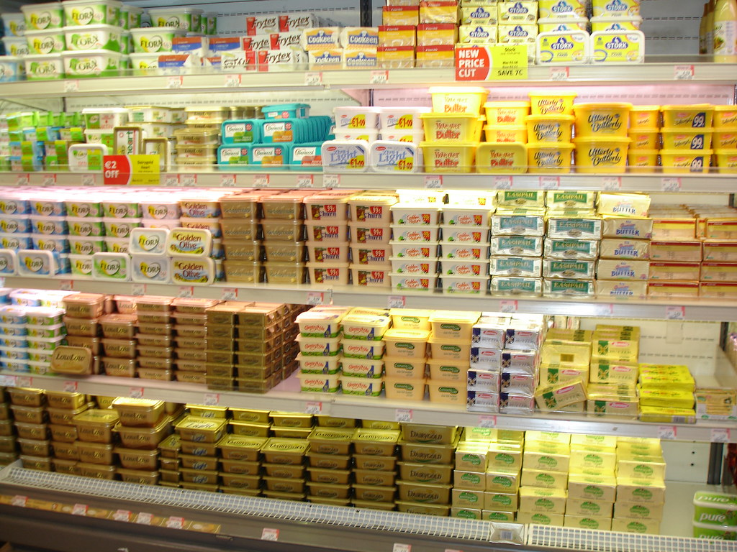
Factors of the PED
Availability of Close Substitutes: goods with close substitutes tend to be more elastic.
If the price of butter goes up, I will just buy more margarine.
Notes:
https://www.flickr.com/photos/dianeduane/193888611

Slide 6

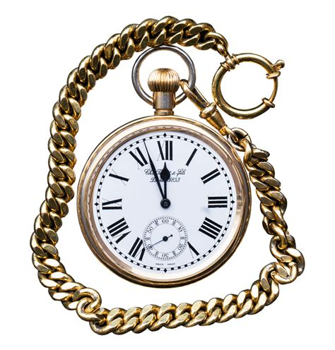
Factors of the PED
Necessities versus Luxuries: necessities tend to be less elastic than luxury items.
I need to take my heart medication even if it is expensive, but I might wait for a sale on that new pocket watch.
Notes:
https://www.piqsels.com/en/public-domain-photo-otrvf/download
https://pixabay.com/photos/pocket-watch-clock-close-up-old-2531472/

Slide 7
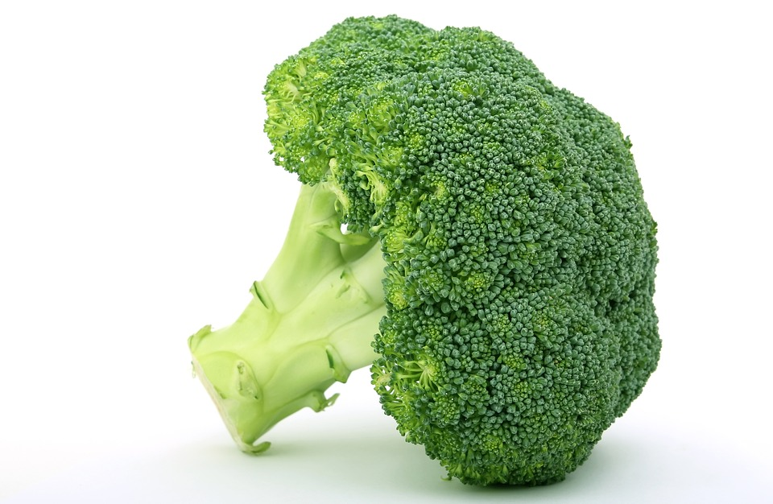
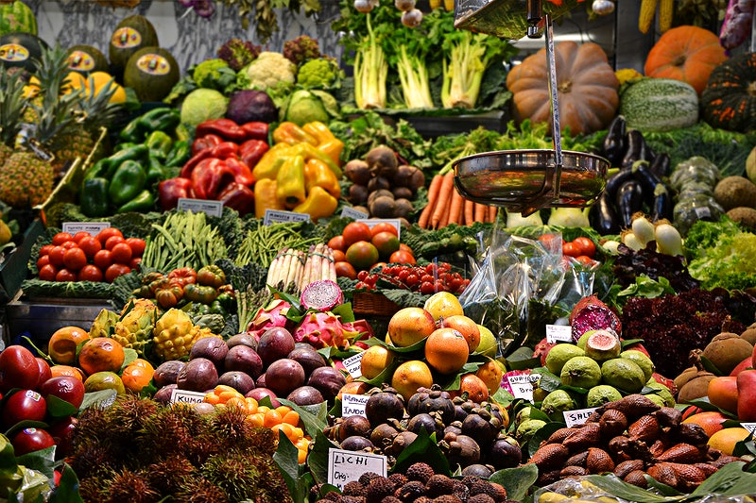
Factors of the PED
Broadness of the market: broader markets tend to be less elastic.
The vegetable market will be less elastic than the broccoli market with more substitutes.
Notes:
https://pixabay.com/da/photos/appetit-broccoli-brocoli-broccolli-1238251/
https://www.wallpaperflare.com/assorted-fruits-at-the-market-assorted-vegetable-lot-shop-marketplace-wallpaper-wjcvg

Slide 8

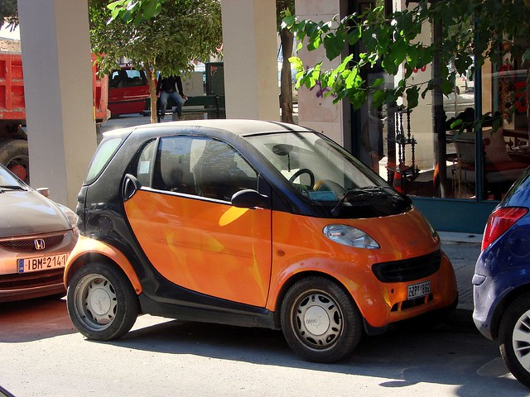
Factors of the PED
Time Horizons: goods tend to have more elastic demand over longer time horizons.
When the price of gasoline goes up, initially we don’t decrease our consumption by much because of our dependence. Over time, however, we can switch to more fuel-efficient cars, carpool or may ride a skateboard!
Notes:
https://flickr.com/photos/orangejack/1528513146

Slide 9
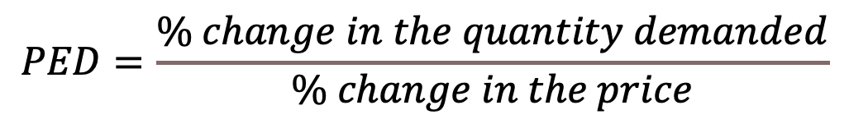

Calculating the PED
$$PED=\frac{\% change in the quantity demanded}{\% change in the price}$$
Let’s say the price of a good increases by 5% and the quantity demanded decreases by 1%.
$$PED=\frac{1}{5}=0.2$$
Notice there is no negative sign on the change in quantity. We report price elasticity of demand in absolute values. We know prices and quantities are negatively correlated, however.

Slide 10
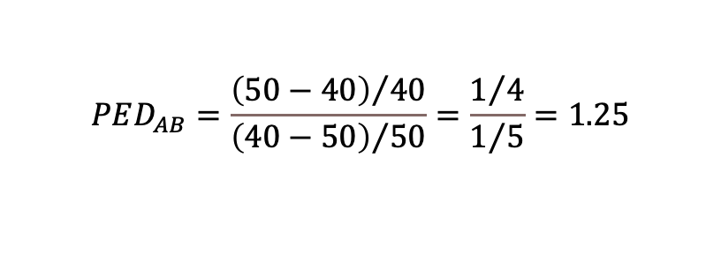
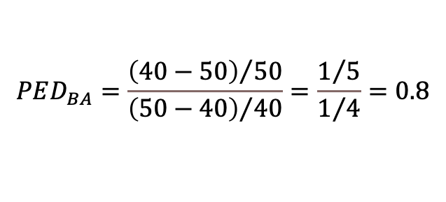
Midpoint Method
The problem with the first way:
Point A | Price = $50 | Quantity = 40
Point B | Price = $40 | Quantity = 50
Using simple percent changes from A to B, the price falls by 20% and the quantity rises by 25%, indicating a price elasticity of demand of 1.25. However, from B to A, the price rises by 25% and the quantity falls by 20% indicating a price elasticity of demand of 0.8.
$$PED_{AB}=\frac{{\left(50−40\right)}/{40}}{{\left(40−50\right)}/{50}}=\frac{1/4}{1/5}=1.25$$
$$PED_{BA}=\frac{{\left(40−50\right)}/{50}}{{\left(50−40\right)}/{40}}=\frac{1/5}{1/4}=0.8$$

Slide 11
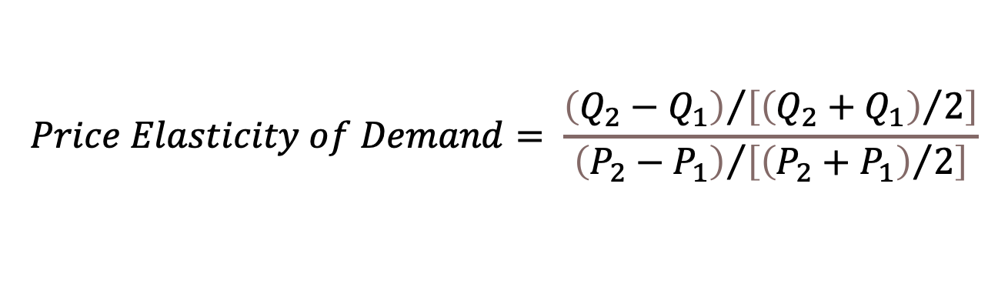
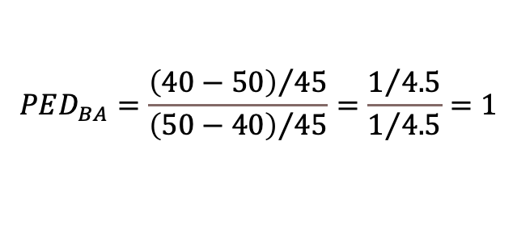
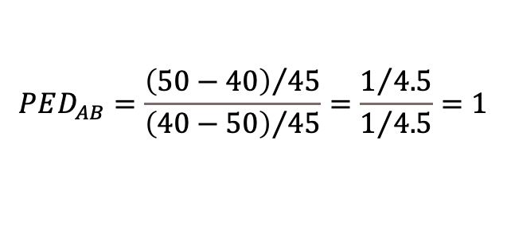
Midpoint Method
Point A | Price = $50 | Quantity = 40
Point B | Price = $40 | Quantity = 50
Midpoint | Price = $45 | Quantity = 45
$$Price Elasticity of Demand= \frac{{\left(Q_{2}−Q_{1}\right)}/{\left[{\left(Q_{2}+Q_{1}\right)}/2\right]}}{{\left(P_{2}−P_{1}\right)}/{\left[{\left(P_{2}+P_{1}\right)}/2\right]}}$$
$$PED_{AB}=\frac{{\left(50−40\right)}/{45}}{{\left(40−50\right)}/{45}}=\frac{1/{4.5}}{1/{4.5}}=1$$
$$PED_{BA}=\frac{{\left(40−50\right)}/{45}}{{\left(50−40\right)}/{45}}=\frac{1/{4.5}}{1/{4.5}}=1$$

Slide 12
Family of Demand Curves
Perfectly Inelastic = 0
Inelastic Demand < 1
P
P
50
50
22% increase
40
Unit elastic Demand = 1
40
P
22% increase
50
50
Q
40
90
95
Q
5.4% decrease
Perfectly Elastic = ∞
Elastic Demand > 1
P
P
any price above $40, quantity demanded is 0
40
50
Q
22% decrease
50
22% increase
40
at exactly $40, consumers will buy any quantity
40
any price below $40, quantity demanded is infinite.
Q
70
95
Q
30% decrease

Slide 13
The PED and Revenue
The impact of a price change on total revenue depends on the elasticity of demand.
Total Revenue = Price x Quantity
The Case of Inelastic Demand
The Case of Elastic Demand
A: TR=$40*95=$3,800
A: TR=$40*95=$3,800
B: TR=$50*90=$4,500
B: TR=$50*70=$3,500
Price
Price
$50
$50
$40
$40
90
95
70
95
Quantity
Quantity

Slide 14
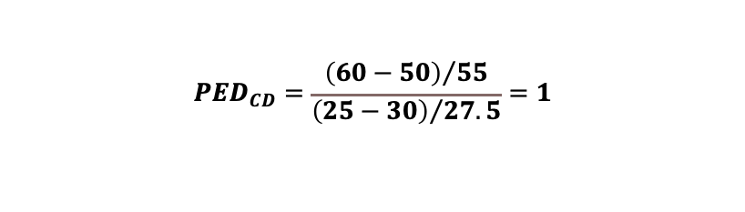


The PED Along a Linear Demand Curve
The slope of a linear demand curve is constant, but the elasticity along the curve is not.
slope is the ratio of changes in the two variables and elasticity is the ratio of percent changes.
At points with a high price and low quantity – elastic
At points with a low price and high quantity – inelastic
P
$$PED_{AB}=\frac{{\left(20−10\right)}/{15}}{{\left(45−50\right)}/{47.5}}=6.3$$
A
50
B
45
$$PED_{CD}=\frac{{\left(60−50\right)}/{55}}{{\left(25−30\right)}/{27.5}}=1$$
C
30
D
25
E
$$PED_{EF}=\frac{{\left(100−90\right)}/{95}}{{\left(5−10\right)}/{7.5}}=0.16$$
10
F
5
10
20
50
60
90
100
Q

Slide 15


The PED Along a Linear Demand Curve
A to B: When prices are too high, you don’t have enough demand . Lowering prices causes a larger percent increase in the quantity and total revenue increases.
C to D: You have found your sweet spot as far as revenue goes because the percent change in quantity is the same as the percent change in price.
E to F: When prices are too low, you don’t have revenue per unit. Raising prices causes a smaller percent decrease in the quantity and total revenue increases.
P
Lower your price to raise revenue
A
50
B
45
C
$$Just right!$$
30
D
25
E
$$Raise your price$$
$$to raise revenue$$
10
F
5
10
20
50
60
90
100
Q

Slide 16
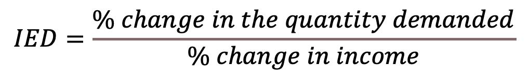
Income Elasticity of Demand
The Income Elasticity of Demand: a measure of how much the quantity demanded of a good responds to a change in consumers income.
$$IED=\frac{\% change in the quantity demanded}{\% change in income}$$
IED>0: normal good
IED<0: Inferior good

Slide 17

Cross-Price Elasticity of Demand
The Cross-Price Elasticity of Demand: a measure of how much the quantity demanded of a good responds to a change in the price of another good.
$$CPED=\frac{\% change in the quantity demanded of good 1}{\% change in the price of good 2}$$
CPED > 0: substitute
CPED < 0: complement

Slide 18

Price Elasticity of Supply
Price Elasticity of Supply: a measure of how much the quantity supplied of a good or serivce responds to a change in its price.
$$PES=\frac{\% change in the quantity supplied}{\% change in the price}$$

Slide 19
Family of Supply Curves
Perfectly Inelastic = 0
Inelastic Supply < 1
P
P
5
5
Unit elastic Supply = 1
22% increase
4
4
P
5
22% increase
100
Q
4
100
110
Q
10% increase
Perfectly Elastic = ∞
Elastic Supply > 1
P
P
100
125
any price above $4, quantity supplied is infinite.
Q
22% increase
5
22% increase
4
at exactly $4, producers will supply any quantity
4
any price below $4, quantity supplied is 0.
Q
100
200
Q
67% increase

Slide 20
Price Elasticity of Supply
P
supply
Elasticity<1
Firms often have capacity constraints, which leads to a changing elasticity over the supply curve.
The supply curve is elastic at low levels with a 67% increase in supply for a 29% increase in price.
The supply curve is inelastic at high levels with a 5% increase in supply for a 22% increase in price.
$15
$12
Elasticity>1
$4
$3
100
200
500
Q
525

