Slide 1
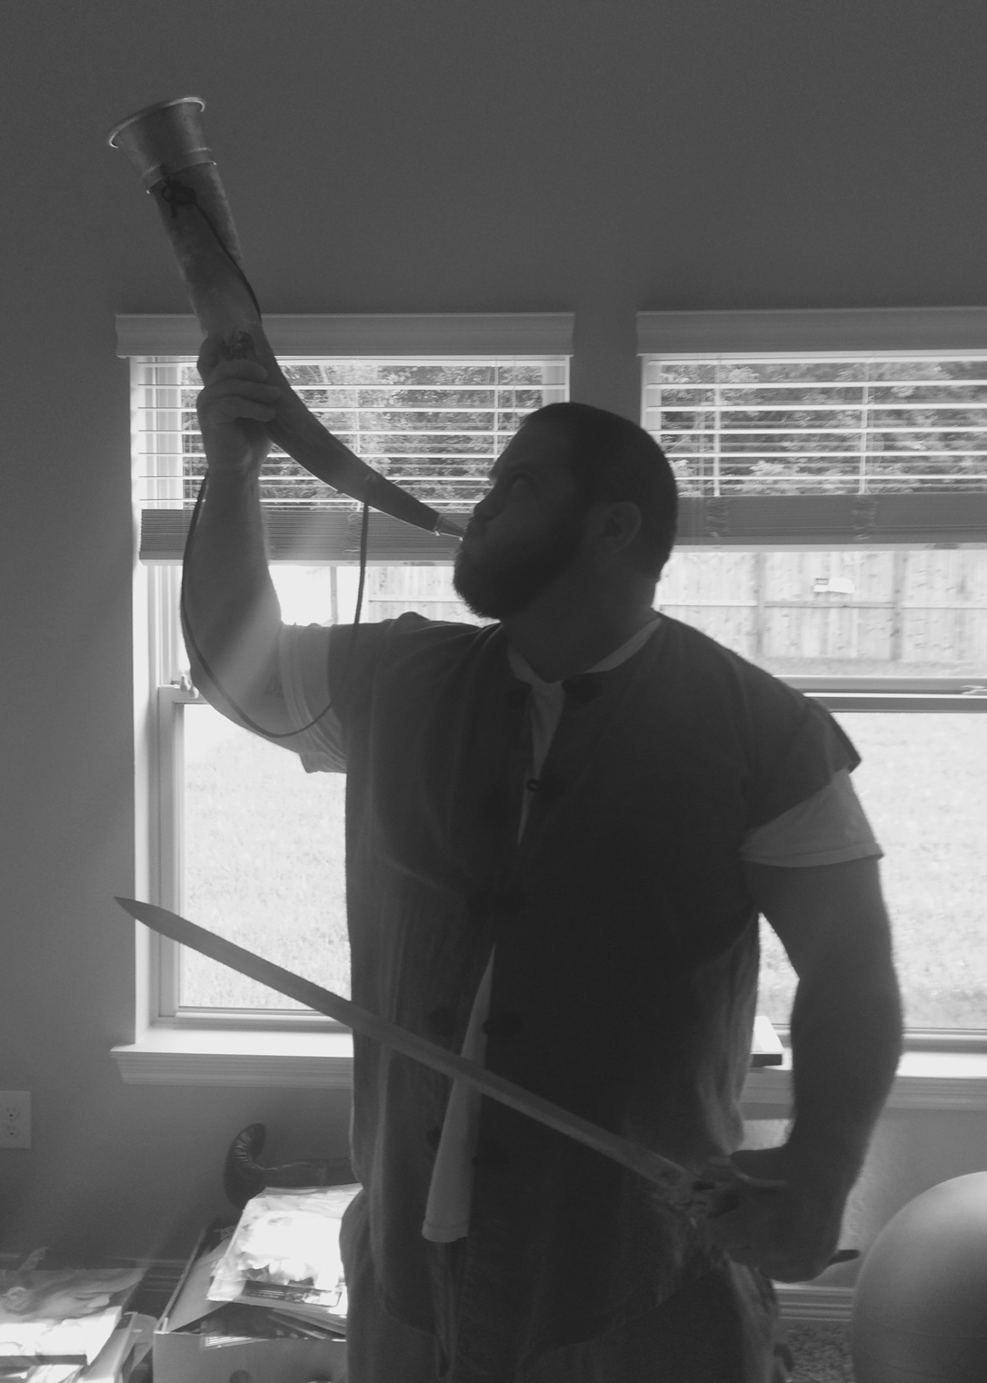
A Story of Economics:
A Principles Tale
By Jimmy DeNicco

Slide 2

A Story of Economics: A Principles Tale
ACT I: Getting to Know You, Economics:
Introduction
Markets
Elasticity
Markets and Government Policies
The Welfare of Markets
Externalities and Types of Goods

Slide 3

Introduction
Hello! I’m Jimmy!

Slide 4
Introduction
Objective: Describe the field of economics, including microeconomics and macroeconomics.
  What is economics?
  What is microeconomics?
  How do households and firms make decisions?
  What tradeoffs do nations face in production?
  How does trade affect national production?
  What is macroeconomics?
  What is the long and short of economic theory?

Slide 5
Economics
What is economics?
  A study of choice in a world of scarcity.
Unlimited Needs and wants
Problem of Scarcity
Limited Resources
Three Economic Questions
What to produce?
How to produce?
For whom to produce?
Centrally Planned
Mixed
Free Enterprise
Notes:
I want to lock it all up in my pocket.

Slide 6
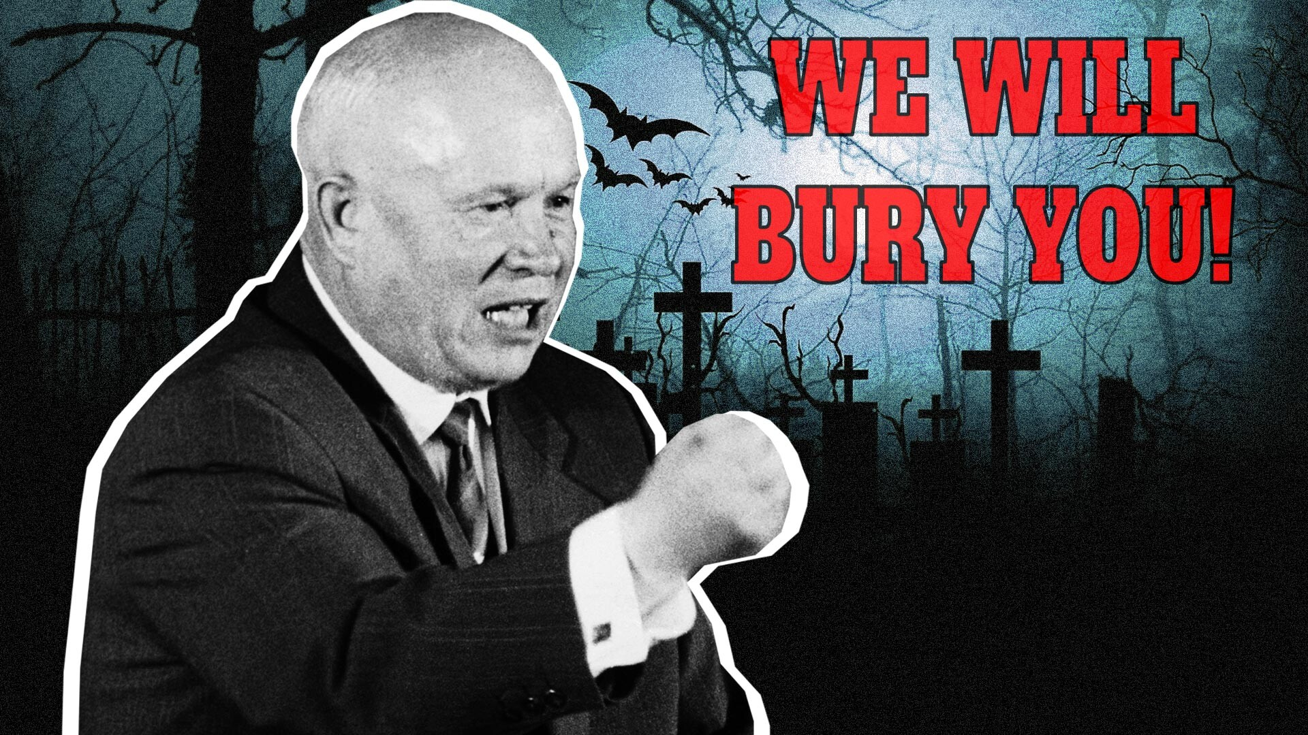
Markets
Market Economy – an economy that allocates resources through the decentralized decisions of many firms and households as they interact in markets for goods and services…The Invisible Hand.
This is as opposed to central economic planning like occurred in the Soviet Union – doesn’t work out so well!
Notes:
https://www.rbth.com/history/334638-we-will-bury-you-Khrushchev
Soviet Central Planning Video
http://www.youtube.com/watch?v=-2BgMu32Yuk&feature=related

Slide 7
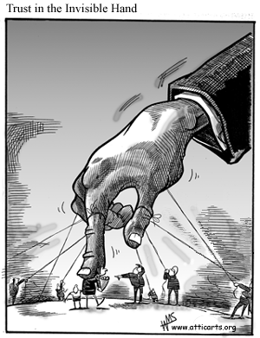
Roles of Government
In order to facilitate The Invisible Hand, the government must enforce rules and maintain institutions that are key to the market economy.
Property Rights – the ability of an individual to own and exercise control over scarce resources.
Notes:
https://checksbalances.clio.nl/2017/03/the-wounded-invisible-hand-regulating-the-world/

Slide 8

Roles of Government
In order to facilitate efficiency, the government can help improve markets.
  Market Failure: a situation in which a market left on its own fails to allocate resources efficiently.
  Externality – which is the uncompensated impact of one person’s actions on the well-being of a bystander.
  -Tragedy of the Commons
  Market power – which refers to the ability of a single person or small group to unduly influence market prices.
  -Monopolies.
Notes:
https://www.pexels.com/photo/building-capital-capitol-federal-government-129115/

Slide 9

Roles of Government
Government can also intervene in the market to facilitate equality.
An economic question but also a question of fairness or social justice.
Your thoughts on addressing equality are often based on your politics.
Notes:
https://commons.wikimedia.org/wiki/File:Off-Balance-Scale.svg

Slide 10

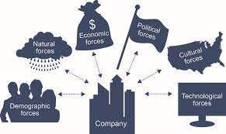
Microeconomics
Microeconomics: the study of how households and firms make decisions and how they interact in markets.
Notes:
https://thenounproject.com/icon/household-250948/
https://commons.wikimedia.org/wiki/File:Fundamentals_of_Business_-_Fig._1.3_-_Business_and_its_Environment.jpg

Slide 11
Marginal Analysis
Rational People: people who systematically and purposefully do the best they can to achieve their objectives.
Marginal Analysis: incremental and constantly evolving cost benefit analysis. When making decisions, people compare the marginal costs to the marginal benefits.
John Jacob Jingleheimer Schmidt has already invested $100 million on a business venture he thought would make him $150 million in revenue. He has a really bad day and finds out that he needs to invest more money to finish the product and the actual revenue he will earn is only going to be $ 110 million. Which of the following is true?
  He should scrap the project no matter what and cut his losses.
  He should invest only up to $10 million more.
  He should invest only up to $150 million more.
  He should invest only up to $110 million more.
  He should only invest more money no matter what it costs.
Notes:
Total cost $500>Total benefit $300
but
Marginal Cost $0<Marginal Benefit $300

Slide 12
Marginal Analysis
Rational People: people who systematically and purposefully do the best they can to achieve their objectives.
Marginal Analysis: incremental and constantly evolving cost benefit analysis. When making decisions, people compare the marginal costs to the marginal benefits.
  When making decisions, people compare the marginal costs to the marginal benefits.
John Jacob Jingleheimer Schmidt has already invested $100 million on a business venture he thought would make him $150 million in revenue. He has a really bad day and finds out that he needs to invest more money to finish the product and the actual revenue he will earn is only going to be $ 110 million. Which of the following is true?
  He should scrap the project no matter what and cut his losses.
  He should invest only up to $10 million more.
  He should invest only up to $150 million more.
  He should invest only up to $110 million more.
  He should only invest more money no matter what it costs.
Notes:
Total cost $500>Total benefit $300
but
Marginal Cost $0<Marginal Benefit $300

Slide 13
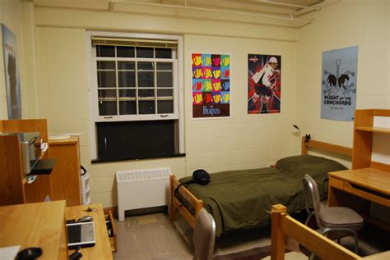
Opportunity Costs
  Opportunity Costs: Whatever must be given up to obtain something (explicit and implicit).
What are the Opportunity Costs of Going to School?
Notes:
http://northstarmoving.com/blog/2015/dorms-vs-college-apartments/

Slide 14
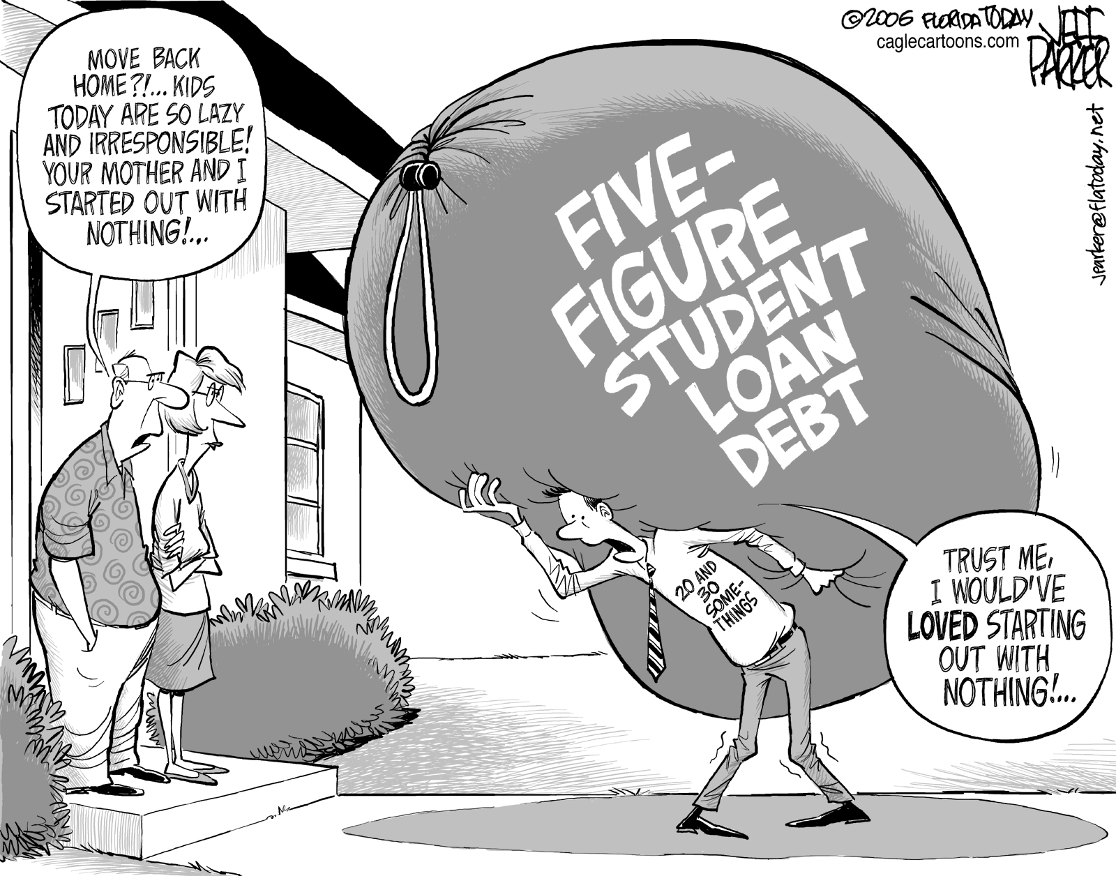
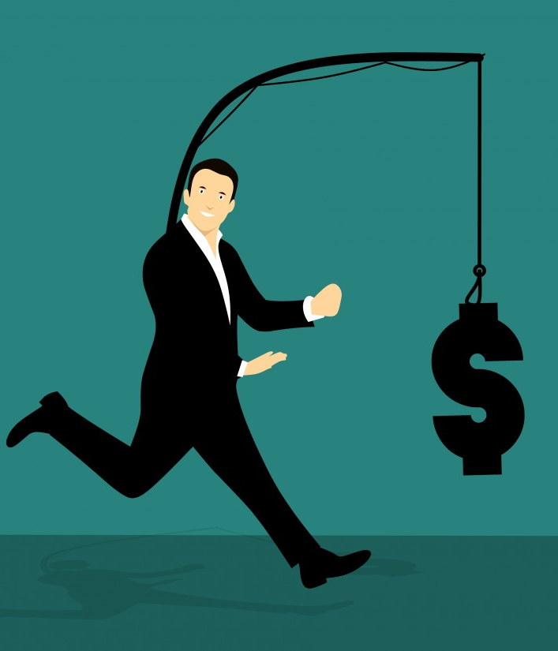
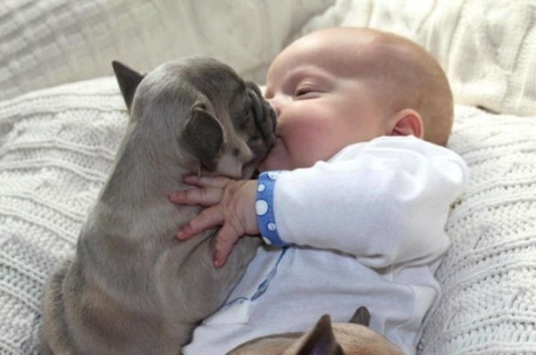
Opportunity Costs of Going to School
Lost Salary
Tuition
Lost Leisure Time
Notes:
http://jobsanger.blogspot.com/2012/06/deal-on-student-loans-maybe.html
https://pxhere.com/en/photo/1453161

Slide 15
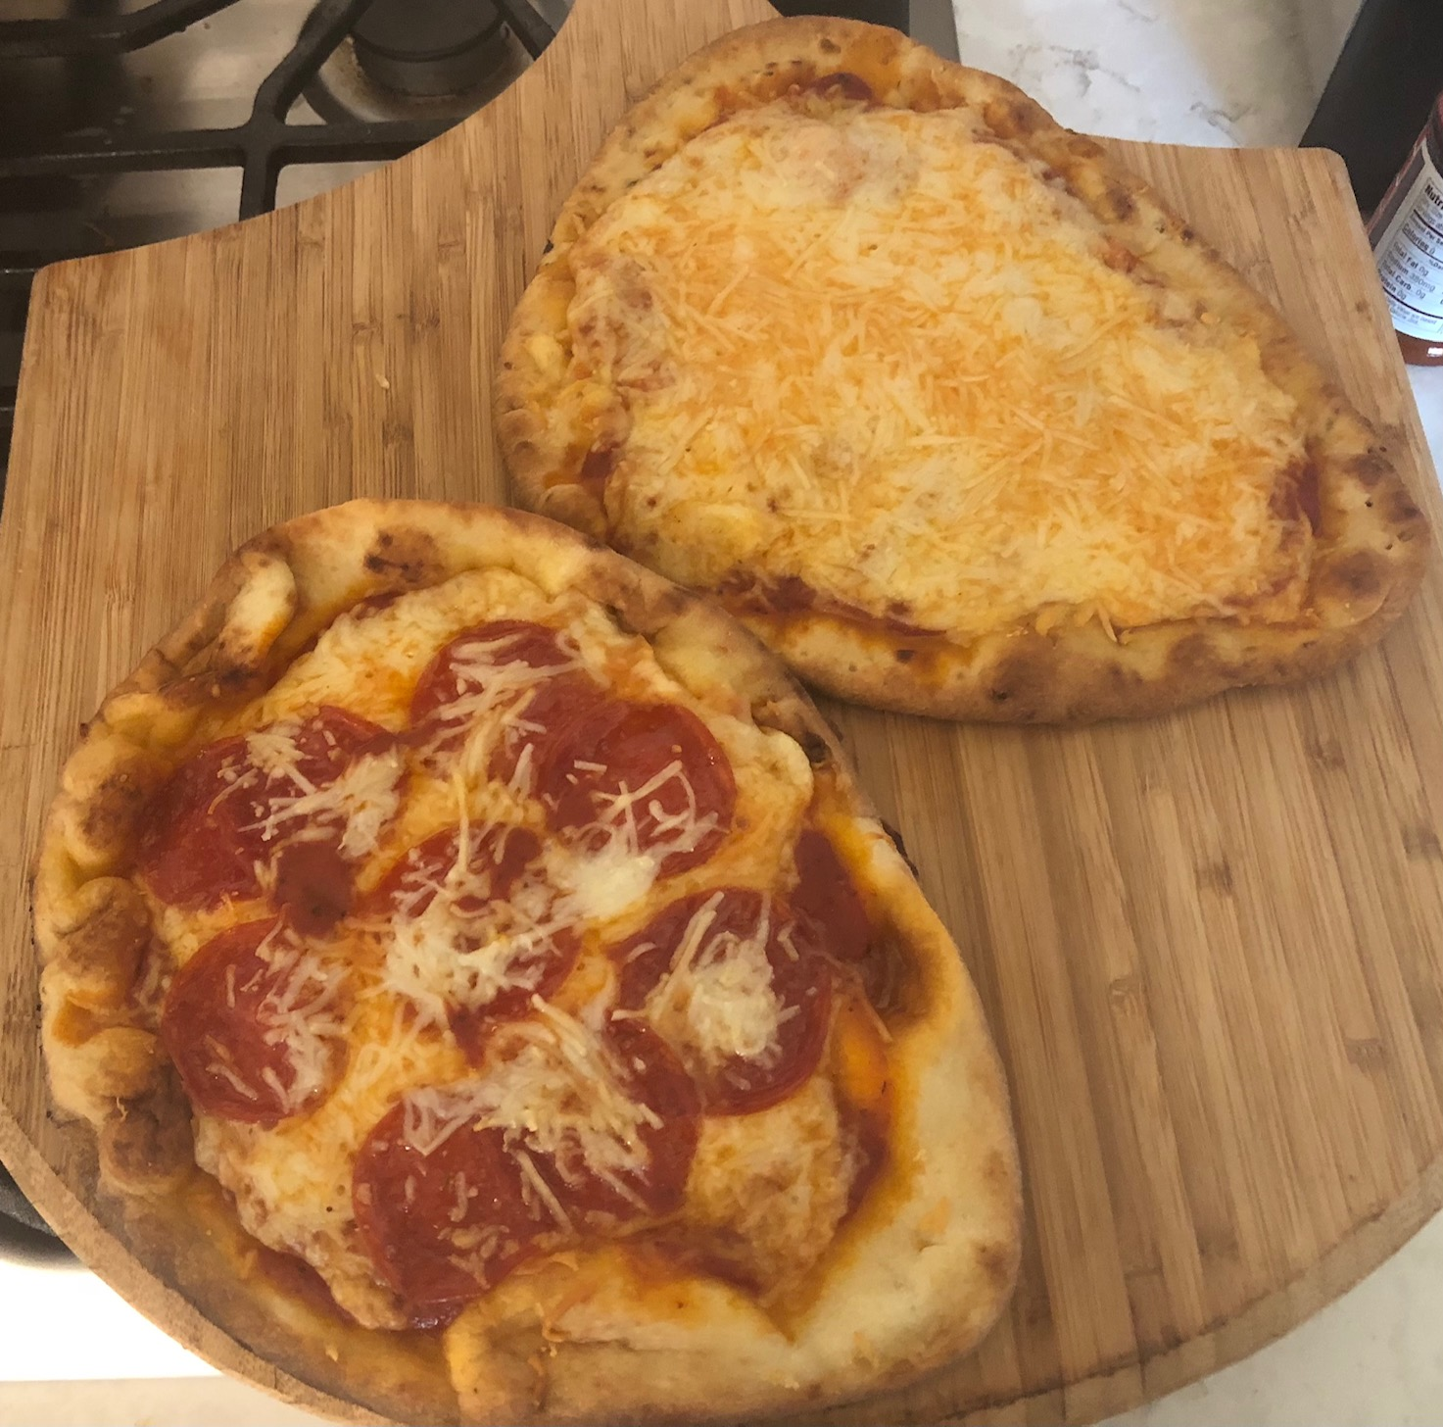
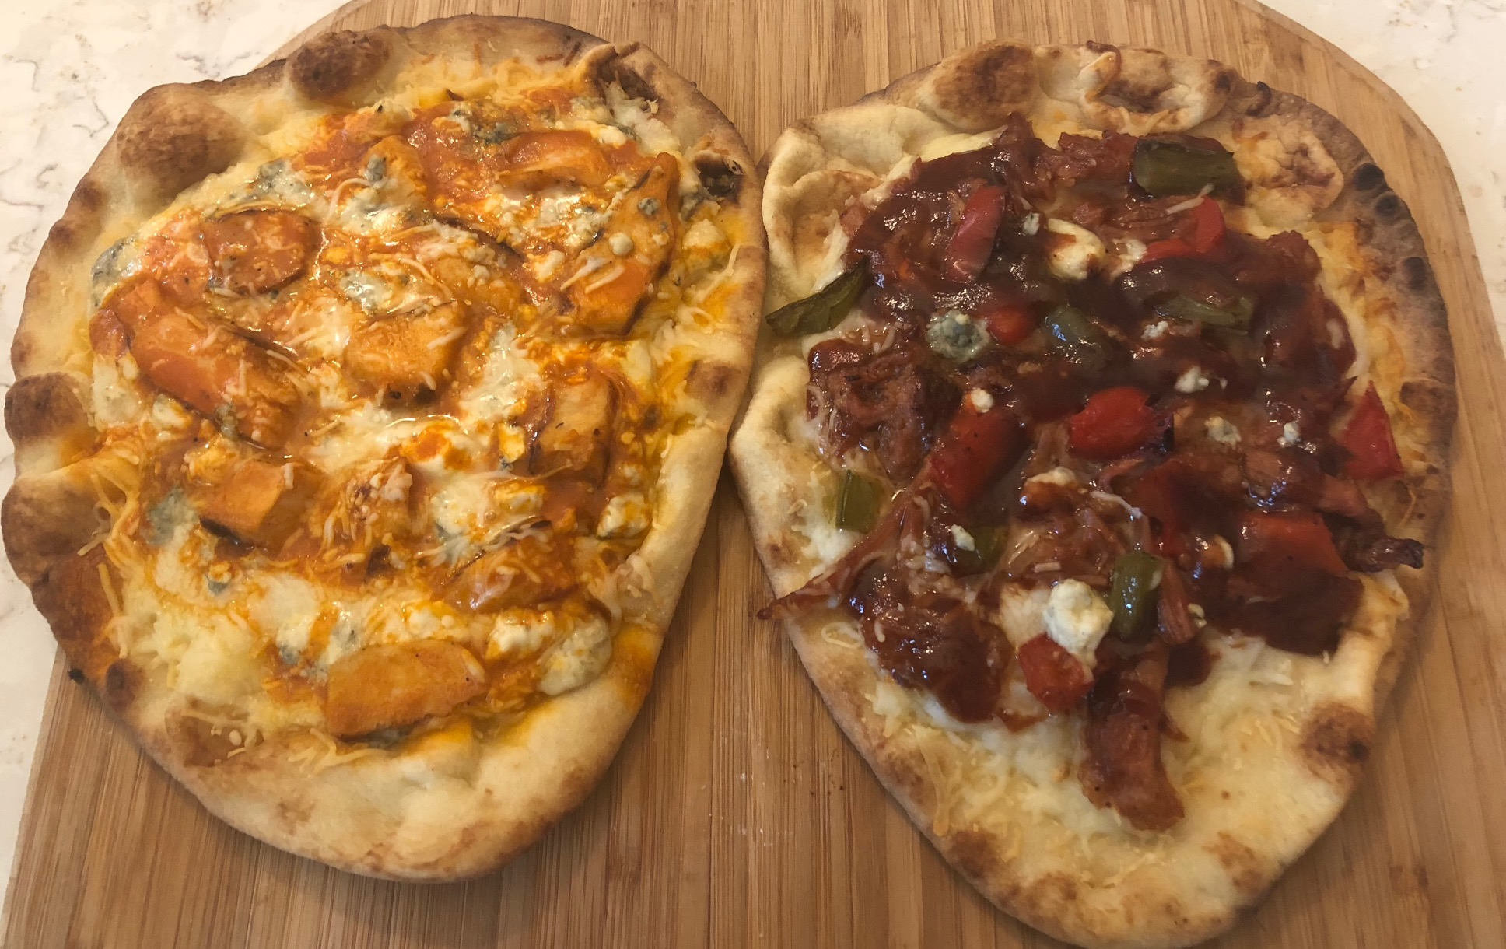
Marginal Analysis: A Consumer’s Choice
A person’s willingness to pay for a good is based on the marginal benefit that an extra unit of the good would yield. That marginal benefit depends on how many units the person already has. Diminishing marginal utility of consumption, states the more we have of a certain good, the less satisfaction we receive from another unit of that good.
Notes:
My Pictures

Slide 16
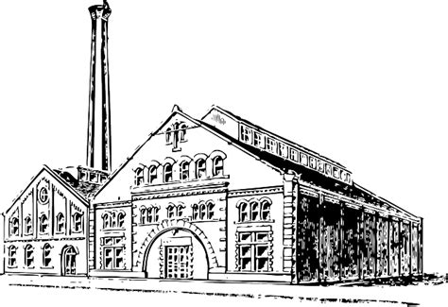
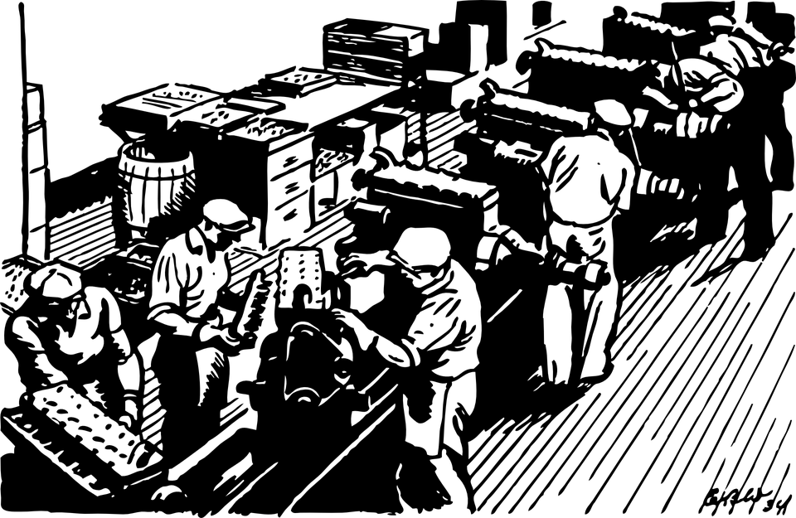
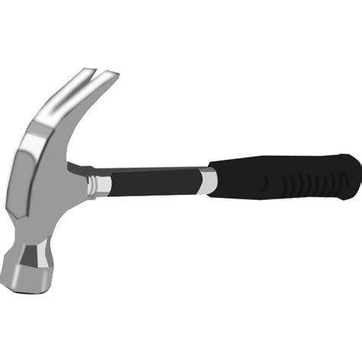
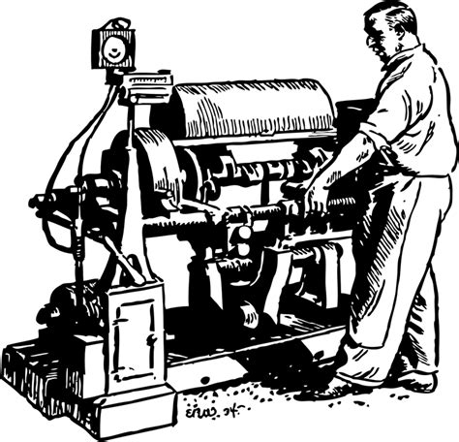
Marginal Analysis: A Producers' Choice
Labor
Physical Capital
Factories
Tools
Machinery
Notes:
https://pixabay.com/ko/공장-자동차-엔진-조립-생산-제조업체-인력-자동-선-35104/
https://pixabay.com/vectors/factory-building-chimney-victorian-33004/
https://pixabay.com/vectors/machine-crankshaft-working-man-35105/

Slide 17
Marginal Analysis: A Producer’s Choice
After all of Jimmy’s variables and assumptions are put in place, this is the revenue tables that he foresees. In this instance how many people should Jimmy hire with the following production schedule if each worker costs $60,000 annually? Diminishing marginal productivity (DMP) states that production increases at a decreasing rate as we add more of an input while holding other inputs constant.
Number of Workers | Total Revenue
1 | $120,000
2 | $230,000
3 | $330,000
4 | $420,000
5 | $500,000
6 | $570,000
7 | $630,000
8 | $680,000

Slide 18
Marginal Analysis: A Producer’s Choice
After all of Jimmy’s variables and assumptions are put in place, this is the revenue tables that he foresees. In this instance how many people should Jimmy hire with the following production schedule if each worker costs $60,000 annually?
Number of Workers | Total Revenue | Marginal Revenue | Marginal Cost
1 | $120,000 | $120,000 | $60,000
2 | $230,000 | $110,000 | $60,000
3 | $330,000 | $100,000 | $60,000
4 | $420,000 | $90,000 | $60,000
5 | $500,000 | $80,000 | $60,000
6 | $570,000 | $70,000 | $60,000
7 | $630,000 | $60,000 | $60,000
8 | $680,000 | $50,000 | $60,000

Slide 19
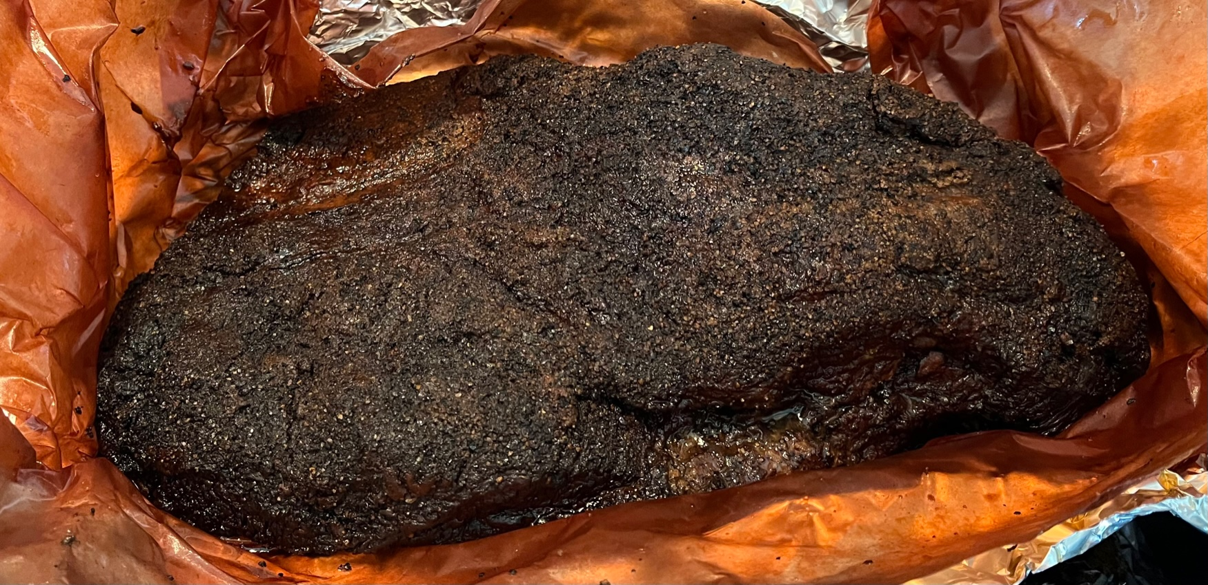
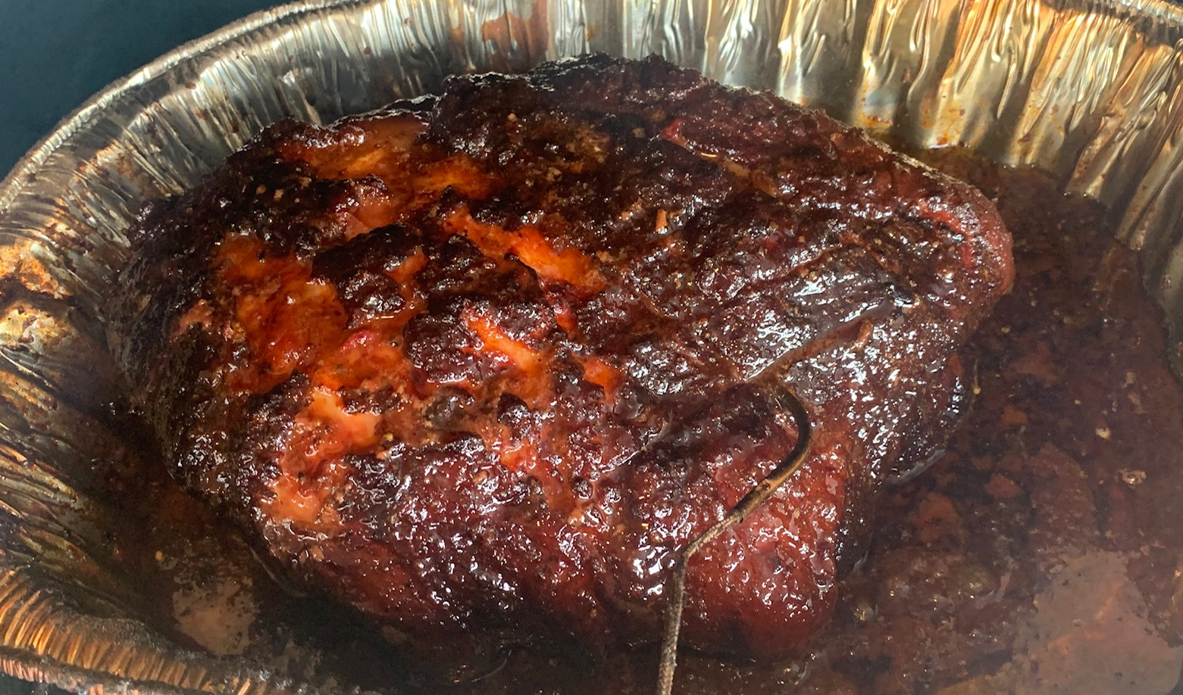
Tradeoffs in National Production
Imagine an economy that produces just two things…two of my favorite things, briskets (Br) and pork butts (PB)!
I rub my brisket down with yellow mustard, then I use Big Mo Cason’s brisket rub. I smoke it at about 225 degrees for however long it takes to get to 195 degrees. Then I pour the juices I have collected in a drip pan on it, wrap it in butcher paper and tinfoil and let it rest in the oven at 170 for about 4 hours.
My Pork Butts get a Dijon mustard and apple cider vinegar rub down and injections. I season it with a red fajita seasoning and brown sugar. I smoke until it reaches 200 degrees, so it just falls apart. I throw it in the crockpot with the juices I once again collect in a drip pan and shred it into pulled pork.

Slide 20
Tradeoffs in National Production
The Production Possibilities Frontier: shows the combination of output that the economy can possibly produce given the available factors of production and the available production technology.
  We face trade offs and have opportunity costs associated with those trade offs.
Br
10 K
5K
PB

Slide 21
Production Possibilities Frontier
Trade-offs – can’t produce more cars without giving up more computers.
Opportunity costs – how many briskets do we have to give up to get another pork butt.
From B to C, the opportunity cost of producing 1000 more pork butts s is 2000 briskets.
Bowed Shape – the opportunity costs increase as we move to one extreme or the other.
At point D, the resources best suited to brisket production are being used for pork butt production, which is inefficient. (big losses for small gains)
Br
A
F - impossible
10 K
B
8K
6K
C
E - inefficient
D
3K 4K
5K
PB

Slide 22
Technology and the PPF
A Technological Advance in the Brisket Industry
A Technological Advance in the Pork Butt Industry
Br
Br
PB
PB

Slide 23
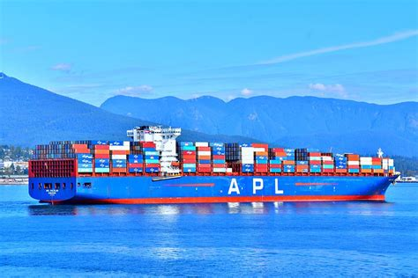
International Trade
Trade allows countries to specialize and enjoy a great variety of goods and services.
You can make what you have an advantage making and buy the rest from someone else!
Notes:
https://www.pxfuel.com/en/free-photo-xxeuu
I think there are fair criticisms of Trade deals for sure. Not all free trade is “free.” But this is how countries can be made better off from trade.

Slide 24

International Trade
 | Amount Produced and Consumed in a Day
 | Briskets | Pork Butts
Lucy D | 9 | 45
Jimmy D | 30 | 60

Slide 25
International Trade
Lucy D’s Production Possibilities Frontier
Jimmy D’s Production Possibilities Frontier
Br
Br
30
If there is no trade Jimmy D chooses this production and consumption.
If there is no trade Lucy chooses this production and consumption.
9
15
5
20
45
PB
30
60
PB

Slide 26
International Trade
Absolute Advantage: the ability to produce a good using fewer inputs than another producer.
Comparative Advantage: the ability to produce a good at a lower opportunity cost than another producer.
The Price of Trade: For Both Parties to gain from trade, the price at which they trade must lie between the two opportunity costs.

Slide 27



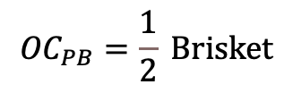
International Trade
Lucy D’s Production Possibilities Frontier
Jimmy D’s Production Possibilities Frontier
Br
Br
30
${OC}_{PB}=\frac{1}{5} B$risket
$${OC}_{PB}=\frac{1}{2} Brisket$$
$${OC}_{Br}=5 Pork Butts$$
$${OC}_{Br}=2 Pork Butts$$
9
15
5
20
45
PB
30
60
PB

Slide 28

International Trade
Jimmy D:
Hey Lucy, I have a great idea that will make us both fatter and happier. I know your production possibilities frontier and if you give me 21 of the 45 pork butts you can make, I will give you 7 briskets. Now you will get 24 pork butts and 7 briskets!
Lucy D:
This sounds like a scam. I will hear you out, but if you are scamming me, I am going to bite your face!

Slide 29
International Trade
 |  | Lucy D |  | Jimmy D
 |  | Briskets | Pork Butts | Briskets | Pork Butts
Without Trade | Production and Consumption | 5 | 20 | 15 | 30
With Trade | Production
 | Trade
 | Consumption
Gains From Trade | Increase in Consumption

Slide 30
International Trade
 |  | Lucy D |  | Jimmy D
 |  | Briskets | Pork Butts | Briskets | Pork Butts
Without Trade | Production and Consumption | 5 | 20 | 15 | 30
With Trade | Production | 0 | 45 | 24 | 12
 | Trade | Gets 7 | Gives 21 | Gives 7 | Gets 21
 | Consumption | 7 | 24 | 17 | 33
Gains From Trade | Increase in Consumption

Slide 31
International Trade
 |  | Lucy D |  | Jimmy D
 |  | Briskets | Pork Butts | Briskets | Pork Butts
Without Trade | Production and Consumption | 5 | 20 | 15 | 30
With Trade | Production | 0 | 45 | 24 | 12
 | Trade | Gets 7 | Gives 21 | Gives 7 | Gets 21
 | Consumption | 7 | 24 | 17 | 33
Gains From Trade | Increase in Consumption | +2 | +4 | +2 | +3

Slide 32
International Trade
Lucy D’s Production Possibilities Frontier
Jimmy D’s Production Possibilities Frontier
Br
Br
30
1715
9
7
5
20 24
45
PB
30 33
60
PB

Slide 33

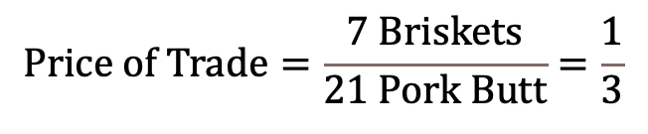
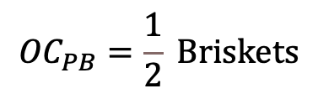


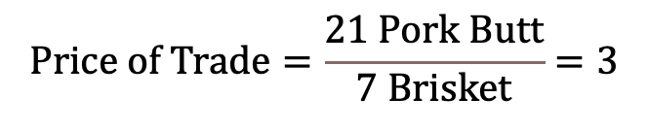
International Trade
Lucy D
Jimmy D
${OC}_{PB}=\frac{1}{5} B$riskets
$${OC}_{PB}=\frac{1}{2} Briskets$$
$${OC}_{Br}=5 Pork Butts$$
$${OC}_{Br}=2 Pork Butts$$
$$Price of Trade=\frac{7 Briskets}{21 Pork Butt}=\frac{1}{3}$$
or
$$Price of Trade=\frac{21 Pork Butt}{7 Brisket}=3$$

Slide 34

Macroeconomics
Macroeconomics: the study of economy wide phenomena, including inflation, unemployment and economic growth.
Notes:
https://pixabay.com/illustrations/globe-earth-world-globalization-86244/

Slide 35
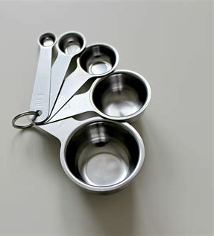
The Measures
Production, Expenditures and Income: Gross Domestic Product (GDP)
Prices and inflation: Consumer Price Index (CPI)
Labor Market: Unemployment Rate (UR)
Notes:
https://www.pxfuel.com/en/free-photo-exhim

Slide 36
The Short Run - Business Cycles
AGGREGATE
ECONOMI
C ACT I V I TY
aggregate economic activity
normal growth path
expansion
contraction
expansion
trough
peak
trough
peak
TIME

Slide 37
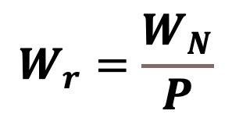
Sticky Wages and the Phillips Curve
  The Phillips Curve asserts and inverse relationship between inflation and unemployment in the short run based on the sticky wage theory.
  As prices rise, real wages fall, and people will be hired…maybe. It doesn’t always happen that way. The empirical evidence on the Phillips curve is mixed.
$$W_{r}=\frac{W_{N}}{P}$$

Slide 38

The Long Run - Economic Growth
Economic growth is a long run phenomenon referring to an increase in aggregate production and the market value of goods and services in an economy over time.
Productivity – the quantity of goods and services produced from each unit of labor.
Factors improving productivity include:
  Physical Capital.
  Human Capital.
  Natural Resources.
  Entrepreneurship.
  Social and Legal Framework
  *Technology,
Notes:
https://pixabay.com/es/illustrations/productividad-trabajo-empresario-1995786/
https://data.oecd.org/gdp/gross-domestic-product-gdp.htm

