Slide 1

Monopoly

Slide 2
Monopoly
Objective: Describe the attributes of a monopoly.
  What is a monopoly and how does it come about?
  What are the implications of a monopoly for profits and economic well-being?
  How can markets and policy makers address the inefficiency of a monopoly?

Slide 3
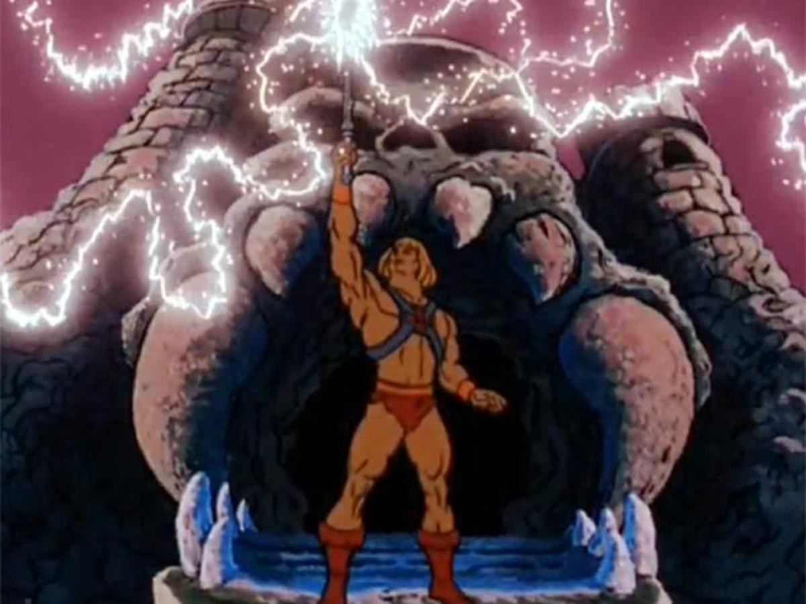
Monopoly
Monopoly: a firm that is the sole seller of a product without close substitutes.
The fact that the firm doesn’t face competition gives them power over the price. They can set prices to maximize profits.
I have the power!
Notes:
https://medium.com/the-mission/why-kids-need-heroic-adventures-788fc34bfda0

Slide 4
Monopoly Versus Competition
Competitive Firm’s Demand Curve
Monopolist’s Demand Curve
A competitive firm is a price taker…they can sell any amount at that price.
A monopolist is the sole producer and has power over the price. They can raise or lower prices to maximize profits.
P
P
Demand
Demand
Q
Q

Slide 5
A Monopoly’s Revenue:
  With an increase in Output Q:
    Output effect: more output sold, so Q is higher, which tends to increase total revenue.
    Price effect: price falls, so P is lower, which tends to decrease total revenue.
TR= Price x Quantity

Slide 6
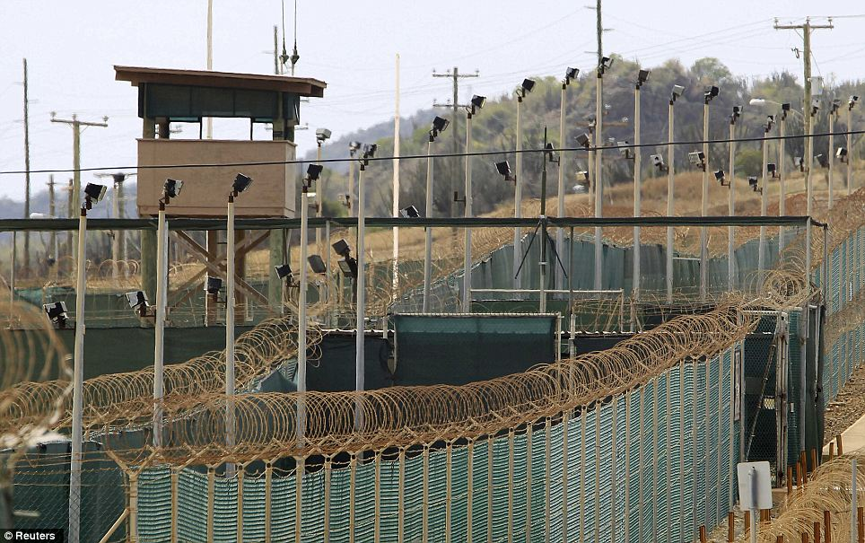
Why Monopolies Arise
Monopolies Arise due to barriers to entry from three mains sources….Resource Control, Government Created Barriers and the Natural Production Process.
Notes:
https://www.ibtimes.com/sites/www.ibtimes.com/files/2016/02/23/gitmo_1.jpg

Slide 7

Barriers To Entry: Resource Control
Monopoly Resources: A key resource required for production is owned by a single firm.

Slide 8

Barriers To Entry: Government Created Barriers
Government Created Barriers: The government gives a single firm the exclusive right to produce some good or service.
i.e. Patents and Copy Rights
This incentivizes R&D with a profit motive!
Notes:
https://www.anh-usa.org/wp-content/uploads/2015/11/pills-money-web.jpg

Slide 9
Barriers To Entry: Natural Monopoly - Production Process
Cost
Natural Monopoly (Production Process): a monopoly that arises because a single firm can supply a good or service to an entire market at a smaller cost than could two or more firms.
For any given amount of output, a larger number of firms leads to less output per firm and a higher Average Total Cost.
The Economies of Scale for a natural monopoly show a continually declining average total cost curve.
ATC
Q

Slide 10
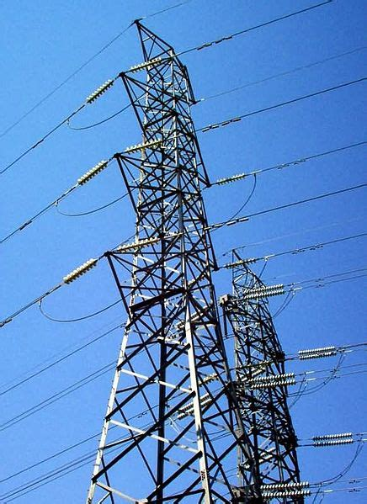
Barriers To Entry: Natural Monopoly (Production Process)
In the case of electricity distribution, the fixed cost to set up power lines is very high, but the variable cost of connecting one more customer is relatively very low. It is often inefficient to have more than one provider.
Notes:
https://s3-us-west-2.amazonaws.com/courses-images/wp-content/uploads/sites/1934/2017/06/13202238/436px-electricalgrid.jpeg

Slide 11
A Monopoly’s Revenue
Quantity | Price $ | Total Revenue $ | Average Revenue $ | Marginal Revenue $
0 | 15 | 0
1 | 14 | 14 | 14 | 14
2 | 13 | 26 | 13 | 12
3 | 12 | 36 | 12 | 10
4 | 11 | 44 | 11 | 8
5 | 10 | 50 | 10 | 6
6 | 9 | 54 | 9 | 4
7 | 8 | 56 | 8 | 2
8 | 7 | 56 | 7 | 0
9 | 6 | 54 | 6 | -2
10 | 5 | 50 | 5 | -4
Notes:
MR is lower than average revenue because you lower the price to sell more…you lower the price for all units, so average revenue is still just equal to the price.

Slide 12
A Monopoly’s Profit
2. …and then the demand curve shows the price consistent with this quantity.
Costs and Revenue
MC
1. The intersection of the MR and MC curve determines the profit maximizing quantity…
P _{Mon}
Monopoly Profit
(P-ATC) x Q
ATC
D
ATC
MR
Q _{max}
Q

Slide 13
Dead Weight Loss
Dead Weight Loss
A monopoly charges a price higher than marginal cost, resulting in a a quantity below the efficient level.
Costs and Revenue
P_{Mon}
MC
DWL
D
MR
Q _{Mon}
Q _{efficient}
Q
Notes:
Deadwieght loss due to mark up over marginal cost.
Are monopolies a good way to organize a market?
Firms can earn profits from higher prices…
…but consumers pay higher prices!
Is it possible that the benefits to firms outweigh the costs to consumers?
Because the allocation of resources is different from a competitive market (which we found maximizes economic well being), in some way the monopoly fails to maximize total economic well being.
The Problem: a monopolized market produces and sells a quantity of output below the level that maximizes total surplus.
The profit is not the problem, but rather the high price discourages some consumers from buying the good.
If the high price did not discourage buying from some consumers (resulting in low output), it would raise producer surplus by the same amount it reduced consumer surplus…
…leaving total surplus the same as the social planner can achieve.

Slide 14
Monopoly Versus Generic Drugs
During the life of the patent, the drug company operates as a monopoly…after the patent expires, firms enter with generic drugs and competition forces prices down to where Price = Marginal Cost.
Costs and Revenue
P_{Mon}
MC
P_{PC}
DWL_{Mon}
D’=AR’=MR’
D=AR
MR
Q _{Mon}
Q _{PC}
Q

Slide 15
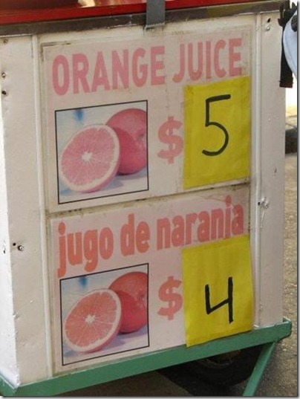
Price Discrimination
Price Discrimination: the business practice of selling the same good at different prices to different customers.
If firms can distinguish between consumer’ willingness to pay, they can price discriminate, leading to an increase in profits and a more efficient market.
Notes:
https://www.reddit.com/r/funny/comments/ksy09/because_orange_juice_tastes_better/

Slide 16
Single Price Monopolist
*To make the math easier, we will assume a constant MC and no FC, which makes MC=ATC and makes producer surplus equal to profit.
Costs and Revenue
CS
P _{M}
Profit
DWL
MC=ATC
D
MR
Q _{M}
Q

Slide 17
Perfect Price Discrimination – 1st Degree
A Monopolist with perfect price discrimination (or 1st degree price discrimination) reduces consumer surplus to zero, but increases the total surplus, which now equals the profit. (Assume no fixed cost and marginal cost is constant here. This makes MC=ATC=AVC.)
Costs and Revenue
Profit
MC=ATC
D
Q

Slide 18
Happy Medium: 2nd or 3rd Degree
Even if we cannot perfectly price discriminate, the the market become more efficient, and the firm increases profits if we can break consumers up into two or more different groups.
Costs and Revenue
CS
P ₁
Profit
CS
P ₂
Profit
DWL
MC=ATC
D
MR
Q ₁
Q ₂
Q

Slide 19


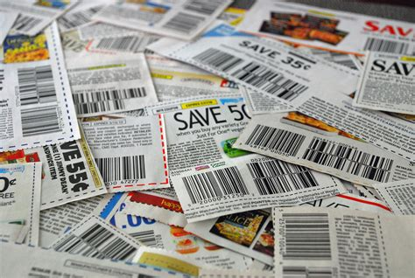
Types of Price Discrimination
1st-degree
2nd-degree
Profit
Quantity | Discount
10 -20 | %5
20-50 | 10%
40-100 | 15%
100 or more | 25%
MC
D
Q
3rd-degree
Profile
Time Use
Income
Notes:
Financial Aid is another example
https://www.pngall.com/cinema-png
https://i1.wp.com/bestplacesofinterest.com/wp-content/uploads/2017/06/airline-ticket-300x198.png?resize=400%2C264
https://static.pexels.com/photos/51202/pexels-photo-51202.jpeg

Slide 20
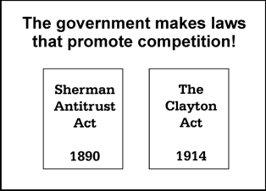
Public Policy Prescriptions for Monopolies: Antitrust
Increase Competition With Antitrust Laws: the government can take various antitrust measures to increase competition, including preventing mergers, breaking companies up into small companies, and preventing companies from coordinating activities.
There can be costs to these laws, such as lost efficiency with mergers being prevented.

Slide 21
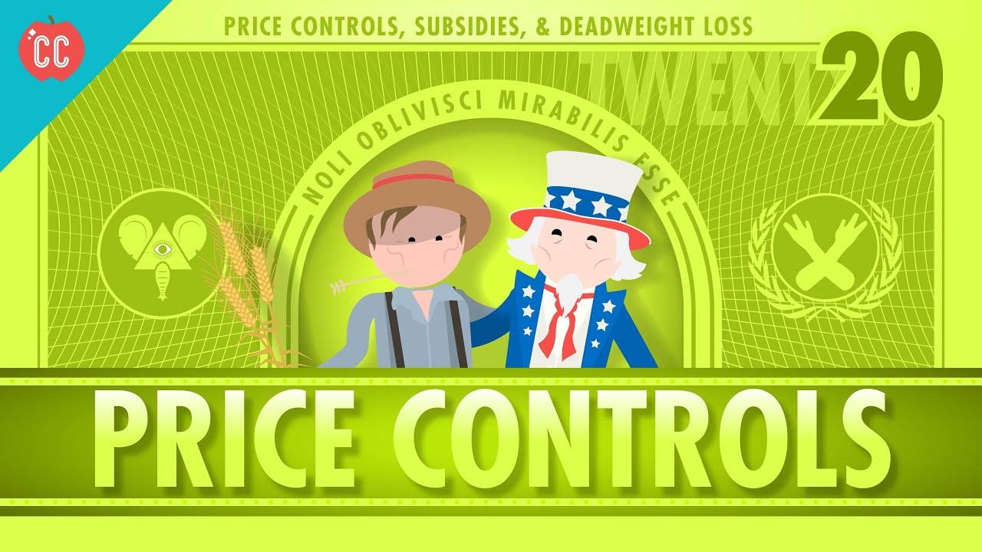
Natural Monopolies: Regulation
Regulation: the government can regulate the price the monopoly charges (often with natural monopolies).
There are problems with choosing the right price and the lack of incentives to become more efficient with price setting.
Notes:
https://www.youtube.com/watch?v=01lKDkYSFDg

Slide 22
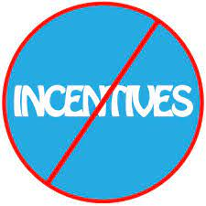
Natural Monopolies: Regulation
MC Pricing
Any Price Setting
Cost
ATC
ATC
Loss
regulated price
MC
D
Q
Notes:
https://www.cloudinspectorwd.com/get-customer-testimonials/
Problems with Marginal Cost Pricing:
Picking the marginal cost will maximize total surplus with an efficient allocation of resource…
…but natural monopolies always have a marginal cost curve below the total average cost curve.
You could subsidize the losses, but that means taxes!
Setting Price equal to any cost gives the monopolist no incentive to reduce costs.
Firms reduce costs to increase profits…
…but if the monopolist knows the price will fall if the cost falls…
…then know they will not benefit from lowers costs…
…and will not try to reduce them!

Slide 23


Other Options
Public Ownership: The government takes over the monopoly.
The issue no now profit motive to keep cost down and encourage efficiency.
The losers of a failed public ownership are the tax-payers.
Hands Off Approach: Sometimes the solution can be worse than the problem!
Notes:
https://pcgamesmacos.blogspot.com/2015/09/hands-off-30-cracked-for-mac-monitor.html
https://fabiusmaximus.com/2014/12/29/taylor-swift-shake-it-off-america-politics-reform-75244/

