Slide 1

Externalities and Types of Goods

Slide 2
Externalities and Types of Goods
Objective: Evaluate the effects of externalities and the policies associated with them and identify how they are related to different types of goods.
What is an externality and what types of policies can be implemented to address externalities?
How do corrective taxes and tradable permits work to address pollution?
How do subsidies and tax rebates work to address activities positive externalities?
What are some private solutions to externalities and when do those solutions break down?
How do externalities apply to different types of goods?

Slide 3
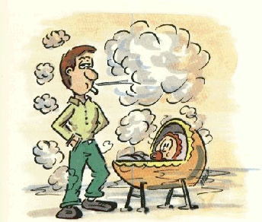
Negative Externality
Externality: The uncompensated impact of one person’s actions on the well-being of a bystander.
Smoking cigarettes around children has a negative externality associated with it and has obvious policy implications to protect the health of the children.
Notes:
https://edu.glogster.com/glog/the-truth-about-tobacco/205tborqpe2?=glogpedia-source

Slide 4

Positive Externality
The restoration of historic buildings convey a positive externality because people other than the owner enjoy the beauty and history of them, and they can also raise property values and create business for everyone in the area.
The owner, however, does not get the full benefit and is too quick to tear the building down.
The government tries to solve this with by partially compensating the costs.
Notes:
https://nara.getarchive.net/media/a-nighttime-view-of-the-alamo-chapel-located-at-1-alamo-plaza-san-antonio-texas-1a126d

Slide 5

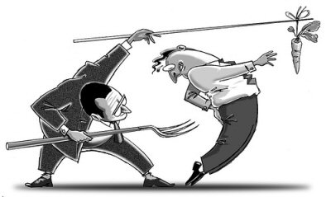
Public Policy
Direct Regulation: regulate behavior directly.
Market-based Policy: provide incentives so that private decision makers will choose to solve the problem on their own.
Notes:
https://www.flickr.com/photos/donkeyhotey/5789845977
https://padraig.ca/85/motivation-throwing-away-the-carrots-and-sticks/

Slide 6
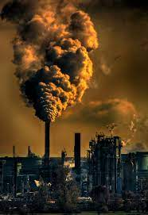
Pollution: Corrective Taxes and Permits
The smoke-stacks creates a negative externality with pollution of the air.
Firms have much more information about their own private costs of production than they do the external cost to everyone around them. They are focused on efficiency and maximizing profits and can therefore be short sighted.
The government may see the bigger picture more clearly created a potential role for government.
Notes:
https://pxhere.com/en/photo/1550759

Slide 7
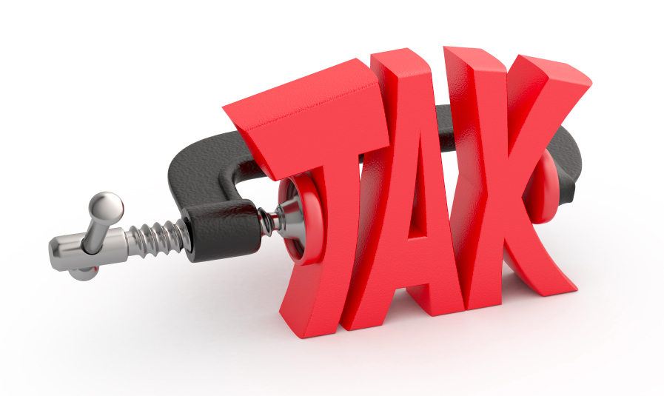
Corrective Tax
Corrective Tax: a tax designed to induce private decision makers to take account of the social costs that arise from a negative externality.
Notes:
https://annemariesegal.com/2013/11/10/section-83b-election-for-startup-founders/

Slide 8
Corrective Tax
Aluminum Market
The producer does not consider the external cost in his production decisions…
…They produce too much aluminum compared to the social optimum, causing the externality…
…The social planner could solve the problem with a tax on each ton of aluminum produced…
…internalizing the externality, raising the cost of production and shifting the supply curve left by the size of the tax.
P
Social Cost
(private + external)
D
(private value)
S
(private cost)
external cost
Q_{optimal}
Q_{market}
Q

Slide 9
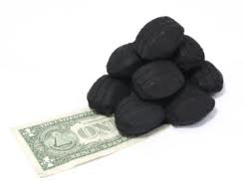
Tradable Permits
The EPA can regulate pollution by setting limits on things like carbon emissions by distributing pollution permits.
Firms can sell unused permits if the have lower than allowed levels of pollution...
…This means that regardless of the initial allocation, the final allocation will be efficient…
…Firms that can reduce pollution at a low cost will then sell their extra permits to firms with high costs of reducing pollution.
Notes:
https://www.dreamstime.com/royalty-free-stock-photo-coal-dollars-image4224535

Slide 10
Corrective Tax Versus Pollution Permits
In both cases, firms pay for their pollution either with taxes or the permits (opportunity cost of not selling permits if they already have them).
Corrective Tax
Pollution Permits
Price of Pollution
Price of Pollution
Supply of pollution permits
Corrective Tax
P
P
Demand for Pollution Rights
Demand for Pollution Rights
2. …which, together with demand curve determines the price of pollution.
1. A corrective tax sets the price of pollution…
Q
Quantity of Pollution
Q
Quantity of Pollution
2. …which, with the demand curve determines the quantity of pollution
1. Pollution permits set the supply of pollution…

Slide 11

Positive Externalities: Subsidies
Subsidy: money that is paid usually by a government to keep the price of a product or service low or to help a business or organization to continue to function
Notes:
https://www.flickr.com/photos/30478819@N08/51522705387

Slide 12
Positive Externalities: Subsidies
The social value is greater than the private value…
The external benefit of electric Car production is not considered (cleaner environment) because the firm isn't paid for it and the consumer doesn’t get all the benefit…
…There is too little of it compared to the social optimum…
…The social planner could solve the problem with a subsidy…
…thus making industrial policy, lowering the private cost of production and shifting the supply curve right by the size of the subsidy.
Electric Car Production
P
Supply
(private cost)
external benefit
Shift from subsidy that is right on
Social Value
(private value + external benefit)
Demand
(private value)
Q_{market}
Q_{optimal}
Q

Slide 13


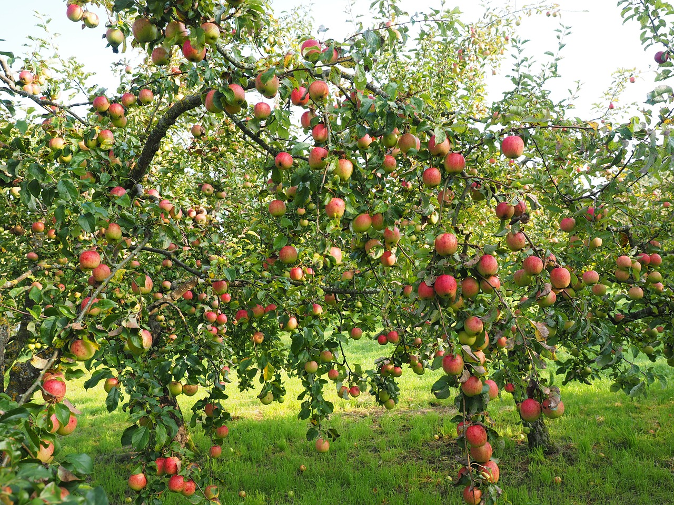

Private Solutions
Teaching responsible behavior like parents teaching their children not to litter.
Social and environmental activism including charities.
Relying on the self-interest of relevant parties.
Integrating businesses like the apple grower buying out the beekeeper.
They confer positive externalities on each other with nectar for the bees from the apples and pollination of the flowers on the apple trees from the bees. Neither consider the positive externality and the beekeeper doesn’t plant enough trees and the beekeeper keeps too few bees.
Contractual agreements
Notes:
https://pixabay.com/vectors/trash-to-throw-away-pictograms-4945418/
https://cvpost.org/panel-discuss-impact-agriculture-water-quality-wednesday-evening-eau-claire-library/sierra-club-logo/
https://pixabay.com/photos/apples-apple-tree-fruit-red-fresh-693971/
https://freesvg.org/1433878496

Slide 14
Private Solutions
Coase Theorem: the proposition that if property rights are clearly defined and private parties can bargain with low costs over the allocation of resources, they can solve the problem of externalities on their own.
Transaction Costs: The costs that parties incur in the process of agreeing to and following through on the bargain.
Too Many Cooks in the Kitchen: A deal could be possible but finding the right price for both parties can difficult. The more parties involved in the deal, the more difficult it can be to satisfy all parties.
Notes:
The cost of the contract between beekeeper and orchard owner, or one values it too much.

Slide 15


Characteristics of Goods
Excludability: the property of a good whereby a person can be prevented from using it.
Rival in Consumption: the property of a good whereby one person’s use diminishes other people’s use.
Notes:
https://www.dreamstime.com/illustration/stop-security-cartoon.html
https://parentingisnteasy.co/twins-fight-pacifier/

Slide 16


Private and Club Goods
Private Goods: goods that are both excludable and rival in consumption.
Club Goods: goods that are excludable but not rival in consumption.
Notes:
https://depositphotos.com/268595710/stock-photo-medium-rare-ribeye-steak-with.html
https://www.yourgolftravel.com/the-masters

Slide 17

Public Goods
Public Goods: goods that are neither excludable nor rival in consumption.
Free Rider: a person who receives the benefit of a good but avoids paying for it.
This leaves a role for government:
If the value to a population is greater than the cost, a fireworks display is efficient for the town to put on.
A private firm couldn’t make a large enough profit due to free riders and doesn’t account for the social benefit.
It is left for the government to use tax dollars to pay for it.
Notes:
https://secrethouston.com/new-years-eve-fireworks-in-houston/

Slide 18

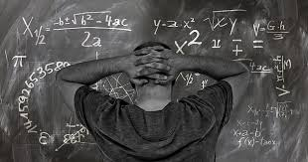
Public Goods
National Defense: We all benefit from the safety provided by national defense.
Due to the expense, the private market would fail to provide adequate national defense. Only those who could afford it would benefit, so it wouldn’t really be national defense at all.
Basic Research: results in public knowledge, which makes us all generally better off.
There is little profit incentive for researching public knowledge.
Government agencies subsidize basic research.
This does not apply to private knowledge for which there are patents.
Notes:
https://lisalouisecooke.com/2018/02/19/us-military-records-for-genealogy/
https://www.piqsels.com/en/public-domain-photo-favsb/download/828x1792
Public Goods: Often have positive externalities because some people receive something with out paying for it.
i.e. someone puts up a tornado siren.
Basic research medicine, mathematics, physics, chemistry, biology, and even economics.

Slide 19
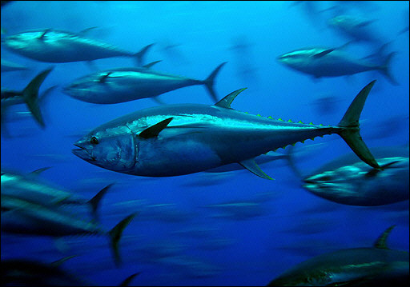

Common Resources
Common Resources: goods that are rival in consumption but are not excludable.
Fish, Whales and other Wildlife: many species have commercial value and sometimes short-term profits cloud judgement on long term sustainability.
Clean Air and Water: markets sometimes do not adequately protect the environment.
Notes:
https://www.pxfuel.com/en/free-photo-oymis
Common Resources: negative externalities because some are worse off without being compensated for it.
i.e. less fish in the sea as they are taken from the Ocean.

Slide 20
Types of Goods
RIVAL IN CONSUMPTION
YES
NO
PRIVATE
CLUB
YES
EXCLUDABLE
COMMON RESOURCE
PUBLIC
NO

Slide 21
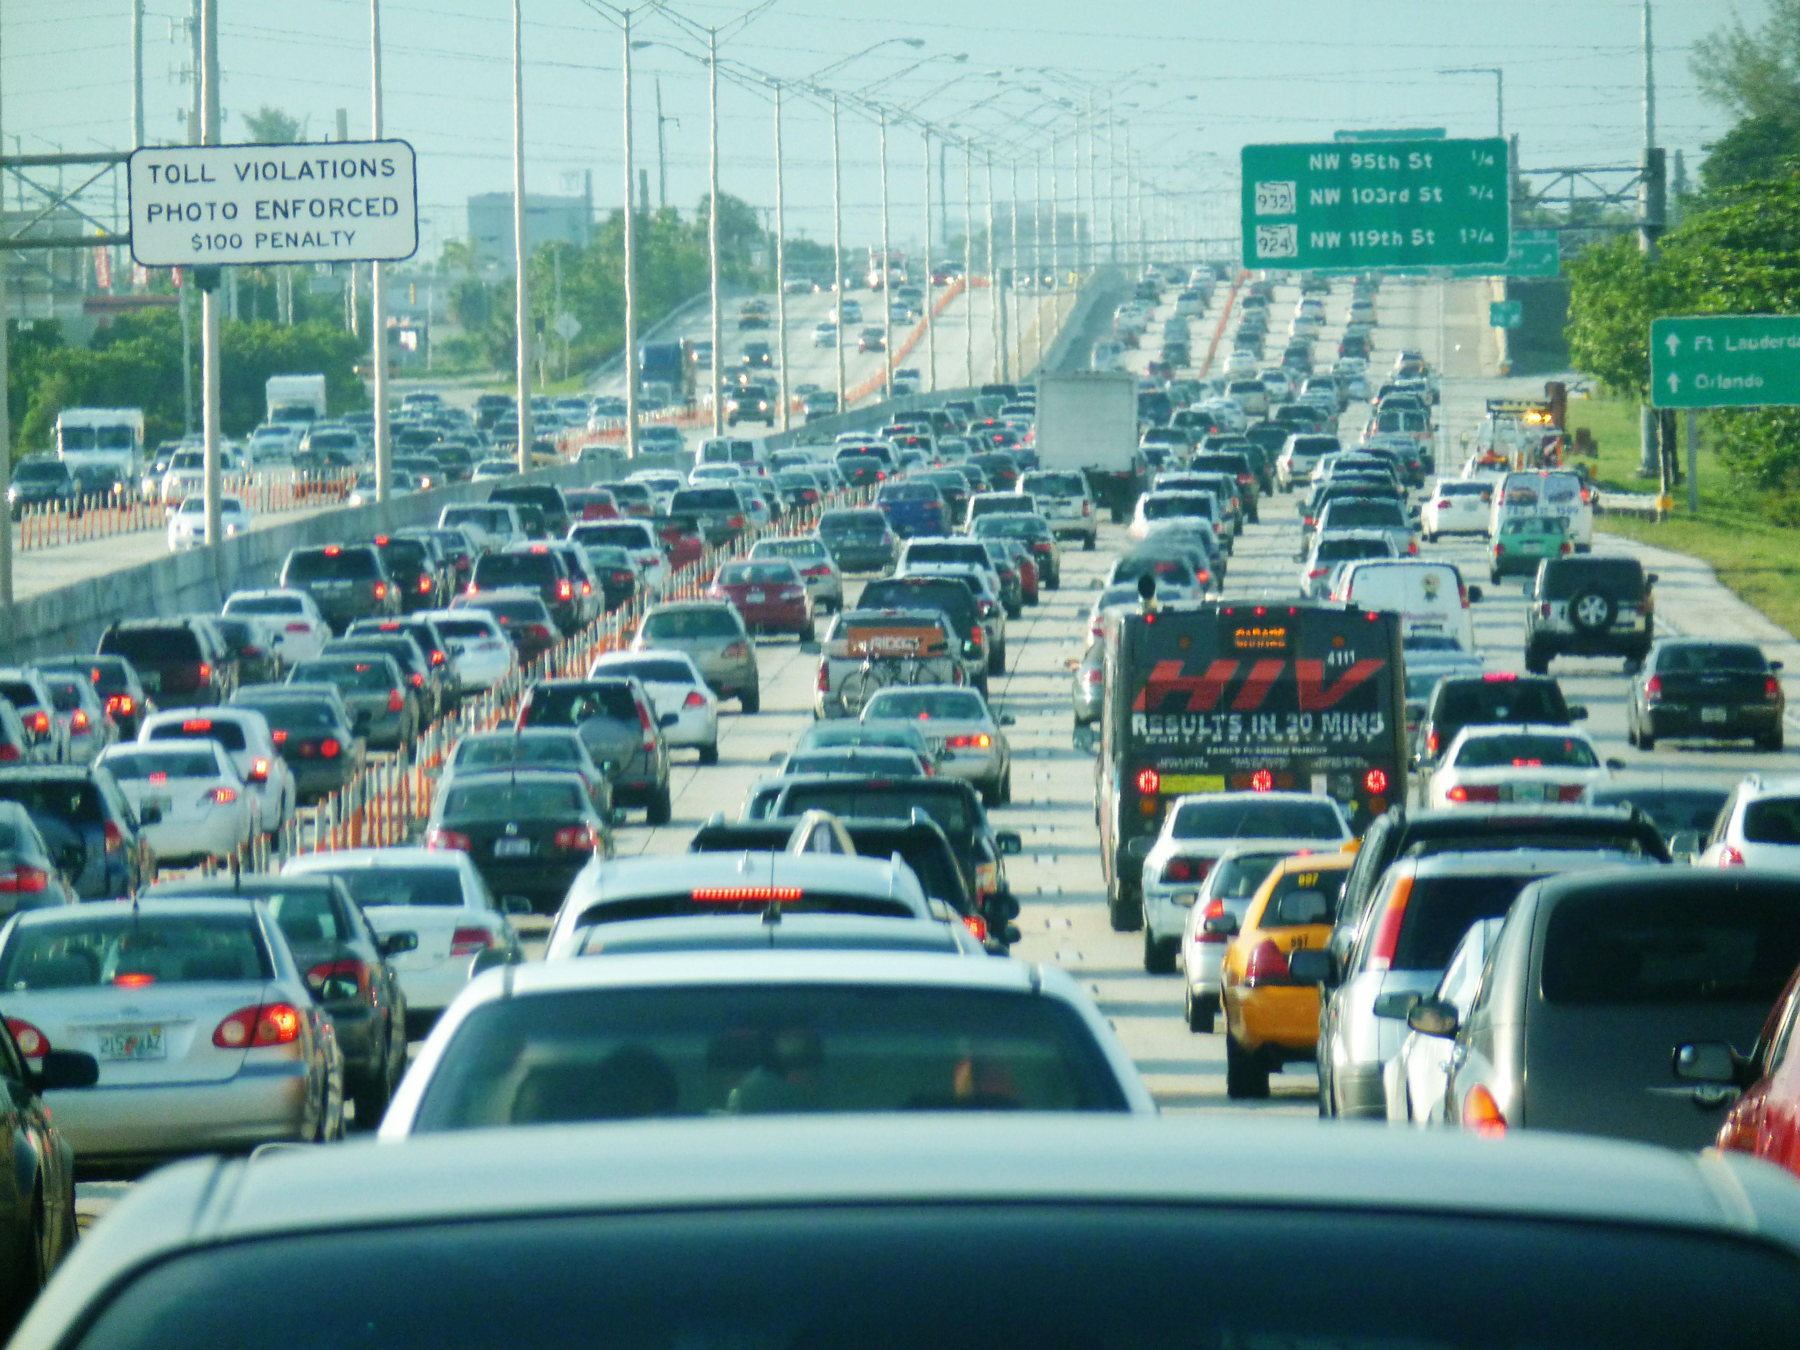
Roads Crossing Boundaries
Roads: Road could fall under any of the 4 categories.
A public road that is not congested is a public good.
A public road that is congested is a common resource.
A toll road that is not congested is a club good.
A toll road that is congested is a private good.
Notes:
https://commons.wikimedia.org/wiki/File:Miami_traffic_congestion,_I-95_North_rush_hour.jpg

