Slide 1
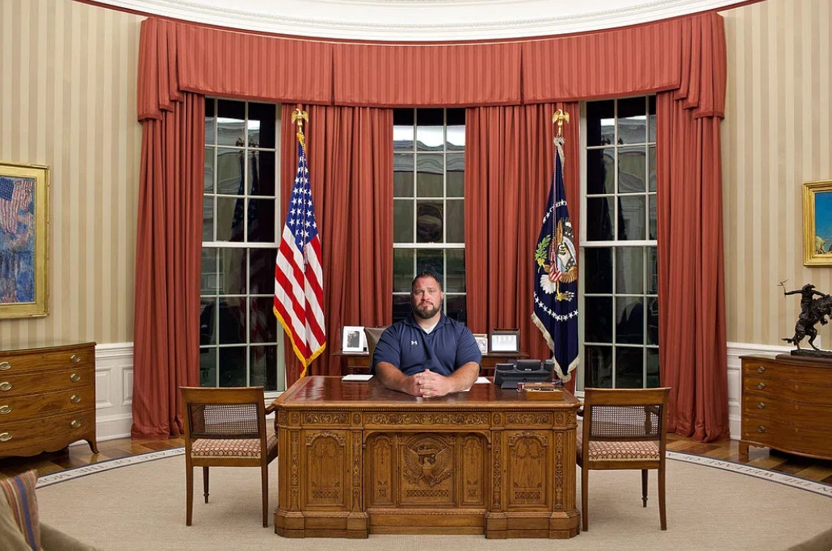
Fiscal Policy
Notes:
Make sure to talk about that I am just showing influences of different policies. I am not saying every time this is the way it will happen. So if some of this might go against some world view you have about economic policy, I'm not saying you are wrong. You may be right. We will go over how cutting corporate taxes can lead to long run increases in our standard of living through increased investment. But of course cutting corporate taxes may not always lead to that. The proper policy is situation dependent. Sometimes increasing government spending is right, sometimes cutting it is right. Sometimes increasing taxes is right, sometimes cutting them is right, it depends. Again, I am just showing you certain influences and pressures that result from different policy decisions. If you have questions or don’t feel like something jives with views you, please ask questions. That makes it fun!

Slide 2
Fiscal Policy
Objective: Describe the role of government and analyze policy responses to business cycle shocks.
  What is the appropriate role of government in the economy?
  How does government spending affect the aggregate economy in the short run and the long run?
  How do corporate taxes and personal income taxes affect the aggregate economy in the short run and the long run?
  What is structural policy?
Notes:
Make sure to talk about that I am just showing influences of different policies. I am not saying everytime this is the way it will happen. So if some of this might go against some world view you have about economic policy, I'm not saying you are wrong. You may be right. We will go over how cutting corporate taxes can lead to long run increases in our standard of living through increased investment. But of course cutting corporate taxes may not always lead to that. The proper policy is situation dependent. Sometimes increasing government spending is right, sometimes cutting it is right. Sometimes increasing taxes is right, sometimes cutting them is right, it depends. Again, I am just showing you certain influences and pressures that result from different policy decisions. If you have questions or don’t feel like something jives with views you, please ask questions. That makes it fun!

Slide 3

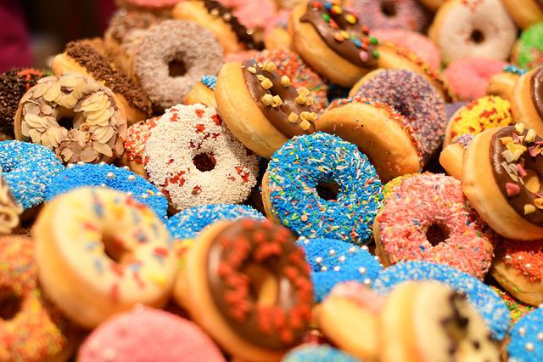
Role of Government
    A Traditional Economic View
Pareto Optimal: an allocation of goods is Pareto Optimal if there is no way to rearrange the allocation such that at least one agent is better off without making any other agent worse off.
  - Example: We have a room full of people.
      Everyone has one donut: Pareto Optimal? YES
      One person has all the donuts: Pareto Optimal? ???
Notes:
https://www.pexels.com/photo/selective-focus-photograph-of-half-eaten-doughnut-with-sprinkles-1822105/
One prevailing notion about the role of government involvement concerns paerto optimality. It doesn’t care about the distribution in the economy, but rather efficiency. It only cares if there are wasted resources.

Slide 4
Role of Government
Pareto Optimal: an allocation of goods is Pareto Optimal if there is no way to rearrange the allocation such that at least one agent is better off without making any other agent worse off.
  - Example: We have a room full of people.
      Everyone has one donut: Pareto Optimal? YES
      One person has all the donuts: Pareto Optimal? ???
    There are strong criticisms of using this criteria to define the role of government.
      It discounts inequality.
        - Pareto Optimality isn’t about distribution, but rather efficiency…i.e. there are no wasted slices of pie.
      It also discounts value judgments.
        It leaves no room for the government to carry out the will of the people with regard to issues of fairness.
Notes:
One prevailing notion about the role of government involvement concerns paerto optimality. It doesn’t care about the distribution in the economy, but rather efficiency. It only cares if there are wasted resources.

Slide 5
Role of Government
A Competitive Equilibrium (C.E.) : is a set of quantities and prices, given exogenous variables and parameters, such that consumers maximize utility, and firms maximize profit, both subject to their constraints and taking all prices as given, such that, all markets clear.
The First Fundamental Welfare Theorem: states that under certain conditions, a competitive equilibrium is Pareto Optimal.
  Adam Smith, laissez-faire, the invisible hand.
  The government is not necessary to achieve pareto optimality except under certain conditions.
Conditions
  Competitive Markets at Full Equilibrium.
  Markets are Complete - There are No Externalities
  Perfect Information – No Distortion of Incentives

Slide 6
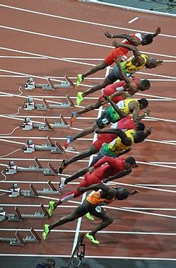
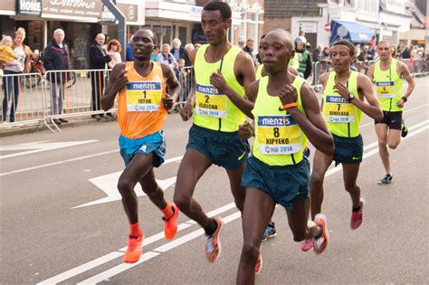
Beliefs on Role Of Government
Long Run: There is just one question you need to answer, what is the tradeoff in standards of living between policies of equality and efficiency?
Short Run: There is just one question you need to answer, how sticky are prices and wages?

Slide 7




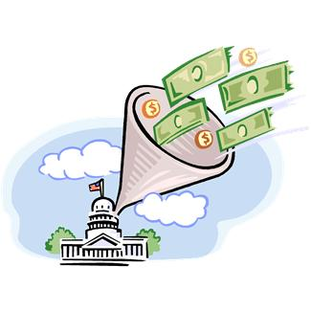

EXPANSIONARY FISCAL POLICY
Increased Government Spending
Corporate Tax Cuts
Income Tax Cuts

Slide 8

Government Stimulus
P
LRAS
SRAS
AD
$$AD=C+I+G+NX$$
P_{B}
B
P_{A}
A
Y_{B}*
Y
Notes:
PE is the expectations of prices from both sides, the consumer and the producer!
WRITE IT UP ON THE BOARD AND KEEP DOING IT WITH THE DIFFERENT EXAMPLES.
for SRAS talk about how prices are higher than what you expected and what you set your prices at, you can sell more.

Slide 9
Government Multiplier
Government Multiplier Effect: The additional shifts in aggregate demand that result when fiscal policy changes income and thereby changes consumer spending.
  Marginal Propensity to Consumer (MPC): The fraction of extra income that a household consumes rather than saves.
Increase government spending by 20 Billion with MPC = 0.8 :
➔ (.8)*20B ➔ C ⬆ $16B
➔ (.8)*16B ➔ C ⬆ $12.8B
(.8)*12.8B ➔ C ⬆ $10.24B
…..so on and so forth.

Slide 10
Government Stimulus
P
LRAS
SRAS
AD
$$AD=C+I+G+NX$$
P_{B}
B
P_{A}
A
Y_{B}*
Y
Notes:
PE is the expectations of prices from both sides, the consumer and the producer!
WRITE IT UP ON THE BOARD AND KEEP DOING IT WITH THE DIFFERENT EXAMPLES.
for SRAS talk about how prices are higher than what you expected and what you set your prices at, you can sell more.

Slide 11

Government Stimulus
$$AD=C+I+G+NX$$
i
S_{M}
r
D_{LF}
S’_{LF}
S_{LF}
i'
r’
r
i
D’_{M}
D_{M}
Q_{M}
Q_{M}
Q’_{LF}
Q*_{LF}
Q_{LF}

Slide 12


Increases in Government Spending
LRAS
LRAS
P
AD
$$AD=C+I+G+NX$$
SRAS
P_{D}
D
P_{B}
B
$$LRAS=Y^{∗}=Af(K,L,H,R)$$
P_{C}
C
P_{A}
A
Y_{D}*
Y_{B}*
Y
Notes:
WRITE OUT!

Slide 13
Accommodating Monetary Policy
Accommodating Monetary Policy: The central bank can also affect aggregate demand and can work in tandem with fiscal policy to make it more effective.
  - In the case of expansionary fiscal policy, the central bank can help reduce the crowding out effect with expansionary monetary policy.
Open Market Purchase of Bonds
Savings with increased supply money
S_{M}
S’_{M}
i
r
D_{LF}
S_{LF}
S’_{LF}
r
i
r’
i’
D_{M}
Q_{M}
Q’_{M}
Q_{M}
Q_{LF}
Q’_{LF}
Q_{LF}

Slide 14
Government Spending That Improves LRAS
LRAS
LRAS’
P
SRAS
SRAS’
Spending on A, K, L, H, R,
K – small business loans or grants
H – health and education and job training
R – spending or subsidies for energy production
L – ensuring worker protections
A – grants toward research and development
P_{A}
P_{B}
AD’
AD
Y_{A}*
Y_{B}*
Y (out put/GDP)
Notes:
Talk in terms of we need in coordination with expansionary policy for crowding out.

Slide 15


Corporate Tax Cut: Long Run
LRAS
LRAS’
P
SRAS
SRAS’
$$AD=C+I+G+NX$$
P_{A}
P_{B}
$$LRAS=Y^{∗}=Af(K,L,H,R)$$
AD’
AD
Y_{A}*
Y_{B}*
Y

Slide 16

Income Tax Cut: It Depends
Income Tax Cut Debate
The effects of an income tax cut depend on whether people spend the extra disposable income on consumption goods or if they unleash their animal sprits and invest the money in entrepreneurial endeavors. There is likely a mix of both.
As to which types of spending will be dominant, it is likely to depend on current economic conditions, the size of the tax cut and whether it is permanent or temporary.
Notes:
Make sure to talk about S corporations and how they are taxed at the personal income level, so that lends credence to supply side.

Slide 17
Tax Multiplier
Tax Multiplier Effect: The additional shifts in aggregate demand that result when fiscal policy changes income and thereby changes consumer spending.
  - Let’s say the government implements a $20B tax cut.
    The tax multiplier is smaller than the government multiplier because there is no initial injection of $20B.

Slide 18

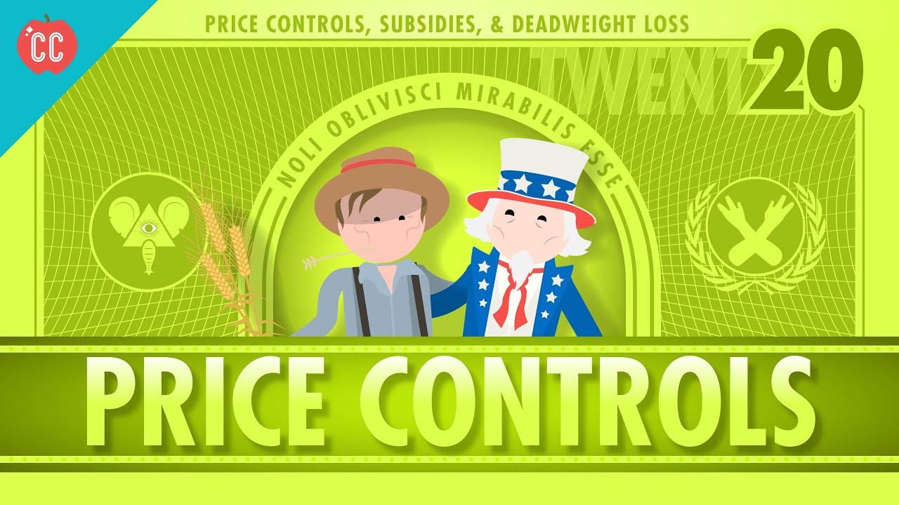
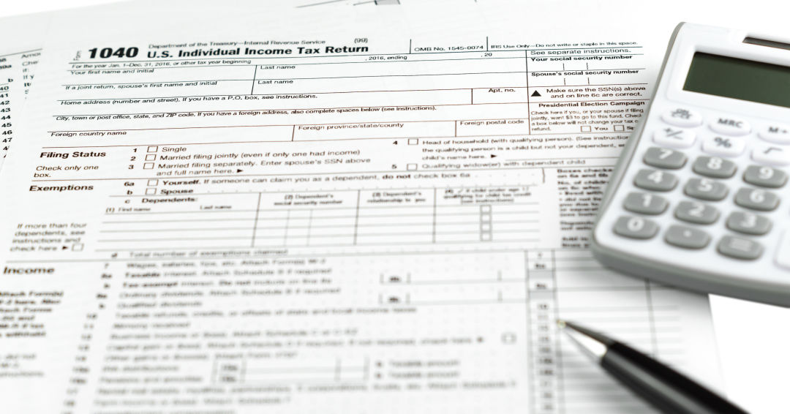


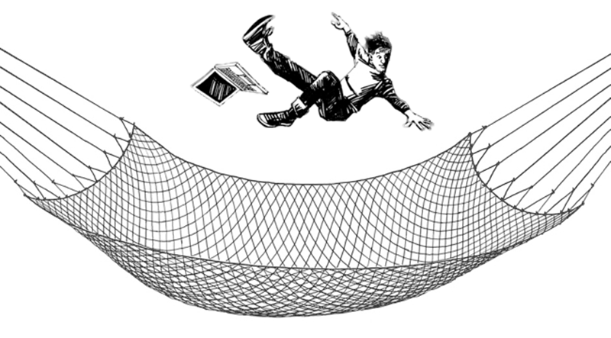

Structural Policy
Structural Policy: policy aimed at changing the fabric or fundamental makeup of the economy.
Price Controls
Tax Code
Public Sector Enterprises
Regulation
Social Safety Net
Job Training
Notes:
https://kboo.org/media/100360-cares-act-tax-cuts-wealthy-spur-oregon-effort-remove-cuts-state-tax-code
https://www.vijana.fm/2010/08/10/getting-off-the-bench/
https://technofaq.org/posts/2017/11/regulation-must-be-responsive-ct-compliances-brian-connell-tombs-notes/
https://www.huaxingnets.com/knotted-nylon-twine-safety-net.html
https://support.skillscommons.org/showcases/apprenticeships/the-basics/

