Slide 1

Household Choices

Slide 2
Household Choices
Objective: Explain the interaction between budget constraints and indifference curves.
  What are budget constraints and indifference curves?
  Where do we find the optimal bundle of consumption based on income and prices?
  How do changes in wages affect the labor-leisure choice?
  How do changes in real interest rates affect the two-period consumer choice?

Slide 3
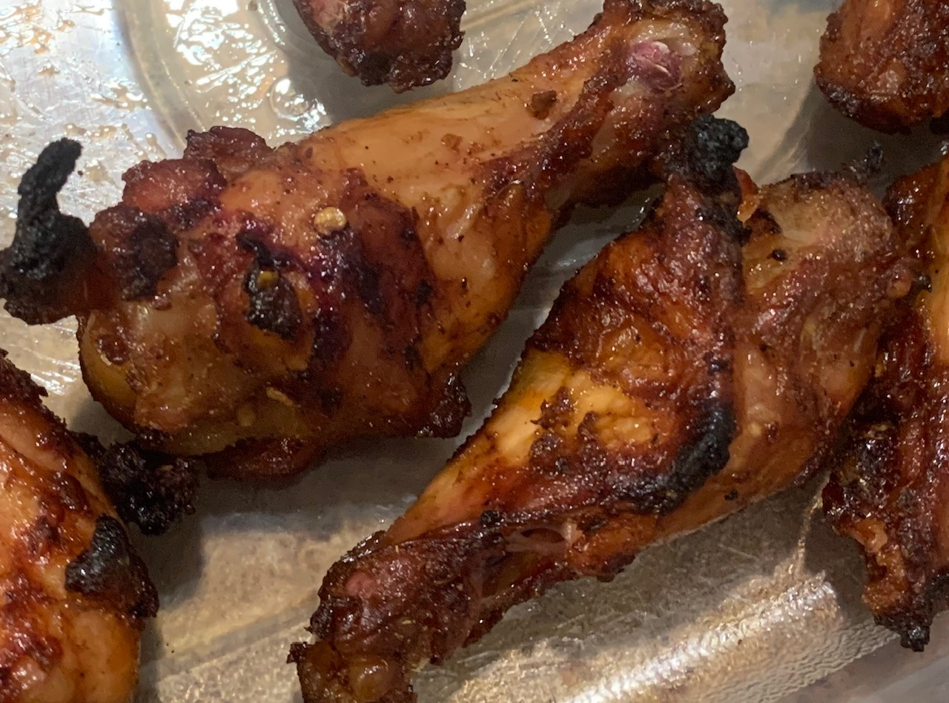



What Choices
Consumption Bundle Choice
Wings vs Beer
VS
Labor, Leisure Choice
Work vs Play
VS
Buy Now
Save for Later
Two-Period Consumer Choice
Now vs Later
VS
Notes:
https://freesvg.org/baseball-player
https://pixabay.com/en/baseball-batter-hitting-sport-1606943/

Slide 4

What can I Afford?
Budget Constraint: the limit on the consumption bundles that a consumer can afford.
Notes:
https://pxhere.com/en/photo/1230051

Slide 5


Budget Constraint
IPA
We are headed to the Tavern with $60…we have some choices to make!
Number of Beers | Number of Wings | Spending on Beers | Spending on Wings | Total Spending
10 | 0 | $60 | $0 | $60
9 | 6 | $54 | $6 | $60
8 | 12 | $48 | $12 | $60
7 | 18 | $42 | $18 | $60
6 | 24 | $36 | $24 | $60
5 | 30 | $30 | $30 | $60
4 | 36 | $24 | $36 | $60
3 | 42 | $18 | $42 | $60
2 | 48 | $12 | $48 | $60
1 | 54 | $6 | $54 | $60
0 | 60 | $0 | $60 | $60

Slide 6
Budget Constraint
Notice the slope is 1/6, which is also the relative price of a Wing to a Beer.

Slide 7
What do I want?
Indifference Curve: a curve that shows consumption bundles that give a consumer the same level of satisfaction.
Notes:
I made

Slide 8
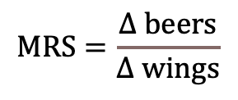


Indifference Curves: MRS
Marginal Rate of Substitution (MRS): the rate at which a consumer is willing to trade one good for another…the slope of the indifference curve any point.
Indifference curves are downward sloping. The slope represents the MRS. Consumers like both goods, so to give one up they need more of the other.
Beers
$$MRS=\frac{∆ beers}{∆ wings}$$
$$∆ beers$$
$$∆ wings$$
Wings

Slide 9
Indifference Curves: Rank of Preferences
Beers
Higher indifference curves are preferred to lower ones. People usually prefer more to less.
A
B
D
C
Wings
Notes:
A consumer’s is indifferent between point A, B and C because they are all on the same difference curve…
…From A to B, the consumer gives up wings, but is compensated enough by the increase in beers.
A consumer’s set of indifference curves gives a complete ranking of the consumer’s preferences…
…The consumer prefers D to any of A, B or C because it is on a higher indifference curve where they can get more of both…
…or at least be compensated enough for the good he gives up like moving from B or C to D.

Slide 10
Indifference Curves: Ghostbusters Rule
Beers
Indifference curves cannot cross. The consumer is indifferent between C and B and is indifferent between A and C. However, the consumer prefers B to A…which is of course impossible!
A
B
C
Wings

Slide 11
Indifference Curves: Bowed Inward
Indifference curves are bowed inward. Again, the slope represents the MRS.
The rate at which a consumer is willing to trade a wing for a beer and vice versa depends on the amount of goods they are already consuming.
Whether they are hungrier or thirstier, depends what they have currently consumed.
Beers
The consumer needs more beer for every wing as we move to the left and up the indifference curve.
10
6
4
3
0
10
15
30
35
Wings
Notes:
The MRS depends on how much of each good the consumer is currently consuming…people are more willing to trade away goods they have in abundance.

Slide 12
Indifference Curves: Two Extremes
Perfect Substitutes
Perfect Compliments
1 lb gold bar
Left mitten
6
4
2
15
10
1
2
3
2 lb gold bar
10
15
Right mitten

Slide 13



Consumer’s Optimal Choice
The optimal point where the budgets constraint is tangent to the indifference curve…the marginal rate of substitution equals the relative price of the goods.
This point represents the best combination of wings and beer the consumer can afford, where the marginal utility of beer per dollar spent equals the marginal utility of wings per dollar spent. You have maximized your utility per dollar spent!
Optimal
$$Slope=MRS$$
Beers
$$\frac{P_{W}}{P_{B}}=\frac{{MU}_{W}}{{MU}_{B}}$$
$$\frac{{MU}_{B}}{P_{B}}=\frac{{MU}_{W}}{P_{W}}$$
Wings
Notes:
The consumer finds their optimal bundle of consumption at the point they maximize their total utility per dollar spent. We like efficiency in economics, and we want to maximize our “happiness factor” per dollar! To find this point, we need to bring our two worlds of what we want and what we can afford together. Remember, there an infinite number of these IC moving up and to the right. We want to reach as high of an IC as possible. We stand on tippy toes and stretch and reach as far as we can, and where we can just barley touch on of the IC, we find our optimal bundle of consumption. In the graph below that point is where our BC is tangent to one of our IC. When two curves are tangent, it means they touch at just one point. Our budget constrains our reach. This is the best we can possible do give our preferences and our constraints. In mathematical terms, the optimal bundle of consumption is where the slope of the BC equal to the slope, or MRS, of the IC. That can be written as the relative prices of the goods equal to the relative marginal utility of the goods. Again, the marginal utility represents the additional satisfaction of the last unit of a good consumed. It hopefully makes sense that the MRS, or the willingness of a consumer to trade one good for another depends on the relative marginal utility of the two goods. My willingness to trade a one good for another depends on the additional satisfaction I receive for one good versus another. Here, my willingness to trade a beer for a wing would depend on how much satisfaction I gain from the wing versus how much I lose from giving up a beer. I can rearrange the equation to show the optimal bundle of consumption is at the point where the marginal utility per dollar spent on beer equals the marginal utility per dollar spent on wings. In other words where my bang for my buck for wings equals my bang for my buck for beers! At this point I have maximized my total utility per dollar spent. If I deviate from the point, my total utility per dollar spent will decline and I would be better off spending more money on the good that brings me more utility per dollar.

Slide 14

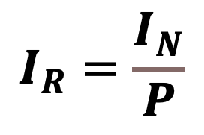
Optimal Choice:
Change in Nominal Income
Income Effect: the change in consumption that results when a consumer moves to a new indifference curve.
$$I_{R}=\frac{I_{N}}{P}$$
Notes:
https://www.pexels.com/photo/gold-round-coins-50545/
https://wiobyrne.com/remediating-my-digital-identity-for-make-cycle-2-clmooc/
Keegan-Michael Key

Slide 15
Optimal Choice:
Normal Good
Beers
When the consumer’s income rises, the budget constraint shifts parallel out to the right. The consumer will now enjoy both more Wings and more Beers (both normal goods). We call that fatter and happier!
B₂
B
B₁
A
W₁
Wings
W₂

Slide 16
Optimal Choice:
Inferior Good
When the consumer’s income rises, the budget constraint shifts parallel out to the right. The consumer will enjoy more Wings (normal good) but less Frat Beer (inferior good). They will start drinking better beer now!
Frat House Beers
FB₁
A
FB₂
B
W₁
W₂
Wings

Slide 17

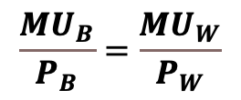
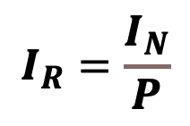
Optimal Choice: Change in Price
Income Effect: the change in consumption that results when a consumer moves to a new indifference curve.
$$I_{R}=\frac{I_{N}}{P}$$
Substitution Effect: the change in consumption that results when a price change moves the consumer along a given indifference curve to a point with a new marginal rate of substitution.
$$\frac{{MU}_{B}}{P_{B}}=\frac{{MU}_{W}}{P_{W}}$$
Notes:
https://www.pexels.com/photo/gold-round-coins-50545/
https://shirt.woot.com/derby/entry/34662/substitute-teacher

Slide 18
Optimal Choice: Change in Price
Beers
A Decrease in the Price of Beer:
From point A to point B, the substitution effect is taking place, reducing consumption of Wings and increasing the consumption of Beers.
From Point B to point C, the income effect is taking place, increasing the consumption of both normal goods (seen in income effect from B to C).
B₃
C
income effect
B₂
B
substitution effect
A
B₁
W₂
W₁
Wings
W₃
substitution effect
income effect
Notes:
We shift new budget constraint back parallel to find tangent point with old indifference curve, because our optimal MRS is always the slope of our budget constraint. So that is the point on our old indifference curve through the substitution effect.
A to B substitution, B to C income. A to C shows you both effects. Normal versus inferior seen in income effect.

Slide 19
Optimal Choice: Change in Price
Beers
A Decrease in the Price of Double Jack
Good | Income Effect | Substituion Effect | Total Effect
Beers | ⬆ | ⬆ | ⬆
Wings | ⬆ | ⬇ | ?
***note drawn with substitution effect dominating for BSW.
B₃
C
income effect
B₂
B
substitution effect
A
B₁
W₂
W₁
Wings
W₃
substitution effect
income effect
Notes:
We shift new budget constraint back parallel to find tangent point with old indifference curve, because our optimal MRS is always the slope of our budget constraint. So that is the point on our old indifference curve through the substitution effect.
A to B substitution, B to C income. A to C shows you both effects. Normal versus inferior seen in income effect.

Slide 20



Labor vs Leisure
Work vs Play
One Yard Fight
I Win???
Game Winner

Slide 21
Labor Versus Leisure
Why work?
  We work for money so we can buy things…In Economics, we call it Consumption.
    We consume both for survival and for utility…buying things makes us happy and can often times enhance our leisure time when we have it.
The Effects of an increase in wages:
  Substitution Effect: will induce a larger supply of labor due to a higher price for leisure.
    Work more for greater pay so that we can increase our consumption.
  Income Effect: will reduce the labor supply
    Work less for the same money and enjoy more leisure time.
    Leisure is a normal good.

Slide 22

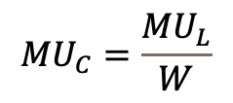

Worker’s Optimal Choice
Optimal
$$Slope=MRS$$
Consumption
This point represents the optimal combination of leisure and consumption, where the marginal utility of consumption equals the marginal utility of leisure per dollar “spent” on leisure. You have once again maximized your utility per dollar spent!
$$W=\frac{{MU}_{L}}{{MU}_{C}}$$
wage*24hrs
$${MU}_{C}=\frac{{MU}_{L}}{W}$$
24 hrs
Leisure

Slide 23
Worker’s Optimal Choice –
A Change in Wages
There are both income and substitution effects with a change in wage.
If substitution effects dominate, then leisure decreases, and consumption increases.
If income effects dominate, then both current leisure and consumption increases.
Increase in Wage
Substitution Effect Dominates
Income Effect Dominates
consumption
consumption
IC₁
C
C
A
A
IC₂
IC₂
IC₁
Hours of Leisure
Hours of Leisure

Slide 24

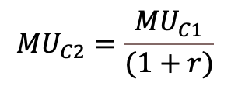
Two-Period Optimal Choice
Optimal
This point represents the optimal combination of period one and period 2 consumption, where the marginal utility of period 2 consumptions equals the marginal utility of period one consumption per dollar “spent”.
You work in period 1 and then retire. Whatever you save for period two earns a real interest rate of r.
C2
$$Slope=MRS$$
(1+r)$=\frac{{MU}_{C1}}{{MU}_{C2}}$
earnings*(1+r)
$${MU}_{C2}=\frac{{MU}_{C1}}{(1+r)}$$
earnings
C1

Slide 25
Two-Period Optimal Choice –
A Change in Real Interest Rates
There are both income and substitution effects with a change in interest rate.
If substitution effects dominate, then current consumption decreases and future consumption increases.
If income effects dominate, then both current and future consumption will increase.
Increase in Interest Rate
Substitution Effect Dominates
Income Effect Dominates
C2
C2
IC₁
C
C
A
IC₂
A
IC₂
IC₁
C1
C1

