Slide 1
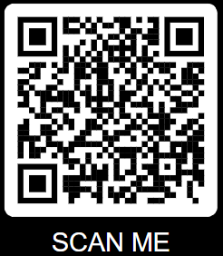
TAKE THE FIGHT TO KID CANCER!
HELP TODAY & MAKE A DONATION
REGISTER FOR OUR UPCOMING EVENT(S) LABOR DAY WEEKEND
10-20-30 Mile Endurance Ruck (Hiking)
5k Run
Warrior Basic Team Challenge
www.warriorfoundationnfp.com
SCAN QR CODE TO DONATE AND LEARN HOW YOU CAN JOIN THE FIGHT!
Follow WARRIOR FOUNDATION on Facebook and keep up with the latest news and events!

