Slide 1
Advocating Across Disciplines when Children Discharge into the CPS System
Rose E. Tandeta, MA, CCLS, CIMT
Lauren Ragan Wilkerson, MA, MT-BC
UCSF Benioff Children’s Hospital Oakland

Slide 2
Learning Objectives
Participants will be able to identify the prevalence of abuse/neglect that results in hospitalization of children
Participants will be able to identify racial disparities and systemic racism at play in child protective services decisions and actions
Participants will be able to identify interventions within their role in working with children who will be separated from their primary caregivers due to child welfare involvement
Pt 1

Slide 3
Learning Objectives
Participants will learn strategies to advocate; i.e., questions to ask when helping patients transition into the child welfare system
Participants develop increased confidence in asking challenging questions as it relates to child welfare involvement with patients
Pt 2

Slide 4
Opportunities for Reflection
What racial disparities and systemic racism dynamics are at play in team decisions?
What interventions come to mind for your service delivery?
*with particular care to trauma informed, culturally reflexive, opportunities to advocate
What areas of need arise that require escalation and collaboration?
Who comes to mind to collaborate/co-treat with for culturally reflexive sessions ?

Slide 5
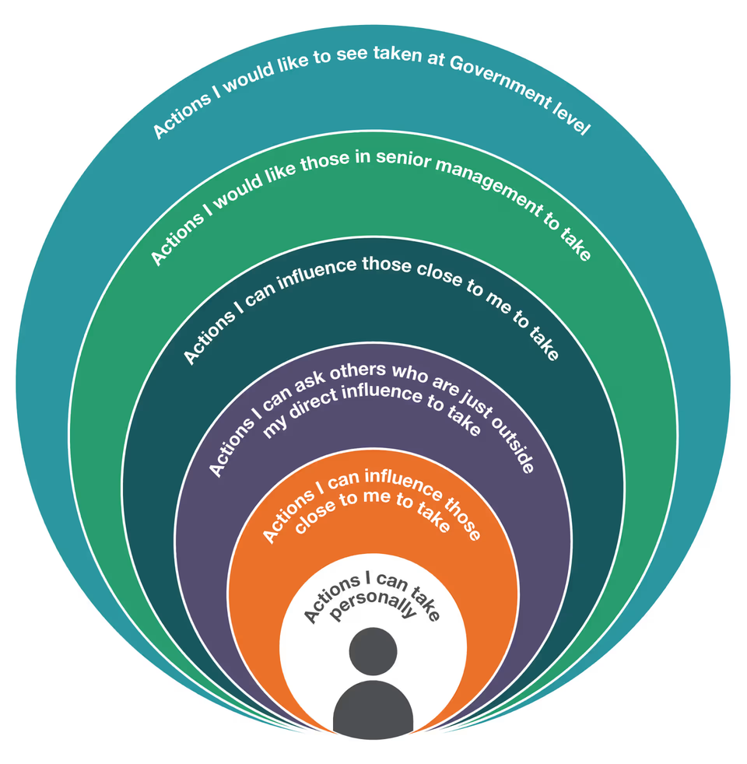
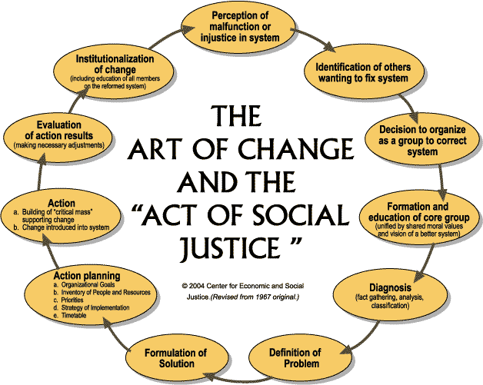
Spheres of Influence & The Art of Change

Slide 6
Case Example:
The Catalyst
  Z
  12-year-old black male
  No family contact allowed
  Thanksgiving week
Notes:
We will provide some brief context to these few examples for a baseline as we dive deeper into the work behind our advocacy, and I can say that this case was something of a catalyst for Lauren and me.
Z was a 12yo black male admitted to the hospital after a bystander called 911 because it looked as if Z had been punched in the face, without actually witnessing any violence between Z or his father, who he was with at the time at the bus stop. Immediately there was a no contact hold placed by CPS, preventing Z from speaking to any of his family members and requiring all hospital staff from deferring any family member that called for him to CPS. Z's injuries were more superficial and while slightly concussed, he was a very bright, energetic and engaging kid. It was Thanksgiving week, which resulted in the hospital not being staffed as it normally would be, specifically there was a covering social worker. I had also only been with this institution for 1-2 years at the time.
It was clear from early on that Z would be discharging into foster care, given the no contact with his family, but no specific information was provided to the interdisciplinary team about why this was the case. It was also quickly decided that CPS would be the ones to pick him up and take him wherever he was going, but they would not share where that location was to anyone in the hospital, including Z. Having developed a relationship with Z over the course of the days that he was in the hospital, Lauren and I were the only providers that seemed to know him well enough to question this decision, but ultimately communication between CPS and the hospital providers was non-existent, and even as Z begged to be told where he was going, he was not given any information, just told to go with this person. Unsurprisingly, Z was not thrilled with the hospital that seemed to have turned on him when they were supposed to care for him.

Slide 7
Case Example
  M & D
  8-year-old and 1-year-old black males
  MVC
  Consistent caregiver at bedside, “Dad”

Slide 8
Case Example
  E
  3-year-old white female
  Fictitious disorder

Slide 9
Case Example
  A
  9-year-old white male
  Medical neglect

Slide 10
Case Example
  H
  9-year-old white male
  MVC

Slide 11
Pause and Take Notice
Let's Compare and Contrast!
What are noticeable differences between the cases?
What are the subtle differences?
What dynamics are at play to allow for these best case scenarios?

Slide 12
Opportunities for Reflection
What come up for you when you hear these case examples?
What clinical experiences of yours left you feelings powerless and/or wanting to take action?
Were you aware of discrepancies like this in your clinical practice?
Does this make you think of other discrepancies with patients of color and their care/discharge planning?
Could you feel more empowered to have an impact and make change?
Notes:
First opportunity for audience participation

Slide 13
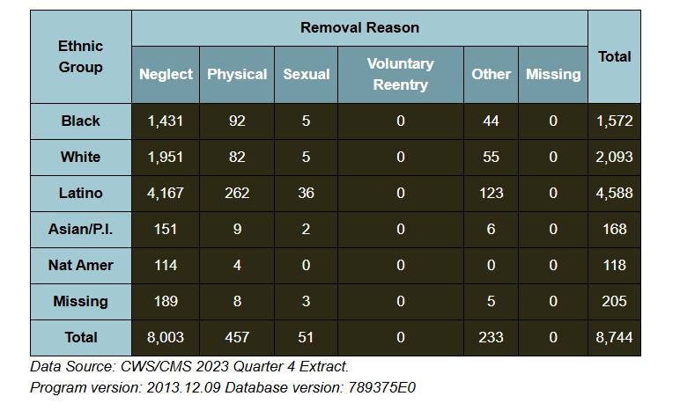
Entry into Foster Care in California

Slide 14
Black families are overrepresented in reports to CPS
Black families are investigated with more frequency by CPS
Black children spend more time in foster care than their white counterparts
Black children are less likely to reunify with their families
Black and Native American children are more likely to be placed with strangers
Black children in the foster care system are less likely to receive supportive services than their white counterparts
Child welfare workers are primarily white (58%)
When families are referred to child protective services, they are evaluated by an individual caseworker rather than a group or committee.
Reviews of counties in California found that the child protective agency did not have enough bilingual providers to meet the language needs of the population that they serve, AND the area also lacked language accessible services in prevention programs.
                (HHSD, 2021)
National Facts About Representation in Foster Care & in the Child Protective System
Notes:
Lack of language access leads to harm

Slide 15
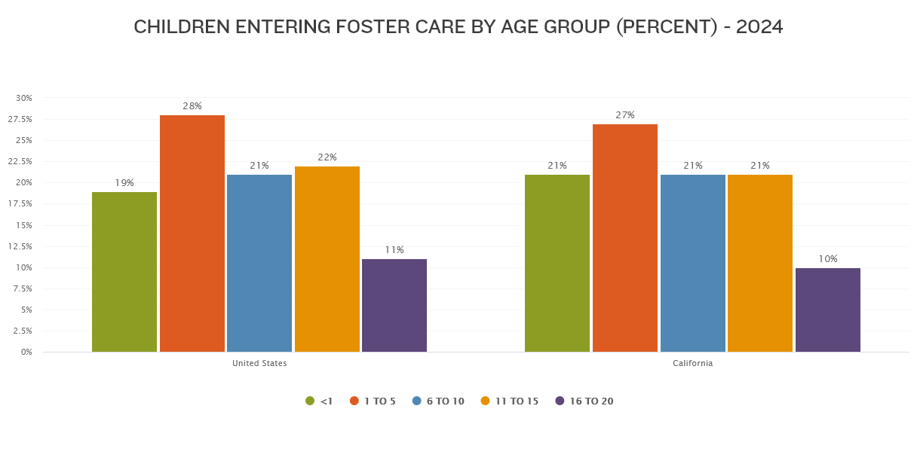
California versus US averages
Fig. 1 "Children Entering Foster Care by Age Group (Percent) - 2024, Annie E. Casey Foundation. Retrieved June 18, 2026 from https://datacenter.aecf.org/data/line/6269-children-entering-foster-care?loc=1&loct=2#2/6/false/1096,2545,1095,2048,574,1729,37,871,870,573/asc/any/13036.

Slide 16
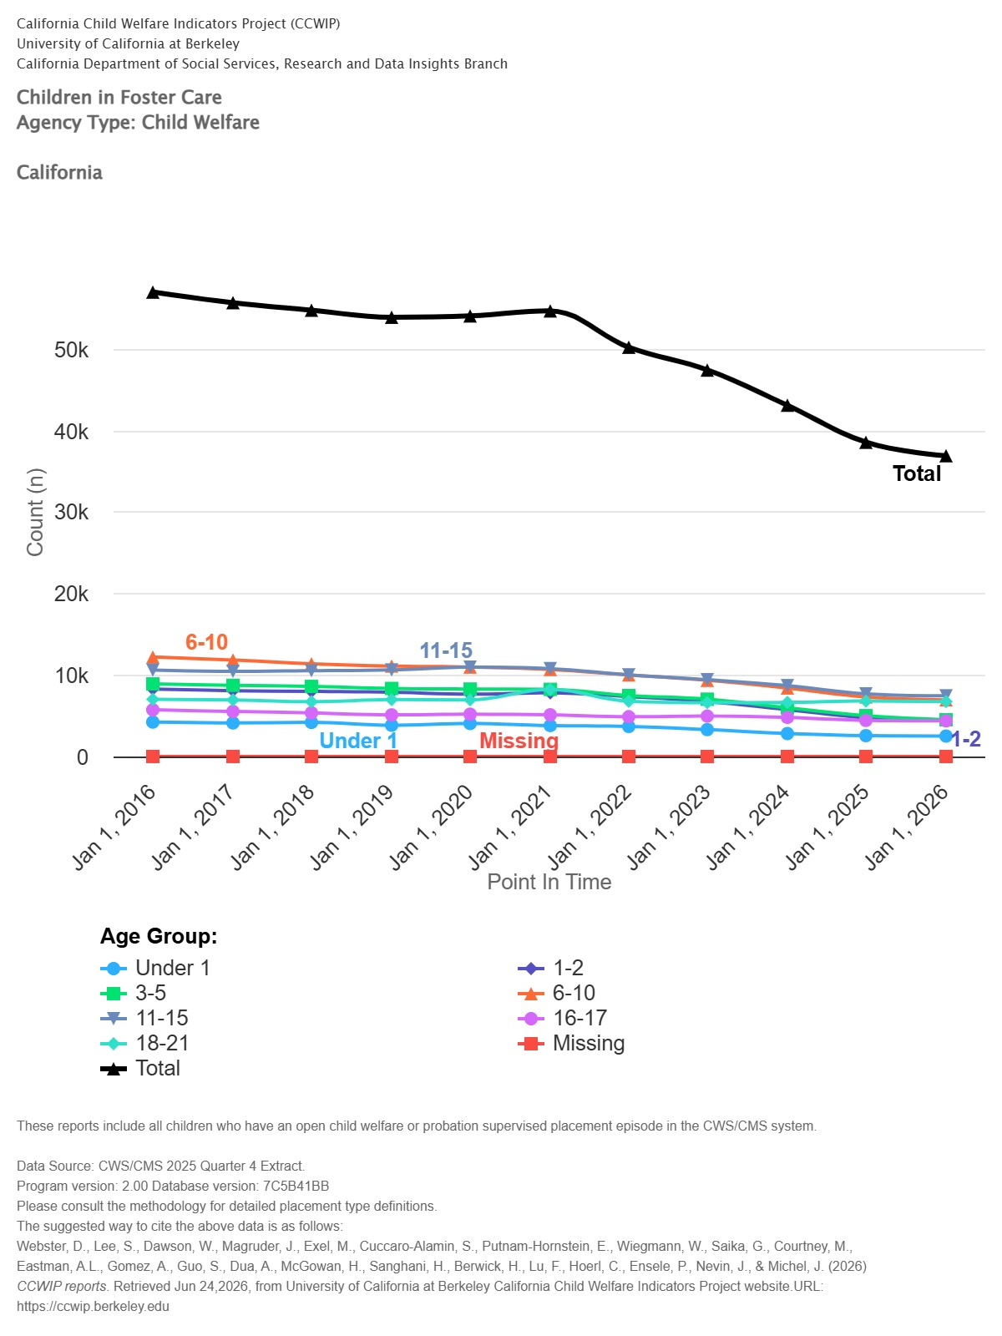
Number of children currently in foster care in California

Slide 17
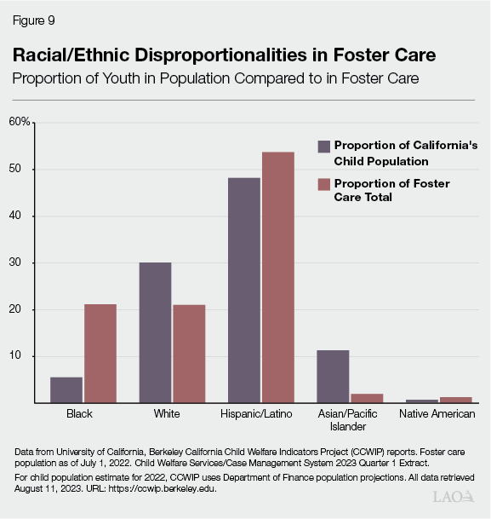
Disproportionality in Foster Care in
California
Notes:
What bias do you think is in play that would reflect these numbers? What are some cultural differences? How can you leverage your professional understanding when advocating and supporting families who find themselves in these circumstances?

Slide 18
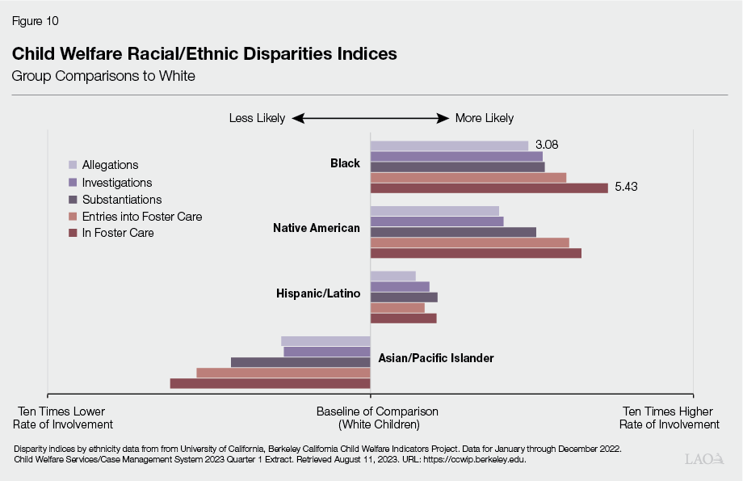
Disparity by Ethnicity

Slide 19
Intersectionality
Contextual intersectionality: How various forms of oppression overlap within a specific context
Situated intersectionality: How different power relationships affecting different identities can explain the many way inequality can take place and show up in many domains (e.g., social, economic, political, etc.)
In relation to CPS: both contextual and situated intersectionality help us understand that CPS is an organization that creates hierarchies of power and marginalization for those it is involved with
There are clear disadvantages to certain populations in the CPS system where professional discretion is made by predominantly White, middle-class caseworkers.
21

Slide 20
Intersectionality
"...as long as Black families are disproportionately poor, they are likely to continue to be disproportionately reported to CPS at higher rates than White children," (Williams-Butler, 2023).
21

Slide 21
Patient Rights
You have the right to dignity and respect
The right to respect for your cultural, psychosocial, spiritual and personal values, beliefs and preferences.
The right to a safe health care setting, free from mental, verbal, physical or sexual abuse, neglect, exploitation and harassment. You have the right to access protective and advocacy services; this includes notifying government agencies of neglect or abuse.
The right to receive appropriate pain management as well as information about pain and pain relief measures. You have the right to participate in pain management decisions.
The right to be free from any form of restraint or seclusion as a means of coercion, discipline, convenience or retaliation by staff.
You have the right to information
The right to receive information in terms you can understand about your or your child's diagnosis, treatments, expected treatment outcomes (including unanticipated outcomes) and prospects for recovery.
The right to request medical interpreter services, if needed, at no cost to you.
The right to know the name of the health care provider who has primary responsibility for coordinating your or your child's care, as well as the names and professional relationships of other providers involved in this care.
You have the right to participate
The right to actively participate in the development and implementation of your or your child's health care plan.
The right to make care decisions and to receive information about any proposed treatment or procedure in order to give informed consent or refuse a course of treatment.
The right to participate in ethical questions that arise in the course of care, including issues of conflict resolution, withholding resuscitative services, and forgoing or withdrawing life-sustaining treatment. To consult with an ethics committee member, ask your nurse or doctor. At our San Francisco campus, you may also call (415) 353-1000.
The right to refuse treatment and to leave UCSF against the advice of health care providers, to the extent permitted by law.
The right to receive a reasonable response to requests to refuse care and treatments, in accordance with laws and regulations.
The right to have your end-of-life decisions and wishes addressed by the hospital.
You have the right to privacy
The right to be told the reason for the presence of any individual.
The right to have non-health-care providers leave before an examination and when treatment issues are being discussed.
The right to restrict non-UCSF visitors.
The right to confidential treatment of all communications and records pertaining to your or your child's care and hospital stay, to the extent required by law.
You have the right to raise concerns and complaints
The right to express concerns or complaints about our care with the assurance that the quality of care or future access to care will not be compromised.
The right to expect a reasonable and timely response to your concerns.
21
Notes:
Let's take notice when these rights are violated by the systems. How do you maintain access for children to have their rights while complying with hospital policies and systemic decisions?

Slide 22
Emotional Safety
Up to 80% of ill/injured children and their families experience acute stress responses to hospitalization after an illness, injury or painful medical procedure.
20-30% of parents and 15-25% of children continue to have stress responses that affect their ADLs and adherence to medical treatment after a hospitalization.
The Society of Pediatric Nurses Department created their own Pediatric Bill of Rights, highlighting the need for:
  respect
  privacy
  information
  support
  patient & family-centered care
  Choices
  flexibility
(Needs for patients AND parents/caregivers)
21
Notes:
All of this is taken way when a CPS investigation STARTS – some people are not innocent until proven guilty while others are not.

Slide 23
Child Life Code of Ethics
Principle 5: "CCLSs demonstrate the competencies of the child life profession by continuous efforts to improve professional services and practices provided in the diverse settings in which they work, and in the community at large"
Rule 307: "A CCLS shall always act in the best interest of individuals, serving the overarching requirement to protect the public" (ACLP, 2023)
21

Slide 24
So... now what?
21
Notes:
It's not that we don't have the tools- we are more than capable. But it's understanding the landscaping that we are walking into in order to utilize those necessary tools and finding who to collaborate with in order to optimize those interventions and hopefully the outcome for the child.

Slide 25
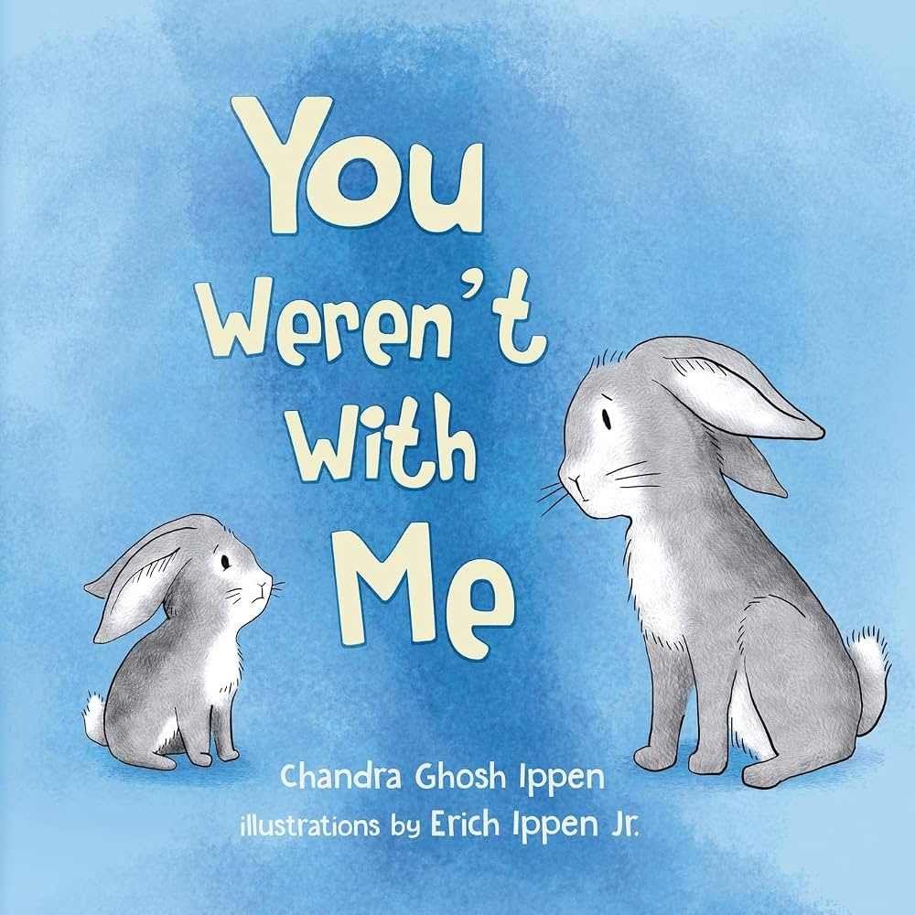
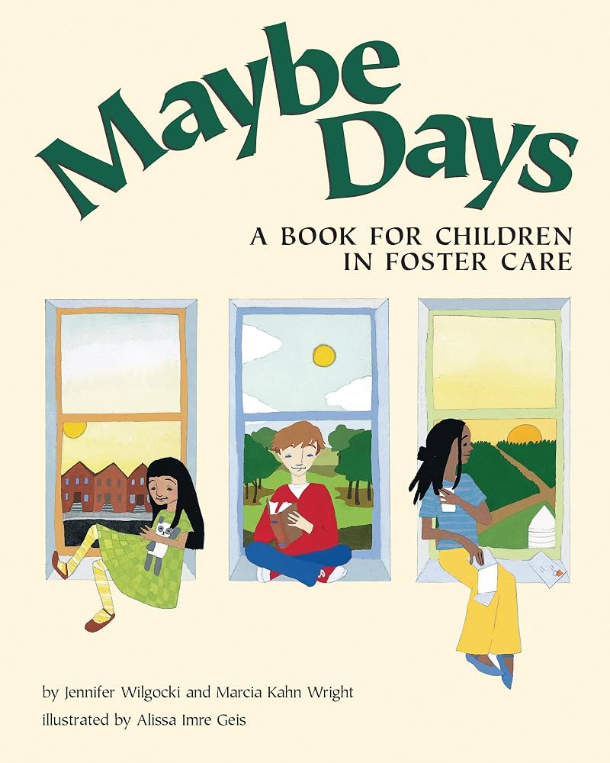
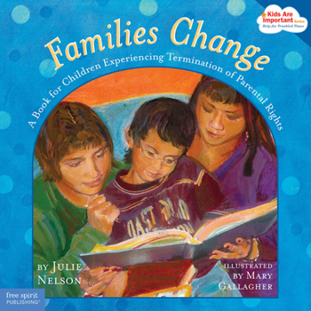

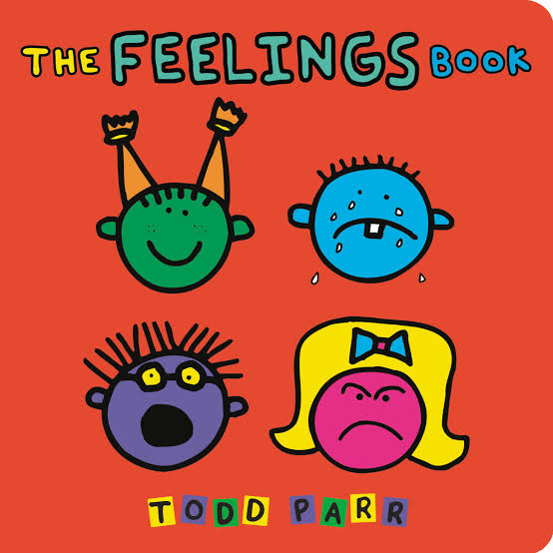
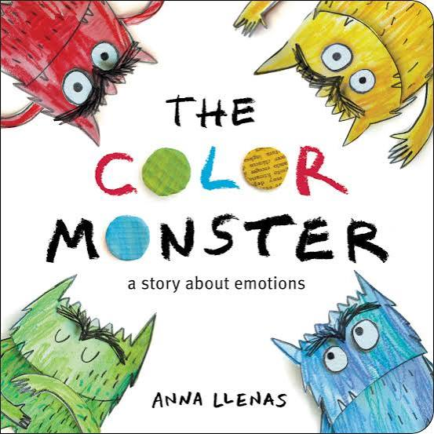
Resources
21

Slide 26
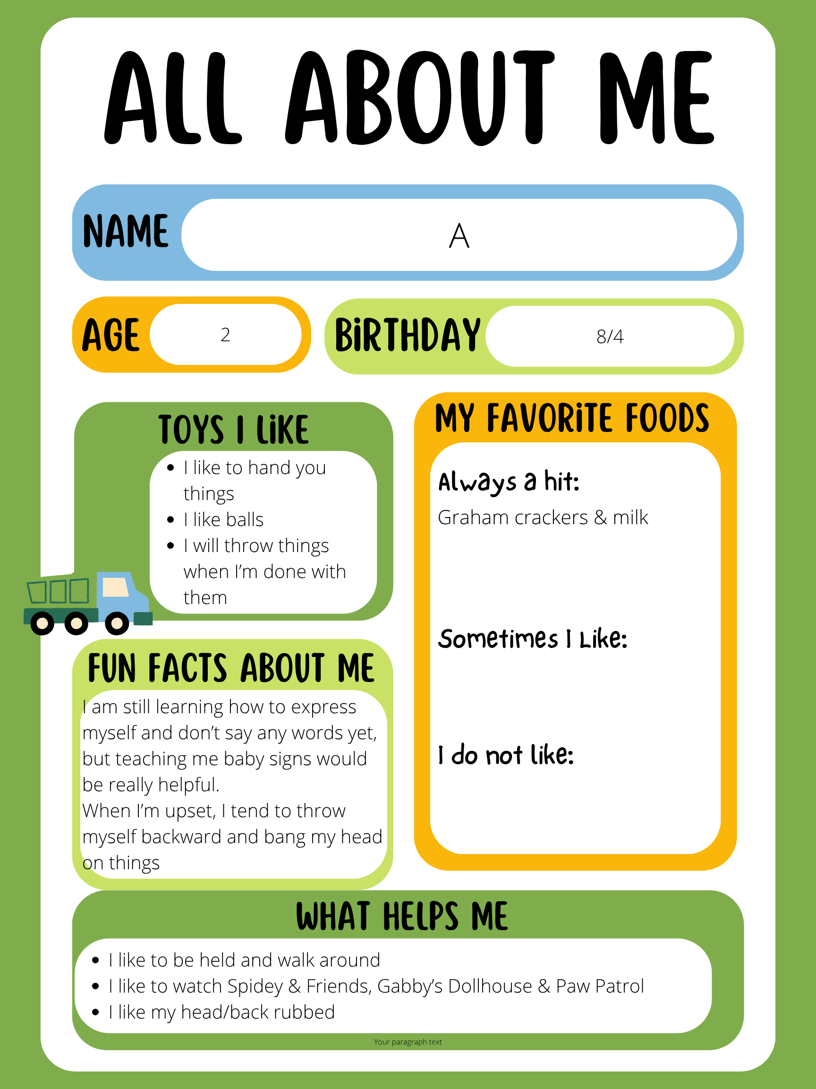
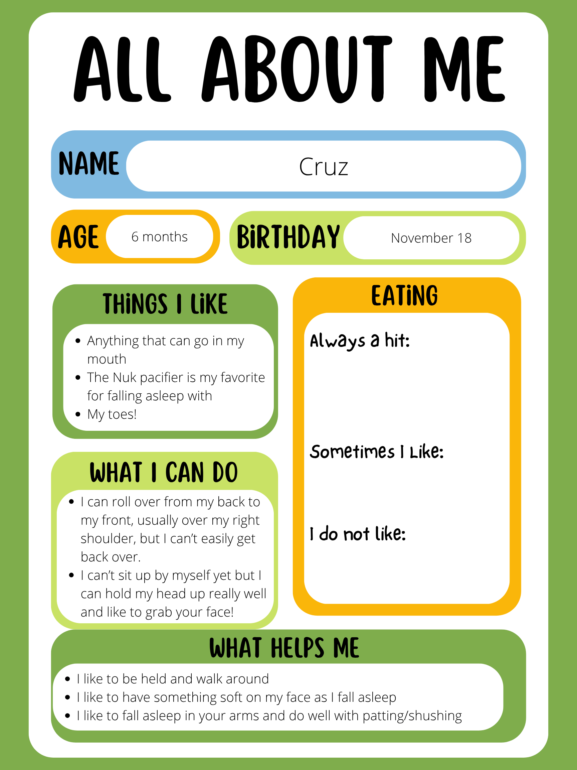
Resources
21

Slide 27
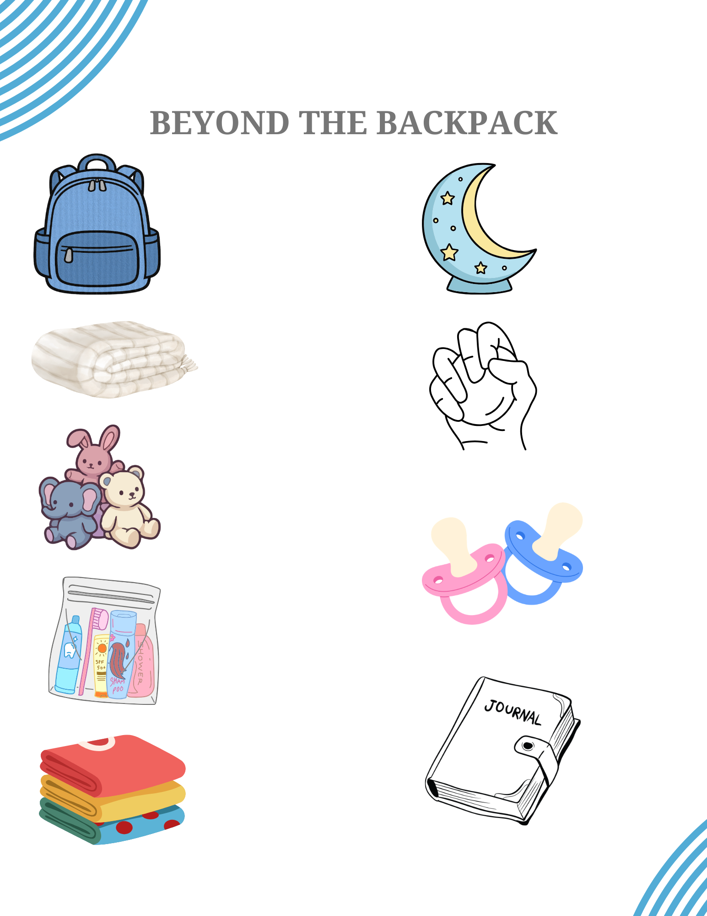
Resources
Deployment Protocol for Beyond the Backpack Project
The criteria to receive a backpack is that the child or adolescent will be transitioning to a foster care home (emergency, short-term, or long-term) or to the assessment center.
Child life specialists will take note of all patients with CPS involvement and track the items provided through the Backpack Contents Form.
Items are located in the trailer on the child life clinical shelf.
  All bins with a “Beyond the Backpack” sign are intended to be used for this population only
  Backpacks can be customized based on the needs of the child or adolescent and situation
  Child Life Specialists can select an activity, toy, or game to include that is developmentally appropriate and of interest to the child or adolescent
  Include all items that patient has collected throughout hospitalization stay ie games/toys/comfort items
Child Life Specialists are responsible for putting the backpack together and providing this resource to patients.
  In the event that child life will not be present at the time of the patient’s discharge, the child life specialist will hand over the backpack to social work before the end of their shift.
Child life specialists will include an “All About Me” sheet and pertinent information about the child or adolescent for example:
  Interests
  Trauma triggers
  Tips & strategies for managing behaviors and to support coping
  Recommendations for age-appropriate toys, developmentally appropriate activities, or books
The child life specialist or social worker can touch base with the case worker to ensure the backpack leaves with the patient and informs them about the “All About Me” sheet
21

Slide 28
Thank You.

Slide 29
References
Alfandari, R. & Taylor, B. J. (2023). Processes of multiprofessional child protection decision making in hospital settings: Systemic narrative review. Trauma, Violence & Abuse, 24(1), 295-312.
Association of Child Life Professionals (2023). Child life code of ethics.
Barth, R.P., Berrick, J.D., Garcia, A.R., Drake, B., Jonson-Reid, M., Gyourko, J.R. & Greeson, J.K.P. (2022). Research to consider while effectively re- designing child welfare systems. Research on Social Work Practice, 32(5), 483-498.
Berkman, E., Brown, E., Scott, M. & Adiele, A. (2022). Racism in child welfare: Ethical considerations of harm. Special Issue: Racism in Health and Bioethics, 36, 298-304.
Clark, H., Cross, J., Davis, J., Fogg, N., Gordon, J., Van Allen, K. (2025). Society of pediatric nurses pediatric bill of rights. Journal of Pediatric Nursing, 82, 174-177.
Feely, M. & Bosk. E.A. (2021). That which is essential has been made invisible: The need to bring a structural risk perspective to reduce racial disproportionality in child welfare. Race and Social Problems, 13, 49-62.
Getz, Z., Simmel, C., Zhang, L. & Greenfield, B. (2022). “Short-stayers” in child welfare: Characteristics and system experiences. Child and Youth Services Review, 138, 1-5.
**Gordon, J. (2021). Emotional safety in pediatrics: Introduction. The Journal of Child Life.
Hambrick, E.P., Oppenheim-Weller, S., N’zi, A.M., & Taussig, H.N. (2016). Mental health interventions for children in foster care: A systematic review. Children and Youth Services Review, 70, 65-77.
Hayes, C., Bhaskara, A., Tongs, C., Bisht, A., & Buus, N. (2024). What purpose do voices serve if no one is listening? A systematic review of children and young people’s perspectives on living in the foster care system. Child & Youth Care Forum, 53, 525-562.
Health & Human Services Department (2021). Child welfare practice to address racial disproportionality and disparity. Bulletins for Professionals. https://www.govinfo.gov/app/details/GOVPUB-HE-PURL- gpo159394.
Heyman, J.C., White-Ryan, L., Kelly, P., Farmer, G.L., Leaman, T.L., & Davis, H.J. (2020). Voices about foster care: The value of trust. Children and Youth Services Review, 113, 1-9.
Mitchell, M.B. & Kuczynski, L. (2010). Does anyone know what is going on? Examining children’s lived experience of the transition into foster care. Children and Youth Services Review, 32, 437-444.
Reddy, J., Williams-Isom, A., Putnam-Hornstein, E. (2022). Racial sensitivity training: An inadequate solution to systemic racial disparities in child protection systems. Child Abuse & Neglect, 128, 1-4.
Thomas, M.M.C., Waldfogel, J., & Williams, O.F. (2023). Inequities in child protective services contact between black and white children. Child Maltreatment, 28(1), 42-54.
Trent, M. (2019). The Impact of Racism on Child and Adolescent Health. Pediatrics, 144(2). American Academy of Pediatrics. https://doi.org/10.1542/peds.2019-1765.
White, S., & Persson, S. (2022). Racial Discrimination in Child Welfare Is a Human Rights Violation—Let’s Talk About It That Way. Americanbar.Org. https://www.americanbar.org/groups/litigation/resources/newsletters/childrens-rights/racial-discrimination-child-welfare-human-rights-violation-lets-talk-about-it-way/
Williams-Butler, A. (2023). Intersectionality and structural gendered racism: Theoretical consideration for Black women, children, and families impacted by child protective services in the United States. Critical Social Policy, 43(3), 514-535.
50%

