Slide 1
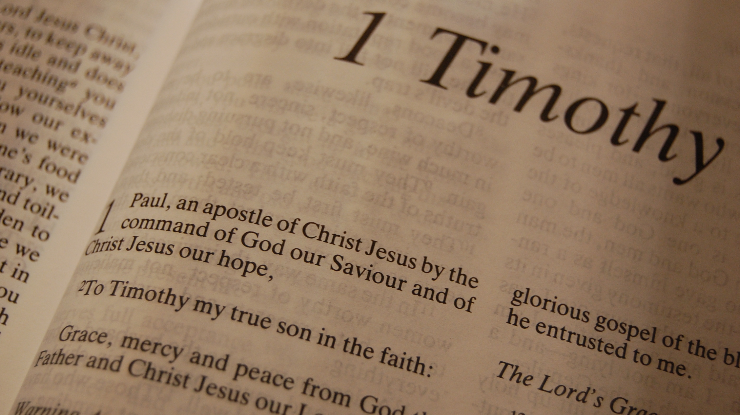

Slide 2
1 Timothy
Chapter 2

Slide 3
1 Timothy 2:1
“Therefore I exhort first of all that supplications, prayers, intercessions, and giving of thanks be made for all men,”
Notes:
“supplications” – seeking, asking, entreating
“prayers” – prayer addressed to God
“intercessions” – a conference or conversation
“giving of thanks” – gratitude; thankfulness; thanksgiving

Slide 4
1 Timothy 2:2
“for kings and all who are in authority, that we may lead a quiet and peaceable life in all godliness and reverence.”
Notes:
“lead” – to lead through, lead across, send across, to pass
“quiet” – tranquil
“peaceable” – steady or settled due to a divinely-inspired inner calmness. Where do we get the “divinely-inspired inner calmness?” We get it from God in Christ (Philippians 4:6-7).
“godliness” – reverence, respect, piety toward God
“reverence” – honor, dignity, majesty

Slide 5
1 Timothy 2:3
“For this is good and acceptable in the sight of God our Savior,”

Slide 6
1 Timothy 2:4
“who desires all men to be saved and to come to the knowledge of the truth.”
Notes:
“all men to be saved” – This goes against “Calvinism.” Calvinism says that not everyone has an opportunity to become a child of God. But Paul is clear when he says that God desires all to be saved. Peter wrote, “The Lord is not slack concerning His promise, as some count slackness, but is longsuffering toward us, not willing that any should perish but that all should come to repentance” (2 Peter 3:9).
“knowledge” – precise and correct knowledge that one gets only through the word. This is not special knowledge that come directly from God separate from the word. The word used in 1 Corinthians 13:8 is special knowledge that comes directly from God.

Slide 7
1 Timothy 2:5
“For there is one God and one Mediator between God and men, the Man Christ Jesus,”

Slide 8
1 Timothy 2:6
“who gave Himself a ransom for all, to be testified in due time,”

Slide 9
1 Timothy 2:7
“for which I was appointed a preacher and an apostle – I am speaking the truth in Christ and not lying – a teacher of the Gentiles in faith and truth.”

Slide 10
1 Timothy 2:8
“I desire therefore that the men pray everywhere, lifting up holy hands, without wrath and doubting;”

Slide 11
1 Timothy 2:9
“in like manner also, that the women adorn themselves in modest apparel, with propriety and moderation, not with braided hair or gold or pearls or costly clothing,”

Slide 12
1 Timothy 2:10
“but, which is proper for women professing godliness, with good works.”

Slide 13
1 Timothy 2:11
“Let a woman learn in silence with all submission.”

Slide 14
1 Timothy 2:12
“And I do not permit a woman to teach or to have authority over a man, but to be in silence.”

Slide 15
1 Timothy 2:13
“For Adam was formed first, then Eve.”

Slide 16
1 Timothy 2:14
“And Adam was not deceived, but the woman being deceived, fell into transgression.”

Slide 17
1 Timothy 2:15
“Nevertheless she will be saved in childbearing if they continue in faith, love, and holiness, with self-control.”

