Slide 1
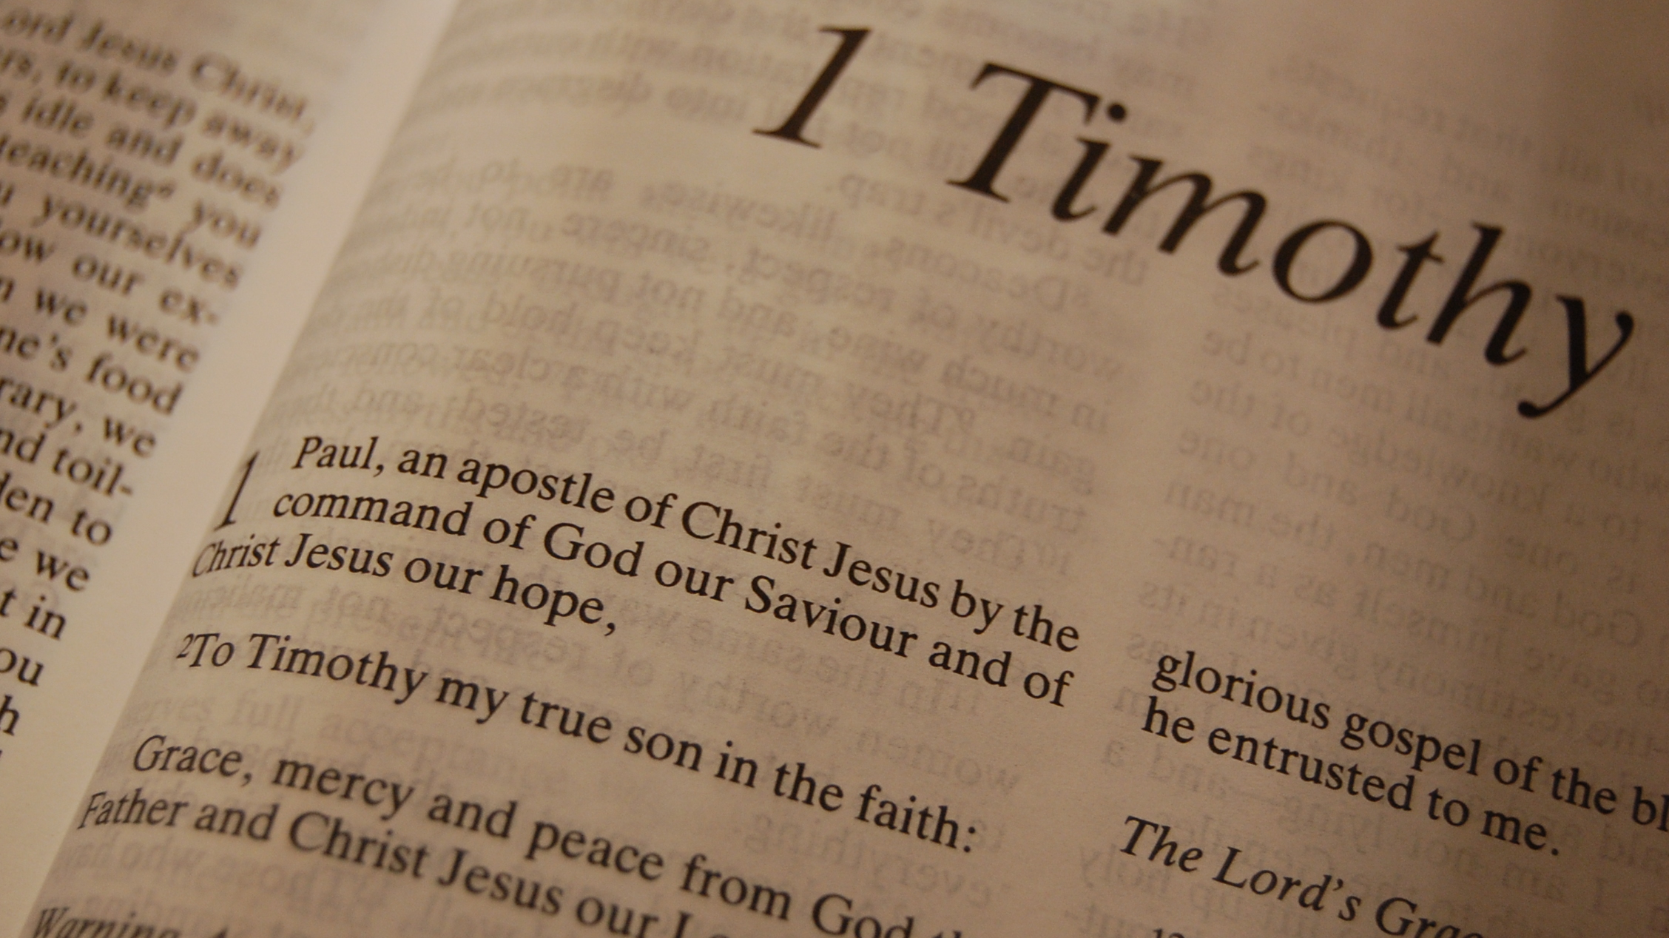

Slide 2
1 Timothy
Chapter 3

Slide 3
1 Timothy 3:1
“This is a faithful saying: If a man desires the position of a bishop, he desires a good work.”

Slide 4
1 Timothy 3:2
“A bishop then must be blameless, the husband of one wife, temperate, sober-minded, of good behavior, hospitable, able to teach;”
Notes:
“A bishop” = elder, overseer, pastor, shepherd
“must be” = None of the following qualifications can be excluded. The man must have all the qualifications listed in order to be an elder. And the qualifications are in the present tense. Example: It would do no good to have an elder who at one times was hospitable, but is no longer such.
“blameless” = That cannot be laid hold of; not open to censure. This does not mean the man is sinlessly perfect. But that there is nothing he has done that is so grievous that anyone can lay it to his charge.
“the husband of one wife” = Paul does not say that an elder must be married only once nor does it say an elder cannot remarry.
1. 1 Corinthians 7:39 – “A wife is bound by law as long as her husband lives; but if her husband dies, she is at liberty to be married to whom she wishes, only in the Lord”
2. If a man’s wife dies and he becomes a widower, the present tense force of being the “husband of one wife” would seem to exclude him from being qualified for the eldership.
3. What about a man who is divorced and remarried?
4. If the phrase “the husband of one wife” does not mean “having been married only once in his life,” that would seem to admit the possibility that a man who has been divorced and is remarried to “one wife” could be eligible.
5. Matthew 19:9 – “And I say to you, whoever divorces his wife, except for sexual immorality, and marries another, commits adultery; and whoever marries her who is divorced commit adultery.”
6. It would still be the case that a man who divorced his wife because of sexual infidelity and married another woman would/could be “the husband of one wife.”
“temperate” = sober, abstaining from wine
“sober-minded” = curbing one’s desires and impulses; self-controlled
“of good behavior” = A man living with decorum, a well-ordered life
“hospitable” = Generous to guests; loving strangers
“able to teach” = Not necessarily always teaching a Bible Class; a man who is apt and skillful in teaching the doctrine of Christ. Able to teach the lost about Christ.

Slide 5
1 Timothy 3:3
“not given to wine, not violent, not greedy for money, but gentle, not quarrelsome, not covetous;”
Notes:
“not given to wine” = Not addicted to wine; drunken. Remember in the previous verse, Paul tells Timothy that men must be “temperate” which means, “sober, abstaining from wine.” A man must not be addicted to something that can take control over him. That is also in the meaning of “sober-minded” and “of good behavior.”
“not violent” = not a bruiser, ready with a blow; not contentious, nor a quarrelsome person
“but gentle” = equitable, fair, mild, gentle
“not quarrelsome” = Abstaining from fighting; not contentious (causing an argument)
“not greedy for money” “not covetous” = not loving money; not greedy for filthy or evil money

Slide 6
1 Timothy 3:4
“one who rules his own house well, having his children in submission with all reverence”
Notes:
“one who rules his own house well” =
1. “rule” – to be over, to superintend, preside over
2. “well” – rightly, so that there is no room for blame. This father has led the family in the right direction and has control over their spiritual direction
“having his children in submission with all reverence” =
1. Elders must have children. This is one or more. Just because the word is in the plural does not mean the man must have more than one.
2. “submission” – obedience
3. “reverence” – dignity, gravity, honor, purity
4. All the elders’ children must be in submission to him under his house. Once the children have left the home and no longer under his house rule they are no longer in submission to him.

Slide 7
1 Timothy 3:5
“(for if a man does not know how to rule his own house, how will he take care of the church of God?);”

Slide 8
1 Timothy 3:6
“not a novice, lest being puffed up with pride he fall into the same condemnation as the devil.”
Notes:
“not a novice” = not a new convert; newly-planted. He is not to be a recently converted Christian. He must have had time to develop and grow as a follower of God. Or else how could he shepherd a congregation? He could be lead away into pride.

Slide 9
1 Timothy 3:7
“Moreover he must have a good testimony among those who are outside, lest he fall into reproach and the snare of the devil.”
Notes:
“good testimony” = In an ethical sense, of testimony concerning one’s character. People in the world must look to this man as one who is honest and trustworthy. If he is not how can they (in the world) trust what he says about being godly.
“snare of the devil” = the allurements to sin by which the devil holds one bound. The man who does not have a good reputation in the world could bring that same lifestyle into his leadership.

Slide 10
1 Timothy 3:8
“Likewise deacons must be reverent, not double-tongued, not given to much wine, not greedy for money,”
Notes:
“Likewise” = in a similar manner
“deacons” = this is a special office or work. While we are all servants of God, this is a one who, by virtue of the office assigned him by the church, cares for the poor and has charge of and distributes to the needs of the work of the church
“reverent” = Honorable in character
“not double-tongued” = not saying one thing with one person, and another thing with someone else
“not given to much wine” = Literally, “not to be occupied with much wine.” What is Paul saying? Is it okay for a deacon to drink some wine? And what is some as opposed to much? How do we come to that conclusion?
1. Ecclesiastes 7:17 – “Do not be overly wicked…” Does Solomon mean that we can be moderately wicked?
2. 1 Peter 4:4 – “In regard to these, they think it strange that you do not run with them in the same flood (excess) of dissipation (an abandoned, riotous life), speaking evil of you.” Does Peter give Christians the right to practice a little dissipation (riotous life)?
3. To say that a deacon can drink in moderation and not to excess and use this verse is inconsistent. Notice the following:
Elders (1 Timothy 3:2-3) – abstain; don’t even be near it
Deacons (1 Timothy 3:8) – drink moderately
Wives (1 Timothy 3:11) – abstain
Aged men (Titus 2:2) – abstain
Aged women (Titus 2:3) – drink moderately
Does this make sense? Of course Paul was not telling Timothy that certain ones can drink alcohol moderately while others could not. In view of the Bible being consistent, “much wine” must be a loose form of speech intended to express complete restraint in the use of wine.
“not greedy for money” = “greedy” – eager for base gain (greedy of filthy money)

Slide 11
1 Timothy 3:9
“holding the mystery of the faith with a pure conscience.”
Notes:
“holding the mystery of the faith” = Christian truth as hidden from ungodly men; not that they are purposely hiding the truth, but that the ungodly don’t know the truth as of yet.
“pure conscience” = free from any guilt

Slide 12
1 Timothy 3:10
“But let these also first be tested; then let them serve as deacons, being found blameless.”
Notes:
“first be tested” = to see whether a thing be genuine or not, as metals; to examine, scrutinize. Usually a deacon is someone younger in age and but be proven to be able to do the work assigned to him. You must not just appoint a man a deacon and say we don’t know what you can do yet but we will assign that latter.
“being found blameless” = the proof is also in the man being without blame

Slide 13
1 Timothy 3:11
“Likewise, their wives must be reverent, not slanderers, temperate, faithful in all things.”
Notes:
“Their” = deacons; Paul could also be referring to the wives of elders
“wives” = a woman cannot be a deacon
“reverent” = honorable character
“not slanderers” = prone to slander someone; accusing falsely
“temperate” = abstaining from wine
“faithful in all things” =

Slide 14
1 Timothy 3:12
“Let deacons be the husbands of one wife, ruling their children and their own houses well.”
Notes:
“husbands of one wife” = same as above with the elders
“ruling their children” = they must have children and be the ruler or in control of them
“their own houses well” = “ruling” – to be over; preside over

Slide 15
1 Timothy 3:13
“For those who have served well as deacons obtain for themselves a good standing and great boldness in the faith which is in Christ Jesus.”
Notes:
There is much praise given to deacons who serve the church of Christ

Slide 16
1 Timothy 3:14
“These things I write to you, though I hope to come to you shortly;”
Notes:
Paul wrote this ahead of his coming so that Timothy could teach the church how to be organized

Slide 17
1 Timothy 3:15
“but if I am delayed, I write so that you may know how you ought to conduct yourself in the house of God, which is the church of the living God, the pillar and ground of the truth.”
Notes:
“conduct yourself” = to behave oneself; live as the church
“house of God” = family or household of God
“living God” = God is living and active in the lives of the church
“pillar” = a prop or support
“ground” = base, stay, prop, support
“truth” = the truth as taught in the Christian religion, respecting God and the execution of His purposes through Christ

Slide 18
1 Timothy 3:16
“And without controversy great is the mystery of godliness: God was manifested in the flesh, Justified in the Spirit, Seen by angels, Preached among the Gentiles, Believed on in the world, Received up in glory.”
Notes:
“God was manifested in the flesh” = John 1:14 – “And the Word became flesh and dwelt among us, and we beheld His glory, the glory as of the only begotten of the Father, full of grace and truth.”
“Justified in the Spirit” =
“seen by angels”
Preached among the Gentiles” = Paul was doing that and it was done by Peter in Acts 10
“Believed on in the world”
“Received up in glory” = Christ ascended up into heaven (Acts 1:9)

