Slide 1

The Devil’s
Laziness

Slide 2
Laziness
How the devil uses laziness to destroy us

Slide 3
Laziness
The quality of being unwilling to work or use energy
Idleness

Slide 4
Proverbs 10:4
“He who has a slack hand becomes poor, But the hand of the diligent makes rich.”

Slide 5
“slack hand”
“negligent, idle, laxness”

Slide 6
“diligent”
“sharp”
“steady, earnest, and energetic effort”

Slide 7
Proverbs 10:5
“He who gathers in summer is a wise son; He who sleeps in harvest is a son who causes shame.”

Slide 8
Proverbs 12:24
“The hand of the diligent will rule, But the lazy man will be put to forced labor.”

Slide 9
“lazy man”
“negligent, idle, laxness”

Slide 10
Proverbs 14:23
“In all labor there is profit, But idle chatter leads only to poverty.”

Slide 11
Proverbs 19:15
“Laziness casts one into a deep sleep, And an idle person will suffer hunger.”

Slide 12
Lessons From the Ant
Proverbs 6:6

Slide 13
Proverbs 6:6
“Go to the ant, you sluggard! Consider her ways and be wise,”

Slide 14
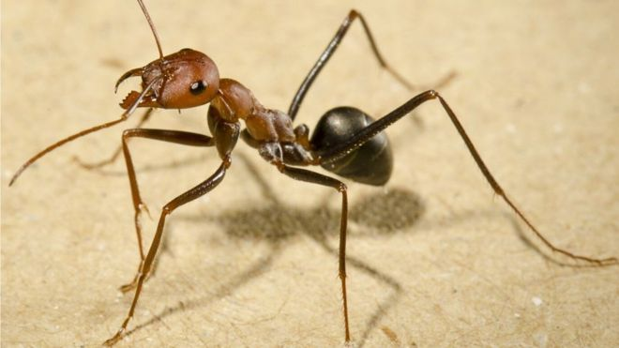

Slide 15
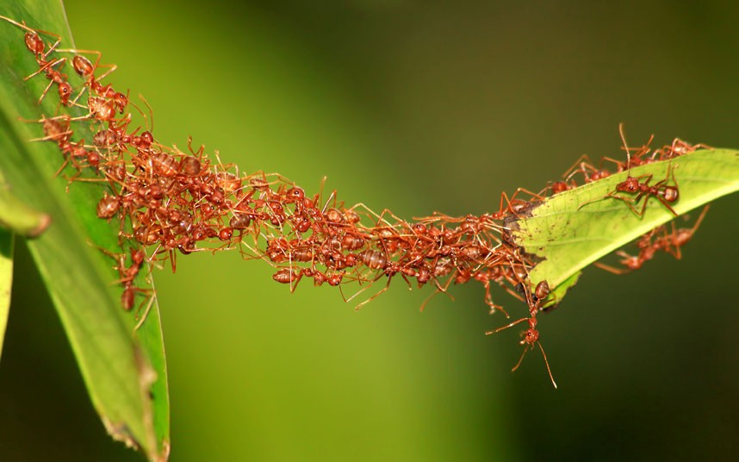

Slide 16
Proverbs 6:7
“Which, having no captain, Overseer or ruler,”

Slide 17
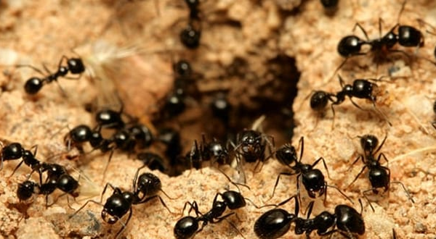

Slide 18
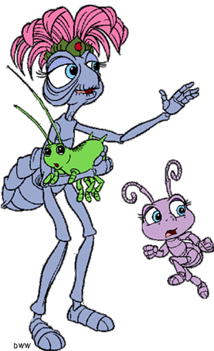
Queen Ant
Unlike what TV cartoons show you – Queen Ants do not rule.
Just like the Bible says, ants have “no captain, overseer or ruler.” (Proverbs 6:7)

Slide 19
Queen Ant
The Queen Ant has two main responsibilities:
  1. Start colonies
  2. Lay Eggs

Slide 20
Proverbs 6:8
“Provides her supplies in the summer, And gathers her food in the harvest.”

Slide 21
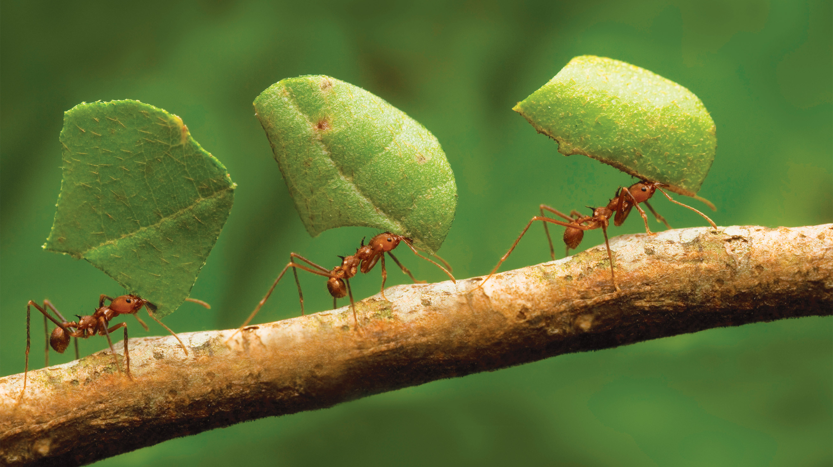

Slide 22
Proverbs 6:9
“How long will you slumber, O sluggard? When will you rise from your sleep?”

Slide 23
Proverbs 6:10
“A little sleep, a little slumber, A little folding of the hands to sleep –”

Slide 24
Proverbs 6:11
“So shall your poverty come on you like a prowler, And your need like an armed man.”

Slide 25

Ants
Swim
Have lungs – tiny holes
Don’t feel pain
Have eyes but most cannot see well

Slide 26
The Devil’s
Laziness

