Slide 1
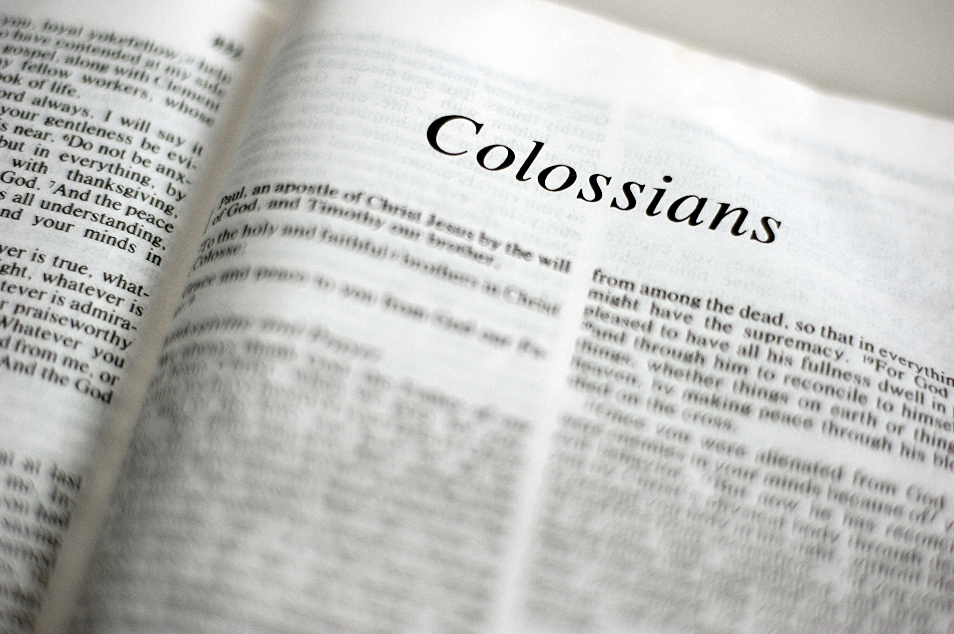

Slide 2
Colossians
Chapter 1

Slide 3
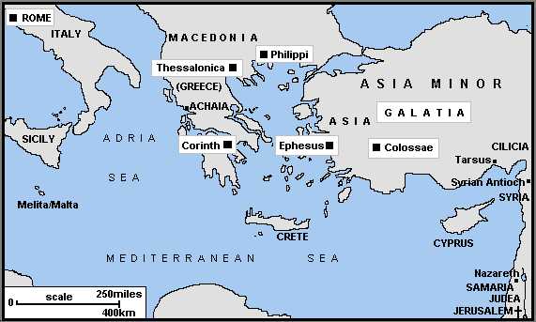

Slide 4
Introduction
Colossians 1:1-2

Slide 5
Colossians 1:1
“Paul, an apostle of Jesus Christ by the will of God, and Timothy our brother,”

Slide 6
Colossians 1:2
“To the saints and faithful brethren in Christ who are in Colosse: Grace to you and peace from God our Father and the Lord Jesus Christ.”

Slide 7
Faith in Christ
Colossians 1:3-8

Slide 8
Colossians 1:3
“We give thanks to the God and Father of our Lord Jesus Christ, praying always for you,”

Slide 9
Colossians 1:4
“since we heard of your faith in Christ Jesus and of your love for all the saints;”

Slide 10
Colossians 1:5
“because of the hope which is laid up for you in heaven, of which you heard before in the word of the truth of the gospel,”

Slide 11
Colossians 1:6
“which has come to you, as it has also in all the world, and is bringing forth fruit, as it is also among you since the day you heard and knew the grace of God in truth;”

Slide 12
Colossians 1:7
“as you also learned from Epaphras, our dear fellow servant, who is a faithful minister of Christ on your behalf, who also declared to us your love in the Spirit.”

Slide 13
Colossians 1:8
“who also declared to us your love in the Spirit.”

Slide 14
Preeminence of Christ
Colossians 1:9-18

Slide 15
Colossians 1:9
“For this reason we also, since the day we heard it, do not cease to pray for you, and to ask that you may be filled with the knowledge of His will in all wisdom and spiritual understanding;”

Slide 16
Colossians 1:10
“that you may walk worthy of the Lord, fully pleasing Him, being fruitful in every good work and increasing in the knowledge of God;”

Slide 17
Colossians 1:11
“strengthened with all might, according to His glorious power, for all patience and longsuffering with joy;”

Slide 18
Colossians 1:12
“giving thanks to the Father who has qualified us to be partakers of the inheritance of the saints in the light.”

Slide 19
Colossians 1:13
“He has delivered us from the power of darkness and conveyed us into the kingdom of the Son of His love,”

Slide 20
“power of darkness”
“power” = influence; authority; moral authority
“darkness” = the accompanying ungodliness and immorality, together with their consequent misery”

Slide 21
“conveyed”
To transpose, transfer, remote from one place to another; change of situation or place. Past tense.

Slide 22
“kingdom”
The rule of Jesus Christ (Son of His love).
This is in the present tense; we are in the kingdom now, not future.

Slide 23
“redemption”
Deliverance effected through the death of Christ from the wrath of God and the merited penalty of sin.

Slide 24
Colossians 1:14
“in whom we have redemption through His blood, the forgiveness of sins.”

Slide 25
“redemption”
Deliverance effected through the death of Christ from the wrath of God and the merited penalty of sin.
We have this “redemption through His blood, the forgiveness of sins.” (past tense)

Slide 26
Romans 6:23
“For the wages of sin is death, but the gift of God is eternal life in Christ Jesus our Lord.”

Slide 27
CONVEYED
(same time)
REDEMTION

Slide 28
Colossians 1:15
“He is the image of the invisible God, the firstborn over all creation.”

Slide 29
Colossians 1:16
“For by Him all things were created that are in heaven and that are on earth, visible and invisible, whether thrones or dominions or principalities or powers. All things were created through Him and for Him.”

Slide 30
Colossians 1:17
“And He is before all things, and in Him all things consist.”

Slide 31
John 1:1
“In the beginning was the Word, and the Word was with God, and the Word was God.”

Slide 32
John 1:2
“He was in the beginning with God.”

Slide 33
John 1:3
“All things were made through Him, and without Him nothing was made that was made.”

Slide 34
John 1:14
“And the Word became flesh and dwelt among us, and we beheld His glory, the glory as of the only begotten of the Father, full of grace and truth.”

Slide 35
Colossians 1:18
“And He is the head of the body, the church, who is the beginning, the firstborn from the dead, that in all things He may have the preeminence.”

Slide 36
Matthew 28:18
“And Jesus came and spoke to them, saying, ‘All authority has been given to Me in heaven and on earth.”

Slide 37
Reconciled in Christ
Colossians 1:19-23

Slide 38
Colossians 1:19
“For it pleased the Father that in Him all the fullness should dwell,”

Slide 39
Colossians 1:20
“and by Him to reconcile all things to Himself, by Him, whether things on earth or things in heaven, having made peace through the blood of His cross.”

Slide 40
Colossians 1:21
“And you, who once were alienated and enemies in your mind by wicked works, yet now He has reconciled”

Slide 41
Colossians 1:22
“in the body of His flesh through death, to present you holy, and blameless, and above reproach in His sight –”

Slide 42
Colossians 1:23
“if indeed you continue in the faith, grounded and steadfast, and are not moved away from the hope of the gospel which you heard, which was preached to every creature under heaven, of which I, Paul, became a minister.”

Slide 43
Sacrificial service for Christ
Colossians 1:24-29

Slide 44
Colossians 1:24
“I now rejoice in my sufferings for you, and fill up in my flesh what is lacking in the afflictions of Christ, for the sake of His body, which is the church,”

Slide 45
Colossians 1:25
“of which I became a minister according to the stewardship from God which was given to me for you, to fulfill the word of God,”

Slide 46
Colossians 1:26
“the mystery which has been hidden from ages and from generations, but now has been revealed to His saints.”

Slide 47
Colossians 1:27
“To them God willed to make known what are the riches of the glory of this mystery among the Gentiles: which is Christ in you, the hope of glory.”

Slide 48
Colossians 1:28
“Him we preach, warning every man and teaching every man in all wisdom, that we may present every man perfect in Christ Jesus.”

Slide 49
Colossians 1:29
“To this end I also labor, striving according to His working which works in me mightily.”

Slide 50
I Stand In Awe of You
You are beautiful beyond description, too marvelous for words. Too wonderful for comprehension,

Slide 51
I Stand In Awe of You
Like nothing ever seen or heard. Who can grasp Your infinite wisdom, who can fathom the depth of Your love?

Slide 52
I Stand In Awe of You
You are beautiful beyond description, majesty enthroned above.

Slide 53
I Stand In Awe of You
And I stand, I stand in awe of You,
I stand, I stand in awe of You;

Slide 54
I Stand In Awe of You
Holy God, to whom all praise is due,
I stand in awe of You!

Slide 55
I’ll Fly Away
Some glad morning
when this life is over,
I’ll fly away,

Slide 56
I’ll Fly Away
To a home on God’s celestial shore,
I’ll fly away.

Slide 57
I’ll Fly Away
I’ll fly away
fly away fly away
I’ll fly away
fly away
O glory,

Slide 58
I’ll Fly Away
I’ll
fly away
fly away
in the morning

Slide 59
I’ll Fly Away
When I die hallelujah by and by
I’ll
fly away
fly away
fly away

Slide 60
I’ll Fly Away
Just a few more
weary days and then,
I’ll fly away

Slide 61
I’ll Fly Away
To a land where joys shall never end.
I’ll fly away

Slide 62
I’ll Fly Away
I’ll fly away
fly away fly away
I’ll fly away
fly away
O glory,

Slide 63
I’ll Fly Away
I’ll
fly away
fly away
in the morning

Slide 64
I’ll Fly Away
When I die hallelujah by and by
I’ll
fly away
fly away
fly away

Slide 65
Light the Fire
I stand to praise You,
But I fall to my knees.
My spirit is willing, but my flesh
Is so weak.

Slide 66
Light the Fire
Light the fire
In my soul.
Fan the flame,
Make me whole.

Slide 67
Light the Fire
Lord, You know
Where I’ve been
So light the fire
In my heart again.

Slide 68
Sanctuary
O Lord prepare me
To be a sanctuary
Pure and holy
Tried and true

Slide 69
Sanctuary
With thanksgiving I’ll
Be a living
Sanctuary for You

Slide 70
Sanctuary
It was You, Lord
Who sent the Savior
Heart and soul, Lord
To every man

Slide 71
Sanctuary
It is You Lord who
knows my weakness
You refine me with
Your own hand

Slide 72
We Will Glorify
We will glorify
The King of kings,
We will glorify
The Lamb

Slide 73
We Will Glorify
We will glorify
The Lord of lords,
Who is the great
I Am.

Slide 74
We Will Glorify
Lord Jehovah
Reigns in majesty,
We will bow before
His throne;

Slide 75
We Will Glorify
We will worship Him
In righteousness,
We will worship
Him alone.

Slide 76
We Will Glorify
He is Lord of heaven,
Lord of earth,
He is Lord
of all live

Slide 77
We Will Glorify
He is Lord above
The universe,
All praise to Him
We give.

