Slide 2
904-600-5604
Text Us Your Questions (No Calls)

Slide 3
Colossians
Chapter 3

Slide 4
Not Carnality but Christ
Colossians 3:1-11

Slide 5
Colossians 3:1
“If then you were raised with Christ, seek those things which are above, where Christ is, sitting at the right hand of God.”

Slide 6
Romans 6:4
“Therefore we were buried with Him through baptism into death, that just as Christ was raised from the dead by the glory of the Father, even so we also should walk in newness of life.”

Slide 7
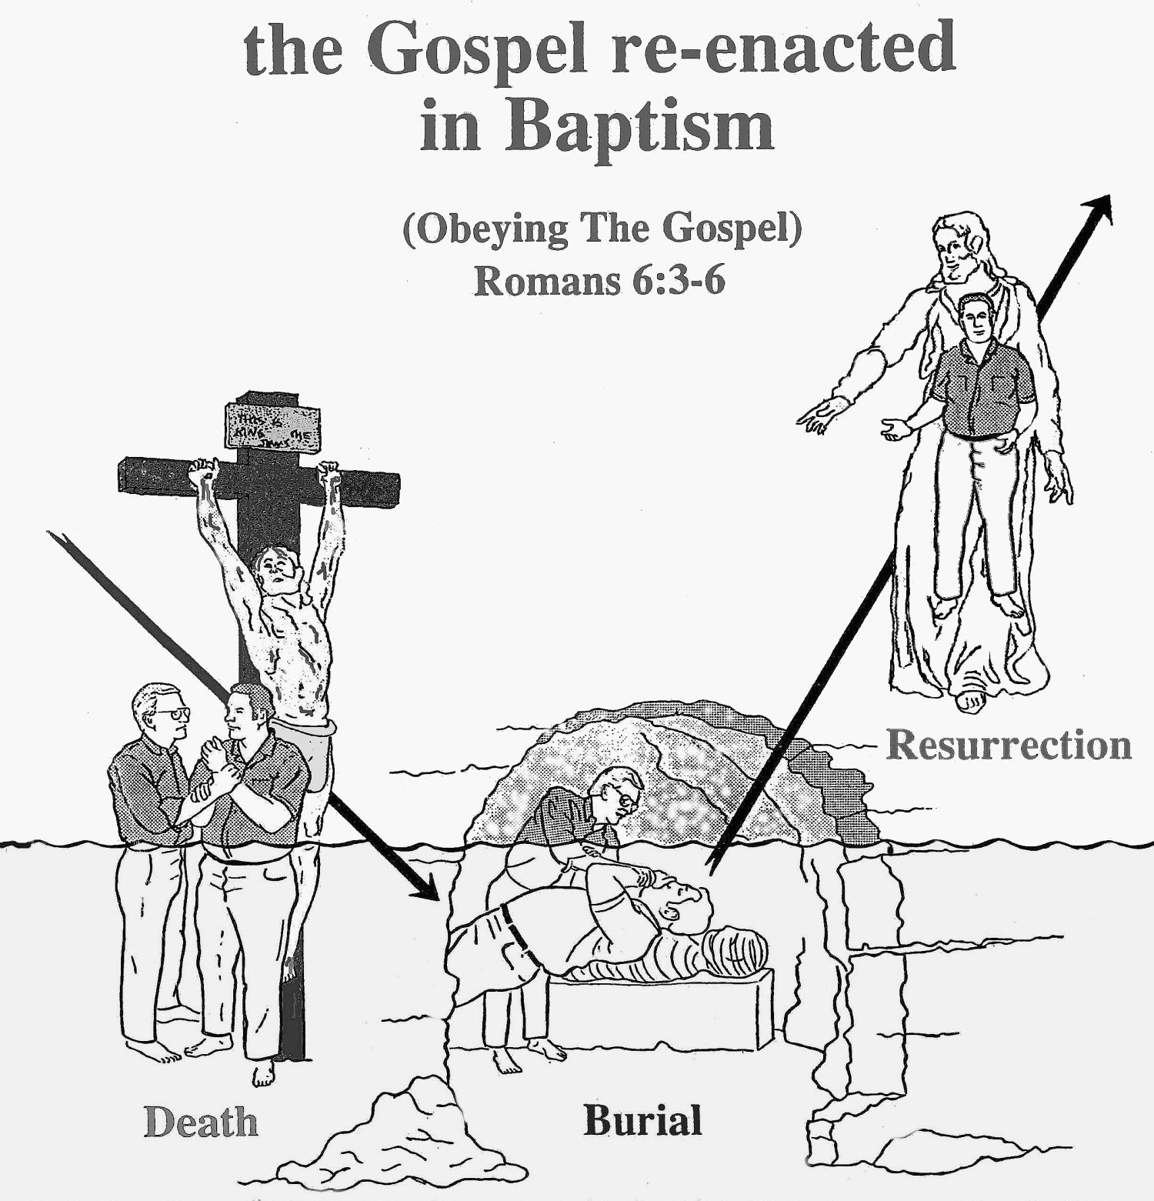

Slide 8
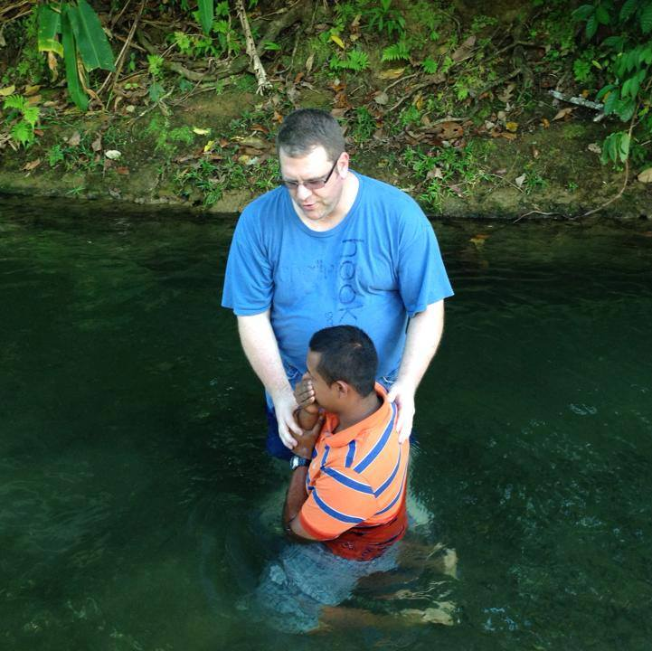

Slide 9
Colossians 3:2
“Set your mind on things above, not on things on the earth.”

Slide 10
“Set your mind”
“to direct one’s mind to a thing, to seek or strive for, to seek one’s interests or advantage; to be of one’s party, side with him (biblehub.com)

Slide 11
“Above”
“Heavenly things; a higher place” (biblehub.com)

Slide 12
Colossians 3:3
“For you died, and your life is hidden with Christ in God.”

Slide 13
“for you died”
Not a physical death
“as having put off all sensibility to worldly things that draw them away from God.” (biblehub.com)

Slide 14
Romans 6:2
“Certainly not! How shall we who died to sin live any longer in it?”

Slide 15
Galatians 2:20
“I have been crucified with Christ; it is no longer I who live, but Christ lives in me; and the life which I now live in the flesh I live by faith in the Son of God, who loved me and gave Himself for me.”

Slide 16
Colossians 3:4
“When Christ who is our life appears, then you also will appear with Him in glory.”

Slide 17
John 14:1
“Let not your heart be troubled; you believe in God, believe also in Me.”

Slide 18
John 14:2
“In My Father’s house are many mansions; if it were not so, I would have told you. I go to prepare a place for you.”

Slide 19
John 14:3
“And if I go and prepare a place for you, I will come again and receive you to Myself; that where I am, there you may be also.”

Slide 20
Colossians 3:5
“Therefore put to death your members which are on the earth: fornication, uncleanness, passion, evil desire, and covetousness, which is idolatry.”

Slide 21
“fornication”
“sexual immorality”
“porneia” = we get our English word pornography

Slide 22
“uncleanness”
“in a moral sense, the impurity of lustful living”

Slide 23
“passion”
“a feeling which the mind suffers, an affection of the mind, emotion, passionate desire”

Slide 24
“Evil desires”
“a desire for what is forbidden, lust”

Slide 25
“covetousness”
“a greedy desire to have more”

Slide 26
“idolatry”
“the worship of false gods”

Slide 27
Colossians 3:6
“Because of these things the wrath of God is coming upon the sons of disobedience,”

Slide 28
Colossians 3:7
“in which you yourselves once walked when you lived in them.”

Slide 29
“Lived in them”
“To be strong” in the vices just mentioned. This is opposed to the ethical death by which Christians are wholly severed from sin.

Slide 30
Colossians 3:8
“But now you yourselves are to put off all these: anger, wrath, malice, blasphemy, filthy language out of your mouth.”

Slide 31
“put off”
“renounce; throw away”

Slide 32
“anger”
“temper, impulse, any violent emotion”

Slide 33
“wrath”
“anger boiling up into a rage”

Slide 34
“Malice”
“ill-will, desire to injure”

Slide 35
“blasphemy”
“slander, detraction, speech injurious to another’s good name”

Slide 36
“filthy language”
“foul speaking, low and obscene speech, shameful speaking”

Slide 37
Ephesians 4:29
“Let no corrupt word proceed out of your mouth, but what is good for necessary edification, that is may impart grace to the hearers.”

Slide 38
Colossians 3:9
“Do not lie to one another, since you have put off the old man with his deeds,”

Slide 39
Colossians 3:10
“and have put on the new man who is renewed in knowledge according to the image of Him who created him,”

Slide 40
Colossians 3:11
“where there is neither Greek nor Jew, circumcised nor uncircumcised, barbarian, Scythian, slave nor free, but Christ is all and in all.”

Slide 41
Character of the new man
Colossians 3:12-17

Slide 42
2 Corinthians 5:17
“Therefore, if anyone is in Christ, he is a new creation; old things have passed away; behold, all things have become new.”

Slide 43
Colossians 3:12
“Therefore, as the elect of God, holy and beloved, put on tender mercies, kindness, humility, meekness, longsuffering;”

Slide 44
“Elect”
“to obtain salvation through Christ; hence Christians are called the chosen or elect of God” (biblehub.com)

Slide 45
“put off”
“renounce; throw away”

Slide 46
“put on”
“to be clothed with (in the sense of sinking into a garment)”

Slide 47
“tender mercies”
“a heart of compassion”

Slide 48
“kindness”
“moral goodness”

Slide 49
“humility”
“lowliness of mind; modesty”

Slide 50
Philippians 2:3
“Let nothing be done through selfish ambition or conceit, but in lowliness of mind let each esteem others better than himself.”

Slide 51
Philippians 2:4
“Let each of you look out not only for his own interests, but also for the interests of others.”

Slide 52
Philippians 2:5
“Let this mind be in you which was also in Christ Jesus.”

Slide 53
“Meekness”
“mildness, gentleness”

Slide 54
“longsuffering”
“patience, forbearance, slowness in avenging wrongs”

Slide 55
Colossians 3:13
“bearing with one another, and forgiving one another, if anyone has a complaint against another; even as Christ forgave you, so you also must do.”

Slide 56
“forgiving”
“to grant forgiveness, to pardon”

Slide 57
Brandt Jean and Amber Guyger

Slide 58
“forgiving”
“to grant forgiveness, to pardon”

Slide 59
Colossians 3:14
“But above all these things put on love, which is the bond of perfection.”

Slide 60
“bond of perfection”
“that in which all the virtues are so bound together that perfection is the result, and not one of them is lacking to that perfection.”

Slide 61
Colossians 3:15
“And let the peace of God rule in your hearts, to which also you were called in one body; and be thankful.”

Slide 62
Colossians 3:16
“Let the word of Christ dwell in you richly in all wisdom, teaching and admonishing one another in psalms and hymns and spiritual songs, singing with grace in your hearts to the Lord.”

Slide 63
Colossians 3:17
“And whatever you do in word or deed, do all in the name of the Lord Jesus, giving thanks to God the Father through Him.”

Slide 64
“in the name of the lord Jesus”
“to do a thing by one’s command and authority, acting on his behalf, promoting his cause”

Slide 65
The Christian Home
Colossians 3:18-25

Slide 66
Colossians 3:18
“Wives, submit to your own husbands, as is fitting in the Lord.”

Slide 67
“submit”
“to subordinate; to arrange under”

Slide 68
“fitting to the lord”
“as your duty to the Lord”
Never are wives to submit to their own husbands when it challenges the word of God.

Slide 69
Colossians 3:19
“Husbands, love your wives and do not be bitter toward them.”

Slide 70
“Love”
“agape” = “to have a preference for, wish well to, regard the welfare of”

Slide 71
“bitter”
“render angry, indignant, harsh”

Slide 72
Colossians 3:20
“Children, obey your parents in all things, for this is well pleasing to the Lord.”

Slide 73
“Obey”
“to obey, be obedient unto, submit to”
“hearken to a command”

Slide 74
Colossians 3:21
“Fathers, do not provoke your children, lest they become discouraged.”

Slide 75
“provoke”
“to stir up, excite; in a bad sense”

Slide 76
Colossians 3:22
“Bondservants, obey in all things your masters according to the flesh, not with eyeservice, as men-pleasers, but in sincerity of heart, fearing God.”

Slide 77
“bondservants”
“In the first century there were those who would not pay their debts. Therefore many were sold or made a slave in order to work off a debts.”

Slide 78
“eyeservice”
Working only when the master or employer was watching.

Slide 79
“men-pleasers”
“Courting the favor of men rather than God”

Slide 80
Colossians 3:23
“And whatever you do, do it heartily, as to the Lord and not to men,”

Slide 81
“Heartily”
“from the heart”
“sincerely”

Slide 82
Colossians 3:24
“knowing that from the Lord you will receive the reward of the inheritance; for you serve the Lord Christ.”

Slide 83
Colossians 3:25
“But he who does wrong will be repaid for what he has done, and there is no partiality.”

Slide 84
904-600-5604
Text Us Your Questions (No Calls)

Slide 85
Step by Step
O God,
You are my God,
And I will ever
Praise You.
(Repeat)

Slide 86
Step by Step
I will seek You
In the morning,
And I will learn
To walk in
Your ways,

Slide 87
Step by Step
And step by step
You’ll lead me,
And I will follow
You all of my days.

Slide 88
Step by Step
O God,
You are my God,
And I will ever
Praise You.
(Repeat)

Slide 89
Step by Step
I will seek You
In the morning,
And I will learn
To walk in
Your ways,

Slide 90
Step by Step
And step by step
You’ll lead me,
And I will follow
You all of my days.

Slide 91
Step by Step
And I will follow
You all of my days.
And I will follow
You all of my days.

Slide 92
Step by Step
And step by step
You’ll lead me,
And I will follow
You all of my days.

Slide 93
Light the Fire
I stand to praise You,
But I fall to my knees.
My spirit is willing, but my flesh
Is so weak.

Slide 94
Light the Fire
Light the fire
In my soul.
Fan the flame,
Make me whole.

Slide 95
Light the Fire
Lord, You know
Where I’ve been
So light the fire
In my heart again.

Slide 96
Oh, To Be Like Thee
Oh, to be like Thee!
Blessed Redeemer;
This is my constant
Longing and prayer;

Slide 97
Oh, To Be Like Thee
Gladly I’ll forfeit
All of earth’s treasures,
Jesus, Thy perfect
Likeness to wear.

Slide 98
Oh, To Be Like Thee
Oh, to be like Thee!
Oh, to be like Thee!
Blessed Redeemer,
Pure as Thou art;

Slide 99
Oh, To Be Like Thee
Come in
Thy sweetness,
Come in
Thy fullness;

Slide 100
Oh, To Be Like Thee
Stamp Thine own
Image deep on
My heart.

Slide 101
Oh, To Be Like Thee
Oh, to be like Thee!
Full of compassion,
Loving, forgiving,
Tender and kind,

Slide 102
Oh, To Be Like Thee
Helping the helpless,
Cheering the fainting,
Seeking the wand’ring
Sinner to find.

Slide 103
Oh, To Be Like Thee
Oh, to be like Thee!
Oh, to be like Thee!
Blessed Redeemer,
Pure as Thou art;

Slide 104
Oh, To Be Like Thee
Come in
Thy sweetness,
Come in
Thy fullness;

Slide 105
Oh, To Be Like Thee
Stamp Thine own
Image deep on
My heart.

Slide 106
You Are My All In All
You are my strength
When I am weak,
You are the treasure
That I seek,
You are my all in all

Slide 107
You Are My All In All
Seeking You as a
Precious jewel,
Lord to give up I’d
Be a fool.
You are my all in all.

Slide 108
You Are My All In All
Jesus, Lamb of God,
Worthy is Your name
Jesus, Lamb of God
Worthy is Your name

Slide 109
You Are My All In All
(Men)
Jesus
(Ladies)
You are my strength
When I am weak,

Slide 110
You Are My All In All
(Men)
Lamb of God
(Ladies)
You are the treasure
That I seek.

Slide 111
You Are My All In All
(Men)
Worthy is Your name
(Ladies)
You are my All in All

Slide 112
You Are My All In All
(Men)
Jesus
(Ladies)
Seeking You as a
Precious jewel

Slide 113
You Are My All In All
(Men)
Lamb of God
(Ladies)
Lord, to give up I’d
Be a fool

Slide 114
You Are My All In All
(Men)
Worthy is Your Name
(Ladies)
You are my All in All

Slide 115
You Are My All In All
(Ladies)
Jesus
(Men)
Taking my sin, my
Cross, my shame

Slide 116
You Are My All In All
(Ladies)
Lamb of God
(Men)
Rising again I bless
Your name

Slide 117
You Are My All In All
(Ladies)
Worthy is Your name
(Men)
You are my
All in All

Slide 118
You Are My All In All
(Ladies)
Jesus
(Men)
When I fall down
You pick me up

Slide 119
You Are My All In All
(Ladies)
Lamb of God
(Men)
When I am dry
You fill my cup

Slide 120
You Are My All In All
(Ladies)
Worthy is Your name
(Men)
You are my
All in All

Slide 121
You Are My All In All
(Ladies)
Worthy is Your name
(Men)
You are my
All in All

Slide 122
You Are My All In All
Jesus, Lamb of God,
Worthy is Your name
Jesus, Lamb of God,
Worthy is Your name

Slide 123
You Are My All In All
Jesus, Lamb of God,
Worthy is Your name
Jesus, Lamb of God,
Worthy is Your name
Worthy is Your name.

