Slide 1


TEAM GLOBAL
USA INC.
PROJECT CARGO I HEAVY TRANSPORT I OOG SPECIALIST
END-TO-END EXECUTION ACROSS NORTH AMERICA

Slide 2


Trans-Pacific Trade Excellence
Who we are
Comprehensive Logistics Solution
US-based (Los Angeles & Atlanta)
FMC Licensed NVOCC
Project Cargo & OOG Specialist
Strong Korea-USA Trade Lane
E-Commerce (Competitive UPS rate)
Ocean Freight (FCL / OOG / Breakbulk)
Air Freight (Time-Critical / Charter)
Inland Transport (RGN / Step deck / Flatbed)
Warehousing & Transloading

Slide 3






Engineering-Led Logistics
Technical Surveys
Permit Excellence
Site Handling
In-depth route surveys and engineering analysis to ensure every inch of transit is optimized for heavy-haul transport.
Mastery of US DOT permits, police escorts, and specialized bridge crossings for oversized manufacturing units.
Turnkey solutions from factory site to foundation, including technical rigging and final positioning of machinery.

Slide 4
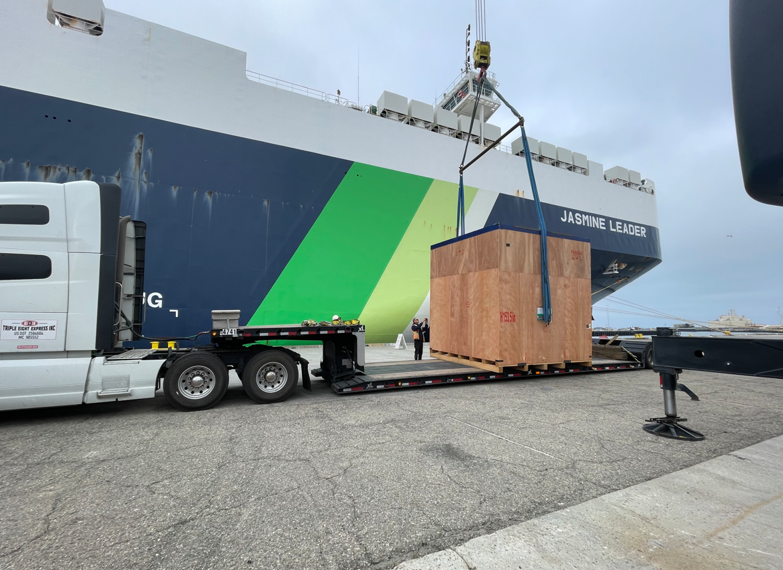
OOG Specialization
Out-of-Gauge (OOG) Expertise
Flat Rack / Open Top Handling
Heavy Industrial Cargo
(Transformers, Cable Reels, Machinery)
Overweight / Over-dimensional Cargo Management
Coordinated Port to Site Execution

Slide 5
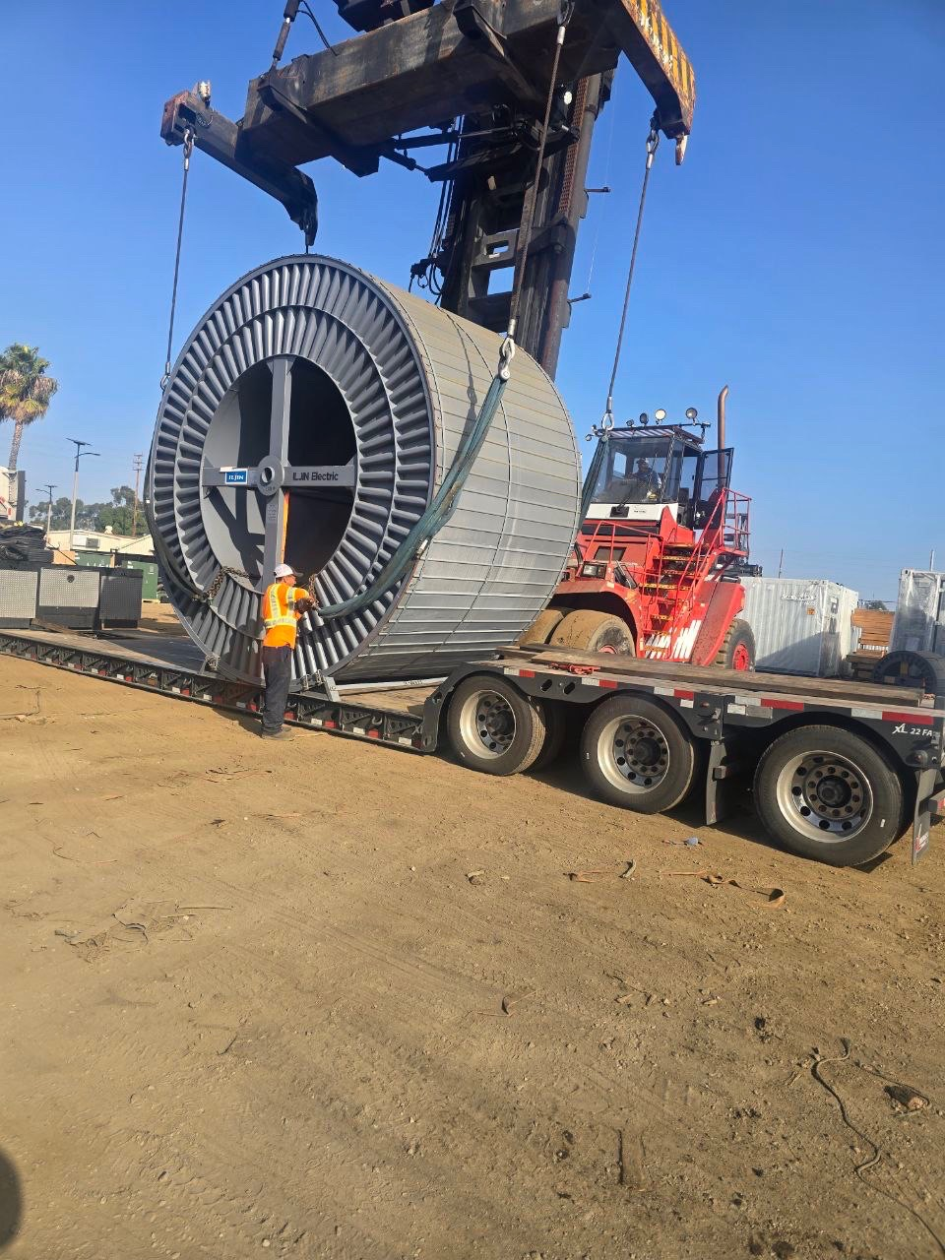

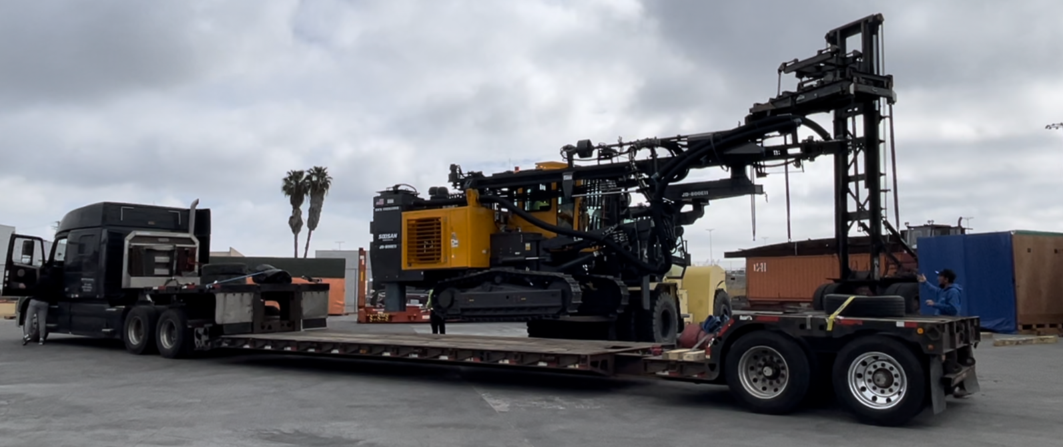
Inland Execution
Heavy Inland Transport Capability
RGN / Lowboy / Multi-axle configuration
Step deck / Flatbed for oversize cargo
Police escort & pilot coordination
Route-controlled delivery execution

Slide 6

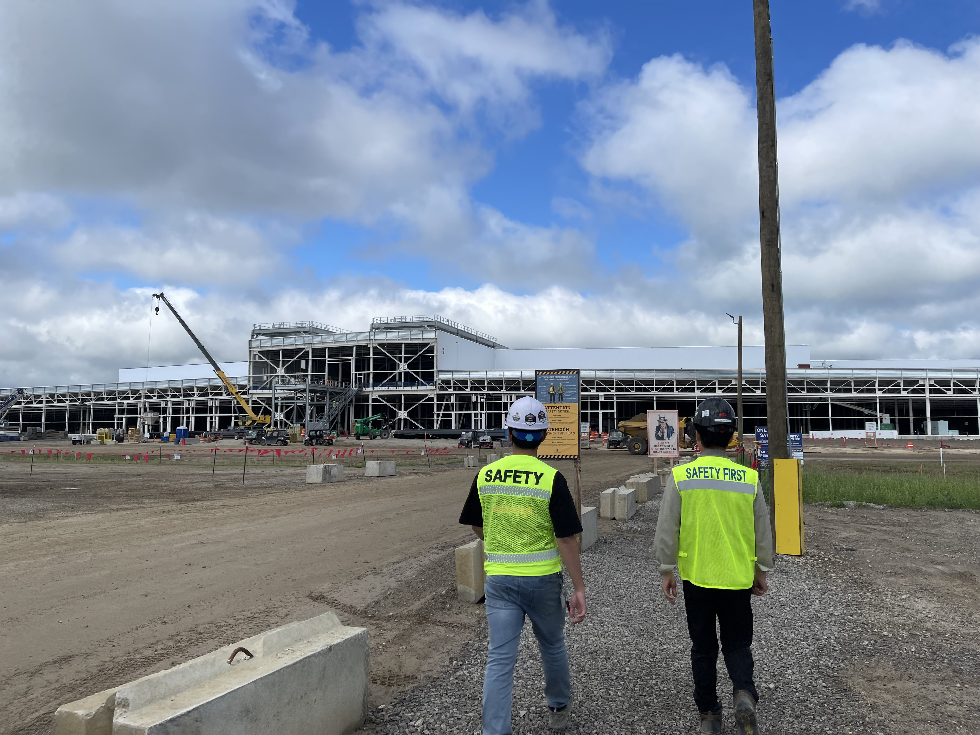

Selected project Experience
Strategic Project Name | Industry Sector
xAI Memphis Data Center Infrastructure PJT | AI Infrastructure & Data Centers
ULTIUM CELLS LLC | EV Battery Infrastructure
BOSK (BlueOvalSK) | EV Joint Venture Logistics
FORD BOSK | Automotive Construction
LGES MI2 / EDWARD ELECTRIC | EV Battery / Energy
QCELLS REDEEMER PJT | Renewable Energy (Solar)
HYUNDAI ENGINEERING AMERICA | Industrial EPC Project
We deliver complex, large-scale industrial projects across North America with proven execution excellence.

Slide 7
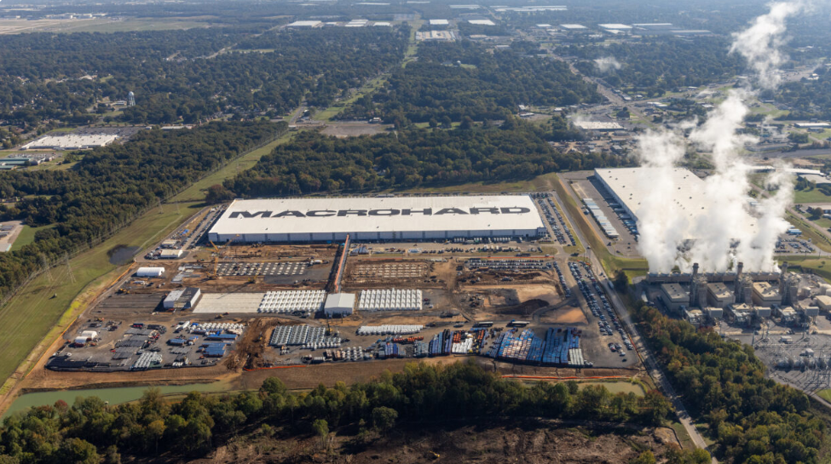
Case Study – Industrial Project Execution
PROJECT
xAI Memphis Data Center Infrastructure
Duration
Ongoing project since July 2025
SCOPE
End-to-end delivery of transformers and critical power equipment
EQUIPMENT
RGN / Flatbed / Stepdeck for heavy and oversize cargo
CHALLENGE
Overweight transport under strict route, permit, and infrastructure limitations.
EXECUTION
Integrated project management including route survey, permit control, inland
transport, and crane coordination
RESULT
Executed with precision, safety, and full operational control

Slide 8
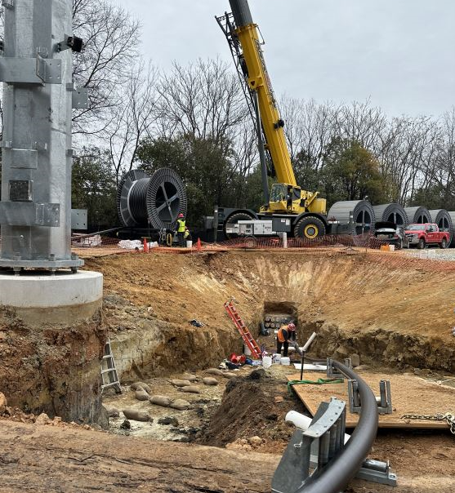
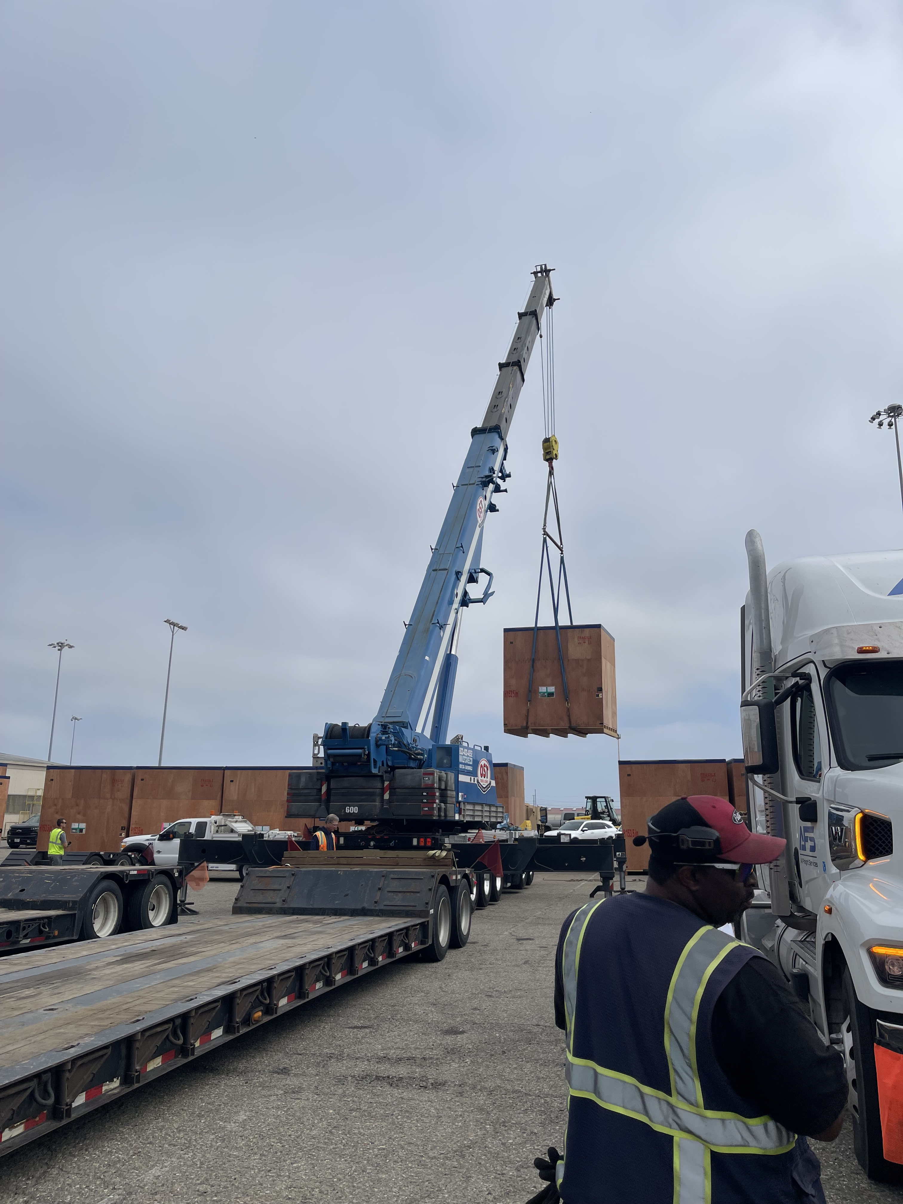

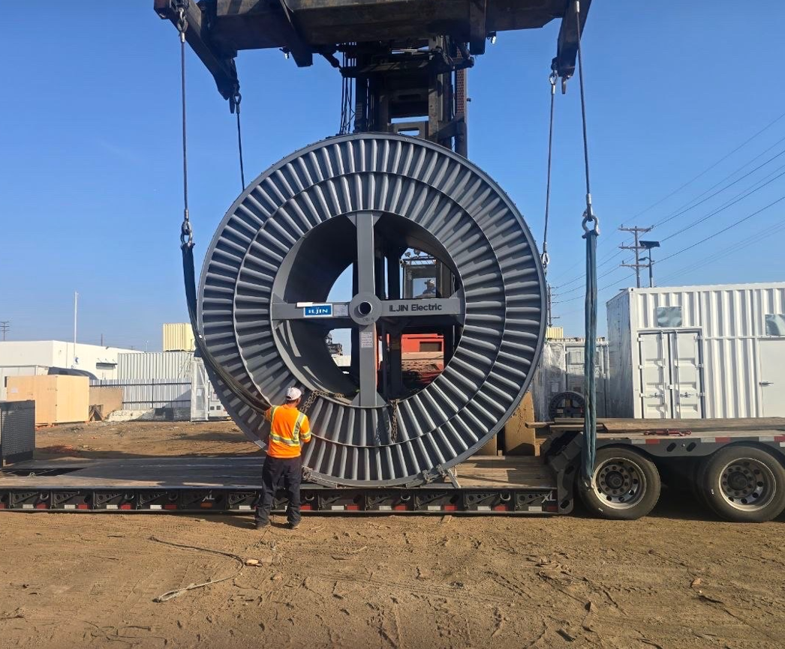
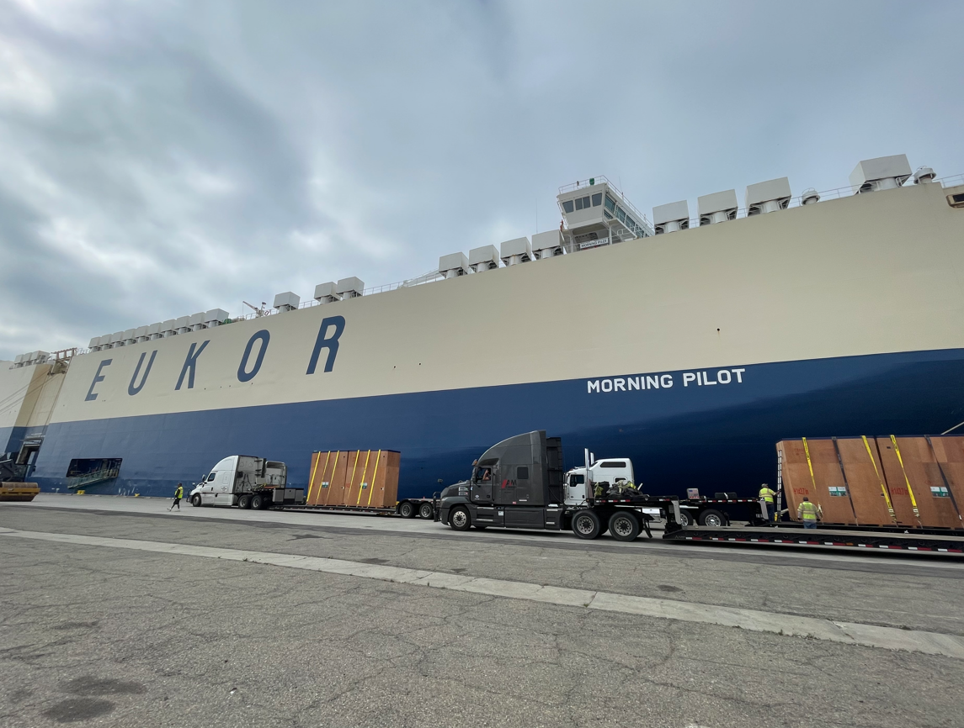
Operational Portfolio: OOG & RORO
EUKOR RORO OPERATIONS
BREAKBULK SOLUTIONS
ENERGY INFRASTRUCTURE
HEAVY MACHINERY

Slide 9

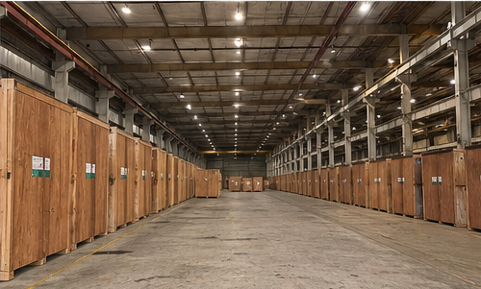
Integrated Warehousing & Transloading
Professional Crating & Storage
Our LA facility offers climate-controlled and secure storage for oversized industrial crates. We provide high-spec export packaging and professional crating to withstand trans-pacific sea freight conditions.
•
Custom ISPM-15 Crating
•
Secure CFS Operations
•
Short & Long-term Hub Storage

Slide 10
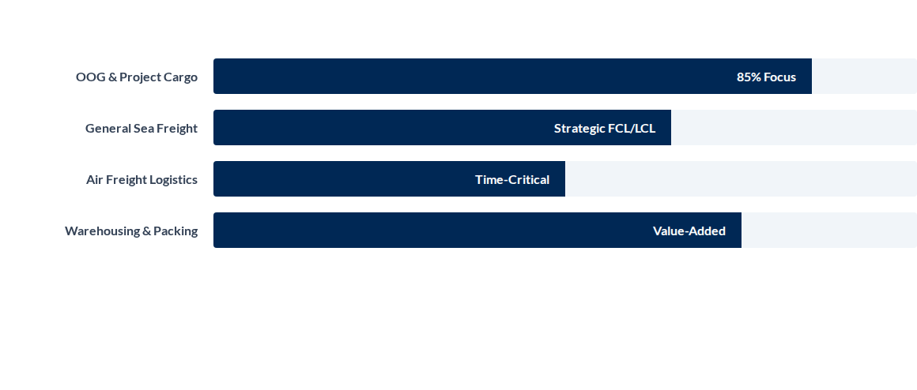
Service Portfolio Distribution
Team Global USA INC. maintains a high-density focus on complex project logistics, outperforming standard freight market averages.

Slide 11
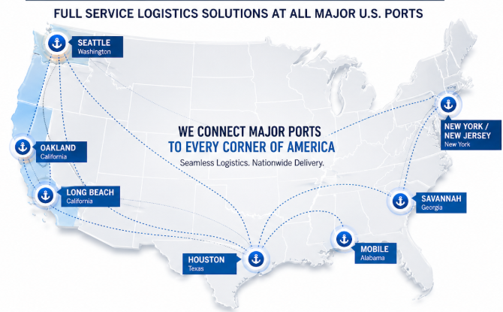
NATIONWIDE PORT COVERAGE
Direct execution from all major U.S. gateways to final site delivery

Slide 12
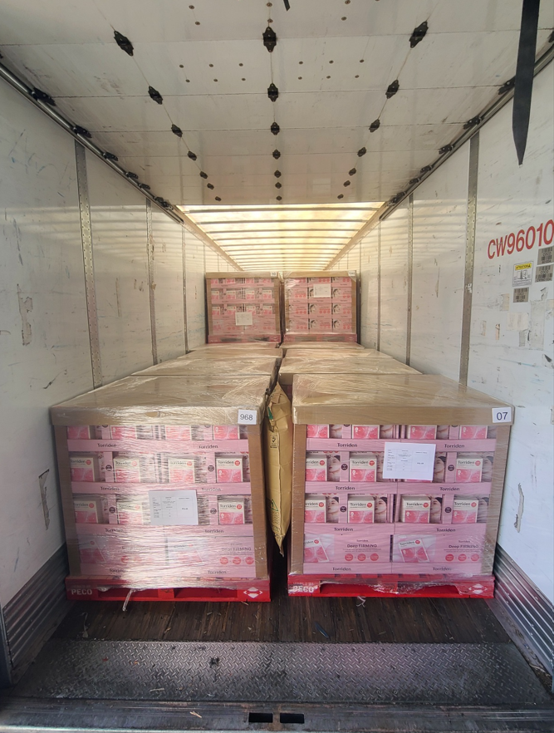
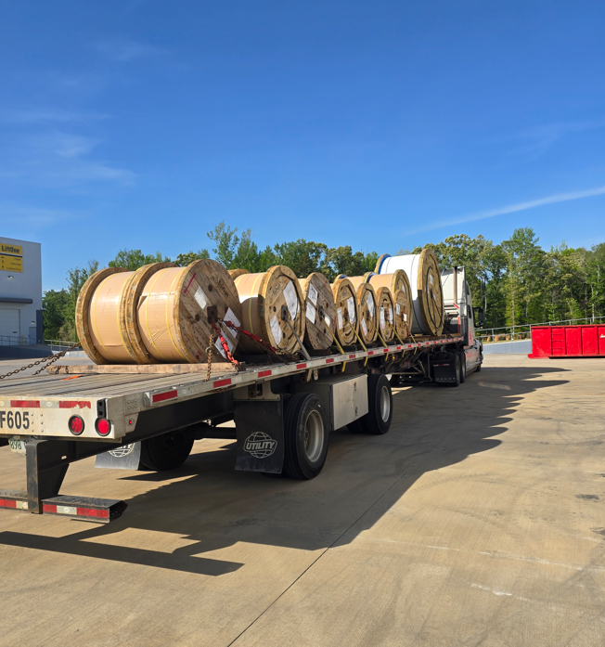

Controlled & Reliable Execution
Safety as a Standard
Pre-Loading inspection & Verification
Securing & lashing supervision
Step-by-step documentation
Damage prevention focus

Slide 13










ECOMMERCE LAST MILE SOLUTIONS
Reliable. Fast. Cost-Effective End-to-End Execution across North America.
OUR LAST MILE CAPABILITIES
BULK CLEARANCE (LST)
Door-To-Door Delivery
Fulfillment Integration
Residential & commercial with time-definite options and GPS tracking.
Seamless connection with major shopping carts and platform APIs.
Simplified Customs
Faster clearance with consolidated list declaration per flight.
Return Management
Real-Time Visibility
Reduced Costs
Efficient handling of returns and product refurbishment for resale.
24/7 status monitoring with proactive exception management.
Lower brokerage fees through efficient batch processing.
Compliant & Secure
Fully compliant with CBP regulations and global standards.
Preferred Rates with UPS
UP TO
60%
Exclusive discounted rates secured for our clients, allowing you to move volume more competitively.
Nationwide Coverage:
OFF RATES*
Receive goods & manifest for shipment
Sorting & preparation for local delivery
Send to UPS network or LMS partners
Final delivery to your end customers
Proof of delivery & detailed reporting

Slide 14
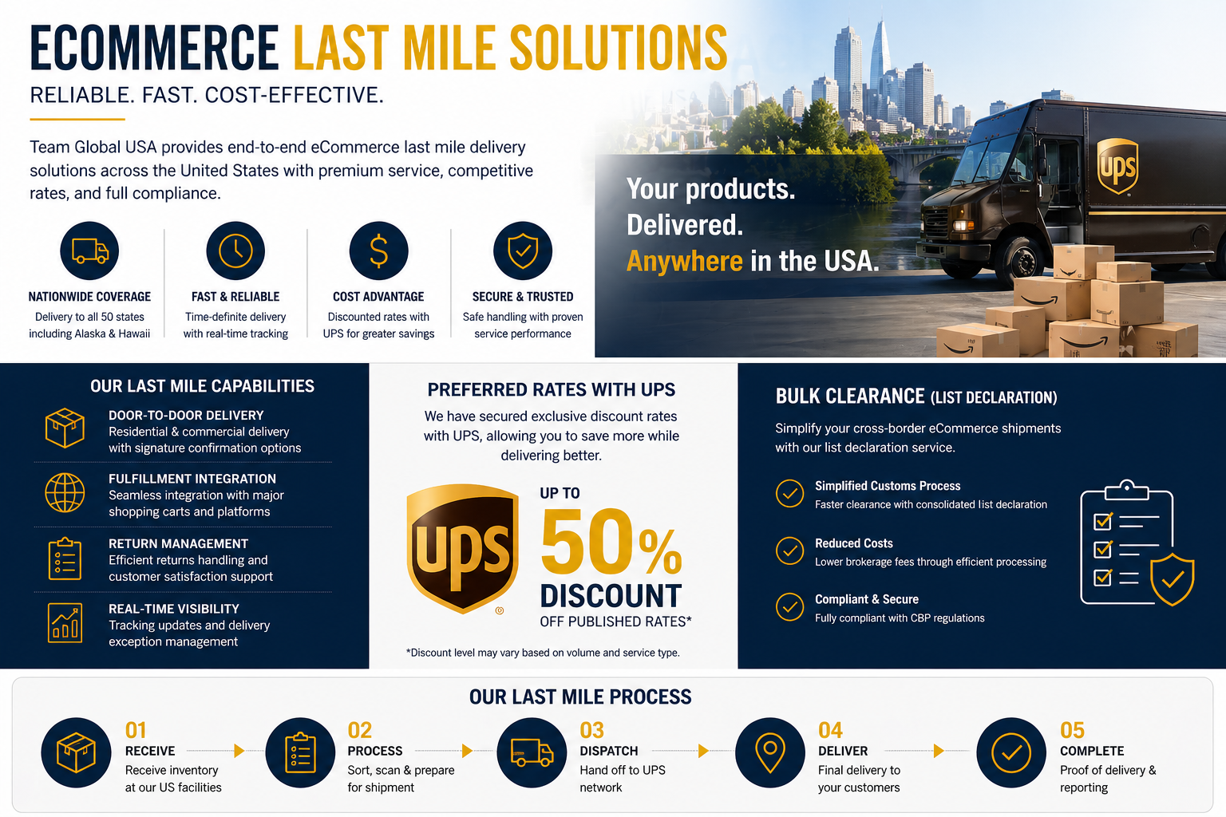

Slide 15

Why Partner With Team Global?
LA-Based Execution: Direct control over the West Coast gateway without third-party intermediaries.
BUILDING
THE PROJECTS OF TOMORROW
Specialized Technical Know-How: Proven experience in handling the "Impossible" industrial loads from Korea.
Integrated Supply Chain: From factory crating in Asia to heavy-haul delivery in the US Heartland.
Network Synergy: We are looking for strategic partners in world-wiide to expand our trans-pacific project network.

Slide 16
TEAM GLOBAL USA INC.
Building Strategic Logistics Partnerships
HQ: Los Angeles, California, USA
www.teamglobal-usa.com

