Slide 1
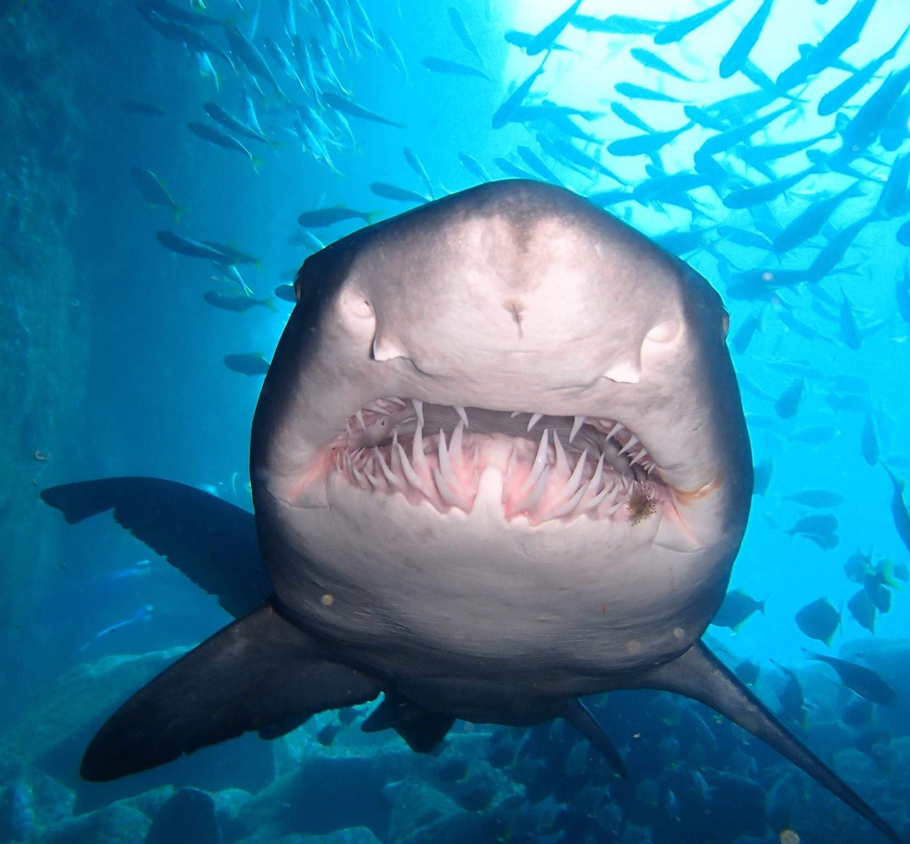
Learning Intention:
Interpret data related to the marine environmental planning and management process
Success Criteria:
Complete Marine Education worksheet
’10. Research Investigation’
Notes:
Image: https://edition.cnn.com/2022/11/02/world/gallery/fish-rock-shalise-leesfield-c2e-spc-intl-scn/index.html
Despite their terrifying toothy grin, grey nurse sharks are mostly harmless to humans. Due to loss of habitat and overfishing, the species is in decline and listed as critically endangered by the IUCN.

Slide 2
Grey Nurse SharK case study
Despite their terrifying toothy grin, grey nurse sharks are mostly harmless to humans.
Due to loss of habitat and overfishing, the species is in decline and listed as critically endangered.
The Story of the Critically Endangered
1960
1970
1980
1990
2000
2010
2020

Slide 3
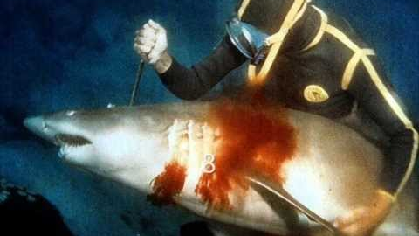
Early 1960s: explosive shotgun powerheads invented and killed many sharks. Image: Ron Taylor
1960
1970
1980
1990
2000
2010
2020
Notes:
Early 1960s: explosive shotgun powerheads invented and killed many sharks. Image: Ron Taylor

Slide 4
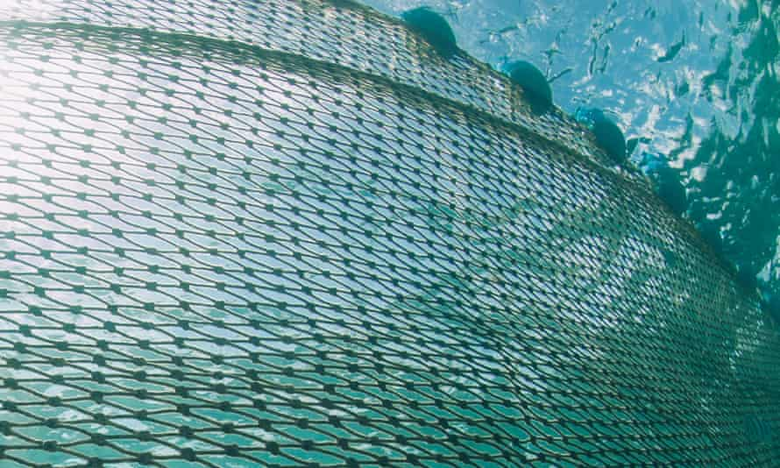
Decline in population size noticed in reduced numbers of GNS
caught in shark nets
1960
1970
1980
1990
2000
2010
2020
Notes:
1950s: GNS east coast population estimated to be 90% larger than today
During the early 1950s (in NSW) and 1960s (in Qld), an average of 36 GNS (grey nurse shark) would be recovered from shark nets every year (Reid & Krogh, 1992; Environment Australia, 2002). In comparison, there was an average of 18 GNS recovered from shark nets every year in the 1980s, and an even lower average of 2 sharks recovered from shark nets every year between 1993-2004 (Australian Government, 2022a).

Slide 5


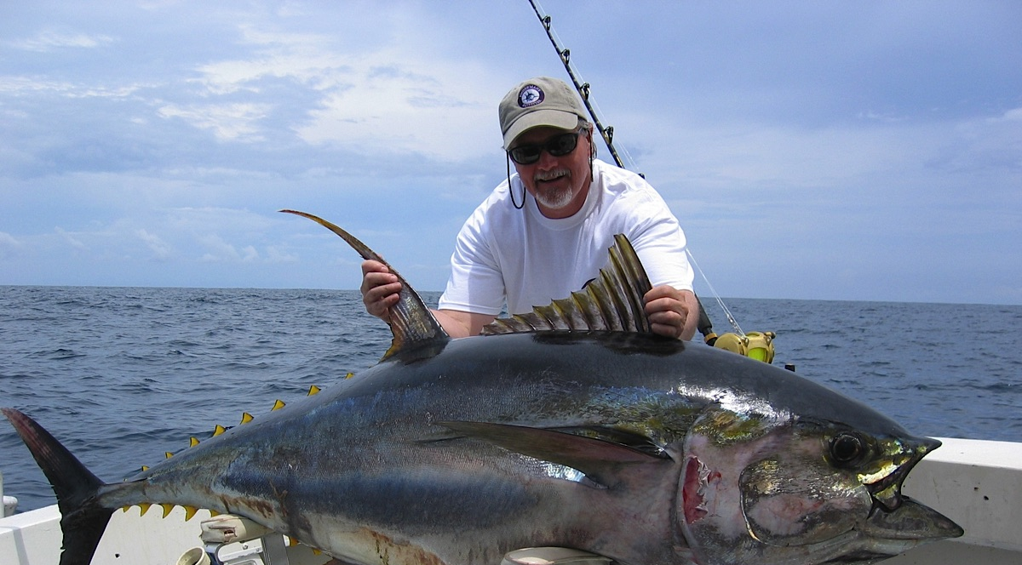
Also noticing a decline in numbers, the game-fishing industry voluntarily banned Grey Nurse Shark captures in 1979
1960
1970
1980
1990
2000
2010
2020
Notes:
1960-1979: Game-fishing clubs catch 405 GNS
Although organized game-fishing began off eastern Australia in 1936, the majority of catches were made after 1960. NSW Game-fishing clubs recorded catching a total of 405 GNS between 1960 and 1979 but GNS were not the primary target species (Pepperrall, 1992). After noticing a decline in numbers, the game-fishers voluntarily banned Grey Nurse Shark captures in 1979 (Australian Government, 2022b).

Slide 6
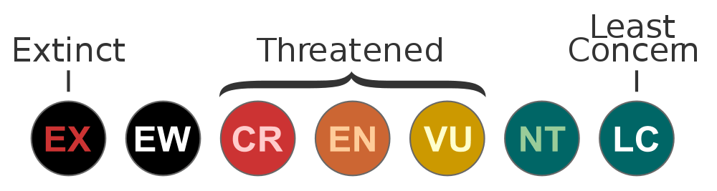
1984: GNS protected
Extinct
Extinct in the Wild
Critically
Endangered
Endangered
Vulnerable
Near Threatened
Least Concern
1960
1970
1980
1990
2000
2010
2020
Notes:
Nov 1984: NSW lists GNS as vulnerable in Fisheries & Oyster Farms Act 1935

Slide 7
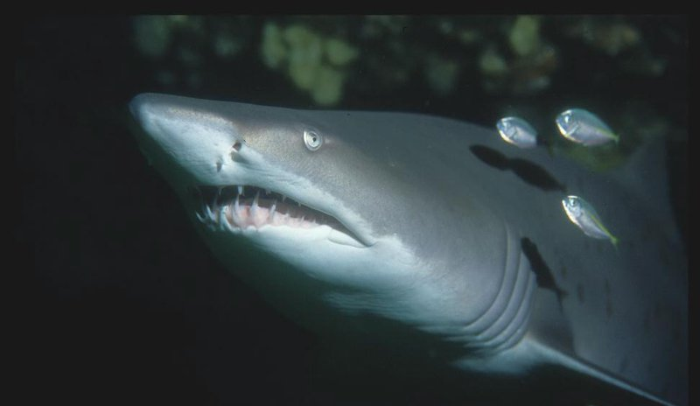
First ever GNS surveys in 1991
9 dives over 3 days at Seal Rocks, and a telephone survey across NSW
1960
1970
1980
1990
2000
2010
2020
Notes:
we would conservatively regard it as vulnerable’
(THE ECOLOGY LAB, 1991)

Slide 8
1997: GNS upgraded to Endangered
Extinct
Extinct in the Wild
Critically
Endangered
Endangered
Vulnerable
Near Threatened
Least Concern
1960
1970
1980
1990
2000
2010
2020
Notes:
1997: Qld protects GNS under Fisheries Act, 1994 (Fisheries Regulation, 1995)
1997: Qld upgrades GNS to endangered in Qld Nature Conservation Act 1992

Slide 9
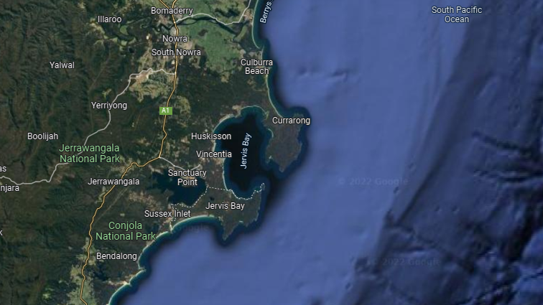
1998: 3 abandoned GNS sites at Jervis Bay NSW protected under the precautionary principle
(see definition next slide)
Protected
1960
1970
1980
1990
2000
2010
2020
Notes:
3 abandoned GNS aggregation sites in popular Jervis Bay protected via the precautionary principle in 1998

Slide 10
The Precautionary Principle
“a lack of full scientific certainty should not be used as a reason for postponing measures to prevent degradation of the natural and cultural heritage of a reserve or zone where there is a threat of serious or irreversible damage”
Extracted from Australian Marine Parks Network - Temperate East Management Plan 2018 - Page 78.
Quoted from the EPBC Act 1999
Notes:
1998: NSW protects 3 GNS sites using precautionary principle
The precautionary principle was applied in 1998 to protect three historically known GNS sites in popular Jervis Bay: The Docks, Boat Harbour and Weedy Valley. They were abandoned Grey Nurse Shark aggregation sites, not included as critical habitat in NSW fisheries legislation. During planning for the Jervis Bay Marine Park, the rationale for protecting these sites was application of the precautionary principle for biodiversity conservation, which the NSW MPA was obliged to consider (Lynch et al., 2004). The park was established in 1998 and its zones and management rules commenced in October 2002 (DPI, 2022).

Slide 11
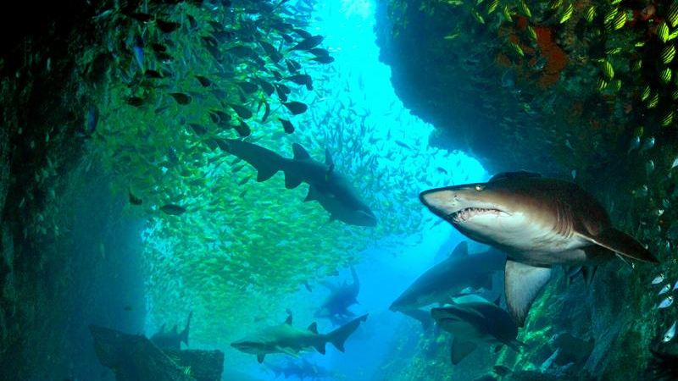
Otway et al., 2003: First large scale survey
(Funded by the National Heritage Trust)
Count
Map
Diver’s Code of Conduct
Identify Threats
1960
1970
1980
1990
2000
2010
2020
Notes:
1998: More preliminary studies at Seal Rocks & SW Rocks by Ecology Lab. The Ecology Lab surveys in 1991 were repeated and extended to include South West Rocks in 1998. The four sites at Seal Rocks were the same: Big Seal, Little Seal, Edith Breaker and Skeleton Rocks. The four sites at South West Rocks were: Fish Rock Cave, Fish Rocks Aquarium, Black Rock and Green Island. These were surveyed over consecutive days from 30 November to 4 December, 1998 to ensure similar timing with previous 1991 and 1995 surveys (Otway and Parker, 2000).

Slide 12
60 previously known aggregation sites
over 2000km were surveyed
40 had been Abandoned
1960
1970
1980
1990
2000
2010
2020

Slide 13
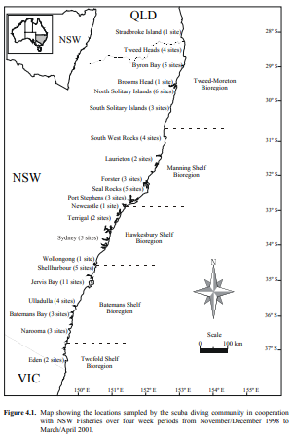
Population Estimates
Worst: 300 Sharks
Likely: 1000 Sharks
Best: 3000 Sharks
Notes:
Dr Nick Otway of NSW Fisheries leads a team of researchers and engages a large percentage of the dive community to conduct 10 surveys between 1998 and 2001 recording all GNS from Flat Rock in southern Queensland to Eden near the NSW/Victoria border. Dr Nick Otway estimates the population size to be 300 (worst), 1000 (likely) and 3000 (best). The highest number of individuals observed during a single survey of 62 reefs in winter 2000 is 292. The sharks are counted in month-long surveys (i.e. 1 survey is 1 month) using underwater visual counts over a 15 minute period. At each site, divers record the number, sex and size of any Grey Nurse sharks present. They also record the presence of hooks, mating scars, etc. (Otway et al., 2003). The surveys are funded by the National Heritage Trust.

Slide 14
2001: Minister upgrades GNS to critically endangered in EPBC Act
1960
1970
1980
1990
2000
2010
2020
Notes:
October 2001: Minister upgrades GNS to critically endangered in EPBC Act

Slide 15

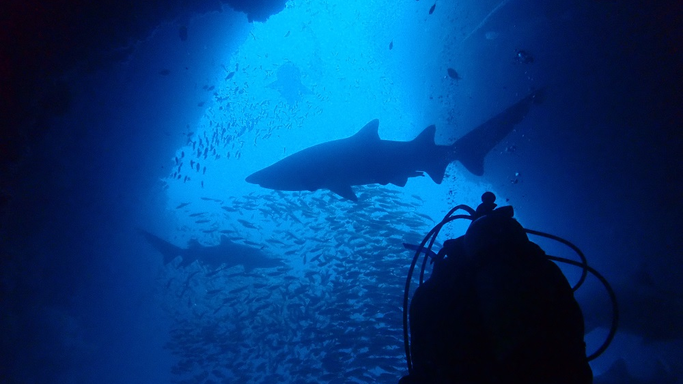
2001: Pimpernel Rock (NSW) in Commonwealth Waters is protected
1960
1970
1980
1990
2000
2010
2020

Slide 16
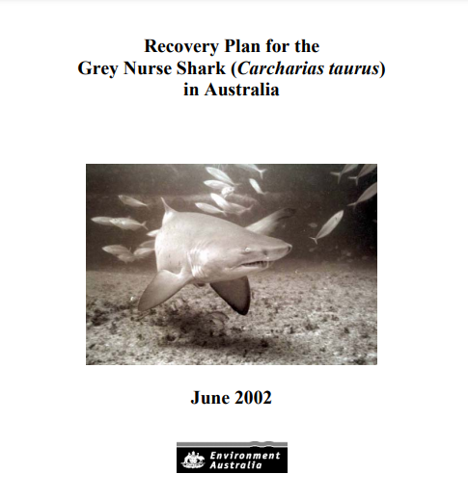
2002: RECOVERY PLAN
OBJECTIVE:
‘to increase Grey Nurse Shark numbers in Australian waters to a level that will see the species is removed from the schedules of the EPBC Act’
Notes:
2002: First Recovery Plan for the Grey Nurse Shark in Australia
The overall recovery plan objective was to increase Grey Nurse Shark numbers in Australian waters to a level that will see the species is removed from the schedules of the EPBC Act (EA, 2002).

Slide 17
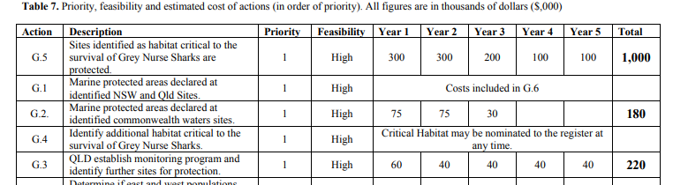
Funds allocated:
$1 million over 5 years
to identify and protect critical habitat sites

Slide 18
$180,000 over 5 years
to identify and declare MPAs at Commonwealth waters sites

Slide 19
2009: PLAN REVIEW
NSW declares and protects
10 aggregation sites as Critical Habitat in 2002
Qld declares and protects
4 aggregation sites as
Critical Habitat in 2003
including Wolf Rock
Notes:
The critical habitat size in NSW is a core 200-m area (no fishing with bait and/or wire trace line, no night diving) surrounded by a 800-1000m buffer zone (no commercial drop, drift and set line fishing) (NSW Fisheries, 2003). Fines vary from $500 for less serious breaches to $11000 for breaking fishing and diving rules in critical habitat sites. If a grey nurse shark is harmed, fines of up to $220,000 apply (NSW Fisheries, 2003).
In December 2003, the Queensland government (EPA) declared Critical Habitats at Wolf Rock (Rainbow Beach), Cherubs Cave (Moreton Island), Henderson Rock (Moreton Island) and Flat Rock (Stradbroke Island). Subsequently Department of Primary Industry (DPI) - Fisheries closed the sites to all extractive activities that include line fishing, crabbing, blue water hunting and marine aquarium collecting. Queensland sites offer protection within a 1.2km radius of the sharks aggregation point. One mooring was installed at Wolf Rock and four moorings were installed at Flat Rock. No moorings were installed at Cherubs Cave or Henderson Rock. All four sites relatively difficult to access due to location.

Slide 20
The Commonwealth had already declared Pimpernel Rock as a Sanctuary Zone and does the same for the Cod Grounds
(Brooms Head) in 2007
(the last of protected GNS sites)
Notes:
The critical habitat size in NSW is a core 200-m area (no fishing with bait and/or wire trace line, no night diving) surrounded by a 800-1000m buffer zone (no commercial drop, drift and set line fishing) (NSW Fisheries, 2003). Fines vary from $500 for less serious breaches to $11000 for breaking fishing and diving rules in critical habitat sites. If a grey nurse shark is harmed, fines of up to $220,000 apply (NSW Fisheries, 2003).

Slide 21

2009 REVIEW OF RECOVERY PLAN
7 additional sites protected
(not mentioned in the 2002 plan)
TOTAL 26 sites protected
Notes:
2009: A total of 26 sites offer protection for GNS along east Australian coast
An additional 7 sites not mentioned in the GNS Recovery Plan were also protected between 2001 and 2009. Making a total of 26 sites (NSW=16; Qld=8; Commonwealth=2) spread across 6 Marine Protected Areas (MPAs) along the east Australian seaboard, at least in part, to manage human interactions with a GNS. The 6 MPAs are: (1) marine reserves managed by the Commonwealth (2) critical habitat and (3) aquatic reserves managed by the NSW DPI, (4) critical habitat managed by Qld Fisheries, (5) marine parks managed by the NSW Marine Parks Authority (NSW MPA) and (6) marine parks managed by the Qld Department of Environment and Resource Management (DERM). Five sites remain open to some form of fishing. While all 16 critical habitat sites were established primarily for GNS conservation, other sites and overlaying zones were often created for additional reasons such as biodiversity conservation (Lynch et al., 2013).

Slide 22
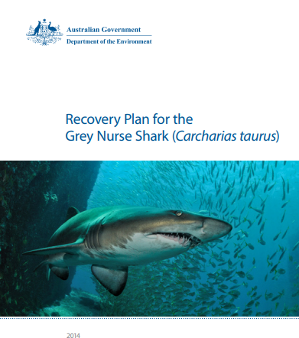
GNS Recovery Plan
2014
Note: no budget provided in the 2014 GNS Plan

Slide 23
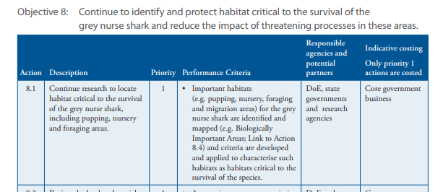
2014 Plan is due for (10 year) review – very few actions met
For example:
1960
1970
1980
1990
2000
2010
2020
Notes:
2002: First Recovery Plan for the Grey Nurse Shark in Australia
The overall recovery plan objective was to increase Grey Nurse Shark numbers in Australian waters to a level that will see the species is removed from the schedules of the EPBC Act (EA, 2002).

Slide 24
ZERO sites protected
since 2007
Notes:
2002: First Recovery Plan for the Grey Nurse Shark in Australia
The overall recovery plan objective was to increase Grey Nurse Shark numbers in Australian waters to a level that will see the species is removed from the schedules of the EPBC Act (EA, 2002).

Slide 25
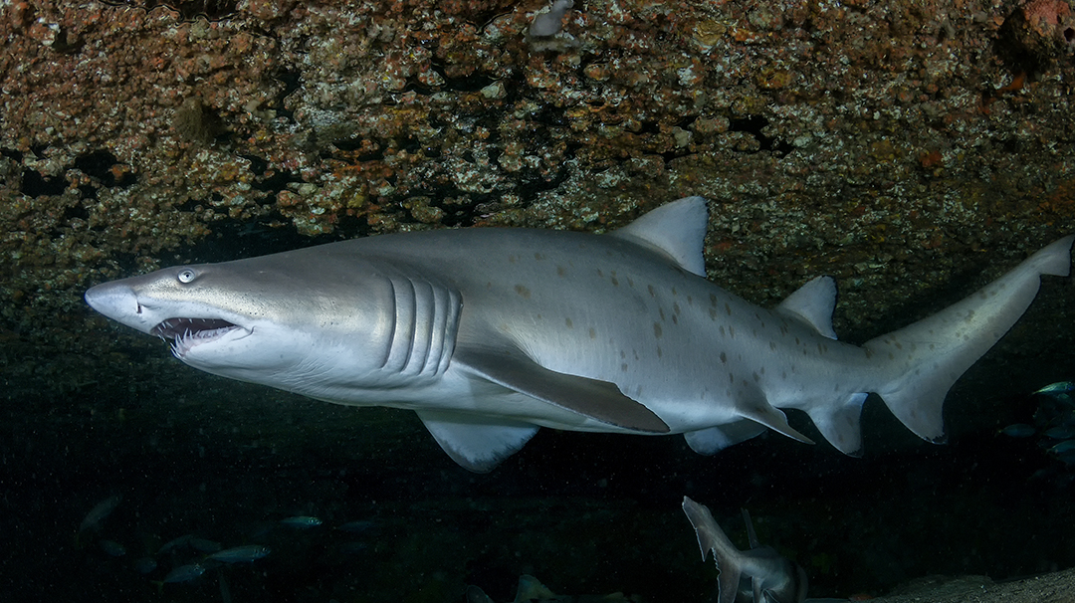
Survey Methods move towards favouring tagging.
TAGS: Genetic, Physical, Natural
1960
1970
1980
1990
2000
2010
2020

Slide 26
Genetic tags
genetic fingerprinting
513 tissue samples to identify related individuals
More relatives = smaller population
2000-3000 GNS
2017 Population estimate:
Notes:
2017: Surveys using genetic fingerprinting estimate pop. size to be 2167-3078
Bradford et al., (2018) used a Close-Kin Mark Recapture (CKMR) model to estimate population size whereby genetic fingerprinting is used rather than physical marks or tags. This survey took 513 tissue samples and used DNA sequencing to identify related individuals (more relatives = smaller population). The model reports a growing population of approximately 3.4 to 4.5% per annum (95% confidence interval 1.2% – 5.7%). However, despite this, Bradford et al. (2018) clearly states the model has many shortcomings (e.g. it uses age growth curves from age-at-length data from USA populations which may not reflect the growth of eastern Australian GNS) and that “further work on the level of risk facing the recovering population would be required before it would be appropriate to alter the range of existing protective measures” (Bradford et al., 2018).

Slide 27
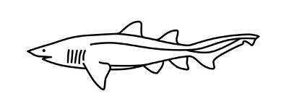


Physical tags
GNS tagged in wINTER migrated north
GNS Tagged in SUMMER migrated south
(n=15)
Acoustic tags ‘ping’ at deployed listening stations

Slide 28
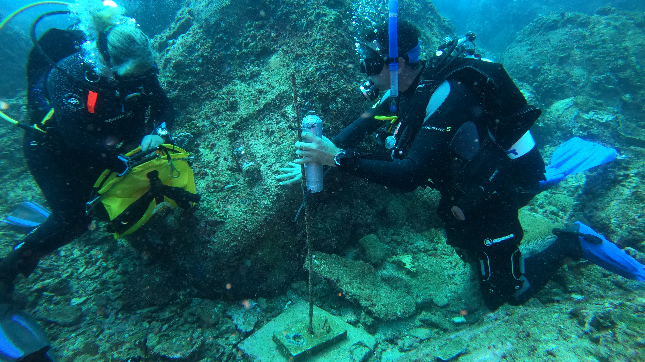
DEPLOYMENT OF ACOUSTIC TAG AT WOBBY ROCK
Photo: Karen Anderson
Notes:
Deployment of acoustic tag receiver at Wobby Rock.

Slide 29
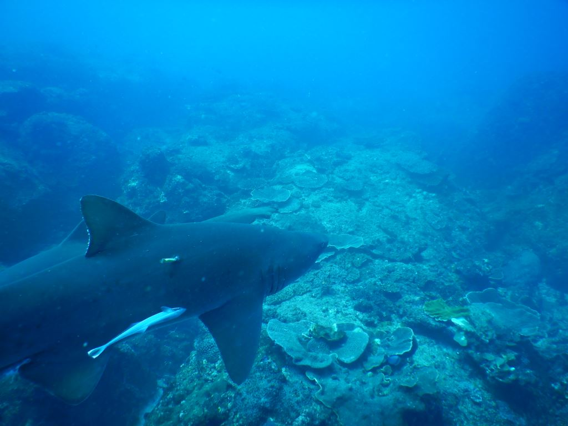
old tag

Slide 30
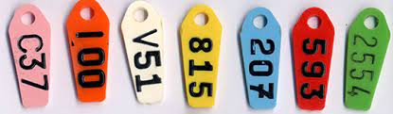
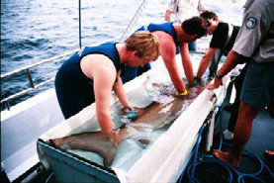
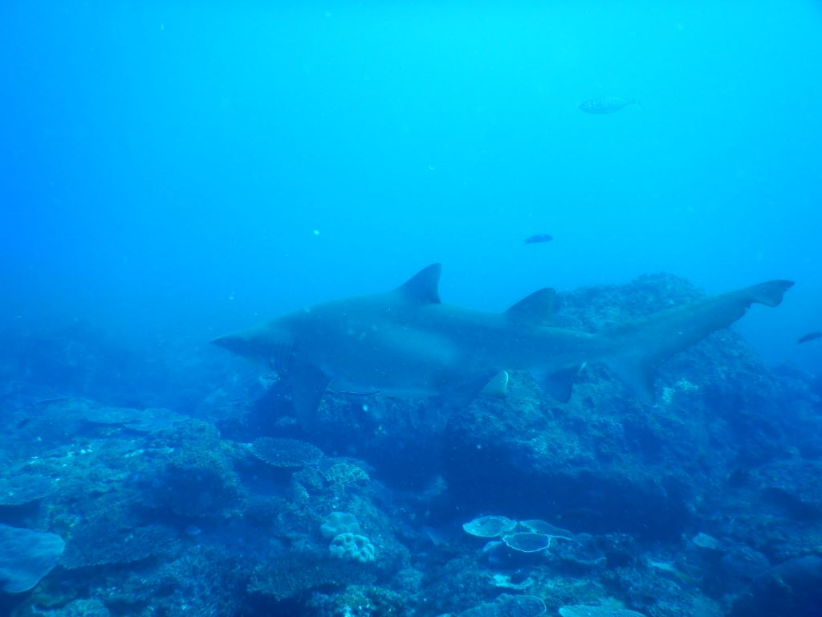
Problems with PHYsical TAGS and recommendations made by independent review of tagging process
Rototags banned
Avoid biofouling (MUST release)
Avoid bringing to surface
Tag as few as possible

Slide 31
WOLF ROCK DIVE CENTRE DIVE REPORTS
12/09/2009: “Another boy who I have seen previously has what now looks likely to be a tag which was never removed. The tag is on his left side front dorsal fin and extremely overgrown. The other side of the dorsal fin is all “bubbled up” possibly from infection”.

Slide 32
WOLF ROCK DIVE CENTRE DIVE REPORTS
08/01/2007: “One with remains of the tag [sighted] from earlier last year”.
06/05/2006: “1 with remains of a tracking device with a scallop out of the rear dorsal fin”.

Slide 33
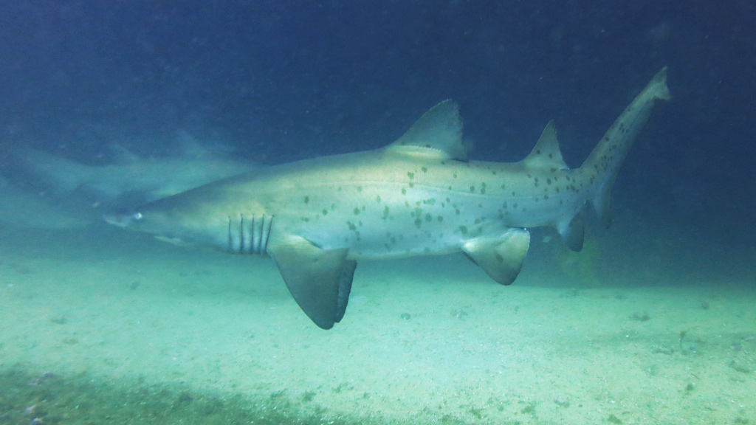
Natural tags
Photographs of GNS spots act as a ‘natural tag’

Slide 34
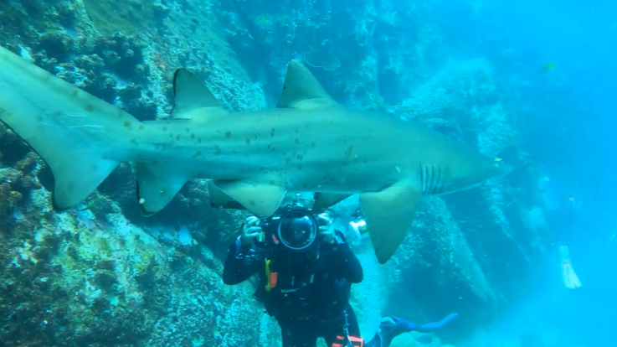
Sharks swim in a circuit, so you can simply sit and wait for them to swim past you.
Photo: Karen Anderson
Notes:
Sharks swim in a circuit, so you can simply sit and wait for them to swim past you.

Slide 35
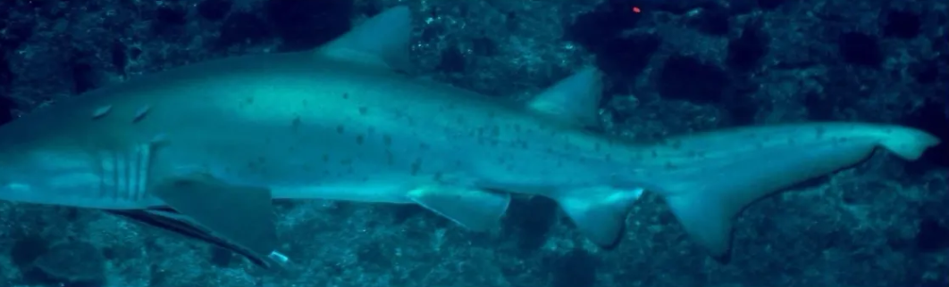
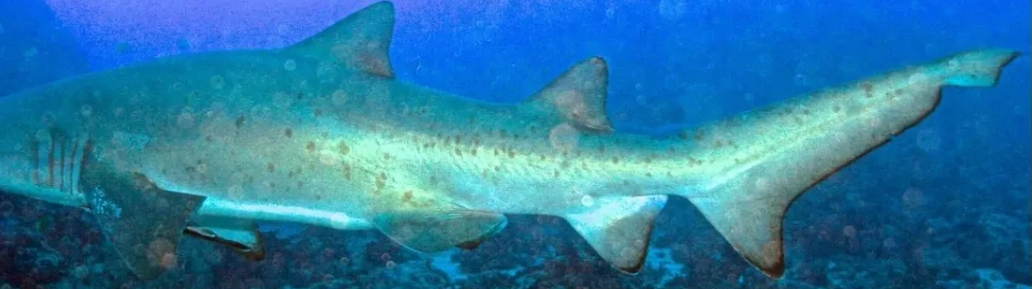
Same shark? ……NEED shark matching software!!!

Slide 36
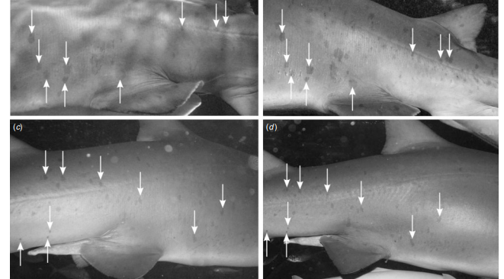
Feb 2004
Feb 2007

Slide 37
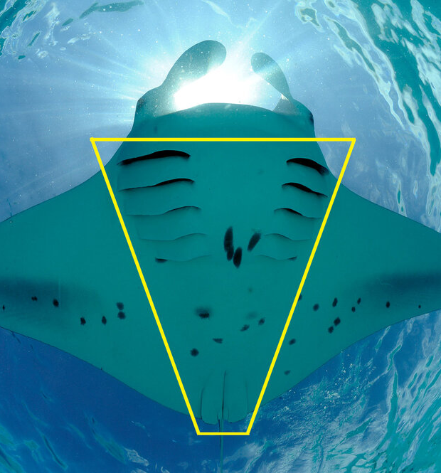
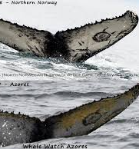

Slide 38
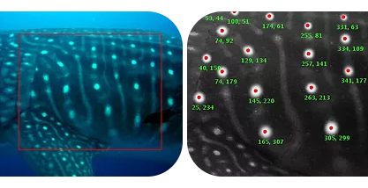

Slide 39

2020 “Molly”
Track shark movements from one site to another
without harm
or risk
2021 “Molly”
2023 “Molly”

Slide 40
NEED Shark Matching Software
Comparable software priced at $7K upfront and $7K/year thereafter

Slide 41
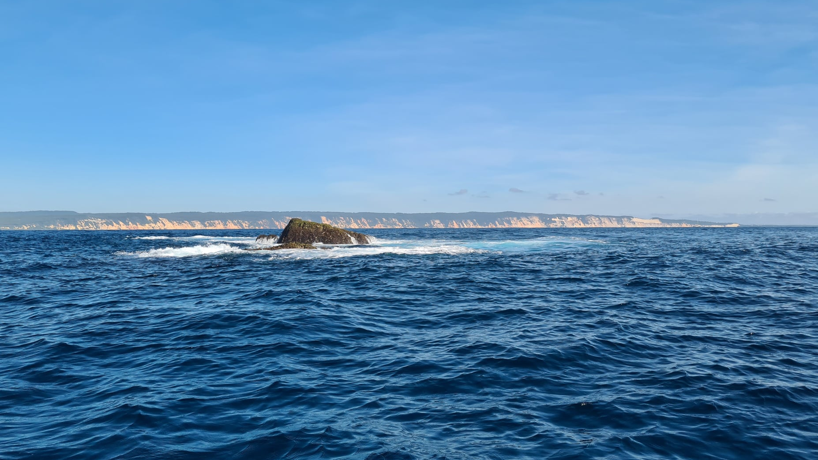
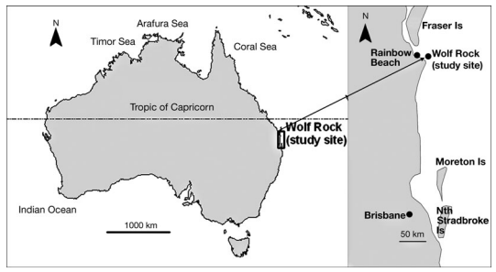

WOLF ROCK, RAINBOW BEACH
MASSIVE GNS AGGREGATION SITE
Notes:
Wolf Rock Rainbow Beach Qld.

Slide 42
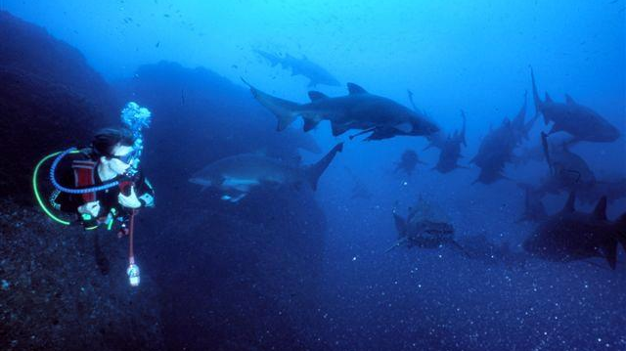
PROTECTED (GREEN ZONE) DECEMBER 2003

Slide 43
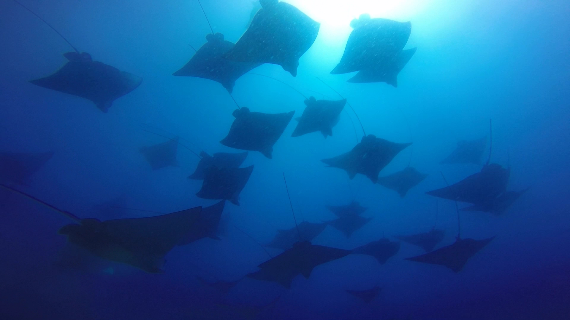
DEEP, DANGEROUS, DIFFICULT TO ACCESS

Slide 44
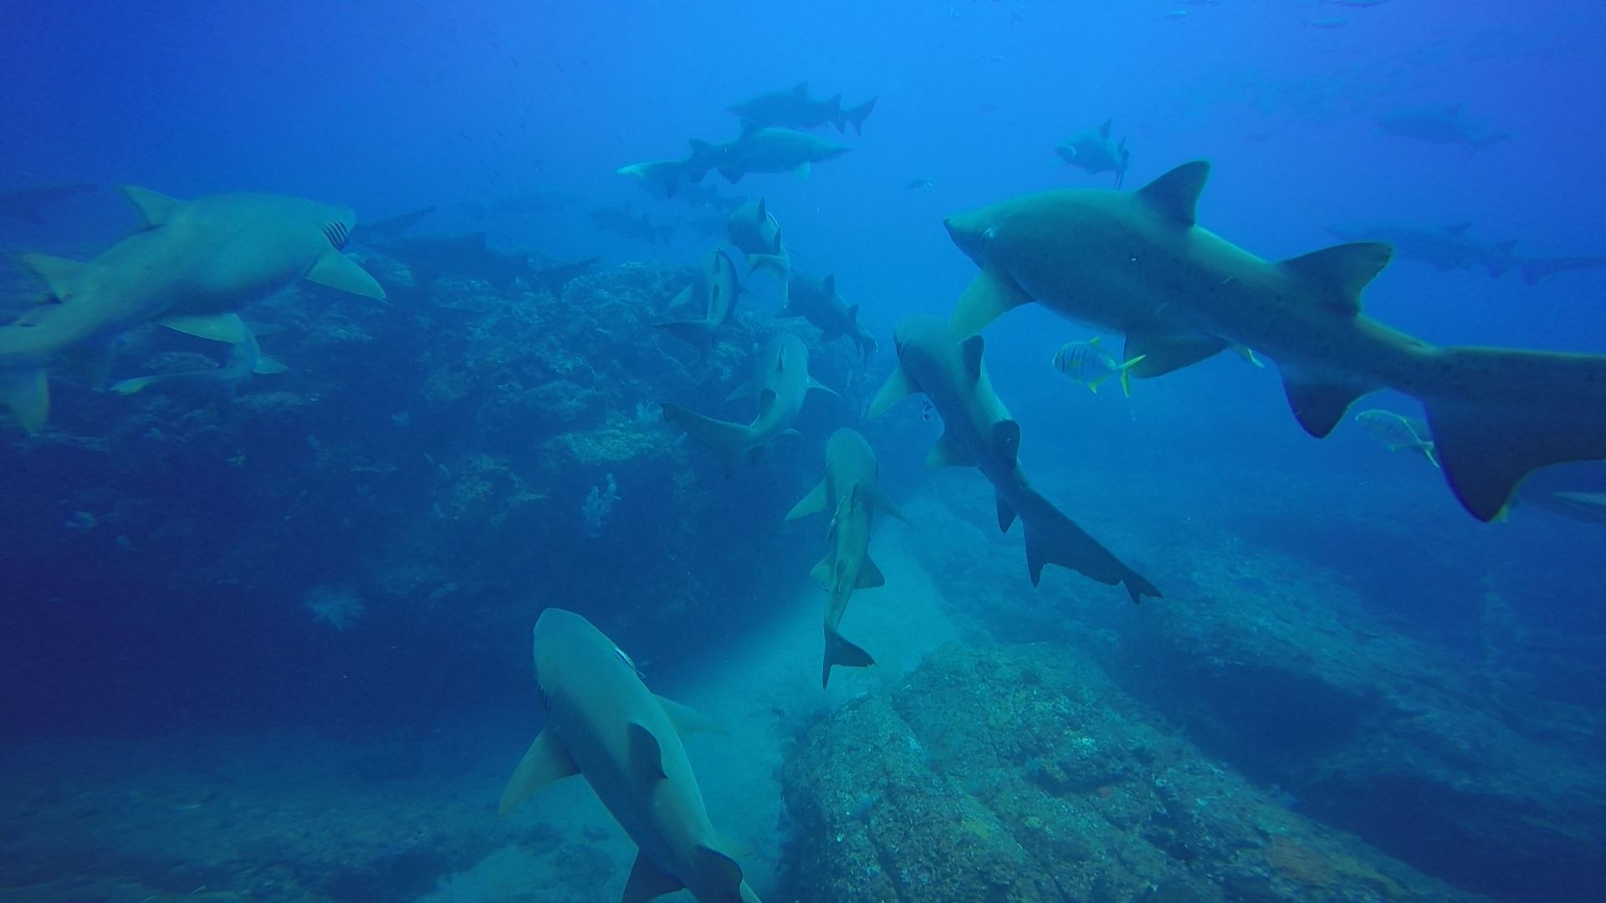
SHARKS START ARRIVING IN SPRING. MATING BEGINS. BOYS LEAVE AT XMAS. PREGNANT GIRLS STAY, BUT LEAVE BEFORE NEXT MATING SEASON.

Slide 45
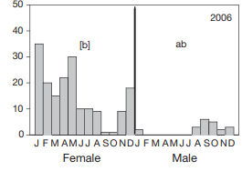
Notes:
Males and more females arrive Winter/Spring. Females visibly pregnant by April. Pregnant females leave August. Don’t know where they go. to give birth.

Slide 46
Where do they go to give birth? No-one knows.
Divers on the Sunshine Coast have seen very pregnant sharks at a local (and very busy) dive site ‘Wobby Rock’. Are the pregnant sharks fleeing Wolf Rock (to avoid the boys) to give birth at Wobby Rock? As per the precautionary principle, divers want it protected as a critical habitat site.
Notes:
Males and more females arrive Winter/Spring. Females visibly pregnant by April. Pregnant females leave August. Don’t know where they go. to give birth.

Slide 47
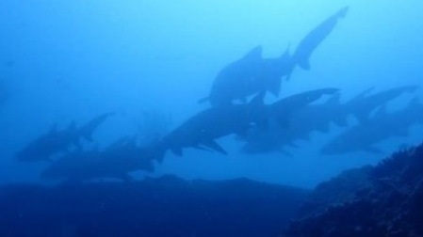
25TH July 2021 WOBBY ROCK
1960
1970
1980
1990
2000
2010
2020

Slide 48
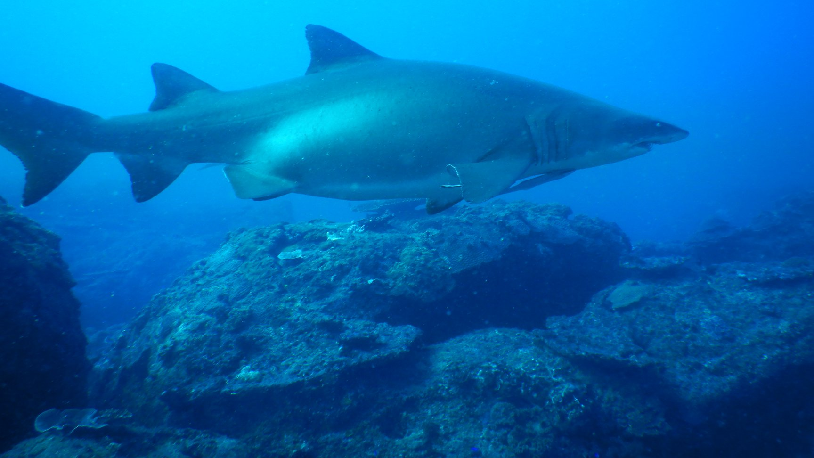
14th July 2018 HEAVILY PREGNANT FEMALE

Slide 49
14th July 2021 HEAVILY PREGNANT FEMALE
Notes:
Heavily pregnant female at Wobby Rock, 14th July 2021

Slide 50
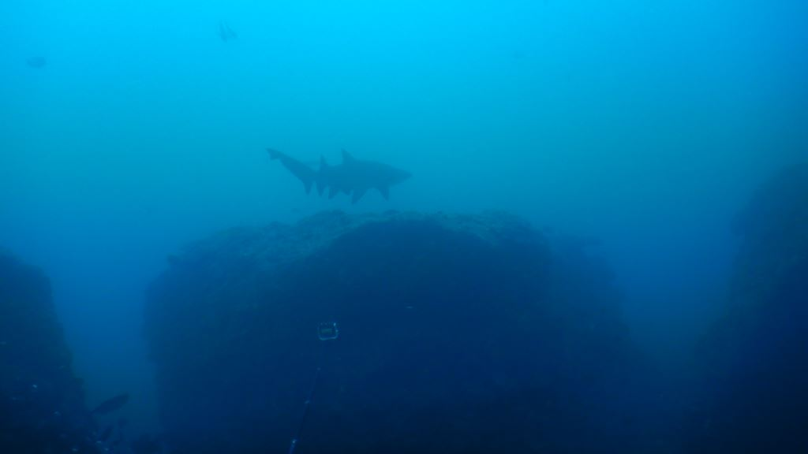
28th OCTOBER 2021, JUVENILE (tbc)

Slide 51
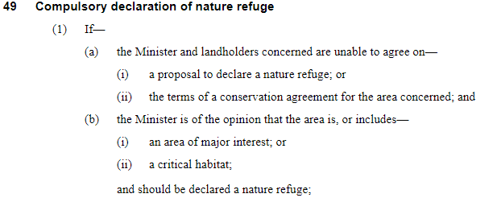
The Nature Conservation Act 1992

Slide 52
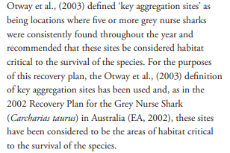
DEFINITION OF CRITICAL HABITAT SITE
Notes:
2014 GNS Recovery Plan

Slide 53
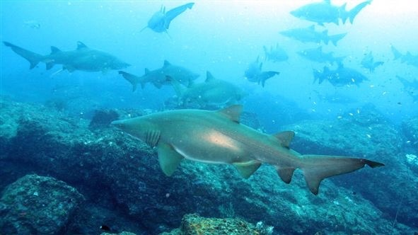
NO DANGEROUS SHARK FEEDING REQUIRED
(BUT THEY STILL NEED TO BE ABLE TO EAT FISH)

Slide 54
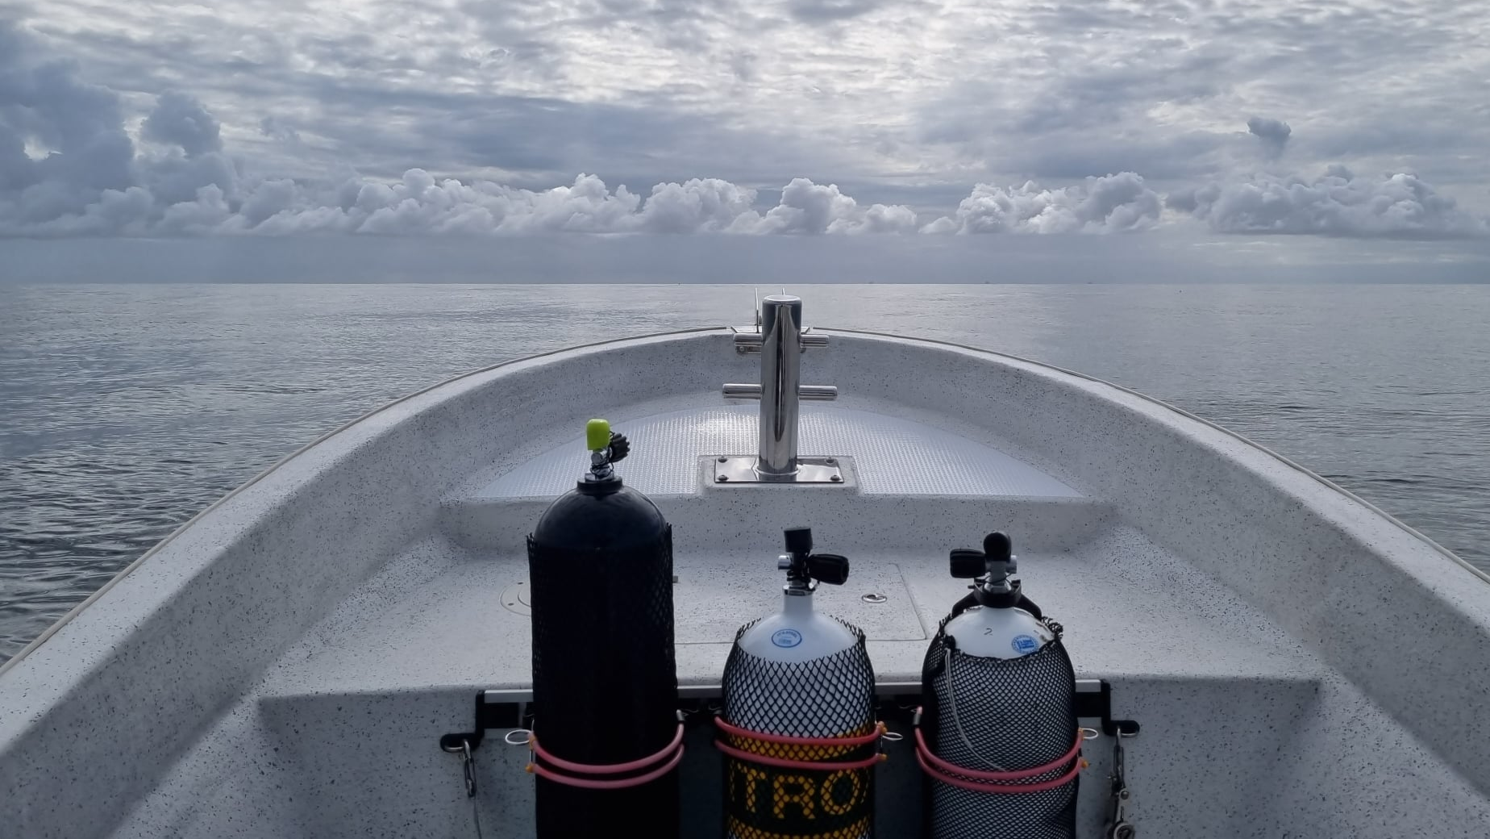
EASY TO ACCESS – 20 MIN BOAT RIDE. NO BAR CROSSING.

Slide 55
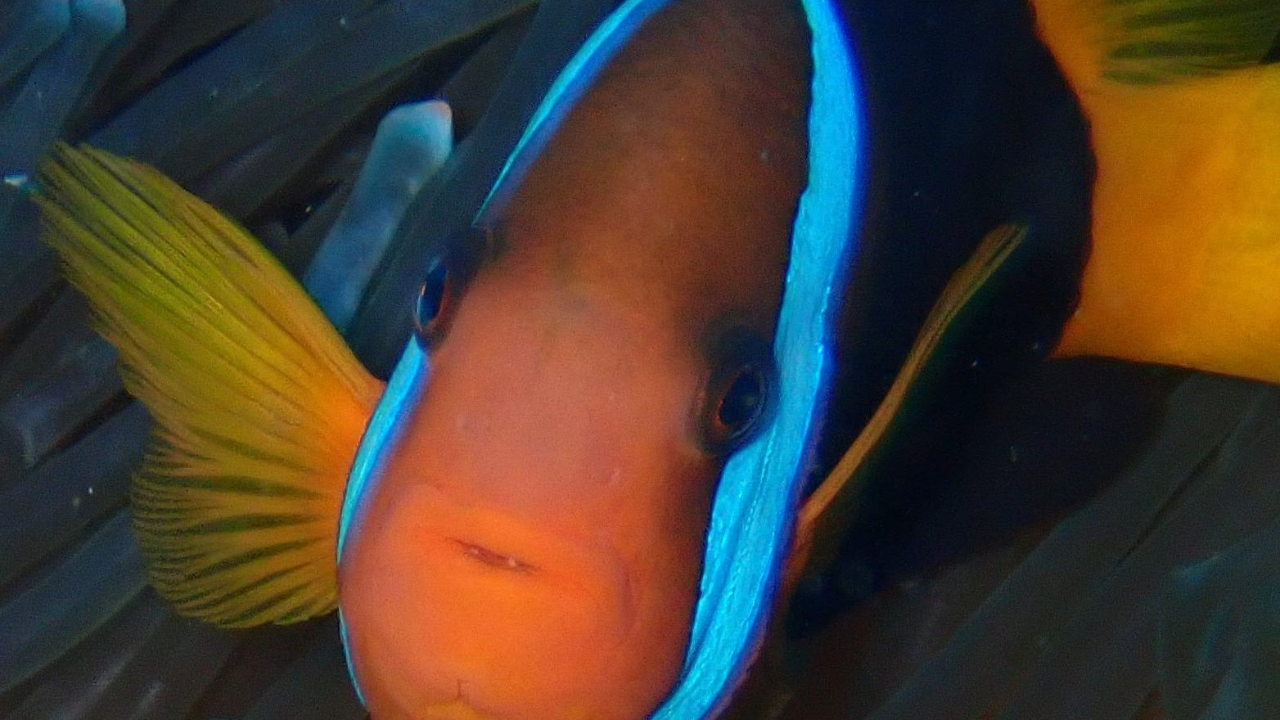
The “locals”

Slide 56
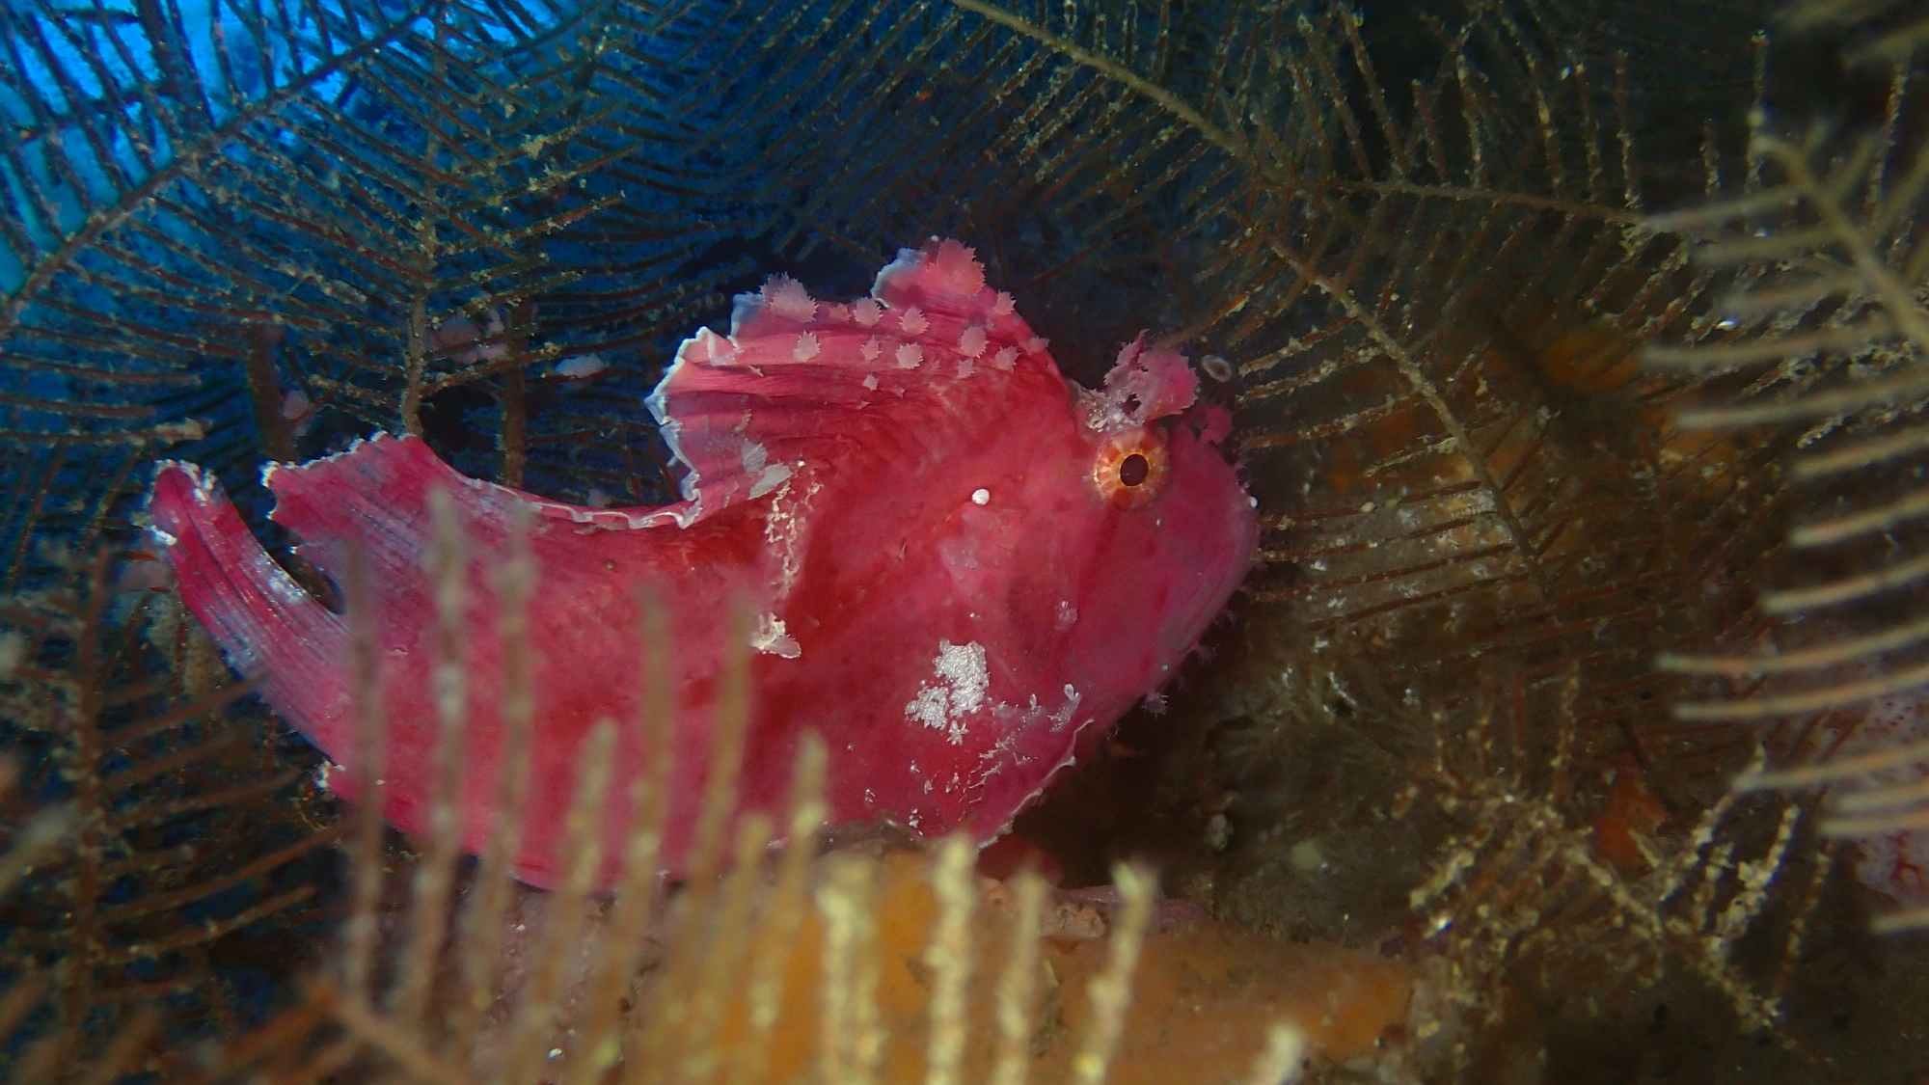

Slide 57
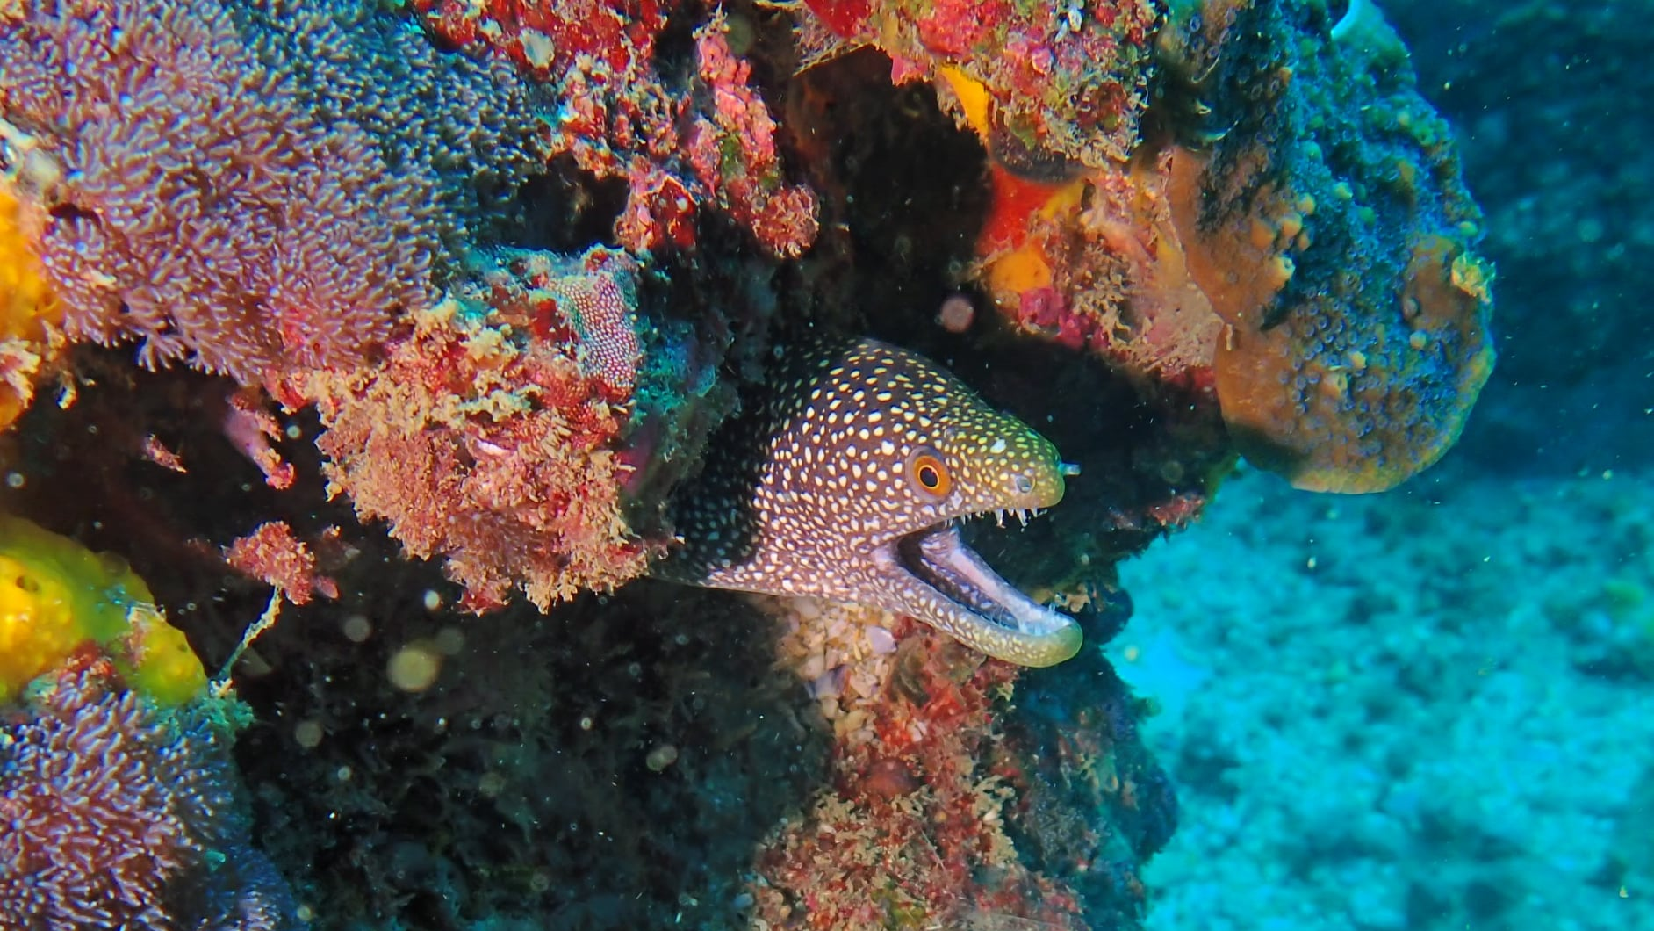

Slide 58
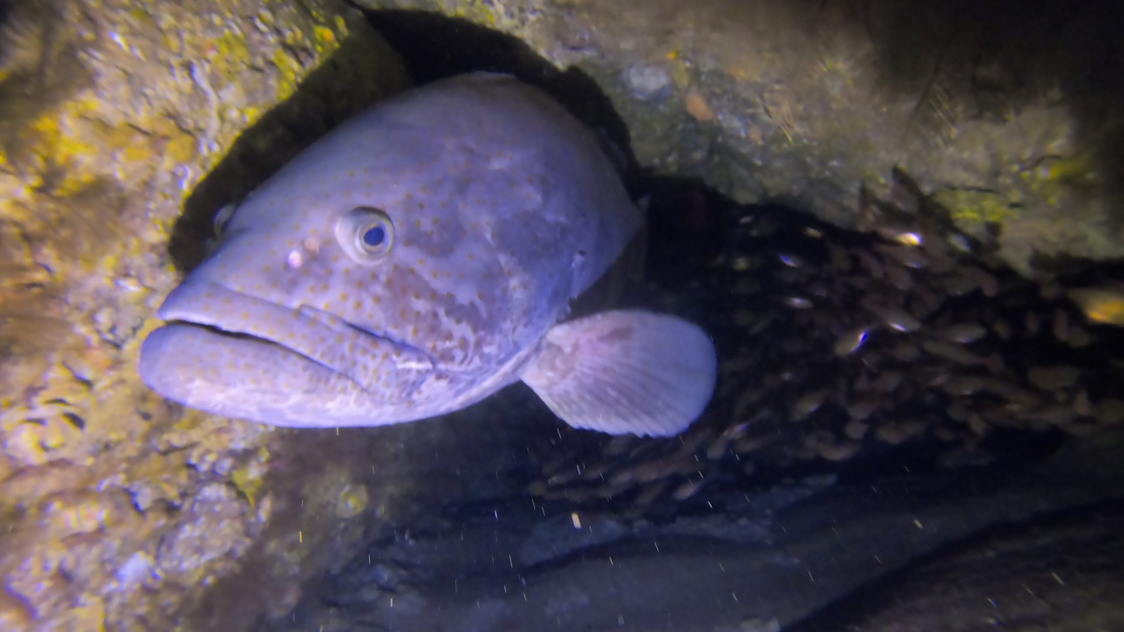

Slide 59
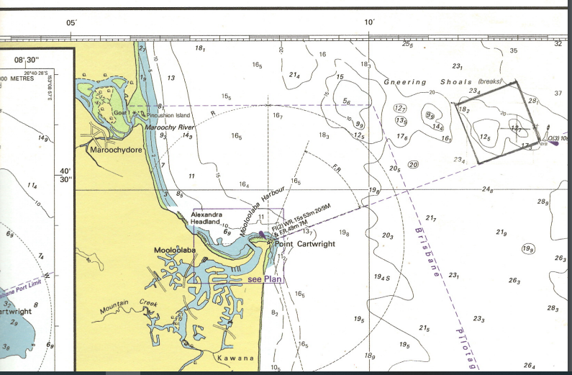
Wobby Rock

Slide 60
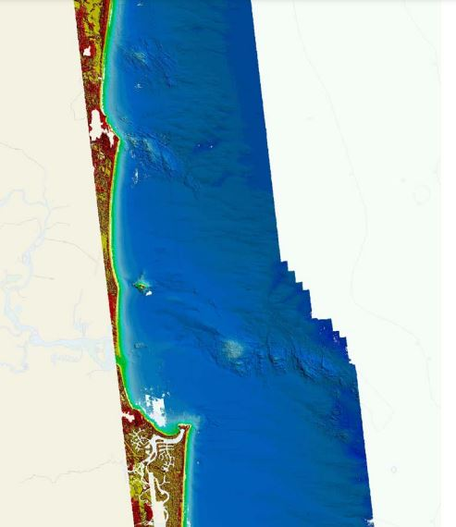
Already protected (no-take green zone)
HMAS
Protected site proposal made by local divers to a local politician (who said he would only support it if he had the support of local fishers)
GNS
(1x1nm)

Slide 61
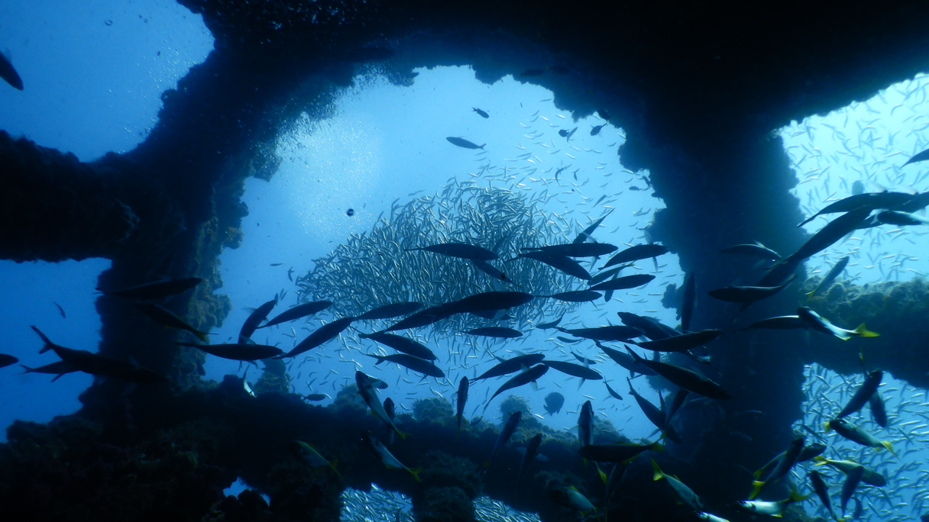
HMAS Brisbane (protected)

Slide 62
Spill over Effect
Local divers argued the MPA would benefit fishers due to the spill-over effect…
GNS
(1x1nm)

Slide 63
REEFS for FISHING
…restocking all the other great fishing spots in the area (indicated in yellow)
GNS
(1x1nm)

Slide 64
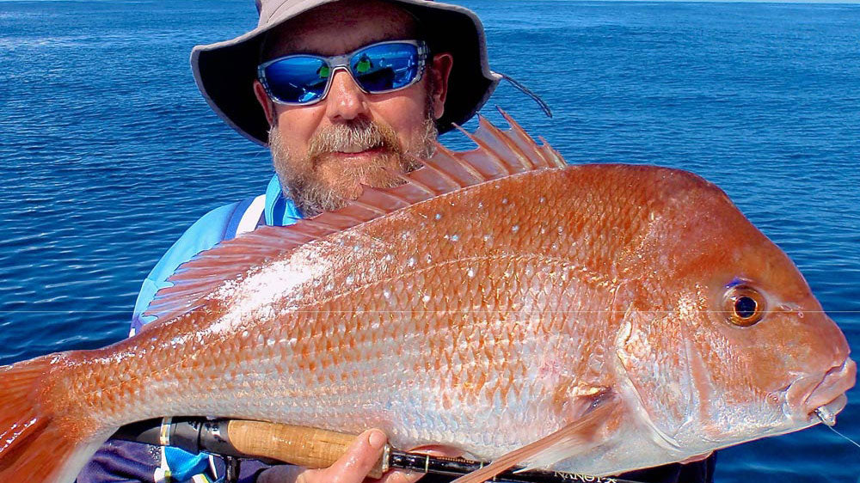
Mooloolaba
The name Mooloolaba is thought to have derived from
‘’Mulu” meaning snapper fish or
“Mullu” meaning red bellied black snake
(Sunshine Coast Council – Heritage, 2022)

Slide 65


Slide 66






Slide 67


This information was current in 2024
Has anything happened since then?
E.g. new recovery plan for GNS?
Notes:
2014 Recovery Plan: https://www.dcceew.gov.au/environment/biodiversity/threatened/recovery-plans/recovery-plan-grey-nurse-shark-carcharias-taurus-2014

Slide 68

Learning Intention:
Interpret data related to the marine environmental planning and management process
Success Criteria:
Complete Marine Education worksheet
‘Research Investigation
Notes:
Image: https://edition.cnn.com/2022/11/02/world/gallery/fish-rock-shalise-leesfield-c2e-spc-intl-scn/index.html
Despite their terrifying toothy grin, grey nurse sharks are mostly harmless to humans. Due to loss of habitat and overfishing, the species is in decline and listed as critically endangered by the IUCN.

