Slide 1
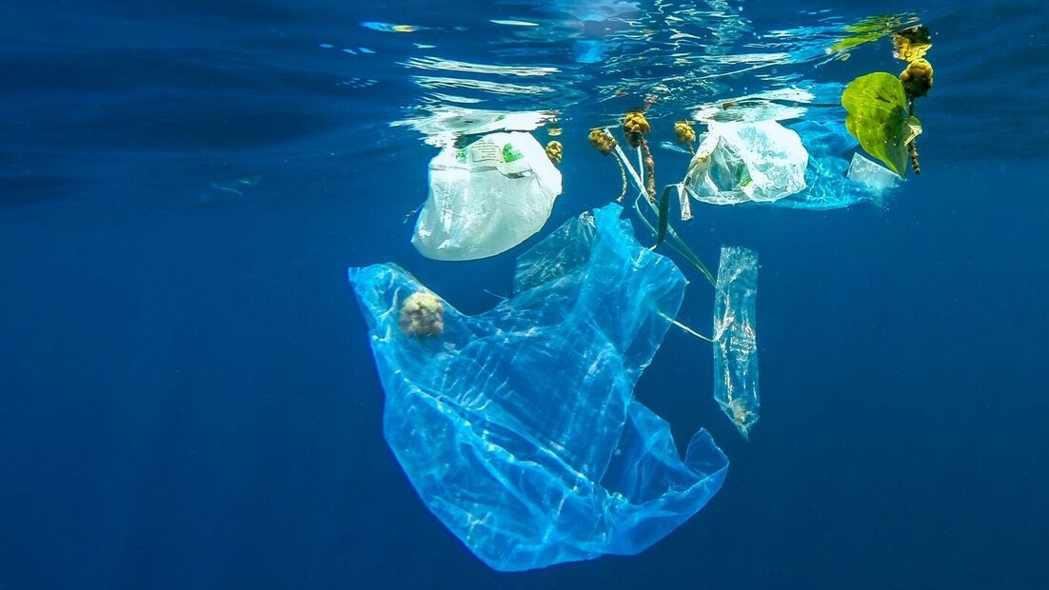
Learning Intention:
Appreciate that marine debris accumulation is a global phenomenon (e.g. ‘The Great Pacific Garbage Patch’). Consider how the causes and solutions (i.e. the use of scientific knowledge) of this issue are influenced by social, economic, cultural and ethical considerations
Success Criteria:
Complete Marine Education worksheet ’13. Dodgy debris’
Notes:
https://www.unep.org/regions/north-america/regional-initiatives/tackling-marine-debris

Slide 2
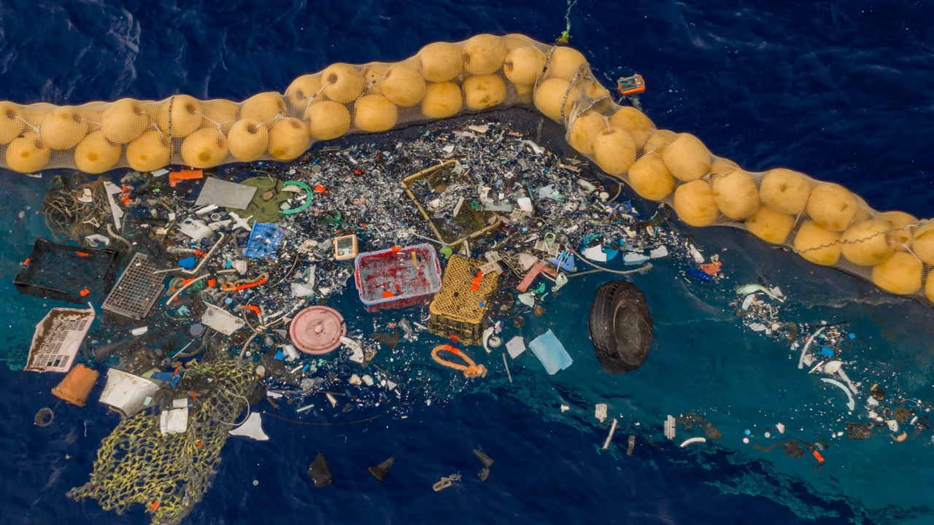
A garbage collector floating through the Great Pacific Garbage Patch. Photo: The Ocean Cleanup

Slide 3
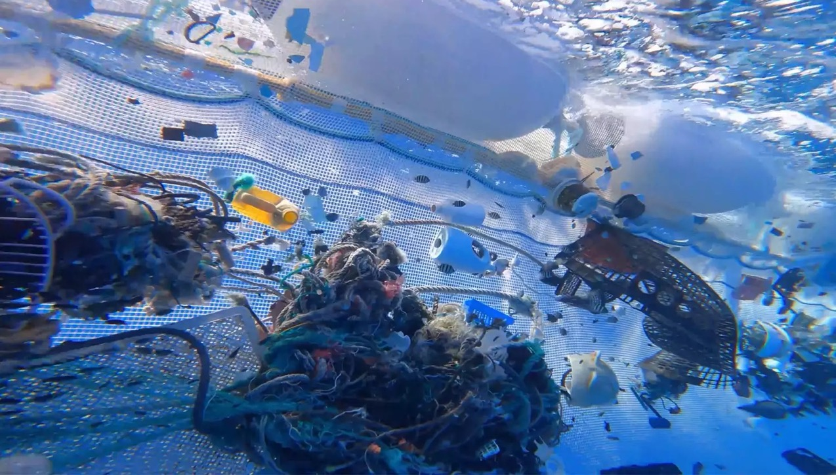
Image: The Ocean Cleanup
Notes:
https://people.com/human-interest/great-pacific-garbage-patch-vast-home-sea-creatures/

Slide 4
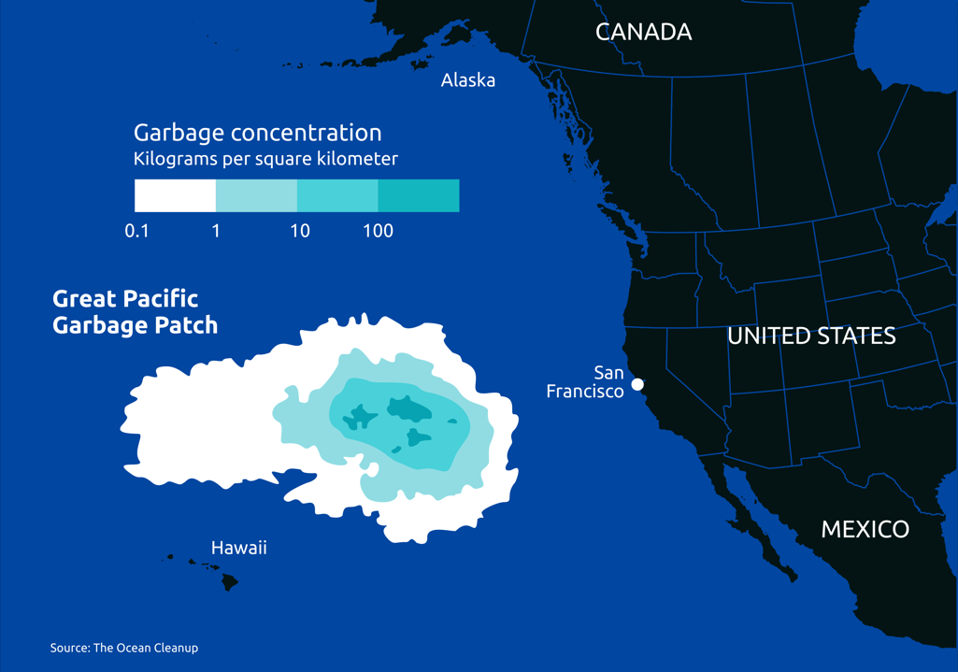
The Great Pacific Garbage Patch
Notes:
https://www.reddit.com/r/dataisbeautiful/comments/w7q2dr/the_size_and_location_of_the_great_pacific/

Slide 5
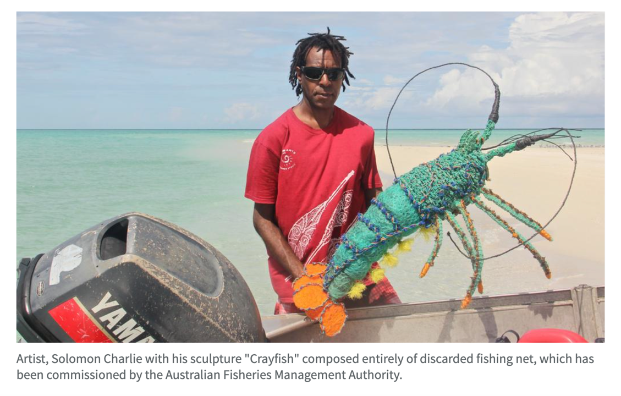

Slide 6
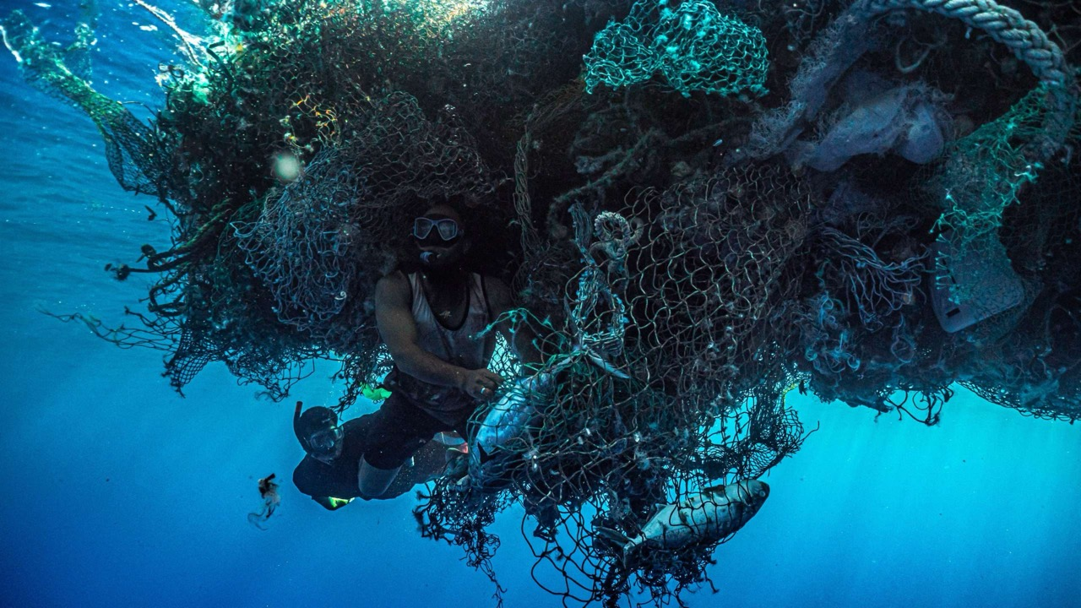

Slide 7
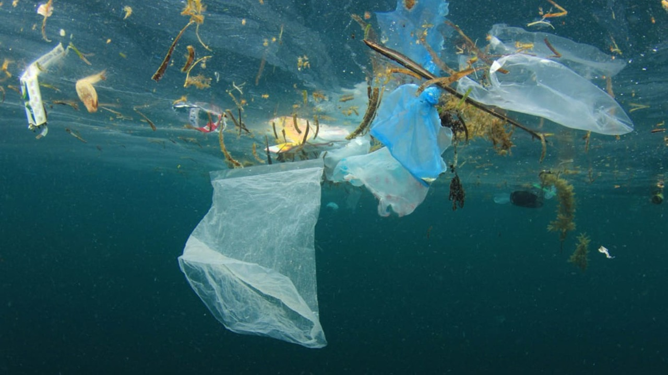

Slide 8
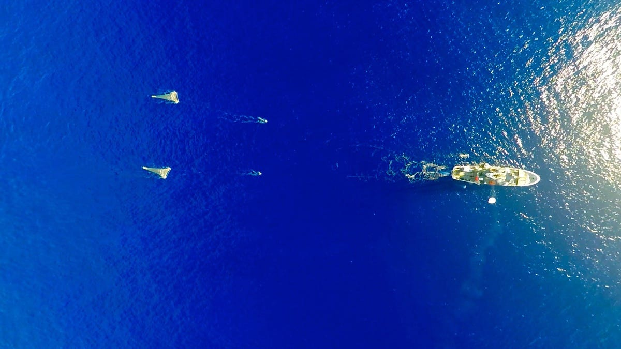
A Dutch-led research expedition brought in netfuls of plastic—and counted them all. About 46% of the total mass of the patch is made up of discarded fishing gear. The rest is trillions of pieces consumer plastic, swept off land and into the sea. Image: The Ocean Cleanup
Notes:
https://qz.com/1234953/we-underestimated-the-size-of-the-great-pacific-garbage-patch-by-16-times

Slide 9
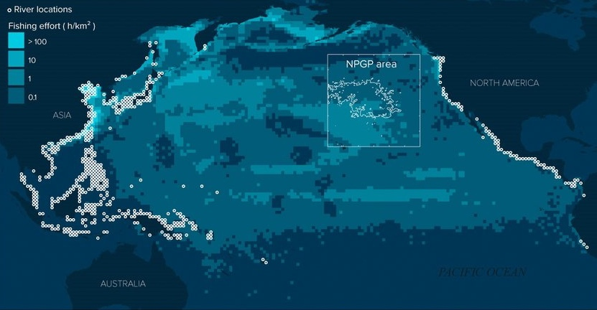

Floating plastic debris in the Great Pacific Garbage Patch (white square) came from either river mouth locations (white circles) or observed fishing grounds (light colours).
Notes:
https://www.researchgate.net/publication/363195772_Industrialised_fishing_nations_largely_contribute_to_floating_plastic_pollution_in_the_North_Pacific_subtropical_gyre?_tp=eyJjb250ZXh0Ijp7ImZpcnN0UGFnZSI6Il9kaXJlY3QiLCJwYWdlIjoiX2RpcmVjdCJ9fQ

Slide 10
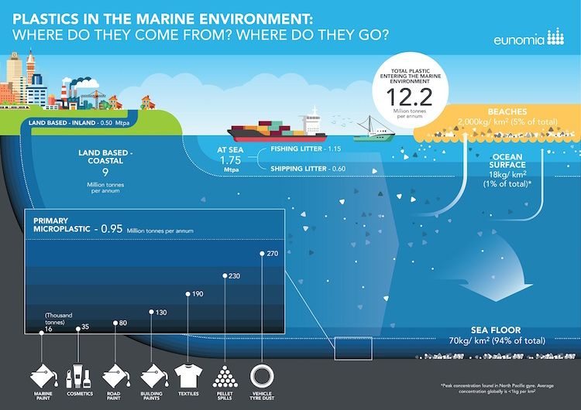
Most plastic in the ocean (roughly 80%) is
land-based
The rest is marine based, mainly fishing nets.
1% is on the surface
94% is on the seafloor
Notes:
https://www.ecowatch.com/80-of-ocean-plastic-comes-from-land-based-sources-new-report-finds-1891173457.html

Slide 11
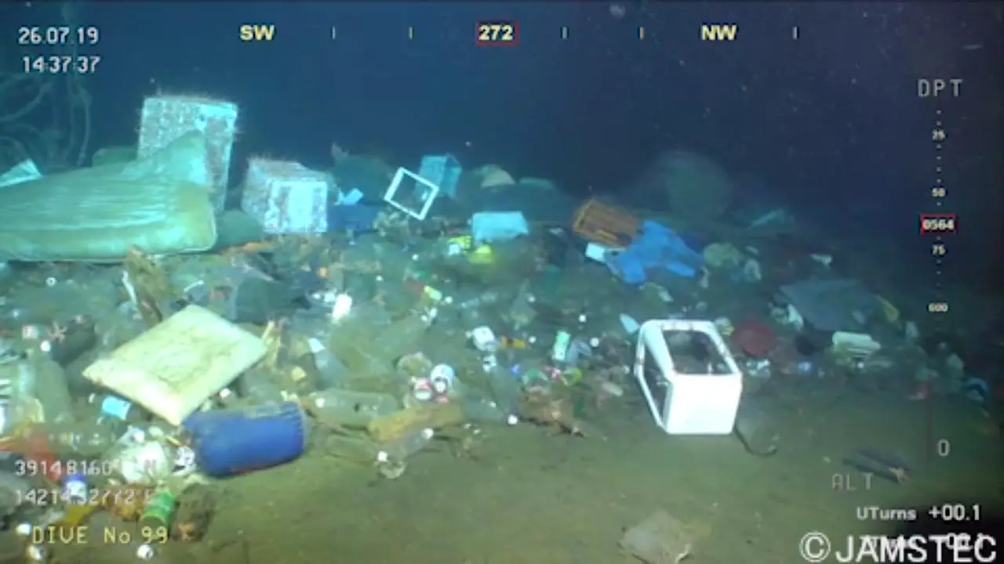
Marine litter ten years after the great 2011 tsunami in Japan. Credit: JAMSTEC [De S. Chiba]
Notes:
https://scitechdaily.com/a-sea-of-garbage-ocean-floor-landfills/

Slide 12
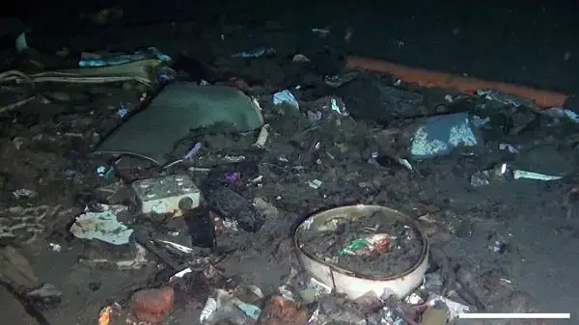
A litter hotspot at 415 m depth in the Strait of Messina, Mediterranean Sea.
Credit: M. Pierdomenico D. Casalbore and F. Chiocci/National Research Council/La Sapienza University in Rome
Notes:
https://scitechdaily.com/a-sea-of-garbage-ocean-floor-landfills/

Slide 13
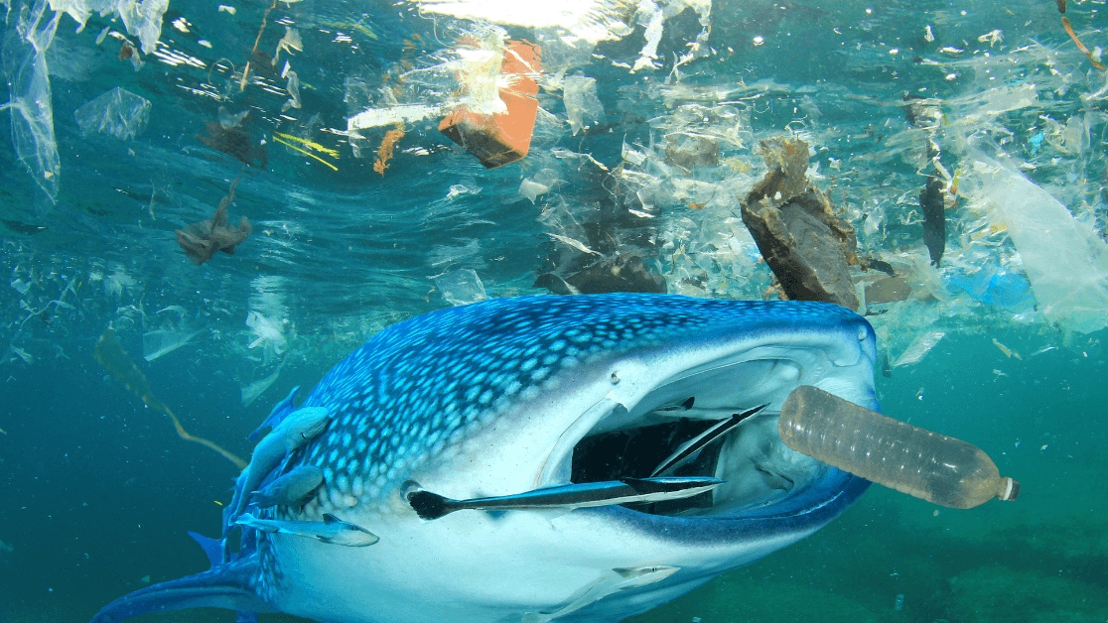
Notes:
https://www.marineinsight.com/shipping-news/mysterious-plastic-objects-found-in-a-45-day-long-sweep-of-the-great-pacific-garbage-patch/

Slide 14
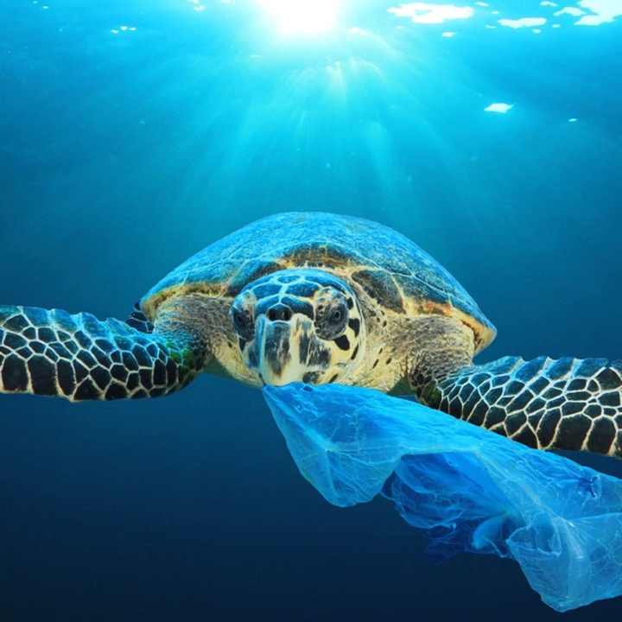
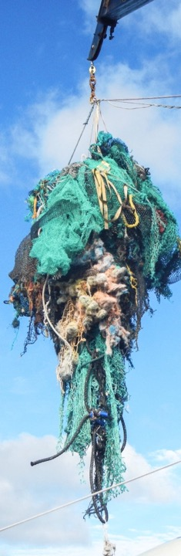
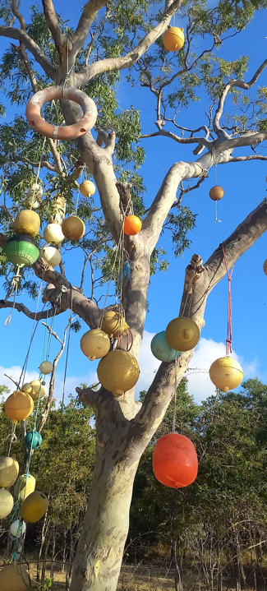
Turtles mistake plastic bags for their favourite food - jellyfish
Great Keppel Island
Notes:
https://www.popsci.com/garbage-patch-pacific-plastic-debris-growing/

Slide 15
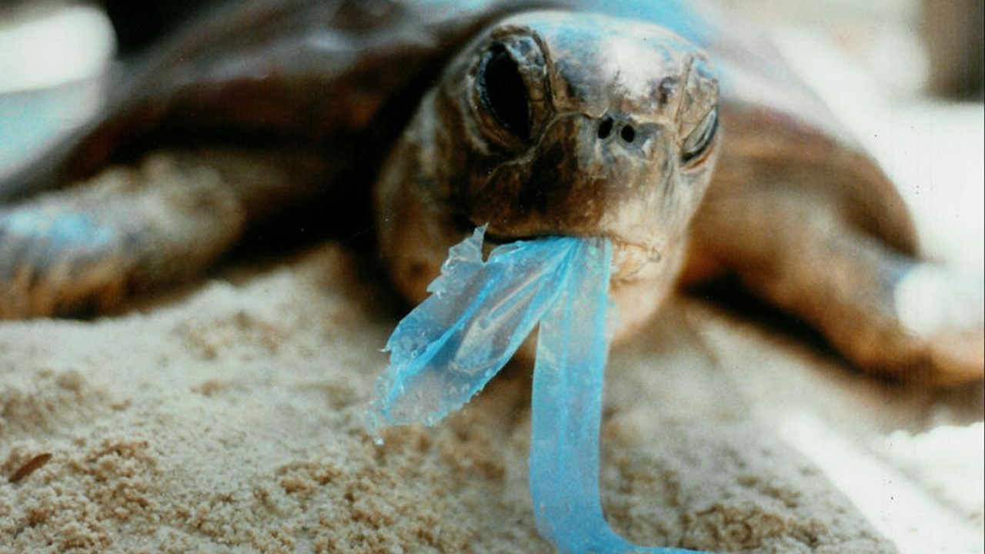

Slide 16
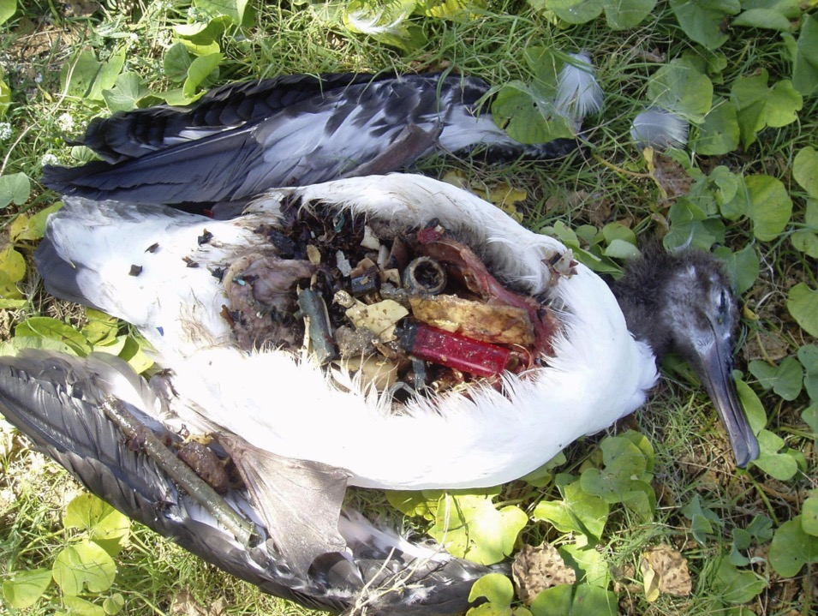
Plastic waste in the belly of a Laysan albatross in Hawaii.
About 40% of the world's seabirds have toxic substances in their bodies due to plastic waste.
Notes:
https://www.japantimes.co.jp/news/2018/09/29/national/science-health/40-worlds-seabirds-toxic-substances-bodies-due-plastic-waste-research-japanese-universities-shows/

Slide 17
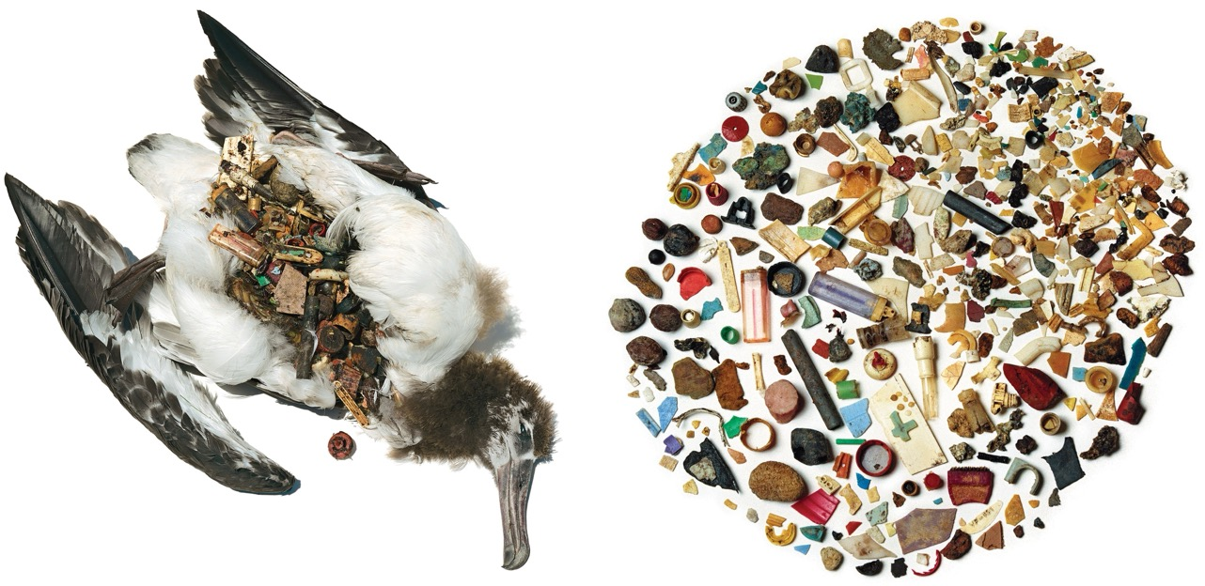
This juvenile Laysan Albatross died from 12 ounces of indigestible items, mostly plastic debris.
Photo: David Liittschwager and Susan Middleton
Notes:
https://www.audubon.org/news/99-percent-seabird-species-could-be-tainted-plastic-2050-science-says

Slide 18
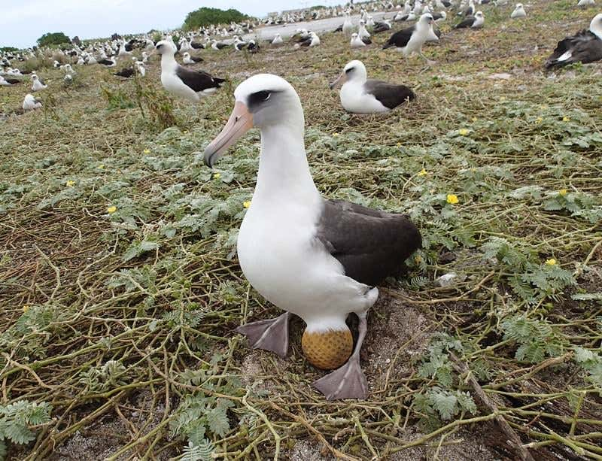
This Laysan albatross is sitting on a golf ball, likely swept in from the Great Pacific Garbage Patch.
Image: Greg Schubert/USFWS
Notes:
https://www.newscientist.com/article/dn25656-plastic-rubbish-takes-eggs-place-in-albatross-nest/

Slide 19
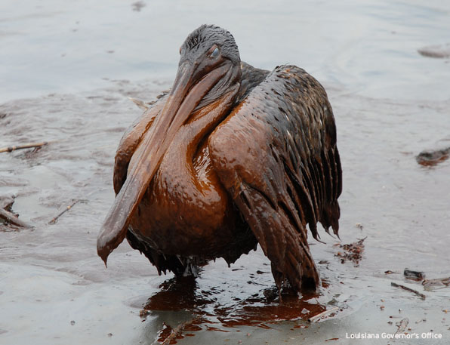
Thousands of birds were killed by the BP Deepwater Horizon Oil Spill in Mexico.

Slide 20
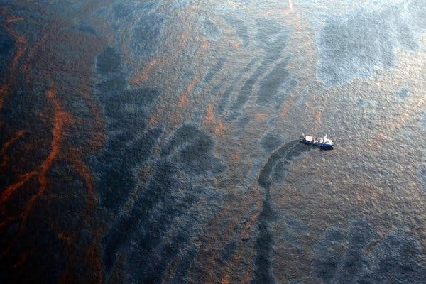
A boat tried to collect oil from the spill on the Gulf of Mexico in April 2010.
Notes:
https://www.nytimes.com/2020/04/19/climate/deepwater-horizon-anniversary.html

Slide 21
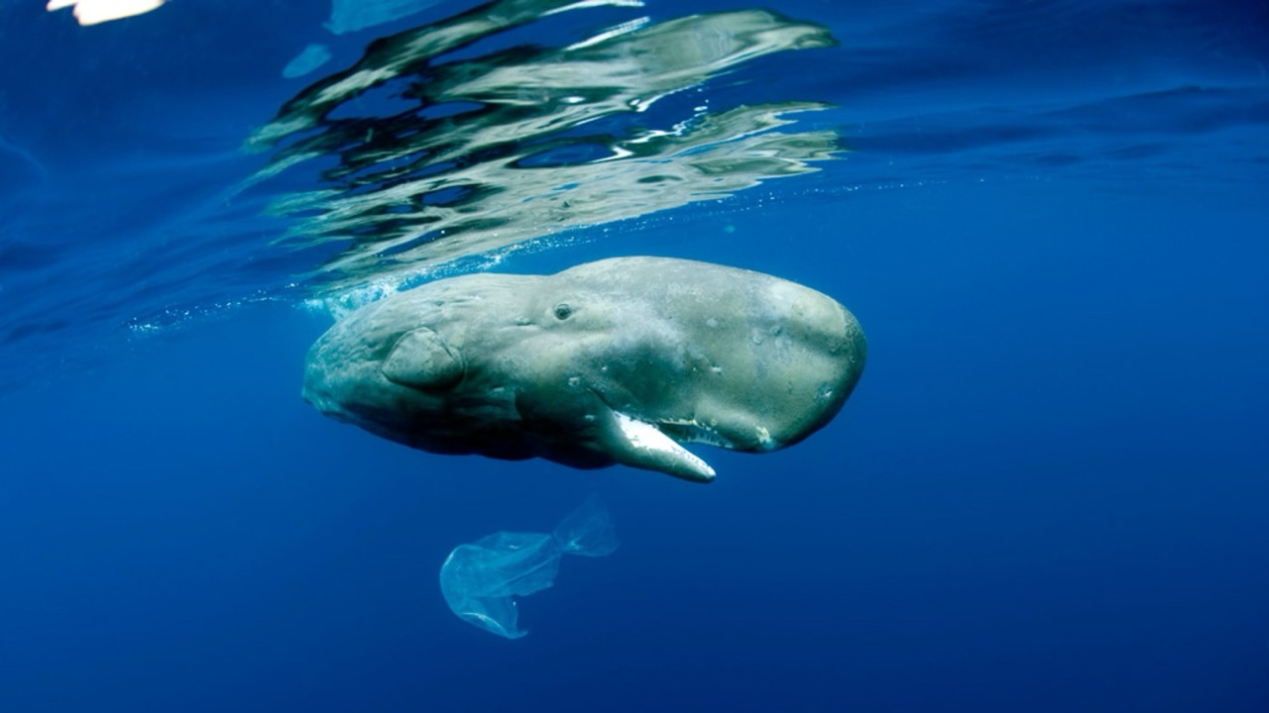
Image: naturepl.com / Franco Banfi / WWF
Notes:
https://wwf.org.au/blogs/plastic-in-our-oceans-is-killing-marine-mammals/

Slide 22
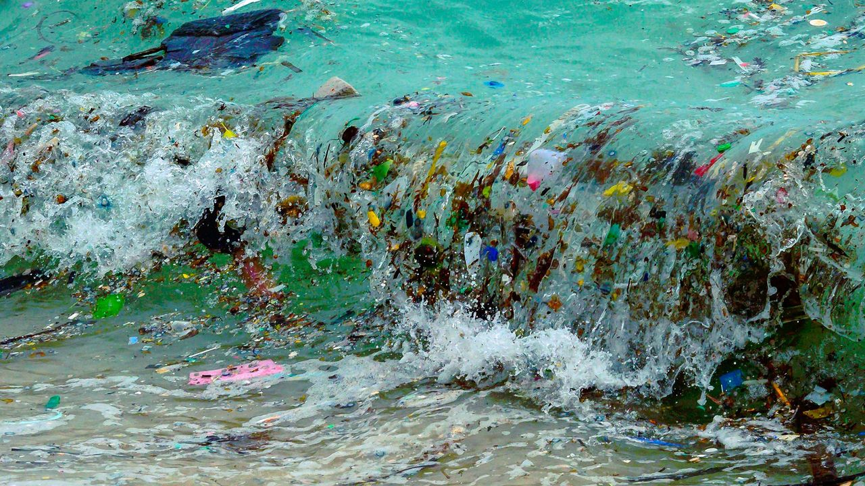
Notes:
https://www.bbc.com/future/article/20220930-the-ocean-gyres-creating-huge-new-plastic-patches

Slide 23
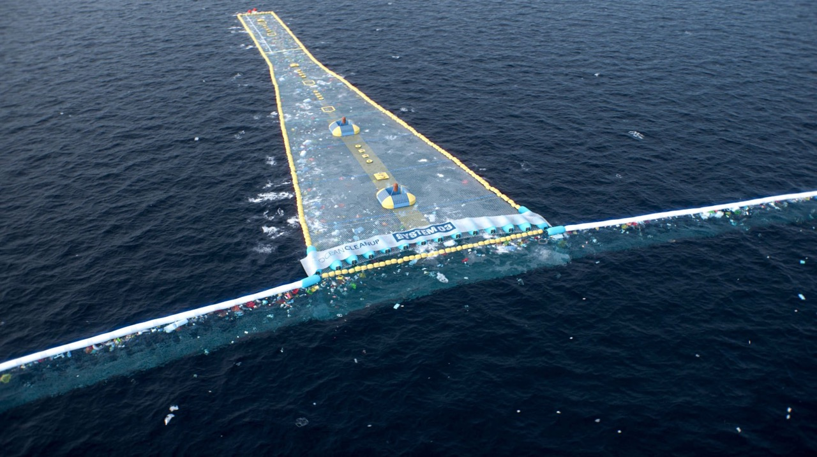
The Ocean Cleanup – started by yr11 student assignment
Notes:
https://www.thisiscolossal.com/2022/09/ocean-cleanup-system-03/

Slide 24
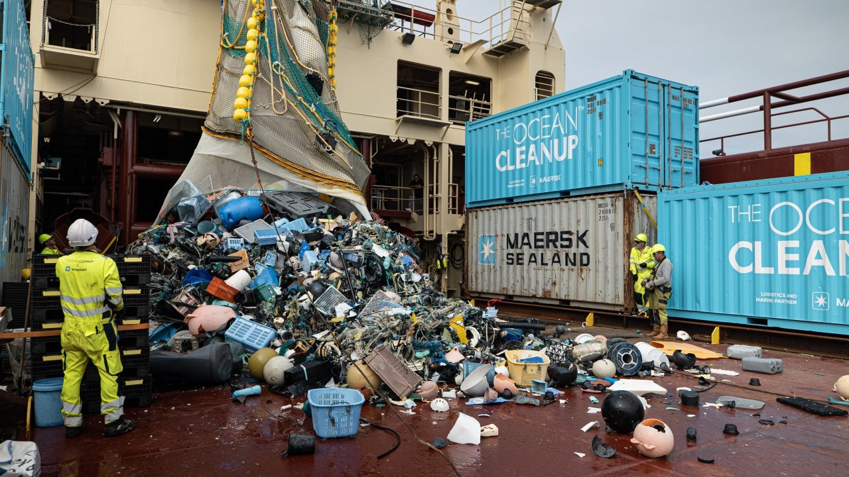

Slide 25
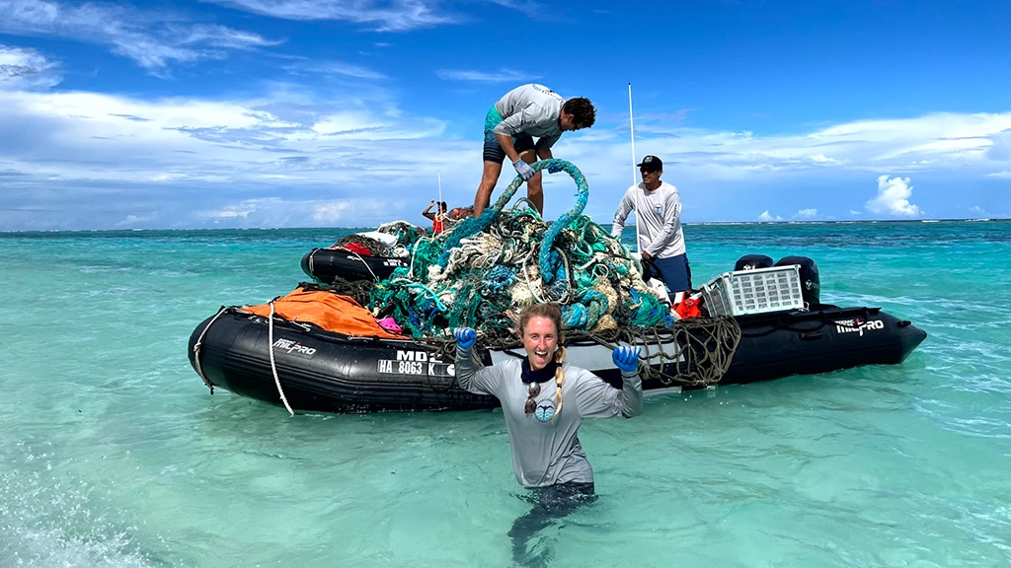
Locals, taking on the challenge
Notes:
https://www.ibsscorp.com/resources/another-marine-debris-cleanup-is-underway

Slide 26
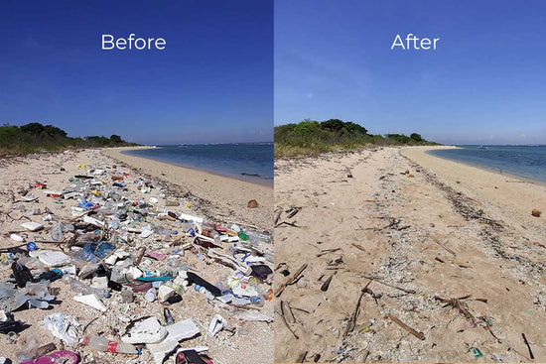
Host a community clean-up.
Combine with a marine debris survey.
Notes:
https://www.4ocean.com/blogs/live-the-mission/how-to-organize-a-community-beach-cleanup

Slide 27
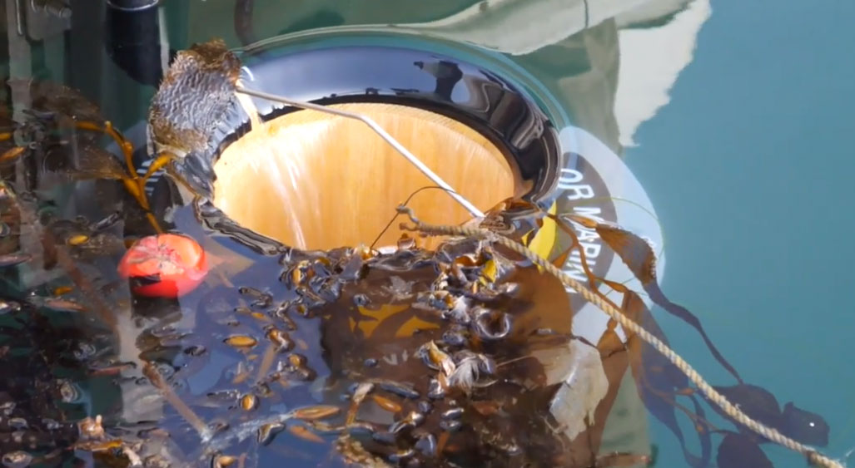
Seabin Project – trapping floating plastics in port
Notes:
https://www.nautilusint.org/en/news-insight/telegraph/seabin-project-trapping-floating-plastics-in-port/

Slide 28
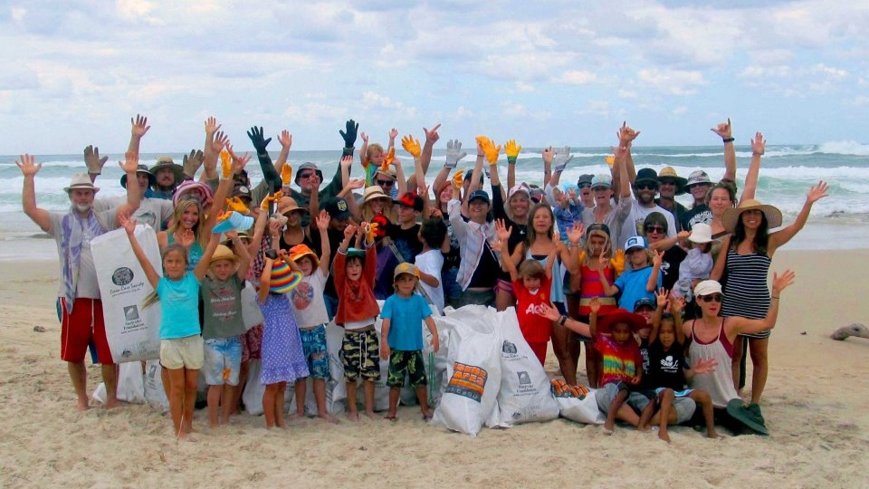

Since the Tangaroa Blue program started in 2004, more than 23 million pieces of marine debris have been removed from the Australian coastline and data on this debris collated and inputted into the Australian Marine Debris Initiative Database.
Notes:
https://www.tangaroablue.org/about-us/

Slide 29
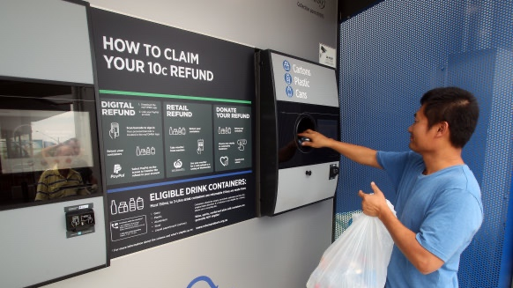
Notes:
https://www.theage.com.au/politics/victoria/ten-cent-cash-for-can-refunds-from-2023-victoria-unveils-container-deposit-scheme-20210414-p57j64.html

Slide 30
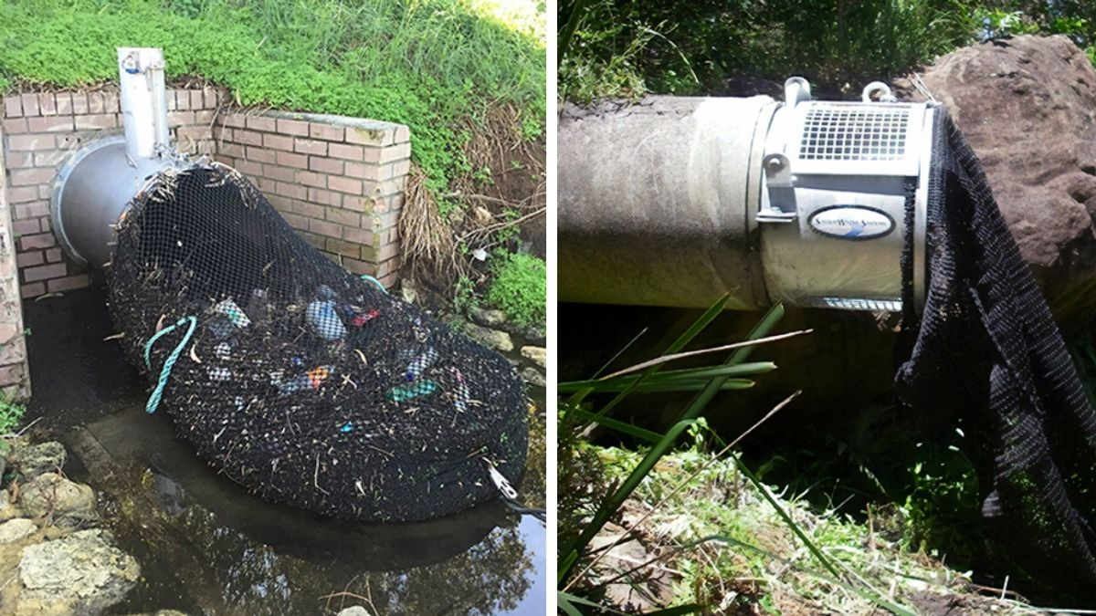
Kwinana has put nets on the outlet of drainage pipes.
Notes:
https://interestingengineering.com/innovation/australian-city-uses-drainage-nets-to-stop-waste-from-polluting-waterways Source: City of Kwinana

Slide 31
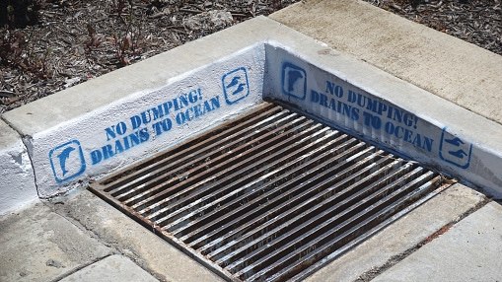

Slide 32

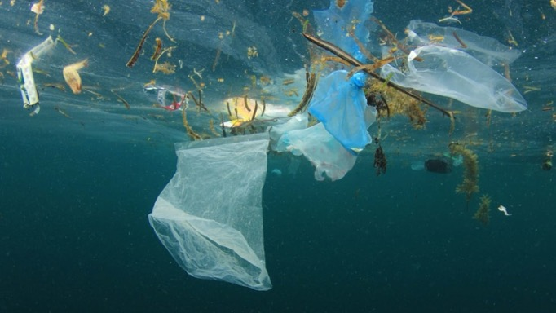
Ethical?
Yes or No?
CAUSE?
Socially Acceptable?
Yes or No?

Slide 33
Economical?
Yes or No?
CAUSE?
Part of our culture in Australia?
Yes or No?

Slide 34


Ethical?
Yes or No?
SOLUTION
Socially Acceptable?
Yes or No?

Slide 35
Economical?
Yes or No?
SOLUTION
Part of our culture in Australia?
Yes or No?

Slide 36


Economic incentives
Notes:
https://www.facebook.com/theblendwhanganui/photos/a.270093303514599/597050094152250/?type=3

Slide 37
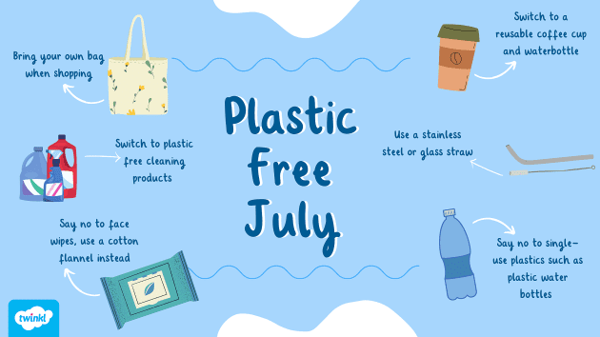
Notes:
https://www.twinkl.com.au/blog/lets-talk-about-going-plastic-free-this-july

Slide 38
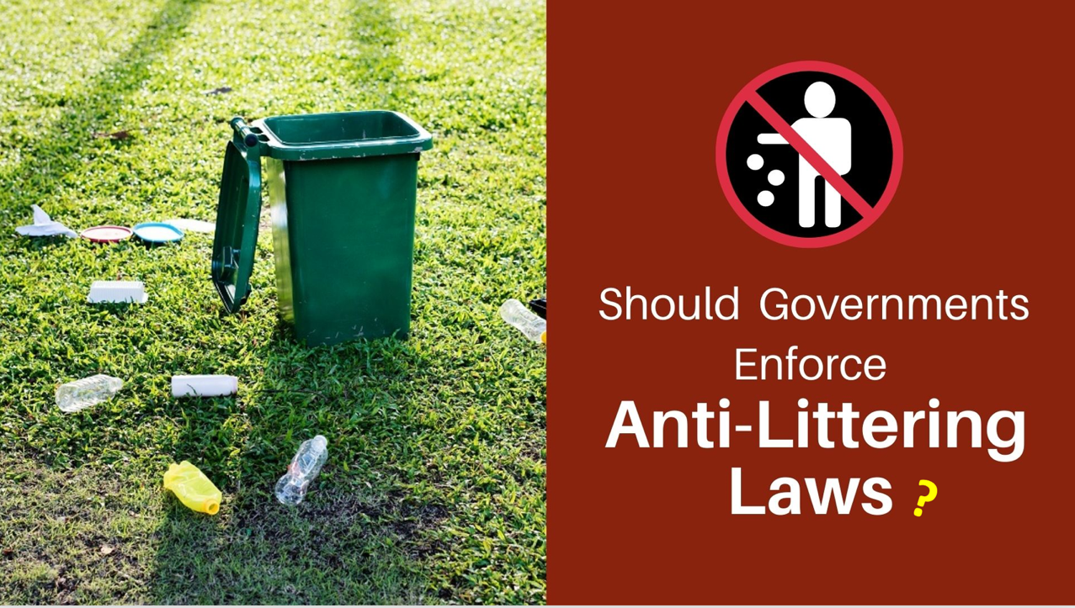
Notes:
https://www.actionforrenewables.org/governments-should-enforce-anti-littering-laws/

Slide 39
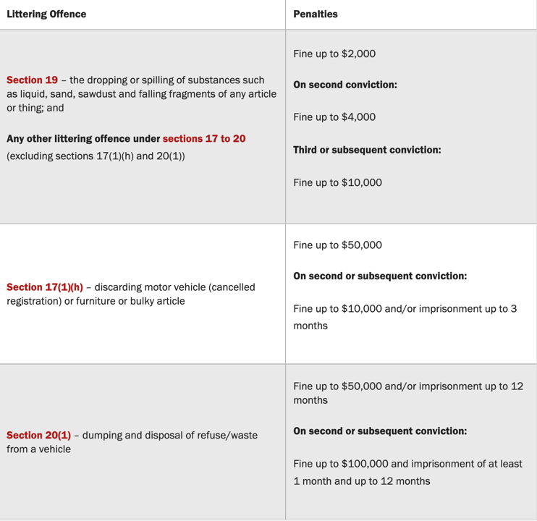
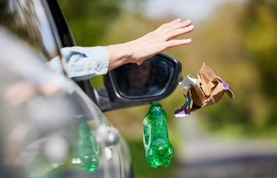
Do not litter in Singapore!
Singapore takes it very seriously.
The city is however very clean.
“Dumping and disposal of refuse/waste from a vehicle –
Fine up to $50,000 and/or imprisonment up to 12 months”.

Slide 40
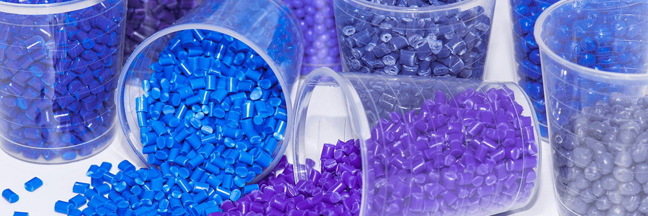
Plastic
Notes:
https://plasquit.wordpress.com/2019/08/14/history-of-plastic/

Slide 41
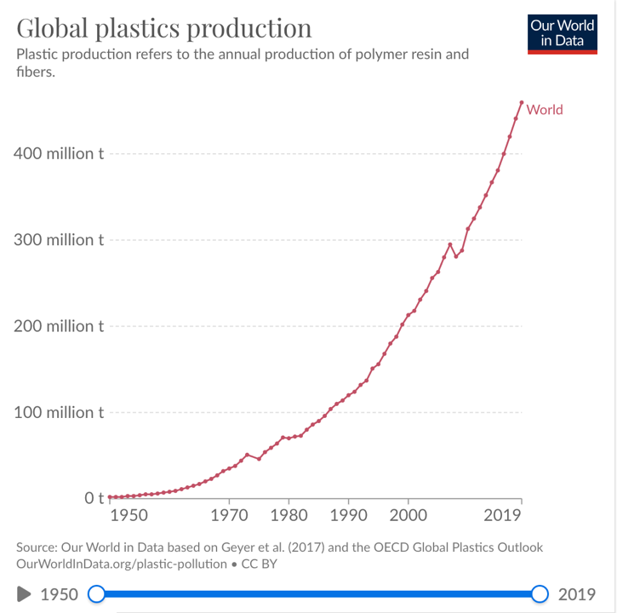
Plastic fantastic: How it changed the world.
In little more than a century, plastic has gone from being hailed as a scientific wonder to being reviled as an environmental scourge.
Notes:
https://ourworldindata.org/plastic-pollution

Slide 42
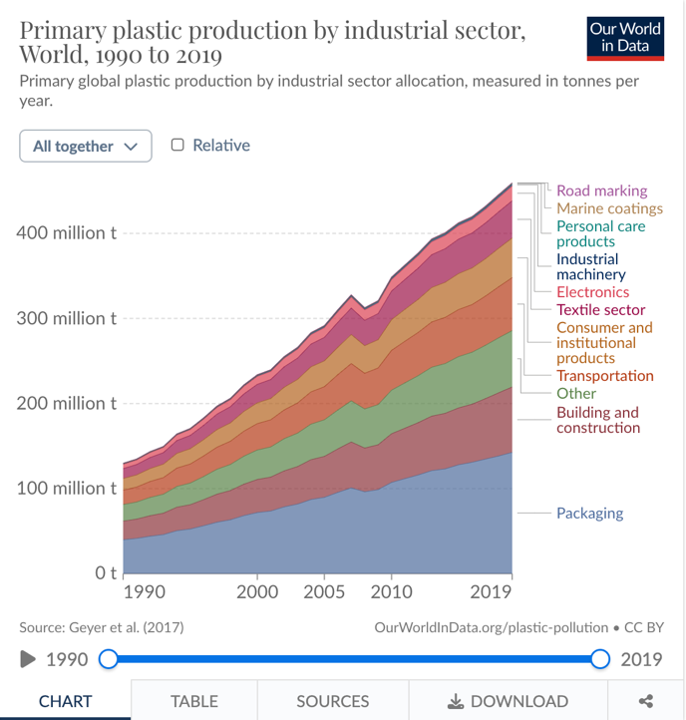
Almost half
of plastic made
is used for
Packaging
Notes:
https://ourworldindata.org/grapher/plastic-fate-to-2050

Slide 43
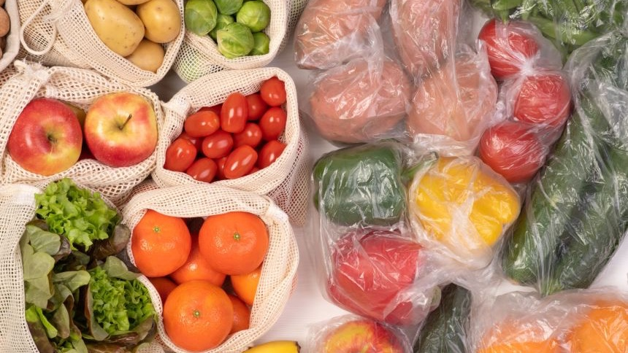

Slide 44
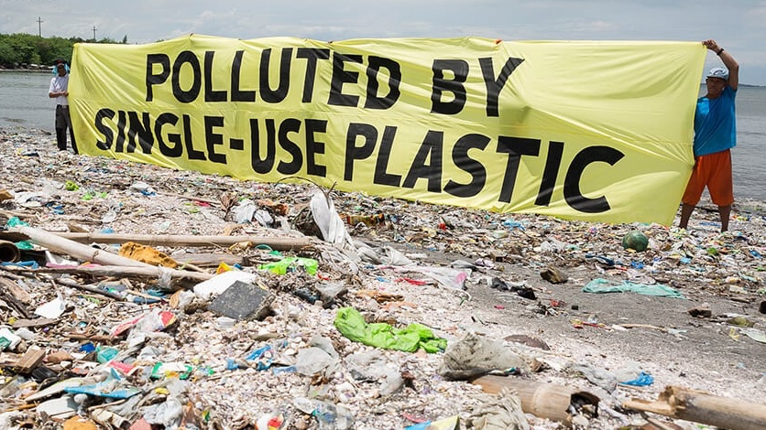
Notes:
https://www.greenpeace.org/usa/oceans/preventing-plastic-pollution/

Slide 45
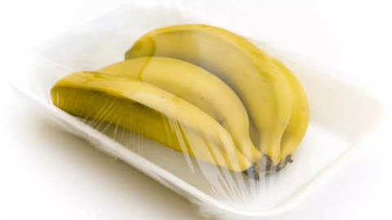

Slide 46
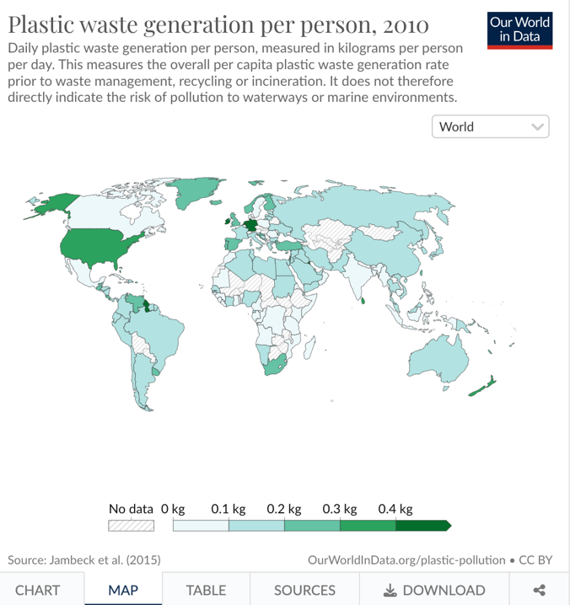
The Germans
Americans and
New Zealanders
(and a little country in Africa called Guyana)
generate the most plastic waste
in kg, per person, per day.

Slide 47
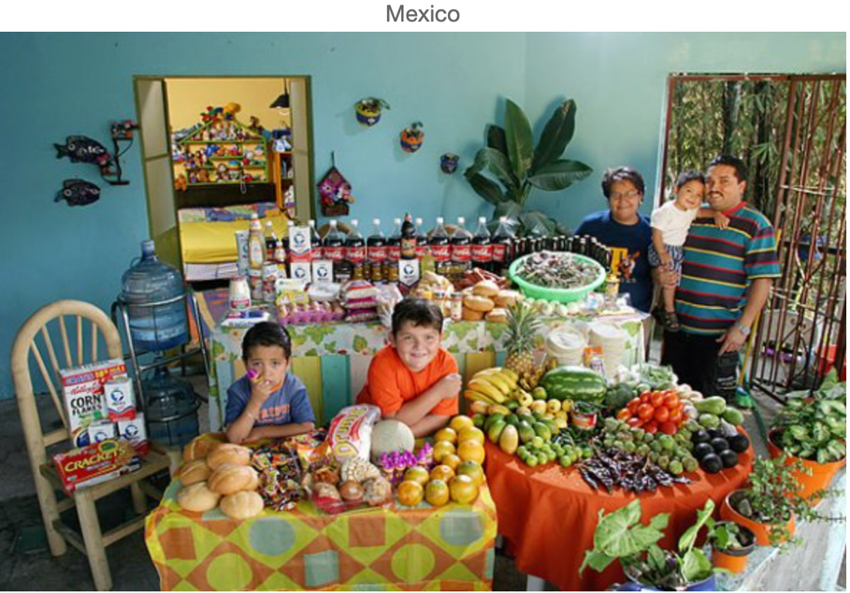
What A Week Of Groceries Looks Like Around The World
Notes:
https://fstoppers.com/food/what-week-groceries-looks-around-world-3251

Slide 48
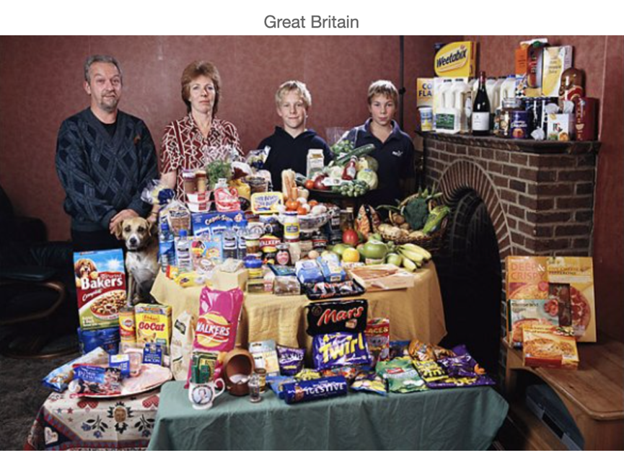
What A Week Of Groceries Looks Like Around The World
Notes:
https://fstoppers.com/food/what-week-groceries-looks-around-world-3251

Slide 49
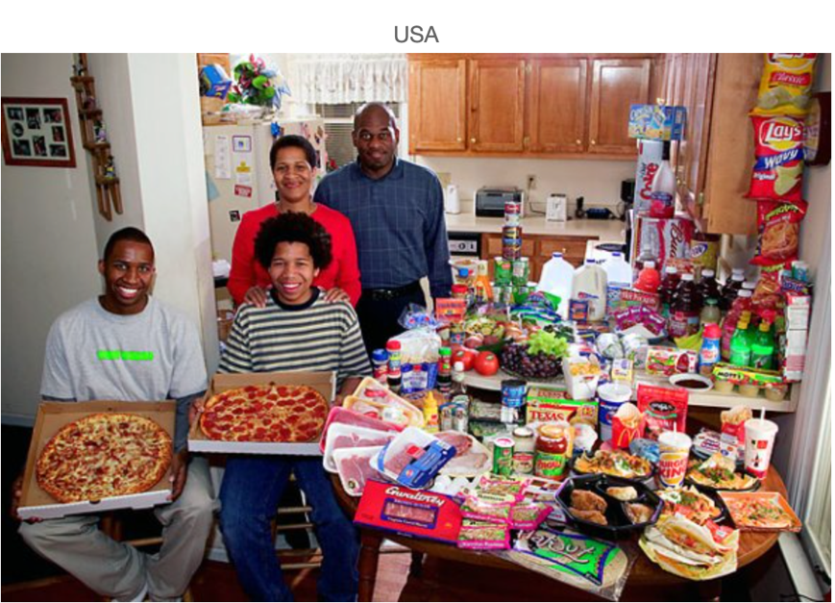
What A Week Of Groceries Looks Like Around The World
Notes:
https://fstoppers.com/food/what-week-groceries-looks-around-world-3251

Slide 50
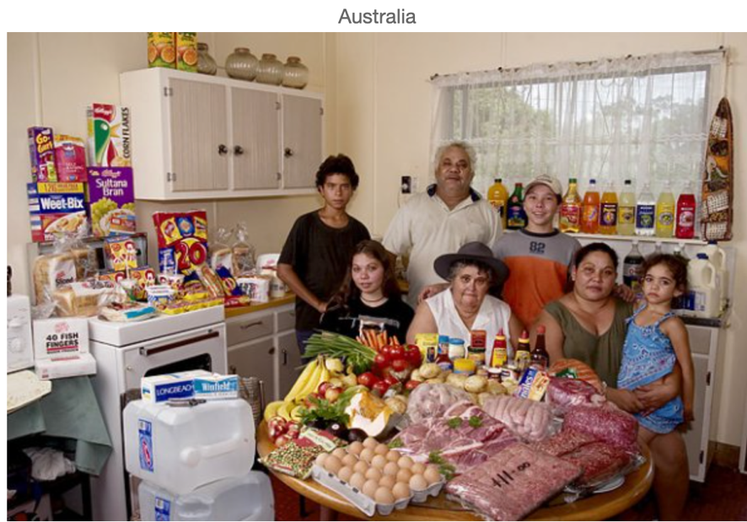
What A Week Of Groceries Looks Like Around The World
Notes:
https://fstoppers.com/food/what-week-groceries-looks-around-world-3251

Slide 51
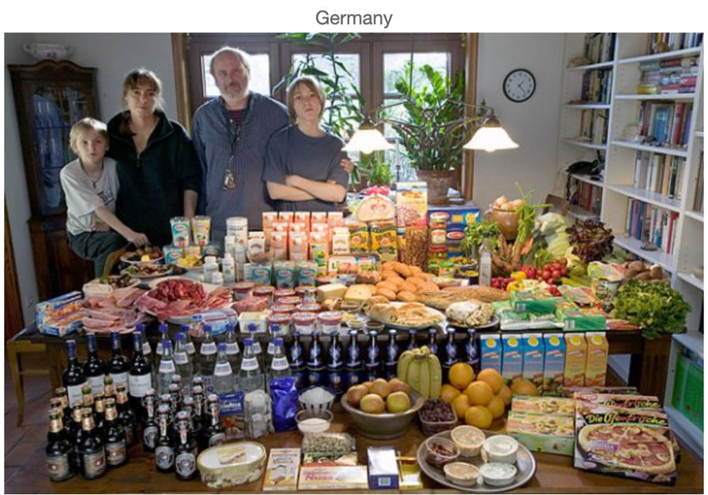
What A Week Of Groceries Looks Like Around The World
Notes:
https://fstoppers.com/food/what-week-groceries-looks-around-world-3251

Slide 52

What A Week Of Groceries Looks Like Around The World
Notes:
https://fstoppers.com/food/what-week-groceries-looks-around-world-3251

Slide 53

What A Week Of Groceries Looks Like Around The World
Notes:
https://fstoppers.com/food/what-week-groceries-looks-around-world-3251

Slide 54

When we’re finished with it,
almost half goes to landfill
Notes:
https://ourworldindata.org/plastic-pollution

Slide 55

Where it is buried
Notes:
https://wastech.com.au/

Slide 56

or not…
In this picture taken on June 3, 2023, a wild elephant eats rubbish mixed with plastic waste near cows at a dump in Ampara, Sri Lanka. — AFP pic

Slide 57

Of the 5800 million tonnes of primary plastic no longer in use,
only 9% has been recycled since 1950.
(in Australia, that number is much higher)

Slide 58

Before 2020,
50-60% of plastics collected for recycling in Australia was sent to Southeast Asia
(In March 2020, Australian governments began regulating the export of plastic by introducing rules and regulations to fill Australia’s obligations under the Basel Convention on the Control of Transboundary Movements of Hazardous Wastes and their Disposal).
Notes:
https://www.dcceew.gov.au/environment/protection/waste/exports/plastic
https://www.maribyrnong.vic.gov.au/Residents/Bins-and-recycling/Recycling-bins

Slide 59

China banned the import of all types of plastic waste in January 2018.
This power move, however, merely redirected waste containers further afield, mainly to the Southeast Asian countries of Malaysia, Vietnam, Thailand, Indonesia and the Philippines.
Notes:
https://borgenproject.org/addressing-open-dumpsites/

Slide 60

Vietnam
50-60% of plastics collected for recycling in Australia are sent to Southeast Asia for processing
Thailand
Indonesia
China
Malaysia
Notes:
https://www.brinknews.com/what-happens-to-australias-plastic-waste/

Slide 61

Notes:
https://www.theaustralian.com.au/subscribe/news/1/?sourceCode=TAWEB_WRE170_a_GGL&dest=https%3A%2F%2Fwww.theaustralian.com.au%2Fnation%2Fmalaysia-returns-australian-plastics%2Fnews-story%2F313e953bb46106941e60b39d8fe3a632&memtype=anonymous&mode=premium&v21=dynamic-high-test-score&V21spcbehaviour=appendend

Slide 62

Germany exported the most
plastic waste
in 2022
Notes:
https://www.statista.com/statistics/1357841/plastic-waste-export-volume-by-country/#:~:text=Germany%20was%20estimated%20to%20be,over%20734%20thousand%20metric%20tons.

Slide 63


Ethical?
Yes or No?
shipping waste from rich countries to poor countries
Socially Acceptable?
Yes or No?

Slide 64
Economical?
Yes or No?
shipping waste from rich countries to poor countries
Culturally accepted?
Yes or No?

Slide 65


Philippines (Pasig River)
emits the most plastic waste to the ocean.
Sri Lanka is second highest.
Followed by Indonesia, Brazil, India, Costa Rica, South Africa and China.
Philippines
Notes:
https://ourworldindata.org/plastic-pollution

Slide 66

Plastic will only enter rivers and the ocean if it’s poorly managed.
Notes:
https://kemiquewatersoluzione.com/2021/08/26/pasig-river-the-worlds-top-plastic-polluter/

Slide 67


Slide 68

Pasig River, Manila, Philippines
The 27km Pasig River,
which runs through Metro Manila, Philippines accounts for 63,000 tonnes
of plastic entering the ocean from a river
per year.
Notes:
http://dennisvillegas.blogspot.com/2009/03/estero-de-paco-views-from-polluted.html

Slide 69

A): Estero de Paco, Philippines before Rehabilitation
B): Estero de Paco, Philippines AFTER Rehabilitation
Notes:
https://www.researchgate.net/figure/A-Estero-de-Paco-before-Rehabilitation-B-Estero-de-Paco-after-rehabilitation-photo_fig1_335700653

Slide 70

It helps if we understand why the high polluting rivers emit
so much plastic
Notes:
https://www.fiftyshadesgreener.ie/blog/waste-out-of-sight-out-of-mind-2

Slide 71

Waste management is expensive.
Thus, low-to-middle income countries tend to have poorer waste management infrastructure.
Waste can be dumped outside of landfills, and landfills that do exist are often open, leaking waste to the surrounding environment.

Slide 72

Caribbean countries that produce more waste have larger gaps in household waste collection services
Notes:
https://medium.com/world-of-opportunity/12-steps-to-fight-marine-pollution-in-the-caribbean-28523007a9c7

Slide 73


Slide 74

Notes:
https://repurpose.global/blog/post/4-of-the-worlds-most-successful-beach-clean-ups

Slide 75

Learning Intention:
Appreciate that marine debris accumulation is a global phenomenon (e.g. ‘The Great Pacific Garbage Patch’). Consider how the causes and solutions (i.e. the use of scientific knowledge) of this issue are influenced by social, economic, cultural and ethical considerations
Success Criteria:
Complete Marine Education worksheet ’13. Dodgy debris’
Notes:
https://www.unep.org/regions/north-america/regional-initiatives/tackling-marine-debris

