Slide 1
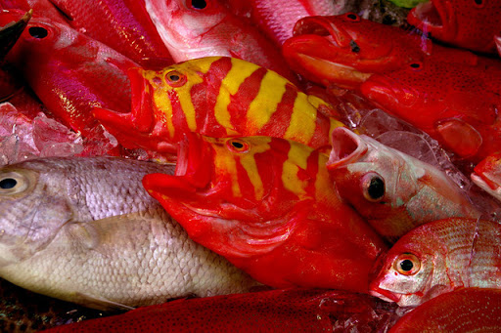
Learning Intention:
Describe how matter cycles through food webs, and the process of bioaccumulation e.g. ciguatera and mackerel (Scomberomorus spp.); mercury and blacktip sharks (Carcharhinus spp.); and toxin accumulation on microplastics.
Success Criteria:
Complete Marine Education worksheet
'3. Toxic Catch’
Notes:
Image: http://www.goodtrips.org/?p=2343

Slide 2

Bioaccumulation
The accumulation of a toxic substance in one’s body
(rate of intake exceeds rate of excretion)
Notes:
Image: https://gfaa.asn.au/ciguatera/

Slide 3
Ciguatera Poisoning

Slide 4
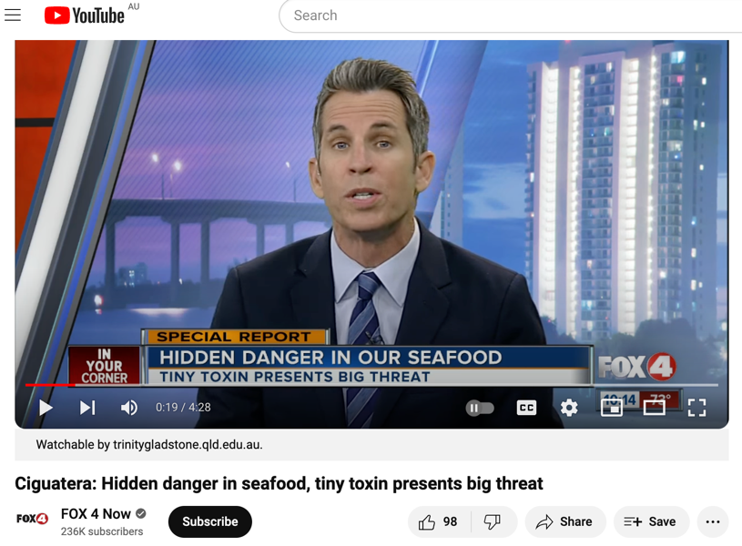
https://www.youtube.com/watch?v=dOmIoFYJxGw

Slide 5
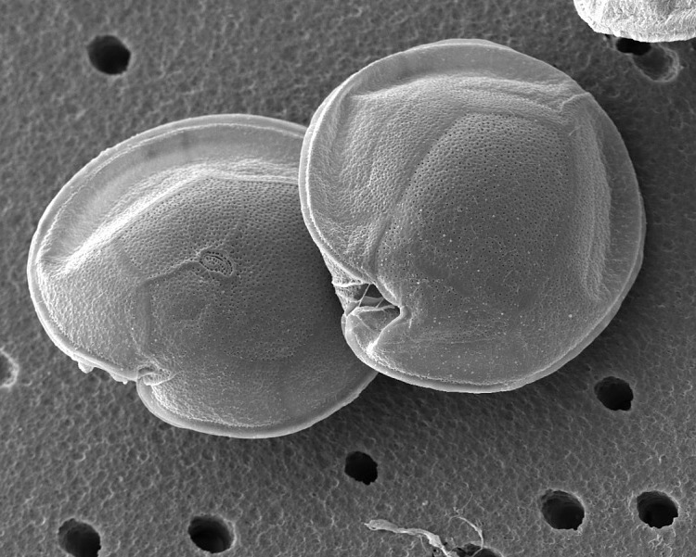
micro-algae Gambierdiscus sp. produces the ciguatoxin, CTX.
CTX
Notes:
Image: https://www.si.edu/object/nmnhbotany_11257199?width=85%25&height=85%25&iframe=true&destination=sisearch/collection-images%3Fpage%3D78991%26edan_q%3D

Slide 6
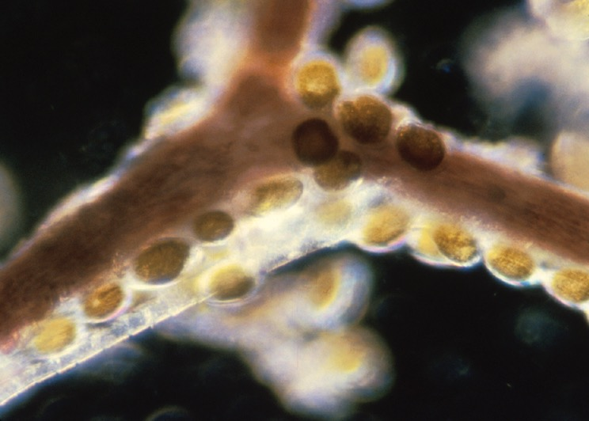
Gambierdiscus sp. live attached to certain corals, seaweeds and seagrasses
in the tropics
Notes:
Image: https://hab.whoi.edu/regions-resources/gallery/photos-cp/

Slide 7
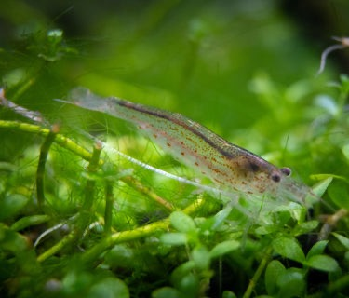
Amano shrimp, Caridina multidentata
Herbivores ingest the Gambierdiscus sp. when grazing
Notes:
Image: https://splashyfishstore.com/blogs/fish-keeping-101/care-guide-for-amano-shrimp

Slide 8
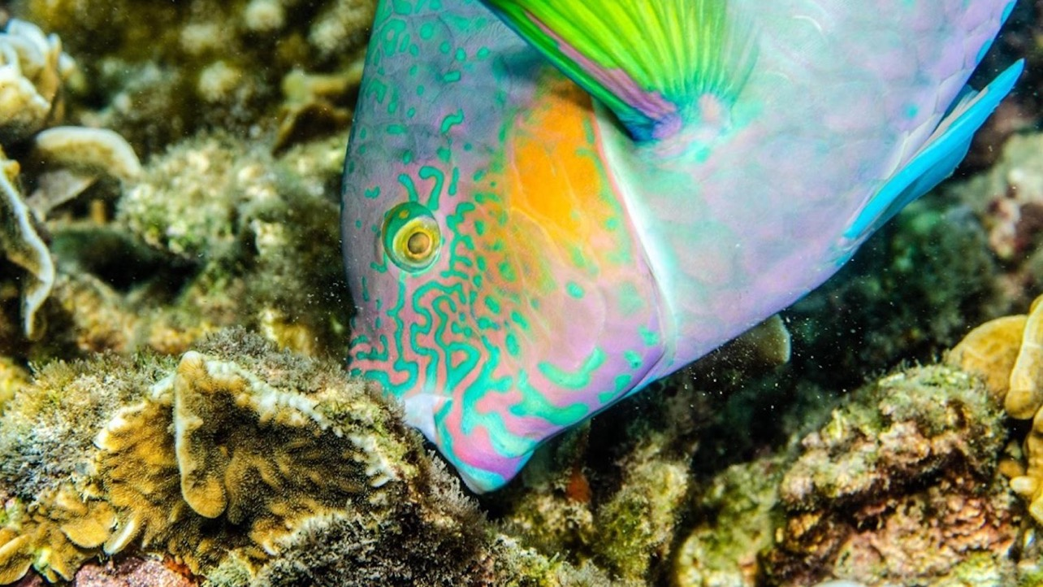
Notes:
Image: https://www.tetiaroasociety.org/nature-notes/herbivorous-fish-and-the-coral-reef

Slide 9
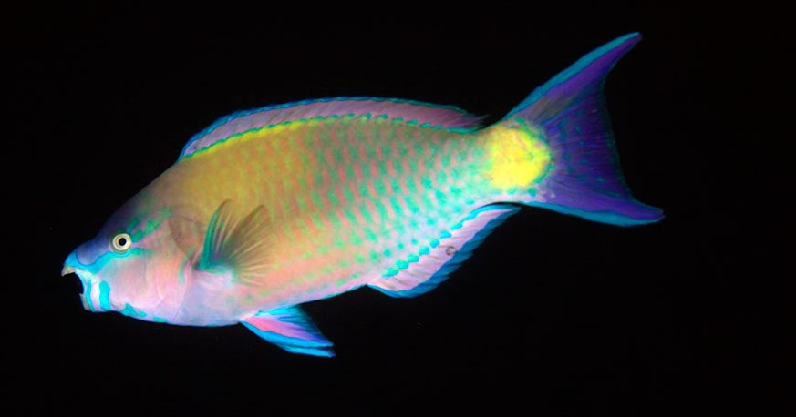
When a herbivore continues to graze on food covered in Gambierdiscus sp.,
the toxin CTX bioaccumulates in its body.
CTX
CTX does not break down!
Notes:
Image: https://www.wired.com/2014/08/absurd-creature-of-the-week-parrotfish/

Slide 10
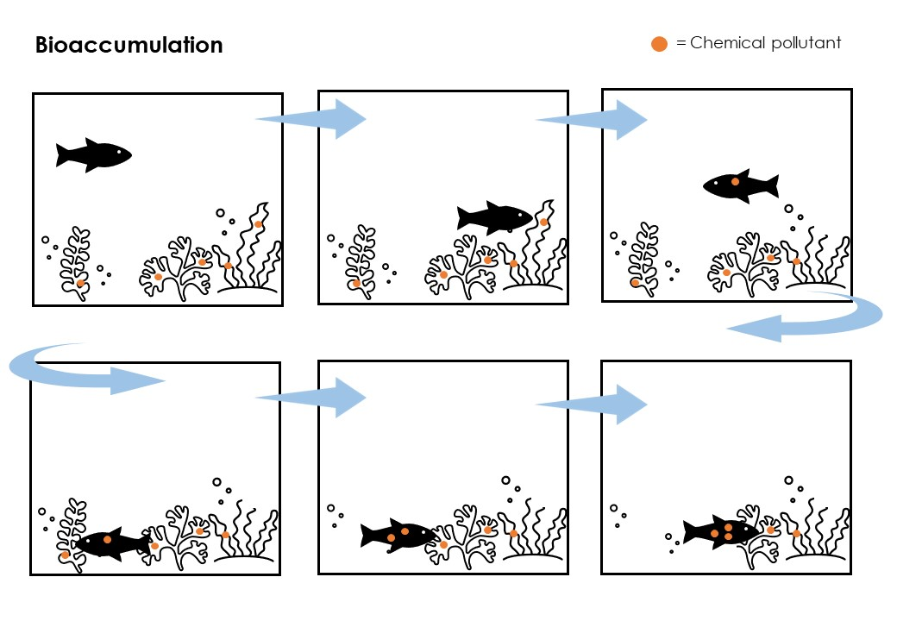
Accumulating more toxins with every meal

Slide 11
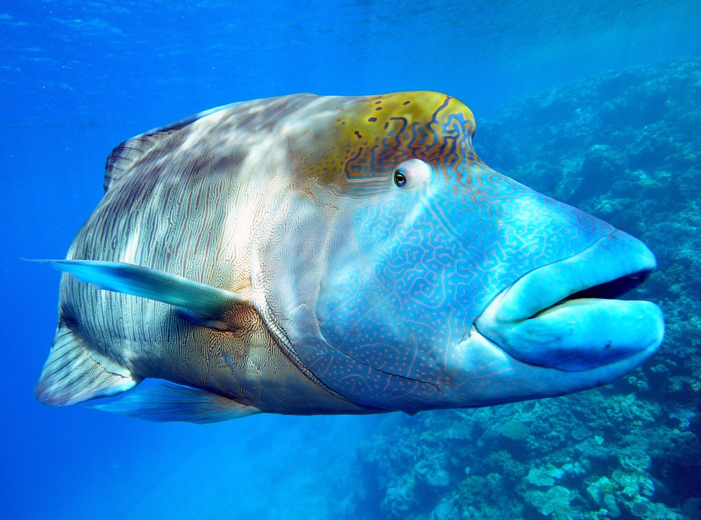
The bigger the fish, the older the fish, the more it eats,
the more (potential) bioaccumulation of CTX.
Humphead wrasse (Cheilinus undulatus) Photo credit: Larry Koester
Notes:
Image: https://marinesanctuary.org/blog/sea-wonder-humphead-wrasse/

Slide 12
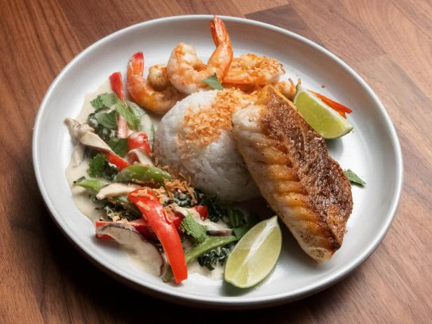
Not much CTX is needed to cause poisoning.
Concentrations around or below
one part per billion can trigger symptoms.
Notes:
Quote: https://gfaa.asn.au/ciguatera/

Slide 13

Symptoms
tingling and numbness in your fingers and toes, and around the lips, tongue, mouth and throat.
reversal of temperature sensation — so hot water feels cold or a cold drink feels hot.
joint and muscle pains with muscular weakness.
nausea, vomiting, diarrhoea or abdominal cramps.

Slide 14
But, it’s not just herbivores we need to avoid eating….

Slide 15
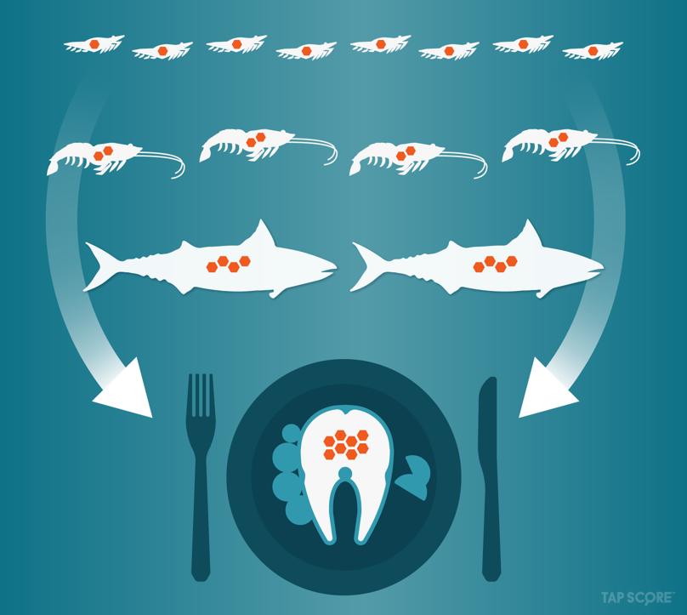
CTX concentrations increase with every trophic level of the
food chain via biomagnification

Slide 16

Biomagnification
is the magnification (in concentration) of a toxic chemical as it moves from one trophic level to the next
Notes:
Image: https://gfaa.asn.au/ciguatera/

Slide 17
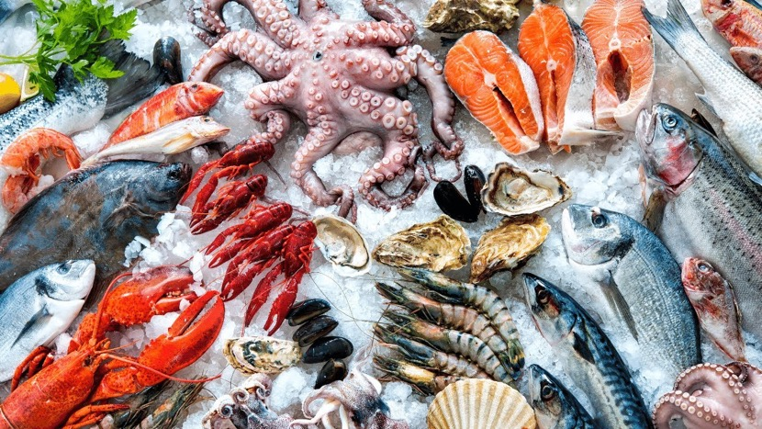
It’s when contaminant concentrations in consumers exceed the contaminant concentrations found in their prey.
Notes:
Quote: Borgå, K., Kidd, K. A., Muir, D. C. G., Berglund, O., Conder, J. M., Gobas, F. A. P. C., et al. (2012). Trophic magnification factors: Considerations of ecology, ecosystems, and study design. Integr. Environ. Assess. Manag. 8, 64–84.
Cited in: https://www.frontiersin.org/articles/10.3389/fenvs.2022.937124/full

Slide 18
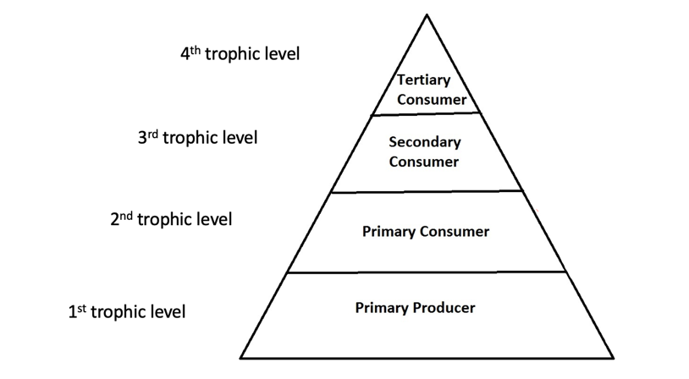

Concentrations magnify with every trophic level

Slide 19
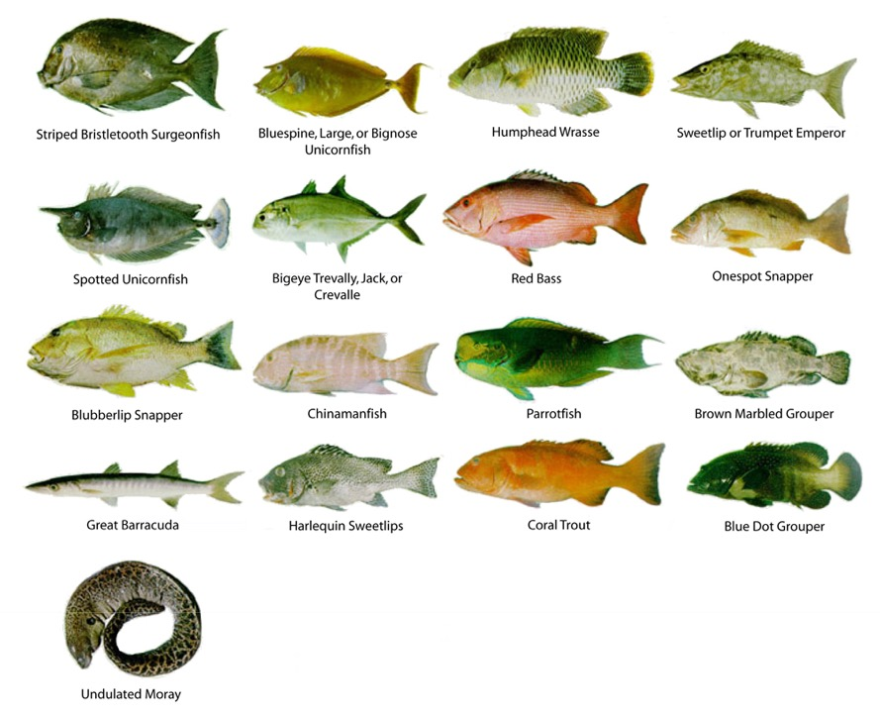
Hundreds of fish species have been reported as carriers of ciguatoxins worldwide
Notes:
Image: https://hab.whoi.edu/regions-resources/gallery/photos-cp/

Slide 20
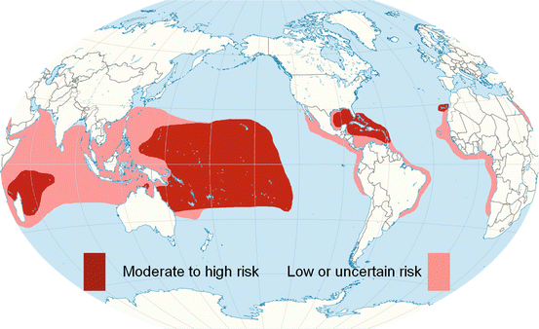
Australia has, on average, 150 cases of ciguatera every year
(mostly in tropical regions)
Approx. 50,000 cases worldwide per year
Image: Lewis, R.J., Vetter, I. (2015). Ciguatoxin and Ciguatera. In: Gopalakrishnakone, P., Haddad Jr., V., Kem, W., Tubaro, A., Kim, E. (eds) Marine and Freshwater Toxins. Springer, Dordrecht. https://doi.org/10.1007/978-94-007-6650-1_13-1
Notes:
Source: https://link.springer.com/referenceworkentry/10.1007/978-94-007-6650-1_13-1

Slide 21
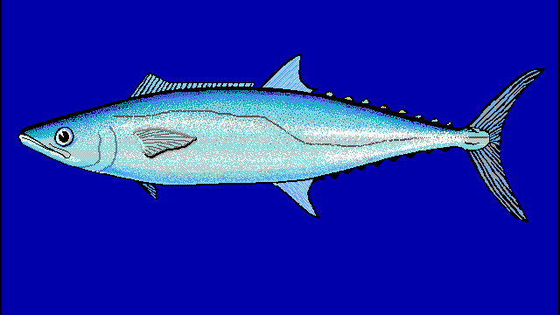
DO NOT EAT extra large fish (well above legal size) such as:
Mackerel fish (Scomberomorus spp.)

Slide 22
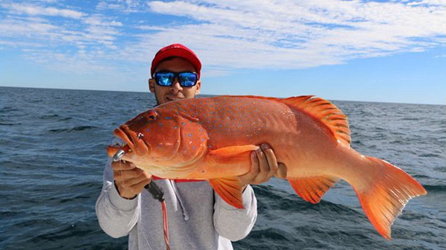
Coral Trout (Plectropomus spp.)
Notes:
Image: https://www.simrad-yachting.com/en-nz/news/blog-posts/how-to-fish-for-coral-trout/

Slide 23
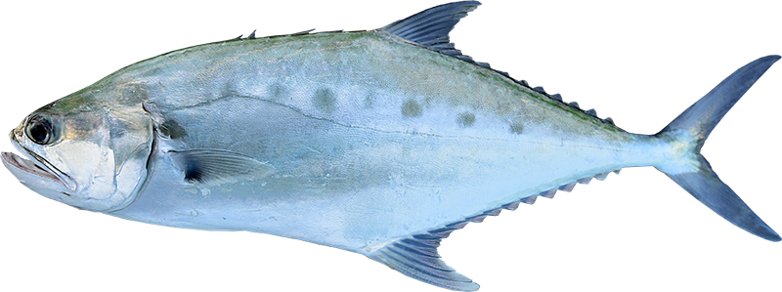
Giant Queenfish (Scomberoides commersonnianus)
Notes:
Image: https://nt.gov.au/marine/recreational-fishing/types-of-fish/fish-species/giant-queenfish

Slide 24
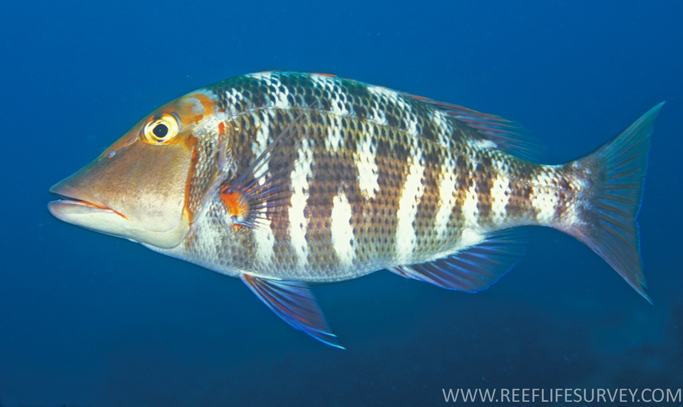
Redthroat (sweetlip) Emperor, Lethrinus miniatus
Notes:
Image; https://fishesofaustralia.net.au/home/species/2753
A Redthroat Emperor, Lethrinus miniatus, in a depth of 22 metres at North Solitary Island, New South Wales. Source: Ian V. Shaw / Reef Life Survey. License: CC By Attribution

Slide 25
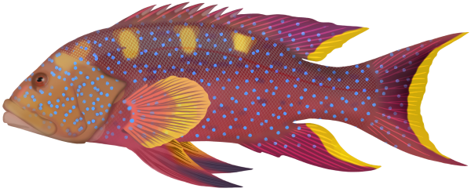
Coronation Trout (Variola spp.)
Notes:
Image: https://marinewise.com.au/fish-species/coronation-trout/

Slide 26
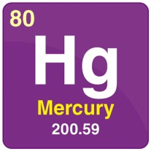
Mercury Poisoning

Slide 27
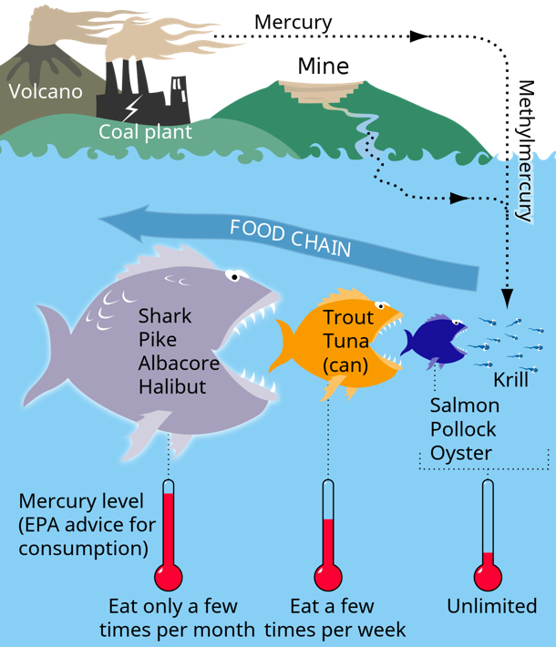
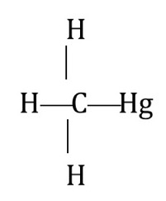
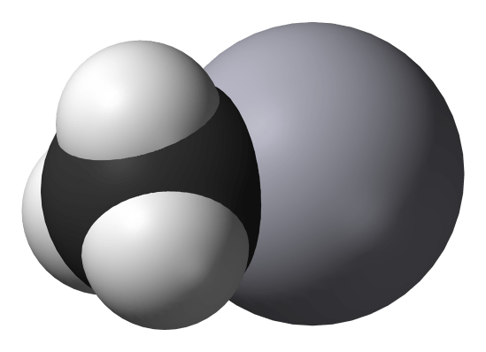
Same processes
(bioaccumulation and biomagnification)
different toxin
(methylmercury CH₃Hg⁺)
CH₃Hg⁺
Notes:
Image: https://goodtopssm.life/product_details/14034332.html

Slide 28
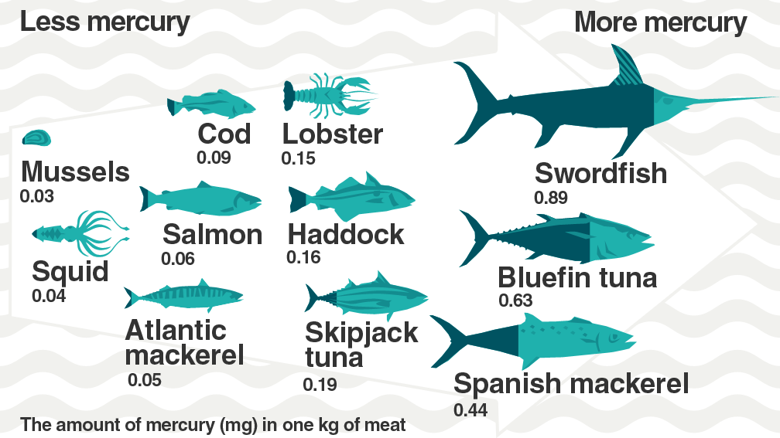
Notes:
Images: https://www.oceanproperty.co.th/?q=mercury-in-fish-wikipedia-ee-Yq65deuv

Slide 29
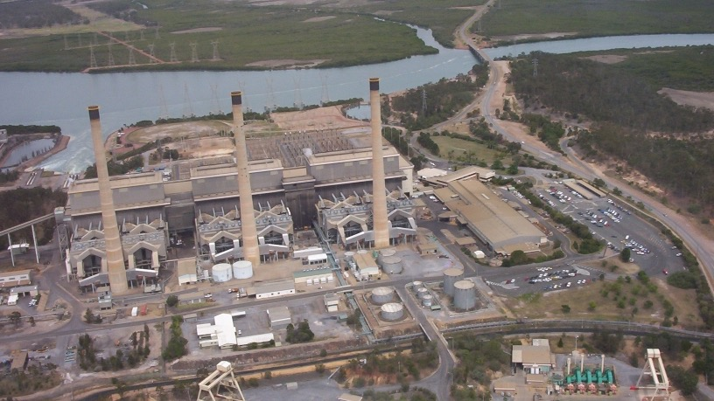
“People who live near coal-burning power plants need to be especially careful about mercury exposure”
Dr Gabrielle Michael Filippelli, Indiana University, May 2023
Notes:
Quote: https://www.nrdc.org/stories/mercurys-journey-coal-burning-power-plants-your-plate

Slide 30
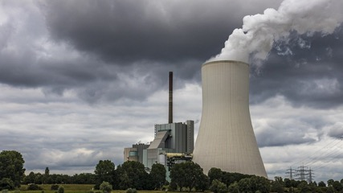
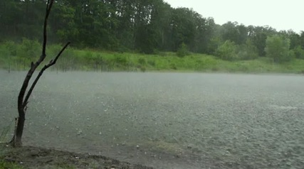
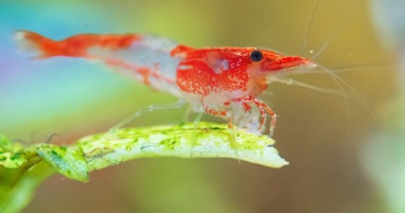
How does it get there?
Mercury is an element found in Earth’s crust.
That is, until we burn fossil fuels and release it into the atmosphere during combustion.
It falls to the ground when it rains.
It enters rivers and streams where bacteria (in O₂ poor sediment) convert it to (organic) methylmercury.
Thus, entering the food chain, starting with uptake by plankton.
Notes:
Image: https://webcam.srs.fs.usda.gov/impacts/mercury/index.shtml
Info: https://www.nrdc.org/stories/mercurys-journey-coal-burning-power-plants-your-plate

Slide 31
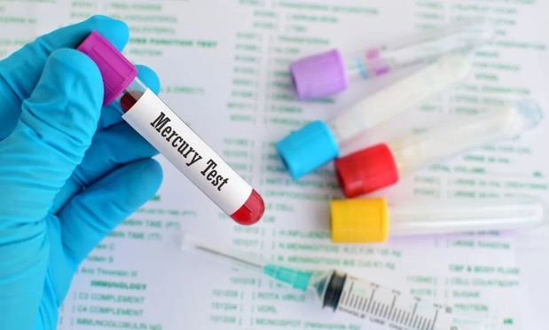
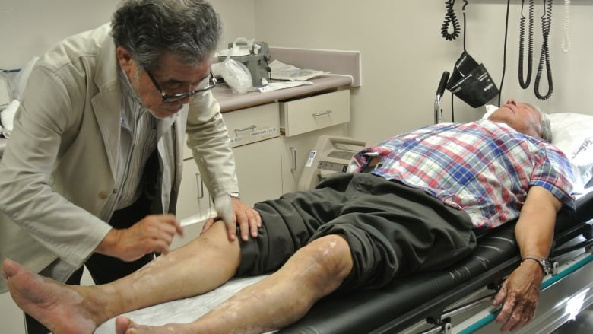
Effects of methylmercury (organic mercury) poisoning
Peripheral vision impairment
Pins & needles, numbness
Lack of coordination of movement
Impaired speech, hearing & walking
Muscle weakness
Notes:
Images: https://www.hseblog.com/health-effects-of-mercury-waste-anesthetic-gases/

Slide 32
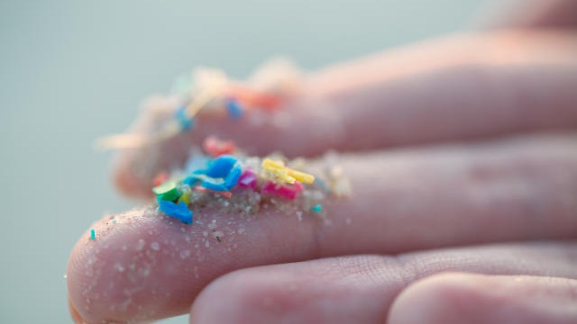
Microplastics

Slide 33
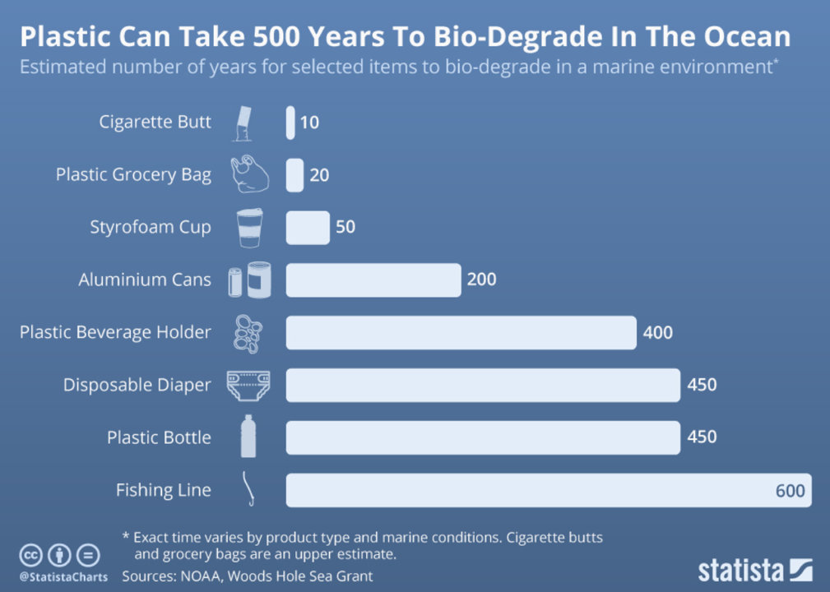
Plastic takes 10s to 100s of years to biodegrade
Notes:
Image: https://www.weforum.org/agenda/2018/11/chart-of-the-day-this-is-how-long-everyday-plastic-items-last-in-the-ocean/

Slide 34
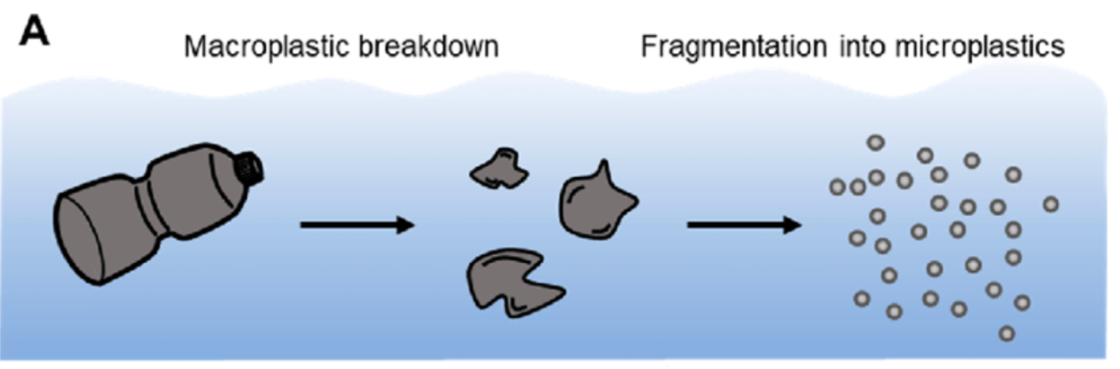
But they don’t stay in-tact for that long. They break into pieces.
Notes:
Image: https://www.researchgate.net/publication/354518939_Microplastics_through_the_Lens_of_Colloid_Science

Slide 35
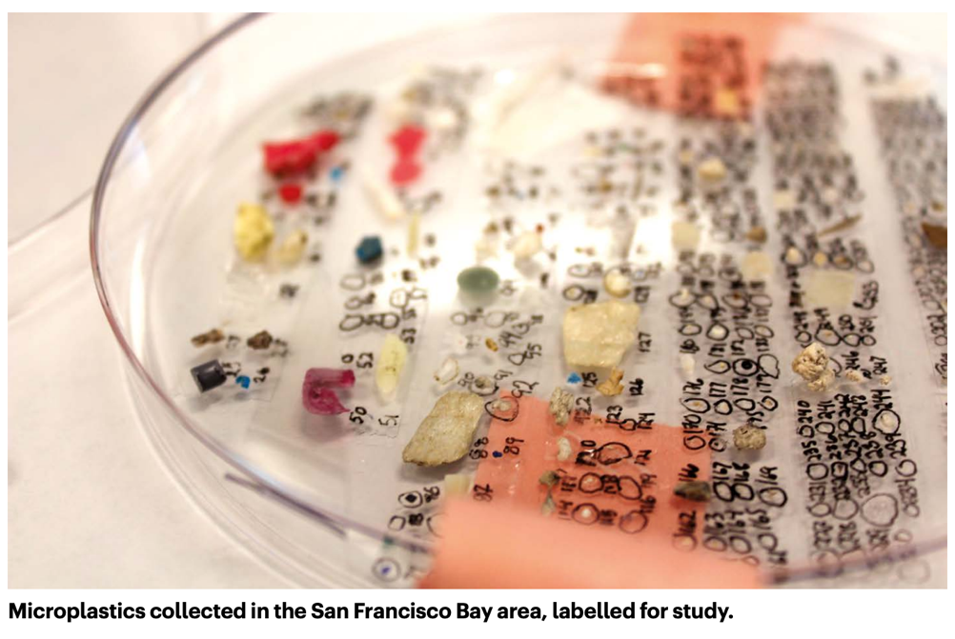
Micro plastics (MPs)
are pieces of plastic
<5mm
in diameter
Notes:
Image: https://edisciplinas.usp.br/pluginfile.php/6591302/mod_resource/content/1/Nature%202021.pdf
Info: https://pubs.acs.org/doi/pdf/10.1021/acs.est.8b05297

Slide 36
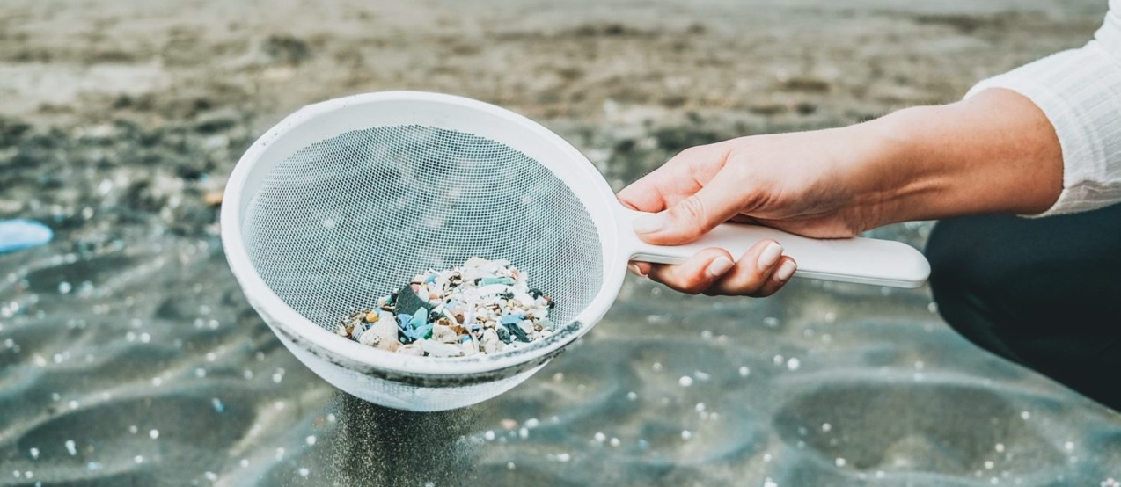
When it breaks down into micro pieces, it’s harder to see

Slide 37
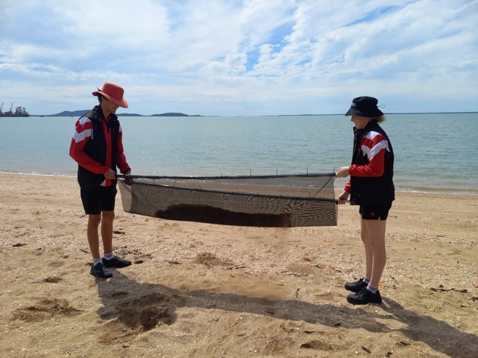
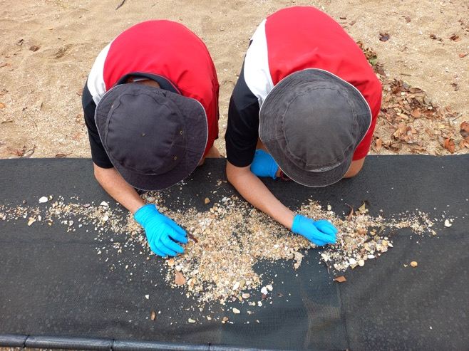
it’s harder to clean up
Flyscreen zip tied to wood sticks

Slide 38
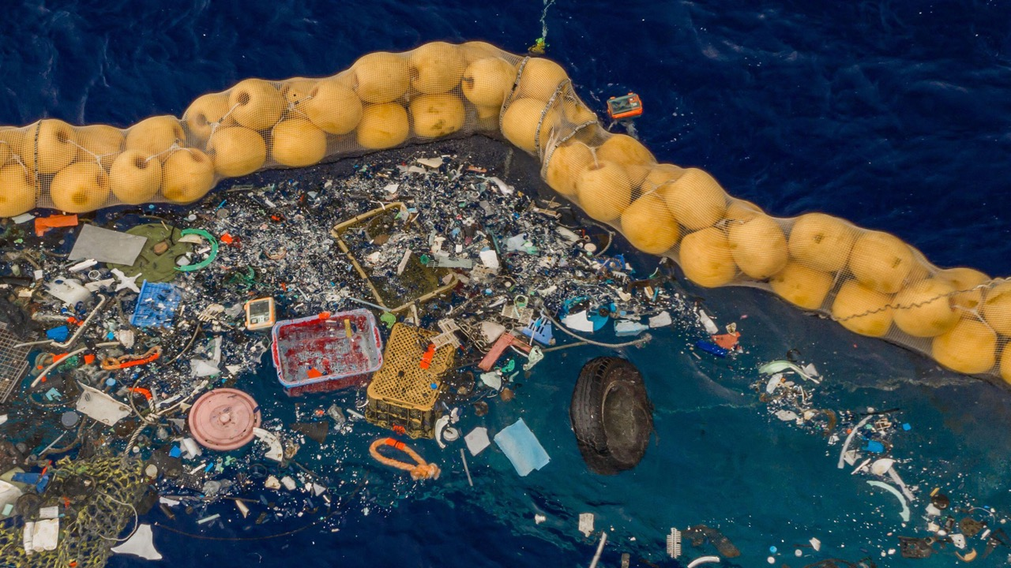
Thus, pick up the big pieces before they become lots of small pieces

Slide 39
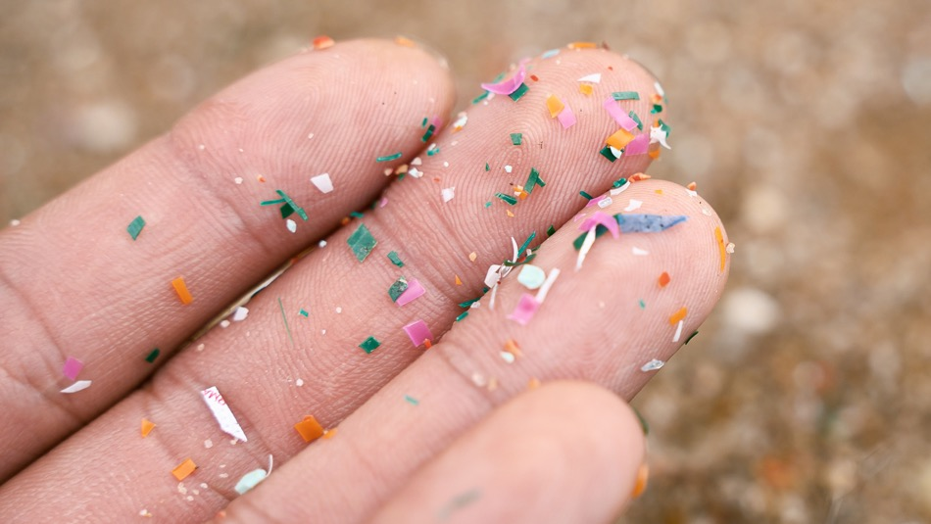

it’s even harder to identify
what’s this piece from?

Slide 40
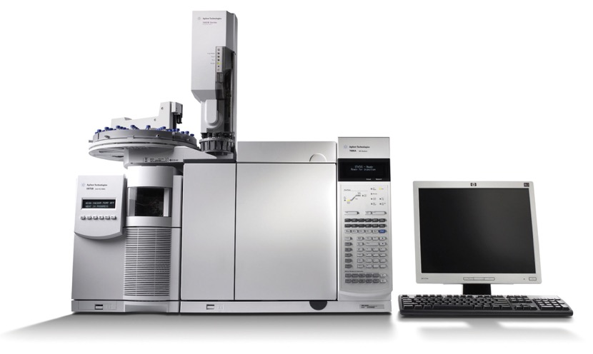
You need expensive equipment to find out exactly what it is
Notes:
Image: https://www.mooreanalytical.com/gc-ms/ Gas chromatography–mass spectrometry (GC-MS)
Great image (not here): The dye adsorbs onto plastic surfaces and renders them fluorescent when irradiated with blue light. Representative confocal fluorescence microscopy images of MPs dispersed in water and stained with Nile Red dye. From left to right: low-density polyethylene (LDPE), polystyrene (PS), polyethylene terephthalate (PET), and polyamide (nylon). Fluorescence emission signals are acquired in the range of 520–720 nm at λex = 500 nm. The scale bar is 200 μm. This figure is reproduced from Sancataldo et al. (2020) with permission of Royal Society of Chemistry (RSC). Source: https://www.frontiersin.org/articles/10.3389/ftox.2021.636640/full

Slide 41
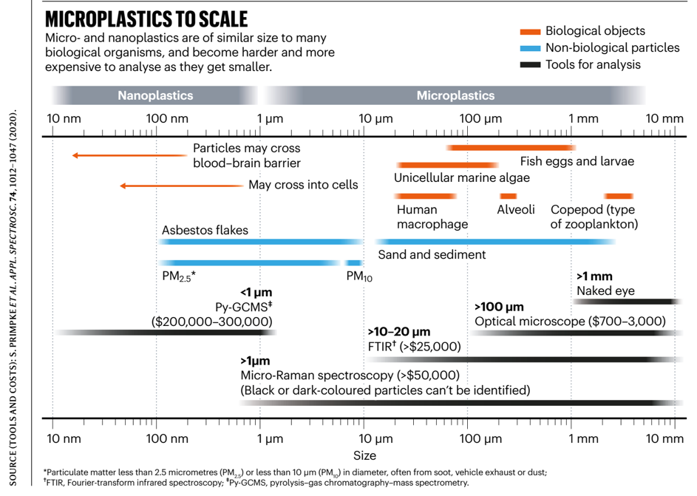
Instruments cost hundreds and thousands of dollars
Notes:
Image: https://edisciplinas.usp.br/pluginfile.php/6591302/mod_resource/content/1/Nature%202021.pdf

Slide 42
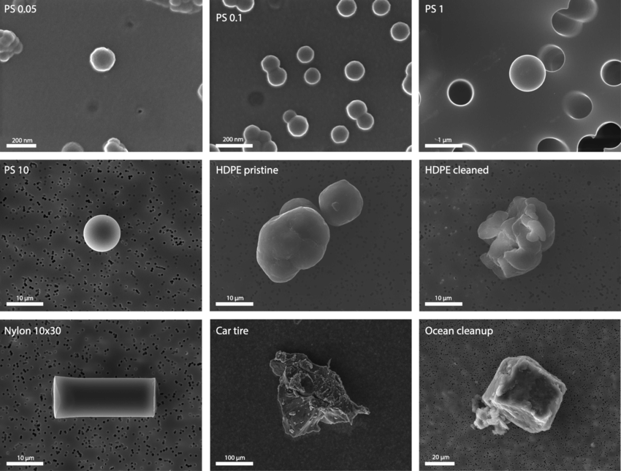
Nanoplastics are even
smaller
than microplastics
Characterization of nanoplastic particles by scanning electron microscopy (SEM). Representative images of polystyrene (PS) spheres of 0.05, 0.1, 1 and 10 μm, high density polyethylene (HDPE) fragments, the nylon fibre of 10 × 30 μm, car tire and ocean clean-up fragments.
Notes:
Image: https://www.researchgate.net/figure/Characterization-of-micro-and-nanoplastic-particles-by-scanning-electron-microscopy_fig1_358190252
Info: https://www.frontiersin.org/journals/endocrinology/articles/10.3389/fendo.2022.1084236/full

Slide 43
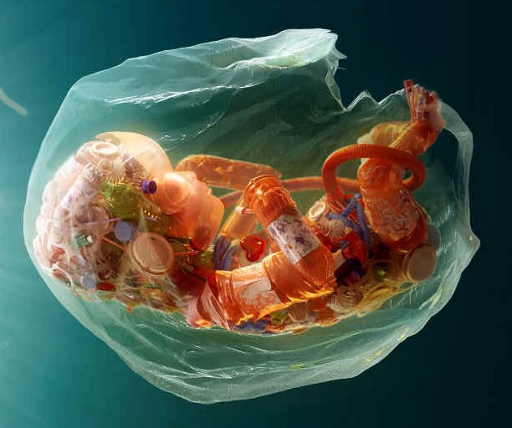
Nanoplastics are so small they can cross over into human cells, the blood-brain barrier and even the placenta.
Notes:
Image: https://www.plasticsoupfoundation.org/wp-content/uploads/2023/05/FLYER_PHS2023_A4.pdf

Slide 44
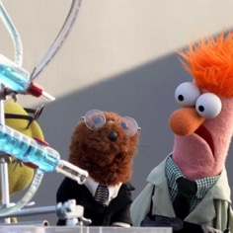
Plastic additives

Slide 45
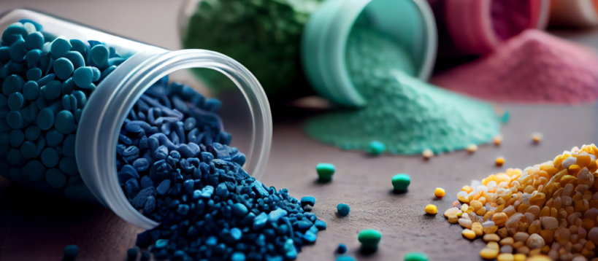
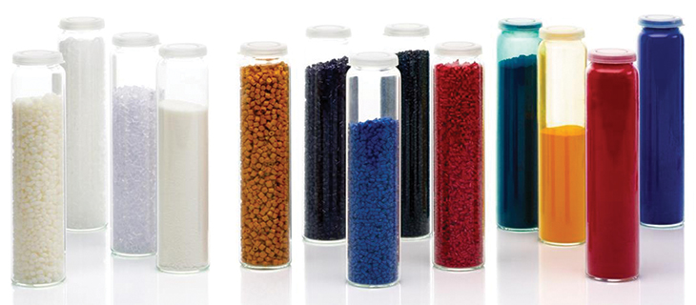
Plastic
additives
are added to plastic to improve its processability, properties, and performance.
They leach out from plastic and microplastic
contaminating the surrounding environment with
a cocktail of toxic chemicals.
Notes:
Image: https://www.plasticsoupfoundation.org/wp-content/uploads/2023/05/FLYER_PHS2023_A4.pdf

Slide 46
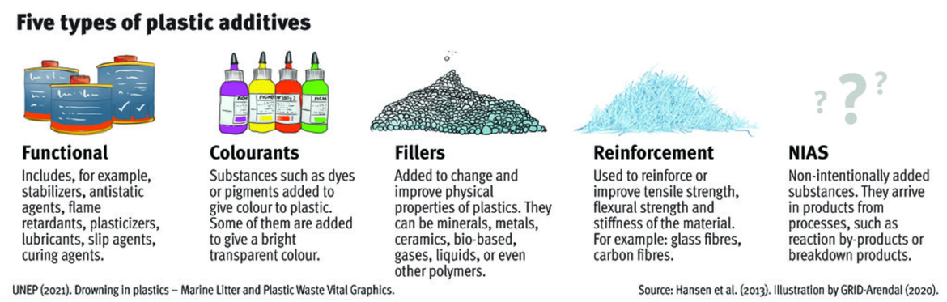
Examples of additives include plasticizers, flame retardants, colorants, antioxidants, stabilizers and antistatic agents.
Notes:
Image: https://www.grida.no/resources/14864
Info: https://pubs.acs.org/doi/pdf/10.1021/acs.est.8b05297
Image of plasticizer: https://www.researchgate.net/publication/341876572_Title_A_Review_on_Plasticizers_and_Eco-Friendly_Bioplasticizers_Biomass_Sources_and_Market

Slide 47
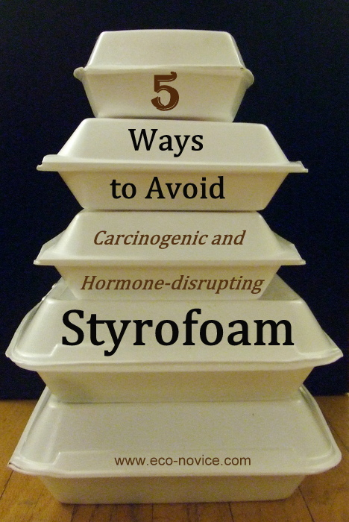
Some additives are carcinogenic, mutagenic and endocrine disruptors.
Notes:
Image: https://www.eco-novice.com/2014/12/5-ways-to-avoid-toxic-styrofoam.html

Slide 48
Microplastic hitch-hikers

Slide 49
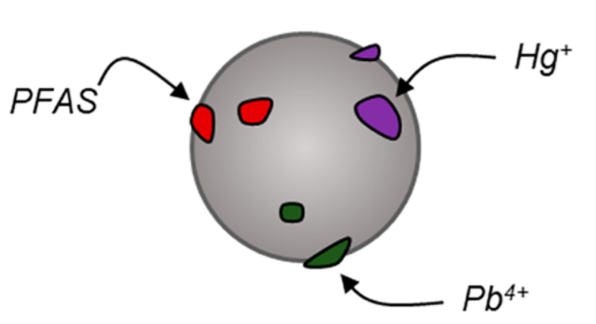


In addition, toxins accumulate on microplastic.
They hitch a ride on the microplastic.
Notes:
Image: https://www.researchgate.net/publication/354518939_Microplastics_through_the_Lens_of_Colloid_Science
More Info: https://www.nature.com/articles/s41598-020-64464-9

Slide 50

Hg and Pb (heavy metals) BPA (additive) and DDT (insecticide) all stick to microplastic.
These chemicals are known to affect the endocrine system.
Notes:
Image: https://www.frontiersin.org/journals/endocrinology/articles/10.3389/fendo.2022.1084236/full

Slide 51
Plastic bioaccumulation

Slide 52

Microplastics are often mistaken for food

Slide 53

https://www.youtube.com/watch?v=GxNXYBYRAIM

Slide 54


It looks like food
Palaemon varians with ingested fluorogenic microbeads of 9.9 µm (green), 2.1 µm (blue), and 0.1 µm (red) in diameter.
Notes:
Image: Source: https://www.sciencedirect.com/science/article/pii/S0147651322002342

Slide 55


It smells like food
.
“Plastic additive Oleamide may be perceived as a feeding cue by marine species potentially increasing the consumption of microplastics”
Notes:
Source: https://www.sciencedirect.com/science/article/abs/pii/S0025326X21005671
Paper: ack Greenshields, Paula Schirrmacher, Jörg D. Hardege (2021). Plastic additive oleamide elicits hyperactivity in hermit crabs, Marine Pollution Bulletin, Volume 169, 112533, ISSN 0025-326X.
Image (hermit crab): https://en.wikipedia.org/wiki/Pagurus_bernhardus

Slide 56


87 studies investigating microplastic contamination found
22,512 out of 23,049 marine individuals
(including representatives across all trophic levels)
were contaminated with microplastics.
Notes:
Info: https://www.ncbi.nlm.nih.gov/pmc/articles/PMC7567360/
Image (left): https://www.sciencelearn.org.nz/resources/2809-how-harmful-are-microplastics
Image (right): https://www.researchgate.net/publication/280640353_Marine_Litter_in_Nordic_waters

Slide 57

Not surprisingly, filter feeders had, on average, higher levels of microplastic contamination than any other feeding strategy.

Slide 58

It’s so small, consumers don’t even realise they’re eating it
Notes:
Image: https://plasticoceans.org/humans-eating-plastic-over-40-pounds-in-a-lifetime/
A 2019 joint study by Dalberg and the University of Newcastle in Australia has revealed the extent of humans eating plastic: every week we eat – on average – one lego brick; every year a dinner plate (100,000 tiny pieces of plastic); every decade a lifebuoy.

Slide 59





Senathirajah & Palanisami (pictured left) from University of Newcastle published a paper in 2019 that stated we eat approximately 1 credit card of plastic every week (5 grams). The statement went global.
we eat equivalent to
(5 grams)
Notes:
Image: https://campaignbriefasia.com/2019/06/12/grey-malaysia-launches-wwf-campaign-that-reveals-plastic-ingestion-by-people-could-be-equating-to-a-credit-card-a-week/
Pletz paper: https://www.sciencedirect.com/science/article/pii/S2666911022000247

Slide 60


Some argue the credit card analogy is a gross over-estimation.
Others argue the credit card analogy is a gross under-estimation.
How it was calculated….
Estimates of particle size and abundance in shellfish, salt, beer, and bottled water were used to estimate particle mass.
Multiplied by the estimated weekly consumption of these products
x
=
5g/wk
Notes:
Image: https://www.sciencedirect.com/science/article/pii/S2666911022000247

Slide 61

Where are the microplastic hotspots?

Slide 62



Global Fishing Watch: Fishing hotspots around the globe
kilometer
How much is plastic?
Notes:
Image (left): https://ycl.it/wp-content/uploads/2017/10/3_The-plastic-ocean-Editorial-Nature-2016-1.pdf
GFW: https://globalfishingwatch.org/

Slide 63


Is it trapped in the mangroves and seagrass?
Jack Greenshields PhD CQU
“Because seagrass is so good at trapping particulate matter and sediment, it may also be very good at trapping plastic, making them at risk of being hotspots for plastic pollution”
“Could seagrass be preventing the microplastics from spreading to adjacent coral reefs?"
Notes:
Image: Gail Riches

Slide 64

https://www.youtube.com/watch?v=QftlXutaYac
Notes:
Article: https://www.cqu.edu.au/news/1051382/researcher-builds-wave-maker-to-understand-microplastics-trapped-in-coastal-marine-ecosystems

Slide 65

“what are the potential health effects (on the seagrass and mangroves) associated with this microplastic trapping ability?”
Pictured left, Jack’s experimental design is a large container (covered with mesh) that he set up for growing mangrove propagules in soil contaminated with varying amounts of microplastic.
☺
☹
Notes:
Image: Gail Riches

Slide 66
Plastic biomagnification
???

Slide 67

There’s not enough data to confirm if biomagnification of microplastics occurs across trophic levels
(even more so with their associated additives)
Spot the difference

Slide 68

https://www.youtube.com/watch?v=GCNTqMX9zBE

Slide 69


Biomagnification has been found in some small-scale laboratory experiments, though many of these use unrealistic (large) amounts of microplastics that are not representative of environmental doses
(Jack Greenshields, pers. comm. 08/03/2024).
Notes:
Miller ME, Hamann M, Kroon FJ. Bioaccumulation and biomagnification of microplastics in marine organisms: A review and meta-analysis of current data. PLoS One. 2020 Oct 16;15(10):e0240792. doi: 10.1371/journal.pone.0240792. PMID: 33064755; PMCID: PMC7567360.

Slide 70



Cause of death? Contaminated food, or plastic bag?

Slide 71


Remember the definition for biomagnification?
It’s when contaminant concentrations in consumers exceed contaminant concentrations found in their prey.
Microplastic in the intestinal tract of a brine shrimp (Artemia sp.).
“In many cases, microplastic concentrations in consumers were LOWER than microplastic concentrations found in their prey”
(Miller, Hamann and Kroon,2020).
Notes:
Image (Right): https://www.researchgate.net/publication/308878476_A_novel_method_for_preparing_microplastic_fibers
Quote: Miller ME, Hamann M, Kroon FJ. Bioaccumulation and biomagnification of microplastics in marine organisms: A review and meta-analysis of current data. PLoS One. 2020 Oct 16;15(10):e0240792. doi: 10.1371/journal.pone.0240792. PMID: 33064755; PMCID: PMC7567360.
Source: https://www.ncbi.nlm.nih.gov/pmc/articles/PMC7567360/

Slide 72

Final thought

Slide 73

Learning Intention:
Describe how matter cycles through food webs, and the process of bioaccumulation e.g. ciguatera and mackerel (Scomberomorus spp.); mercury and blacktip sharks (Carcharhinus spp.); and toxin accumulation on microplastics.
Success Criteria:
Complete Marine Education worksheet
’13. Toxic Catch’
Notes:
Image: http://www.goodtrips.org/?p=2343

